Slide 1

Residuals
Management
Patrick Farnham

Slide 2
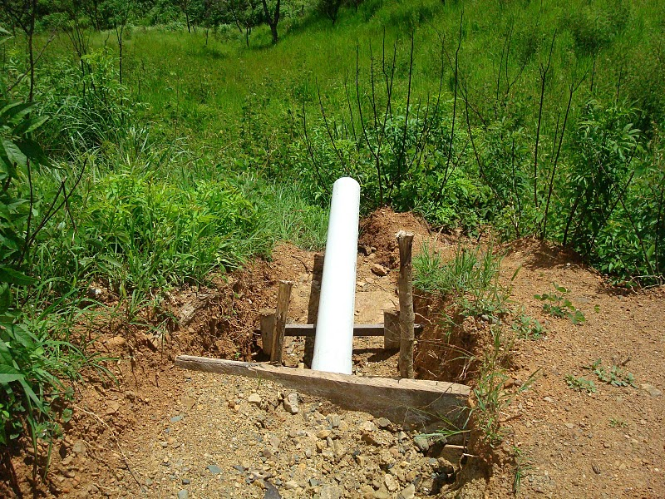

Background
What is happening now?

Slide 3
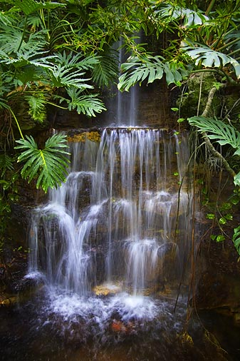

Background
Why should we change?
  Environmental responsibility
  Expansion

Slide 4
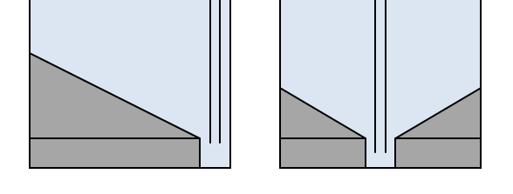
Point Sources
Sed/floc/entrance tank sludges
  Gelatinous Al(OH)3
SRSF backwash
Chemical waste from Cl sol’n preparation
Chemical waste from alum/PACl stock tanks

Slide 5
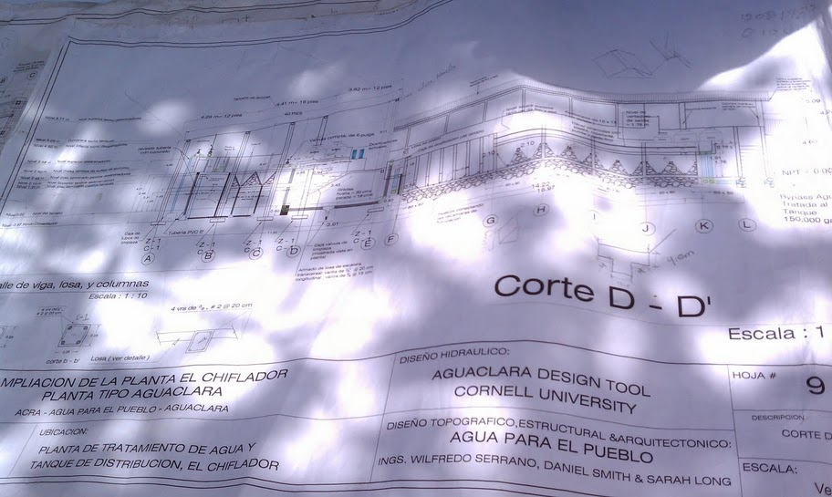
Constraints
Legal restrictions
Money
Feasibility – space and materials

Slide 6

Disposal Standards
10 States, EPA, WHO, etc.
  Very vague
  Clear on toxics
  Not clear on innocuous sludge

Slide 7
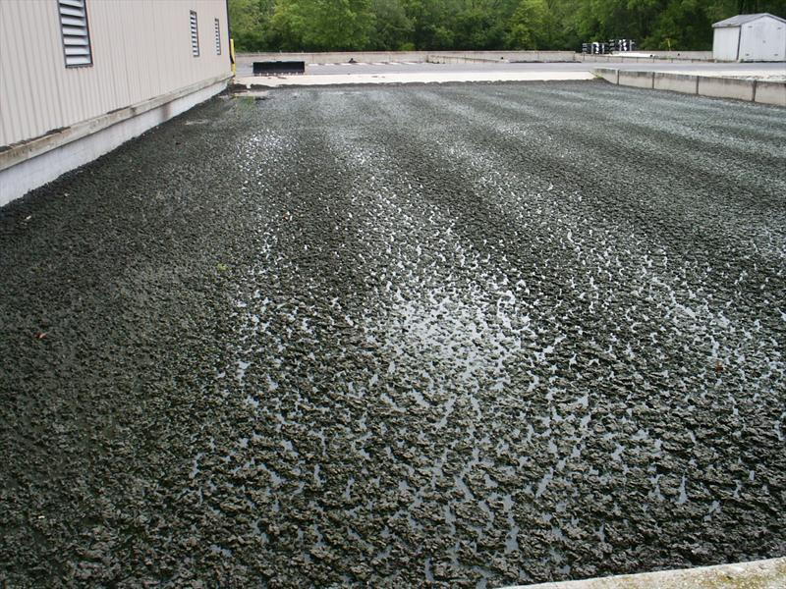
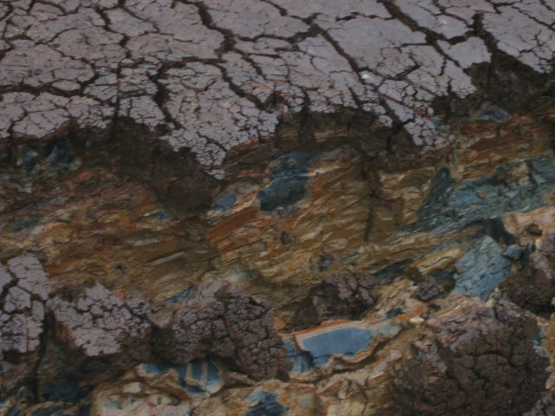
Affordability
Sludge disposal methods
  Thickening, conditioning, incineration = $$
  Need to focus on dewatering
    Uses gravity, not electricity

Slide 8
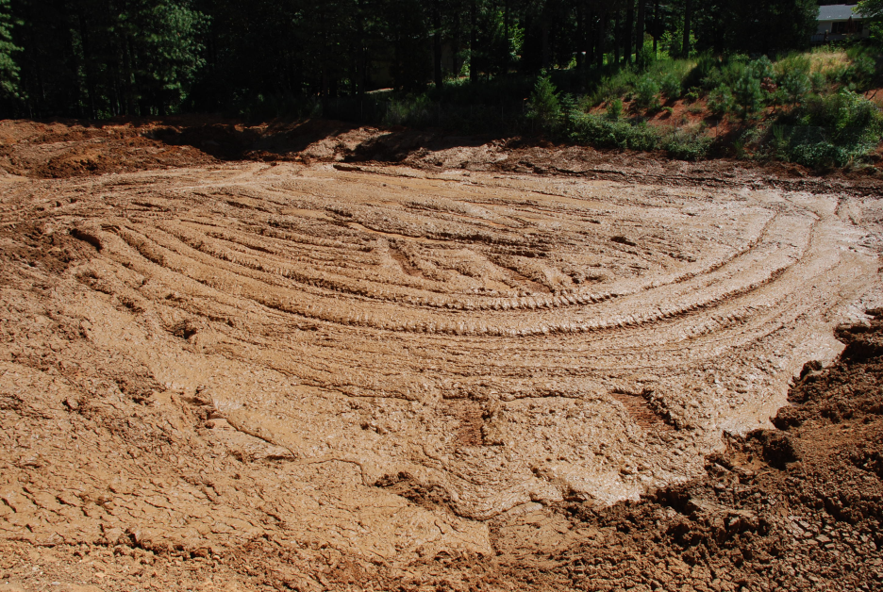
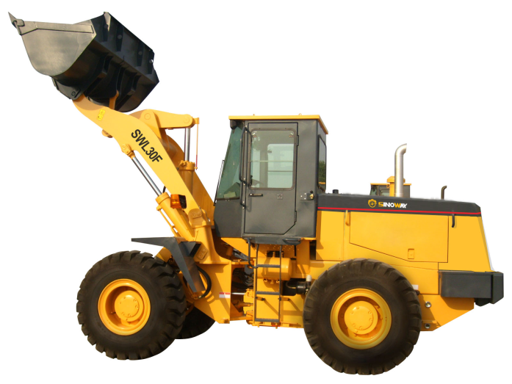
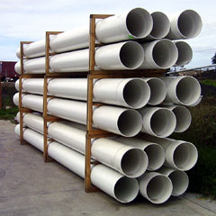
Affordability - Dewatering
Lagoons and drying beds (x2)
  Excavation (initial and solids removal)
  Concrete, underdrains, decanters, liners, gravel

Slide 9
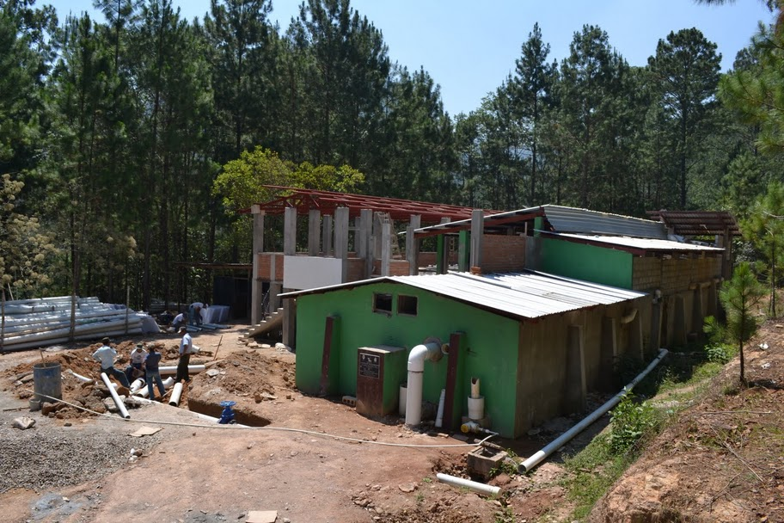
Feasibility
How much space is required?
Topography?
Soil composition?
  Perc test

Slide 10
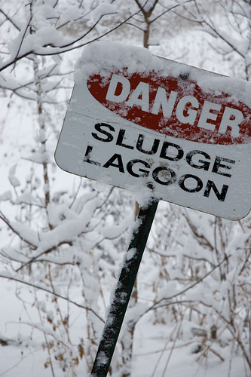
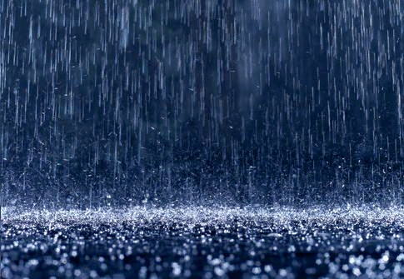
Alum Sludge Problems
Dewaters very poorly – 1% to maybe 10%
Lack of freeze/thaw
Incident rainfall
We wish.

Slide 11
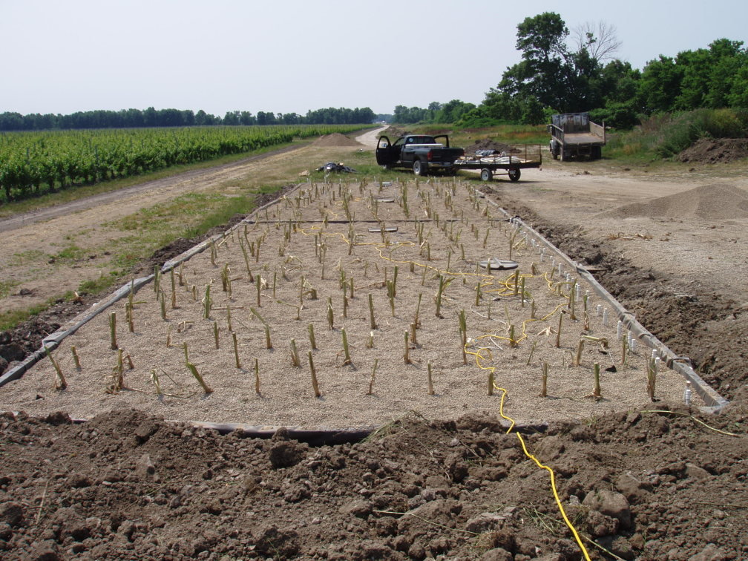
Alternative Methods
Irrigation
  Previous studies
    IL and CT
  Limits available P
Dispersal
  Should limit erosion
  Attempt to encourage percolation

Slide 12
Additional Waste Streams
CaCO3 precipitate
  Any other components?
Large flows from plant bypass/failure
  400 NTU (bypass), 20 NTU (failure)
Chemical waste from Alum/PACl stock tanks

Slide 13
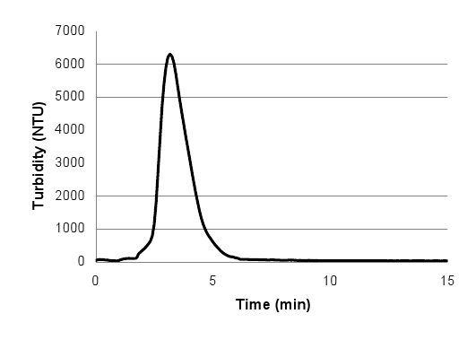
What’s Next
Estimate flow rates of sludge
  Info from Sarah Long (frequency, composition)
Learn more about PACl (before switch)
  More sludge?
  Chris Bordlemay and
  Po-Hsun Lin

Slide 14
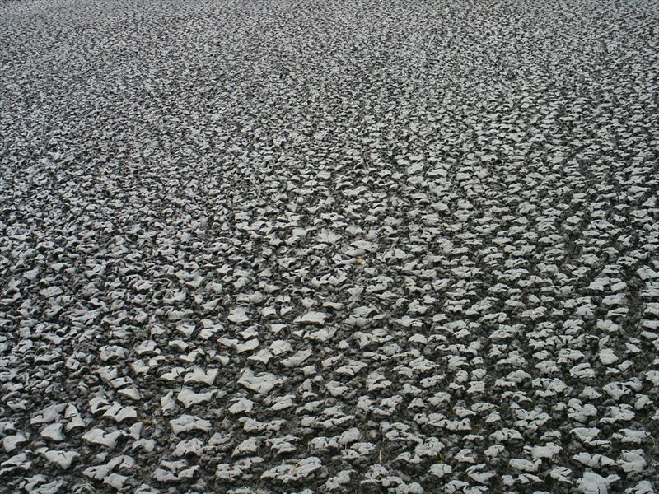

Q&A

