Slide 1

Residuals
Management
Patrick Farnham

Slide 2
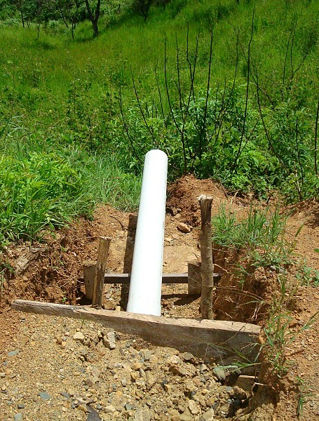
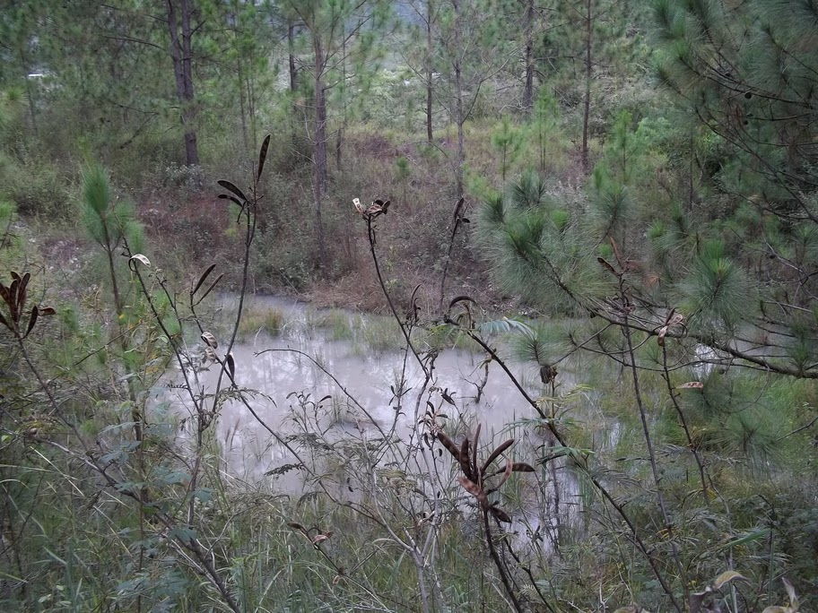

Background/Recap
What is happening now?
Tamara

Slide 3
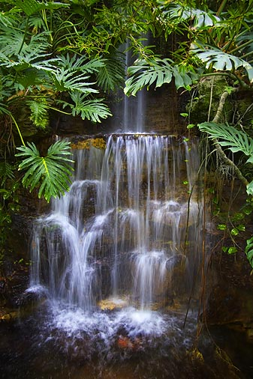
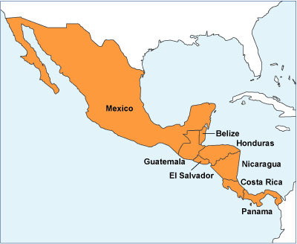
Background/Recap
Why should we change?
  Environmental responsibility:
  Expansion:
    San Nicolas
Notes:
No real law constraints in Honduras. Some exist in the U.S. (mention Cornell), but alum sludge doesn’t contain toxics.
Mention Antonio’s quote about how the “experts” ask where the sludge is going
Scales will increase, new plants located near more people. San Nicolas

Slide 4
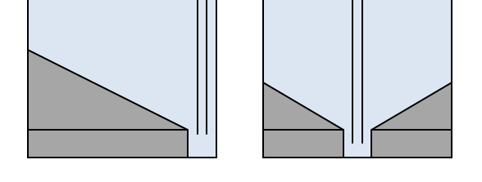
Point Sources
Sed/floc/entrance tank sludges
  Gelatinous Al(OH)3 + clay solids
SRSF backwash (3x plant flow)
Chemical waste from Cl sol’n preparation
Chemical waste from alum/PACl stock tanks
Notes:
All are combined into the one drain pipe

Slide 5
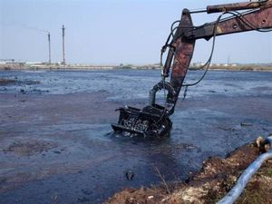
Dewatering: Not Feasible
Lack of polymers and freeze/thaw cycle
Money
Topography
Mosquito threat
Notes:
Add’n of water during rain, mention time scale. Lysing of cells, denaturation of proteins for organic material?
Cost of excavation, and what to do with solids/ how to get them out?
Digging into stone? Slopes? (75% steeper than 30%?)
Mosquito reproduction in stagnant water – malaria and Dengue fever

Slide 6
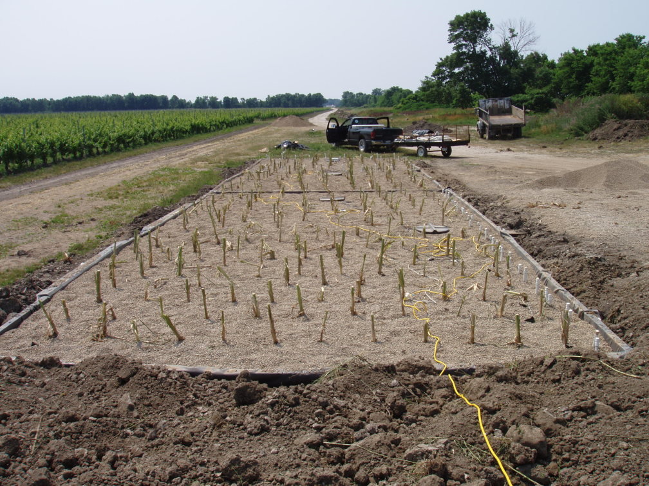
Irrigation: Not Feasible
P limitation and Al toxicity?
Slow percolation
As yet, no need
Notes:
Difficult to get any info about soil pH and type, or plant types
Would clog soil on bottom, no further percolation. Then influent rain, too.
San Nicolas will be first where anything useful is grown downslope.

Slide 7
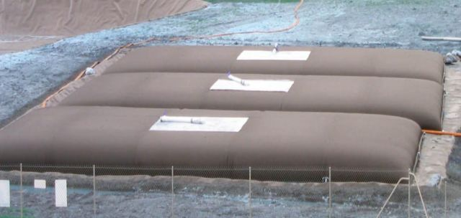
Treatment Not Feasible?
Still must reduce environmental impact and do something with residuals flows
Geotube®: formerly used by CU WTP
Notes:
Talk about Chris Bordlemay and how the Geotubes work. Also that he said they weren’t cost-effective, though a novel idea.

Slide 8
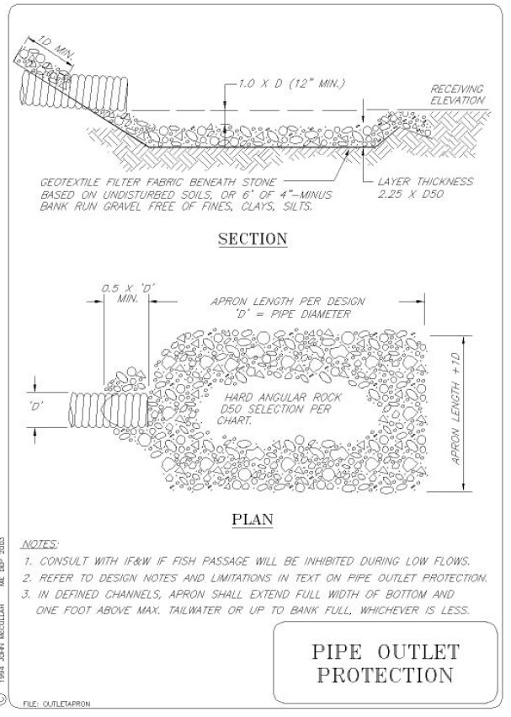
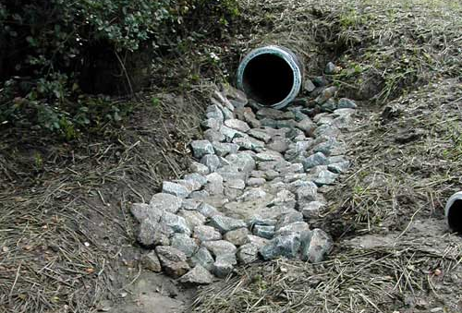
Energy Dissipation
Reduce erosive flows
Metered discharge?
Notes:
Explain POPs and energy dissipation structures
Why use these? Reduce erosion, maybe prevent spike inputs (small-scale storage)

Slide 9
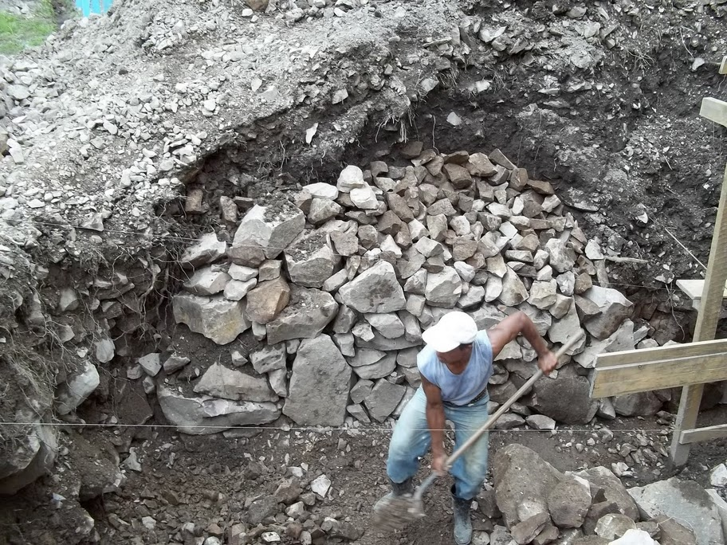
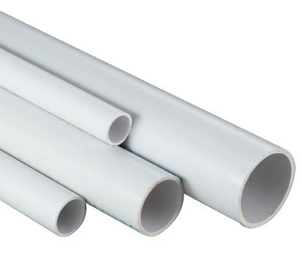
POP Design
Design procedure used by US DOT’s
Materials
Tamara
Notes:
Mention how multiple states publish the same design procedure
Talk about how there are pros:
only materials really needed being rocks PVC.

Slide 10
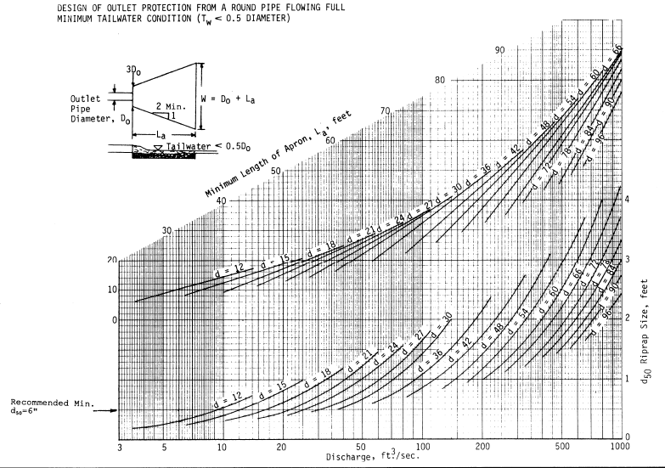
POP Design
Low tailwater constraint satisfied
Nomographs:
Empirical eqns

Slide 11
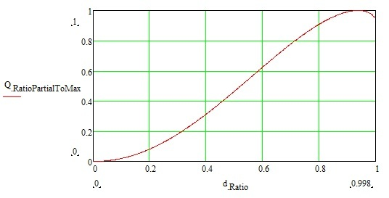
POP Design
Step 1. Qdesign/Qmax -> ddesign/D -> Ax -> Voutlet -> Riprap D50
Step 2. Structure dimensions: depth, width, length
= f(D, Riprap D50, Voutlet)

Slide 12
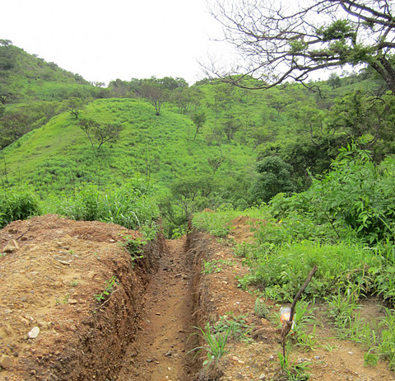
Design Considerations
Design for actual or worst-case drain slope
Example @ Alauca
  Actual slope: 2’ x 5’ x 2.5’
      Riprap: 18”
  W.C. slope: 2’ x 16’ x 4’
      Riprap: 30”
Overdesign issues
Notes:
Talk about how you can calculate required drain pipe diameter if you know the slope and max design flow

Slide 13
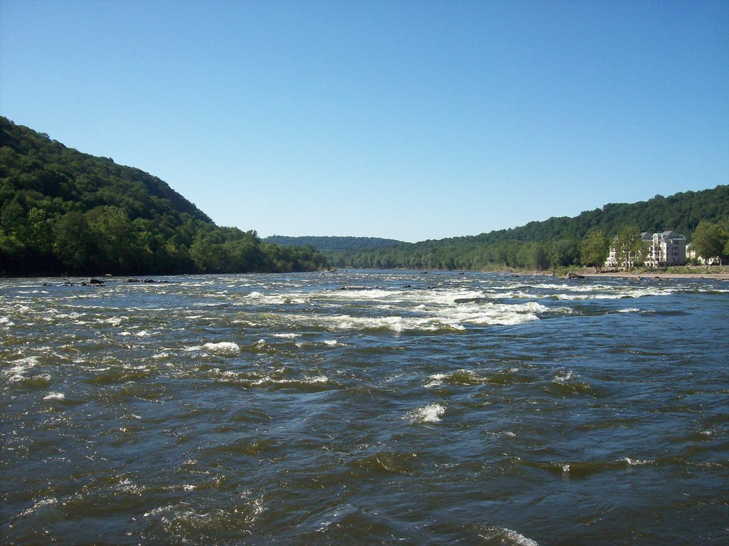
Design Considerations
Avoid flow reconcentration
Prevent structure damage/erosion
Pipe residuals near to receiving body
Notes:
Get near to receiving body but keep structure above high water mark

Slide 14

Future Work
Implementation and monitoring?
Assess impact
Toxicity research (PACl?)

Slide 15
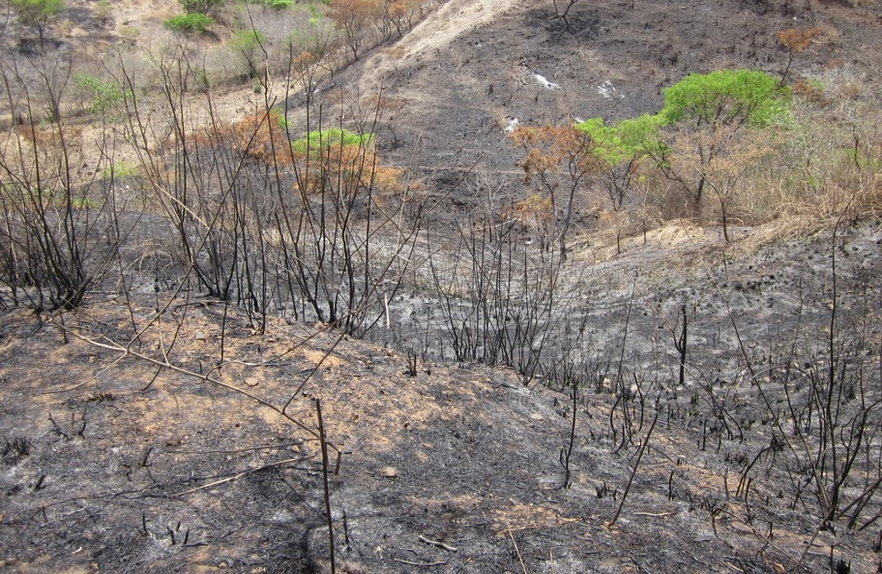

Q & A

