Slide 1
Research on Plate Settler Capture Velocity
Team member: Xiaocan Sun
Yizhao Du
Ruonan Zhang
Advisor: Michael Adelman

Slide 2
Background
Experiment Apparatus
Methods
Analysis
Conclusion & Future Work

Slide 3
Background
The design of plate settler plays an essential role in the performance of both the sedimentation tank and the whole plant with the goal of removing the colloidal particles.

Slide 4
Background
Our goal is to develop model that make it possible to characterize the influence of plate settler capture velocity, coagulant type and dose on the overall operation of an AguaClara plant.

Slide 5
Background
We change capture velocity under the following different conditions:
Coagulant(Alum, PACl)
Raw Water turbidity
Coagulant Dose

Slide 6
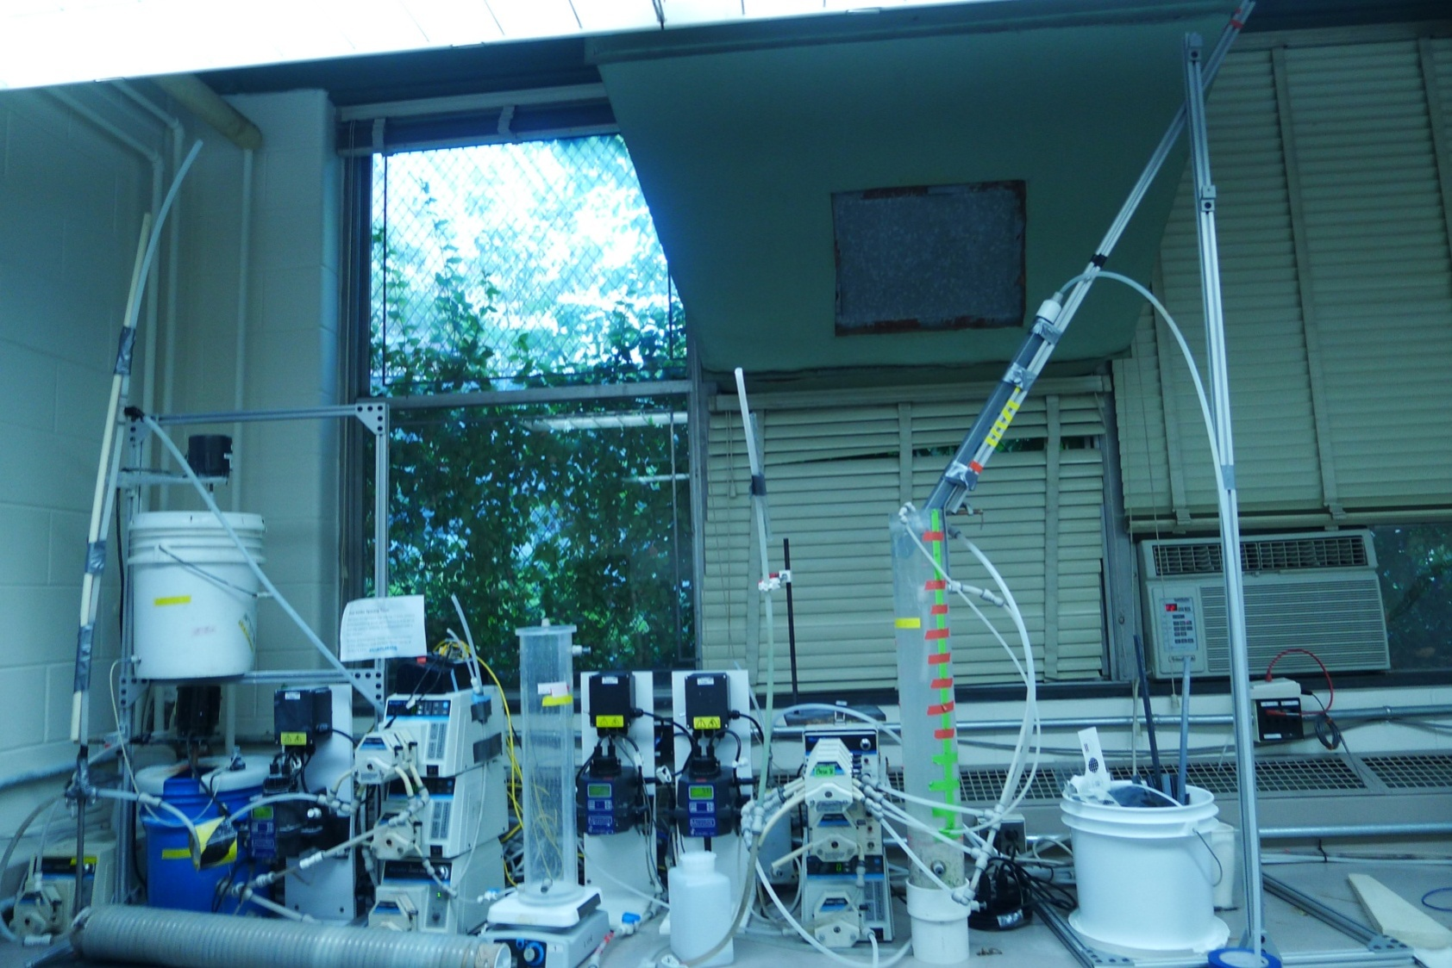
Experiment Apparatus
Coagulant Flow Rate Control Pump
Plant Flow Rate Control Pump
Plate Settler
Clay Storage Tank
Turbidity Meter
Raw Water Storage Tank
Sedimentation Tank
Coagulant Storage Tank
Flocculator

Slide 7
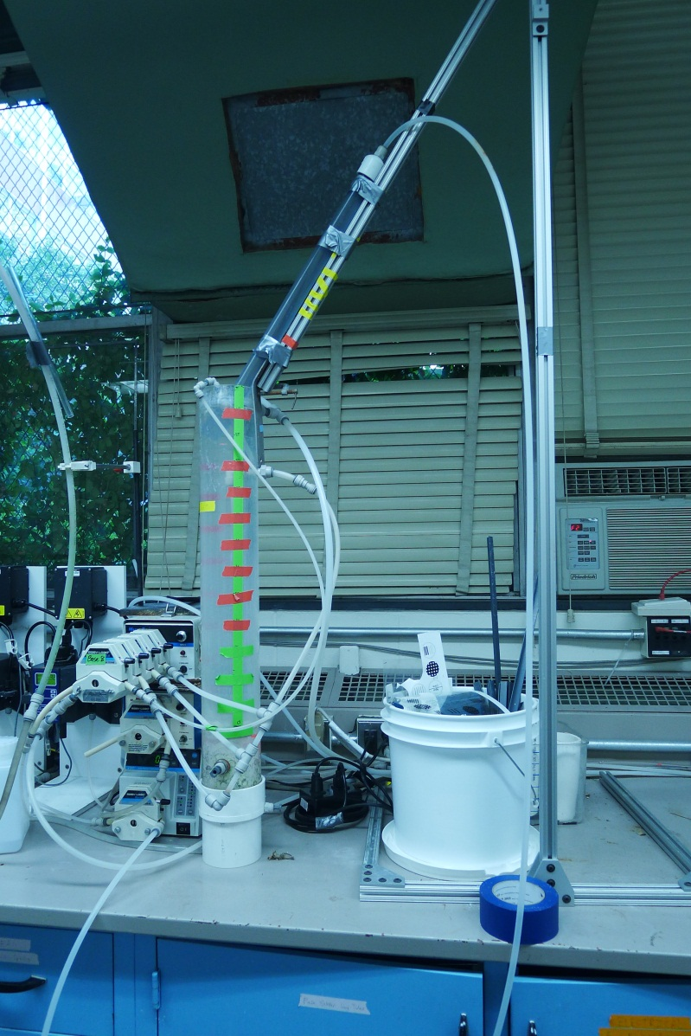
Experiment Apparatus
Water from the flocculator enters the bottom of the sedimentation tank. Then water comes through the tube settler by the rotation of the pump. After tested by the turbidity meter, the water is collected and drained.
L=60cm,
D=2.5cm
60
Tube Settler Capture velocity control pump

Slide 8
METHODS
The parameters to vary in these experiments are
  coagulant type
  coagulant dose
  capture velocity
  raw water turbidity
  humic acid concentration

Slide 9
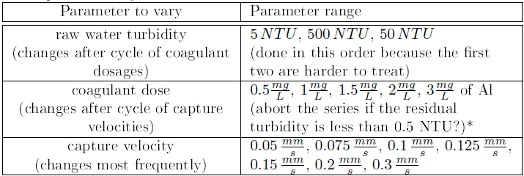
METHODS
Suggested parameter ranges for 3-D scan of turbidity, coagulant dose, and capture velocity

Slide 10
METHODS
Suggested parameter ranges for 3-D scan of turbidity, coagulant dose, and capture velocity

Slide 11
METHODS
Suggested parameter ranges for 3-D scan of turbidity, coagulant dose, and capture velocity

Slide 12
METHODS
3(turbidities) * 5(doses) * 7(velocities) = 105 experiments
One typical cycle
Set Raw Water Turbidity | Alum Dose | Caputure Velocity | Raw Water Turbidity | Sedimentation Tank Turbidity | Tube Settler Turbidity | Removal Efficiency
5 | 0.5 | 0.05 | 5.62 | 4.16 | 2.23 | 60.27
 |  | 0.075 | 5.38 | 3.90 | 2.07 | 61.50
 |  | 0.1 | 5.69 | 4.14 | 2.47 | 56.64
 |  | 0.125 | 5.69 | 4.29 | 2.55 | 55.14
 |  | 0.15 | 5.69 | 4.12 | 2.57 | 54.84
 |  | 0.2 | 5.70 | 4.10 | 2.61 | 54.24
 |  | 0.3 | 5.61 | 3.97 | 2.55 | 54.52

Slide 13
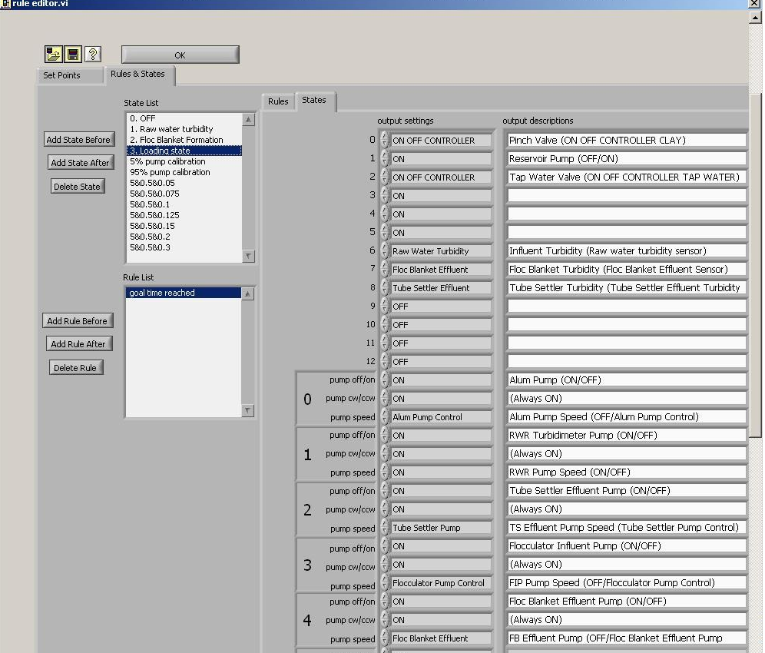
Process Controller
Calibration for each pump in
responds to the flow rate input in
the process controller
Control for three main pumps:
  Coagulant control
  Raw water turbidity control
  Capture velocity control
Take 5 NTU & 0.5 mg/L &
0.05 mm/s as an examples in the
following calculation

Slide 14
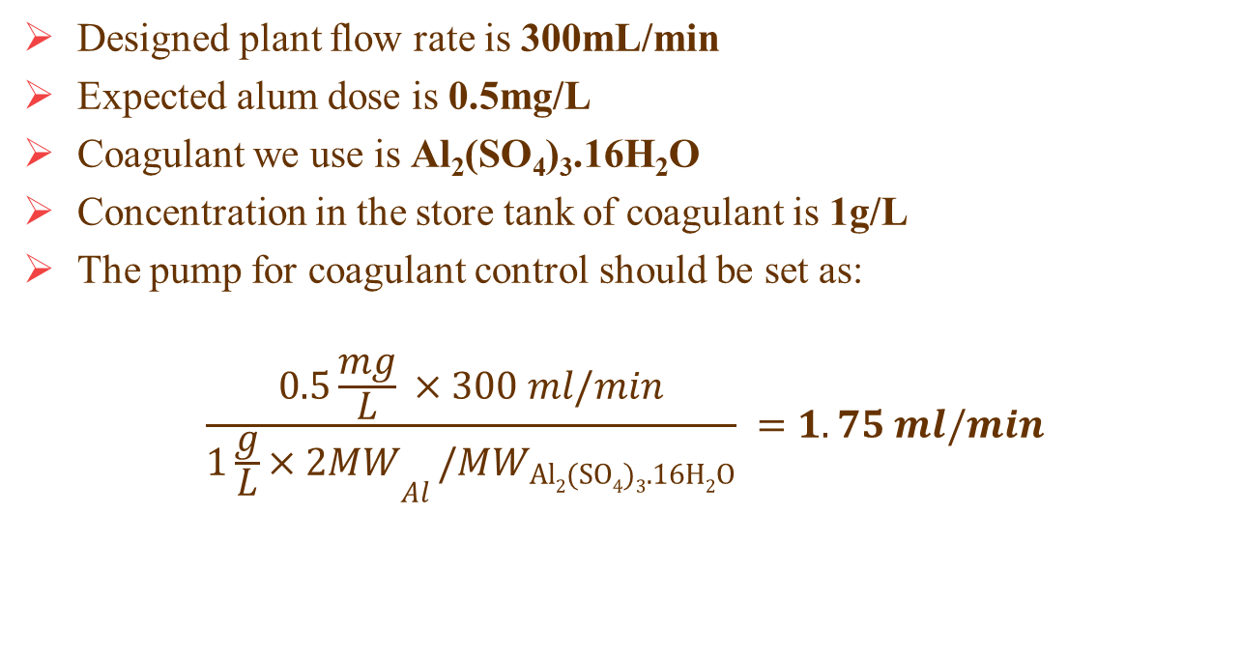
Coagulant Control
Designed plant flow rate is 300mL/min
Expected alum dose is 0.5mg/L
Coagulant we use is Al₂(SO₄)₃.16H₂O
Concentration in the store tank of coagulant is 1g/L
The pump for coagulant control should be set as:
$$\frac{0.5\frac{mg}{L} ×300 ml/min}{{1\frac{g}{L}×2MW}_{Al }/{MW}_{Al2(SO4)3.16H2O}} =1.75 ml/min$$

Slide 15
Raw Water Turbidity Control
Set the raw water turbidity to be 5 NTU
Since 5 NTU is a comparatively low turbidity,
  dilute the suspension of clay
  shorten the “on time” for the pinch valve

Slide 16
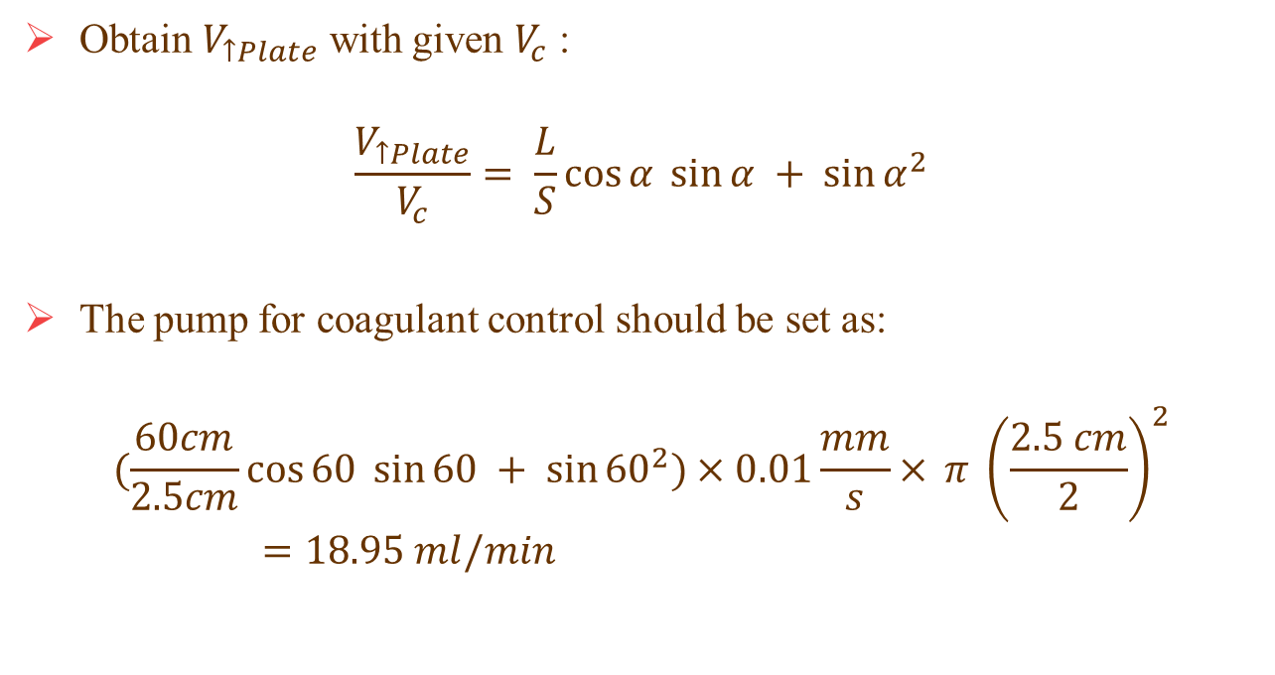
Capture Velocity Control
Obtain $V_{↑Plate}$ with given $V_{c}$ :
$$\frac{V_{↑Plate}}{V_{c}}= \frac{L}{S}\cos{α \sin{α + {\sin{α}}^{2}}}$$
The pump for coagulant control should be set as:
$$(\frac{60cm}{2.5cm}\cos{60 \sin{60 + {\sin{60}}^{2})×0.01\frac{mm}{s}× }}π {\left(\frac{2.5 cm}{2}\right)}^{2}=18.95 ml/min$$

Slide 17
Process Controller
Set different modes for the same alum dose with different capture velocity
Each mode run for 2.5 hours
Process controller will collect data every 5 seconds
Based on observation, the system will go steady 40 minutes’ run
Choose 1000 data for each experiment unit: 60 minutes after the new loading.

Slide 18
Why change the tube?
In the first week’s work, a reverse trend of turbidity was found – floc blanket effluent water got values of turbidity lower than those of tube settler effluent!

Slide 19
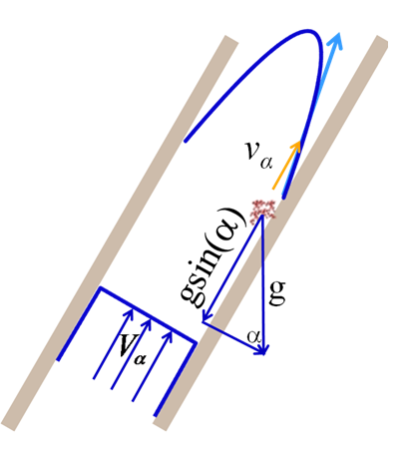

Floc Rollup
To get $v_{α}$ smaller, we need to increase S.

Slide 20
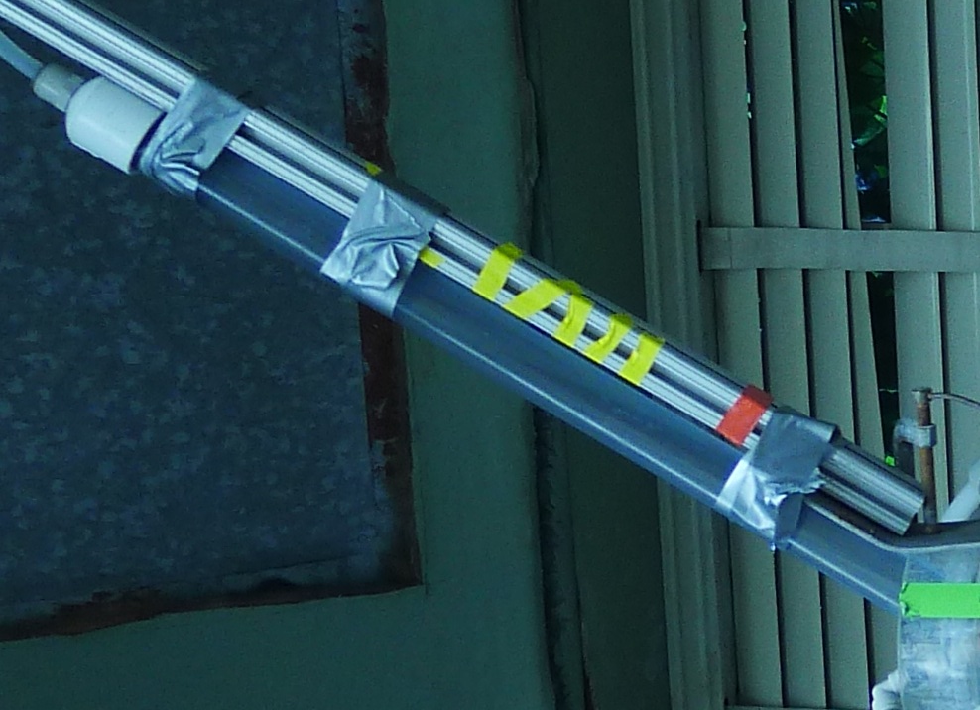
Solution
D=2.5 cm
And it works well

Slide 21
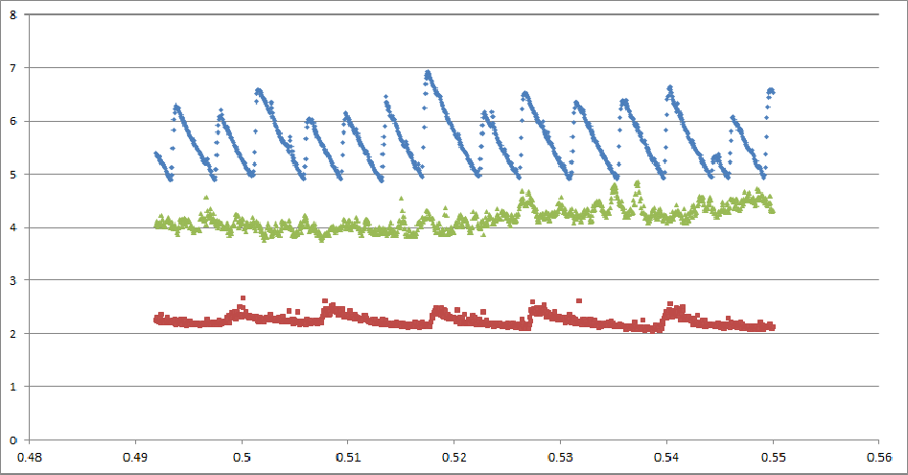
Typical Data

Slide 22
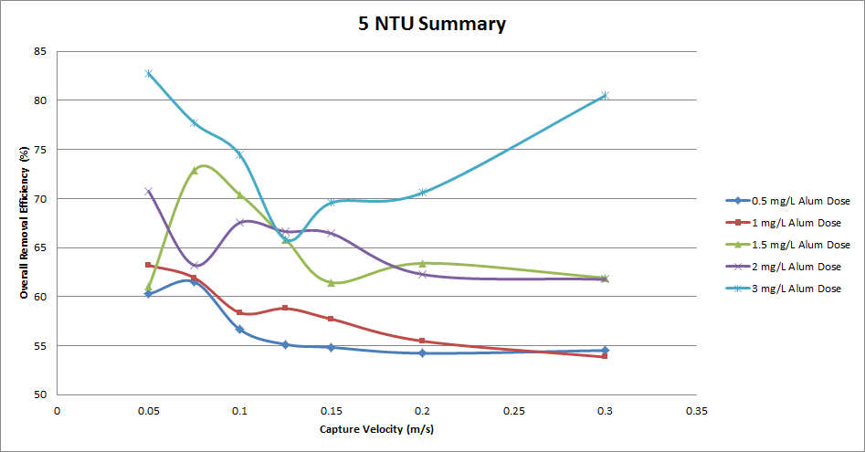
Capture Velocity Change

Slide 23
Highest Efficiency
Occurs when the capture velocities are low
Reason: lower Vc allows the settler to capture flocs settling down slower, while higher Vc doesn’t.

Slide 24
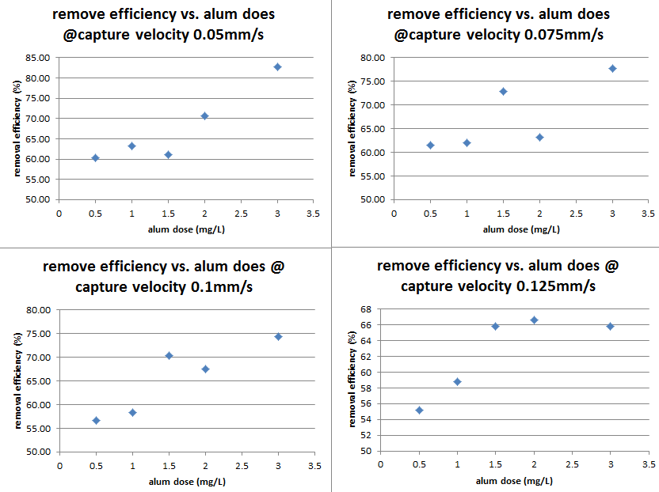
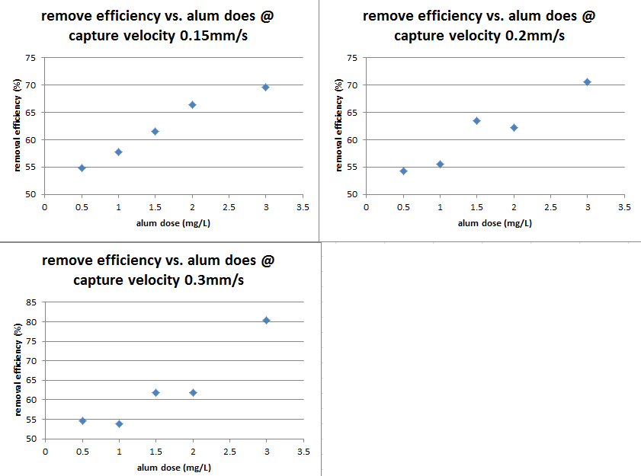
Alum Dose Change

Slide 25
Highest Efficiency
Occurs at high alum doses
The higher the alum added, the larger the chance of aggregating. Therefore more and bigger flocs are formed, which is good for sedimentation.

Slide 26
5 NTU Conclusion
Thus to treat water with this low turbidity, low capture velocity like 0.05 mm/s and alum dose like 3 mg/L would do a nice job.
What about other raw water turbidity levels? – Further tests needed.

Slide 27
Future Work
Use the same setting for Alum Dose and Capture Velocity to test the performance under 500 and 50 NTU turbidity of Raw Water.
PACl might be an alternative for Alum.
If time permitted, humic acid should also be taken into account since they do exist in real situations.

Slide 28
Thanks!

Slide 29
Questions

