Slide 1

Inlet Manifold Team
Julia Morris
Andrew Gorodetsky
Heidi Rausch
TEACH-IN

Slide 2
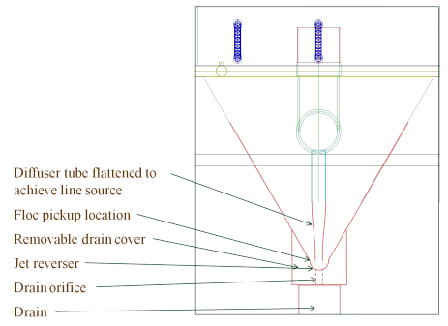
Inlet Manifold
What are we fabricating?

Slide 3
Diffusers
The diffusers are part of the Sedimentation tank
Need to create a line flow, instead of many point flows
Diffusers are made of 2” PVC pipe that is stretched into a thin rectangle

Slide 4
Inlet Manifold Goals
Finding an appropriate method for diffuser fabrication
Should be relatively simple
Must be able to recreate in Honduras

Slide 5
Methods
An easy and cheap method is needed to fabricate the new inlet manifold.
In order to do this, PVC pipe should be heated and then molded into a rectangle that is 1 cm wide with an undetermined length as of now.
It was determined that PVC pipe could be heated using boiling water, a heating blanket, or a heat gun.
So far, boiling water and a heat gun have been tested.

Slide 6
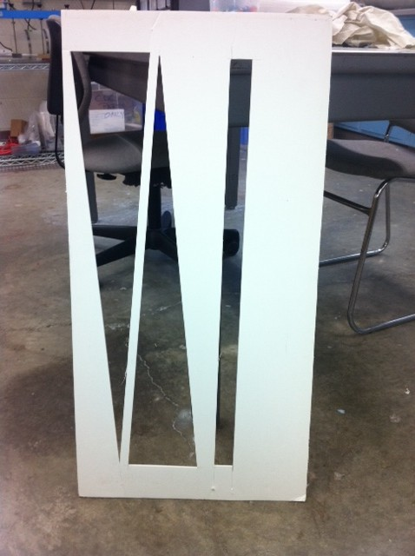
How to Shape the PVC Pipe?
We first decided that a mold would be best.
The hot PVC pipe would be pressed down onto it so that the end would be the rectangle of desired dimensions.

Slide 7
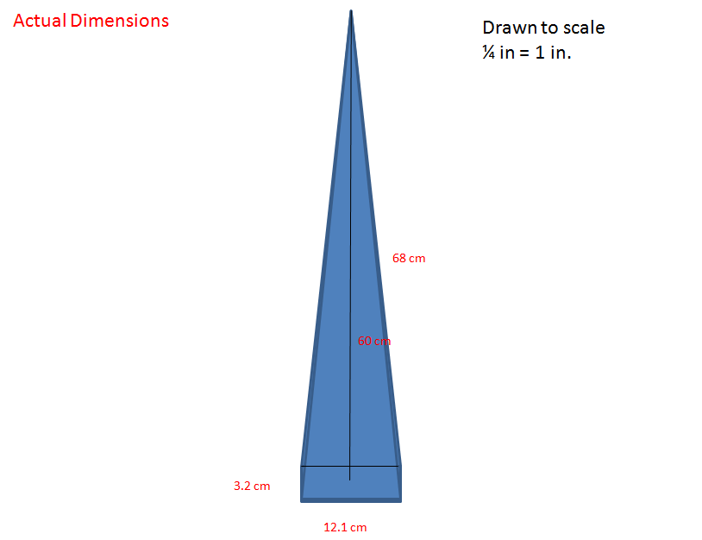

Slide 8
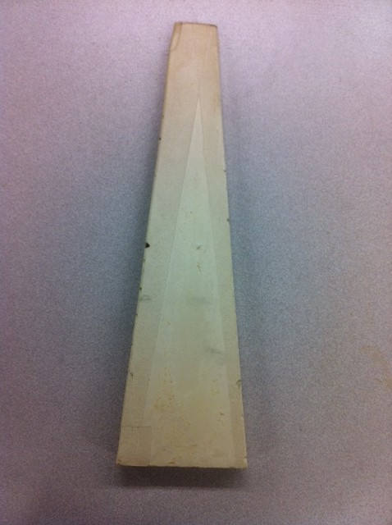
Original Mold
Our mold is made of plaster of paris and can withstand very high temperatures as well as water.

Slide 9
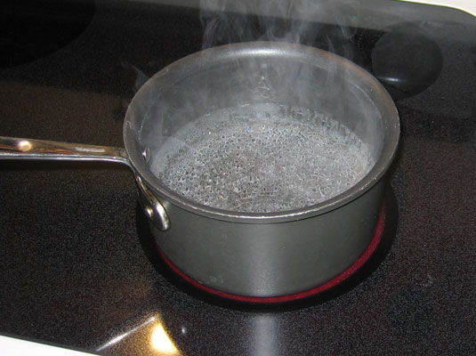
Boiling Water Method
Constantly heated water up in a microwave so that it boiled.
Soaked PVC pipe in the water and stretched it with gloved hands.

Slide 10
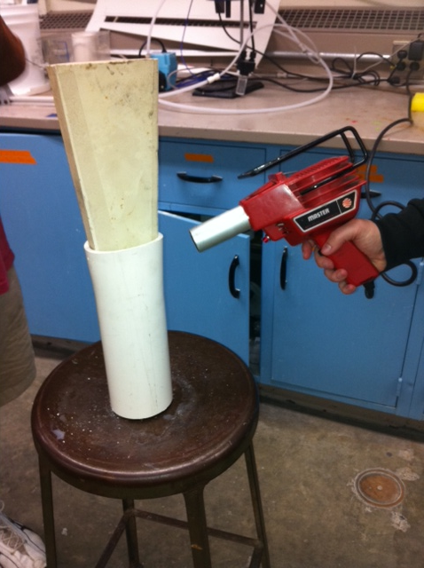
Heat Gun
Using the microwave was slow, so we decided to try heat guns.
Used two heat guns to warm the PVC pipe and slowly pressed it down the mold.

Slide 11
What Worked and What Didn’t?
The boiling water method was effective in heating the PVC pipe, but it was hard to keep the water constantly boiling which kept the PVC pipe hot.
The heat guns were very slow at heating the PVC pipe.
  Took about two hours to get the PVC pipe down the entirety of the mold

Slide 12
Analysis
While both methods got the PVC pipe to the desired temperature, neither of them were very efficient. The boiling water technique can be improved through the use of a hot plate.
The mold did work for the first dimensions given to us for the rectangle at the end of the PVC pipe, but the new dimensions are much smaller and the mold will be a lot more fragile. Another method will be tried out.

Slide 13

Inlet Manifold Future Work
Creating a lever system
Revisiting the use of boiling water
Use of a new type of mold
Use of a heating blanket

Slide 14
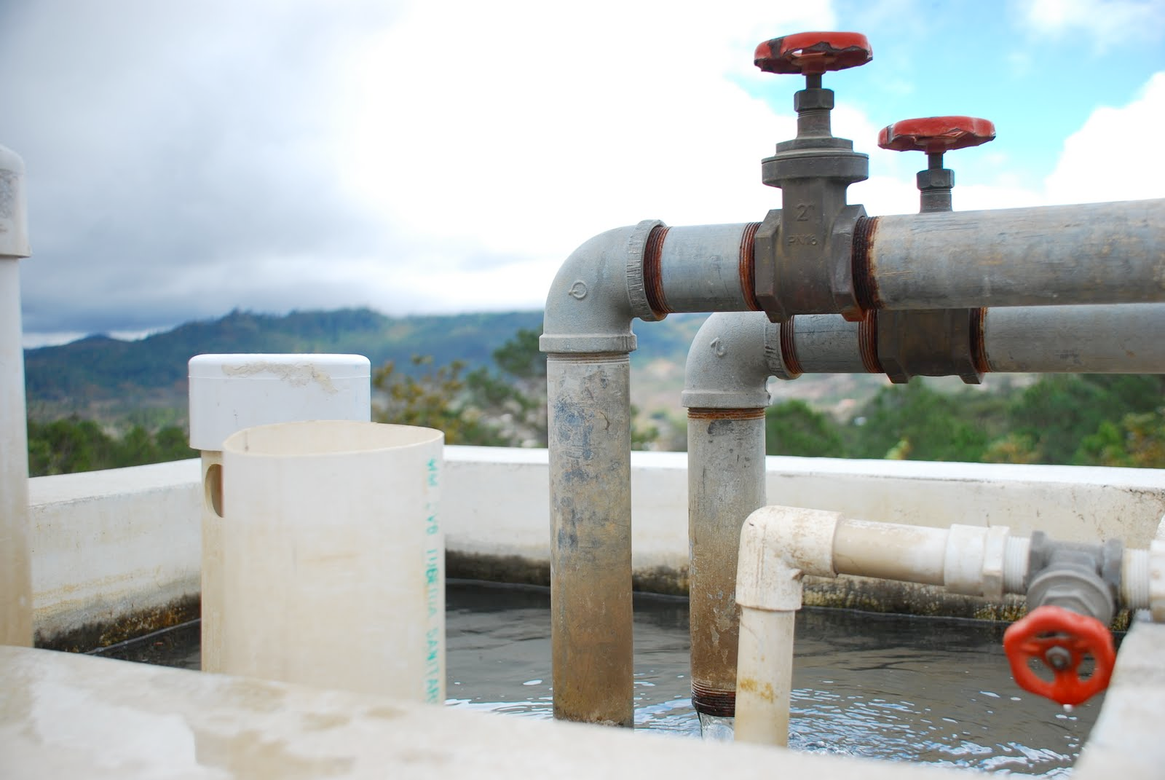
Questions?

