Slide 1

Inlet Manifold
Julia Morris
Andrew Gorodetsky
Heidi Rausch
Final Presentation

Slide 2
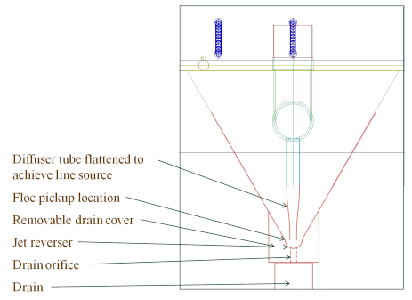
Inlet Manifold
What are we fabricating?

Slide 3
Diffusers
The diffusers are part of the Sedimentation tank
Need to create a line flow, instead of many point flows
Diffusers are made of 2” PVC pipe that is stretched into a thin rectangle

Slide 4
Inlet Manifold Goals
Finding an appropriate method for diffuser fabrication
Should be relatively simple
Must be able to recreate in Honduras

Slide 5
Methods
An easy and cheap method is needed to fabricate the new inlet manifold.
In order to do this, PVC pipe should be heated and then molded into a rectangle that is 1 cm wide with a length of 10 cm.
It was determined that PVC pipe could be heated using boiling water, a heating blanket, or a heat gun.
Both boiling water and a heat gun methods have been tested and using boiling water was the most effective.

Slide 6
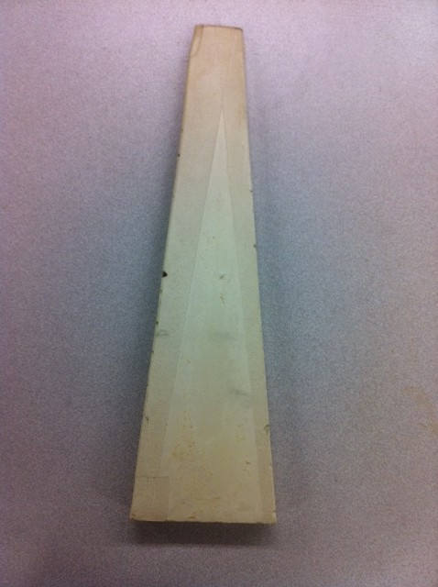
How to Shape the PVC Pipe?
Our first method was to make a mold that was made of plaster of paris and can withstand very high temperatures as well as water.

Slide 7
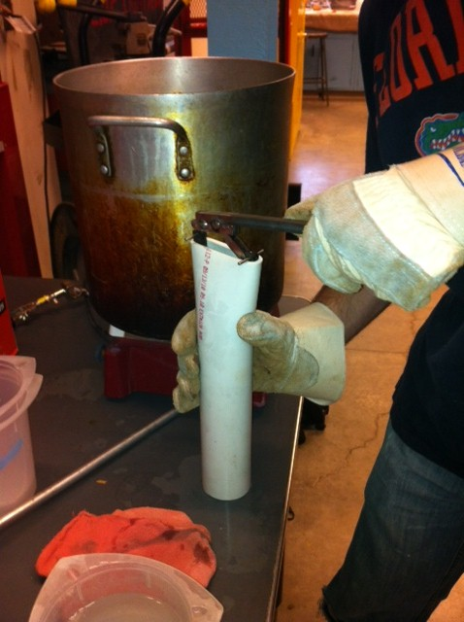
How to Shape the PVC Pipe?
The next method that we tested was to use a jack system. The jack would be inserted into the PVC pipe so that the lever could be pulled down which would stretch the PVC pipe to our desired dimensions.

Slide 8
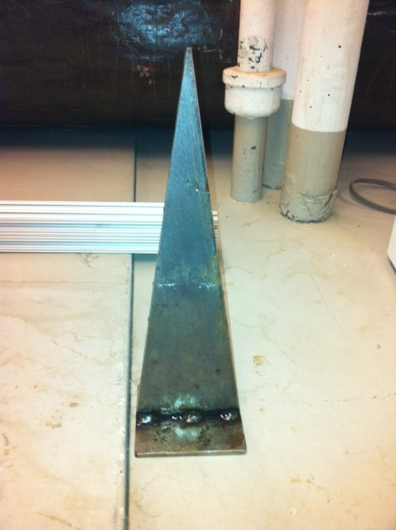
How to Shape the PVC Pipe?
Once the mold was decided to be more effective, a new one was made of steel with the new desired dimensions.

Slide 9
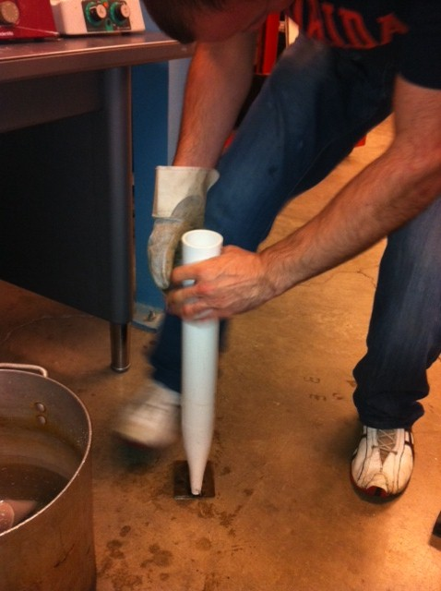
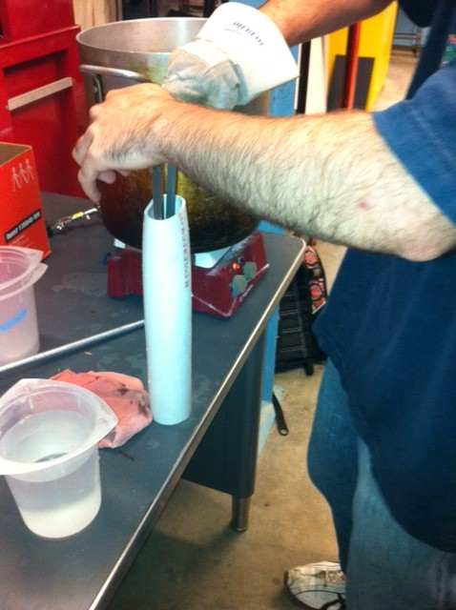

Slide 10
http://www.youtube.com/watch?v=lZ9EGzRt4dM&feature=channel_video_title

Slide 11
What Worked and What Didn’t?
The boiling water method was effective in heating the PVC pipe once we found a working a hot plate.
Using an open fire would be just as effective, if not more, in getting water to boil in Honduras.

Slide 12

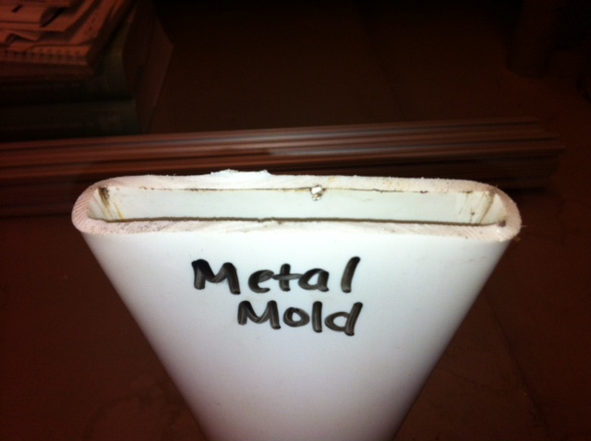
What Worked and What Didn’t?

Slide 13
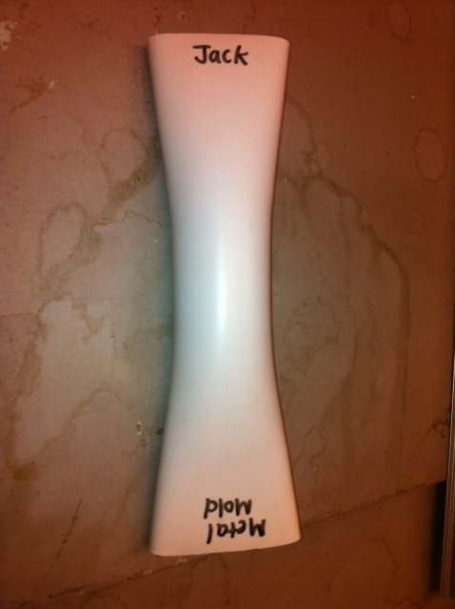
What Worked and What Didn’t?
As shown by the results, using the metal mold created a more uniform PVC pipe.
The jack system, while also pretty effective, also didn’t get the PVC pipe all the way to a 1 cm width.

Slide 14
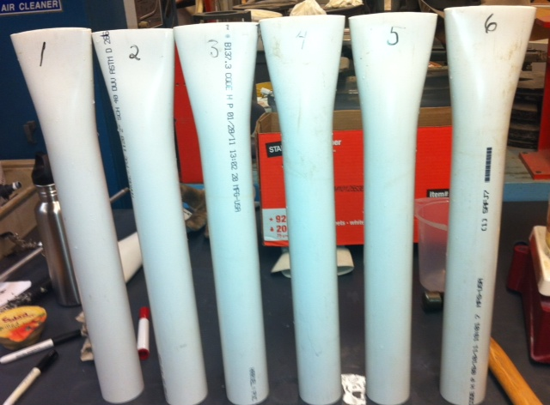

Inlet Manifold Future Work
Figure out a way to make sure diffuser pipes are lined up when installed.
Find dimensions on pipes used in Honduras so that final outside length is 10 cm.

Slide 15
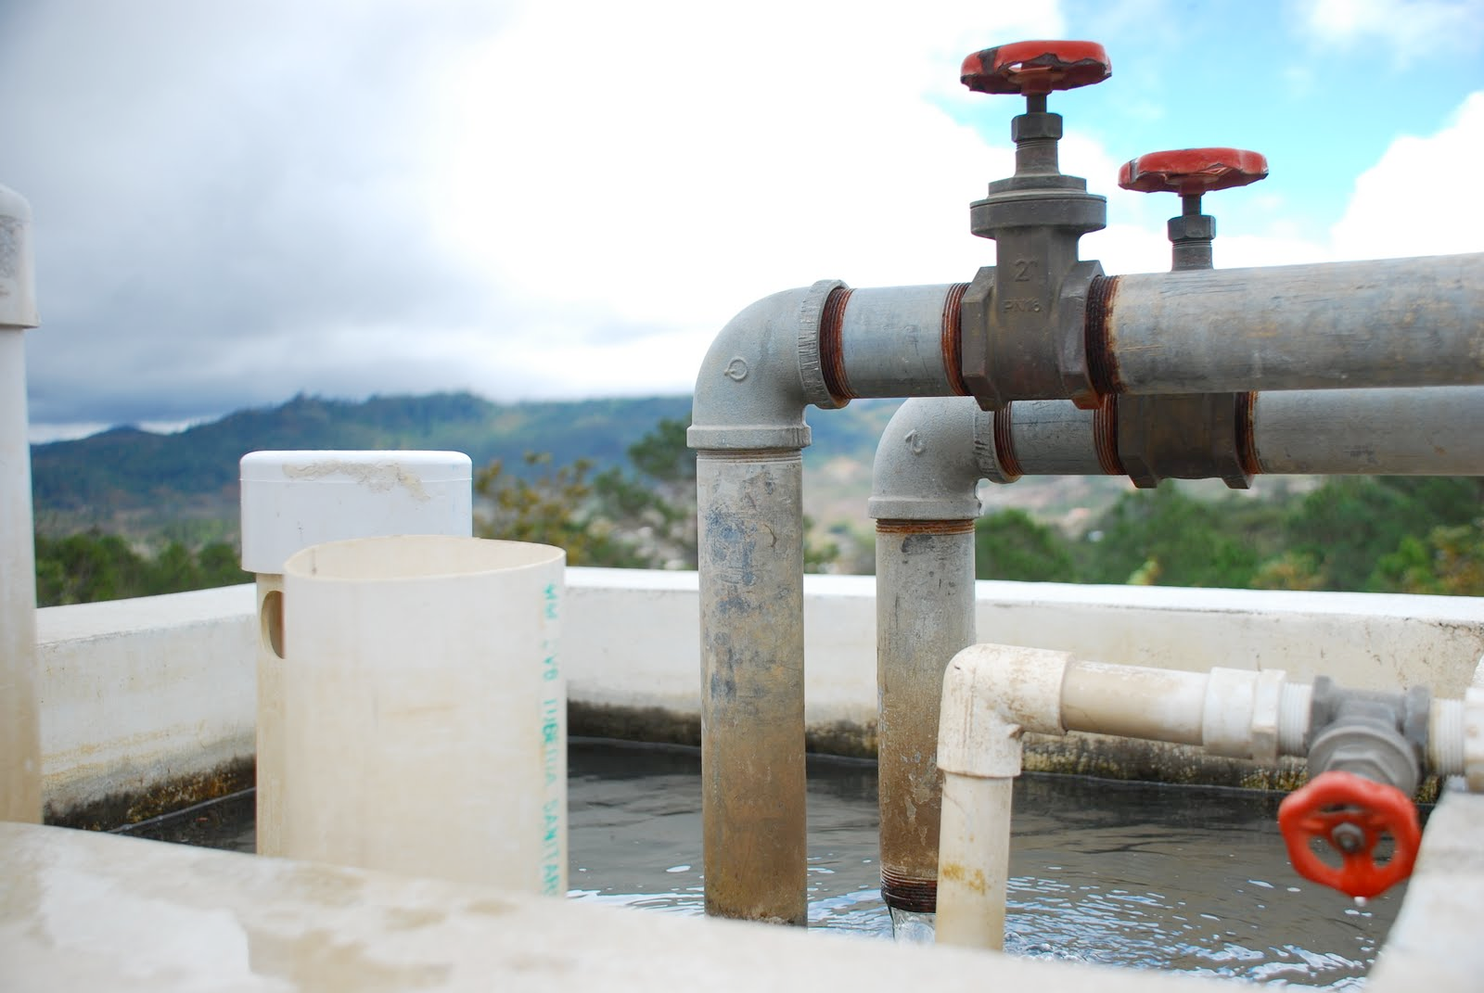
Questions?

