Slide 1

Ram Pump
Jill Freeman
Marisa Perez-Reyes
Marina Servino

Slide 2

Outline
Introduction
Goals
Theory: How a Ram Pump Works
Test Apparatus
Experimental setup
Future work

Slide 3
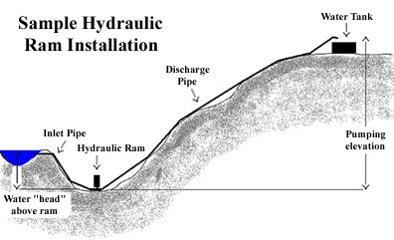
Storage Tanks
AguaClara Plant
AguaClara Ram Pump
Distribution Tank

Slide 4
Ram Pump Parameters
Available drive height = 1.4 meters
Available drive length = 10 feet
Required delivery flow = 0.01 L/s

Slide 5
Goals
Modify and improve ram pump
  Deliver water to an equivalent height of 7.15 m
Improve ram pump set-up
Evaluate possibility of commercial ram pump
Test various ram pump parameters

Slide 6
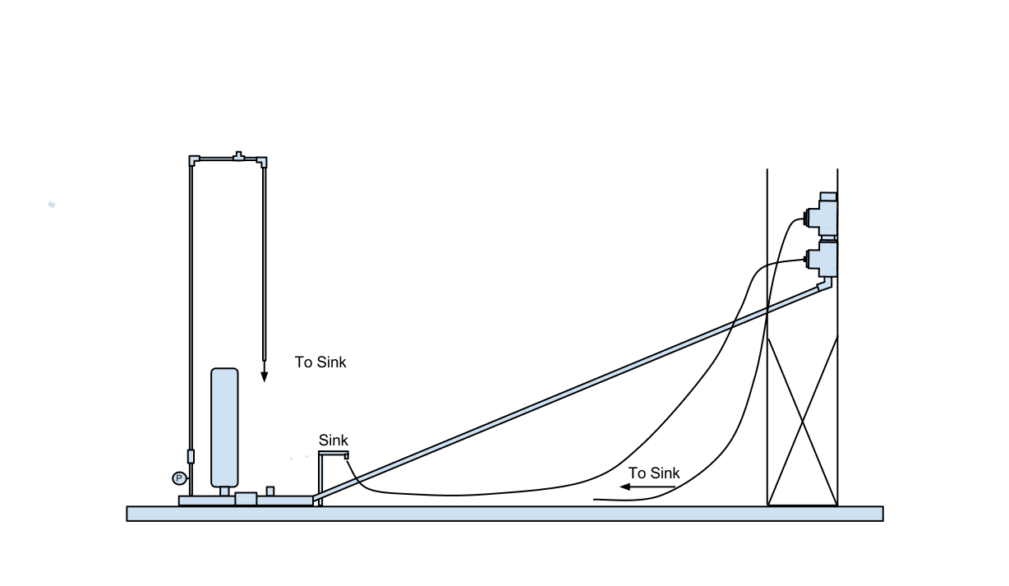
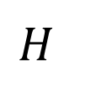

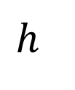
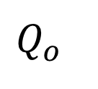
$$Q_{o}$$
$$h$$
$$Q_{i}$$
$$H$$
Notes:
In our trials, we used a delivery height of 2m because we are limited in our lab space and pressure sensors were not working.
We will need

Slide 7
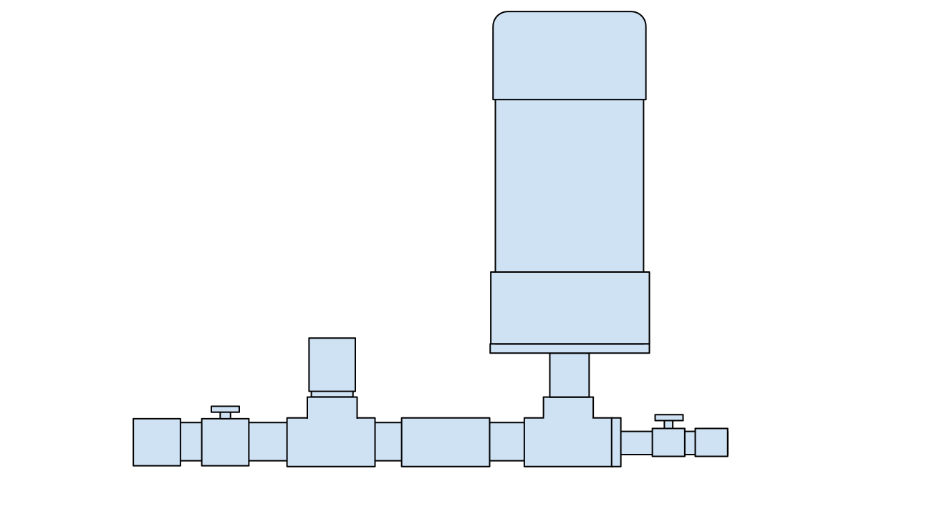

Slide 9

Pump efficiency
$$Q_{o}×h=η\left(Q_{i}×H\right)$$
$$Q_{o}$$
$$h$$
$$Q_{i}$$
$$H$$
Notes:
In our trials, we used a delivery height of 2m because we are limited in our lab space and pressure sensors were not working.
We will need

Slide 10
Ram Pump Operation

Slide 11
Current Work
Build a stable device to collect water from the wasting valve
Seal connections and the air chamber
Check valve research

Slide 12
Future Work
Modify existing check valve
Measuring flow rate
Run tests to determine the effects of various parameters on pump performance
(drive pipe length, angle, and diameter; air chamber size and orientation; and delivery pipe diameter and angle)
Weight in the check valve
Compile research

Slide 13
Questions?

