Slide 1
Ram Pump
Ruju Mehta, Kelly Huang, Ruben Ghijsen

Slide 2

What is it?

Slide 3
See it in action!
Notes:
https://www.facebook.com/photo.php?v=10151915815868513&set=vb.579543512&type=3

Slide 4

Where and Why?

Slide 5

Storage Tanks
AguaClara Plant
Ram Pump
Distribution

Slide 6
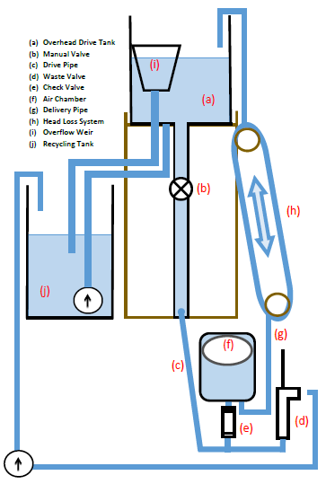
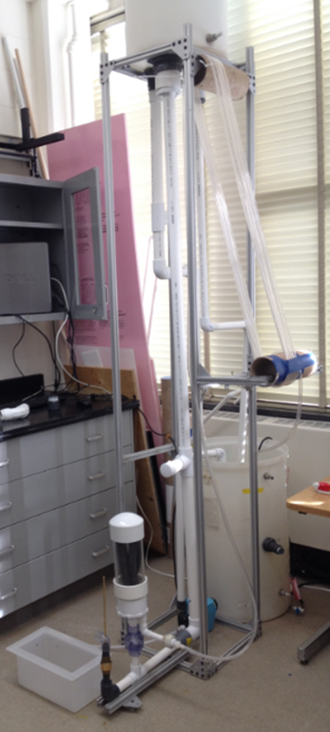
Lab Set-Up
Lab Set-Up

Slide 7
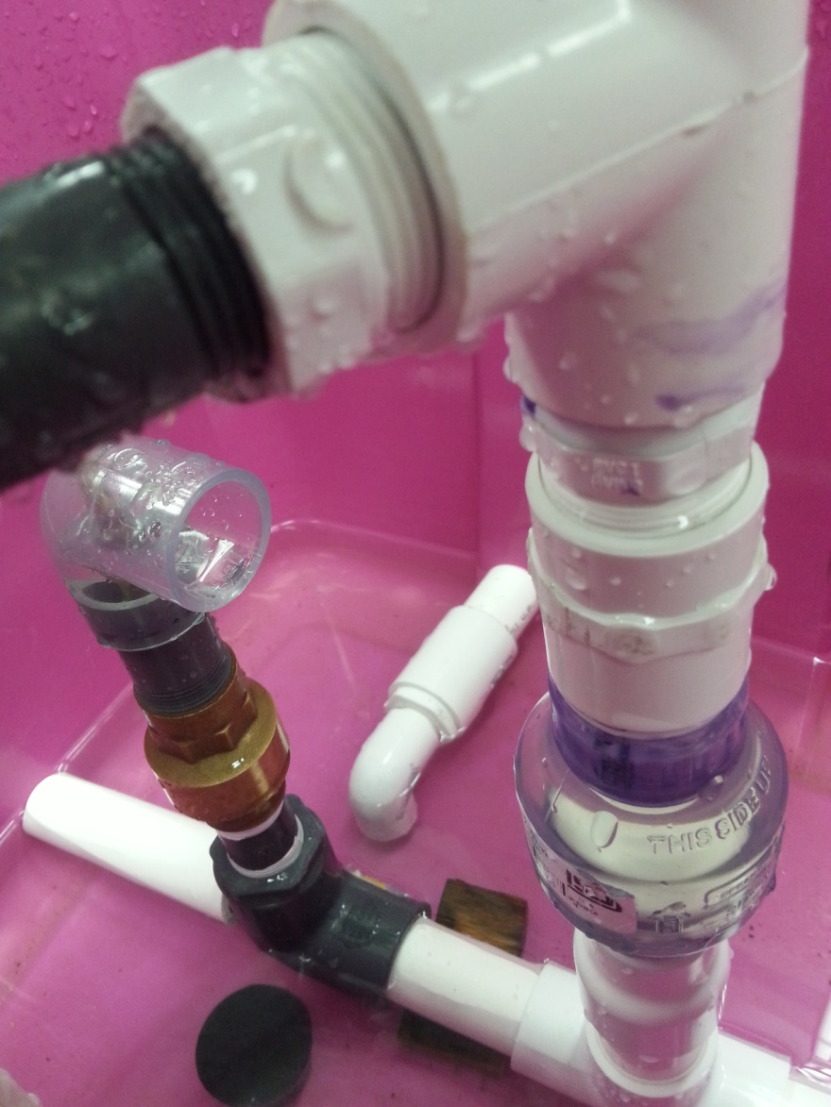
Air Chamber Piping

Slide 8
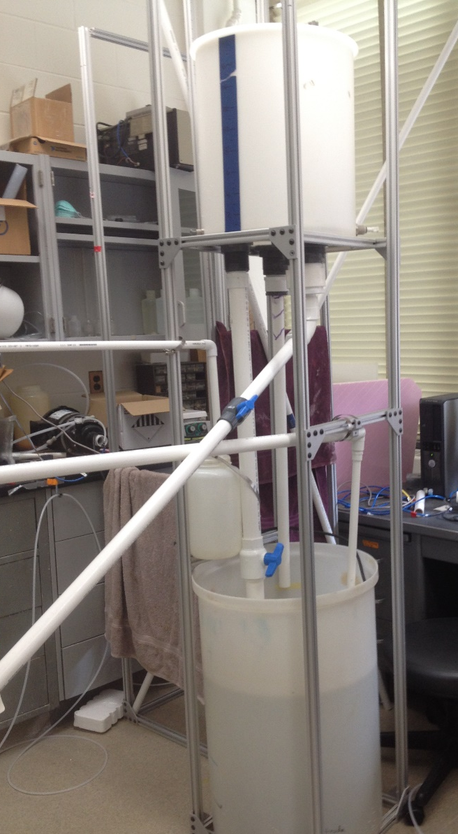
Overhead Drive Tank

Slide 9
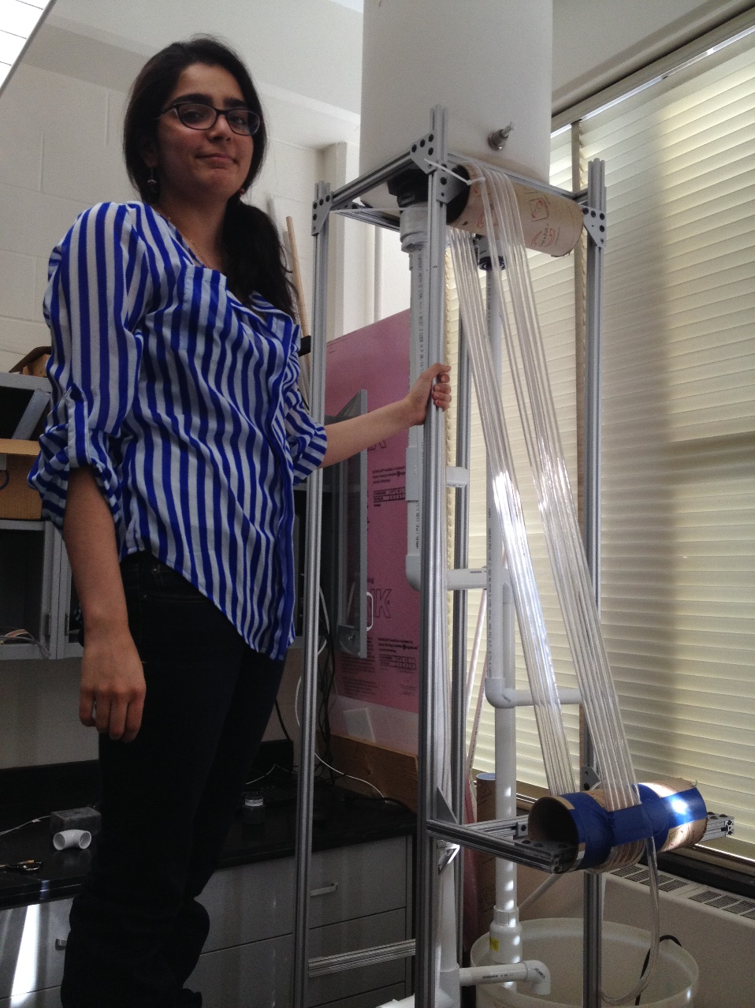
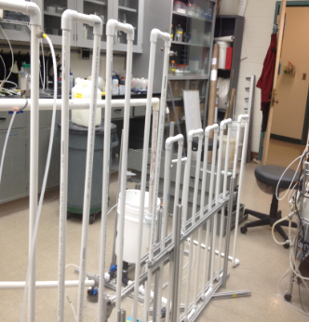
Head loss system

Slide 10
Future Work
finish building
test for optimal flow rate
    weights, types of valves, etc.
durability
reliability Suggestions?
scaling

Slide 11
Questions?

Slide 12
Thank you!

