Slide 1
Ram Pump
Abby Brown, Annie Ding,
Pablo Nistal, Bari Suri

Slide 2
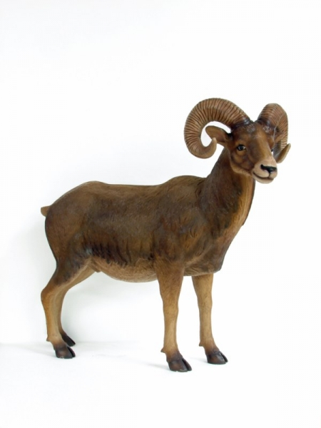
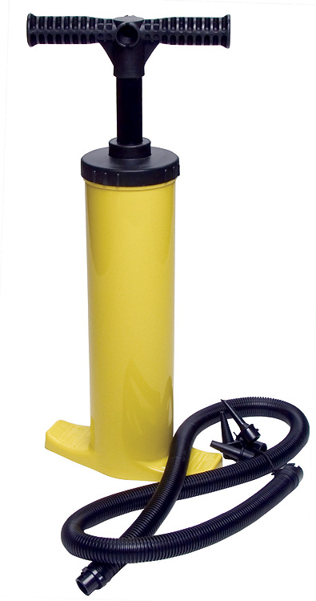
What is a ram pump?
= ?????
Notes:
Abby
Where used in AguaClara plants? -San Nicolas has one to supply stock tanks with clean water for making chemical solutions
Potential future usefulness of the pump- expansion to India

Slide 3


Why do we want to use a ram pump?
Notes:
This is what we want to prevent - Abby

Slide 4
Set-up: In the Plant
Storage Tanks
AguaClara Plant
Effluent
Distribution
Ram Pump
Pumped water
Waste water
Notes:
Abby

Slide 5
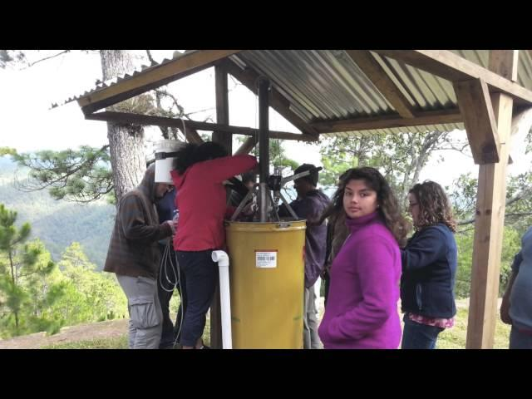
Set-up: In the Plant
Honduras Video
Notes:
12:40 into the video https://www.youtube.com/watch?v=KjRkhhcRi4U - Bari

Slide 6
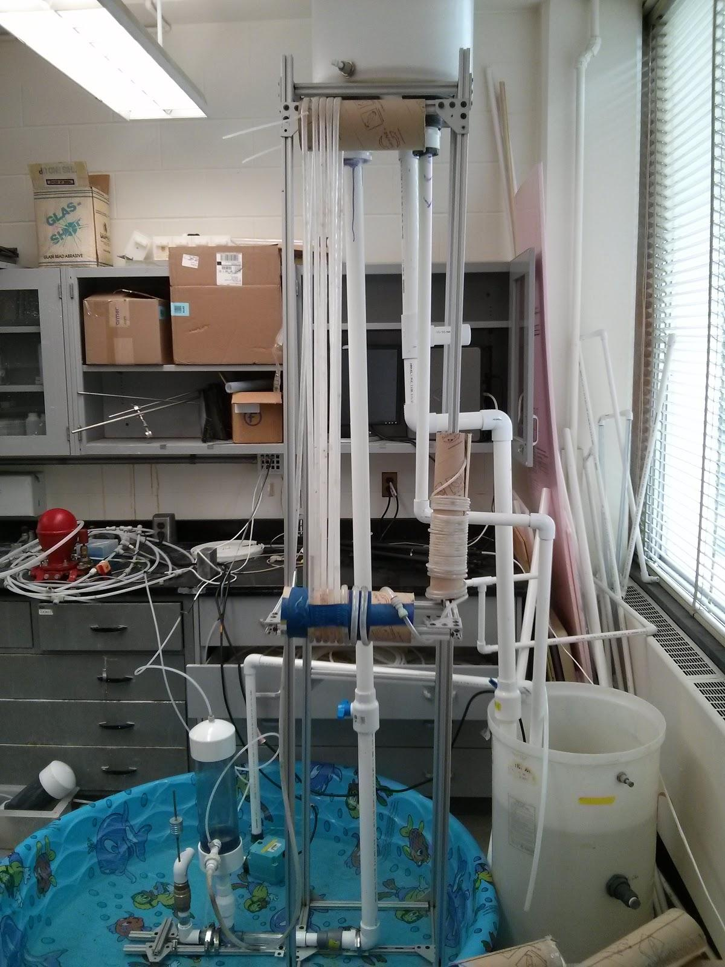
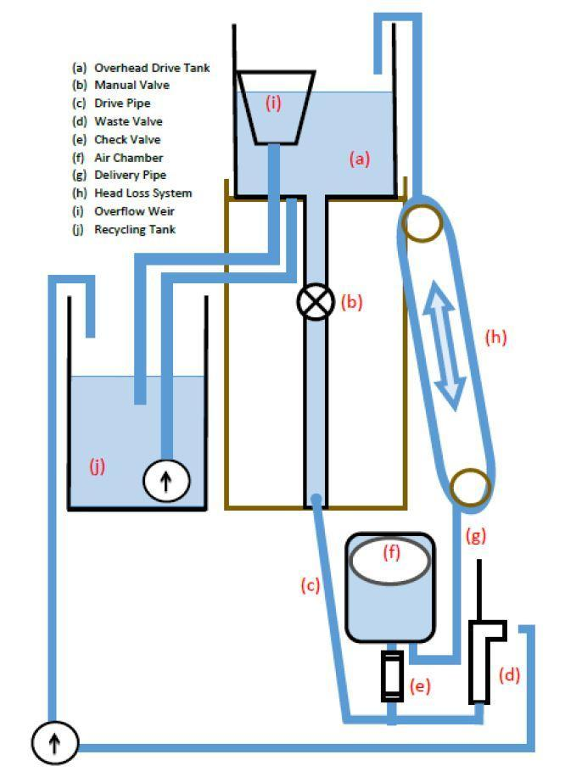
Set-up: In the Lab
Notes:
Bari

Slide 7
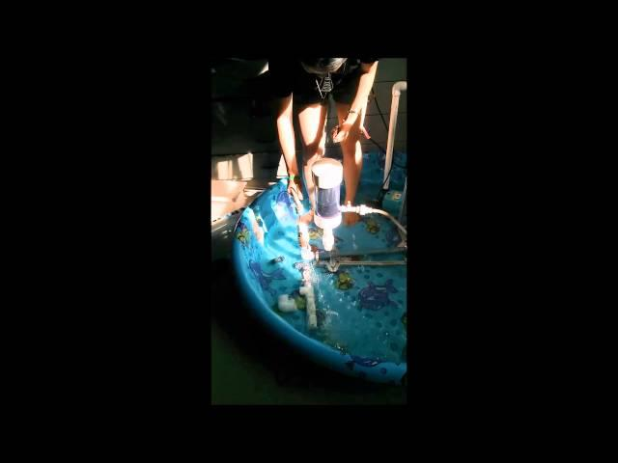
See it in action!
Notes:
Bari

Slide 8
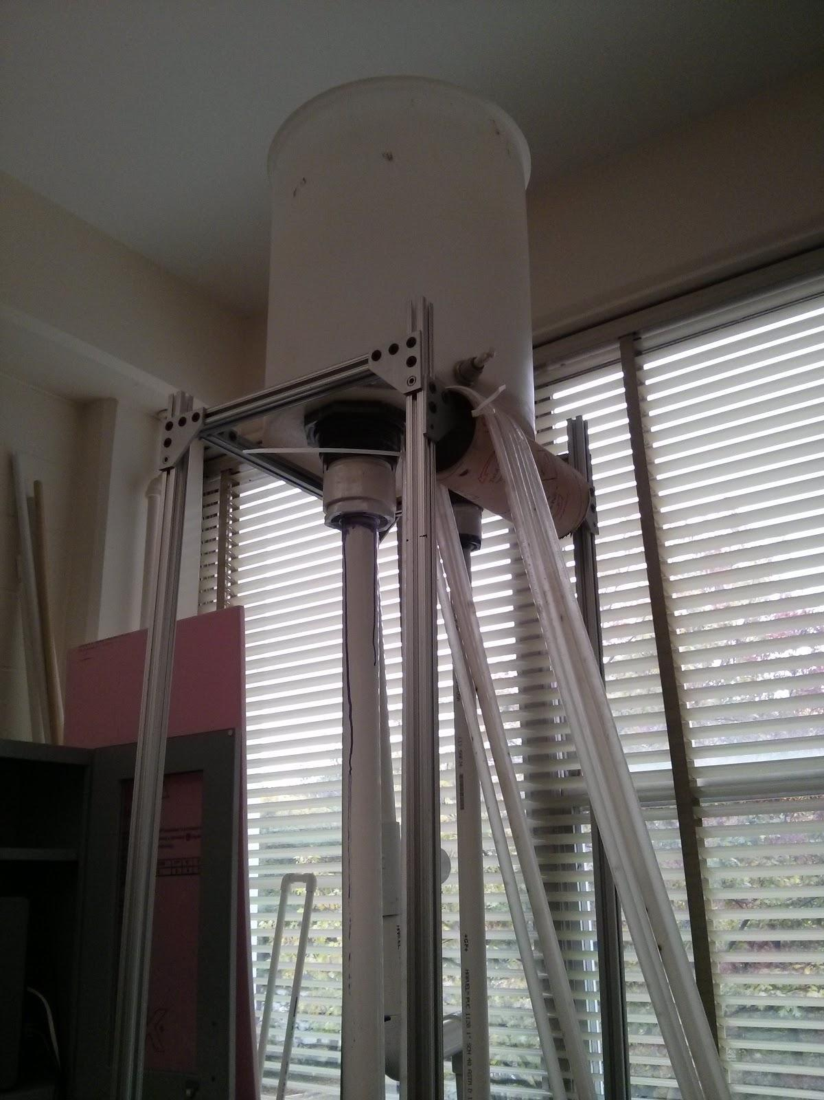
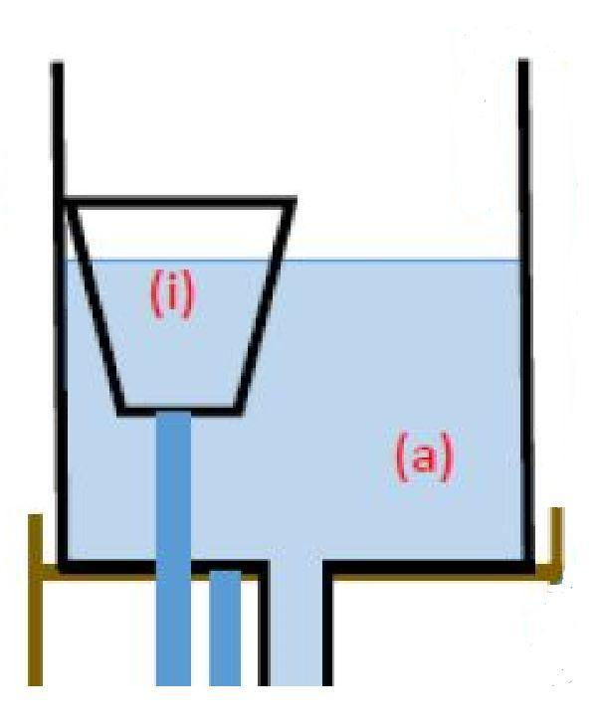
Overhead Drive Tank
Notes:
Pablo

Slide 9
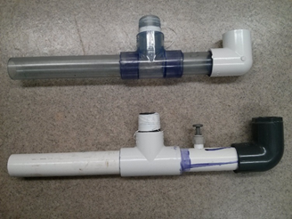
Drive Pipe
Shorter distance between components
Longer distance between components
Notes:
Pablo

Slide 10
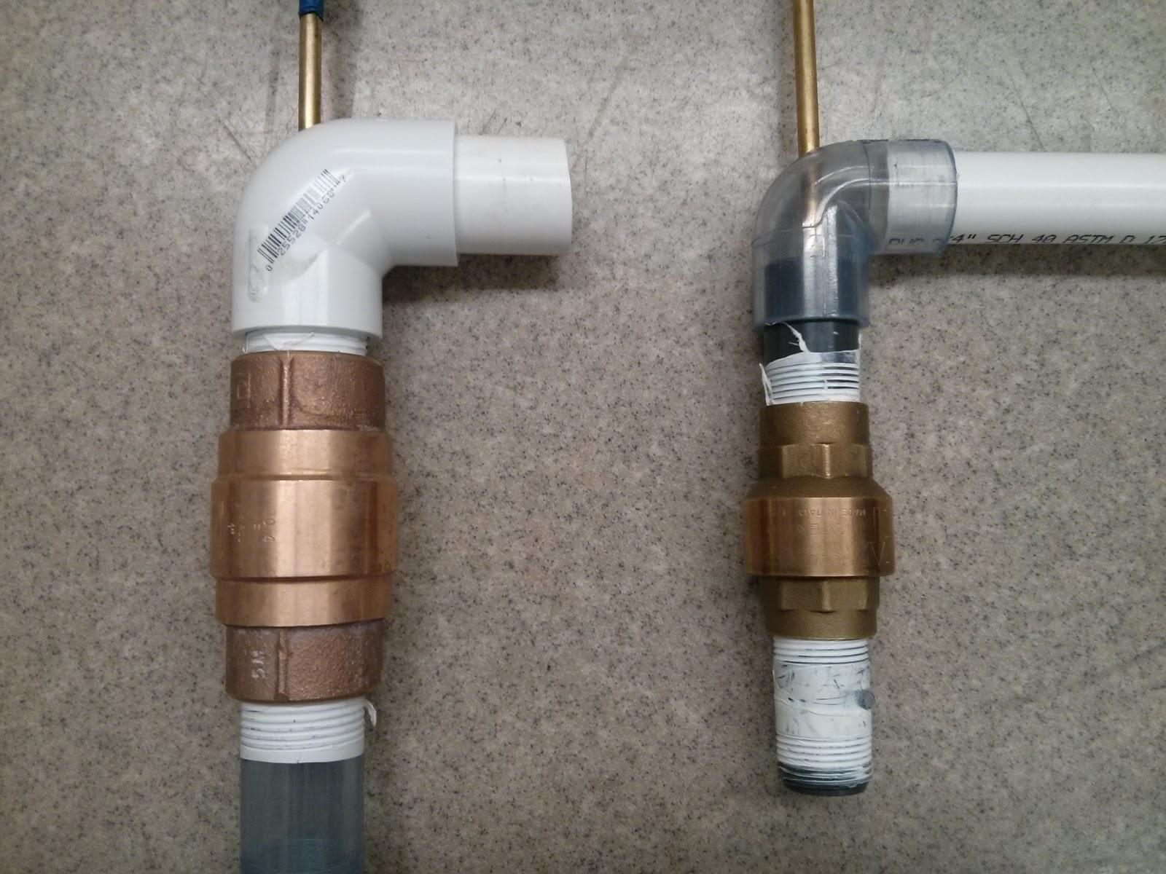
Waste Valve
1” vs ¾” Brass
Notes:
Pablo

Slide 11
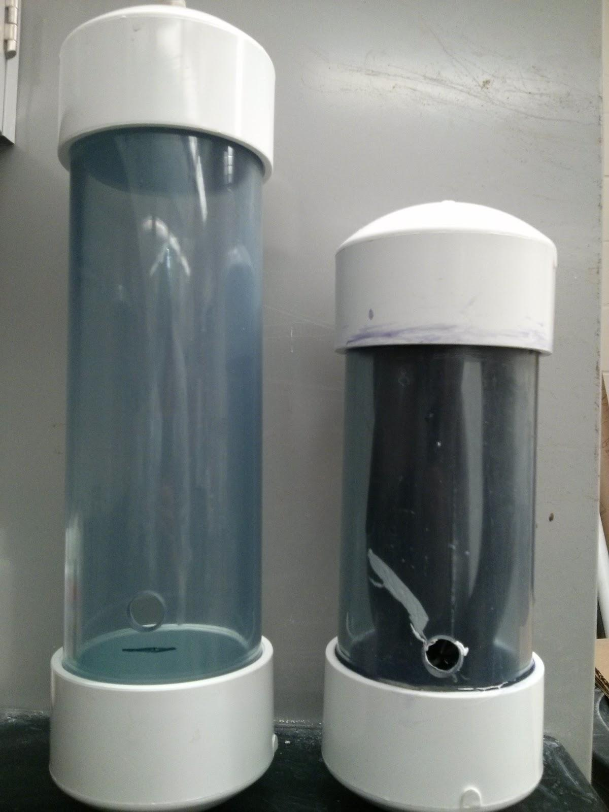
Air Chamber
4 sizes of PVC:
9”, 12”, 15”, 25”
Notes:
Pablo

Slide 12
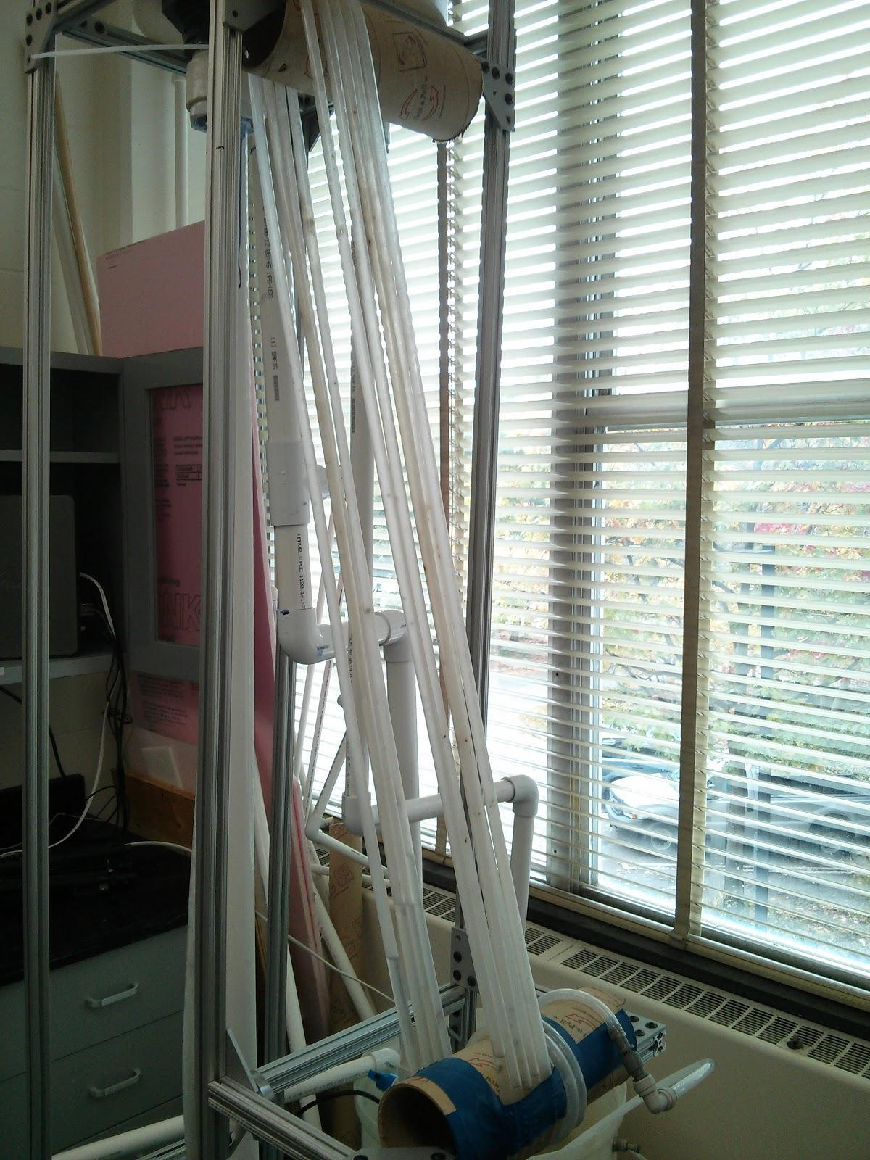
Head Loss System
50’ of coiled clear, flexible ½” tubing
Notes:
Pablo

Slide 13
Future Work
Head Loss System
  Only measures 2m of head loss instead of 7m!
  Potential ideas:
    Use more tubing to increase head loss
    Use the tubing we have more effectively
Experimentation
Data Analysis
Notes:
Annie

Slide 14

Questions/Comments/
Suggestions?
Notes:
Annie

