Slide 1

Ram Pump
Jill Freeman
Sam Rabkin
Mahina Wang

Slide 2

Outline
Introduction
Goals
Theory: How a Ram Pump Works
Test Apparatus
Experimental setup
Future work

Slide 3

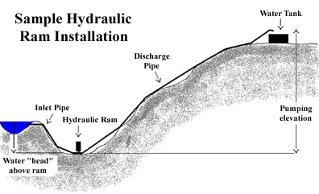
Ram Pumps: Introduction
Notes:
Installed on the treated water line between the AguaClara plant effluent and the distribution storage tank
-will be used for stock tanks (750L coagulant, 208L Cl, 20 gal bathroom = ~1100 L/day) and bathrooms (difficult since AguaClara plants are driven entirely on gravity)

Slide 4
Design Goals
Make design:
  Smaller
  Simpler
  More efficient
Easy maintenance
Determine ways of measurement
Ultimately for January Honduras trip
Notes:
Smaller: smaller diameter pipes (less flow), smaller air chamber (and effect on efficiency)-or even surge pipe
Efficiency-how to figure out and maximize
-rearrange design of Spring’s ram pump to get rid of dead zones
Measure flow rates/pressure (pressure sensors don’t work well with spikes)

Slide 5
Ram Pumps: Introduction
Required input flow rate for Pump Scenario [L/s]
 | 2 hours | All day
Below ground level | 1.07 | 0.09
At ground level | 1.40 | 0.12
Notes:
Possibilities for layout in plant include burying the box for increased head (greater initial cost)
-2 hours is just scenario
2 hours versus 24 hours
-calculated with efficiency of 50%

Slide 6
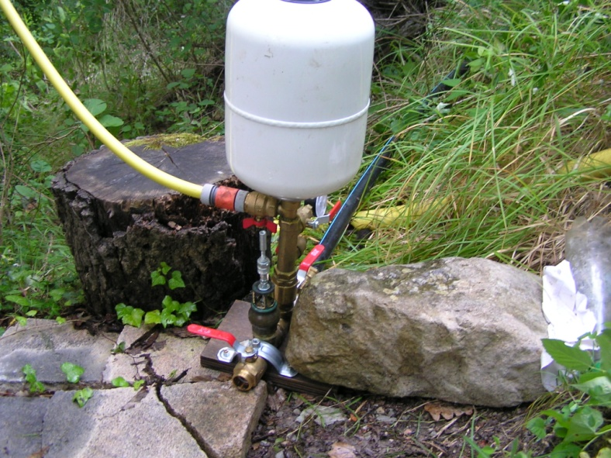
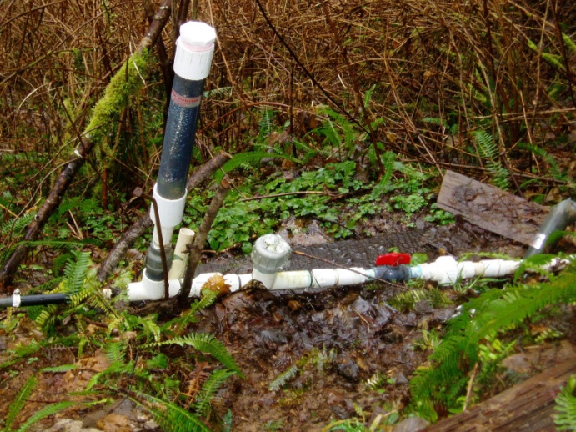
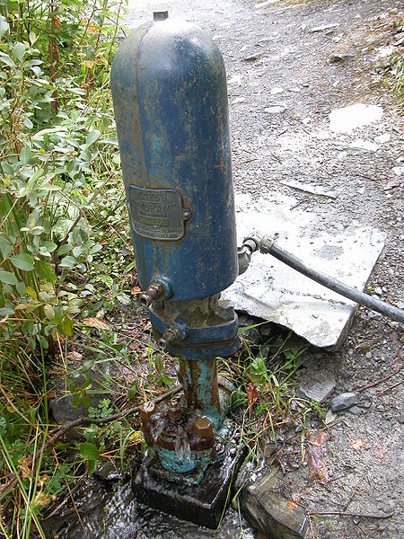
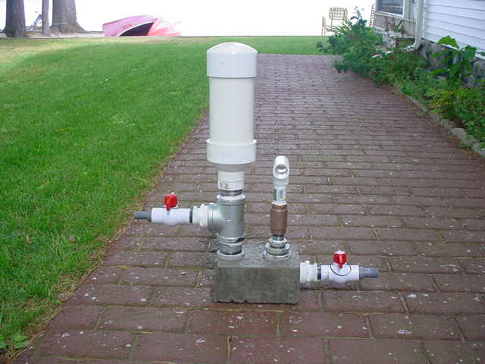
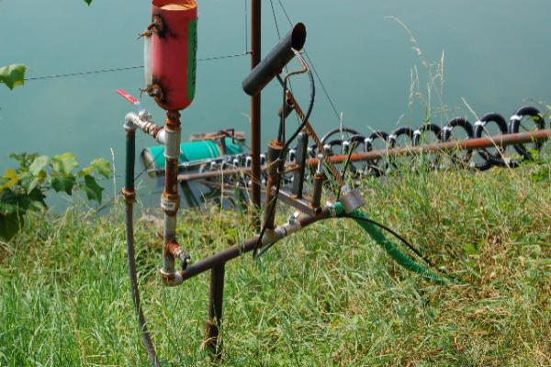
Ram Pumps

Slide 7
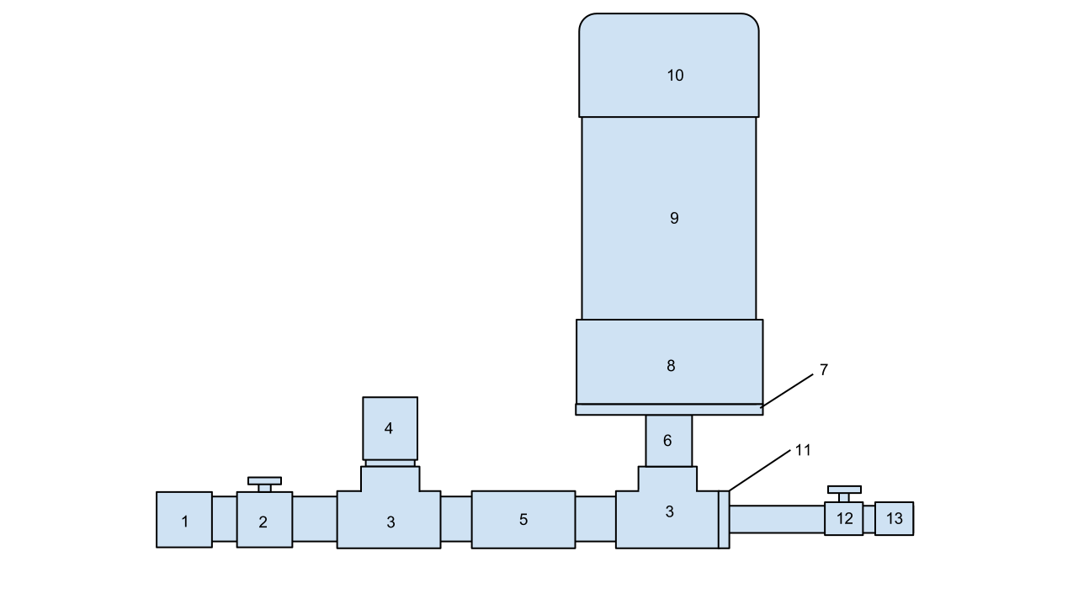
Parts of the Ram Pump
1. Union
2. Valve
3. Tee
4. Check valve – wasting valve
5. Check valve
6. Nipple
7. Bushing
8. Coupling
9. PVC pipe
10. PVC cap
11. Bushing
12. Valve
13. Union
Notes:
Unions (1 & 13): make it easy to remove pump
Valves (2 & 12): allow us to control pressure build-up in air chamber, control water flowing into and out of pump
Wasting valve (4): Initially open – at first it lets water flow through it, but closes once the velocity is high enough. This creates a pressure spike that pushes water through the rest of the pump
Other check valve (5): Initially closed – opens when water flowing through it moves fast enough and closes when the pressure drops, preventing water that passes through it to move backwards through the pump
Nipple, bushing, and coupling serve to connect parts of different sizes
PVC pipe and cap (9 & 10) – Form the air chamber

Slide 8
Check Valves
Check valves are essential to the ram pump, because they allow water to flow in only one direction
The ram pump uses two check valves – the wasting valve, which is initially open, and another valve that is initially closed
Two types of valves that could be used in a ram pump are a ball check valve and a swing check valve

Slide 9
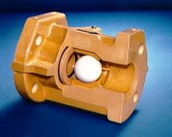
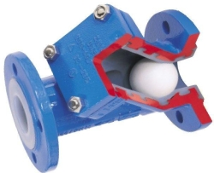
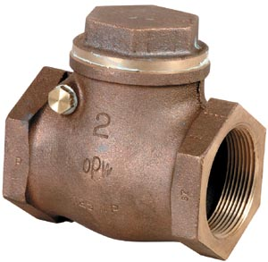
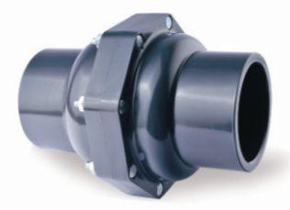
Check Valves

Slide 10
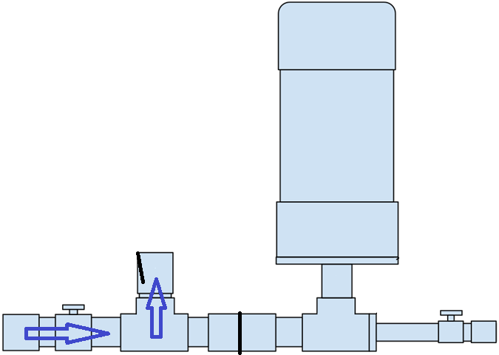
How a Ram Pump Works

Slide 11
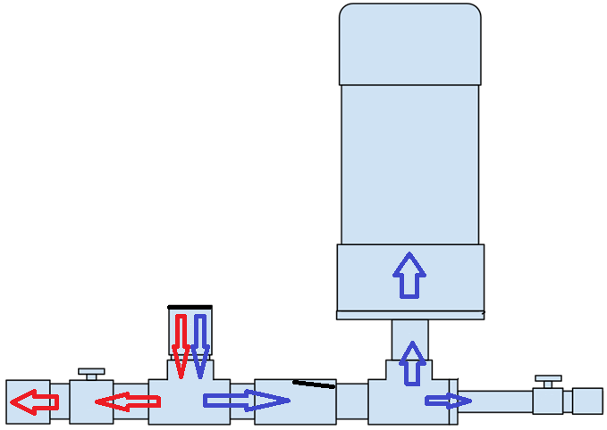
How a Ram Pump Works

Slide 12
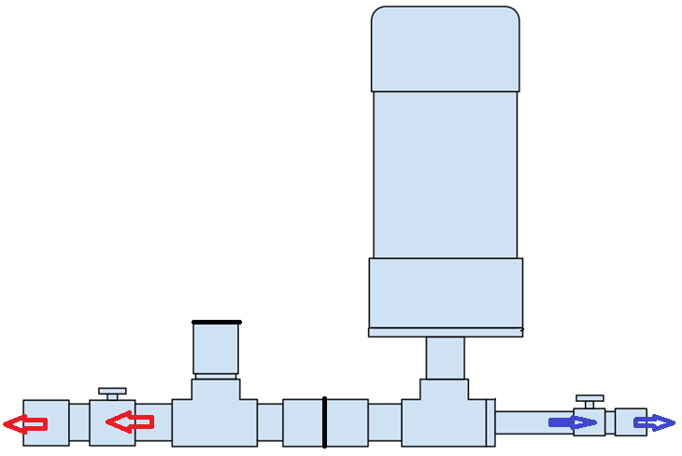
How a Ram Pump Works

Slide 13
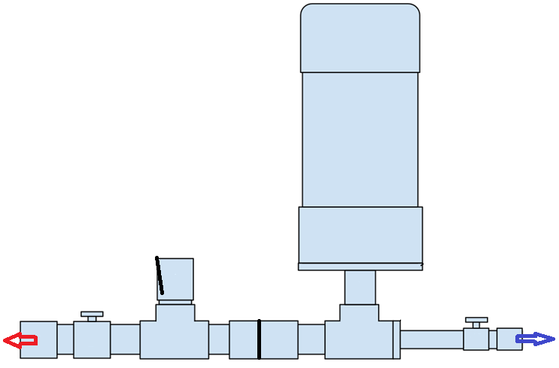
How a Ram Pump Works

Slide 14
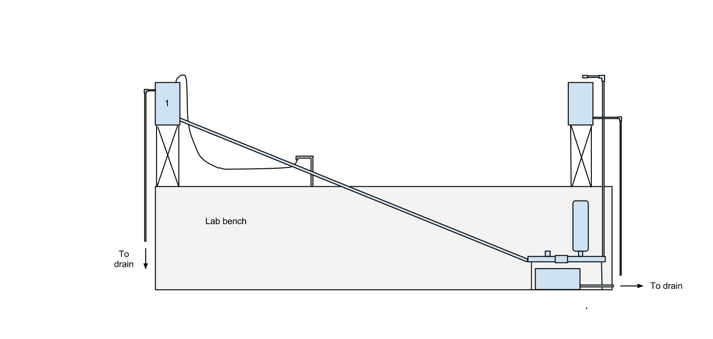
Ram Pump Test Apparatus
Constriction
Drive Tank
Delivery Tank
Sink
Drive Pipe
Delivery Pipe
Ram Pump
Pressure Sensor
Waste Bucket

Slide 15
Features of Apparatus
Pressure sensors or orifice meter to measure flow rates
Pressure sensor to measure head loss
Pump near ground to reduce shaking
Removable air chamber, drive pipe, and check valves

Slide 16
Parameters to Test
Drive pipe diameter
Drive pipe length
Air chamber size and dimensions
Delivery pipe diameter
Check valve design

Slide 17
Questions?

