Slide 1
Ram Pump
The purpose of this presentation is to explain the research done this semester. See Research Report for more information.

Slide 2
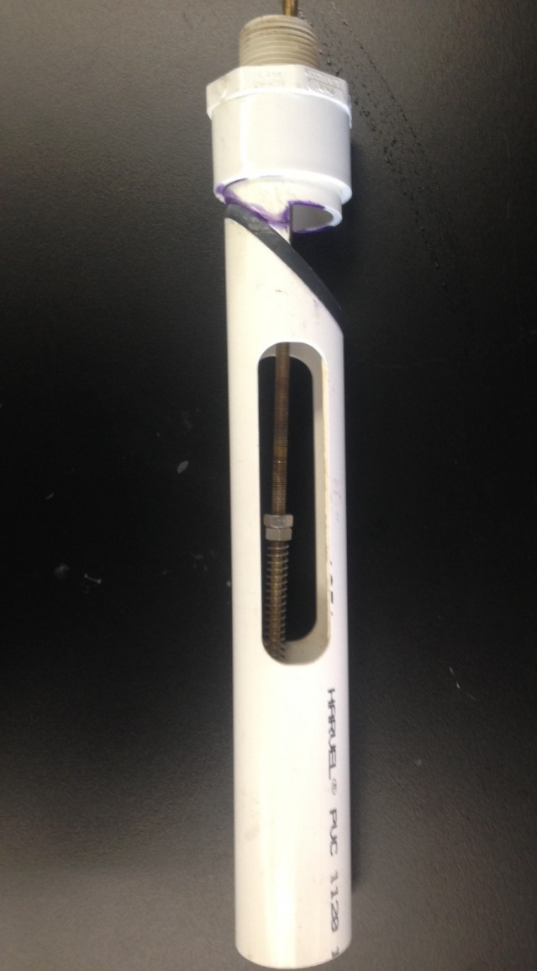
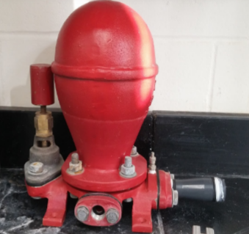
The Ram Pump is used in developing countries where electricity is not readily available
Prototype
Conventional Ram Pump
Notes:
Ram pumps have been used historically to pump water to higher elevations without using electricity. Conventional ram pumps use a horizontal deign like the red one to the right. Our design is a vertical design and is shown on the left. This semester the team worked on finalizing a vertical enclosed design to prevent splashing.

Slide 3
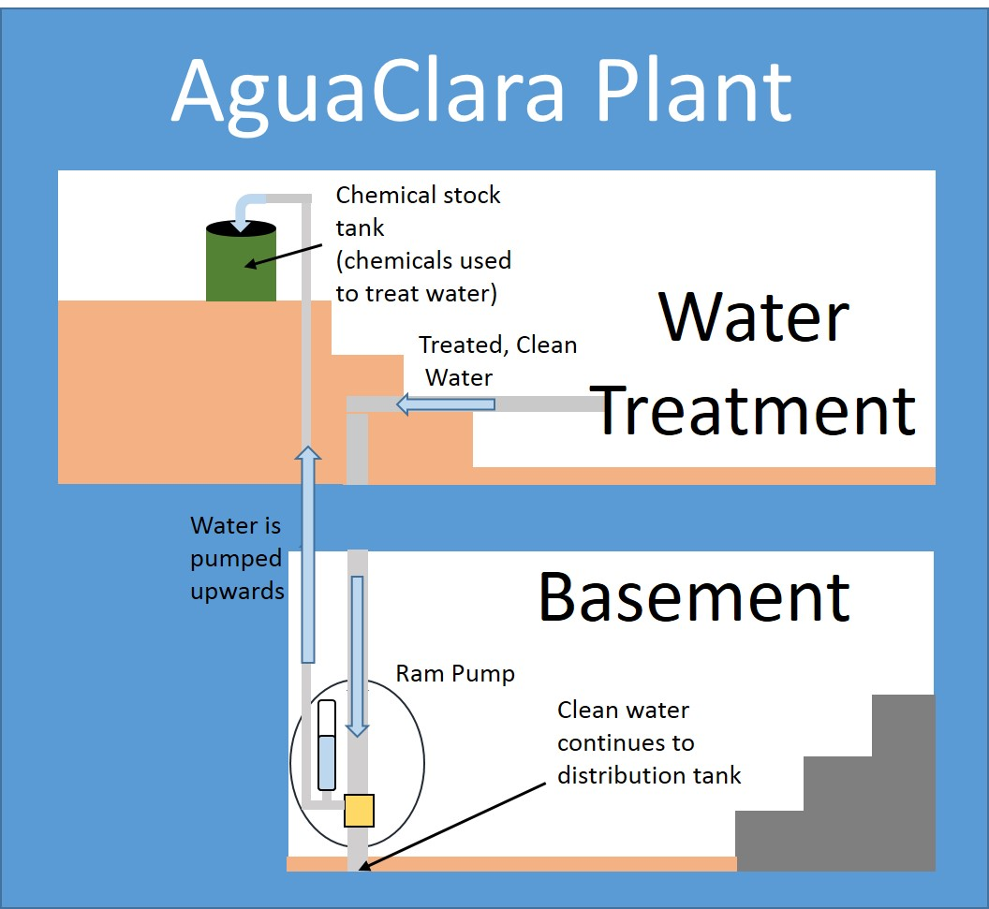
The Ram Pump redirects water headed to distribution back for use at AguaClara treatment plants
Schematic of where the pump fits into the plant
Notes:
The pump allows operators to use the bathrooms and fill chemical stock tanks without carrying buckets of water up two flights of stairs. Although the layout of each plant is different, the ram pump is flexible enough that it can fit into any design. Located in the basement, the ram pump can be turned on or off as needed. The figure shows a general schematic for the location of the ram pump within a plant. This schematic shows how the team hopes to implement the vertical design. Currently, the horizontal (not self-contained) ram pump in use in Honduras is located in the same place, but is contained within a concrete box to contain splashing.

Slide 4
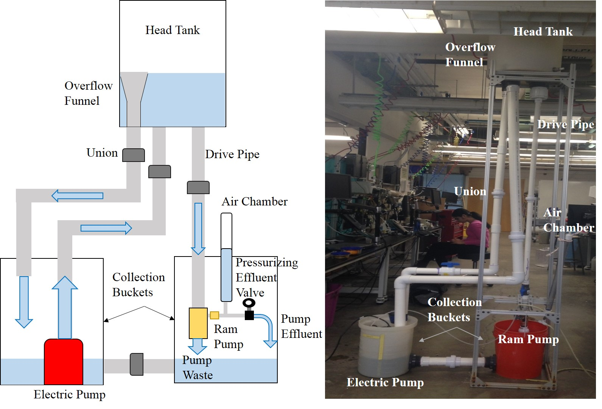
The Ram Pump’s set up in the lab allows for easy flow rate calculations
Notes:
The team's current ram pump set up. Water moves from the electric pump to the head tank, and then down the 1" drive pipe. From there, it flows to the ram pump itself, where it is either discarded into the collection bucket as unpumped water or is pumped through the air chamber and becomes effluent. Since pumping water 4 to 10 meters above the ram pump is impractical in the lab, the setup includes a pressurizing effluent valve which pressurizes the water being pumped, thereby simulating pumping water to a higher elevation.

Slide 5
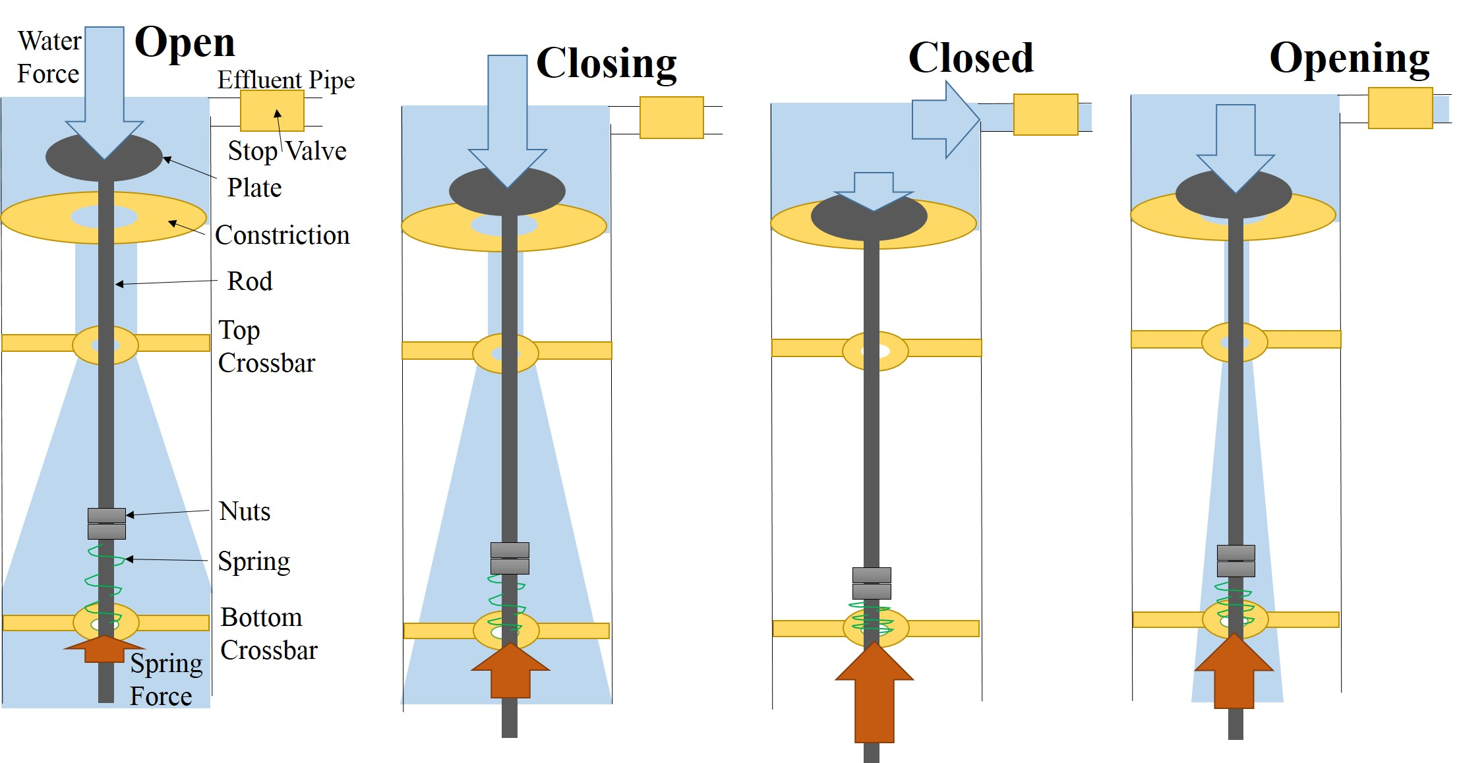
The Ram Pump does not use electricity to operate
Team Name | Research | Final Presentation Spring 2016
Notes:
Water from the drive pipe collides with and flows past the plate, exerting a downwards force which moves the plate onto the constriction and compresses the spring. The pressure spikes within the check valve and induces the water to move through the stop valve and into the effluent pipe. The released pressure combined with the compressed spring move the plate off of the constriction and back into the open position, where the cycle repeats.

Slide 6

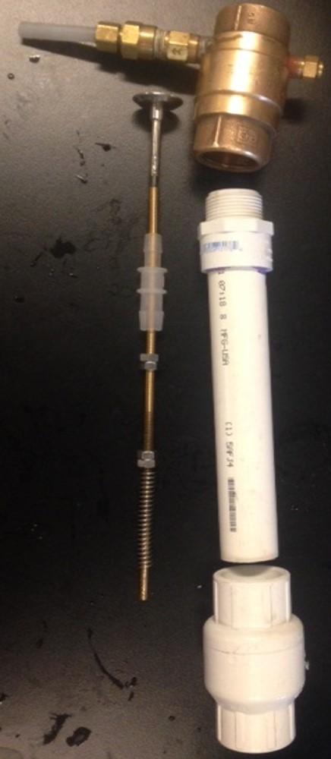
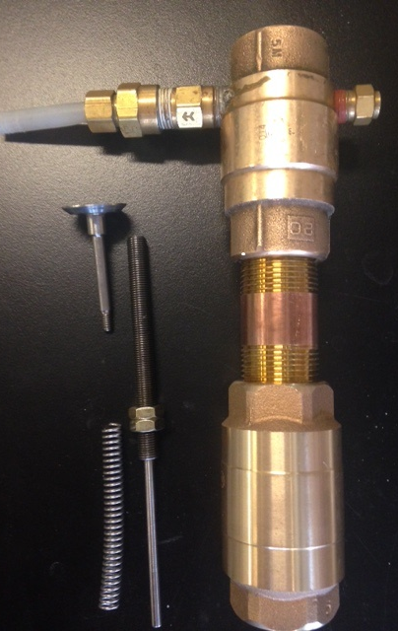
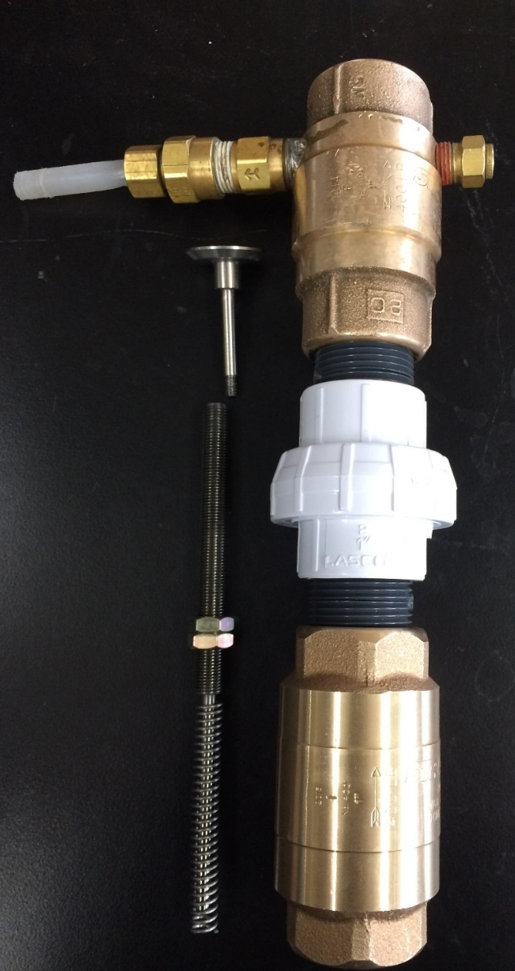
Design progression
Prototype
PVC Design
Brass Design
Union Design
Notes:
The team began with the prototype (far left) of the vertical design from previous semesters. Removing the holes from the design and allowing the water to go through the system instead of out of it, brought the team to the middle-left design, using an empty check valve as the spring-constrictor instead of the fully-restricting plate of the prototype. With stability and durability in mind, the team created the full-brass design in the middle-right, which had no functional changes over the previous iteration. This design was too imprecise, however. To change/adjust the spring, the brass nipple needed to be unscrewed from one of the check valves each time, and it was impossible to consistently screw the nipple back on the same amount every time. This led to inconsistent spring compression, which the team sought to remedy in the next design. By using a union, the spring was guaranteed to be compressed the same amount every time, as the union screws in entirely every time by virtue of it’s design.

Slide 7
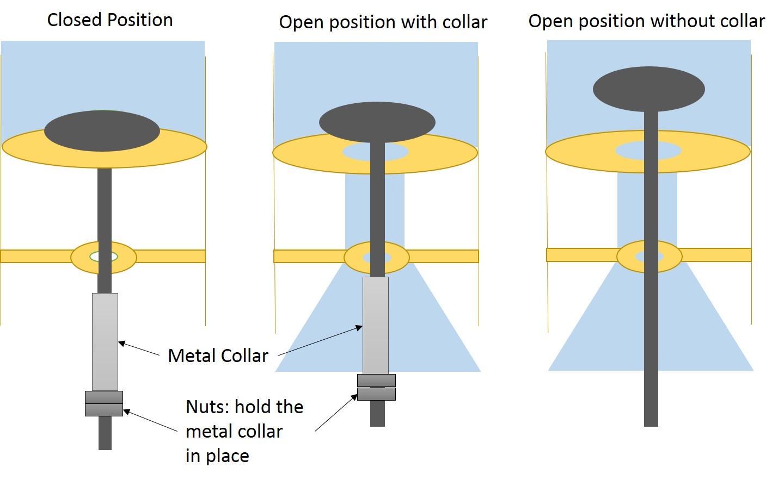
After a few iterations, the team designed an Enclosed-Collar Design
Notes:
Theory behind the collar. The collar will restrict the amplitude of the plate, which will forcibly decrease the cycle time in an easily controlled and reproducible way.

Slide 8
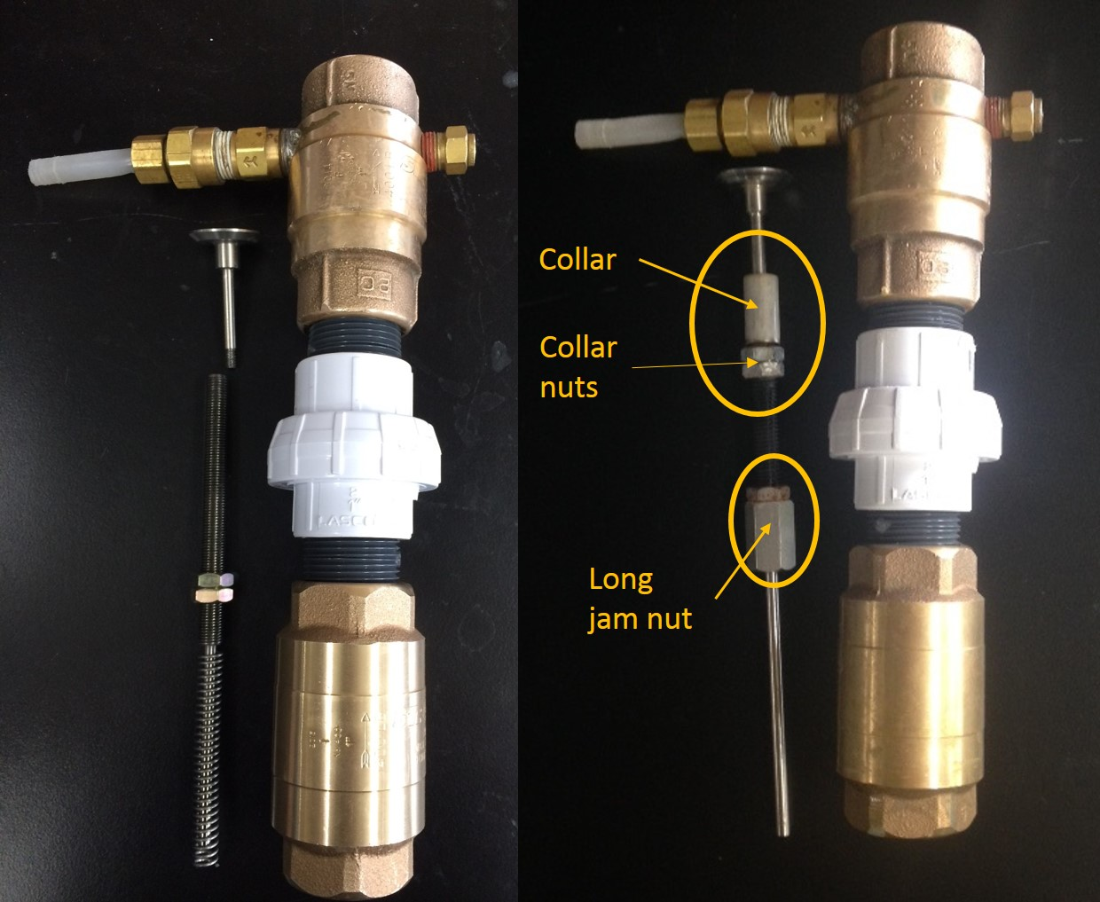
After many iterations, the Enclosed-Collar system was designed
Notes:
This design offers two changes over the previous. The first is the collar, which serves to restrict the amplitude of the plate, as previously described. The second it the replacement of one of the nuts in the jam nut with a long nut. This change was implemented so the unthreaded portion at the bottom of the rod could be extended. This was done so the spring will never be exposed to the threads, which would eventually wear it down. The purpose of the long nut is to still allow compression of the spring within a 1 inch range, which is more than enough to test the spring’s limits.

Slide 9
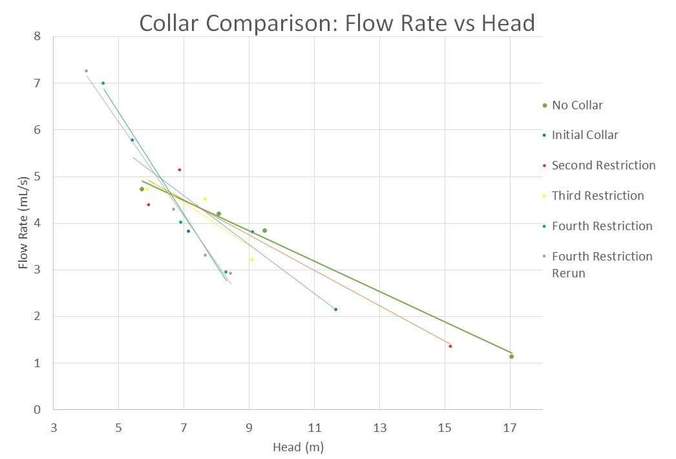
Ordered by increasing restriction (Decreasing plate amplitude)
Notes:
The graph shows the flow rates collected for different plate amplitudes. Intriguingly, changing the amplitude changed the slope of the flow rate vs head plot, which was a completely unexpected result. Regarding the magnitude of the restrictions, the second restriction was 0.168 inches greater than the initial, the third was 0.262 inches greater than the first, and the fourth was 0.278 inches greater than the first (the plate opened a few millimeters). The graph shows that at around the heads needed at AguaClara plants (approximately 7m) the Collar does not make much of a difference. The collar design will still be kept though to allow flexibility for different springs.

Slide 10
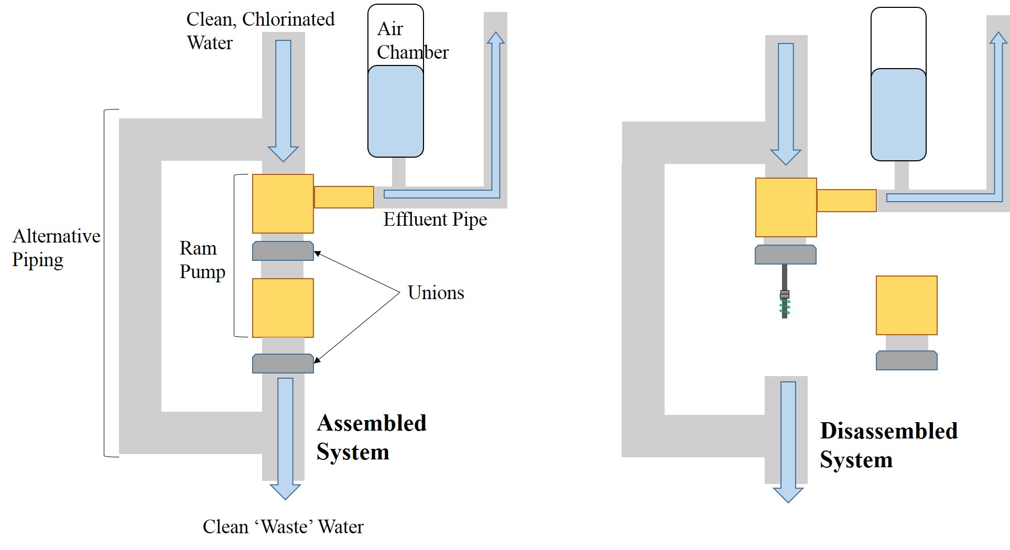
The new design will allow for the pump to more easily be integrated in the plant
Notes:
This is how a vertical ram pump could potentially fit into an AguaClara plant. The system is added onto the piping after chlorination and in the basement, and returns un-pumped water back into the distribution pipe. Should the plant have no further need for the ram pump at any point (if the stock tanks are full), then water can be directed around the ram pump through the alternative pipe. To replace or adjust the spring, two unions need to be undone.

Slide 11

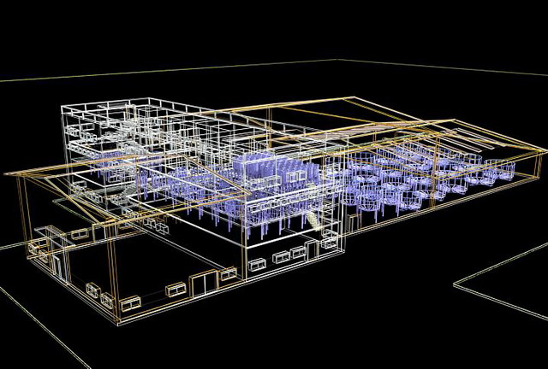
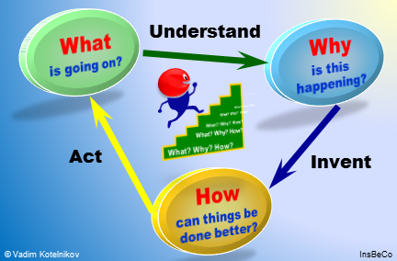
There is still much work to be done
AutoCAD
Notes:
Moving forward, the team will prove consistent functionality and outline a manual and schematic for ease of use within the plant. Using the understanding of the physics gained by testing the collar, the team will work on doing further analysis of the forces within the system in order to provide each AguaClara plant with an estimate of a spring force that will be necessary for the specific plant parameters. Furthermore, the Union-Collar design needs to be modeled in AutoCAD, which the team also hopes to accomplish next semester. Moreover, future teams should test the effect of having the ram pump connected to the distribution piping. It is thought that perhaps an outlet for air will be needed to prevent any vacuum effects from occurring as a result of pump cycles. In addition, future teams can look into trying to restrict the water inside the pump from reaching a zero velocity when the plate is closed to increase pump efficiency.

Slide 12
Questions and
Recommendations
Priya Aggarwal
Civil Engineering
pa289@cornell.edu
Juan Guzman
Environmental Engineering
jfg98@cornell.edu

Slide 13
Appendix
Slides

Slide 14
Air Chamber
Closed
Check Valve
Open
Check Valve
Pressurizing
Effluent
Valve
Stop Valve
Effluent Pipe
Pressurized
Effluent
Air chamber functionality
Ram Pump
(top section)
Notes:
See research report for more information.
Before the ram pump begins to function, the air chamber is filled with air at zero gauge pressure. As the pump operates and the check valve closes, highly pressurized water enters the chamber and compresses the air within it ('Closed Check Valve' in the figure). When the check valve opens and the water depressurizes, the force of the now-compressed air pushes the depressurized water out of the air chamber, through the effluent pipe, and to the effluent valve ('Open Check Valve' in the figure). This effect produces a steady effluent and increases the pump's effluent flow rate.

Slide 15
Pressure is measured at three points
Pressure
Sensors
Notes:
The team takes constant pressure data at three points: the air chamber, the waste valve, and the pressurized effluent. The most relevant point is the pressurized effluent, which allows the team to simulate pumping water to a higher head. The other data points help the team understand the pump physics, and which parts of the pump system experiences the most pressure.

Slide 16
Velocity of water in drive shaft v Time
Terminal Velocity
Pumped water
while valve is closed
Leaked Water
while valve is closed
Velocity of Water in Drive Pipe
Unpumped Water
while valve is open
Time
Notes:
The figure shows two pump cylces. The shaded regions indicate volumes of water. The figure shows that more water will always be un-pumped than pumped in a ram pump.
The velocity going to zero during each cycle, as that is what the team believes happens in the current pump. However, the team also believes that this is not as efficient as it could be. Simple geometry shows diminishing returns in terms of pumped water as the velocity approaches zero (lower triangle height implies lower area). Therefore, if the velocity were to only drop halfway to zero and the cycles would speed up accordingly, the pump should produce a higher flow rate.

Slide 17
Prototype vs Union Design Data
Notes:
The figure shows a graph of flow rates from the pump vs head. The graph shows that exposing the spring to water does not have a significant effect on the flow rate since the results obtained are similar to the results obtained from the prototype design.

Slide 18
Short vs long cycles
Terminal Velocity
Shorter Cycle
Velocity of Water in Drive Pipe
Longer Cycle
Time
Notes:
See slide 9. This is an attempt to explain the data.
This graph displays the difference between short and long pump cycles. While the short cycle pumps less water in each cycle, in a given amount of time there will be more short cycles than long ones.
After some thought and assistance from Professor Weber-Shirk, the team came up with a new hypothesis to explain the data: variable leakage. The hypothesis is as follows: when pumping to higher heads, the pressure on the opposite side of the stop valve (on the other side of the check valve) is significant. As a result, when the check valve closes and the stop valve opens, a sizable volume of high-pressure water (water that has already been pumped) on the opposite side of the stop valve leaks back into the check valve system. When pumping to lower heads, the pressure on the opposite side of the stop valve is not as great, and therefore the pump does not leak as much.

Slide 19
High vs low pressure pumping
Terminal Velocity
Water Pumped per Cycle
at High Pressure
Pumping to
Higher Pressure
Additional Water Pumped
per Cycle at Low Pressure
Pumping to
Low Pressure
Velocity of Water in Drive Pipe
Water Leaked per Cycle
at High Pressure
Additional Water Leaked
per Cycle at Low Pressure
Time
Notes:
See slide 9. This is an attempt to explain the data.
Demonstrates the increased leakage effect at higher heads/pressures. While the volume of water pumped naturally decreases with increasing head, it further decreases as the volume of leaked water becomes even more significant.
Relating this back to short and long cycles, the team believes that shorter cycles lose efficiency far more rapidly than longer cycles because of this phenomenon. Shorter cycles pump less water per cycle than longer ones and have more cycles in any given time interval to compensate. However, this means that there are more cycles during which the stop valve will leak. At higher heads, this leakage quickly inhibits the efficiency of short cycles. On the contrary, low heads have low leakage per cycle. Since short cycles are more efficient than long ones at lower heads (closer to the ideal non-leaky system), the team therefore concludes that shorter cycles must be intrinsically more efficient under ideal conditions (no leakage).

