Slide 1

The Ram Pump
STOP
water hammer time
Christine Curtis, Harrison Gill, Teresa Wong

Slide 2


Slide 3

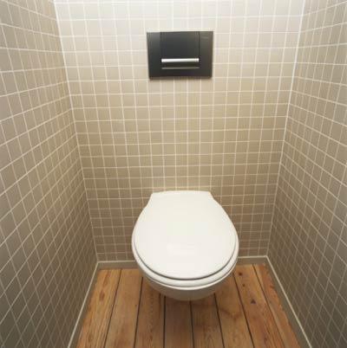
Why do we need a pump?

Slide 4

How do ram pumps work
Valve to high pressure line
Wasting valve
Drive pipe

Slide 5
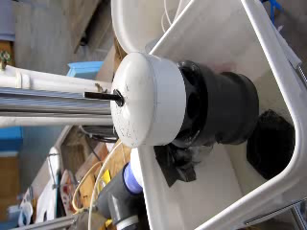
Results
The pump is tunable
It can pump water to the ceiling
We can see how the pump reacts to changing parameters

Slide 6
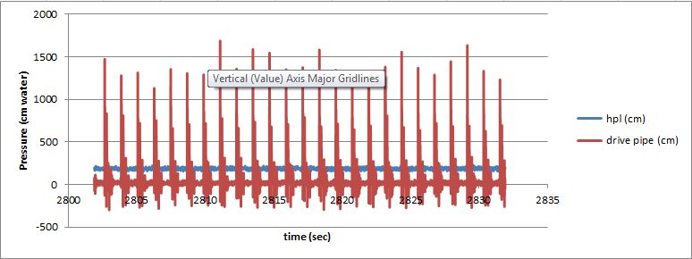
Results
The raw pressure trace from a test with 200 g , a 5 cm stroke length, and a 10 ft drive pipe

Slide 7
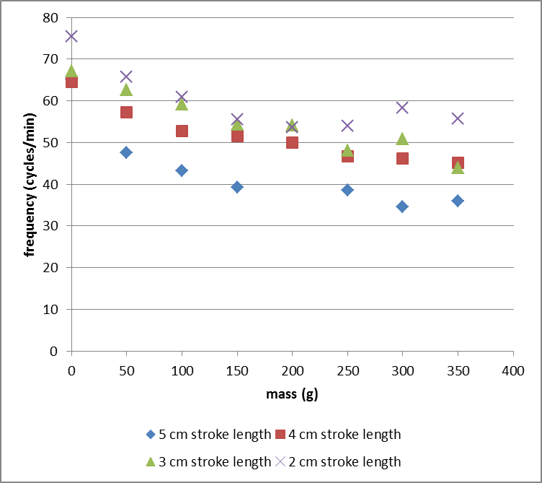
Results
Frequency decreases as mass increase
As mass increases, more force required to close the valve
Force is provided by drag on the valve plate thus higher velocities are required
Frequency vs mass

Slide 8
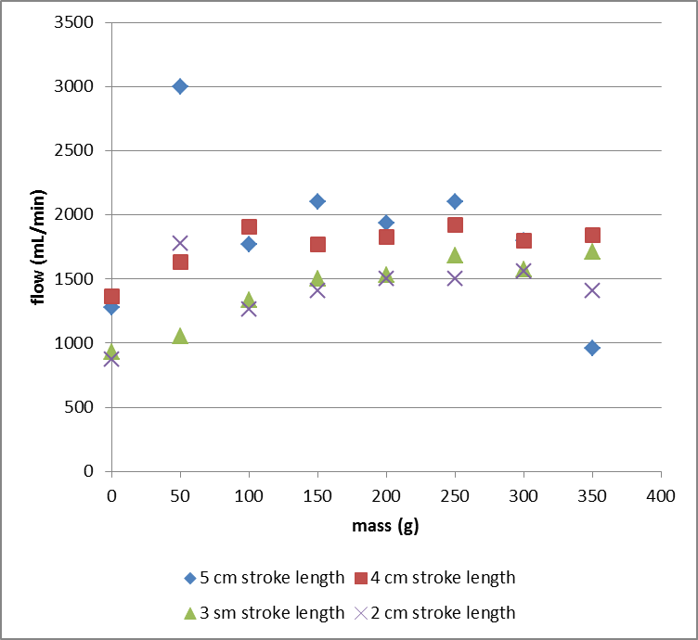
Results
Increasing flow rates with increasing weight
5 cm stroke length begins to decline.
Flow vs mass

Slide 9
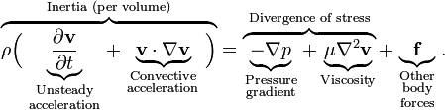

Issues with Pressure Data
Maxing out the pressure sensors
Bernoulli Equation does not apply
  Navier-Stokes?
  Pitot tube meter
Waste valve motion sensor

Slide 10
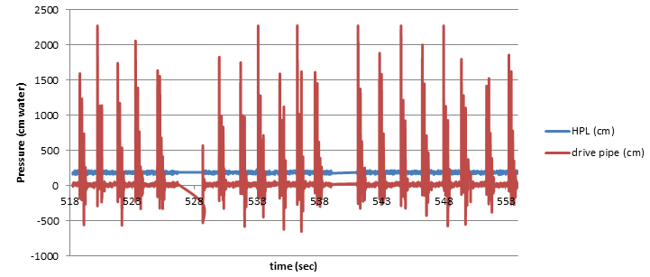
Data Collection: Pressure Sensors!
Notes:
2274 cm water = 200 kPa. for 5cm stroke lengths, 200 g ( or any weight above 50g), medium plate

Slide 11
Issues with Pressure Data
Maxing out the pressure sensors
Bernoulli Equation does not apply
  Navier-Stokes?
  Pitot tube meter
Waste valve motion sensor

Slide 12
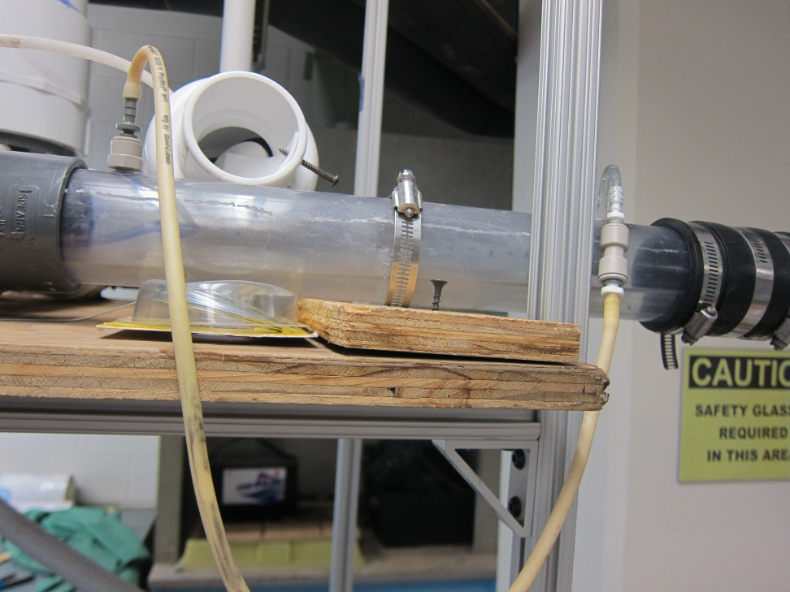
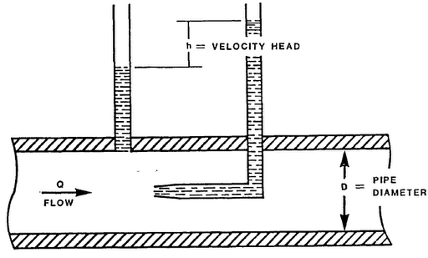
Pitot Tube Meter

Slide 13
Issues with Pressure Data
Maxing out the pressure sensors
Bernoulli Equation does not apply
  Navier-Stokes?
  Pitot tube meter
Waste valve motion sensor

Slide 14
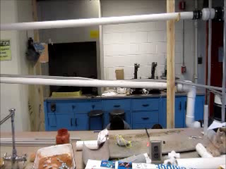
Results

Slide 15
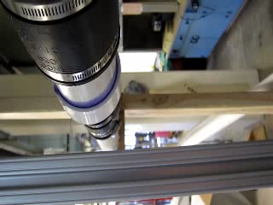
The Actual Shaking
The pump shakes quite violently
This is a loss of energy in the system

Slide 16
The Actual Shaking
How far does the water move?
F=PA from HPL on water
F=MA to calculate the deceleration
V=at+V­₀ assume max velocity and find t
X=-1/2at² + V₀t solve for x
The water should travel 8 cm and the frame shakes approximately 2 cm per cycle

Slide 17
And now…
For something completely different.

Slide 18
Future Challenges
Pump Upgrade
  Reconfiguration
  Removing Bucket
Location in plant
New Data Acquisition
Longevity

Slide 19
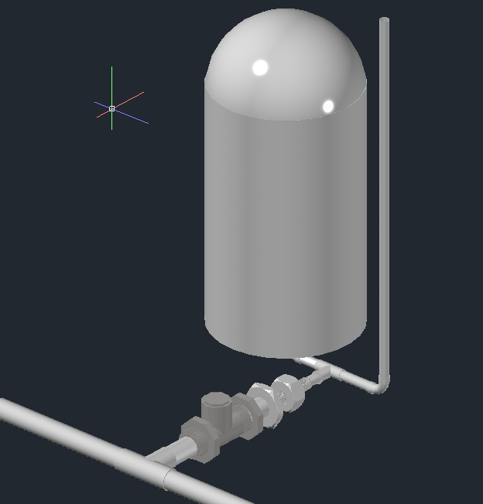
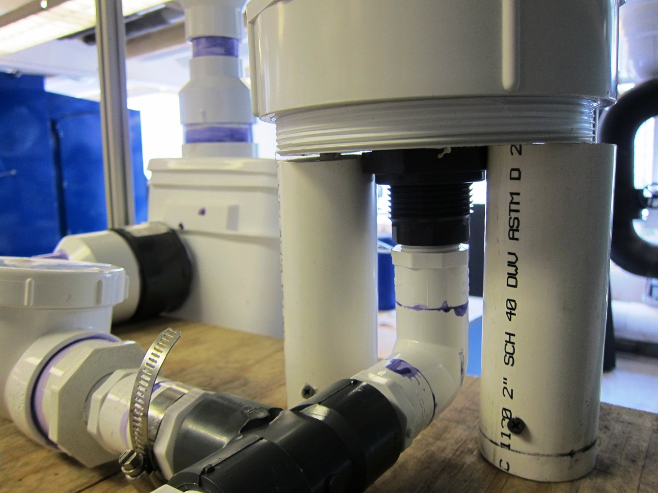
Air Chamber Upgrades
Notes:
Currently
-Threaded cap + 1” bulkhead fitting (requires removing knob)
-Difficult to unscrew
-Requires lathe
Orientation of threaded & welded cap
+Facilitate replacement of inner tubes
+Would not require knob of threaded cap to be removed-
-May not airtight seal with convex nature of cap
Reduced size (currently 96 cm of 6” pvc)
+Literature includes air chamber to absorb shock wave
+Our hydraulic analysis conclude water pumped by momentum, not shock wave

Slide 20
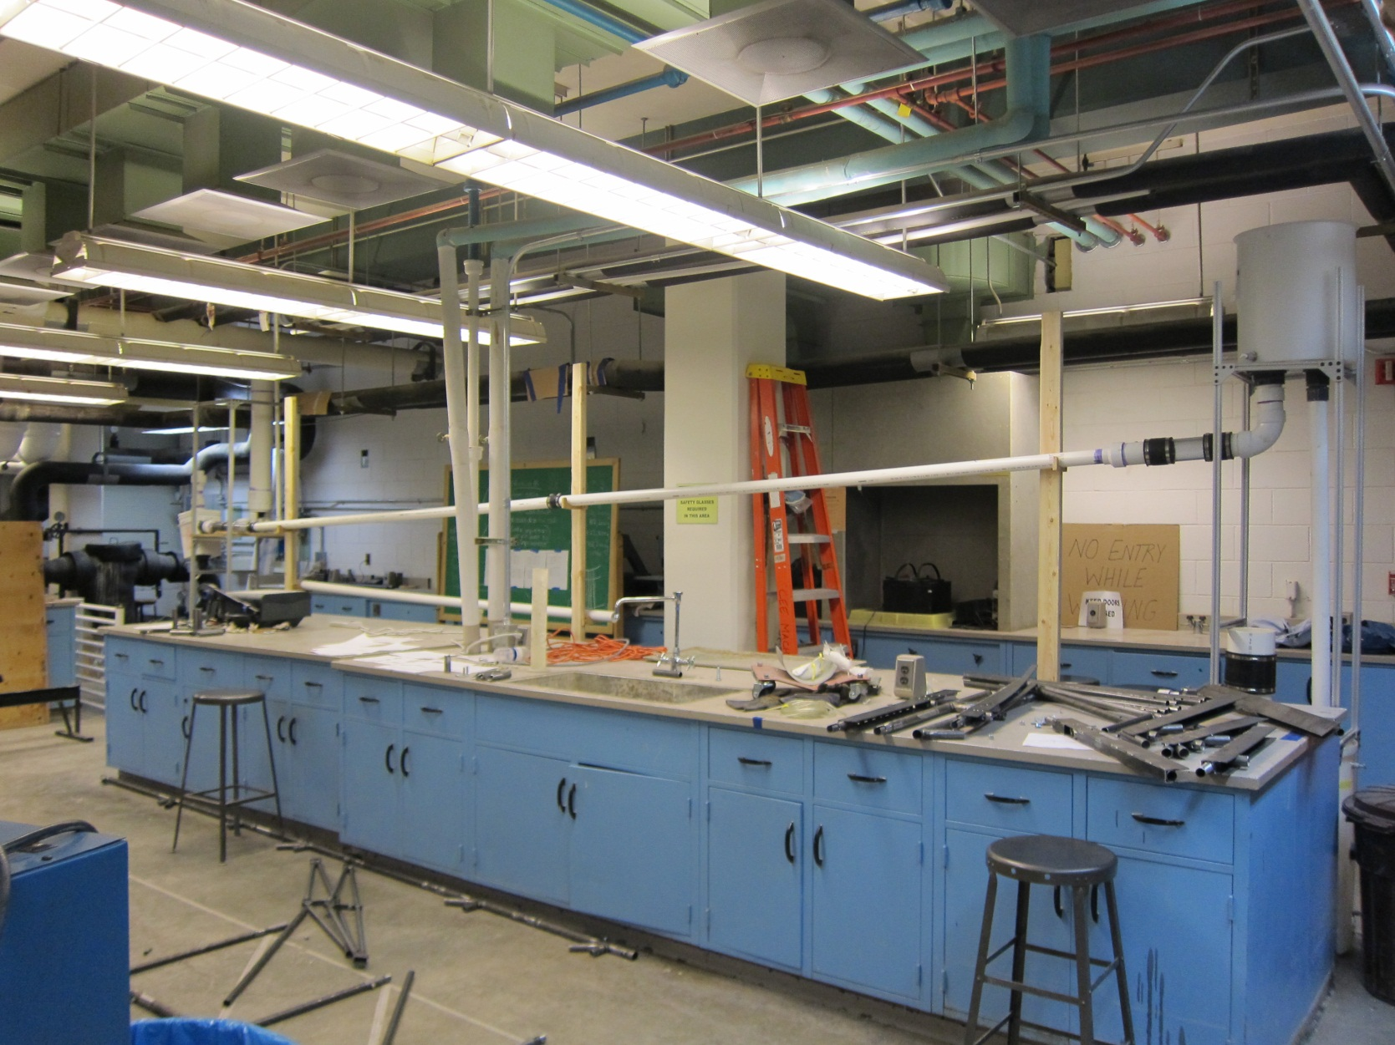
Short Drive Pipe
Notes:
Test 3’ drive with 60 cm head
-No water pumped
-Erratic cycling of wasting valve, regardless of added weight
-High pressure valve did not seem to be cycling (although did open @ least 1)
-Smaller mass in drive pipe reduced momentum available to pump
Causes
-Water passing back and forth through high pressure valve
-Insufficient energy to open high pressure valve
Changed 2 control variables simultaneously
Failure 3’ drive with 100 cm head
-System of elbows

Slide 21
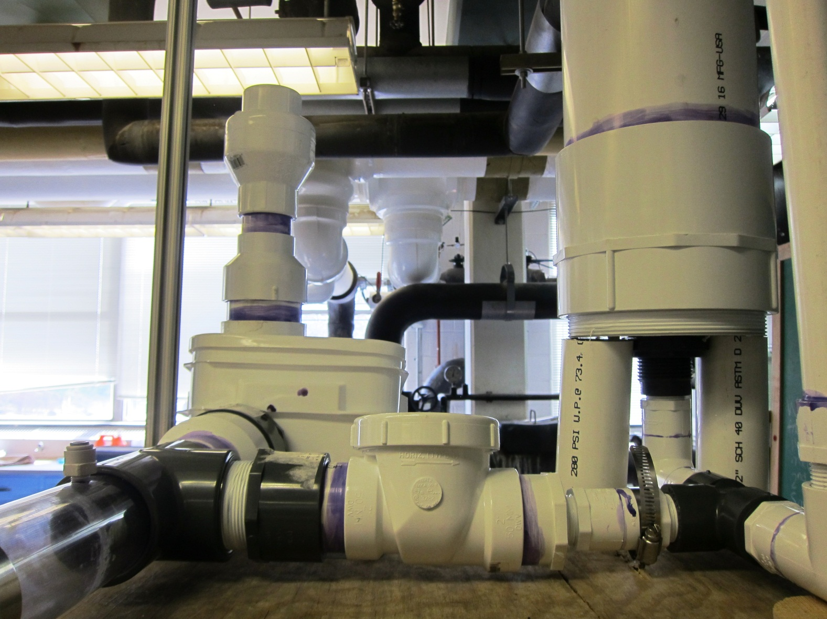
High Pressure Line Upgrades
Notes:
Smaller High Pressure Valve
+Faster closing time
+Faster opening response (data suspecting current high pressure valve opens & closes more than once during a cycle)
Ball Check Valve or Similar
-Swing check dependent on gravity & only 1 direction
+Close due to spring, eliminates directionality of valve & reduce closing time
+Increase force to open valve

Slide 22
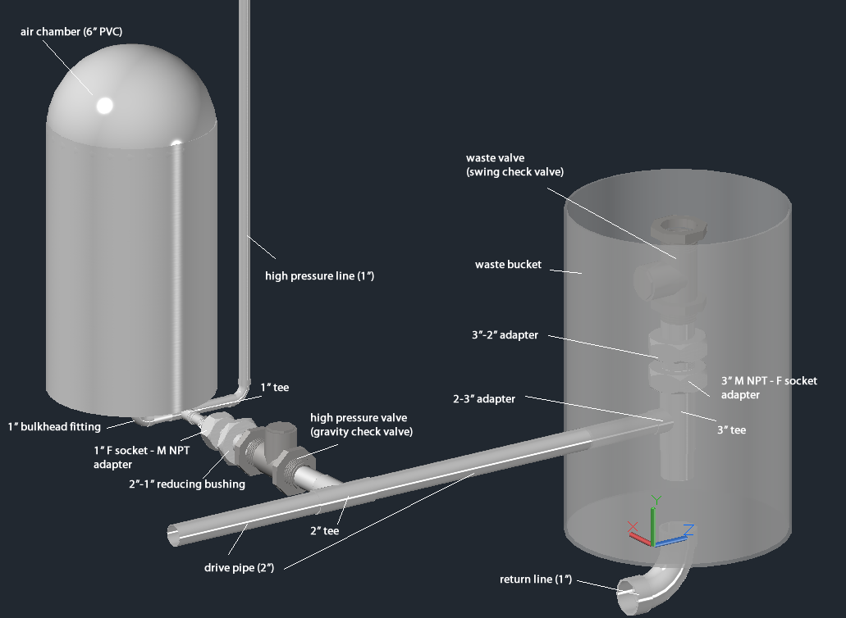
Pump Upgrades
Notes:
90º Bend
-Wasting valve @ foot drive pipe, high pressure line tees off furder thp drive
-Every cycle, water between wasting valve & high pressure line must come to nearly instantaneous stop
Swap position of wasting valve & high pressure line
+Direct path during deceleration may also reduce water hammer & shaking
-Difficulty in construction & installation
-Capture device fitting around drive pipe
-Difficulty to service or remove wasting valve
Option to reduce distance between high pressure line & wasting valve
+Minimize water hammer (energy that must be dissipated)
Remove buckets
Submerged pump

Slide 23
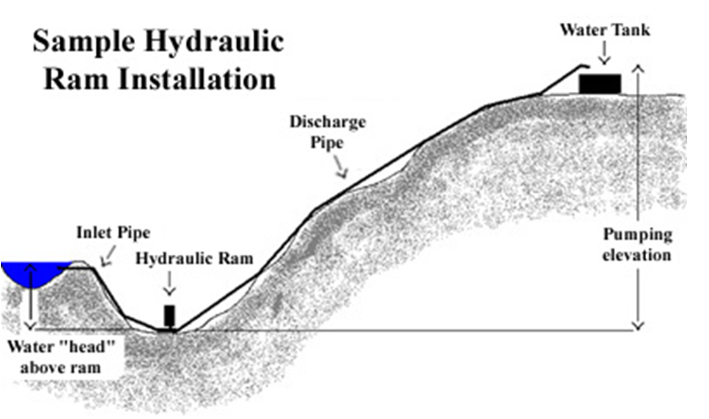
Location in Plant
Downstream of plant, before distribution tank
Gallery of SRSF
Notes:
Downstream of Plant
+Allows for long drive pipe :. More momentum
-Not part of the plant
-Exposure to heat and sunlight (hinders longevity of pump)
Gallery of SRSF
-Requires minimizing length of drive pipe
(length directly proportional to momentum available to pump)
-Depending on design of plant, must be of higher elevation than distribution tank
+Potentially 3m head available
+Housed in concrete, to prevent shaking

Slide 24
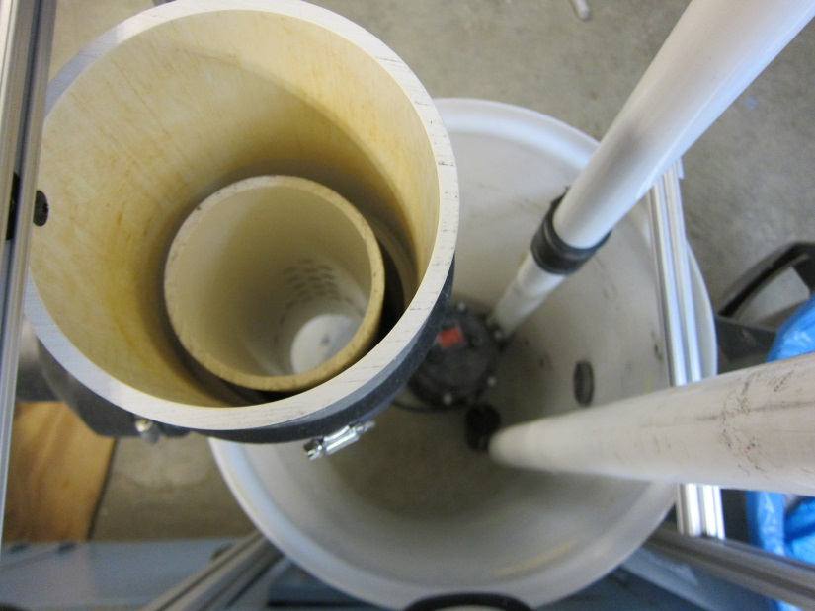
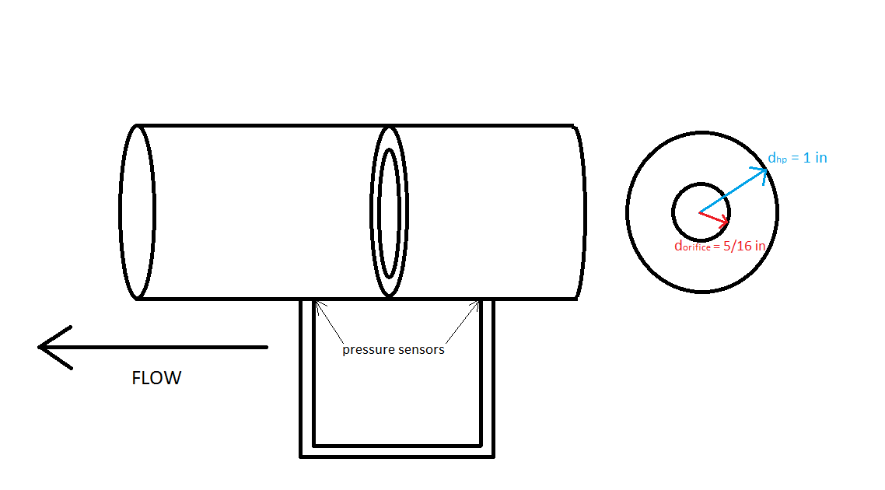
Data Acquisition Improvements
Pressure sensor ports closer together
Use of 7kPa sensor on velocity meter
Flow analysis
  LFOM
  Orifice meter

Slide 25
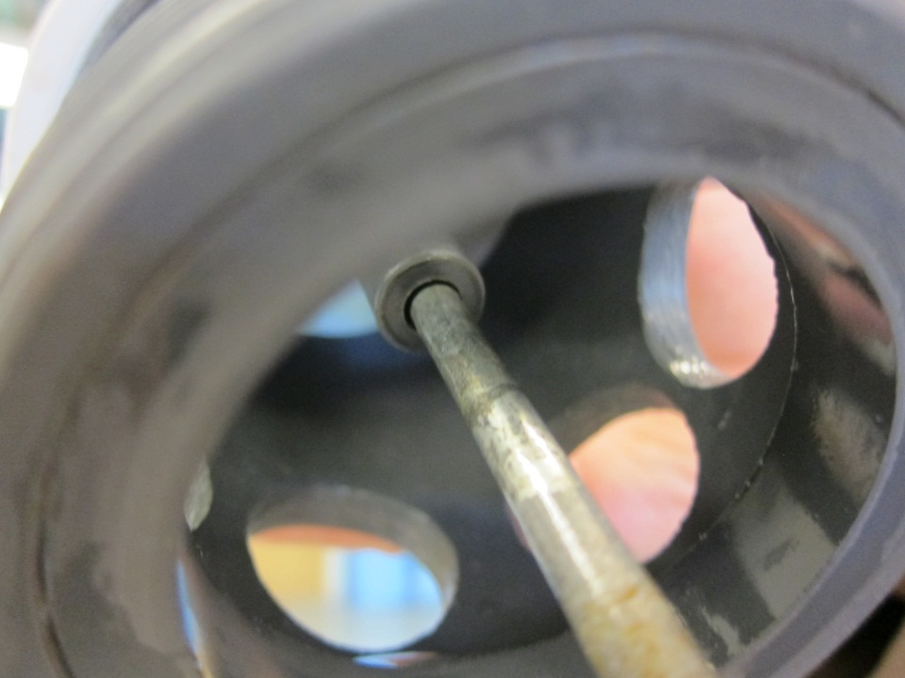
Pump Longevity
Sliding parts on the waste valve = fatigue wear
Switching materials
  Steel on steel
Symmetric weights
Gap between the rod and sleeve
  Lubrication?

Slide 26

Questions?

