Slide 1

Ram Pump
Christine Vernon, Alex Balog, and Madeline Haas

Slide 2

Introduction
  Ram pumps are powered by the water hammer effect
  Only require two moving parts
  Large percentage of waste
  Relatively low drive head to high delivery head
  Video!
Notes:
http://www.youtube.com/watch?v=qWqDurunnK8

Slide 3
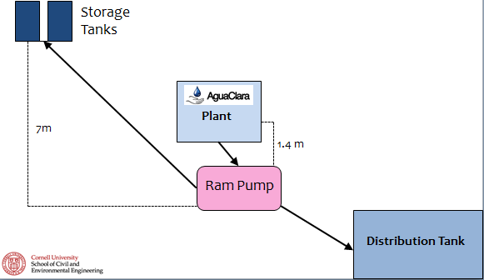
Purpose for AguaClara
To provide plant with clean water for bathrooms and coagulant mixing

Slide 4
Goals
Fix leaks
Improve connection to needle valve
Stabilize inlet flow
Improve waste valve
Create a mathematical model

Slide 5
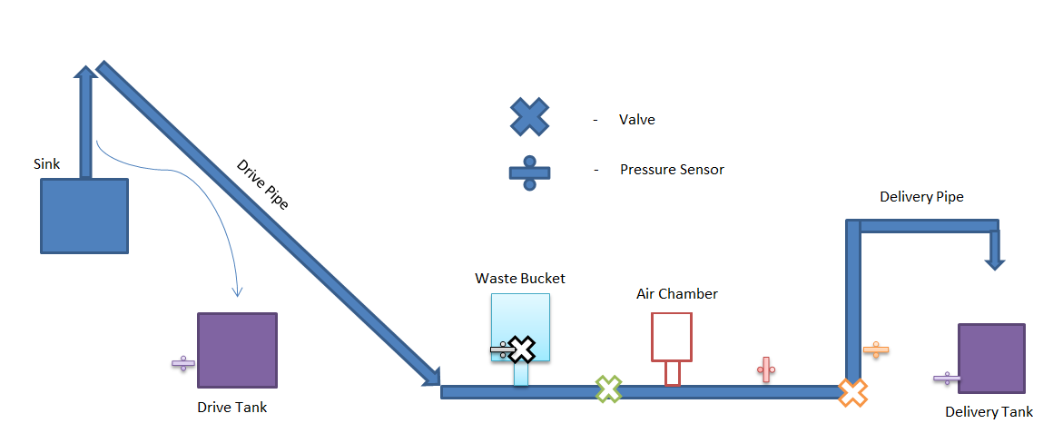
Our Ram Original Pump Set Up

Slide 6
Our Modified Pump Set Up
(for a larger flow rate)

Slide 7
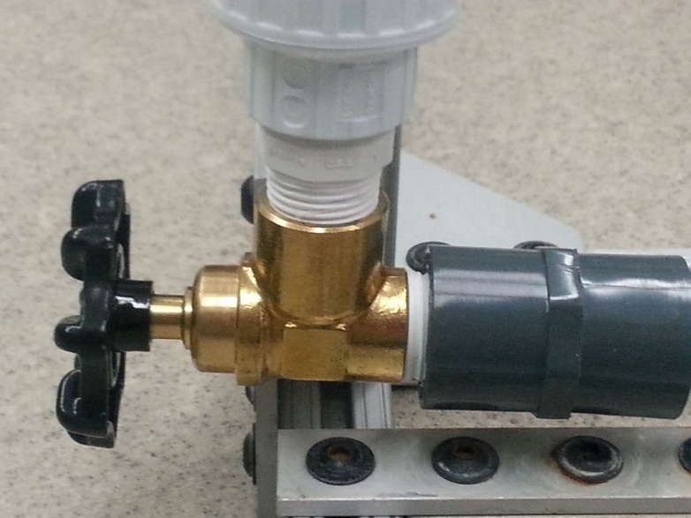
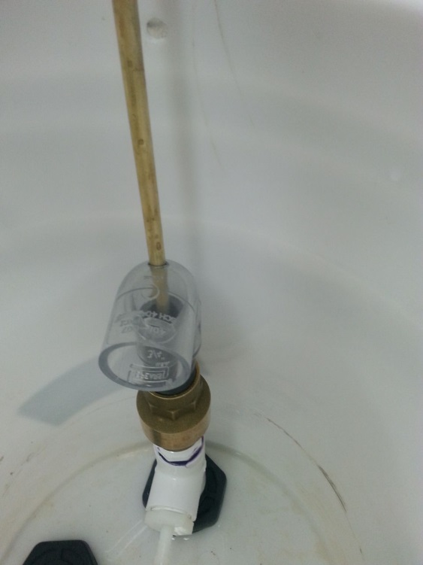
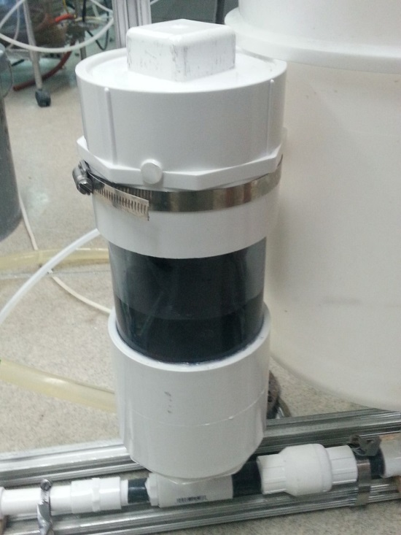
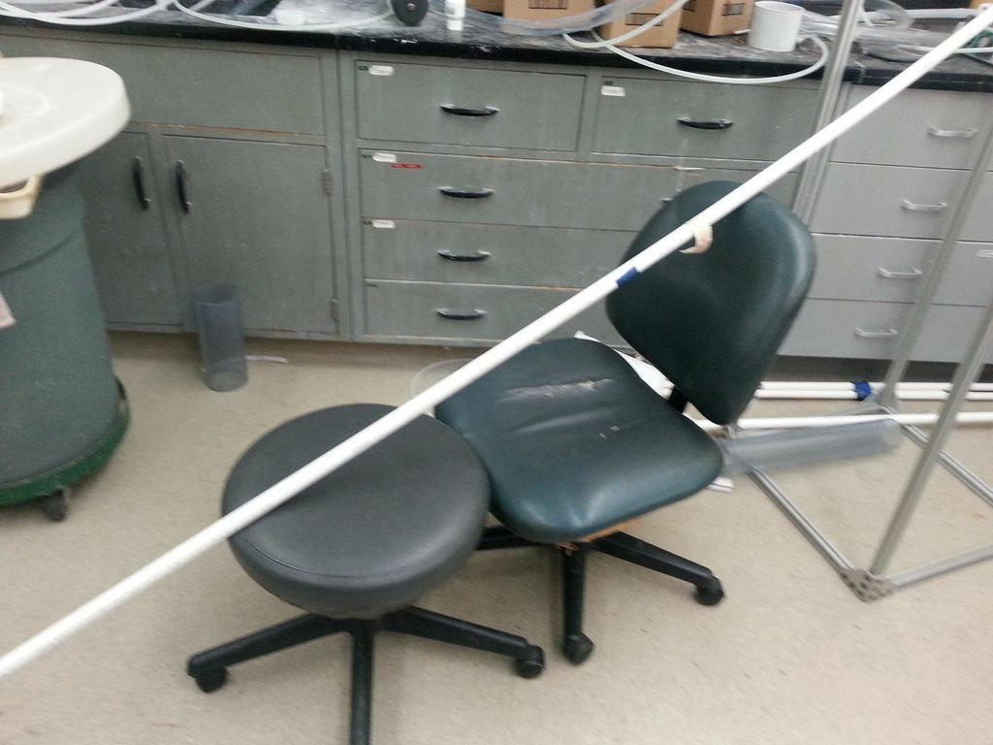
Improvements
New needle valve
Smaller air chamber
New waste valve
Stabilization system

Slide 8
Methods
Flow rate
Weight on waste valve
Stabilize drive pipe
Priming
Monitor pressure in air chamber
Measurements on EasyData

Slide 9
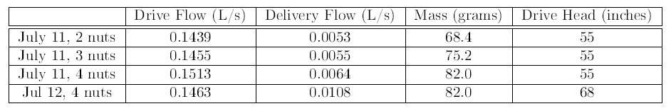
Findings So Far

Slide 10
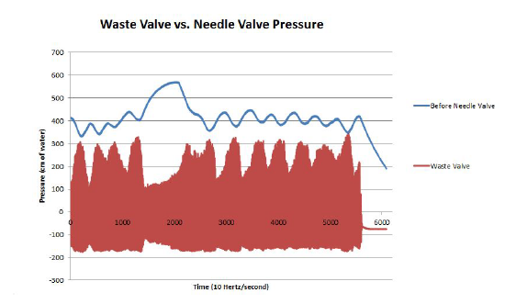
Findings So Far

Slide 11
Our Ram Pump (The Movie!)
Movie!
Notes:
https://www.dropbox.com/s/90blc9ztjndrixy/2013-07-03%2012.30.42.mp4

Slide 12
Challenges
Maximum flow is low (0.151 L/s with tubes, 0.469 L/s without)
Faulty pressure sensors
Air chamber size
Leaks

Slide 13
Future Works
More experiments
  New Set Up
Mathematical Model
Find alternative drive sources
Experiment with air chamber size
Non-visual way to determine pressure differences

Slide 14
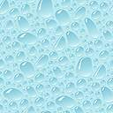

Questions?

