Slide 1

Ram Pump
Ariel Seidner, Ruben Ghijsen, Kelly Huang

Slide 2

Purpose for AguaClara
To provide plant with clean water for coagulant mixing and bathrooms
San Nicolas, Honduras
Storage Tanks
7m
Plant
1.4 m
Ram Pump
Distribution Tank

Slide 3
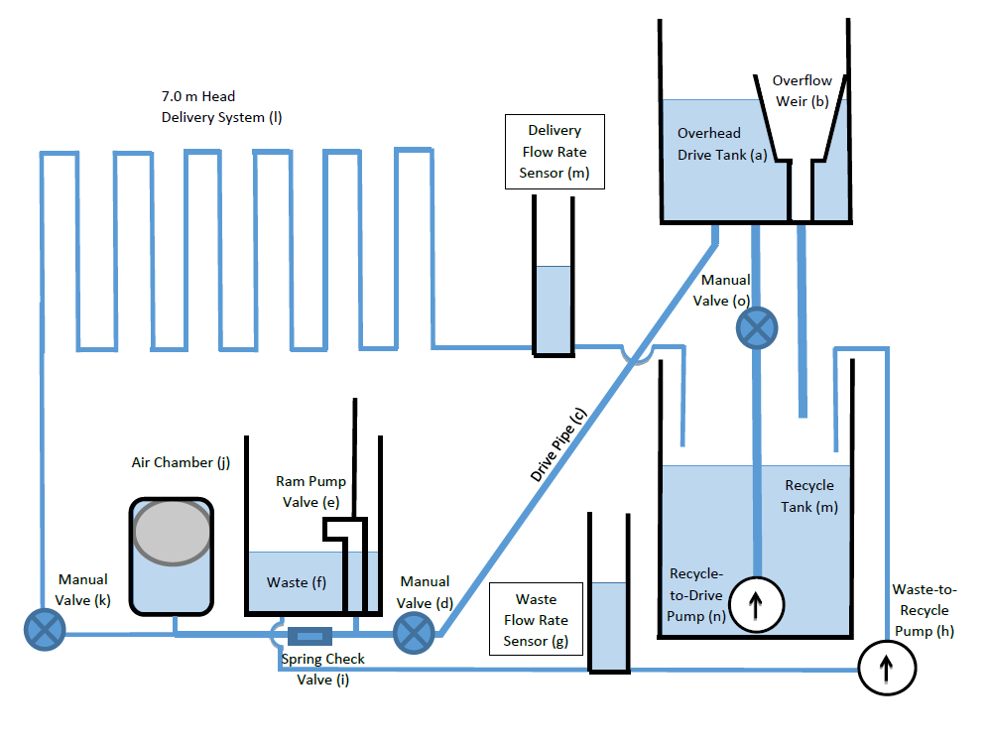
Model 1 Schematic

Slide 4
Simulating Honduras
Overview
Air column
Schematic
Recycling System

Slide 5
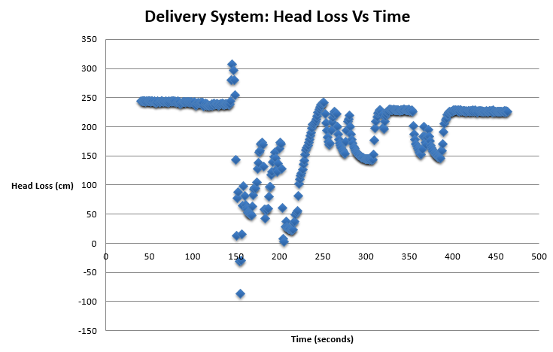
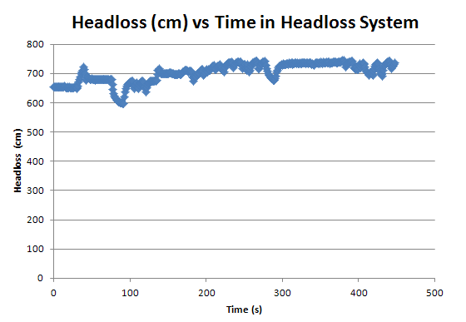
Constant Head loss
Complicated to equalize
Relative stability maintained

Slide 6
Decrease in Headloss
Slight decrease from fittings or absorption by water (air solubility)
Notes:
This would be to explain the slight decrease in headloss that we see after we run the apparatus for a while….

Slide 7
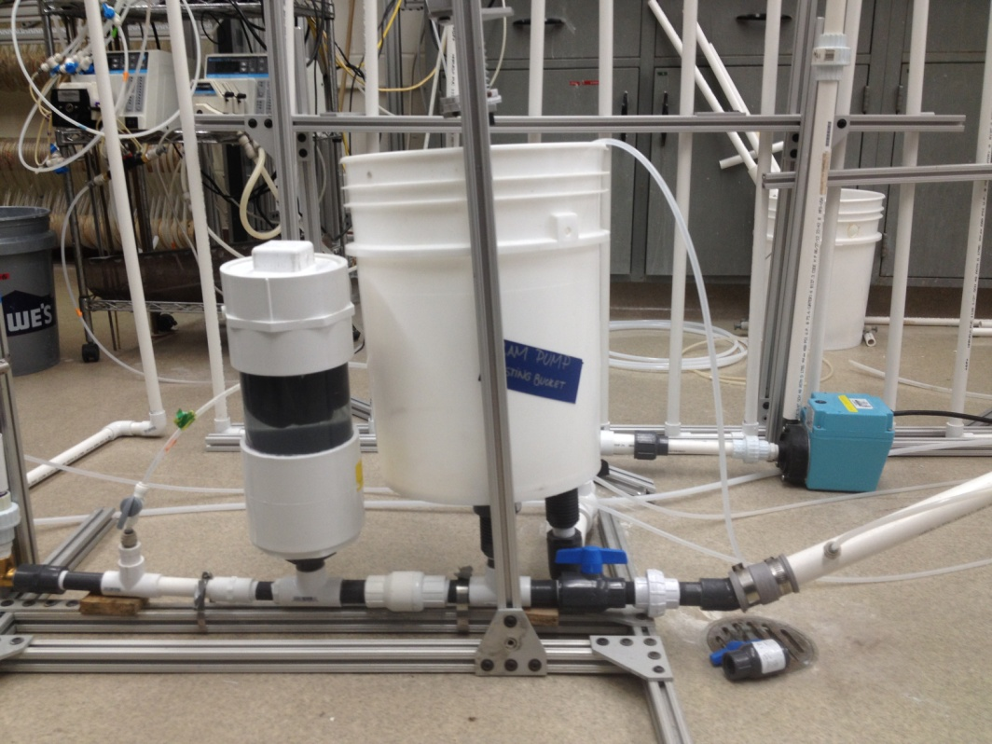
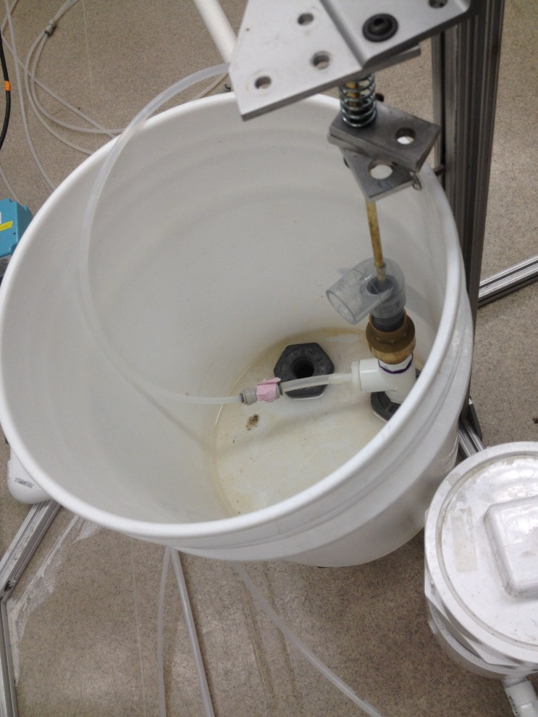
AguaClara Model 1
Installed sensors and connected to PC
  pressure spikes
  head loss

Slide 8
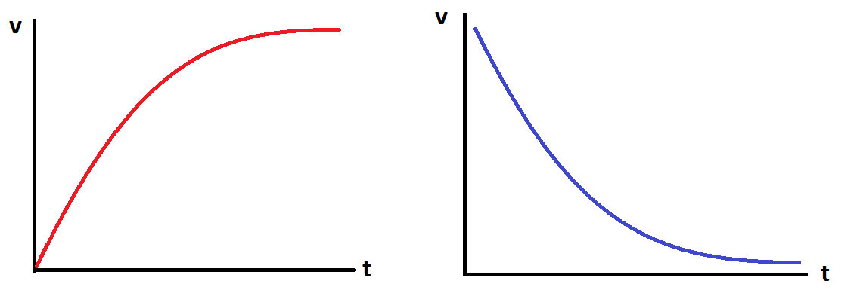
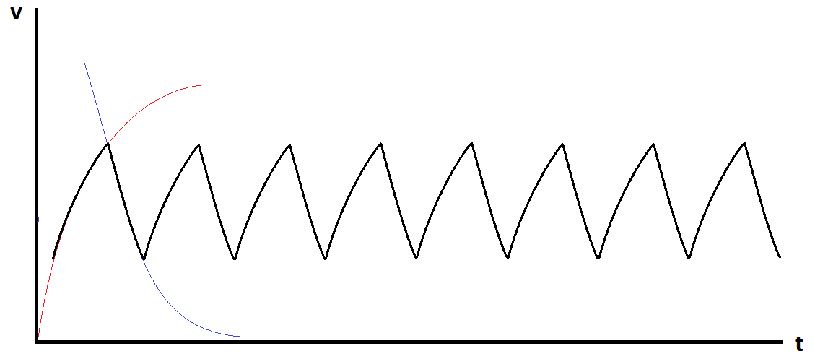
Initial Understandings
Valve Opens
Valve Closes

Slide 9
Spring versus Swing
Comparison of the two setups
Spring
Swing

Slide 10
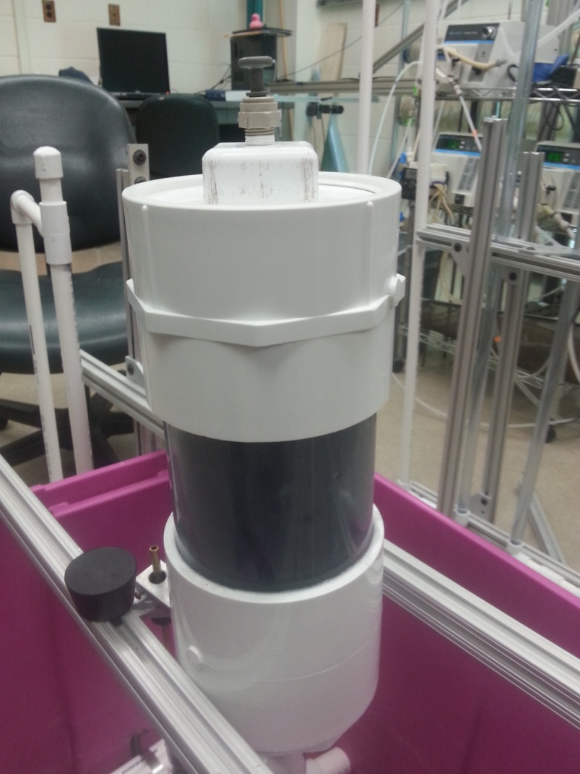
Air Chamber
Effects of air added to the air chamber inconclusive – partially due to head loss system.
Theoretical Max Volume/Cycle
=123mL
Air volume in Chamber (20-50)x
Between 2.46L and 6.15L

Slide 11
The Davey Ram Pump
Model: RIFE Davey Ram Pump
Same components
Order
Closeness
Entry/Exit pipe

Slide 12
What we learned
Model 1
Commercial Pump
Head loss (cm) | Delivery Rate (mL/s) | Power (W)
476.21 | 17.56 | 0.8203
655.74 | 12.48 | 0.8028
722.82 | 16.70 (sp) | 1.184
738.35 | 14.11 (sp) | 1.022
766.73 | 6.187 | 0.4653
Head loss (cm) | Delivery Rate (mL/s) | Power (W)
529.22 | 25.84 | 1.342
602.84 | 26.81 | 1.586
679.21 | 24.67 | 1.643
733.54 | 20.18 | 1.452

Slide 13
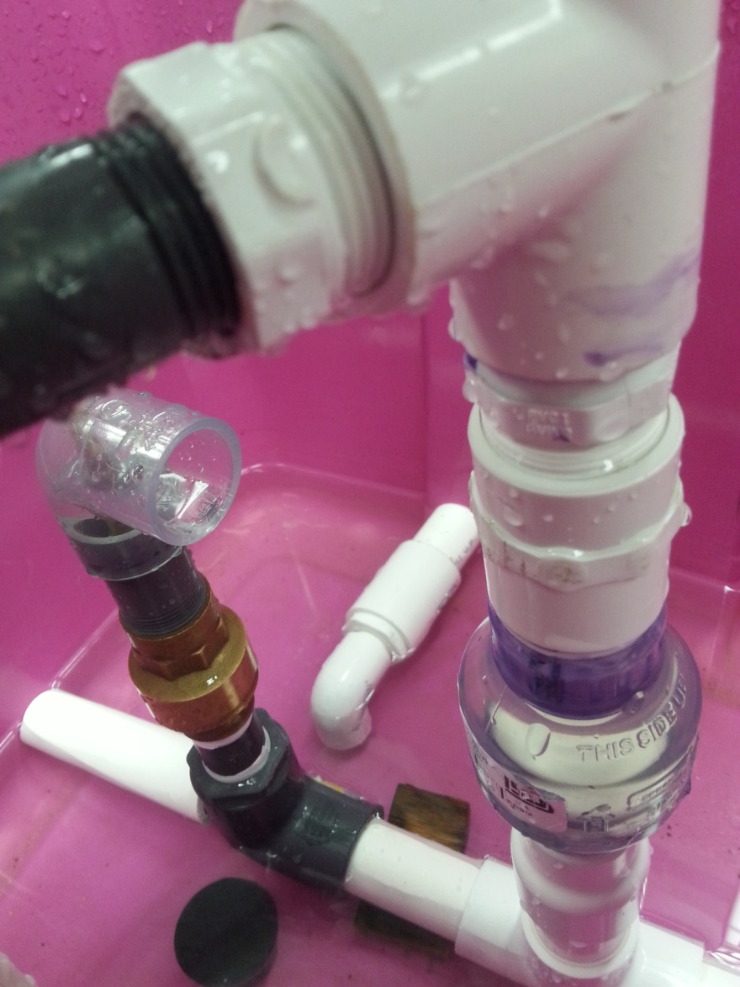
AguaClara Model 2
Why is it better?
How does it work?
What are the major changes?

Slide 14
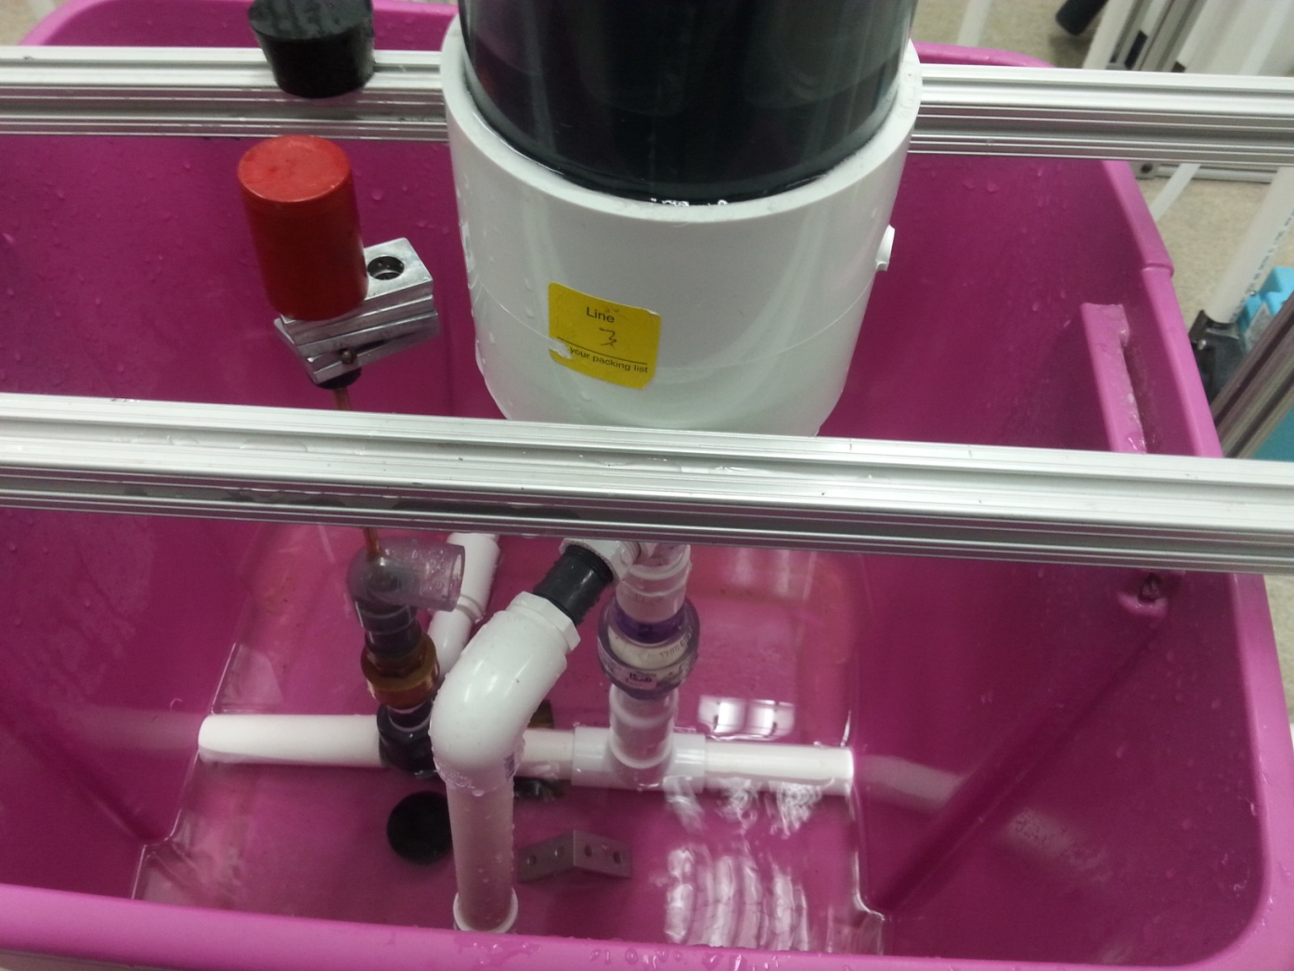
Air Chamber
Check Valve
Waste Valve
Drive Pipe
Delivery Pipe

Slide 15
Final Deliverables
Position of components
The success of AguaClara Model 2 – improved flowrate
Model 2
Head Loss (cm) | Delivery Rate (mL/s) | Power(W)
548 | 28.8 | 1.55
Commercial Pump
Head Loss (cm) | Delivery Rate (mL/s) | Power(W)
529 | 25.8 | 1.34

Slide 16
Future Work
Try different waste valve designs
Change set-up
Size of Air Chamber (determine efficacy)
  Entry and exit pipes
measure and adjust air inside
study commercial ram pump
Flow rate measuring device
Mathematical Model

Slide 17

Questions?

