Slide 1
Ram Pump
Ruju Mehta, Kelly Huang, Ruben Ghijsen

Slide 2

Outline
Ram Pump Background
How it works
Testing since last symposium
Improvements for next semester

Slide 3

Storage Tanks
AguaClara Plant
Ram Pump
Distribution

Slide 4
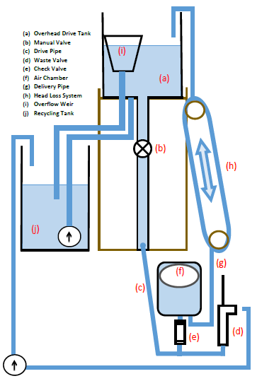
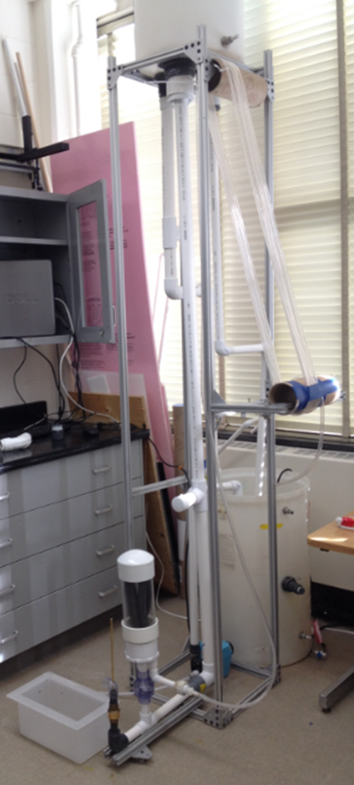
Lab Set-Up
Lab Set-Up

Slide 5
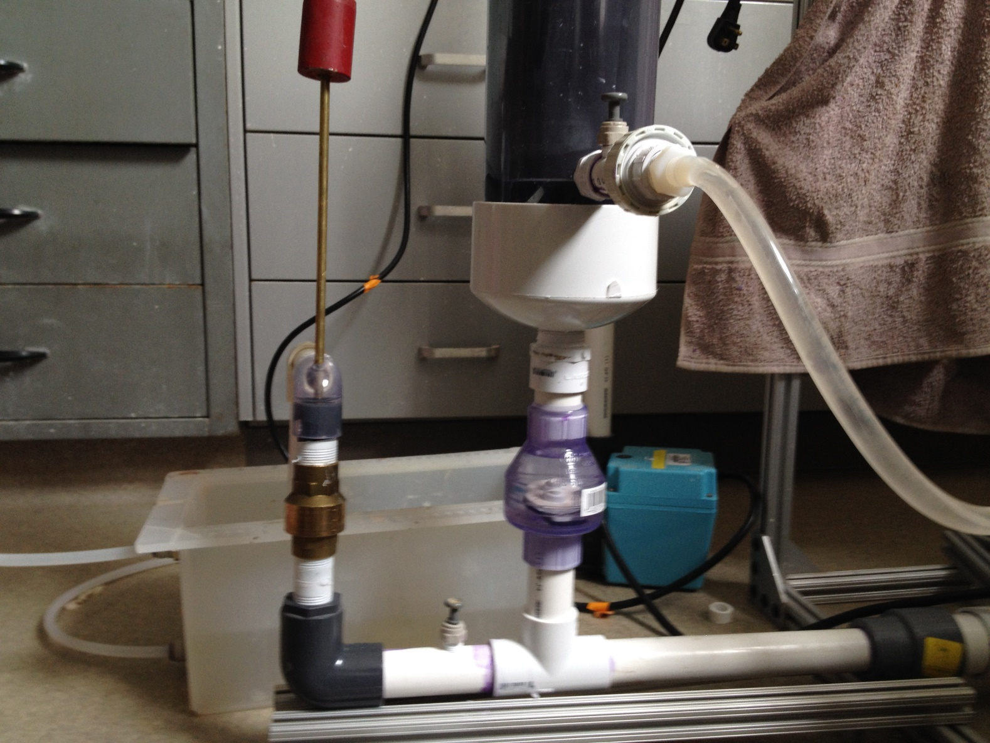
How it works!

Slide 6
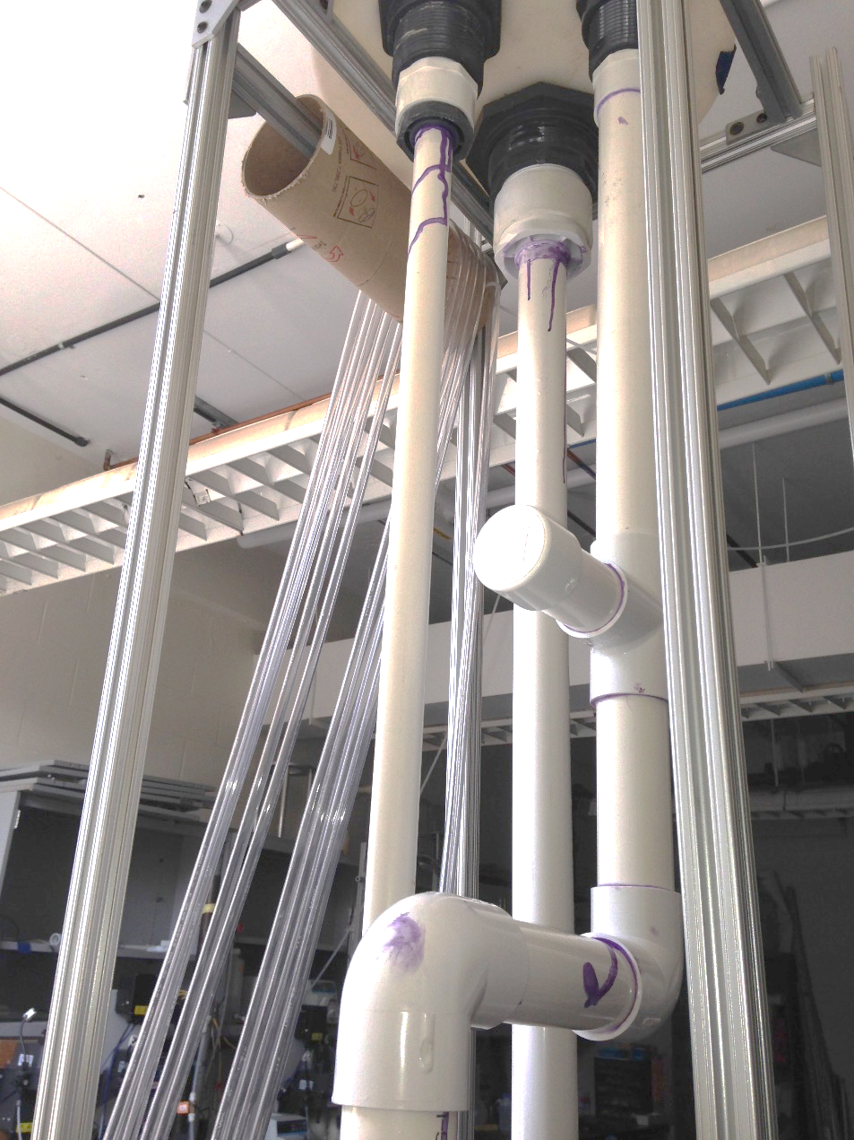
Preliminary Testing
Leaks

Slide 7
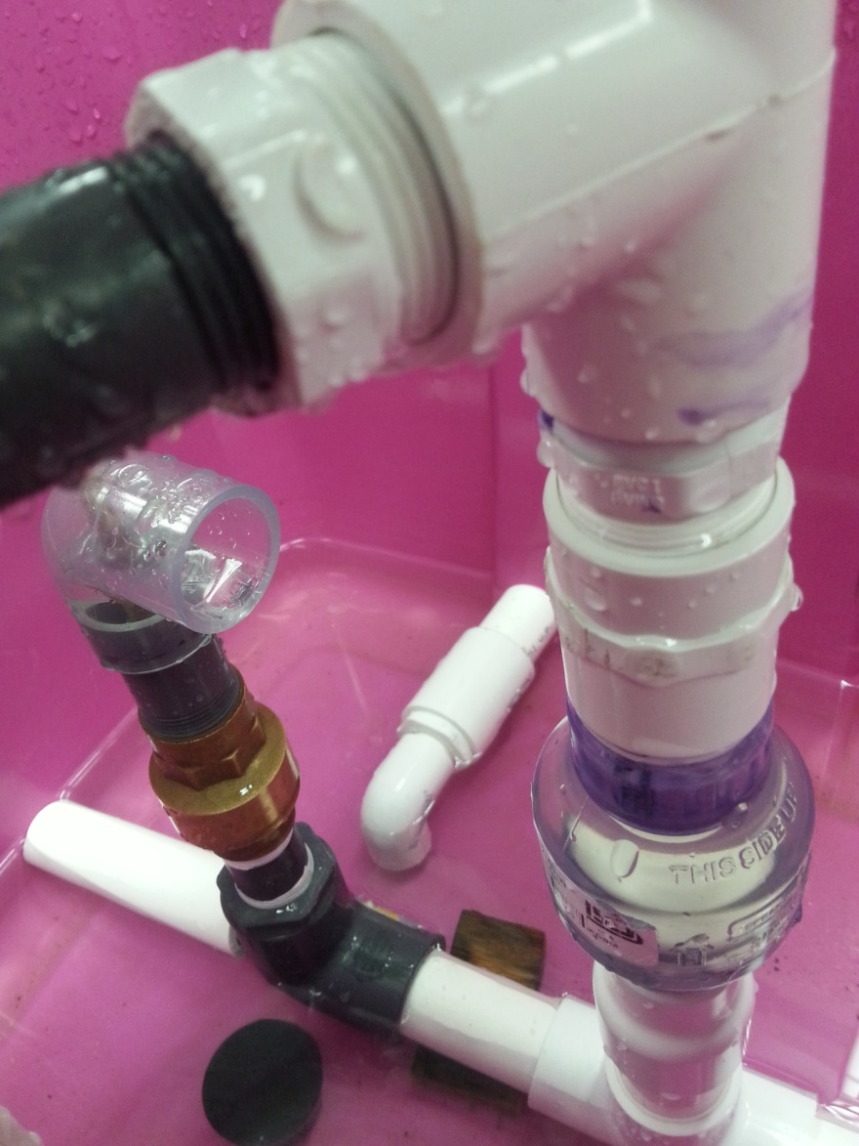
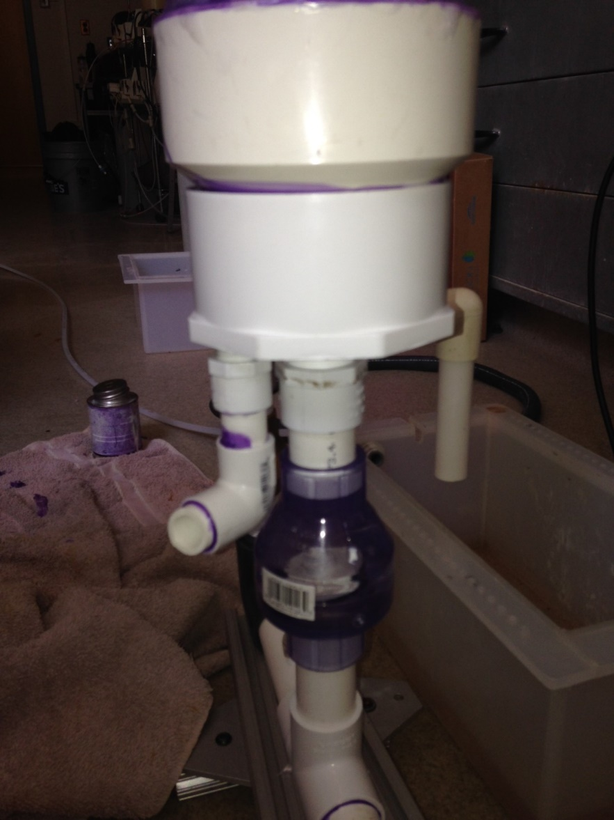
Air Chamber Issues
PIPING 1.0
PIPING 2.0

Slide 8
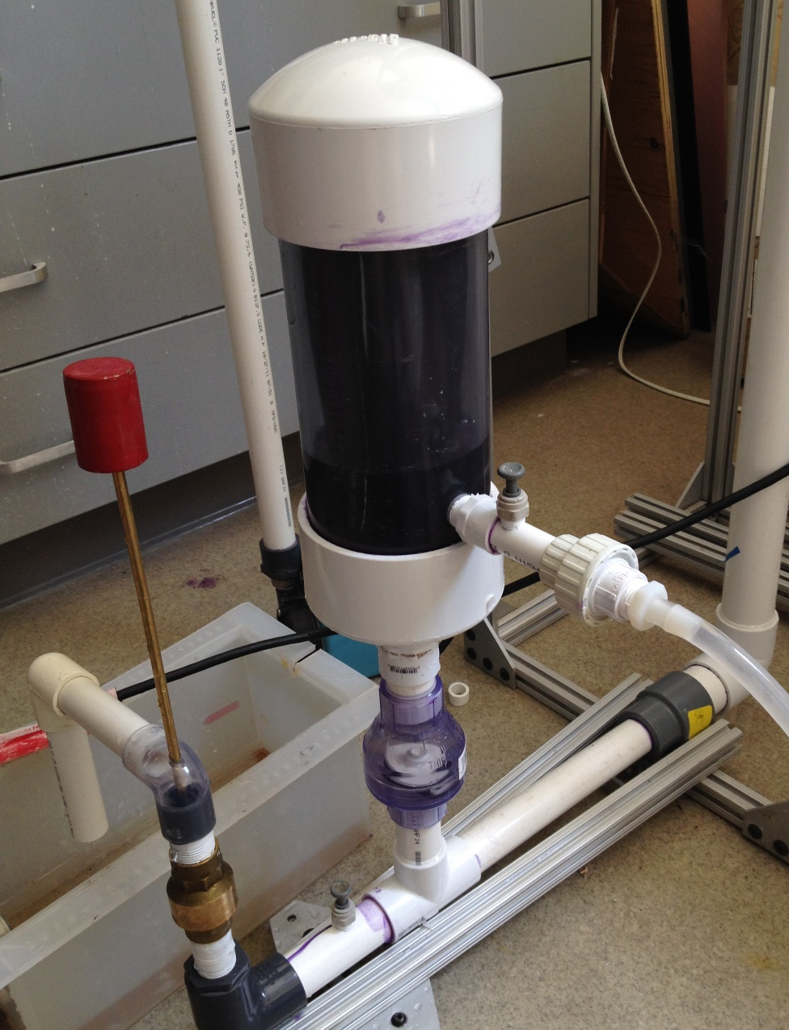
Air Chamber Piping
PIPING 3.0

Slide 9
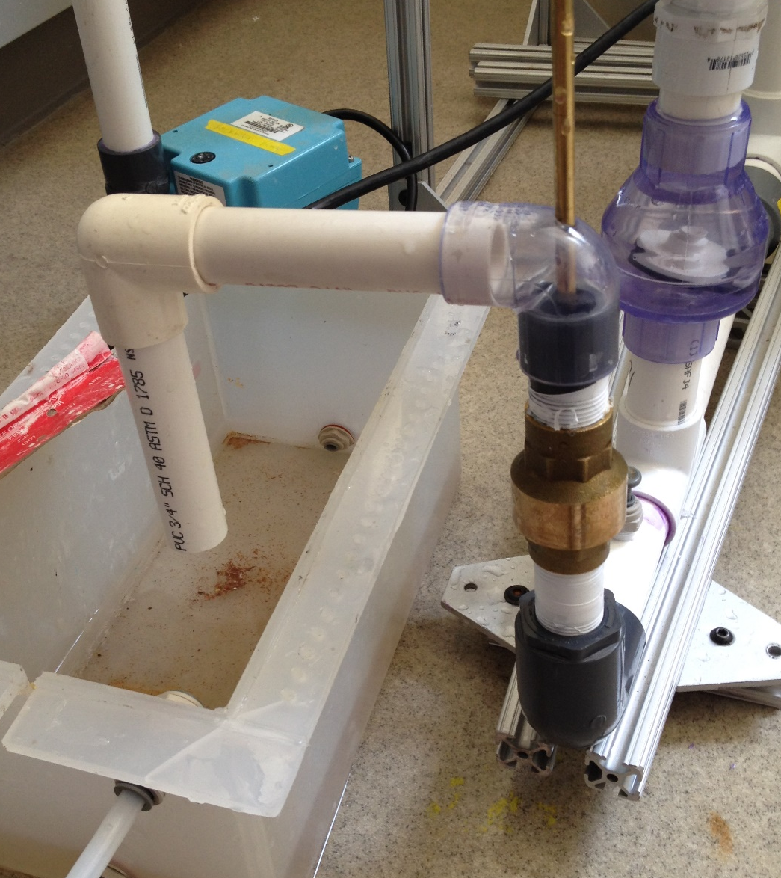
Waste Valve
Spring Valve
Weights

Slide 10
Initial Run
https://www.youtube.com/watch?v=Y3I3NbGUobE&feature=youtu.be
Notes:
Recycling
Delivery
can’t measure stuff

Slide 11
Future Work
Better Recycling system
Measure Head Loss
test for optimal flow rate
    weights, types of valves, etc.
durability
reliability Need longer run time
scaling

Slide 12
Questions?

Slide 13
Thank you!

