Slide 1

Ram Pump Fall 2017
Hydraulic pump to carry water from below a plant to higher elevations in order to restore chemical mixing tanks, plumbing systems, and other processes.
Research | Symposium Presentation Fall 2017
Notes:
The Fall 2017 Ram Pump subteam is currently working on mathematically modeling the ram pump. Some of last semester's experiments proved that the ram pump doesn't operate as anticipated or desired, so the current hope is that modeling will explain the pumps current behavior. With this knowledge, the team will be able to produce a more efficient design that operates as desired.
Link to report: https://www.overleaf.com/11131033dqwpqkxnsxhh#/41962338/

Slide 2
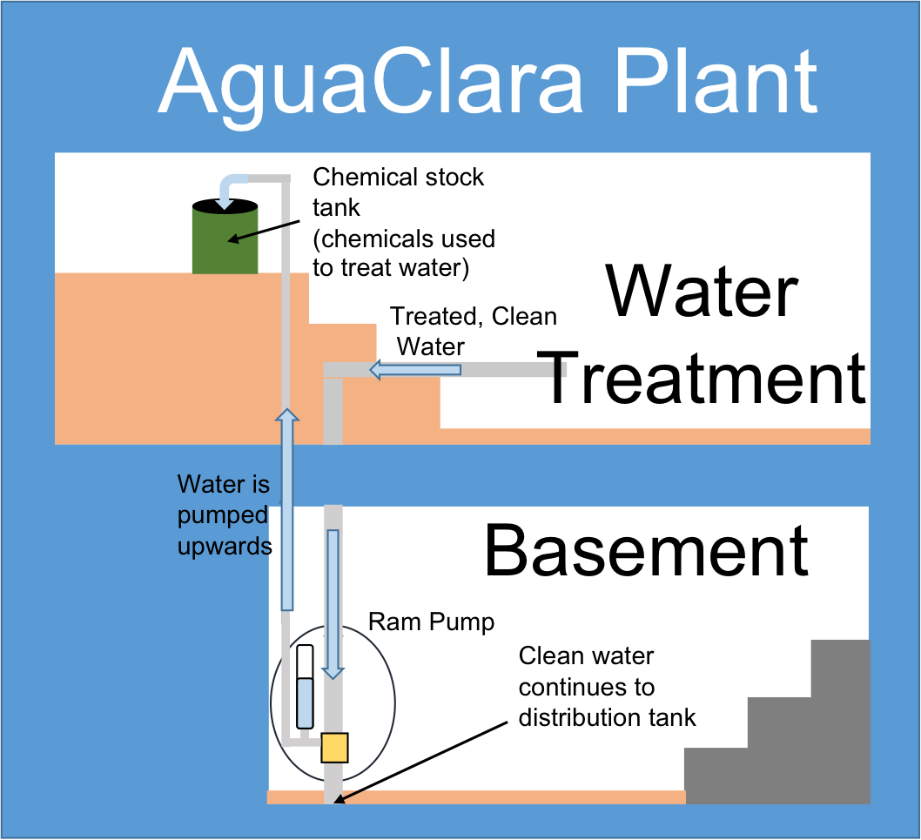
The ram pump brings water to higher elevations
aka upwards to the stock tanks and toilets in the plant.
Ram Pump | Research | Symposium Presentation Fall 2017
Notes:
Figure from:
Aggarwal, P. and Guzman, J. (2016). Ram Pump, Spring 2016. Technical report.
Treated water flowing from the plant above reaches the pump below where it is then delivered back to the beginning of the treatment process.This allows coagulant and chlorine tanks to be replenished autonomously.
Summary: The purpose of the ram pump is use both momentum and negative gauge pressure in order to deliver water at the end of the treatment plant back to the beginning, filling chemical stocks tanks and serving as forms of plumbing.
SPEAKER: Priya

Slide 3
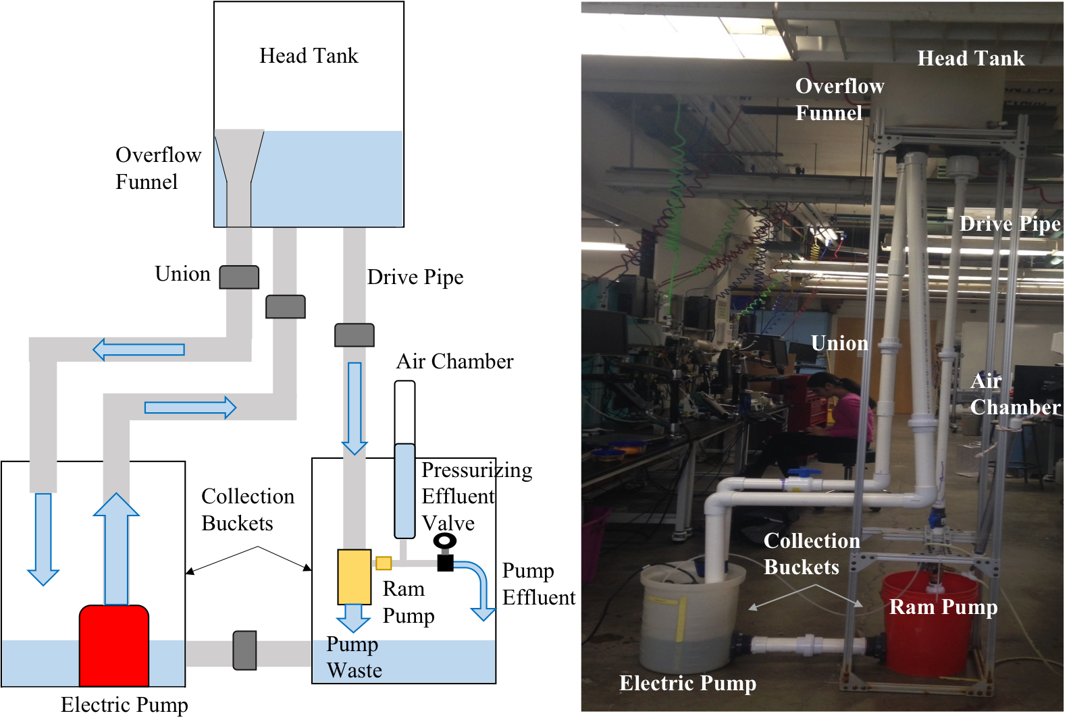
In lab, we use a sump pump, head tank, and drive pipe to drive water through the system.
Ram Pump | Research | Symposium Presentation Fall 2017
Notes:
Priya
Figure from:
Aggarwal, P. and Guzman, J. (2016). Ram Pump, Spring 2016. Technical report.
The electric sump pump delivers water to the head tank at the top of the system. From there, the water flows down the drive pipe and into the ram pump itself. While most of the water exits through the waste valve, a portion is sent toward the effluent valve and air chamber.
Summary: The ram pump simulates the movement of water in a AguaClara facility. The electric sump pump and head tank serves to replicate the continuous flow of treated water from above. Water that isn’t “waste” and sent back up to the top is pump is moved by the ramp pump as effluent, either entering the air chamber or leaving through the effluent valve.

Slide 4
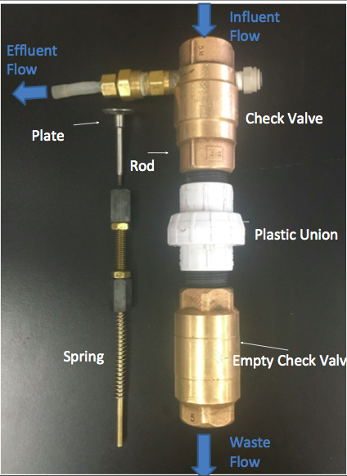
Ram pump
setup
Ram Pump | Research | Symposium Presentation Fall 2017
Notes:
Priya
Ram pump composed of:
2 check valves, plastic union, rod (half threaded, half unthreaded), 2 jam nuts, 2 standoffs, plate, spring, washers.
Effluent brings water up and waste goes through empty check valve.
Summary: the inner workings of the ram pump are easily accessible via the plastic union

Slide 5
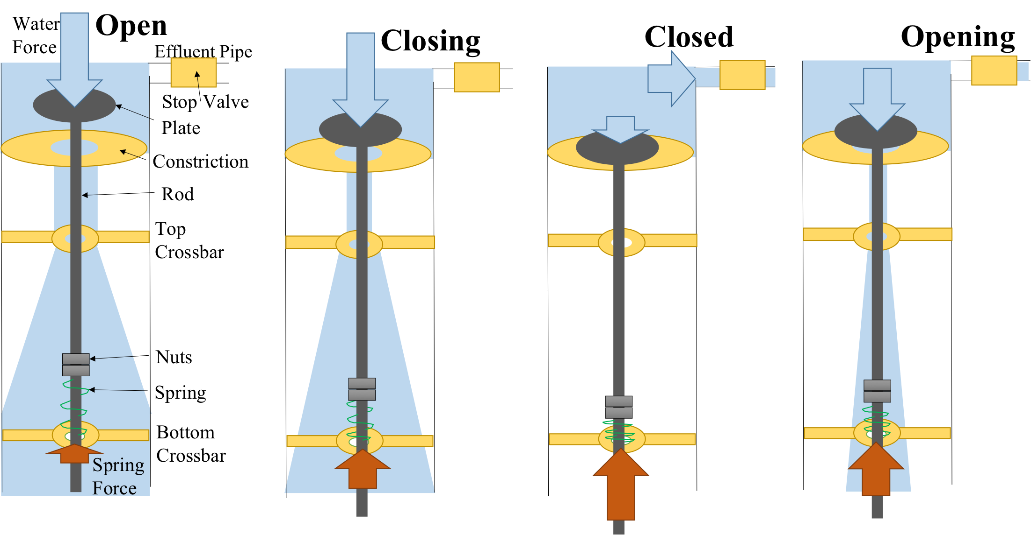
The ram pump is powered by gravity and pressure differences in air and water.
Ram Pump | Research | Symposium Presentation Fall 2017
Notes:
Priya
Figure from:
Aggarwal, P. and Guzman, J. (2016). Ram Pump, Spring 2016. Technical report.
Water from above flows on and around the plate, applying a downward force. As this force persists, the spring-loaded plate covers the opening in the constriction, causing a buildup of pressure. This pressure pushes water through the one-way stop valve and effluent pipe. The spring then completes its oscillatory motion, allowing the check valve to reopen and repeat the process again.
Summary: The ram pump relies on a spring loaded check valve that is sent into oscillatory motion by the downward force applied by incoming water. When the valve finally closes, pressure build up forces the stop valve open for a brief amount of time, allowing effluent to move.

Slide 6
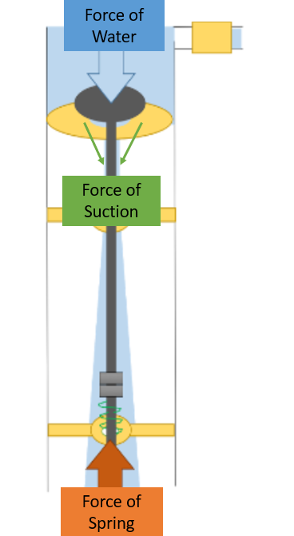
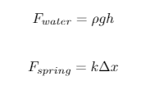



Recap: Force analysis
Known forces
Working on it...
Solve for...
Ram Pump | Research | Symposium Presentation Fall 2017
Notes:
Ana
Figure from:
Aggarwal, P. and Guzman, J. (2016). Ram Pump, Spring 2016. Technical report.
Water from above flows on and around the plate, applying a downward force. As this force persists, the spring-loaded plate covers the opening in the constriction, causing a buildup of pressure. This pressure pushes water through the one-way stop valve and effluent pipe. The spring then completes its oscillatory motion, allowing the check valve to reopen and repeat the process again.
Summary: The ram pump relies on a spring loaded check valve that is sent into oscillatory motion by the downward force applied by incoming water. When the valve finally closes, pressure build up forces the stop valve open for a brief amount of time, allowing effluent to move.

Slide 7
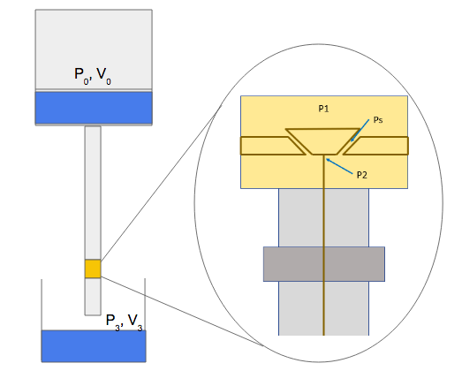
Computing the headloss in the system
Notes:
ana

Slide 8






Major and Minor Head Losses
2.
3.
Ram Pump | Research | Symposium Presentation Fall 2017
Notes:
Ana
Head loss is energy lost to flow resistance
We use the energy equation to the find the total head losses through the system. We find the minor loss coefficients in order to find the Q value using aide design.

Slide 9




Computing the Suction Force
4.
5.
6.
Ram Pump | Research | Symposium Presentation Fall 2017
Notes:
Ana
Once Q is found we can find the velocity at various points in the system. Thereby solving the energy equation at different points in the system is possible. In this way we calculate the pressure at the

Slide 10
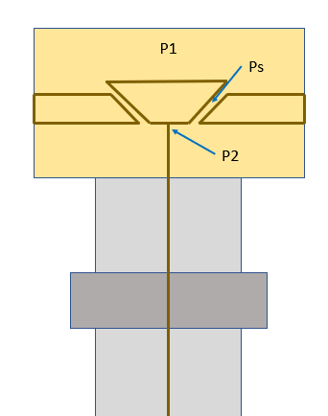
Computing the suction force
Ram Pump | Research | Symposium Presentation Fall 2017
Notes:
ana

Slide 11


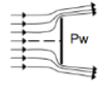

Computing the Suction Force
7.
8.
9.
Ram Pump | Research | Symposium Presentation Fall 2017
Notes:
Ana

Slide 12
Computing the Ideal time the
Plate is closed
F=ma
2. pgh*A_{drive pipe} =m_{water}*a_{drive pipe}
3. a=Δv/Δt
Ram Pump | Research | Symposium Presentation Fall 2017
Notes:
Will
We calculated the ideal amount of time we want the plate to be closed using the above two equations. We set the force of the water to be equal to mass times acceleration in order to find the acceleration. We know the force of the water equals the pressure due to the water times the cross sectional area of the drive pipe. The mass of the water is calculated using that the density times the volume equals the mass. Once the acceleration was found we found the delta t that we want. The change in velocity was chosen arbitrarily as half of the terminal velocity and a quarter of the terminal velocity.

Slide 13
Results of Suction Force Analysis in Jupyter
Maximum suction force possible = 3.551 Newtons
Ideal amount of time for plate to be closed =0.1074 seconds
Ram Pump | Research | Symposium Presentation Fall 2017
Notes:
Will
We proceeded with our model and determined the maximum suction force possible was 10.56 newtowns acting below the plate while open. In order to optimize efficiency of the system and to pump the most water as effluent, the plate ought to be closed for about 0.5 seconds. As the system is currently operating, the plate shuts for a few milliseconds, which shows us that next se

Slide 14




Force of Water Below Plate When Closed
Notes:
Ana = 14 till end

Slide 15
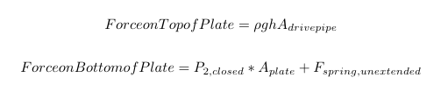

Summary of Forces : When Plate is Closed and V = 0.25Vmax

Slide 16
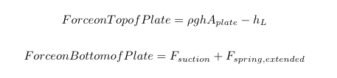

Summary of Forces : When Plate is Open and V = 0.5Vmax

Slide 17
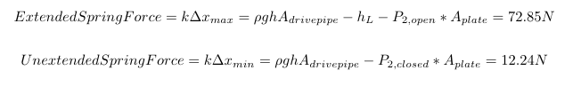

Computing the Spring Forces
What’s the deal with these values???

Slide 18
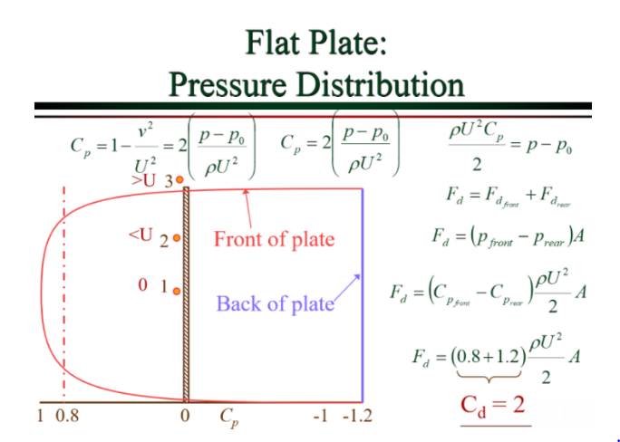
No hydrostatic pressure on top when plate is open!
All of the fluid potential energy is being use to accelerate the water and/or to overcome head losses

Slide 19

Recalculate forces acting on the open plate
Find the optimum spring for the system
Future Work
Notes:
Moving forward, the team will recalculate forces acting on the open plate because they are not hydrostatic, and also determine the optimal spring that we will choose as the system input.

Slide 20
Appendix
Ram Pump | Research | Symposium Presentation Fall 2017

Slide 21
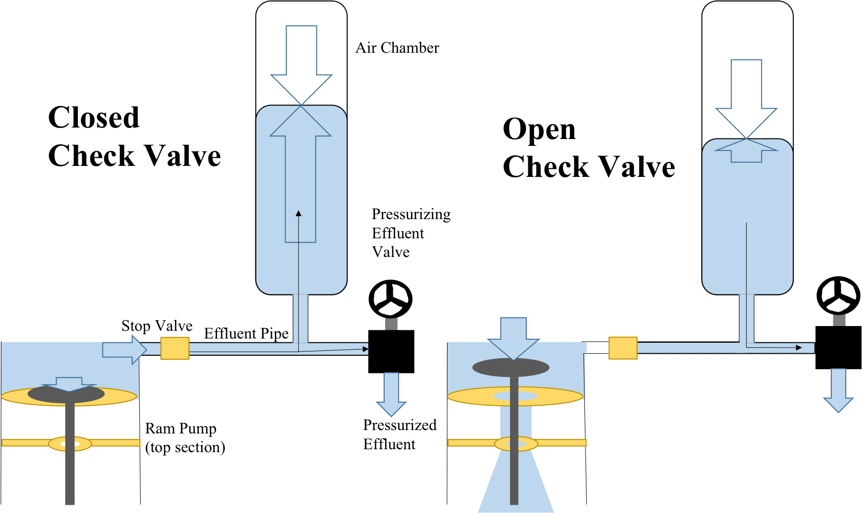
The air chamber controls effluent outflow and simulates high elevations.
Ram Pump | Research | Symposium Presentation Fall 2017
Notes:
Figure from:
Aggarwal, P. and Guzman, J. (2016). Ram Pump, Spring 2016. Technical report.
Starting from zero, the gauge pressure within the air chamber increases as the check valve closes due to pressurized water dramatically entering the cavity. When the spring recoils and the check valve opens, the gas expands and pushes the water toward the effluent pipe and then to the effluent valve.
Summary: The air chamber serves to cushion the intermittent bursts of water produced by the ram pump. When the check valve is closed, pressurized water rushes into the air chamber and out of the effluent valve. As the check valve opens, the stop valve closes and the air within the chamber pushes the water back out down into the effluent pipe, moving water through in a smooth stream.

