Slide 1
Ram Pump
Jill Freeman
Marisa Perez-Reyes
Marina Servino

Slide 2


Outline
Introduction
Review: How a Ram Pump Works
Cost analysis
Results and Conclusions
Applications
Future Work

Slide 3
Review: How the Ram Pump Works
Uses a large amount of water to pump a small amount of water to a height
Operates by water hammer
Key components

Slide 4
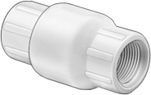

Check Valves
  Importance of operation
  Alternative check valves
  When does it start working? Flow rate dependency

Slide 5
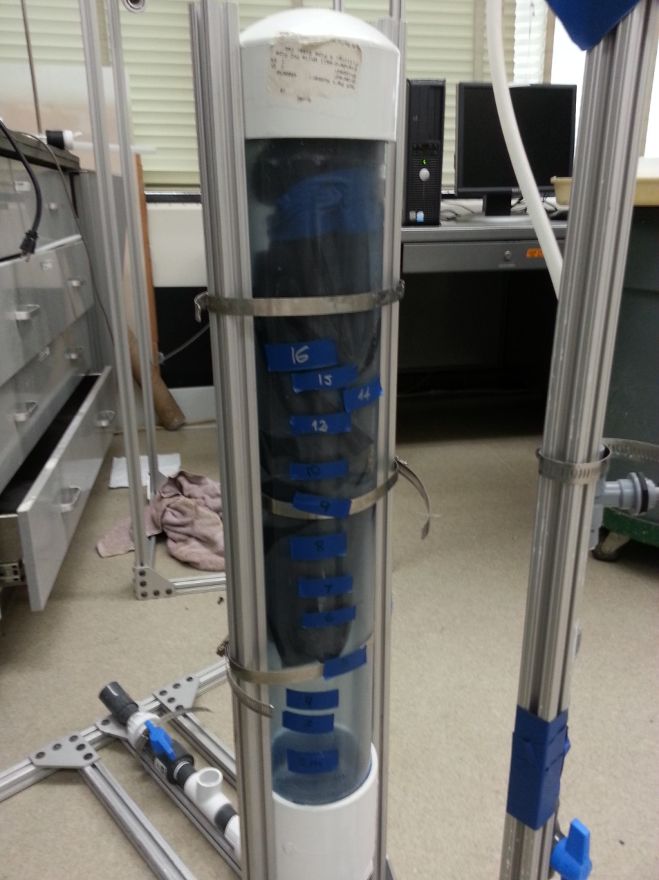
Pressure Chamber
  Must be airtight
  Back pressure powers ram pump
  Relationship between water height and drive height

Slide 6


Slide 7
Cost Analysis
Total cost of AguaClara ram pump will be $99.80.

Slide 8
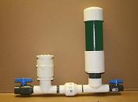
Commercial Ram Pump Options
Most options were more expensive, large scale, and durable
$200 was the least expensive option
  Appears very similar to ours
  Might not ship to Honduras
We chose to build our own
  Design alterations possible
  Less expensive

Slide 9
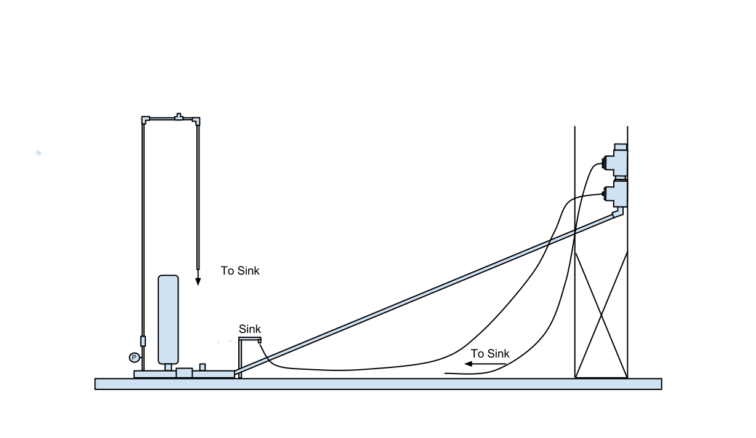
Test Apparatus
Needle valve
Pressure sensor
Notes:
In our trials, we used a delivery height of 2m because we are limited in our lab space and pressure sensors were not working.
We will need

Slide 10
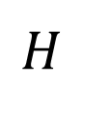

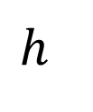
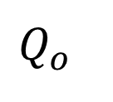

Ram Pump Efficiency
$$Q_{o}×h=η\left(Q_{i}×H\right)$$
$$Q_{o}$$
$$h$$
$$Q_{i}$$
$$H$$
Notes:
In our trials, we used a delivery height of 2m because we are limited in our lab space and pressure sensors were not working.
We will need

Slide 11
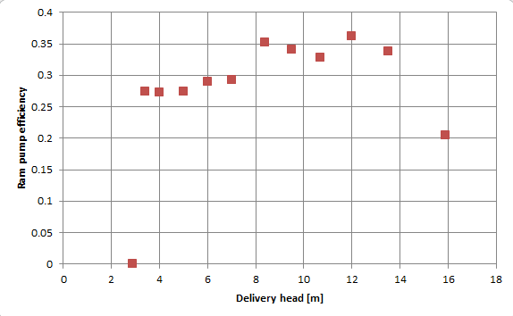
Efficiency vs. Head: 0.15 L/s

Slide 12
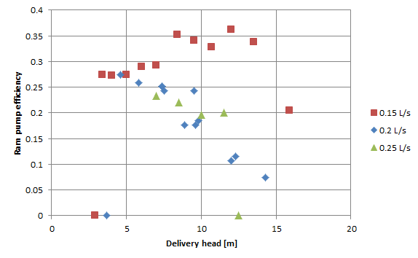
Efficiency vs. Head

Slide 13
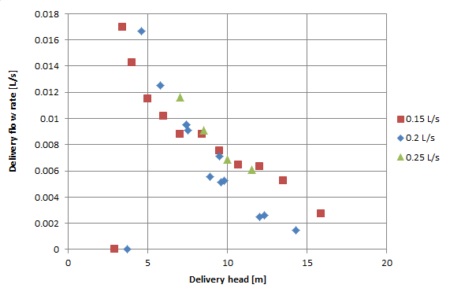
Delivery Flow vs. Head

Slide 14
Efficiency and Flow Rate
Delivery head = 7 m
Drive flow rate | Efficiency | Delivery Flow Rate
0.15 L/s | 0.35 | 0.009 L/s
0.20 L/s | 0.25 | 0.01 L/s
0.25 L/s | 0.23 | 0.012 L/s

Slide 15
AguaClara’s Las Vegas Plant
Site restrictions:
Maximum drive head available: 1.4 m
Required pumping elevation: 7 m
Amount of water needed: 1100 L/day

Slide 16
Where is the Ram Pump in AguaClara plant?
Storage Tanks
Plant
7m
1.4 m
Ram Pump
Distribution Tank

Slide 17
Desired Delivery Flow
1100 L/day
1100 L 3 hours
Q_{delivery} 1 hour
Q_{delivery}= 366.667 L/hr
Qdelivery= 0.102 L/s

Slide 18
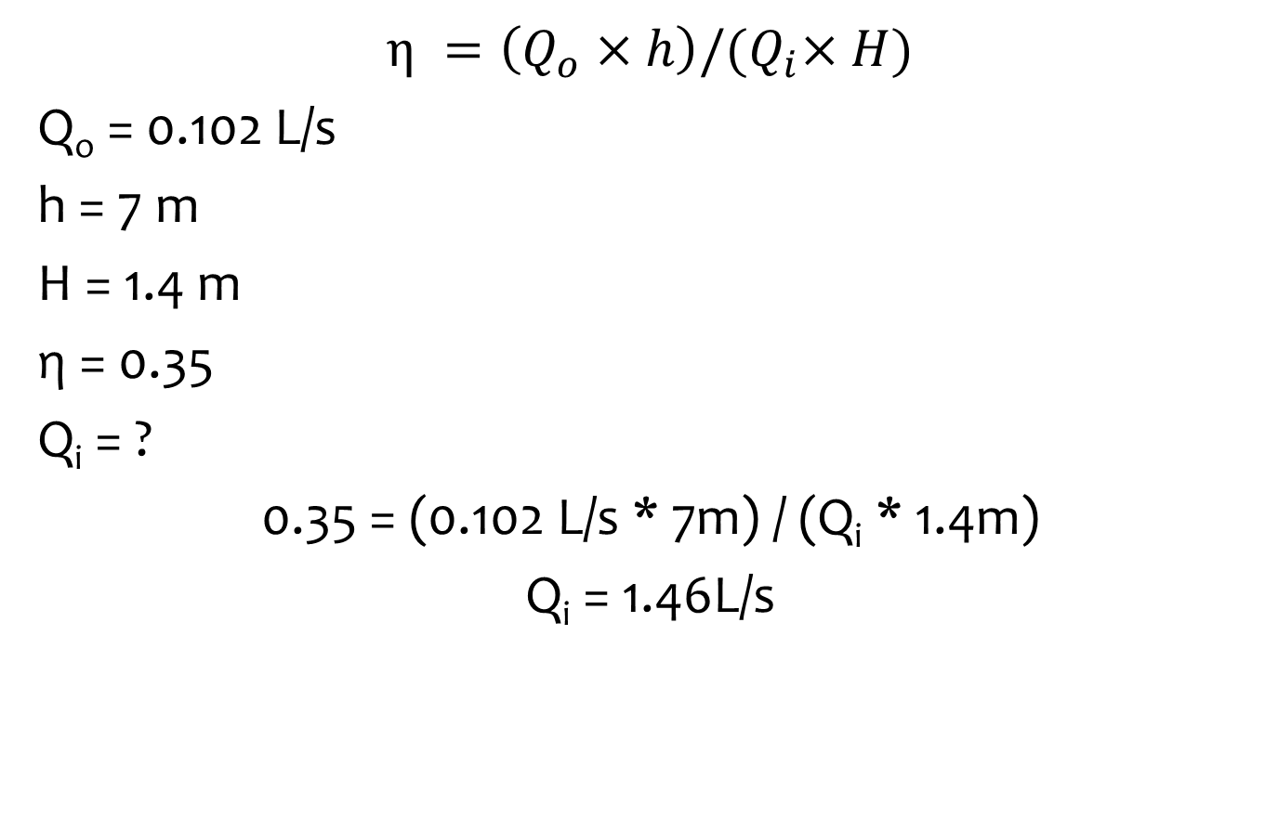
Drive Flow needed
$$η =\left(Q_{o}×h\right)/{(Q}_{i}×H)$$
Q_{o} = 0.102 L/s
h = 7 m
H = 1.4 m
η = 0.35
Q_{i} = ?
0.35 = (0.102 L/s * 7m) / (Q_{i} * 1.4m)
Q_{i} = 1.46L/s

Slide 19
The total flow rate through this plant is: 32 L/s
What fraction of the plant effluent would be necessary to be diverted for use in the ram pump?
1.46/32 * 100= 4.6%

Slide 20
Future Work
Check Valve
More stable structure
Apparatus improvement
Test different parameters
Automatic flow rate measurement

Slide 21
Questions?

