Slide 1
How Water Flows Through the Plant
Notes:
Images formatted, selected, and animated by Rachel Philipson

Slide 2
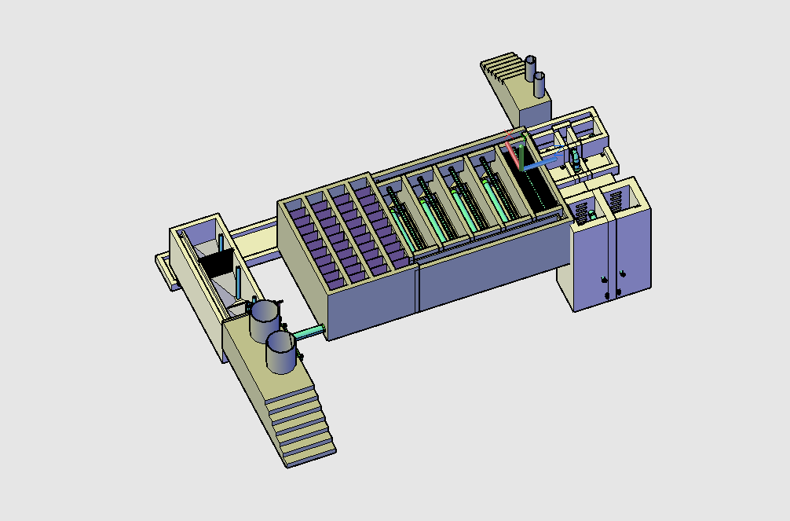
Stacked Rapid Sand Filters
Flocculator
Sedimentation
Tanks
Entrance Tank

Slide 3
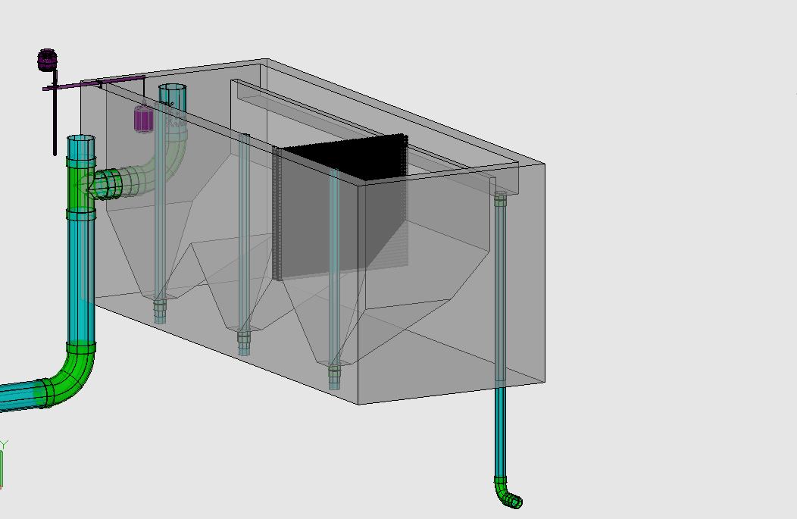
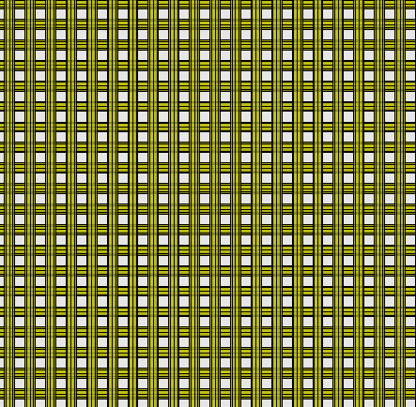
Chemical Dose Controller
Entrance Tank
Overflow Weir
LFOM
Trash Rack
Hopper
Primary Sludge Drain

Slide 4
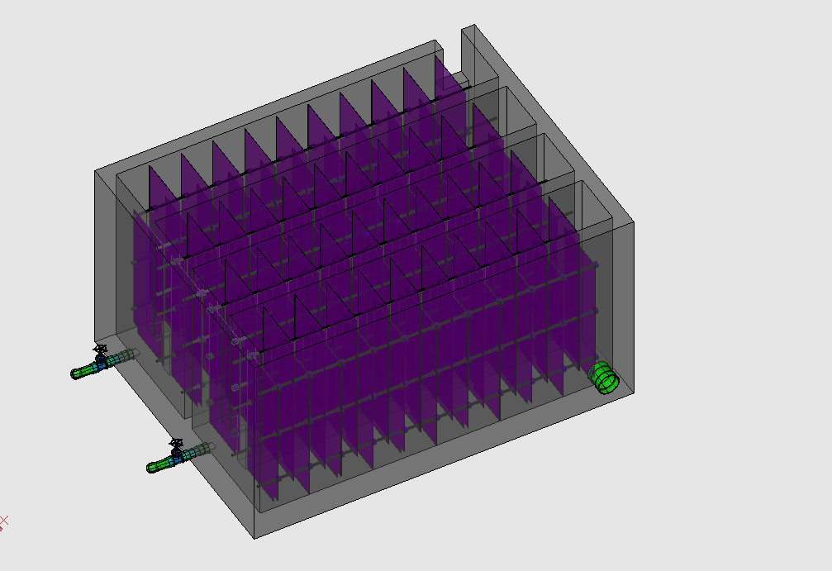
Flocculator
Rapid Mix Pipe

Slide 5
Stacked Rapid Sand Filters
Flocculator
Sedimentation
Tanks
Entrance Tank

Slide 6
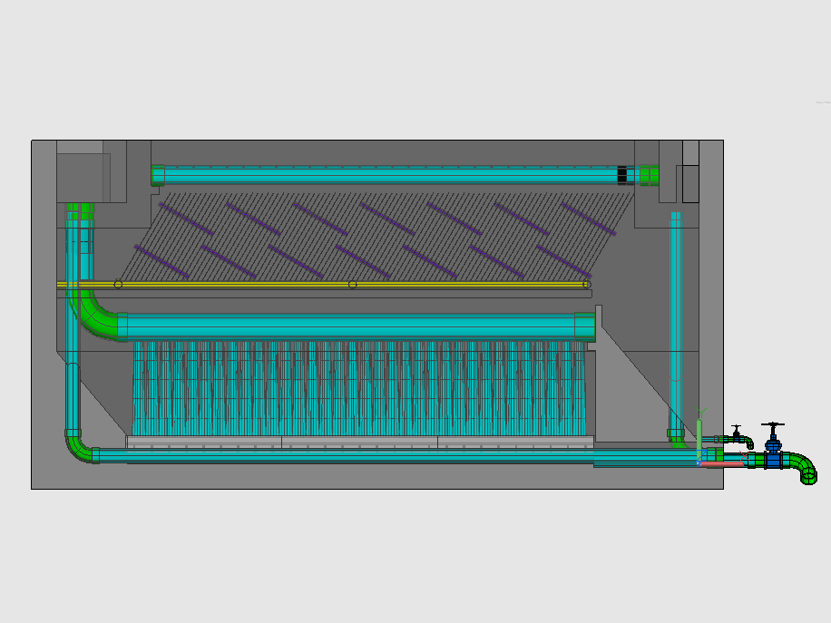
Sedimentation Tank
Entrance Channel
Exit Channel
Launder
Plate Settlers
Inlet Manifold
Floc Weir
Diffusers
Sludge Drain

Slide 7
Stacked Rapid Sand Filters
Flocculator
Entrance Tank
Sedimentation
Tanks

Slide 8
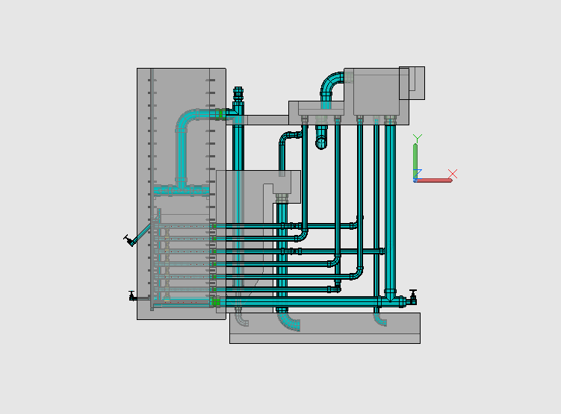
Stacked Rapid Sand Filtration
Filtration Entrance Tank (from Sedimentation Tank)
Exit Tank

