Slide 1
Project Teams

Slide 2
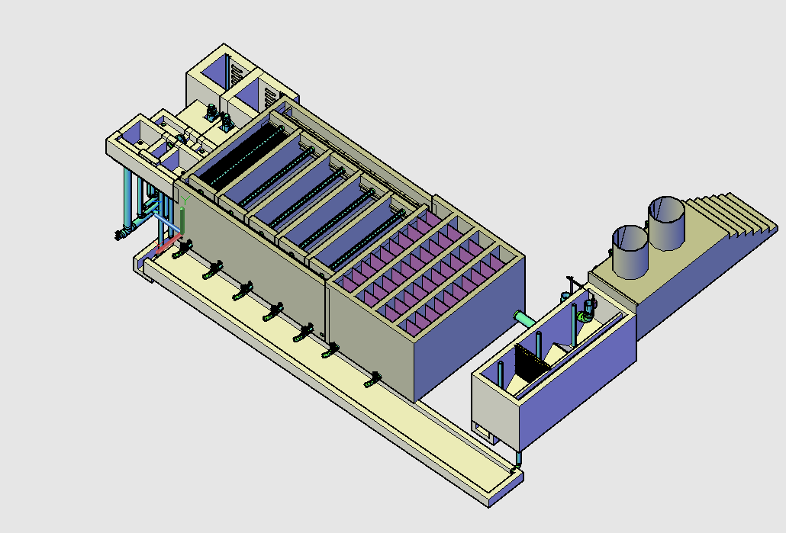
Design
Useful skills: AutoCAD, MathCad, CEE 4540, Spanish fluency

Slide 3
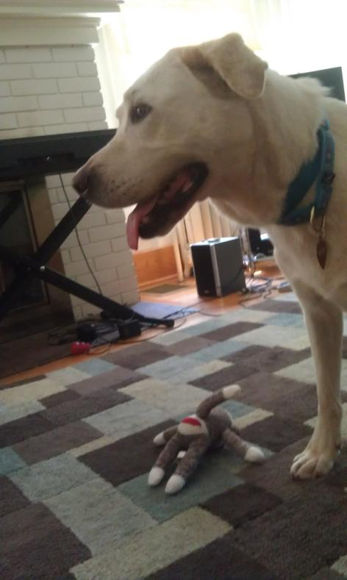
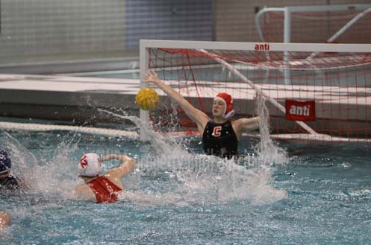
Karen
Research Team Leader
3rd year PhD student
Goalie for Cornell Women’s
Water polo

Slide 4
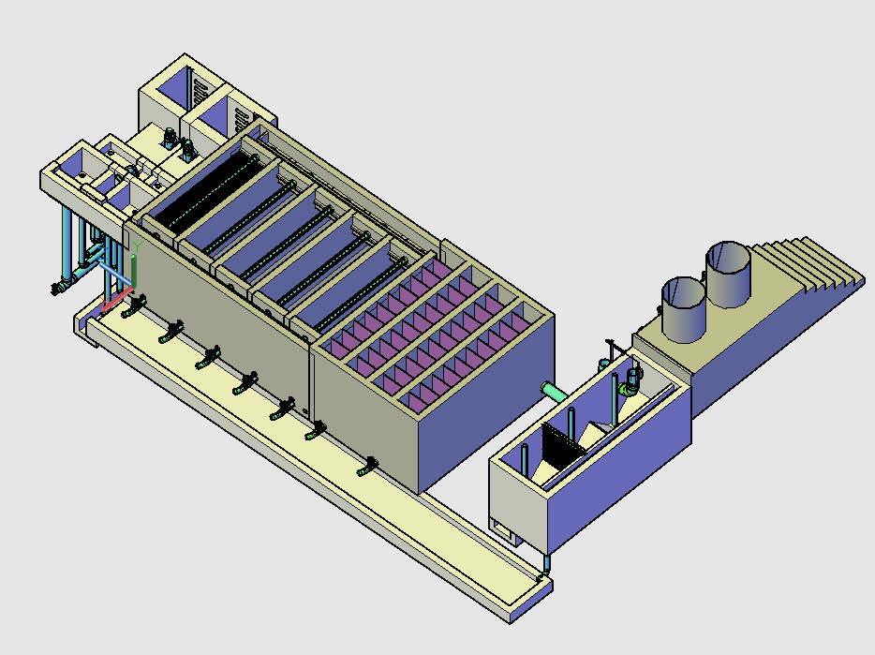

Slide 5
Tube Floc
Experiments! Experiments! Experiments!
Characterizing flocculator performance under various influent conditions and coagulant dosing scenarios
Measuring size and charge of suspensions
Documenting research for publication

Slide 7
Plate Settler Capture Velocity
Experiments!
Characterize performance of the sedimentation tank under various conditions
  Coagulant type and dose
  Influent water quality
  Plate settler length and spacing

Slide 9
Linear Chemical Dose Controller
Continue the work of previous teams by making the dose controller viable
Existing design – document parts, assembly, calibration, and maintenance
Study the influence of coagulant viscosity on design and operation

Slide 11
Stock Tank Mixing
Redesign a prototype mixer
Quantify the human effort required
Develop a low-cost method for measuring concentration of stock, hydrometer

Slide 13
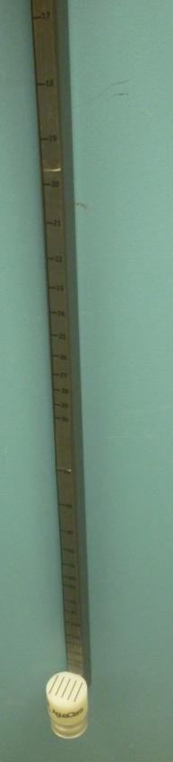
Turbidimeter
Redesign a prototype for optimal performance
  Extend range of use
  Keep costs low
  Improve accuracy

Slide 14
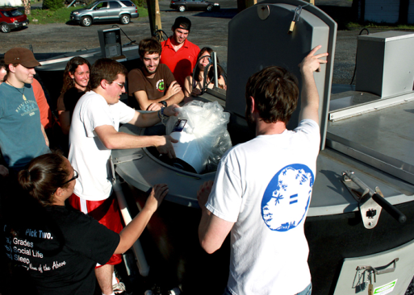
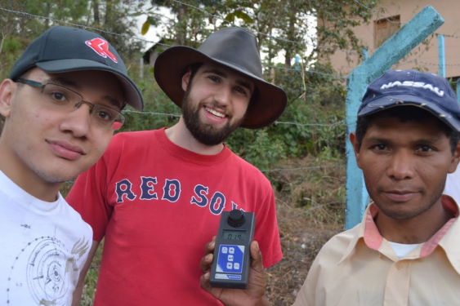
Mickey
AguaClara GRA and 2nd year MS student
Handled a lot of garbage at Lafayette College
Doesn’t always build filters … but when he does, he prefers stacked filtration

Slide 16
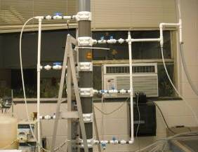
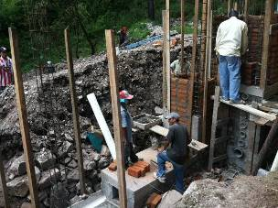
Stacked Rapid Sand Filter
Rationale: continue development of a novel unit process
Work on three scales for the semester
  Bench-scale work on removal mechanisms
  Pilot-scale testing of control system
  First full-scale filter

Slide 17
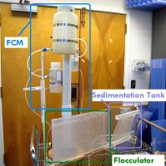
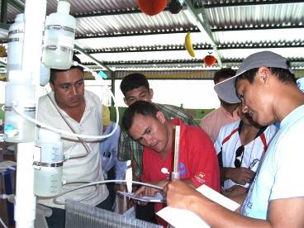
Demo Plant
Rationale: bench-scale demonstration of all AguaClara technology (or as much as possible)
  Dosing, flocculation, sed / floc blanket, SRSF ...
Semester work: design, fabrication, testing

Slide 18
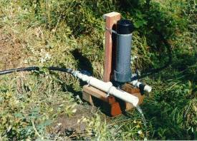
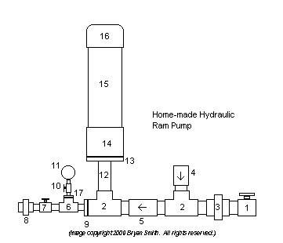
Ram Pump
Background on ram pumps
  Hydraulic transient power
  Raise a small flow with the energy of a large flow
Possible applications in AguaClara facilities
  Water to fill stock tanks
  Sanitary service in plants
  Demo planned, Jan 2012

Slide 19
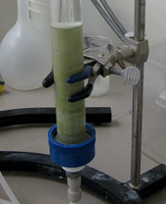
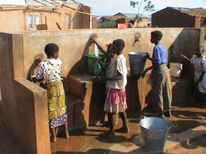
Foam Filter / POU design
Possibilities for an AguaClara POU system
  Polyurethane foam will work for small filters
  Include a tube flocculator, PACl, and sed tank
  Applications: water kiosk, emergencies, ...
Goals: design, fabrication, and lab testing

Slide 21
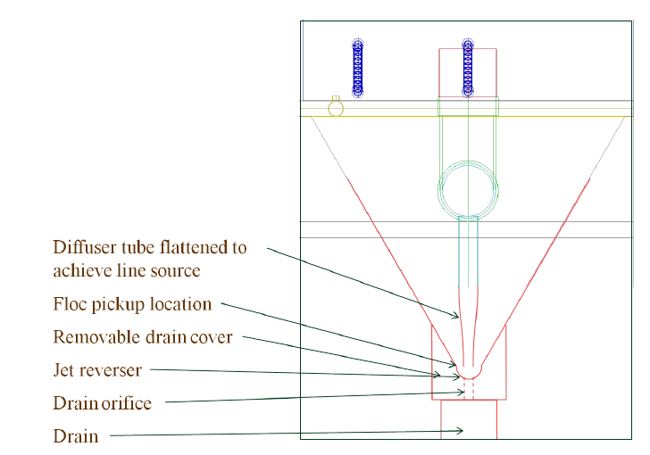
Inlet Manifold Design
New sed tank inlet proposed for Atima plant
  Will allow for floc blanket formation
  A fabrication technique must be ready by October

Slide 23
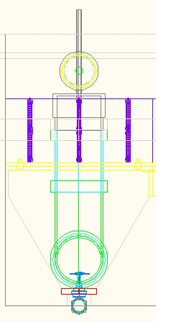
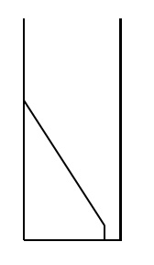
Sed Tank Hydraulics
http://www.youtube.com/watch?v=dJIyzRLWWHE

Slide 24
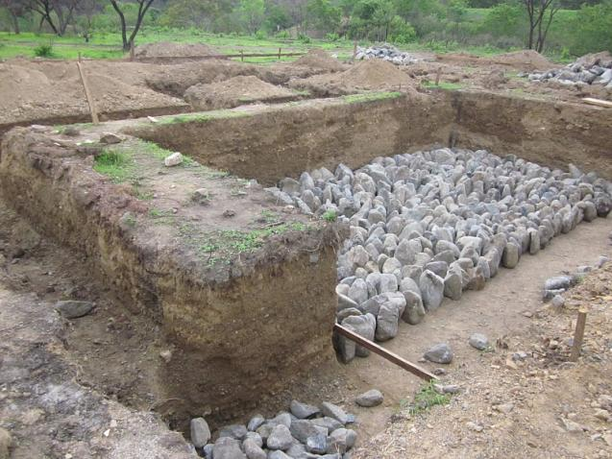
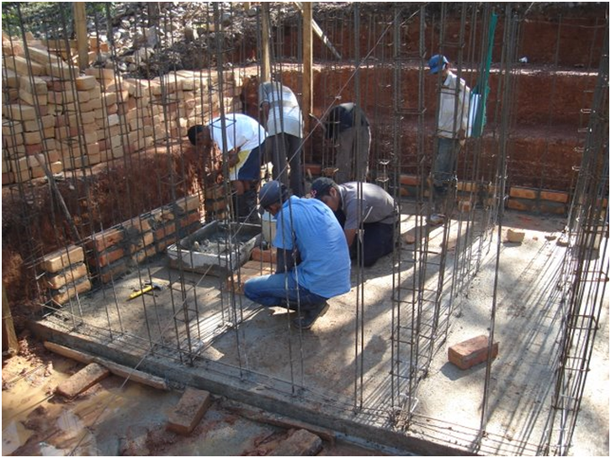
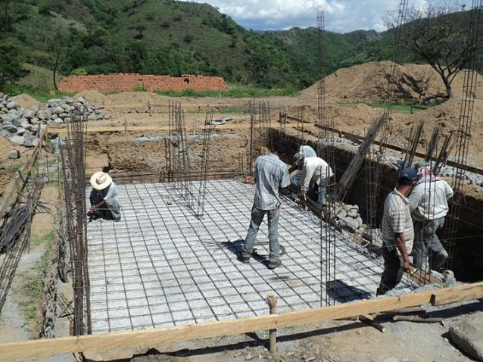
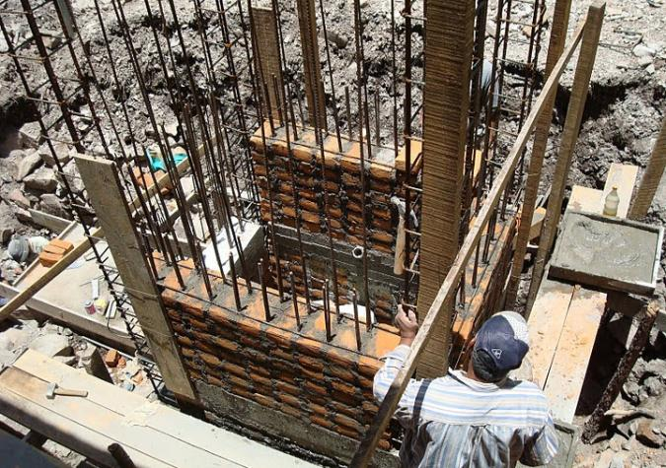
Structures
Notes:
More efficient way to construct walls (holes in bricks for rebar, pretensioned rebar)
How can the amount of rebar and the minimum wall thickness be calculated?

Slide 25
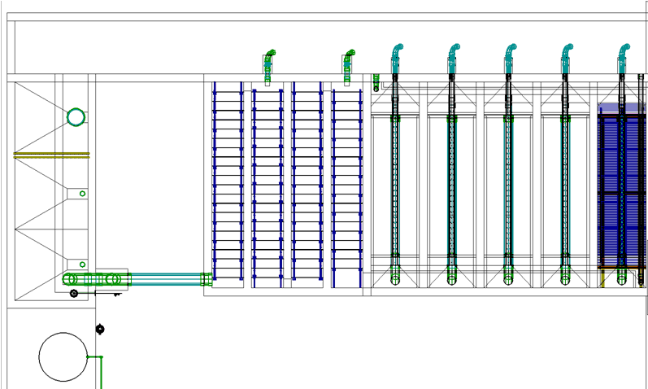
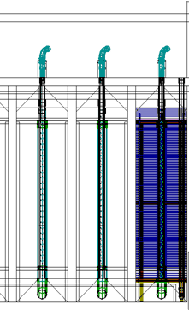
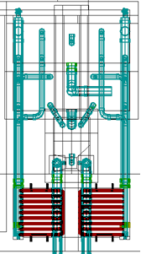
Plant Layout Optimization
Notes:
Big picture
Use the design tool to investigate
Design for expansion and Location of filters

Slide 26
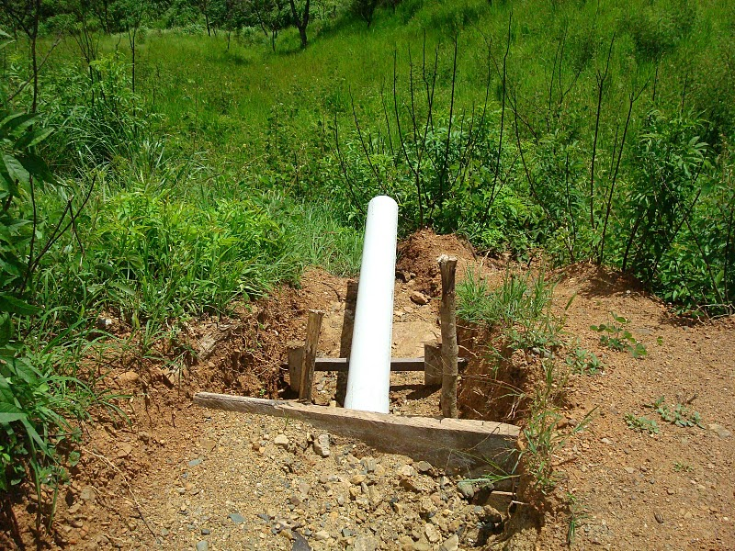
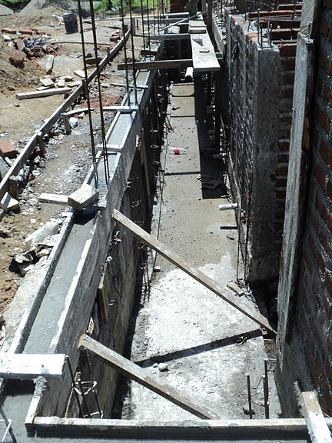
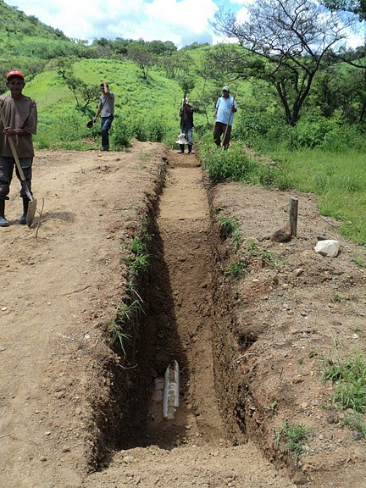
Residuals Management

Slide 27
Water Treatment Technology Selection Guide
Water source
Turbidity
Access to chemicals
Population to be served
Dry season flow rate
Flocculation/
Sedimentation
Filtration: Stacked RSF
WTTSG algorithm
Chlorination
Multiple Stage Filtration

Slide 28
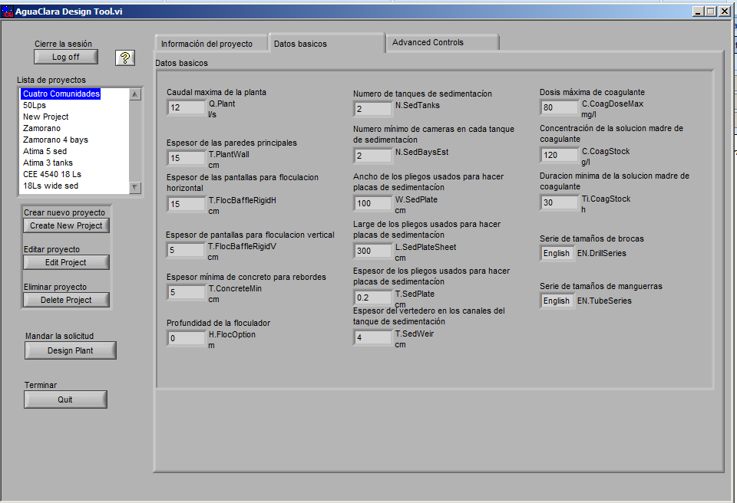
Web Browser UI for ADT
UI is user interface
Eliminate need to download software to submit design request
Switch to a web browser
Increase visibility of AguaClara design tool
Develop interface for design of individual components

Slide 29
Wiki Organizing/Crowd Sourcing
Our wiki is one of our main sources of publicity. Improving our image and making the wiki easier to navigate for new visitors is a priority.
We’ve developed methods to harness the power of Cornell students for the greater good. Would it be possible to post challenges that could be picked up and solved by experts outside of Cornell?

Slide 30
Public Relations
We have a growing need to create a public face for the AguaClara program. We have opportunities to create positive press for Cornell, develop an internationally recognized solution for drinking water, and recruit the best students for Cornell.

