Slide 1
SEPTIC PERITONITIS
Jillian DiFazio, DVM
Resident Emergency and Critical Care
Resident Board Review
11/1/11

Slide 2

Outline
Anatomy and Physiology
Definitions
Pathophysiology
Etiology
History
Clinical Signs
Diagnosis
Treatment
Prognosis

Slide 3
Anatomy and Physiology of peritoneal cavity
Peritoneum is a single cell layer serous membrane with deeper connective tissue layer
Parietal peritoneum lines the inner walls of the peritoneal cavity
Visceral peritoneum covers the surface of all intra-abdominal organs
Fenestrated basement membrane allows particulate matter to pass into lymphatics easily
Peritoneum highly permeable to water and low-molecular weight solutes, permitting equilibration between the peritoneal cavity and the intravascular space

Slide 4
Anatomy and physiology of peritoneal cavity
Healthy animals have <1ml/kg of clear, straw-colored fluid that acts to decrease friction
  Less than 300 nucleated cells per microliter
  Less than 2.5 g/dL of protein
Peritoneal fluid normally circulates around the abdomen because of the negative pressure gradient generated by the diaphragm during breathing
Drainage of peritoneal fluid occurs via the diaphragmatic lymphatics and thoracic duct to the sternal and mediastinal lymph nodes
Notes:
Fluid flows cranially along the ventral abdomen and then dorsally over the liver surface, thereby providing a mechanism for dissemination of localized inflammation or infection. (Hosgood study on Intraperitoneal Circulation and Drainage in the Dog, Vet Surg 1989)

Slide 5
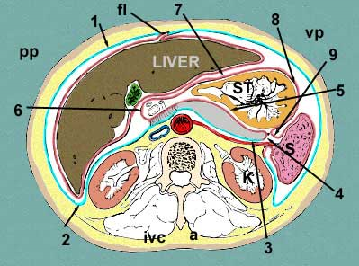
Definitions
Peritonitis= Inflammation of the peritoneal cavity
  Primary vs. secondary vs. tertiary
  Localized vs. generalized
  Septic vs. nonseptic
  Acute vs. chronic
Secondary septic peritonitis is the most common form in the dog and cat
http://home.comcast.net/~wnor/xsectionthroughliver.jpg
Notes:
Peritonitis classified according to underlying etiology (primary vs. secondary vs. tertiary), extent (localized or generalized) or the presence of infectious agents (septic or nonseptic)
Primary peritonitis= spontaneous inflammatory condition in the absence of underlying intraabdominal pathology
Postulated to occur secondary to hematogenous dissemination of infectious agents and is likely facilitated by impaired host immune defenses
Most common cause is effusive form of FIP; other agents reported include Salmonella typhimurium, Chlamydia psittaci, Clostridium limosum, Mesocestoides spp.,
Blastomyces spp, and Candida spp
Secondary peritonitis= Consequence of preexisting aseptic or septic pathologic, intraabdominal condition
Tertiary peritonitis= refers to recurrent intra-abdominal infection after initial surgical and antimicrobial therapy of secondary bacterial peritonitis. The entity has a variable definition, in part because of the different populations of patients in whom it has been described. Earlier reports have focused on patients in the intensive care unit. In this setting, it has been referred to as a "syndrome" characterized by the presence of multiple organ failure, poorly localized infections typically not amenable to percutaneous drainage and a microbial flora different from that of secondary bacterial peritonitis with a preponderance of Enterococci, Candida spp., Coagulase negative staphylococcus and Enterobacter spp. In this population, mortality is 64%, twice that of comparable patients who do not go on to develop tertiary peritonitis. It is not clear precisely why outcomes are so poor in patients with tertiary peritonitis. Investigators have attempted to determine whether differences in outcome from that of secondary peritonitis can be explained simply by the nosocomial nature of tertiary peritonitis and underlying severity of illness. In one study, only higher APACHE II score predicted progression from secondary to tertiary peritonitis and the presence of tertiary peritonitis was not an independent predictor of mortality, suggesting that its high mortality might be more a function of the patient population in which it occurs than the severity of the pathologic process itself. The most important predictors of who will go on to develop tertiary peritonitis are patients with a high APACHE II score, pancreatic or small bowel source, gram-positive, fungal, or other resistant pathogens, malnutrition, and poor surgical source control. In spite of the identification of specific risk factors for tertiary peritonitis, the data supporting a change in empiric antimicrobial therapy or a different surgical approach (e.g., scheduled relaparotomy) to prevent the development of tertiary peritonitis are limited. These findings again suggest that the syndrome might be more a reflection than a cause of adverse outcome.
Nonseptic/aseptic peritonitis most commonly occurs in response to exposure of the peritoneum to sterile fluids (gastric, biliary, or urine), pancreatic enzymes, or foreign
material
Aseptic bile and urine cause minimal peritoneal inflammation, and gastric fluid and pancreatic enzyme leakage lead to a more intense peritoneal reaction

Slide 6
PATHOPHYSIOLOGY OF SEPTIC PERITONITIS
Resident macrophages are stimulated by pathogens (i.e. LPS (gram negative sepsis), cell wall components or bacterial exotoxins (gram positive sepsis)), phagocytose them and produce proinflammatory cytokines and chemokines (TNF-alpha, IL-1, IL-6, IL-8, IFN-gamma), which initiate the innate immune system’s response to the pathogen. Counter-inflammatory mediators (IL-4, IL-10, IL-13, transforming growth factor-B, and glucocorticoids) are also produced.
Macrophage-derived cytokines and chemokines recruit other inflammatory cells (i.e. neutrophils, monocytes) to the affected area
  Neutrophil responses to cytokine signalling can result in extensive host tissue damage secondary to release of products (reactive oxygen species, proteases, lysozymes, lactoferrin, cathepsins, and defensins)
Controlled inflammatory response is beneficial to the host
SIRS/Sepsis occurs with dysregulation of the inflammatory response
Peritonitis is associated with the release of vasoactive substances (i.e. histamine, serotonin, cellular proteases and endotoxins), which ultimately leads to increased capillary permeability and vasodilation. This inflammation leads to loss of isotonic fluid into the abdominal cavity.
  Isotonic fluid loss contributes to tissue ischemia, hypoxia and cellular energy depletion, ultimately leading to cell death
    Cell death contributes to further cytokine release and stimulation of the systemic inflammatory response
Notes:
Gram negative sepsis: LPS-LBP complex binds to membrane-bound CD14 on macrophages, activating macrophages and initiating signalling transduction via TLR-4 and NF-kB to start transcription of inflammatory cytokines
Gram positive sepsis: Activation of the inflammatory cascade occurs in response to cell wall components (lipoteichoic acid, peptidoglycan, peptidoglycan stem peptides) or via elaboration of soluble bacterial exotoxins (superantigens), with transcription of inflammatory cytokines occuring through TLR-2

Slide 7
Pathophysiology of septic peritonitis
Compartmentalization of disease occurs in the peritoneum, resulting in greater concentrations of inflammatory cytokines and markers in peritoneal fluid than in the blood
Additionally, the peritoneum may act as a barrier decreasing the absorption of inflammatory markers into the blood

Slide 8
Evidence for compartmentalization in septic peritonitis
Limits of Peritoneal Cytokine Measurements during
Abdominal Lavage Treatment for Intraabdominal Sepsis
Scheingraber S, Bauerfeind F, Bohme J, et al, Am J Surg 2001
Compartmentalization results in greater concentrations of inflammatory markers in peritoneal fluid than in blood and a lack of correlation between peritoneal fluid and serum inflammatory marker concentrations occurs
TNF-alpha concentrations were found to be greater in the abdominal fluid than in the serum, suggesting that compartmentalization occurs in dogs as well
TNF-alpha Levels in the Serum and Abdominal Fluid of
Dogs with Septic Peritonitis
Humm KR, Boag AK, House AK, VECCS 2008

Slide 9
Evidence for compartmentalization in septic peritonitis
Evaluation of Serum NT-pCNP as a Diagnostic and
Prognostic Biomarker for Sepsis in Dogs
DeClue AE, Osterbur K, Bigio A, Sharp CR, J Vet Intern Med 2011
Prospective observational study including 112 dogs (63 critically ill dogs (sepsis n=29, NSIRS n=34)) and 49 healthy control dogs
Serum NT-pCNP collected and measured within 24 hours of ICU admission for critically ill dogs and on presentation for healthy dogs
Using a cut-off value of 10.1pmol/L, AUC, sensitivity and specificity of NT-pCNP for differentiating dogs with sepsis from dogs with NSIRS or healthy control dogs were 0.71, 65.5% and 89.2%, respectively
Serum NT-pCNP had poor sensitivity for peritoneal sources of sepsis (75% of dogs with septic peritonitis had false negatives)
Excluding dogs with septic peritonitis, AUC, sensitivity and specificity increased to 0.92, 94% and 89%, respectively
Notes:
NT-pCNP= amino terminal of pro-C-type natriuretic peptide, expressed primarily by the vascular endothelium and macrophages IRT to several stimuli, including inflammatory mediators such as TNF, IL-1B and TGF-B, that are known to be important in the pathogenesis of sepsis. Microbial products, including LPS, directly stimulate CNP production.

Slide 10
Etiology
Primary causes
  FIP
  Salmonella typhimurium, Chlamydia psittaci, Clostridium limosum, Mesocestoides spp, Blastomyces spp, Candida spp reported
Secondary causes
  Gastrointestinal
    Leakage/rupture secondary to ulceration, foreign body obstruction, neoplasia, trauma, ischemic damage, torsion (GDV) or dehiscence of a previous surgical incision
  Hebatobiliary
    Liver abscess, liver lobe torsion with abscess formation, ruptured biliary tract (caused by necrotizing cholecystitis or blunt trauma), pancreatitis or pancreatic abscess
  Urogenital
    Septic uroabdomen, renal abscess, pyometra, uterine torsion, prostatic abscess
  Hemolymphatic
    Splenic abscess, splenic torsion with bacterial colonization, mesenteric lymph node abscess formation
  Penetrating abdominal wounds
  Surgical peritoneal contamination
  Peritoneal dialysis
Notes:
Necrotizing cholecystitis usually causes gallbladder rupture (at the poorly vascularized fundus); blunt trauma usually causes ductal injury at the common bile duct
Specifically wrt GDV, risk of peritonitis increased if partial gastrectomy necessary- Beck, J et al. Risk factors associated with short-term outcome and development of perioperative complications in dogs undergoing surgery because of gastric dilatation-volvulus: 166 cases (1992-2003). JAVMA 2006 (retrospective study).

Slide 11
etiology
The most frequent source of infection is the gastrointestinal tract in dogs and cats
  The most common cause of gastrointestinal leakage in the cat is neoplasia (Costello et al 2004)
    One study identified trauma as the most common cause of gastrointestinal leakage in the cat (Parsons et al 2009)
  The most common cause of gastrointestinal leakage is surgical wound dehiscence in the dog (Swann and Hughes 2000, Hogsgood and Salisbury 1988, Greenfield and Walshaw 1987); one study found foreign body ingestion as the most common cause (King 1994)
Costello et al: Underlying cause, pathophysiologic abnormalities, and response to treatment in cats with septic peritonitis: 51 cases
(1990-2001). JAVMA 2004 (225).
Parsons et al: A retrospective study of surgically treated cases of septic peritonitis in the cat (2000-2007). Journal of Small Animal Practice
2009 (59).
Hogsgood G and Salisbury SK: Generalized peritonitis in dogs: 50 cases (1975-1986). JAVMA 1988 (193).
Swann and Hughes: Diagnosis and management of peritonitis. The Veterinary Clinics of North America: Small Animal Practice 2000 (30).
Greenfield and Walshaw: Open peritoneal drainage for the treatment of contaminated peritoneal cavity and septic peritonitis in dogs
and cats: 24 cases (1980-1986). JAVMA 1987 (191).
King, Lesley G. Postoperative complications and prognostic indicators in dogs and cats with septic peritonitis: 23 cases (1989-1992).
JAVMA 1994 (204).
Notes:
Parsons paper- A retrospective study of surgically treated cases of septic peritonitis in the cat (2000-2007). Journal of Small Animal Practice (2009). Out of Royal Veterinary College

Slide 12
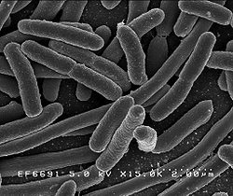
etiology
Most common microbe isolated regardless of underlying cause of septic peritonitis consistently Escherichia coli
  Often polymicrobial
Septic biliary peritonitis
    Bile from normal dogs is sterile
    Possible sources of bacteria include penetrating wounds, ascending bacteria from the gastrointestinal tract, or translocation of bacteria secondary to peritonitis
http://upload.wikimedia.org/wikipedia/commons/thumb/3/32/EscherichiaColi_NIAID.jpg/
250px-EscherichiaColi_NIAID.jpg

Slide 13
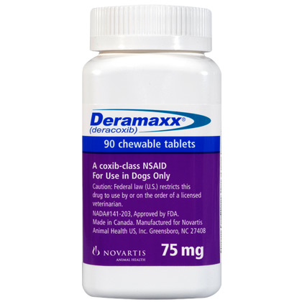
HISTORY
Preexisting medical conditions
Previous surgeries
Current medications
Duration of clinical signs
http://www.1800petmeds.com/images/products/420/10988_420.jpg

Slide 14
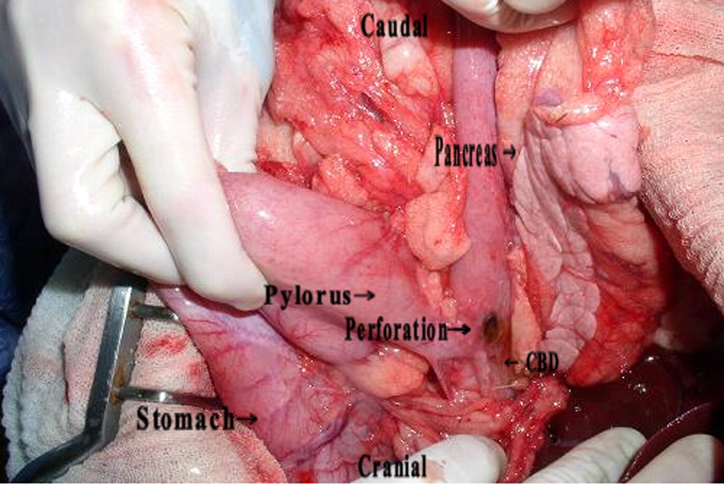
Non-steroidal anti-inflammatories
Lascelles BDX, et al. Gastrointestinal tract perforation in dogs treated with a selective cyclooxygenase-2 inhibitor: 29 cases (2002-2003). JAVMA 2005.
  Retrospective study
  55% of cases received dosage higher than that approved by the FDA
  59% of cases had received another NSAID or corticosteroid within 24 hours
  90% of dogs with gastrointestinal tract perforation fulfilled at least one of the above two criteria
  20/29 died
Case JB, Fick JL, Rooney MB. Proximal duodenal perforation in three dogs following deracoxib administration. JAAHA 2010.
  2/3 survived
  2/3 dogs had received labeled dose
http://www.jaaha.org.proxy.library.cornell.edu/content/46/4/255.full
Notes:
Have the potential to result in gastrointestinal ulcers/perforations secondary to PGE2 or PGI2 inhibition, thus, diminishing mucosal blood flow

Slide 15
Clinical signs
Vary in type and intensity and may reflect the underlying disease process
Peritoneal effusion
Abdominal pain
  Only 43% (Parsons et al) and 62% (Costello et al) of cats were found to exhibit abdominal pain in two recent studies
Anorexia
Vomiting
  Only 48% of cats had a history of vomiting in a recent study (Parsons et al)
Lethargy, mental depression
Costello et al: Underlying cause, pathophysiologic abnormalities, and response to treatment in cats with septic peritonitis: 51 cases
(1990-2001). JAVMA 2004 (225).
Parsons et al: A retrospective study of surgically treated cases of septic peritonitis in the cat (2000-2007). Journal of Small Animal Practice
2009 (59).
Notes:
Peritoneal effusion may be difficult to appreciate on physical exam if small volume of fluid is present
Additionally, may be difficult to detect ultrasonographically if animal is dehydrated
Animals with uroperitoneum may continue to urinate with a concurrent leakage into the peritoneal cavity

Slide 16

PHYSICAL EXAM
Peritoneal effusion
Possible abdominal pain
Signs consistent with systemic inflammatory response syndrome (SIRS)
    A significant number of cats (16%) with septic peritonitis exhibit bradycardia (Costello et al); consistent with findings of previous study of cats with severe sepsis (66%) (Brady et al)
Signs consistent with progressive states of shock
Proposed criteria for the diagnosis of SIRS in Dogs and Cats
Dogs: 2/4 changes Cats: 3/4 changes
required required
Temperature <100.6 or >102.6 <100 or >104
Heart rate >120 <140 or >225
Respiratory rate >20 >40
WBC; % bands <6 or >16; >3% >19 or <5
Costello et al. Underlying cause, pathophysiologic abnormalities, and response to treatment in cats with septic peritonitis: 51 cases
(1990-2001). JAVMA 2004: 225 (6).
Brady et al. Severe sepsis in cats: 29 cases (1986-1998). JAVMA 2000: 217.
Notes:
Mechanism of inappropriate bradycardia is unclear, but it has been postulated to be secondary to increased vagal tone or cytokine-associated myocardial depression

Slide 17
DIAGNOSIS
Complete blood cell count
  Marked neutrophilia with a left shift and toxic change
  Anemia (cats)
    TNF-alpha and IL-1 inhibit erythroid precursor cells, reduce the formation of erythropoietin and blunt the response of the bone marrow to erythropoietin
    Decreased RBC lifespan with cats particularly susceptible to oxidative damage
    Other mechanisms: frequent blood sampling, nutritional deficiencies, gastrointestinal tract blood loss, mechanical and antibody-mediated hemolysis, renal and hepatic insufficiency and bone marrow infiltrative disorders (humans)
Krafte-Jacobs B. Anemia of critical illness and erythropoietin deficiency. Intensive Care Med. 1997: 23.
Hobisch-Hagen P, Wiedermann F, Mayr A, et al. Blunted erythropoietic response to anemia in multiply traumatized patients. Critical Care Med. 2001: 29.
Corwin HL, Krantz SB. Anemia of the critically ill: “acute” anemia of chronic disease. Crit Care Med 2000 (28).
Weiss DJ, Krehbiel JD. Studies of the pathogenesis of anemia of inflammation: erythrocyte survival. Am J Vet Res 1983 (44).
Weiss DJ, Mcclay CB. Studies on the pathogenesis of the erythrocyte destruction associated with the anemia of inflammatory disease. Vet Clin Pathol. 1988 (17)
Notes:
Costello et al study for cats: Median WBC count=14600 cells/ul (range 1500-64000; ref range=5500-19500 cells/uL). Band neutrophilia was identified in 23/36 (64%) cats; median band neutrophil count was 240 cells/uL (range=0-18,000 cells/uL). Toxic WBC changes were reported for 13 (36%) cats and were designated as mild in 3 cats, moderate in 5 and marked in 5.
Anemia was found in 16 of 46 (35%) cats; median PCV was 32% (range, 9% to 63%; reference range, 27% to 45%); anemia has previously been reported to be a common clinicopathologic abnormality in cats with severe sepsis or septic peritonitis (Mueller et al: Use of closed-suction drains to treat generalized peritonitis in dogs and cats: 40 cases (1997-1999). JAVMA 2001: 219- all cats and 50% dogs post-op; and Brady et al: Severe sepsis in cats: 29 cases (1986-1998). JAVMA 2000: 217- 45% of cats. The pathogenesis of anemia associated with sepsis and critical illness in cats is likely complex. Factors that have been proposed to play a role in humans include frequent blood sampling, nutritional deficiencies, gastrointestinal tract blood loss, mechanical and antibody-mediated hemolysis, renal and hepatic insufficiency and bone marrow infiltrative disorders. In addition, inflammatory mediators such as TNF-alpha and IL-1 inhibit erythroid precursor cells, reduce the formation of erythropoietin and blunt the response of the bone marrow to erythropoietin. Decreased RBC lifespan also likely plays a role in the pathogenesis of anemia of inflammation, and RBCs in cats are particularly susceptible to oxidative damage because the feline hemoglobin molecule contains 8 reactive sulfhydryl groups.

Slide 18
diagnosis
Chemistry and blood gas analysis
  Acid-base disturbances
    Metabolic acidosis with hyperlactatemia
  Hypoproteinemia
  Hypoglycemia/hyperglycemia
  Hyperbilirubinemia
  Elevated liver values (associated with increased mortality in dogs with septic peritonitis, Winkler and Greenfield, JVECC 2000)
  Azotemia
  Electrolyte abnormalities
    Hypocalcemia
    Hyperkalemia (if uroabdomen)
    Disturbances of sodium/chloride
Notes:
Costello et al paper: median pH= 7.33 (range, 7.08-7.51; reference range, 7.36 to 7.47), acidemia (pH<7.36) was identified in 21/34 cats, alkalemia (pH>7.47) in 2. Serum lactate concentration was measured in 33/51 cats. Median lactate concentration was 2.9mmol/L (range, 0.5 to 11.3 mmol/L; reference range, 0.6 to 2.5mmol/L). Hyperlactatemia was identified in 21 of 33 (64%) cats.
Costello et al paper: Serum albumin concentration was measured in 37 of the 51 cats. Mean +/- SD serum albumin concentration was 2.14 +/- 0.67 g/dL (reference range, 2.7 to 3.9 g/dL). 81% of cats had hypoalbuminemia. Hypoalbuminemia is common in animals with septic peritonitis and has been reported as a complication of open peritoneal drainage in dogs and cats. It is also common in cats with severe sepsis. Hypoalbuminemia may be caused by increased losses, malnutrition, hepatic dysfunction, increased capillary permeability and shifting of hepatic synthetic pathways away from albumin production and towards production of acute phase proteins.
Median blood glucose concentration (n=46 cats) was 125 (range, 25 to 494 mg/dL; reference range, 75 to 199mg/dL). Hypoglycemia was identified in 10 cats, and hyperglycemia was identified in 6. Hypoglycemia secondary to increased peripheral glucose use, impaired gluconeogenesis, depleted glycogen stores
Serum ionized calcium concentration was measured in 34 cats and was low in 20 (59%). Mean +/- SD serum ionized calcium conentration was 1.09 +/- 0.11 mmol/L (reference range, 1.13 to 1.33mmol/L). Hypocalcemia secondary to parathyroid gland suppresion, inadequate vitamin D concentrations and parathyroid hormone/vitamin D resistance
Median total bilirbuin concentration (n=36) was 0.5mg/dL (range, 0.1 to 9.9mg/dL; reference range. 0.1-0.5 mg/dL). Hyperbilirubinemia was identified in 44% cats. Serum ALT was high in 28% cats (median ALT=65, 13-912 U/L; reference range, 20-107 U/L). Median ALP (n=36) was 29.5 U/L (range, 10-246 U/L, reference range, 23-107 U/L). GGT measured in 27 cats and was high in 17. Median GGT was 11 (range, 5-26 U/L; reference range=1-5U/L). Hepatic dysfunction can be a serious sequela of sepsis and septic peritonitis. Hepatosplanchnic perfusion is impaired in septic shock, which leads to decreased oxygen and nutrient delivery to the liver. High serum ALT and GGT activities have been associated with high mortality rates in dogs with septic peritonitis (Winkler and Greenfield, JVECC 2000) and in the present study, median serum ALT activity was significantly higher in cats that died despite treatment than in cats that survived. The difference in median ALT activities between groups was not clinically significant.

Slide 19

diagnosis
Urinalysis
  May provide insight into underlying etiology
Urine culture and sensitivity
Coagulation assessment
  If severe sepsis with coagulation derangements, may see prolongation of clotting times, thrombocytopenia, decreased fibrinogen, elevation in fibrin degradation products and D-dimers, and/or decreased antithrombin levels
http://www.shoutfactory.com/productlines/DIC.gif

Slide 20
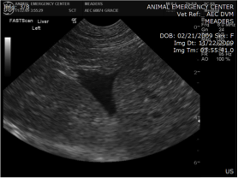
Diagnosis
Imaging
  Radiography
    Focal or generalized loss of detail (ground glass appearance)
    Pneumoperitoneum
    Gastrointestinal foreign body or obstruction, GDV
    Abdominal mass effect
    Prostatomegaly or pyometra
  Ultrasonography
    Localizing peritoneal effusion
    Defining underlying etiology of peritonitis
  Contrast radiography
    Excretory urography or cystourethrography for confirmed uroabdomen
http://www.aecreno.com/ultrasound/anaphylaxis/images/
anaphylaxis003.jpg
Notes:
Pneumoperitoneum secondary to perforation of a hollow viscous organ, penetrating trauma (including recent abdominal surgery), or the presence of gas-producing anaerobic bacteria

Slide 21
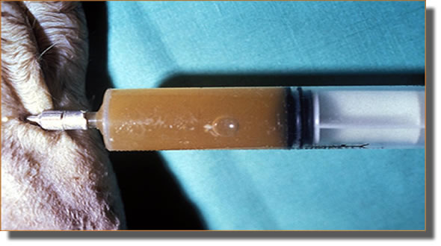
DIAGNOSIS
Fluid analysis
  Single paracentesis attempts are successful in only 20% of patients with low volumes of peritoneal effusion (3mL/kg) and in 80% of patients with larger volumes (10mL/kg)
  Ultrasound-guidance increases yield
  Four-quadrant sampling
  Diagnostic peritoneal lavage
http://www.aamefe.org/peritonitis_infecciosa_felina_ford_archivos/fig2a.jpg
Notes:
Diagnostic peritoneal peritoneal lavage should only be performed when peritonitis is suspected despite the absence of detectable effusion or when a minimal volume of effusion makes it difficult to obtain a sample. Diagnostic peritoneal lavage is ideally performed using a peritoneal dialysis catheter but can also be performed using an over-the-needle, large bore (14 to 16 gauge) catheter. The technique is performed by infusion of 22ml/kg of a warmed, sterile isotonic saline solution through the catheter inserted in an aseptically prepared site just caudal to the umbilicus and retrieval of a sample for analysis and culture and sensitivity. It is important to remember that the lavage solution will dilute the sample and therefore may alter the analysis. A repeat lavage may increase the accuracy of the technique when results of the first procedure are equivocal.

Slide 22
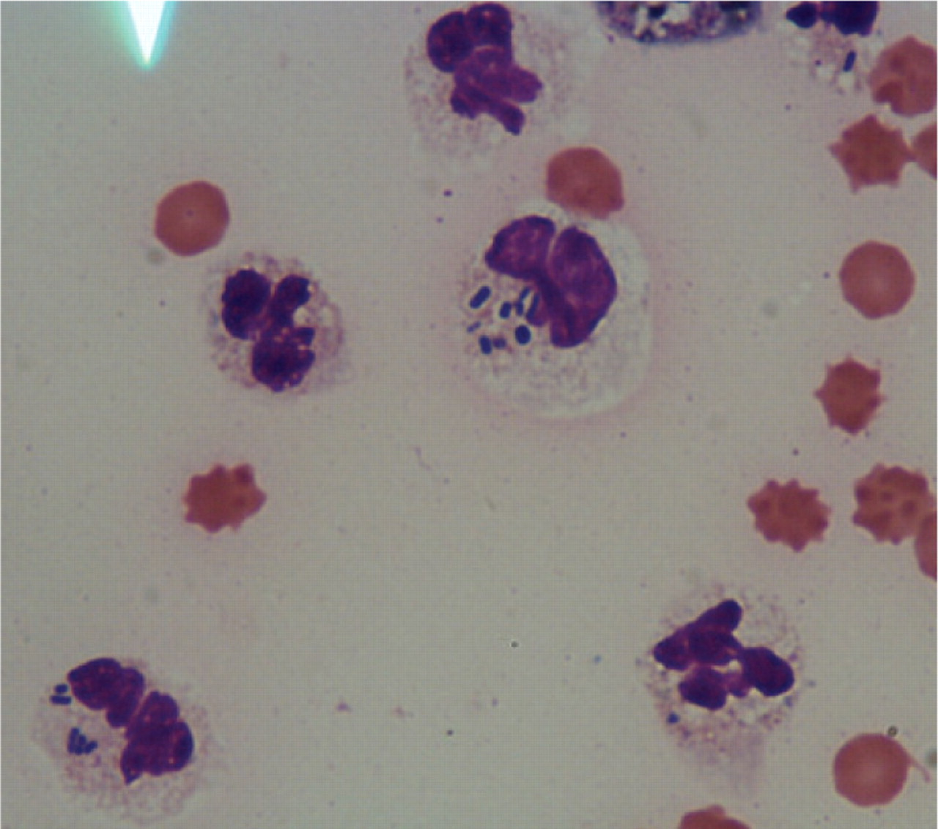
DIAGNOSIS
Fluid analysis
  Leukocyte counts in peritoneal fluid
    Normal <500 cell/uL
    Mild to moderate inflammation= 1000-2000 cells/uL
    Marked inflammation >2000 cells/uL
    Postoperative celiotomy patients can normally have marked inflammation; >9000 cells/uL marked inflammation if post-surgical
    Reduced peritoneal nucleated cell counts expected with antibiotic therapy
    Bonczynski et al found peritoneal fluid nucleated cell count to be one of the most reliable diagnostic variables for septic effusion in dogs and cats
      A peritoneal fluid nucleated cell count cutoff value of 13,000 cells/uL was 86% sensitive and 100% specific in dogs and 100% sensitive and 100% specific in cats for septic effusion
  Degeneration of neutrophils
  Intracellular bacteria
Peritoneal fluid cytology has been reported to be 57%-100% accurate in the diagnosis of septic peritonitis
http://veterinaryrecord.bmj.com/content/165/15/436/F1.large.jpg
Mueller MG, Ludwig LL, Barton LJ: Use of closed suction drains to treat generalized peritonitis in dogs and cats: 40 cases (1997-1999).
J Am Vet Med Assoc 2001 (219).
Lanz OI, Ellison GW, Bellah JR, et al: Surgical treatment of septic peritonitis without abdominal drainage in 28 dogs.
J Am Anim Hosp Assoc 2001 (37).
Hardie EM, Rawlings CA, Calvert CA: Severe sepsis in seleceted small animal surgical patients. J Am Anim Hosp Assoc 1986 (22).
Bonczynski JJ, Ludwig LL, Barton LJ, et al: Comparison of peritoneal fluid and peripheral blood pH, bicarbonate, glucose and lactate
concentration as a diagnostic tool for septic peritonitis in dogs and cats. Veterinary Surgery 2003 (32).

Slide 23
DIAGNOSIS
Fluid analysis
  Lactate and glucose concentrations
    Glucose concentration difference of >20 mg/dL between paired blood and peritoneal fluid glucose 100% sensitive and 100% specific for dogs; 86% sensitive and 100% specific in cats
    Blood-to-fluid lactate difference <-2 mmol.L predictive of septic peritonitis in dogs (63% sensitive,100% specific, 84% accurate)
      Levin et al found all dogs with septic effusions had a peritoneal fluid lactate >2.5 mmol/L (91% sensitive, 100% specific)
    Blood-to-fluid lactate difference statistically significant in Levin et al study but not accurate for detecting septic peritoneal effusion in cats
Bonczynski JJ, Ludwig LL, Barton LJ, et al: Comparison of peritoneal fluid and peripheral blood pH, bicarbonate, glucose and lactate concentration as a diagnostic
tool for septic peritonitis in dogs and cats. Veterinary Surgery 2003 (32).
Swann H, Hughes D: Use of abdominal fluid pH, pO2, (glucose), and (lactate) to differentiate bacterial peritonitis from non-bacterial causes of abdominal effusion
in dogs and cats. Proceedings, International Veterinary Emergency and Critical Care Society, San Antonio, TX: 1996.
Van Hoogmoed L, Rodger LD, Spier SJ, et al: Evaluation of peritoneal pH, glucose concentration, and lactate dehydrogenase activity for detection of septic
peritonitis in horses. J Am Vet Med Assoc 1999 (214).
Levin GM, Bonczynski JJ, Ludwig LL, et al: Lactate as a diagnostic test for septic peritoneal effusions in dogs and cats.J Am Anim Hosp Assoc 2004 (40).
Notes:
Swann study: 14 dogs and 2 cats, a peritoneal fluid pH<7.2, pCO2>55mm hg, glucose concentration <50mg/dL, and lactate concentration > 5.5 mmol/L were specific for a septic peritoneal effusion. It was reported also that the difference between blood glucose and peritoneal fluid glucose concentrations was more sensitive and specific than peritoneal fluid glucose concentration alone for the diagnosis of septic peritonitis (Van Hoogmoed et al, JAVMA, 1999).
Bonczynski study limited by small sample size for lactate; 100% sensitivity and 100% specificity for blood-to-fluid lactate difference <-2 mmol/L
Levin study- if cutoff blood-to-fluid lactate value <-1.5 mmol/L used, 88% sensitivity, 91% specificity, 90% accuracy
Lower pH in septic effusion is likely because of the production of lactate from neutrophilic glycolysis and bacterial metabolites in the peritoneal fluid
It is hypothesized that the glucose concentrations decrease in the abdominal fluid as bacterial invasion increases. This may be because of glucose use by bacteria and phagocytic cells, glycolysis in the peritoneal fluid, or low blood to fluid glucose transport.

Slide 24
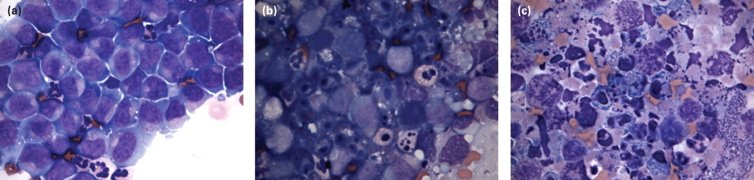
diagnosis
  Nestor et al. evaluated peritoneal fluid lactate and glucose concentration in dogs with neoplastic and nonneoplastic peritoneal effusions and found that dogs with neoplasia had significantly lower glucose concentrations and higher lactate levels in their abdominal fluid than did dogs without neoplasia
http://veterinaryrecord.bmj.com/content/167/14/519/F1.large.jpg
Nestor DD, McCollough SM, Schaeffer DJ: Biochemical analysis of neoplastic versus nonneoplastic abdominal effsuions in dogs.
J Am Anim Hosp Assoc 2004 (40).
Notes:
The preferential use of glucose by neoplastic cells and increased metabolism by those cells may have accounted for the decreased glucose seen in the neoplastic effusions.14 One study in humans also documented lower glucose levels in neoplastic effusions.
Neoplastic cells have been shown to use anaerobic glycolysis for energy, thereby producing increased levels of lactate. This increased production of lactate may explain the higher levels of lactate observed in the neoplastic effusions

Slide 25
DIAGNOSIS
Fluid analysis
  No significant difference in peritoneal fluid protein concentration between septic or nonseptic effusion in either dogs or cats
  Measurements of pH have been reported to be a reliable index for septic effusion in dogs, horses and humans
    Bonczynski et al found that peritoneal fluid pH was significantly lower in septic effusions than non-septic effusions in cats but not in dogs
  In humans, the blood-to-fluid pH difference has been reported to be more accurate as a diagnostic tool than absolute pH
    Bonczynski et al did not detect any significant difference in blood-to-fluid pH difference between septic and non-septic effusions in either dogs or cats
Bonczynski JJ, Ludwig LL, Barton LJ, et al: Comparison of peritoneal fluid and peripheral blood pH, bicarbonate, glucose and lactate concentration as a
diagnostic tool for septic peritonitis in dogs and cats. Veterinary Surgery 2003 (32).
Swann H, Hughes D: Use of abdominal fluid pH, pO2, (glucose), and (lactate) to differentiate bacterial peritonitis from non-bacterial causes of abdominal
effusion in dogs and cats. Proceedings, International Veterinary Emergency and Critical Care Society, San Antonio, TX: 1996.
Van Hoogmoed L, Rodger LD, Spier SJ, et al: Evaluation of peritoneal pH, glucose concentration, and lactate dehydrogenase activity for detection of septic
peritonitis in horses. J Am Vet Med Assoc 1999 (214).
Garcia-Tsao G, Conn HO, Lerner E: The diagnosis of bacterial peritonitis: comparison of pH, lactate concentration and leukocyte count.Hepatology 1985 (5).

Slide 26
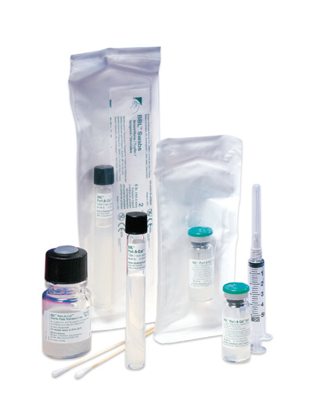
DIAGNOSIS
Gold standard of diagnosis: culture
  Aerobic and anaerobic cultures should be obtained at the time of preliminary diagnosis prior to antibiotic therapy initiation
http://www.nwhospital.org/lab/images/lab_test_images/Lab_JPEG_large/Port_a_Cul_Family.jpg

Slide 27
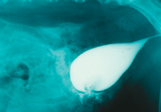
DIAGNOSIS
Uroperitoneum
  Diagnosed if peritoneal fluid creatinine exceeds that of the serum creatinine >2:1
  or
  Diagnosed if peritoneal fluid potassium exceeds that of the serum potassium >1.4:1
Septic uroperitoneum if culture positive or intracellular bacteria noted on cytology
http://veterinarynews.dvm360.com/dvm/data/articlestandard//dvm/412004/126791/i2.jpg

Slide 28
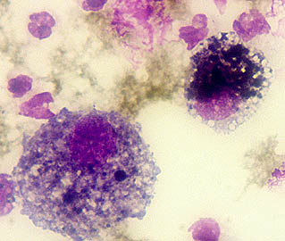
diagnosis
Bile peritonitis
  Diagnosed if biliary concentration is ≥2x higher in the peritoneal fluid than in the serum (100% effective in diagnosing)
  or
  Diagnosed if bile pigment or crystals are visible on cytologic examination of the peritoneal effusion
Septic bile peritonitis if culture positive or intracellular bacteria noted on cytology
http://www.vet.uga.edu/VPP/CLERK/guisto/fig02.jpg

Slide 29
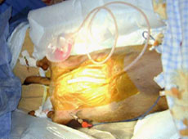
treatment
The goals of treatment are to identify and address the source of contamination in order to resolve the infection and treat the systemic consequences of such infection
Medical stabilization
Surgical treatment
Post-operative care
http://www.vmsg.com/files/images/cr_septic_peritonitis_2.jpg

Slide 30
Medical stabilization
The goals of medical treatment are to restore normal fluid and electrolyte balance and minimize ongoing contamination
  Fluid resuscitation
    Crystalloids, colloids
    Due to significant amounts of protein lost into the peritoneal cavity, albumin administration may be warranted
  Electrolytes and dextrose should be supplemented if indicated
  Vasopressor therapy
  Blood products
  Urinary catheter if uroabdomen
  Broad-spectrum antibiotic therapy

Slide 31
MEDICAl stabilization
Broad-spectrum antibiotic therapy
  Should be initiated immediately after confirming the diagnosis of septic peritonitis
  Escherichia coli, Clostridium spp, and Enterococcus spp are common isolates
  Empiric broad-spectrum antibiotic therapy
    Second-generation cephalosporin monotherapy- cefoxitin 30mg/kg IV Q6-8hrs
    Combination antibiotic therapy
      Ampicillin or cefazolin 22mg/kg IV Q8hrs + enrofloxacin 10-20mg/kg IV Q24hrs [dog], 5mg/kg IV Q24hs [cat] or aminoglycoside (amikacin 15mg/kg IV Q24hrs or gentamicin 6.6mg/kg IV Q24hrs)
      Metronidazole 10mg/kg IV Q12hrs if extended anaerobic coverage required
  Antibiotic therapy should be tailored when culture and sensitivity results are available
Notes:
*Mortality rates in a variety of studies have shown a relationship between appropriate antibiotic choice prior to results of culture & sensitivity.
The mortality rate was higher (45% vs 29%) for patients in the Mueller study in which antimicrobials selected for empirical treatment were inappropriate (ie, bacteria that were eventually isolated were found to be resistant to antimicrobials chosen empirically) than for patients in which antimicrobials selected for empirical treatment were appropriate, but this differ- ence was not significant.
Animals with polymicrobial infections had a higher mortality rate (54%) than did animals from which a single organism was isolated (24%), but again this difference was not significant. A higher mortality rate could be expected with polymicrobial infections, because some bacteria, especially endotoxin-generat- ing facultative anaerobes and obligate anaerobes, can act in a synergistic fashion.
Ludwig study- biliary microbes- most commonly sensitive to enrofloxacin, amikacin, tribrissen or chloramphenicol; only 30% sensitive to cephalosporin first generation; recommended also to use metronidazole to expand anaerobic coverage

Slide 32

Surgical treatment
The goals of surgical treatment for septic peritonitis include resolving the cause of the infection and diminishing the infectious and foreign material load
Exploratory laparotomy
Surgical treatment is tailored to the individual case and the underlying cause of the septic peritonitis
https://dims.vetstreet.com/dims3/MMAH/resize/354x266/http://assets.prod.vetlearn.
com/aa/e8b7f069ff11e0a54c0050568d17ce/file/October%20main%20page.jpg

Slide 33
Surgical treatment
Common themes in reducing the underlying cAUSE OF SEPTIC PERITONITIS
Monofilament suture material should be used
Placement of non-absorbable suture material or mesh within the abdominal cavity should be avoided
The organ that is the source of the septic peritonitis should be isolated from the rest of the abdomen with laparotomy sponges to prevent further contamination during surgical correction
Serosal patching or omental wrapping should be performed on repaired gastrointestinal sources of septic peritonitis
The omentum should be preserved as much as possible
Feeding tube placement should be considered during initial surgical exploration
Notes:
Surgical applications of the omentum relate to its immunogenic, angiogenic and adhesive properties and include intracapsular prostatic omentalization for prostatic abscess formation, pancreatic abscess omentalization, omentalization of enterotomy or intestinal resection and anastomosis sites and around gastrostomy or enterostomy tube sites.
Because enteral nutrition directly nourishes enterocytes and decreases bacterial translocation across the intestinal wall, feeding tube placement (gastrostomy or jejunostomy) should be considered during initial surgical exploration

Slide 34
Surgical treatment
COMMON THEMES IN DIMINISHING THE INFECTIOUS AND FOREIGN MATERIAL LOAD
Combination of debridement and lavage
Localized peritonitis should be treated with lavage of the affected area only
A thorough lavage of the entire abdominal cavity with body-temperature sterile isotonic fluid is essential if peritonitis is generalized
Addition of antiseptics and antibiotics to lavage fluid is not recommended
Notes:
Antiseptics and antibiotics can induce a chemical peritonitis
All lavage fluid should be retrieved because fluid accumulation in the abdominal cavity impairs bacterial opsonization and clearance

Slide 35
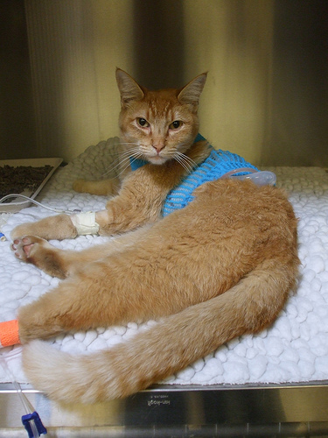
Surgical treatment
Closure
Primary closure
Open peritoneal drainage
Closed suction drains
http://farm4.static.flickr.com/3279/2637803581_6d1054b443.jpg

Slide 36
Primary closure
Primary closure is recommended if debridement and lavage can resolve the infectious and foreign material load and the source of contamination can be controlled
The peritoneal cavity is capable of absorbing fluid at a rate of 3% to 8% of the animal’s body weight per hour

Slide 37
Primary closure
Surgical Treatment of Septic Peritonitis Without
Abdominal Drainage in 28 Dogs
Lanz OI et al, JAAHA 2001
Retrospective study evaluating 28 dogs with septic peritonitis caused by variable underlying etiologies
Primary closure had been pursued in these cases because the etiology had been identified and definitively corrected, lavage had been effective with residual contamination minimal and the virulence of the bacteria had been thought to be low
The most common cause of peritonitis in this study was gastrointestinal leakage 21/28 (75%) cases
Overall mortality rate was 46%

Slide 38
Drainage techniques
Open abdominal drainage and closed suction drains are recommended if debridement and lavage cannot resolve the infectious and foreign material load or if the source of contamination cannot be controlled
Patients with any form of abdominal drainage are susceptible to superinfection with nosocomial bacteria and are subject to massive fluid and protein losses

Slide 39
OPEN peritoneal drainage
Simple continuous pattern of nonabsorbable suture in the rectus abdominus muscle, loosely enough to allow drainage through a gap of 1 to 6 cm in the body wall
A preassembled, sterile bandage comprised of a nonadherent contact layer, laparotomy sponges or gauze pads, roll cotton or surgical towels, roll gauze, and an outer water-impermeable layer is placed to absorb fluid and protect the abdominal contents from the environment
Initially the bandage is replaced twice during the first 24 hours and daily thereafter (frequency based on drainage of individual)
Alternatively, patients with severely contaminated tissues may be placed under general anesthesia and the abdomen explored and lavaged daily before reapplying the bandage
Abdominal closure can typically be performed 3-5 days following the initial surgery
Indwelling urinary catheter may aid in reducing contamination
Notes:
Open peritoneal drainage used as a surgical treatment for generalized suppurative peritonitis first described in human medical literature in 1979.

Slide 40
Disadvantages of Open peritoneal drainage
Loss of large amounts of fluid and plasma proteins from the peritoneal cavity
Inability to achieve complete peritoneal drainage due to patient positioning
Evisceration of abdominal organs
Spontaneous formation of intestinal fistulae
Nosocomial infections
Intensive nursing care
Adhesion of viscera to bandage material
Continued peritonitis and sepsis

Slide 41
Open peritoneal drainage
Open peritoneal drainage in experimental peritonitis in dogs
Oscher RJ and Rosin E, Vet Surg 2001
Open abdominal drainage was shown experimentally to be the most efficient method of providing abdominal drainage
    Prospective study in 12 experimental dogs found 100% survival rate in group managed with open peritoneal drainage and a 33% mortality rate in those managed with a closed abdomen
      The source of contamination was not removed or corrected prior to closed/open abdominal management

Slide 42
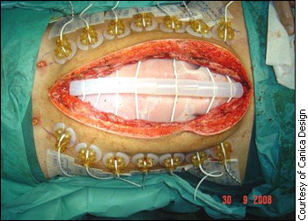
Open Peritoneal drainage
Open Abdominal Drainage in the Treatment of Generalized
Peritonitis in 25 Dogs and Cats
Woolfson JM and Dulisch ML, Vet Surg 1986
Retrospective study evaluating 20 dogs and 5 cats with septic peritonitis caused by variable underlying etiologies
  Overall mortality rate was 48%
http://trialx.com/curetalk/wp-content/blogs.dir/7/files/2011/05/diseases/Open_Abdomen-3.jpg
Notes:
Out of Angell/Tufts

Slide 43
Open peritoneal drainage
Open Peritoneal Drainage for Treatment of Contaminated
Peritoneal Cavity and Septic Peritonitis in Dogs and Cats: 24 Cases
(1980-1986)
Greenfield CL and Walshaw R, JAVMA 1987
Retrospective study evaluating 22 dogs and 2 cats with septic peritonitis caused by variable underlying etiologies
  Most common underlying etiology gastrointestinal leakage
  Overall mortality 33%
    7/8 deaths occurred prior to or at time of definitive abdominal closure and 3/8 deaths attributable to disease other than peritonitis
  Hypoproteinemia and dehydration during the open peritoneal drainage period were not seen as clinical problems in the majority (23/24;96%) of the animals in this study
  Different bacteria were isolated from specimens obtains at closure in 4/24 cases
Notes:
Out of MSU

Slide 44
Open peritoneal drainage
Potential Prognostic Indicators in Diffuse Peritonitis Treated with
Open Peritoneal Drainage in the Canine Patient
Winkler KP and Greenfield CL, JVECC 2000
Retrospective study evaluating 19 dogs with septic peritonitis managed with open peritoneal drainage between August 1990 and March 1996
Overall mortality rate of 21%

Slide 45
Open peritoneal drainage vs. primary closure
Open Peritoneal Drainage Versus Primary Closure for the
Treatment of Septic Peritonitis in Dogs and Cats:
42 Cases (1993-1999)
Staatz AJ, Monnet E, Seim HB III, Vet Surg 2002
Retrospective study evaluating 36 dogs and 6 cats; 7/36 dogs and 2/6 cats treated with open peritoneal drainage
No significant difference in survival between animals in the open peritoneal drainage group versus the primary closure group
Overall mortality rate 29%
A significantly greater number of animals in the open peritoneal drainage group received plasma, blood and a jejunostomy tube than animals in the primary closure group
A significantly greater number of days were spent in the ICU in the open peritoneal drainage group than the primary closure group
Notes:
Out of CSU
Abd lavage performed Q24hrs on animals with OPD

Slide 46
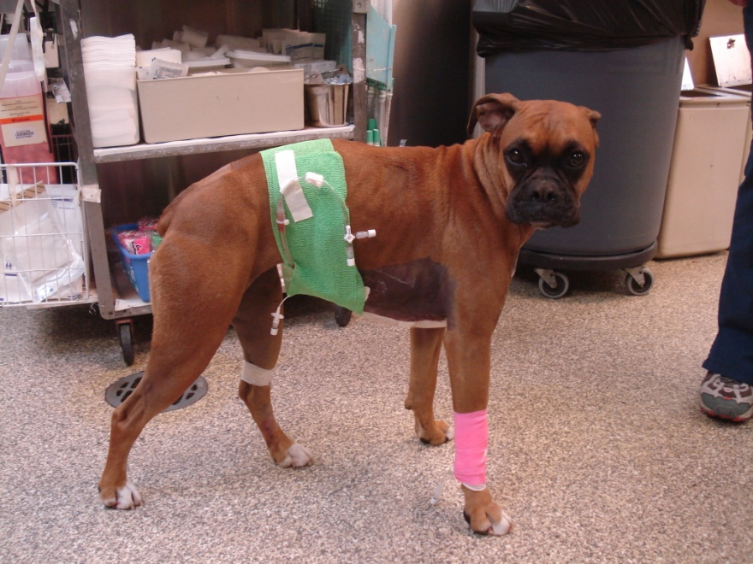
Closed suction drains
Uses an external suction device to create negative pressure within the peritoneal cavity
  Jackson-Pratt drain
Several advantages over open peritoneal drainage
  Decreased risk of nosocomial infection
  Less intensive nursing care and bandaging requirements
  Decreased risk for evisceration
  Need for only one surgical procedure
Disadvantages of closed suction drains
  Drains may induce fluid production
  Drains may become occluded
    Mueller et al retrospective study in 40 dogs and cats with septic peritonitis revealed that drains remained patent despite remaining in place for as long as 8 days
http://sites.tufts.edu/progressnotes/files/2011/07/slide0003_image010.jpg
Mueller MG, Ludwig LL and Barton LJ: Use of closed-suction drains to treat generalized peritonitis in dogs and cats 40 cases
(1997-1999). J Am Vet Med Assoc 2001 (219).

Slide 47
Closed suction drains
Drain placement will vary based on origin of sepsis, but often placed between liver and diaphragm
One drain usually sufficient for small dogs and cats; 2+ drains for larger dogs
Drain tubes exit body wall through a paramedian stab incision and are sutured to the abdominal skin with a pursestring and Chinese finger-trap sutures
After routine closure of the abdomen, the suction reservoir bulb is attached with vacuum applied
Protective abdominal bandage place steriley with daily bandage changes
Fluid collected aseptically and quantified every 4-6 hours, or more frequently if needed
When drain production decreased significantly and cytologic analysis suggests resolution of peritonitis, drains can be pulled
Sterile bandage reapplied to cover drain exit site for 24 hours

Slide 48
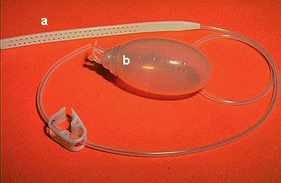
Closed suction drains
Use of Closed-Suction Drains to Treat Generalized Peritonitis in
Dogs and Cats: 40 Cases (1997-1999)
Mueller MG, Ludwig LL, Barton LJ, JAVMA 2001
Retrospective study of 30 dogs and 10 cats with septic peritonitis caused by a variety of underlying etiologies (gastrointestinal tract most common source of contamination) managed with flat closed-suction drains
Overall mortality rate 30%
Most deaths occurred within 18 hours after surgery
Anemia and hypoproteinemia were common postop complications
http://www.vetmed.wsu.edu/resources/Techniques/images/drain_ball.jpg
Notes:
Out of AMC

Slide 49
Drain production
Evaluation of Postceliotomy Peritoneal Drain Fluid Volume,
Cytology, and Blood-to-Peritoneal Fluid Lactate and Glucose
Differences in Normal Dogs
Szabo SD, Jermyn K, Neel J, Mathews KG, Vet Surg 2011
Prospective study evaluating 10 healthy Beagle dogs
After exploratory celiotomy, a closed-suction peritoneal drain was placed, and peritoneal fluid was recorded every 6 hours for 7 days, cytology performed, and paired fluid-blood glucose and lactate concentrations recorded every 12 hours
  Mean peritoneal fluid volume decreased from 2.8ml/kg/day (day 1) to 0.6ml/kg/day (day 7)
  All dogs had degenerate neutrophils in fluid throughout the 7 days
  After day 4, blood-to peritoneal glucose concentration differences >20mg/dL occurred in all dogs and >70% of dogs had blood-to-peritoneal lactate <-2mmol/L
  4/10 dogs developed contaminated drains

Slide 50
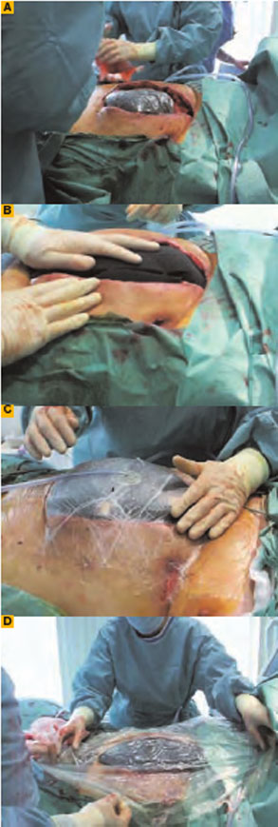
Vacuum-Assisted closure
Human medicine
Open abdomen technique for septic abdomens
Open abdomen technique used routinely for trauma patients to reduce surgical time and limit abdominal compartment syndrome
VAC limits adhesions and fascial retraction
Risk of intestinal fistula formation
http://www.the-hospitalist.org/SpringboardWebApp/userfiles/hosp/image/2007_05_pp40_01_A.jpg
Notes:
VAC uses medical-grade, open cell polyurethane ether foam.2,4 The pore size is generally 400-600 micrometers. This foam is cut to fit the wound bed before it is applied to the wound. If necessary, multiple pieces of foam can be used to connect separate wounds or to fill up any remaining gaps. Adhesive tape is then applied over an additional three to five cm border of intact skin to provide a seal.4 Then a track pad is placed over a small hole in the adhesive tape. A tube connects the track pad to an adjustable vacuum pump and a canister for collecting effluent fluids. The pump can be adjusted for both the timing (intermittent vs. continuous) and the magnitude of the vacuum effect.4 In general, an intermittent cycle (five minutes on, two minutes off) is used; this has been shown to be most beneficial.2 The VAC system is easy to apply, even on difficult wounds like the open abdomen. (See Figure 2, left.)
With the VAC technique, the open wound is converted into a controlled and temporarily closed environment. Animal studies have shown that VAC optimizes blood flow, decreases local edema, reduces bacteria levels, and removes excess fluids from the wound.2,8 (See Figure 3, above.) The cyclical application of sub-atmospheric pressure alters the cytoskeleton of the cells in the wound bed, triggering a cascade of intracellular signals that increases the rate of cell division and, thus, the formation of granulation tissue.9 This results in faster healing of the wounds than would have occurred with regular therapy; further, it significantly reduces hospitalization time and expenses.

Slide 51
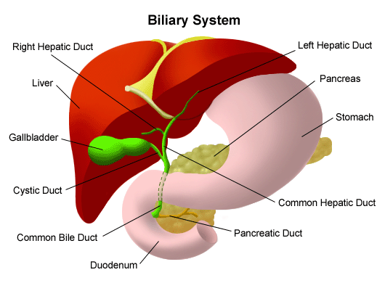
Extrahepatic biliary surgery
Primary repair
Biliary diversion (cholecystoduodenostomy)
Cholecystectomy
Open peritoneal drainage not recommended as it was only successful in 2/9 cases of septic biliary effusions in Ludwig et al study (Vet Surg 1997)
http://drugster.info/img/term/cancer-bile-duct-2430_1.gif
Notes:
Cholecystectomy preferred method of treatment in the human literature
Most reported cases of gallbladder rupture in the veterinary literature are a result of gallbladder disease, and cholecystectomy has also been the recommended treatment.

Slide 52
Bottom line
NO STATISTICAL DIFFERENCE BETWEEN
OPEN VS. CLOSED VS. CLOSED-SUCTION DRAIN MANAGEMENT OF SEPTIC PERITONITIS

Slide 53
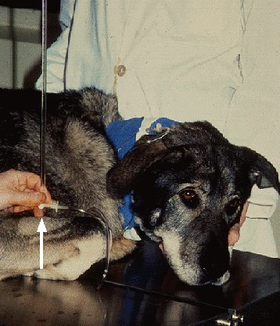
POSToperative monitoring
Temperature
Respiratory rate and effort
Heart rate
Blood pressure (ideally direct monitoring)
Continuous ECG monitoring
Central venous pressures
Urine output
Weights
Acid-base/electrolyte status
Complete blood cell counts
Serum chemistries
Clotting times
Drain production
http://www.vetmed.wsu.edu/resources/Techniques/images/cvp4.jpg

Slide 54
Postoperative care
Aggressive fluid therapy
Blood component therapy and synthetic colloidal support with goal of maintaining packed cell volume > 24%, total protein > 3.5g/dL, and colloidal osmotic pressure > 15mm Hg
Continued broad-spectrum antibiotic therapy pending culture & sensitivity results
Analgesia
Enteral/parenteral nutrition
Vasopressor support
Treatment of complications including systemic inflammatory response, cardiac dysrhythmias, disseminated intravascular coagulopathies, aspiration pneumonia, pancreatitis, dependent and peripheral limb edema, acute renal failure, hepatic dysfunction and cholestasis

Slide 55
Prognosis
Depends on underlying etiology
Overall survival rates for animals with peritonitis 50-70%
  Cats were reported to have a lower survival rate than dogs in two studies; however Costello (2004) study focusing on 51 cats with septic peritonitis found a 70% survival in animals in which treatment was pursued
Poor prognostic indicators include refractory hypotension, cardiovascular collapse, disseminated intravascular coagulation and respiratory disease (King 1994)
  Administration of inappropriate antibiotics appeared to be associated with poorer prognosis, but not statistically so (King 1994 and Mueller 2001)
  Development of pancreatitis, high liver values, leukocytosis/leukopenia, hyper/hypoglycemia, abdominal pain, and degree of abdominal effusion not associated with outcome (King 1994)
    High liver values negative prognostic indicator in Winkler study and Greenfield (2001, JVECC)
Overall survival rate in bile peritonitis is 50%
  Bacterial contamination was highly associated with mortality in animals with bile peritonitis in Ludwig et al study (Vet Surg, 1997) and Mehler et al study (Vet Surg 2004)
    27% of animals with septic biliary effusions survived compared with 100% with aseptic effusions; 45% of dogs with septic biliary effusions survived compared with 87% with aseptic effusions
Cats with uroperitoneum have an overall survival rate of 62%, whereas dogs have 43%-56.2%
Notes:
Most animals that die do so early (within 18 hours of sx)-JAVMA 2001
Postop hypotension- correlated with survival- all 6 tx with dopamine postop died
***Fluid admin rate not associated with development of resp disease

Slide 56
PROGNOSIS
Comparison of Dogs with Septic Peritonitis: 1988-1993
versus 1999-2003
Bentley AM, Otto CM, Shofer FS, JVECC 2007
Retrospective study evaluating dogs treated surgically for septic peritonitis between 1988-1993 and 1999-2003
No significant difference in survival among dogs treated surgically for septic peritonitis between 1988 and 1993 (21/33 [64%] and 1999-2003 [57%]) was detected
Trend toward enrofloxacin use in place of aminoglycosides, increasing use of colloids and greater attention to pain management and ulcer prevention
Most dogs managed with primary closure although closed-suction drains used increasingly in later group
Perioperative hypotension and preoperative hypoalbuminemia associated with non-survival

Slide 57
Identification of risk factors for septic peritonitis and failure to survive following Gastrointestinal surgery in dogs
Grimes et al
JAVMA, Vol 238, No. 4, February 15, 2011
The probability of death tripled when dogs had septic peritonitis before surgery
  11% of surgeries involving dogs without preoperative septic peritonitis were followed by death
  33% of surgeries involving dogs with preoperative septic peritonitis were followed by death
Low preoperative plasma protein and serum albumin concentrations, as well as the presence of preoperative septic peritonitis were significantly associated with failure to survive and postoperative development of septic peritonitis
Gastrointestinal foreign bodies were consistently protective
Odds of death increased when gastrointestinal surgery was performed in conjunction with surgery of the extrahepatic biliary system
Intraoperative hypotension was significantly associated with postoperative development of septic peritonitis and death
Allen, DASD, Schertel ER. Prevalence of small intestinal dehiscence and associated clinical factors: a retrospective study of 121 dogs. J Am Anim
Hosp Assoc 1992; 28
Ralphs SC, Jessen CR, Lipowitz AJ. Risk factors for leakage following intestinal anastomosis in dogs and cats 115 cases (1991-2000). JAVMA 2003; 223
Harvey HJ. Complications of small intestinal biopsy in hypoalbuminemic dogs. Vet Surg 1990; 19
Notes:
Records for 197 dogs (225 surgeries) were evaluated
In 35 (16%) surgeries, the dogs died prior to hospital discharge
In 28 (12%) surgeries, the dogs developed septic peritonitis
For 45 (20%) surgeries, dogs had preoperative septic peritonitis; of those, approximately a third resulted n continued septic peritonitis (17/45; 38%) or death (15/45; 33%)
Of the 180 surgeries performed in dogs lacking preoperative septic peritonitis, 11 (6%) resulted in development of septic peritonitis and 20 (11%) resulted in death
Enteric healing is impaired when septic peritonitis is present. Collagen synthesis is an important aspect of wound healing: it imparts wound strength and seals small tissue defects to prevent leakage after closure. In rodents, peritonitis results in weaker anastomotic bursting pressure and less total collagen content of the anastomosis site than in unaffected rodents. This reduction in collagen coincides with reduction of new collagen and total protein synthesis at the anastomotic site, potentially due to depletion of amino acid substrate and energy stores. In addition, septic peritonitis results in high amounts of TNF-alpha (pro-inflammatory cytokine). In turn, TNF-alpha has been shown to reduce gene expression of collagen alpha 1 and of TGF-B (profibrotic cytokine). Additionally, an increase in collagen destruction associated with collagenases can occur with septic peritonitis. In humans with septic peritonitis, active matrix metalloproteinase-8, which is a collagenase of neutrophil origin, is of higher concentration in the serum and urine than in people without the condition. – Grimes et al, JAVMA 2011
Serum albumin concentration in dogs nd cats has been identified as a significant predictor of anastomotic complications; however, other veterinary studies have not confirmed this relationship. Collection of intestinal biopsy specimens from hypoalbuminemic dogs reportedly results in no enteric healing complications (Harvey HJ. Complications of small intestinal biopsy in hypoalbuminemic dogs. Vet Surg 1990; 19; 289-292). In contrast, human studies have consistently demonstrated albumin concentrations to be a predictor of postoperative complications as well as of death, even when the concentration varies within the reference limits. In 1 human study, the increase in the estimated odds of death ranged from 24% to 56% for every 2.5g/dL reduction in albumin concentration. Although albumin is not an essential element of wound healing, it serves as a marker for disease and nutritional status, maintains oncotic pressure and binds proteins and other substances critical in wound healing. Other than albumin, proteins considered important in wound healing are collagen, acute phase proteins (IL, C-reactive protein, TNFs, and haptoglobin), protease inhibitors, ceruloplasmin and fibrinogen. Substantial influence over inflammation and wound healing.

Slide 58
summARY
Septic peritonitis is the most common cause of sepsis in our small animal patients with overall mortality rates ranging from 50-70%
Outcome is dependent on aggressive medical management, definitive surgical management and aggressive post-operative care
There is no statistical difference in outcome between animals managed open, closed or with closed-suction drains

Slide 59

QUESTIONS?

Slide 60
references
Allen, DASD, Schertel ER. Prevalence of small intestinal dehiscence and associated clinical factors: a retrospective study of 121 dogs. J Am Anim Hosp Assoc 1992; 28
Bentley AM, Otto CM, Shofer FS, Comparison of dogs with septic peritonitis: 1988-1993 versus 1999-2003. JVECC 2007: 17 (4).
Bonczynski JJ, Ludwig LL, Barton LJ, Loar A, Peterson ME: Comparison of peritoneal fluid and peripheral blood pH, bicarbonate, glucose and lactate concentration as a diagnostic tool for septic peritonitis in dogs and cats. Vet Surg 2003: 32.
Brady CA, Otto CM, Van Winkle TJ, King LG, Severe sepsis in cats: 29 cases (1986-1998). JAVMA 2000: 217 (4).
Case JB, Fick JL, Rooney MB. Proximal duodenal perforation in three dogs following deracoxib administration. JAAHA 2010.
Costello MF, Drobatz KJ, Aronson LR and King LG, Underlying cause, pathophysiologic abnormalities, and response to treatment in cats with septic peritonitis: 51 cases (1990-2001). JAVMA 2004: 225 (6).
Corwin HL, Krantz SB. Anemia of the critically ill: “acute” anemia of chronic disease. Crit Care Med 2000 (28).
DeClue AE, Osterbur K, A Bigio and Sharp CR, Evaluation of serum NT-pCNP as a diagnostic and prognostic biomarker for sepsis in dogs. J Vet Intern Med 2011: 25.
Garcia-Tsao G, Conn HO, Lerner E: The diagnosis of bacterial peritonitis: comparison of pH, lactate concentration and leukocyte count.Hepatology 1985 (5).
Greenfield CL and Walshaw R, Open peritoneal drainage for treatment of contaminated peritoneal cavity and septic peritonitis in dogs and cats: 24 cases (1980-1986), JAVMA 1987: 191 (1).
Grimes JA, Schmiedt CW, Cornell KK, Radlinksy MAG, Identification of risk factors for septic peritonitis and failure to survive following gastrointestinal surgery in dogs. JAVMA 2011: 238 (4).

Slide 61
references
Hardie EM, Rawlings CA, Calvert CA: Severe sepsis in seleceted small animal surgical patients. J Am Anim Hosp Assoc 1986 (22).
Harvey HJ. Complications of small intestinal biopsy in hypoalbuminemic dogs. Vet Surg 1990; 19
Hobisch-Hagen P, Wiedermann F, Mayr A, et al. Blunted erythropoietic response to anemia in multiply traumatized patients. Critical Care Med. 2001: 29.
Hosgood G and Salisbury SK, Generalized peritonitis in dogs: 50 cases. JAVMA 1988: 193 (11).
Hosgood G, Salisbury SK, Cantwell HD DeNicola DB, Intraperitoneal circulation and drainage in the dog. Vet Surg 1989: 18 (4).
Kellett- Gregory, LM, Boller EM, Brown DC, Silverstein DC, Ionized calcium concentrations in cats with septic peritonitis: 55 cases (1990-2008). JVECC 2010: 20 (4).
King, LG, Postoperative complications and prognostic indicators in dogs and cats with septic peritonitis: 23 cases (1989-1992). JAVMA 1994: 204 (3).
Krafte-Jacobs B. Anemia of critical illness and erythropoietin deficiency. Intensive Care Med. 1997: 23.
Lanz OI, Ellison GW, Bellah JR, Weichman G, VanGilder J, Surgical treatment of septic peritonitis without abdomianl drainage in 28 dogs. JAAHA 2001: 37.
Lascelles BDX, et al. Gastrointestinal tract perforation in dogs treated with a selective cyclooxygenase-2 inhibitor: 29 cases (2002-2003). JAVMA 2005.
Levin GM. Bonczynski JJ, Ludwig LL, Barton LJ and Loar AS, Lactate as a diagnostic test for septic peritoneal effusions in dogs and cats. JAAHA 2004 (40
Mueller MG, Ludwig LL, Barton LJ, Use of Closed-Suction Drains to Treat Generalized Peritonitis Dogs and Cats: 40 Cases (1997-1999)., JAVMA 2001.
Nestor DD, McCollough SM, Schaeffer DJ: Biochemical analysis of neoplastic versus nonneoplastic abdominal effsuions in dogs. J Am Anim Hosp Assoc 2004 (40).

Slide 62
references
Oscher RJ and Rosin E, Open peritoneal drainage in experimental peritonitis in dogs. Vet Surg 2001
Parsons KJ, Owen LJ, Lee K, Tivers MS and Gregory SP, A retrospective study of surgically treated cases of septic peritonitis in the cat (2000-2007). J Sm Anim Prac 2009 (50).
Pumphrey SA, Pirie CG, Rozanski EA, Uveitis associated with septic peritonitis in a cat. JVECC 2011: 21 (3).
Ralphs SC, Jessen CR, Lipowitz AJ. Risk factors for leakage following intestinal anastomosis in dogs and cats 115 cases (1991-2000). JAVMA 2003; 223
Rogers CL, Gibson C, Mitchell SL, Keating JH, Rozanski EA, Disseminated candidiasis secondary to fungal and bacterial peritonitis in a young dog. JVECC 2009: 19 (2).
Ruthrauff CM, Smith J, Glerum L, Primary bacterial septic peritonitis in cats: 13 cases. JAAHA 2009 (45).
Staatz AJ, Monnet E, Seim HB III, Open peritoneal drainage versus primary closure for the treatment of septic peritonitis in dogs and cats: 42 cases (1993-1999). Vet Surg 2002: 31.
Swann and Hughes, Diagnosis and management of peritonitis. Veterinary Clinics of North America: Small Animal Practice 2000: 30 (3).
Szabo SD, Jermyn K, Neel J, Mathews KG, Evaluation of postceliotomy peritoneal drain fluid volume, cytology, and blood-to-peritoneal fluid lactate and glucose differences in normal dogs. Vet Surg 2011 (40).
Weiss DJ, Krehbiel JD. Studies of the pathogenesis of anemia of inflammation: erythrocyte survival. Am J Vet Res 1983 (44).
Weiss DJ, Mcclay CB. Studies on the pathogenesis of the erythrocyte destruction associated with the anemia of inflammatory disease. Vet Clin Pathol. 1988 (17)
Winkler KP and Greenfield CL, Potential prognostic indicators in diffuse peritonitis treated with open peritoneal drainage in the canine patient. JVECC 2000: 10 (4).
Woolfson JM and Dulisch ML, Open abdominal drainage in the treatment of generalized peritonitis in 25 dogs and cats. Vet Surg 1986: 15 (1).

