Slide 1
West Respiratory Physiology
Structure and Function

Slide 2
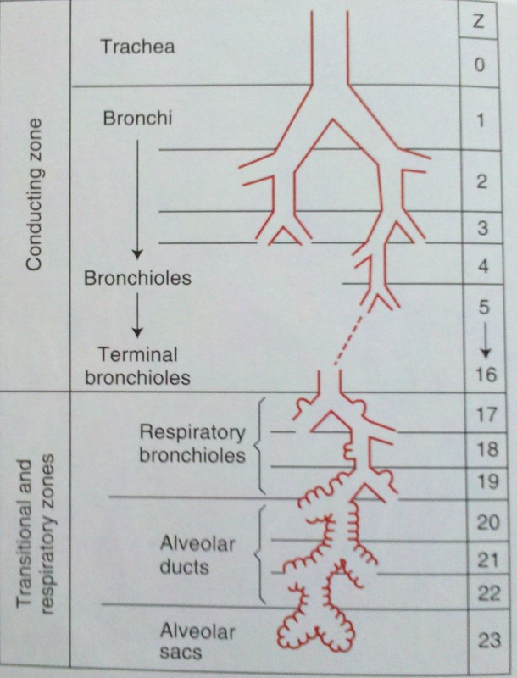
Alveolar Dead Space
Respiratory Zone

Slide 3
Blood gas interface is thin with large surface area
Airflow is convective up to terminal bronchioles
Airflow is diffusive at the level of the respiratory zone

Slide 4
Fick’s law of diffusion states:
  Diffusive properties dependent upon relative concentrations across a permeable membrane
  Diffuse properties proportional to area and inverse to thickness
  Diffuse properties of solute directly proportional to temperature of solution
  Diffuse properties are directly proportional to distance of diffusion

Slide 5
Fick’s law of diffusion states:
  Diffusive properties dependent upon relative concentrations across a permeable membrane
  Diffuse properties proportional to area and inverse to thickness
  Diffuse properties of solute directly proportional to temperature of solution
  Diffuse properties are directly proportional to distance of diffusion

Slide 6
How do you calculate the partial pressure of a gas?

Slide 7
How do you calculate the partial pressure of a gas?
  P_{gas}=[gas] x P_{total}
  P_{O2}=Fi_{O2} x P_{Ba}

