Slide 1
Ventilator waveforms pp 34-48

Slide 2
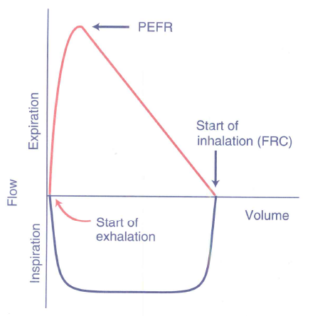
Flow-volume loops
Which direction is flow in this machine generated, normal breath?

Slide 3
Flow-volume loops
Which direction is flow in this machine generated, normal breath?

Slide 4
Flow-volume loops
Where is start of inspiration and start of expiration?

Slide 5
Flow-volume loops
Where is start of inspiration and start of expiration?

Slide 6
Flow-volume loops
Where is the peak expiratory flow rate?

Slide 7
Flow-volume loops
Where is the peak expiratory flow rate?

Slide 8
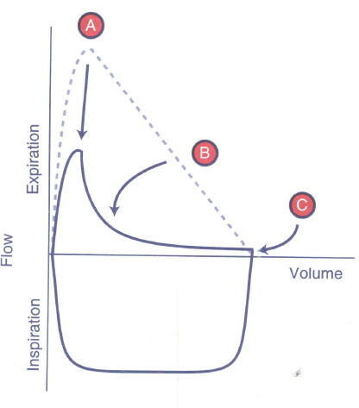
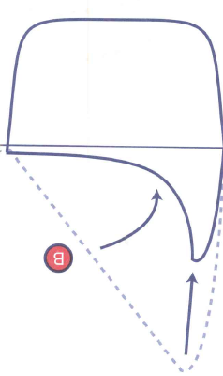
Flow-volume loops
What phase of respiration is altered in this flow-volume loop?

Slide 9
Flow-volume loops
What phase of respiration is altered in this flow-volume loop?
Expiration

Slide 10
Flow-volume loops
What is the cause of this change in expiratory flow?

Slide 11
Flow-volume loops
What is the cause of this change in expiratory flow?
Airway obstruction
Notes:
Results in a scooping of the peak expiratory flow rates

Slide 12
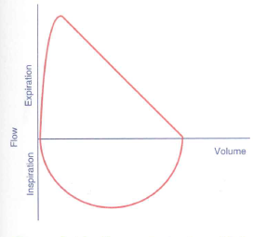
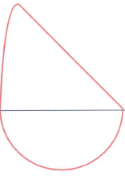
Flow-Volume loops
What is the process depicted here?

Slide 13
Flow-Volume loops
What is the process depicted here?
Air trapping

Slide 14
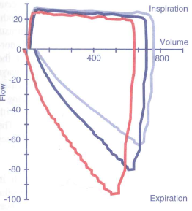
Flow-volume loops: Compliance
Which represents the highest and lowest compliance?

Slide 15
Flow-volume loops: Compliance
Light blue: highest compliance
Red: lowest compliance

Slide 16
Flow-volume loops: Compliance
Provide an explanation of variations in expiratory flow loops in various compliances

Slide 17
Flow-volume loops: Compliance
Increased work done whilst stretching elastic tissues in a lower compliant system is then conferred to increased elastic recoil

Slide 18
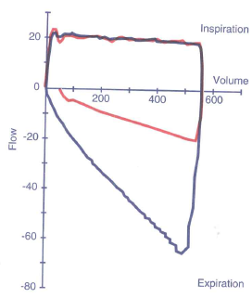
Flow-volume loops: resistance
Which phase of respiration is affected in this diagram?

Slide 19
Flow-volume loops: resistance
Which phase of respiration is affected in this diagram?

Slide 20
Flow-volume loops: resistance
What is the primary process occurring here?

Slide 21
Flow-volume loops: resistance
What is the primary process occurring here?
Increased resistance

Slide 22
Flow-volume loops: resistance
What treatment may you try for this condition?

Slide 23
Flow-volume loops: resistance
What treatment may you try for this condition?
Bronchodilators

Slide 24
Flow-volume loops: resistance
What is depicted at the arrow?

Slide 25
Flow-volume loops: resistance
What is depicted at the arrow?
Leak

