Slide 1
Management of Traumatic Brain Injury
Kelly Blackstock
Resident review session
June 12, 2012

Slide 2
Outline
Patient assessement
    Generalized
    Neurologic
Extracranial management
    IV fluids
    Oxygenation and ventilation
Intracranial management
    Hyperosmotic agents
    Glycemic control
    Hypothermia
    Anti-convulsants
    Barbituates
    Corticosteroids
Surgical management

Slide 3
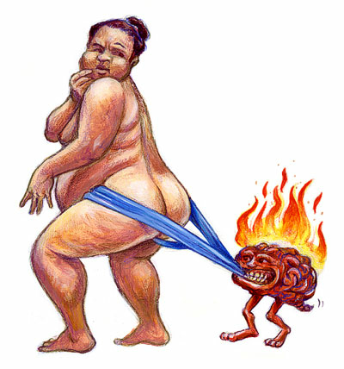
Patient assessment

Slide 4
Patient assessment
Start with the basics
    Airway
    Breathing
    Circulation
Stabilization package
    ECG, BP, pulse oximetry
Minimum data base
    PCV/TS, BG, electrolytes, USG
Look for hyperglycemia
Search for fractures, wounds etc
Priority should be avoidance of hypovolemia and hypoxia
Notes:
Humans- 60% have concurrent injuries to other organs (Siefal et al JNT 1993; 12: 599)
There is a very strong correlation in people with both hypovolemia and hypoxia and increases in ICP as well as Increases in mortality
Hyperglycemia is related to head trama severity in both animals and humans

Slide 5
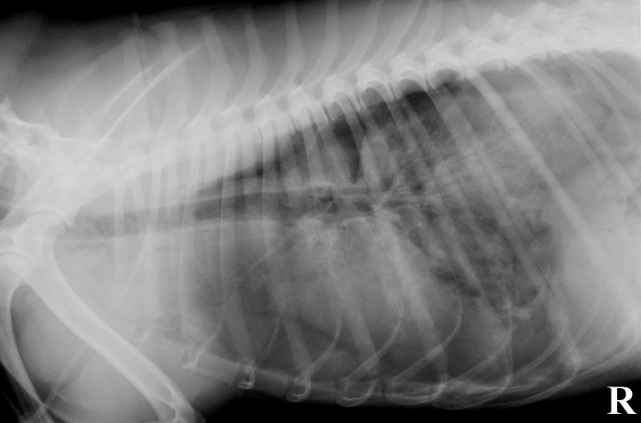
Patient assessment- Hypoxia
Respiratory function often altered in TBI patients
Can arise from:
    Altered drive
    Pulmonary injury
    Pleural space disease
    Chest wall abnormalities
    Diaphragmatic hernias
    Neurogenic pulmonary edema

Slide 6
Neurogenic pulmonary edema
Pathogenesis not understood
CNS overstimulation of sympatho-adrenal activity
May be associated with a more global cascade
Can occur up to 14 days following original injury

Slide 7
Neurogenic pulmonary edema
Theory:
CNS overstimulation of sympatho-adrenal activity→ Peripheral vasoconstriction and increased venous returen→
Systemic hypertension→
Increase in LV afterload and diminished stroke volume→
Accumulation of blood in pulmonary capillaries→
Pulmonary hypertension→
Pulmonary edema

Slide 8
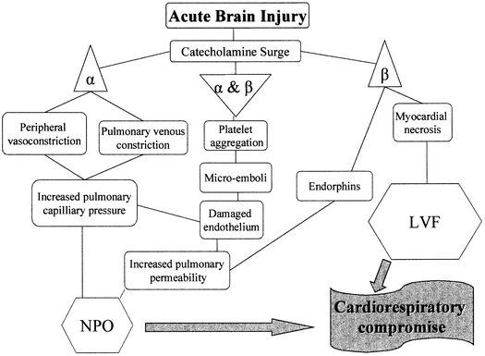
http://crashingpatient.com

Slide 9
Neurogenic pulmonary edema
Clinical signs
    Dyspnea
    Hypoxia
    Hypercapnea
Effects can be severe but are generally self-limiting
Resolution typically within hours to days

Slide 10
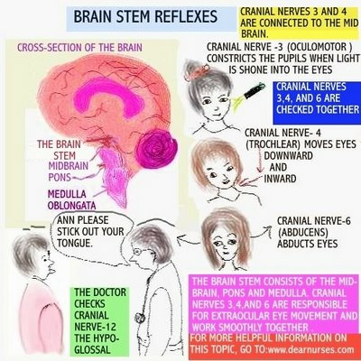
Neurologic Assessment
Mentation
Breathing pattern
Pupil size and responsiveness
Ocular position and movements
Skeletal-motor responses
Notes:
Keep in mind when evaluating these things that physical trauma and shock may complicate your interpretation of these things
It is recommended that repeat neurologic reassessment be made every 30-60min initially to monitor treatment efficacy an to catch deterioration

Slide 11
Level of Consciousness
Most reliable empiric measure of impaired cerebral function
Abnormalities indicate direct cortical injury or interference with transmission of sensory stimulation by brainstem or RAS
Comatose mentation indicative of bilateral or global cerebral abnormalities or brainstem injury
Notes:
If comatose automatically given guarded-grave prognosis with humans

Slide 12
Motor Activity
Can be affected by level of consciousness
DECEREBRATE RIGIDITY: indicative of cerebral damage, see opisthotonus with hyperextension of all four limbs
DECEREBELLATE RIGIDITY: indicative of cerebellar damage, see variable flexionaodn extension of hindlimbs
Notes:
If decrebrate rigidity is observed in combination with a comatose mentation, assumtion is that there has been damage to the RAS within the midbrain. IN people this carries with it a grave prognosis

Slide 13
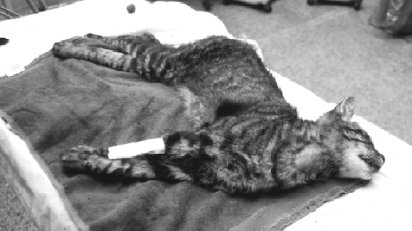
Decerebrate rigidity

Slide 14
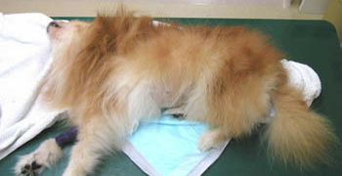
Decerebellate rigidity

Slide 15
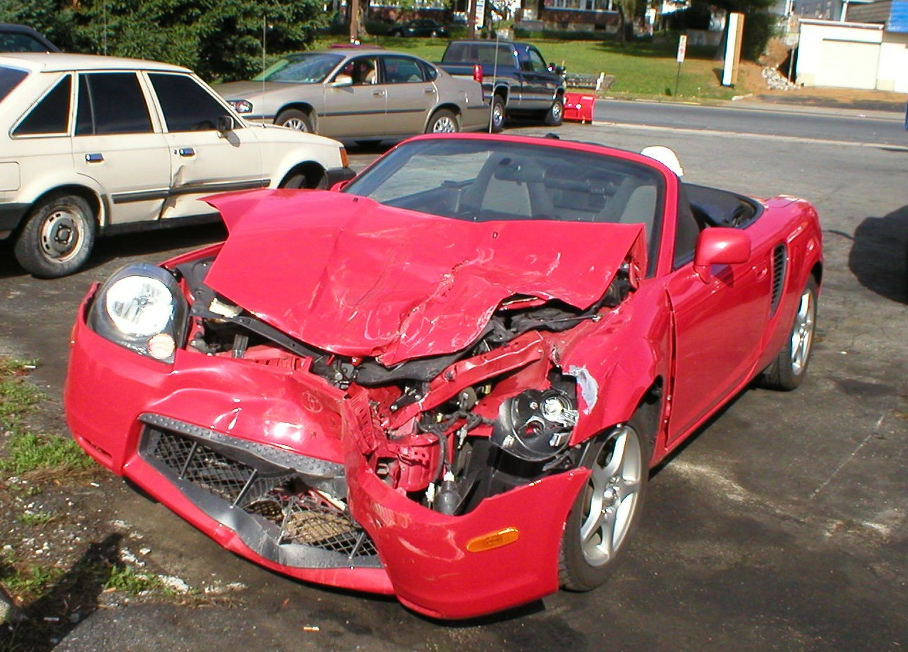
Herniation
External herniation
Subfalcine herniation
Transtentorial herniation
Uncal herniation
Cerebellar/Tonsilar herniation
Notes:
Supratentorial herniation is attributable to direct mechanical compression by an accumulating mass or to increased intracranial pressure
Subfalcine herniation - The cingulate gyrus of the frontal lobe is pushed beneath the falx cerebri when an expanding mass lesion causes a medial shift of the ipsilateral hemisphere. This is the most common type of herniation.
Central transtentorial herniation - This type of injury is characterized by the displacement of the basal nuclei and cerebral hemispheres downward while the diencephalon and adjacent midbrain are pushed through the tentorial notch.
Uncal herniation - This type of injury involves the displacement of the medial edge of the uncus and the hippocampal gyrus medially and over the ipsilateral edge of the tentorium cerebelli foramen, causing compression of the midbrain; the ipsilateral or contralateral third nerve may be stretched or compressed.
Cerebellar herniation - This injury is marked by an infratentorial herniation in which the tonsil of the cerebellum is pushed through the foramen magnum and compresses the medulla, leading to bradycardia and respiratory arrest.

Slide 16
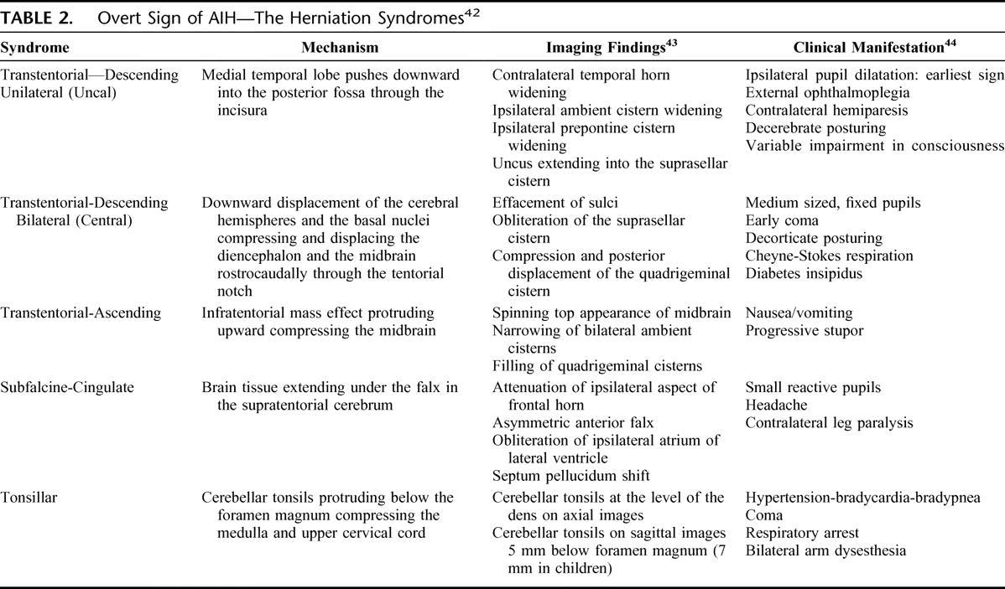

Slide 17
HERNIATION
A
B
C
A: Coronal B: Axial C: Sagittal
Subfalcine
Uncal
Descending transtentorial
Tonsillar
Ascending transtentorial
External
Notes:
Brain herniation is associated with severe disability and death if not treated rapidly and aggressively

Slide 18
Neuro-ophthalmologic assessment
Determine degree of ocular trauma for accurate assessment
Normal pupil response = normal rostral brainstem, optic chiasm, nerves and retina
Miotic pupils = forebrain injury
Progression of mydriasis may indicate herniation
Fixed, unresponsive midrange pupils can be seen with cerebellar herniation
Notes:
Why do we see these changes with herniation?
Transtentorial herniate places pressure on the 3rd CN (oculomotor), interrupting PNS input to the eye, result is dilation. You can see with with brainstem compression as well

Slide 19
Glasgow Coma Scale
The Glasgow Coma Scale (GCS) defines the severity of a TBI within 48 hours of injury.
Divided into 3 categories
    Verbal response
    Eye opening
    Motor response
Each category given a score from 1-6
Grade of mild, moderate or severe head injury based on this score
SCORE
Severe TBI = 3-8
Moderate TBI = 9-12
Mild TBI = 13-15

Slide 20
Glasgow Coma Scale
Eye opening
Spontaneous = 4
To speech = 3
To painful stimulation = 2
No response = 1
Verbal response
Oriented to person, place, and date = 5
Converses but is disoriented = 4
Says inappropriate words = 3
Incomprehensible sounds = 2
No response = 1
Motor response
Follows commands = 6
Makes localizing movements to pain = 5
Makes withdrawal movements to pain = 4
Flexor (decorticate) posturing to pain = 3
Extensor (decerebrate) posturing to pain = 2
No response = 1
Notes:
The Glasgow Coma Scale (GCS) defines the severity of a TBI within 48 hours of injury.

Slide 21
JVIM 2001; 15(6): 581-584
Notes:
University of Georgia
End point survival at 48 hours
Evaluated MGCS, gender, weight and presence of skull fractures

Slide 22
Modified Glasgow Coma Scale
3 Categories
Score of 1-6 per category
Total possible 3-18
The higher the score the better the prognosis
Notes:
Given the limited data showing a correlation with survival, maybe better utilized as objective assessment of progression rather than prognostic indicator

Slide 23
PROBABILITY OF SURVIVAL V. MGCS
Notes:
7 dogs died
MGCS showed 50% probability of dying with score of 8 or less
All other variables not predictive

Slide 24

Medical management

Slide 25
Emergency department goals
SBP > 90mmHg at all times, preferably =120mmHg with MBP > 85mmHg
ICP < 20mHg
CPP > 60mmHg
O2 saturation > 90%
PaCO2 >60mmHg
Notes:
Set targeted goal therapy in people
Remember goal is to avoid any event of hypovolemia and hypoxia
Correct all tissue deficits with aggressive stabilization, and optimize oxygenation and ventilation

Slide 26
Intravenous fluids
Primary goal is rapid restoration of intravascular volume
Historically there were recommendations to limit therapy
    Idea that dehydration would help to lower ICP
    Little data supports this
    Considered contraindicated in human medicine
Hypotension associated with significant increases in morbidity and mortality
    Any episode of hypotension (BP<90mmHg) or hypoxia (PaO2<60mmHg) during resuscitation is associated with 150% increase in morbidity and mortality. JTrauma 1993; 34:216-222
    New study shows hypotensive events increase mortality dramatically but no difference between trauma patients and TBI patients. Jtrauma 2005; 59: 830-835
Notes:
Correction of hypovolemia will ensure adequate CPP
Secondary insults exert a powerful adverse influence on outcome, and are more profound in presence of hypotension and hypoxia

Slide 27
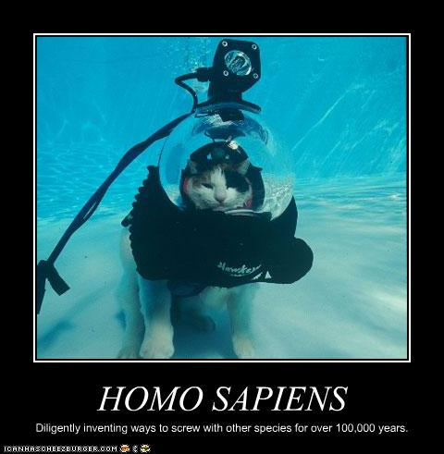
Intravenous fluids
Options: isotonic crystalloids, hypertonic crystalloids, artificial colloids and blood products
BBB plays major role
Notes:
BBB: if intact will freely filter water but no ions or larger colloid molecules

Slide 28
Colloids
Exert little influence on cerebral water content and on ICP
Remember in the brain it is the OSMOLARITY rather than ONCOTIC pressure that determines movement of water
If BBB is disrupted: non-selective movement ions and colloidal particles that can increase ICP
Benefits outweigh the risks
Notes:
More for volume restoration and improvements in BP/CPP

Slide 29
Hypertonic crystalloids
May be superior, rapid resuscitation with small volumes
Rapid rise OSMOLARITY→ transcapillary shift of intracellular and interstitial fluids into the vasculature
Peak effects occurs within minutes
Duration 15-75min
If followed by a colloid effect can last for several hours
Must be followed by a crystalloid
Notes:
Combination of hypertonic and colloid shown to be more effective at resuscitation than either solution alone – Curr Opin Anaesth 1993;6: 400-408

Slide 30
Oxygenation
Decreased oxygen delivery perpetuates secondary brain injury
Mortality can double in patients with hypoxia
Nasal and transtracheal oxygen can increase inspired oxygen up to 40% with flow rates between 50-100ml/kg/min
Caution when placing these as struggling, anxiety and cough can all increase ICP

Slide 31
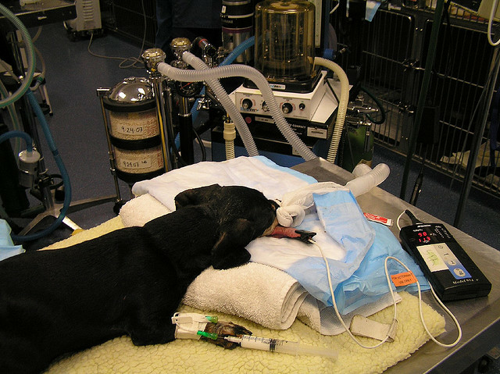
Ventilation
Most important autoregulatory factor is PaCO2
Hypoventilation → vasodilation → Increased ICP
Arterial sample most accurate
Patients unable to maintain normal levels may require intubation of mechanical ventilation
Notes:
Venous samples can be used but typically are 5mmHg higher than the arterial sample
EtCO2 is also useful but tends to underestimate levels

Slide 32
Hyperventilation
Manipulation of autoregulation to control ICP
Increased ventilation → hypocapnea → vasoconstriction → decreased CBV → decreased ICP
However, even moderate hypocapnea (< 34mmHg) can cause excessive vasoconstriction
Leads to decrease in global CBF, perpetuates cerebral hypoperfusion, increased ischemic risk
May be considered for brief periods with acute deterioration (NEVER <30mmHg)

Slide 33
Influencing ICP
Head position: keep at angle of 15-30 degrees
    Decreased CBV by increasing venous drainage
    No effect on cerebral oxygen
    Higher angles will decrease CPP
    Recommend stiff board to avoid bending of the neck (obstruction of drainage)
No restrictive collars or wraps
No jugular catheters or venapuncture

Slide 34
Hypertonic agents-Mannitol
First line of treatment to decrease ICP and increase CPP
Recommended in TBI with progressive neurologic detioration
Contraindicated with hypovolemia
Dose: 0.5-1.5 G/kg over 15-20 min
Patients receiving high dose mannitol when compared to low dose have shown better long term outcomes
Cruz et al. JNSurg 2004; 100(3): 376-383
Notes:
Hypovolemia: initially increased plasma volume → increases renal blood flow and glomerular filtration, it is freely filtered by the kidneys so keeps fluids an lytes with it as it is excreted.
Study was out of Brasil, 44 patients with severe diffuse, non-penetrating TBI, given roughly 1.4G/kg v. roughly 0.7G/kg, saw significantly better outcomes at 6 mos in high dose group (Fletcher said that this researcher committed suicide and that no one was ever able to locate this data, so take with a grain of salt)

Slide 35
Mannitol
MECHANISM OF ACTION (controversial)
Blood viscosity: transient decrease leads to cerebral vascular vasoconstriction with improvements in flow
    Immediate and most profound effect
    Lasts around 75mins
Osmotic effects: pulls water from the intracellular and interstitial space into the vasculature
    Delay in onset, 15-30 following administration
    Peak effect at 1 hour
    Lasts 6-8 hours
    Effect can be limited with decrease perfusion to the brain
    May help with vascular endothelial swelling

Slide 36
Mannitol
POSSIBLE NEGATIVE EFFECTS
Worsening of intracranial hemorrhage
    Osmotic effect could increase volume of bleed
    No clinical evidence supports this
    Benefits outweigh the risks, should disregard
Reverse osmotic shift
    Can see with prolonged contact (multiple boluses and CRIs)
    Get accumulation in extravascular space, uptake astrocytes
    Subsequent development of edema and increased ICP
    Less likely with appropriate use

Slide 37
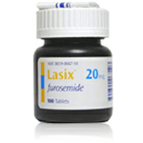
Mannitol with Furosemide
Furosemide
    Can act to decrease CSF production
    Works synergistically with mannitol
Recent evidence suggests that addition has no effect
Due to risk of hypovolemia it is no longer recommended
Notes:
Synergy can act prolong osmotic gradient and lower ICP
Anesth 2006; 105: 1176

Slide 38
Hypertonic agents-Hypertonic saline
MECHANISM OF ACTION
Osmotic movement of water
Decreased cerebral endothelial swelling
Decreased brain excitotoxicity
Decreased adhesion of PMN cells
Dose: 4ml/kg of 7.5% soln, 5.3ml/kg of 3% soln over 2-5 min
Duration: 15-75 min
Benefits on ICP are maintained for longer
Notes:
With intact BBB, NaCl is the driving force for movement of water
Leads to improvement in regional blood flow and enhanced oxygen delivery
By promoting reuptake
Modification of inflammatory response

Slide 39
Hypertonic saline
POSSIBLE NEGATIVE EFFECTS
Contraindicated with hyponatremia
    Too rapid a rise in Na can dehydrate brain paranchyma
    Causes changes in mentation, seizures or central pontine myelysis
Rapid volume expanding effects
    May aggrevate pulmonary edema and contusion
Notes:
Clinical signs can include, depression, weakness, ataxia, spastic paresis, loss postural reactions, hypermetra, episodic myoclonus, impaired sensory perception

Slide 40
Hypertonic v. Mannitol
Qureshi et al. Neurosurg 1999; 44(5): 1055-1063
    Ovine model
    Mannitol v. 3% NaCl v. 23.4% NaCl
    ICP decreased most with 23% NaCl
    At 2hrs only 3% had sustained ICP effects
    Mannitol group at 2hrs, ICP was higher
Battison et al. CCM 2005; 33(1): 196-202
    Human study
    20% mannitol v. 7.5% NaCl/6% dextran
    Combo lowered ICP more effectively and had longer duration of effect
Notes:
When equimolar doses of mannitol, 3% NaCl, and 23.4% NaCl were compared in a ovine model of intracerebral hemorrhage, ICP reduction was most prominent after 23.4% NaCl administration.52 How- ever, after 2 hours only 3% NaCl had a sustained effect on ICP and the ICP in the mannitol-treated animals exceeded the pretreatment ICP. The CPP was also higher in the 3% NaCl treated group compared with mannitol. This study suggests that hypertonic saline may actually be favored over mannitol.
comparing the effects of equimolar doses of 20% mannitol and 7.5%saline/6% dextran-70 in human patients with increased ICP demonstrated that the hypertonic saline-dextran solution lowered ICP more effectively than mannitol. The study also demon- strated that the hypertonic saline-dextran solution had a longer duration of effect than mannitol

Slide 41
Hypertonic v. Mannitol
Meta-analysis
5 trials, 112 patients, 184 episodes of increased ICP
Found hypertonic to be more effective than mannitol for the treatment of increased ICP
No significant adverse effects were reported
Crit Care Med 2011; 39:554 –559)
Notes:
Had to investigate equimolar doses
Outcome was considered normalization of ICP
Only small trials located
Argues for larger multicenter trial

Slide 42
Hypertonic v. Mannitol
Human guidelines still consider mannitol the first line of treatment
With this recent data suggests that this recommendation may need to be reviewed especially in patients with shock and hypotension
Hypertonic should be given to patients that have received multiple doses of mannitol
Notes:
Had to investigate equimolar doses
Outcome was considered normalization of ICP
Only small trials located
Argues for larger multicenter trial

Slide 43
Ancillary Therapies
Glycemic control
Hypothermia
Corticosteroids
Notes:
Had to investigate equimolar doses
Outcome was considered normalization of ICP
Only small trials located
Argues for larger multicenter trial

Slide 44

Glycemic control
Hyperglycemia is associated with increased mortality and worsened neurologic outcomes in people
Reflection of injury v. worsens secondary injury
Exact mechanism of increase unknown, related sympatho-adrenal response

Slide 45
Glycemic control
Retrospective study
52 dogs and 70 cats with head trauma
Classified as mild, moderate or severe head injury
Compared to controls
BG collected within 1 hour
Findings: [BG] was significantly associated with severity of head trauma but not with outcome
JAVMA 2001; 218(7): 1124

Slide 46
Glycemic control
Possible mechanisms for potentiating injury
Increase in ROS
EAA release
Cerebral edema
Cerebral acidosis
Alters cerebral vasculature

Slide 47
Glycemic control
Regulation of BG has been shown to be detrimental, no longer recommended
Oddo et al. CCM 2008 36(12); 3233
    Tight glycemic control was associated with decreased cerebral extracellular glucose availablity, increased prevalence of brain energy crisis, which in turn was correlated with increases in mortality
Helbok et al. Neurocrit Care 2010; 12: 317
    Acute reductions in serum glucose, even to levels within the normal range, may be associated with brain energy metabolic crisis and LPR elevation in poor grade SAH patients
Notes:
LPR = lactate pyruvate ratio

Slide 48

Hypothermia
Mechanism of decreasing secondary injury not well defined
Traditionally thought to decrease metabolism
Now, suspect that it leads to a decrease in the release of EAA → inhibition of post-traumatic inflammatory responses

Slide 49
Hypothermia-canine case report

Slide 50
Hypothermia- BTF guidelines
Preliminary findings suggest that a greater decrease in mortality risk is observed when target temperatures are maintained for more than 48hrs.
Prophylactic hypothermia is associated with significantly higher Glasgow Outcome Scale scores when compared to controls

Slide 51
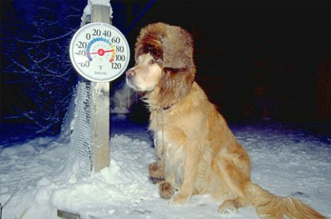
Hypothermia
DISADVANTAGES:
Coagulation disorders
Increased susceptibility to infections
Hypotension
Bradycardia
Arrhythmias

Slide 52
Hypothermia
Meta-analysis
Patients were cooled by surface cooling with ice as well as NG lavage with ice water
Temperature was maintained at 33°C for 48hrs
Determined that more complications were seen with hypothermia but no difference in mortality
National Acute Brain Injury Study. JNT 2008; 25: 62
Notes:
As current literature has failed to consistently support and influence on Morbidity or Mortality, use is not rec at this time
That being said increased temperatures should be avoided as well, which we can see from direct trauma to thermoregulatory center, excitement, seizures and pain) this increases cellular metabolism and leads to vasodilation, worsening increases in ICP

Slide 53
Anti-convulsant treatment
Seizure activity complicates between 4-50% of cases involving TBI in humans
People who have at least one seizure after TBI have 86% risk of additional seizures within next 2 years.
In veterinary medicine this incidence is believed to be low
Risk factors:
    Injury severity
    Depressed skull fractures
    Epidural/Subdural/Intracerebral hematomas
    Penetrating head wounds
    Seizure within first 24hrs of injury

Slide 54
Anti-convulsant treatment
Prophylaxis
    Reduces incidence of seizures within the 1st week following trauma
    No effect on intermediate or long term seizure activity
    Studies have not shown that prevention of post-traumatic seizures improves outcome
No data in veterinary medicine
Prophylactic therapy for 7 days can be considered
Therapy should always be instituted in patients that have seizures

Slide 55
Barbituates
Have ability to decrease the energy demand of the cerebral tissue → vasoconstriction → decrease CBF→ decreased ICP
Little evidence for efficacy and some evidence for detriment to survival
Prophylaxis did not prevent increases in ICP, and may have shown worse outcome when compared to other interventions
Has some improvement in outcome when used as “last-resort”
Notes:
Should be used when other interventions have failed
Pentobarbital and Thiopental are the drugs most often used
Complications = hypotension land hypoventilation, requires intensive monitoring and mechanical ventilation to prevent adverse effects on CPP

Slide 56
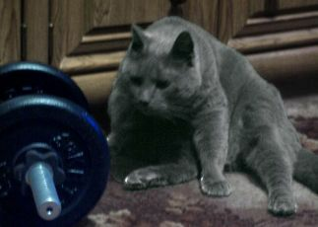
Corticosteroids
Contraindicated in human medicine
Associated with
    Hyperglycemia
    Immunosuppression
    Delayed wound healing
    Gastric ulceration
    Exaccerbation of catabolic state
Recent clinical trials and meta-analysis showed that the use (including methylprednisone) increases mortality in TBI patients

Slide 57
Corticosteroids
Randomized controlled trial
10,008 patients with TBI
GCS < 14, within 8 hrs of injury
48hrs of corticosteroid infusion v. placebo
Followed for 6 months
Risk of death was higher in corticosteroid group (25.7% v. 22.3%) as was the risk of severe disability
Conclusions: Corticosteroids not recommended for routine treatment of head trauma
Lancet 2005; 365(9475): 1957
Notes:
There is also a Cochrane review that was published after this in 2005, included 20 trials with 12,303 patients, concluded too much heterogeneity and that majority of patients belonged to the CRASH trial, therefore findings in that study is what will base recommendations from

Slide 58
Surgery
Decompressive craniectomy
No consensus as to if and when surgery should be performed
Decision in veterinary medicine usually based on imaging findings and discretion of the neurologist
Indications
    Open or depressed skull fractures
    Ongoing hemorrhage
    Foreign material or hematoma removal
    Declining neurologic status despite aggressive medical management

Slide 59
Surgery
Mortality was similar between groups
Surgery group
    Fewer interventions to control ICP
    Spent less time with ICP above thresholds
    Fewer days in ICU
    Worse Extended Glasgow Outcome Scores
    Greater risk of unfavorable outcomes
Notes:
In adults with severe diffuse traumatic brain injury and refractory intracranial hypertension, early bifrontotemporoparietal decompressive craniectomy decreased
intracranial pressure and the length of stay in the ICU but was associated with more unfavorable outcomes.

Slide 60

Surgery
Randomized Evaluation of Surgery with Craniectomy for Uncontrolled Elevations of ICP
Look for this study in the future
http://www.rescueicp.com/
International, prospective multi-center randomized trial
Craniectomy v. medical management
Have recruited 334/400 patients they intended to recruit

Slide 61
Review

Slide 62
BTF guidlines
Blood pressure should be monitored and hypotension (SBP <90mmHg) avoided
Oxygenation should be monitored and hypoxia (PaO2 <60mmHg or O2 saturation <90%) should be avoided
Mannitol is effective for control of raised ICP at doses of 0.25 G/kg to 1 G/kg. Arterial hypotension should be avoided
Restrict mannitol use prior to ICP monitoring to patients with signs of transtentorial herniation or progressive neurological deterioration not attributable to extracranial causes

Slide 63
BTF guidlines
Pooled data indicate that prophylactic hypothermia is not significantly associated with decreased mortality when compared to normothermic controls. However, preliminary findings suggest that a greater decrease in mortality risk is observed when target temperatures are maintained for more than 48hrs. Prophylactic hypothermia is associated with significantly higher Glasgow Outcome Scale scores when compared to controls

Slide 64
BTF guidlines
Periprocedural antibiotics for intubation should be administered to reduce the incidence of pneumonia. However, it doe not change length of stay or mortality. Early tracheostomy should be performed to reduce MV days. However, it does not alter mortality or the rate of nosocomial pneumonia
Routine ventricular catheter exchange or prophylactic antibiotics for ventricular catheter placement is not recommended to reduce infection. Early extubation in qualified patients can be done without risk of pneumonia

Slide 65
BTF guidlines
Graduated comression stockings or intermittent pneumatic compression stockings are recommended, unless lower extremity injuries prevent their use. Use should be continued until patients are ambulatory. Low molecular wt heparin or low dose unfractionated heparin should be used in combination with mechanical prophylaxis. However, there is an increase risk for expansion of intracranial hemorrhage

Slide 66
BTF guidlines
ICP should be monitored in all salvageable patients with severe TBI and an abnormal CT scan. Abnormal CT is one that reveals hematomas, contusions, swelling, herniation, or compressed basal cisterns
ICP monitoring is indicated in patiens with severe TBI with a normal CT scan if 2 or more of the following features are noted at admission: age over 40, unilateral or bilateral motor posturing or SBP<90mmHg

Slide 67
BTF guidlines
Treatment should be initiated with ICP thresholds above 20mmHg
A combinationof ICP values and clinical and brain CT findings, should be used to determine the need for treatment
Aggressive attmepts to maintain CPP above 70mmHg with fluids and pressors should be avoided because of the risk of ARDS
CPP<50mmHg should be avoided

Slide 68
BTF guidlines
Jugular venous saturation <50% or brain tissue oxygen tension <15mmHg are treatment thresholds.
Prophylactic administrationof arbiturates to induce burst suppression EEG is not recommended
High dose barbiturate is recommend to control elevated ICP refractory to maximum standard medical and surgical treatment. Hemodynamic stability is essential before and during barbiturate therapy.
Propofol is recommended for the control of ICP but not for improvement in mortality or 6 mos outcome. High dose propofol can produce significant morbidity

Slide 69
BTF guidlines
Patients should be fed to attain full caloric replacement by day 7 post injury
Prophylactic use of phenytoin or valproate is not recommended for preventing late PTS
Anticonvulsants are indicated to decrease the incidence of early PTS. However, early PTS are not associated with worse outcomes
Prophylactic hyperventilation is not recommended, unless as a temporizing measure for the reduction of elevated ICP

Slide 70
BTF guidlines
Hyperventilation should be avoided in first 24hrs when CBF is often critically reduced
The use of steroids is not recommend for improving outcome or reducing ICP. In patients with moderate or severe TBI, high dose methylprednisolone is associated with increased mortality and is contraindicated

Slide 71
Prognosis-CRASH calculator
http://www.crash2.lshtm.ac.uk/Risk calculator/index.html

Slide 72
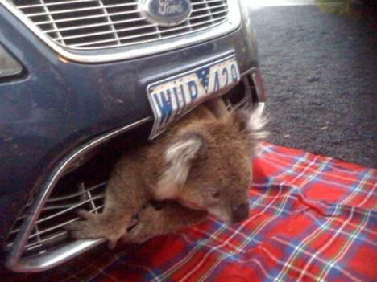
QUESTIONS?

