Slide 1
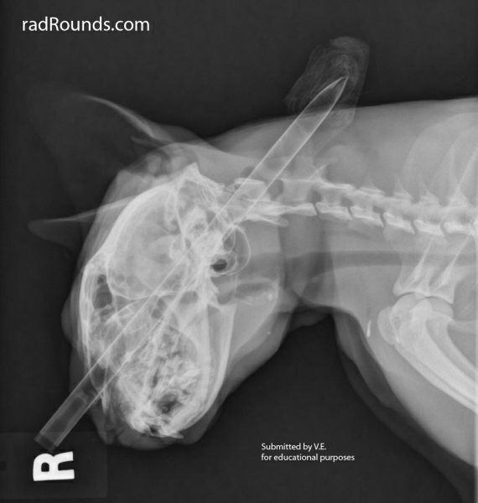
Functions of Magnesium
Cofactor for several cellular reactions
Blocks the NMDA receptor (removed by depolarization)
Blocks voltage gated Ca⁺⁺ channels on pre-synaptic membrane
Blocks Ca⁺⁺ channels in vascular smooth muscle→vasodilation
Down regulates p53 and up-regulates APP
Notes:
Cellular reactions such as oxydative phosphorylation, glcolysis, protein synthesis etc
APP neuroprotective gene

Slide 2
Magnesium in TBI
Marked decrease in brain intracellular free and total Mg
Lower levels associated with vasospasm and compromised cell function
Concentration correlates with severity of injury
Marked correlation between decreased Mg levels and outcome
Notes:
Decrease in Mg can last up to 4 days
Outcome includes development of cerebral edema, behavioral abnormalities and impaired cognitive performance
Given its function can see secondary increases in intracellular calcium by activation of NMDA receptors, vasospasm and compromised cell function

Slide 3
Role of Mg
Vink et al, J Biol Chem 1988; 263: 757-61

Slide 4
Cerebral vasospasm
Occurs in >1/3 of all TBI patients and indicates severe damage
Generally develops 2-15 days post-trauma
Hypoperfusion occurs in 50% of all patients with vasospasm

Slide 5
Cerebral vasospasm
Mechanisms:
  Chronic depolarization
  Endothelin release
  Decreased availability of NO
  cGMP depletion
  Potentiation of prostaglandin induced vasoconstriction
  ROS
  Decreased Mg

Slide 6
Ischemia
Why is the brain more susceptible?
  Higher oxygen and glucose requirements
  Minimal oxygen storage capacity
  Few recruitable capillaries

Slide 7
Ischemia
Prognosis in head injury has been strictly correlated with
      Incidence of ischemia
      Duration of ischemia
      Extent of ischemia
>90% of autopsied human patients had some degree of ischemic lesion
(Lancet 1971 1:265-266)
Notes:
There is an imbalance between delivery and consumption
Critical threshold 15-10mmHg PtO2
Incidence duration and extent of hypoxia are correlated with poor outcome
**This can occur even in presence of normal CPP and ICP**
Hypotension and hypoxia are seen in more than a third of TBI patients and both are potent predictors of mortality.^

Slide 8
Focal tissue compression from hematomas
Intracranial hypertension
Vasospasm
Cerebral Ischemia
Edema
Arterial hypotension
Autoregulatory failure
And then comes reperfusion…

Slide 9
Dysregulated Ions
Cells become more depolarized
Na+/H+ ATPase inhibited
Na+/K+ ATPase inhibited
Na+/Ca+ channel reverses
End result is net efflux of K⁺ and an influx of Na⁺, Ca²⁺, and Cl⁻
Glutamate
Notes:
Key mechanism for maintaining pH is Na/H exchanger, this is inhibited during ischemia. Na travels down its concentration gradient resulting in increased intracellular Na. Because the Na/K ATPase is also inhibited the Na/Ca exchanger reverses allowing for the influx of Ca

Slide 10
Arachadonic acid
Notes:
SOR-superoxide radical

Slide 11
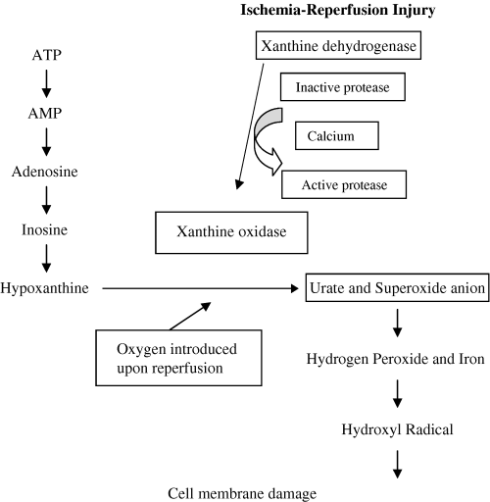
NAD
XYANTHINE
And
URIC ACID
SOD
Fe⁺⁺
CATALASE
GSH
O2 and Water
McMicheal, JVECC 2004, 14(4); 231-41
Notes:
Nicotinomide adenine dinucleotide

Slide 12

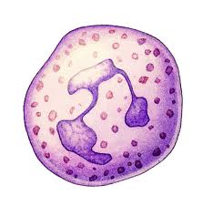
Inflammatory Mediators
Inflammatory mediators
IL-1β
ROS
TLR
Ca
TNFα
NF-κB
PLA₂
ICAM-1, E-selectin
TXA2
PAF, Cytokines
LTB4
Complement
Notes:
Important cytokines are TNF alpha, IL1, IL6, IL8 and MCP-1
All above changes lead to increased vascular permeability, chemotaxis and endothelial injury

Slide 13
Factors that favor ROS
Hypoperfusion
Multiple mechanisms for intracellular Ca accumulation
Local tissue acidosis
Hemorrhage provides source of iron
Catecholamines
NO
High concentrations of PUFAs
Notes:
Catecholamines have direct and indirect mechanisms
Because brain is rich in lipids, it is particularly susceptible to oxidative injury

Slide 14
Quick review
Wake up!!

Slide 15
Na
Na
Madikians et al, IJNT 2006; 3(1): 9-17

Slide 16
Quick review
Lactic acidosis
Accumulation of intracellular Na⁺ and Ca⁺⁺ →cytotoxic edema and depolarization
Elevated extracellular excitatory neurotransmitters
Oxygen free radical production
Increased cytokine production
NO accumulation
Activation of arachidonic acid (phospholipase A2 activation), kinins, complement, coagulation and fibrinolytic cascades
Notes:
(Ca shifts to XO pathway, Fe released (also from hemorrhage) brain tissue high in iron as well as PUFAs and cholesterol, perfect environment for this type of damage, free radicals particularly damaging and probably play a major role in secondary damage. Free radicals created from ischemia, arachadonic acid metabolites, catecholamine oxidation and activated neutrophils.
(TNF-alpha, interleukins, adhesion molecules), may be induced by elevated glutamate production
NO accumulation-excessive vasodilation, free radical and glutamate-mediated tissue damage
REMEMBER:
Maintanence of ischemic environment can exacerbate all the above
Hypotension and hypoxia, which may accompany brain trauma will make all above worse
End result of all these processes is an increase in intracranial pressure

