Slide 1
Traumatic Brain Injury
Kelly Blackstock
Board Review June 5, 2012

Slide 2
Traumatic brain injury (TBI)
result of an external mechanical force applied to the cranium and the intracranial contents
associated diminished or altered state of consciousness
leads to temporary or permanent impairments, functional disability, or psychosocial maladjustment
manifest clinically from concussion to coma and death
definition of TBI has not been consistent and tends to vary according to specialties and circumstances

Slide 3
Subcategories
Primary injury
  physical disruption of intracranial structures immediately following the trauma
Secondary injury
  biologic cascades instigated immediately after impact
Notes:
Secondary: including release of inflammatory mediators and excitatory neurotransmitters, and changes in cellular membrane permeability
Both lead to the development of increased ICP

Slide 4
Primary Injury

Slide 5
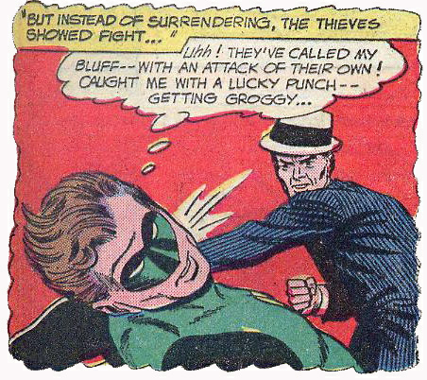
Primary Injury
Extent of injury is a function of:
  force of impact
  acceleratory, deceleratory and rotational forces of the impacting object
  reactive forces of intracranial contents
Beyond the control of the clinician

Slide 6
Primary Injury
Impact loading (contact and inertial)
Impulsive loading (inertial)
Static loading
Physical mechanisms: load and force
Notes:
Impact loading - Collision of the head with a solid object at a tangible speed, combination of contact forces and inertial forces
Inertial force ensues when the head is set in motion with or without any contact force, leading to acceleration of the head.
Contact force occurs when impact injury is delivered to the head at rest.
Impulsive loading - Sudden motion without significant physical contact
Static or quasistatic loading - Loading in which the effect of speed of occurrence may not be significant, rare and occurs when a slowly moving object traps the head against a fixed rigid structure and gradually squeezes the skull, causing many comminuted fractures that may be enough to deform the brain and lead to fatal injury.
Contact or inertial forces may strain the brain tissue beyond its structural tolerance, leading to injury.

Slide 7
Strain
Primary Injury
Compressive - Tissue compression
Tensile - Tissue stretching
Shear - Tissue distortion produced when tissue slides over other tissue
Notes:
Strain is the amount of tissue deformation caused by an applied mechanical force

Slide 8
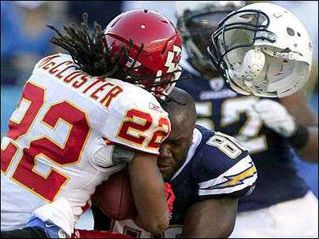
Clinical manifestations
Primary Injury
Focal injury
  Skull fractures
  Contusions
  Lacerations
  Intracranial hematomas
Diffuse axonal injury
  Concussion
Notes:
Contusions- due to displacement of the brain within the skull causing impact, can have unconsciousness for several minutes,
Laceration-most severe of primary brain injuries, characterized by physical disruption of the brain parenchyma hemorrhage can be severe, can accumulate in various spaces within the calvarium (axial and extra-axial)
Diffuse axonal injury is characterized by extensive, generalized damage to the white matter of the brain. Strains of the tentorium and falx during high-speed acceleration/deceleration produced by lateral motions of the head may cause the injuries. Diffuse axonal injury also could occur as a result of ischemia.
Concussion is caused by deformity of the deep structures of the brain, leading to widespread neurologic dysfunction that can result in impaired consciousness or coma. Concussion is considered a mild form of diffuse axonal injury, unconsciousness characterized as brief loss, not associated with any underlying histopathologic lesions, consists of parenchymal hemorrhage and edema, clinical signs range from mild to severe

Slide 9
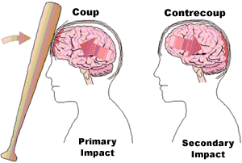
Coup and contrecoup contusions
Can occur alone with impact loading or together with impulsive loading (acceleration/deceleration)
Notes:
Coup contusions occur at the area of direct impact to the skull and occur because of the creation of negative pressure when the skull, distorted at the site of impact, returns to its normal shape
Contrecoup contusions are similar to coup contusions but are located opposite the site of direct impact. Cavitation in the brain, from negative pressure due to translational acceleration impacts from inertial loading, may cause contrecoup contusions as the skull and dura matter start to accelerate before the brain on initial impact
The amount of energy dissipated at the site of direct impact determines whether the ensuing contusion is of the coup or contrecoup type. Most of the energy of impact from a small, hard object tends to dissipate at the impact site, leading to a coup contusion. In contrast, impact from a larger object causes less injury at the impact site, because energy is dissipated at the beginning or end of the head motion, leading to a contrecoup contusion.

Slide 10
Intracranial hemorrhages
Epidural hematoma
Subdural hematoma
Subarachnoid hematoma
Intracerebral hematoma
Notes:
Intracerebral aka axial
All the others are considered extraaxial, literature suggests that extraaxial hemorrhage is rare in dogs and cats after head injury, however mounting evidence that this type of hemorrhage occurs in up to 10% of animals with mild head injury and up to 80% with severe head injury :
-Dewey C, Downs M, Aron D, et al. Acute traumatic intracranial haemorrhage in dogs and cats. Vet Comp Orthop Traumatol 1993;6:153–158. 9.
-Platt SR, Radaelli ST, McDonnell JJ. Computed tomography after mild head trauma in dogs. Vet Rec 2002; 151(8):243. 10.
-Platt SR, Adams V, McConnell F, et al. Magnetic resonance imaging evaluation of head trauma in 32 dogs; associations with modified Glasgow coma score and patient outcome. J Vet Int Med 2007; 21(5):1145.

Slide 11
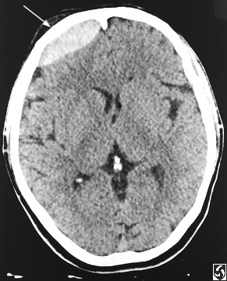
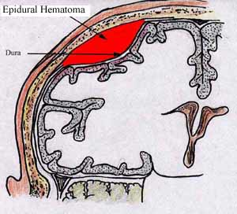
Epidural hematoma
Notes:
When hematoma occurs from laceration of an artery, blood collection can cause rapid neurologic deterioration.

Slide 12
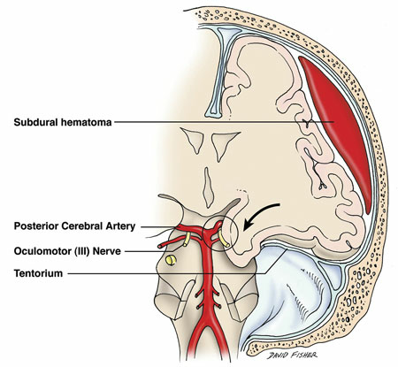
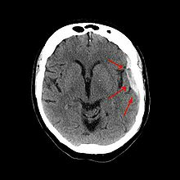
Subdural hematoma
Notes:
Between dura and arachnoid space
The associated mortality rate is high, approximately 60-80%.

Slide 13
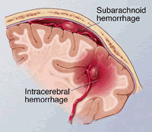
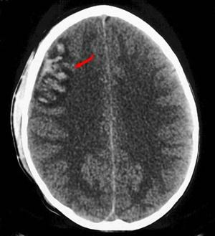
Subarachnoid hematoma
Notes:
. If not associated with another brain pathology, this type of hemorrhage could be benign. Traumatic subarachnoid hemorrhage may lead to a communicating hydrocephalus if blood products obstruct the arachnoid villi or in the event of a noncommunicating hydrocephalus secondary to a blood clot obstructing the third or fourth ventricle.

Slide 14
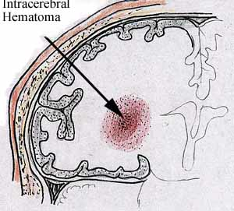
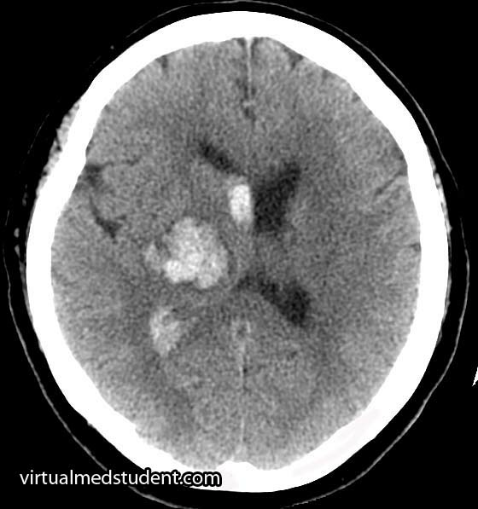
Intracerebral hematoma
Notes:
occur within the cerebral parenchyma secondary to lacerations or to contusion of the brain, with injury to larger, deeper cerebral vessels occurring with extensive cortical contusion.

Slide 15

Causes of primary injury in pets
Automobile induced trauma
Missile injuries (gunshot wounds)
Bite Wounds
Falls
Malicious human activity
Notes:
most dogs were examined following blunt vehicular trauma, while most cats were examined because of a crush injury

Slide 16
Secondary injury

Slide 17
Hemorrhage
Ischemia
Reperfusion
Edema
Secondary Injury
⬆ICP
Vasospasm
Increased metabolism
Excitatory NT
Notes:
According to Silverstein most common factors leading to secondary brain injury are:
Excitotoxicity, ischemia, inflammation, ATP depletion, ROS formation, accumulations of Na and Ca, NO accumulation and Cerebral acidosis

Slide 18
Edema: normal water balance
Notes:
modified version of Starling’s principle applies in the brain, Excess water and solute are efficiently kept out since any water entering the brain does so without any solute and purely under hydrostatic pressure. The opposing osmotic force immediately developed by the retained ions and plasma proteins in the blood then sets up an immediate opposing force driving the water back into the blood

Slide 19
Types of edema
Cytotoxic edema: water accumulation irrespective of endothelial integrity, ie normal BBB
  Increased cellular permeability
  Ion pump failures
  Cellular reasorption of osmotically active solutes
Vasogenic edema: caused by mechanical disruption or functional breakdown of endothlial layer of brain vessels
  Ions and proteins leak into interstitium
Notes:
Osmotic and water imbalance
Can be induced by primary or secondary injury
Cellular swelling is primarily of the astrocytes but can involve the myelin lamallae and dendritic swelling

Slide 20
Mechanisms of cytotoxic edema
Aquaporins-likely passive
Accumulations of CO2, resultant exchange of H⁺ and HCO₃⁻ for Na⁺ and Cl⁻
Ischemia leading to breakdown of glycogen into osmotic bi-products
ROS increasing cellular permeability
Ion pump failure leading to accumulations of Na⁺ and Cl⁻

Slide 21
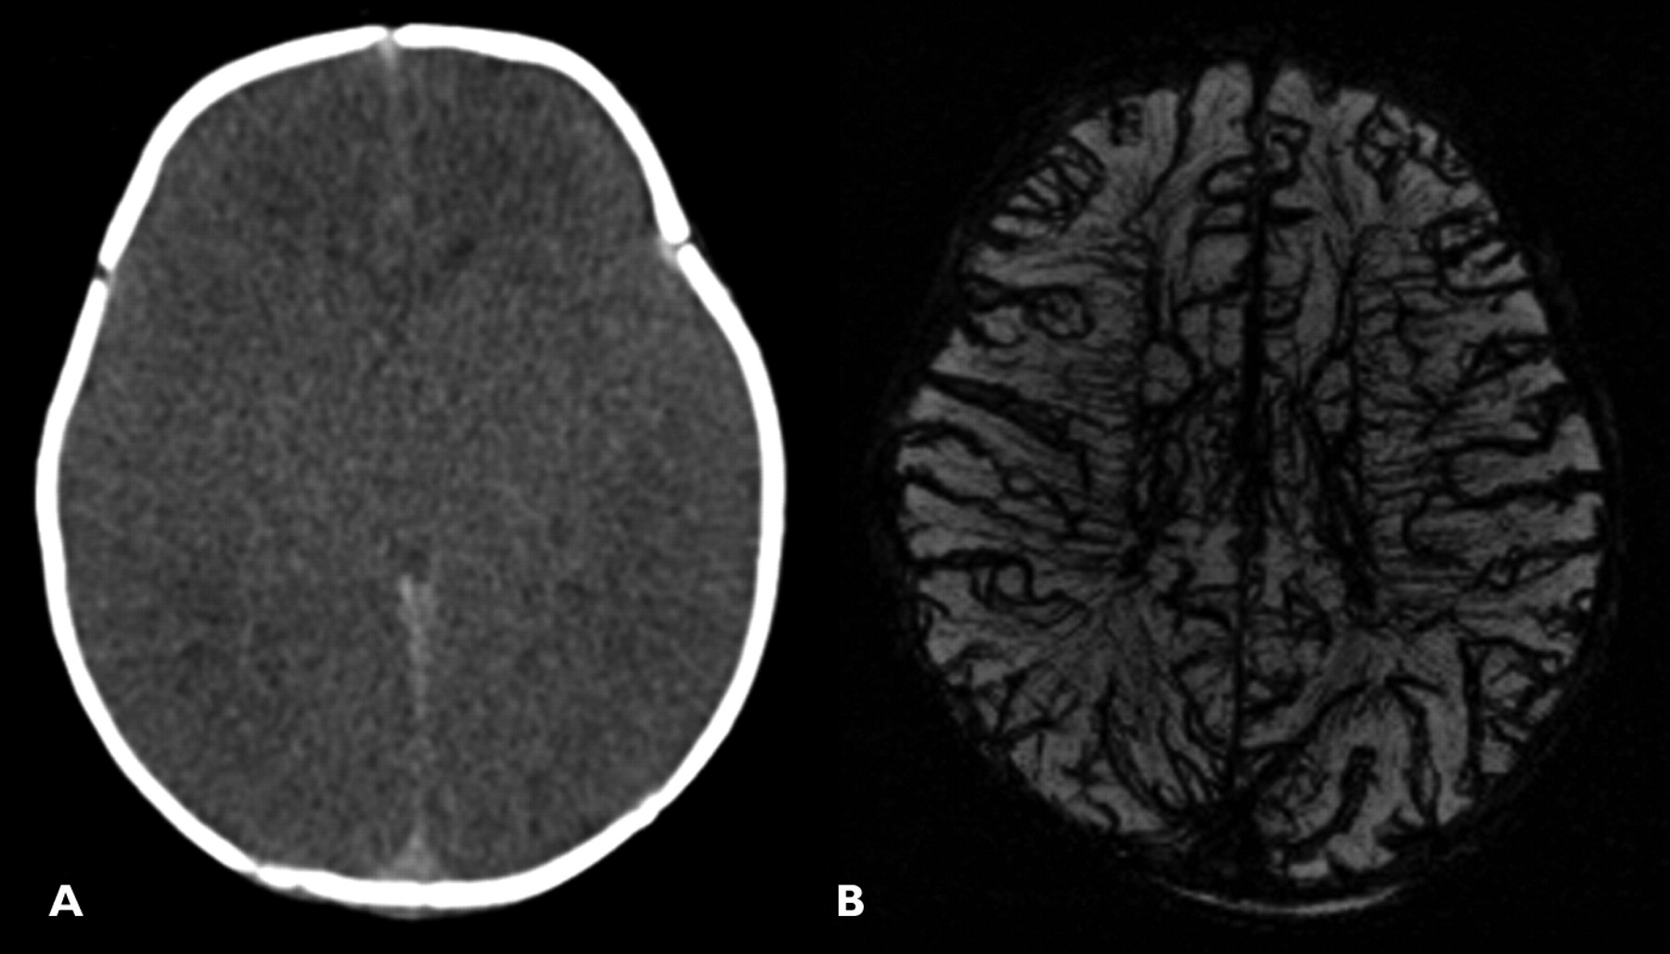
Vasogenic edema
Frequency and contribution in TBI is unclear
Primary etiology is breakdown of BBB→ that includes plasma proteins
Accumulation of fluid within the white matter
May also see cellular swelling (astrocytes) due to uptake of extravasated proteins

Slide 22
Consequences of edema
Increased ICP
Depolarization of cells
Stimulation of Ca⁺⁺ channel allowing influx
Increase release of excitatory NT
Decreased uptake of excitatory NT
Notes:
Cellular swelling can produce numerous deleterious secondary effects in the cell, including (1) membrane depolarization secondary to loss of intracellular K leading to inﬂux of Ca through voltage-gated channels; (2) activation of mechanosensitive channels, leading to direct inﬂux of Ca; and (3) release and decreased uptake of excitatory amino acids, as seen in astrocytes

Slide 23
Intracranial pressure dynamics
Normal ICP for dogs and cats is between 5 and 12 mmHg
Normal contents include brain paranchyma, blood and CSF, normally in equilibrium, where ICP remains constant
Monro-Kellie Doctrine

Slide 24
Monro-Kellie Doctrine
V_{intracranial}=V_{brain} + V_{CSF} + V_{blood} + V_{mass lesion}
Notes:
V is volume
Monroe-Kellie doctrine holds that the skull is a rigid compartment that contains 3 components: brain parenchyma, arterial and venous blood, and CSF
Sudden increases in any of these volumes can lead to dramatic increases in ICP
With severe head trauma, hemorrhage and edema can add to the volume within the cranial vault, As volume increases, one or more of the components of the cavity must accommodate for the increased volume or increase in ICP will occur

Slide 25
Intracranial compliance
Initial accommodation or volume buffering
Accomplished by fluid shifts in the brain vasculature and CSF pathways
Limited buffering capacity
As ICP increases compliance decreases
If ICP increases beyond the limits of the compensatory mechanisms cerebral perfusion is compromised and ischemia of brain tissue occurs

Slide 26
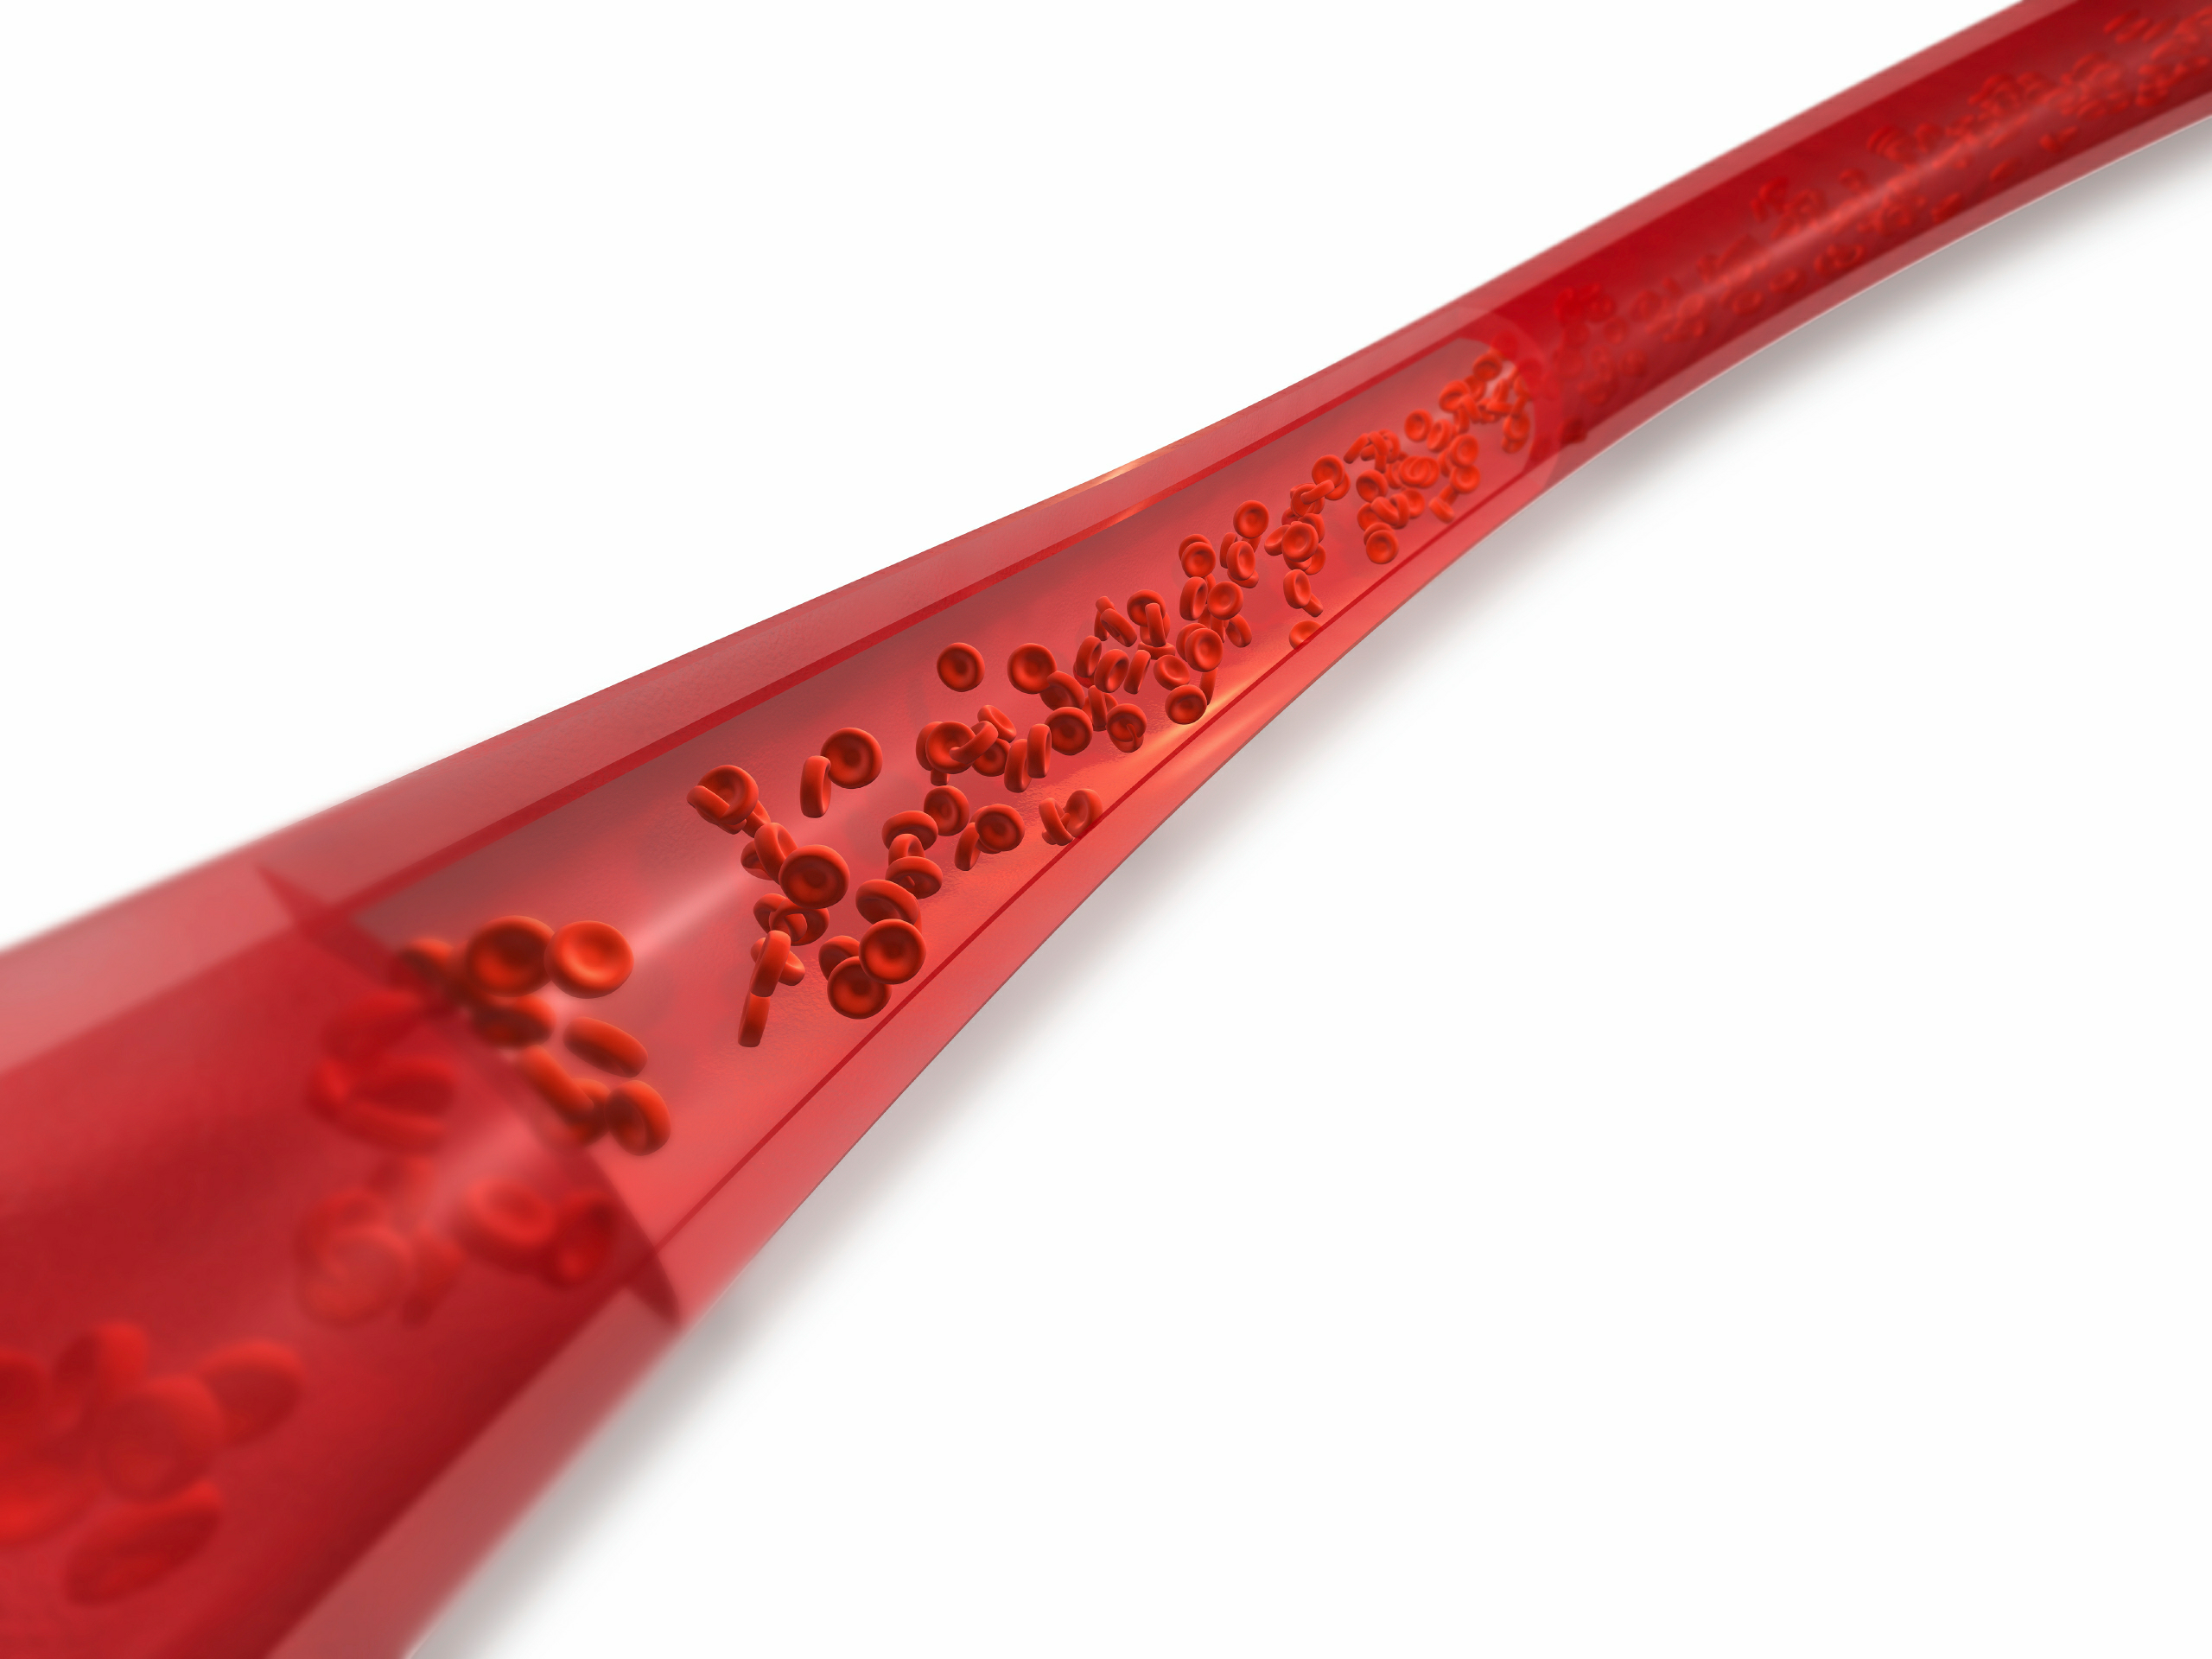
CBV
Only component capable of rapid changes in volume
Poor intracranial compliance: small changes in CBV will lead to significant increases in ICP
Therefore management of CBV is very important in trauma

Slide 27
Cerebral blood flow/volume (CBF)
CBF: volume of blood that traverses the cerebral vasculature per unit time
Carries all oxygen and nutritional support
Cerebral perfusion pressure (CPP) is a primary determinant of cerebral blood flow (CBF)
CBF = CPP/CVR
CPP = MAP - ICP
Notes:
where resistance depends primarily on viscosity and vessel diameter (R = Lη/πr⁴)

Slide 28
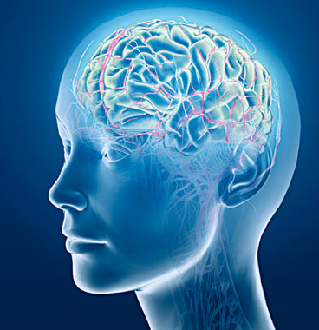
Regulatory factors
Blood pressure
PaCO2
PaO2
Cerebral metabolism
Drugs
Notes:
Pressure autoregulation is a link of systemic BP changes to brain vascular tone, dependent on intact and functional BBB
Increase MAP → vasoconstriction
Decrease MAP→ vasodilation
Chemical autoregulation- direct responsiveness to brain vasculature to the partial pressure of CO2 (PaCO2)
Elevated PaCO2 → vasodilation
Decreased PaCO2 → vasoconstriction
Also includes PaO2 partial pressures less than 60mmHg will lead to increased CBF
Metabolic autoregulation-increases in metabolic rate with increase CBF, see this with seizures fever and pain
Drugs such as Ketamine and inhaled anesthetics lead to vasodilation thereby increasing ICP

Slide 29
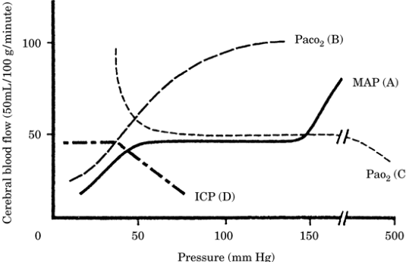
Autoregulation
Notes:
CPP 50-150 mmHg
CO2 20-60 mmHg
O2 <60mmHg

Slide 30
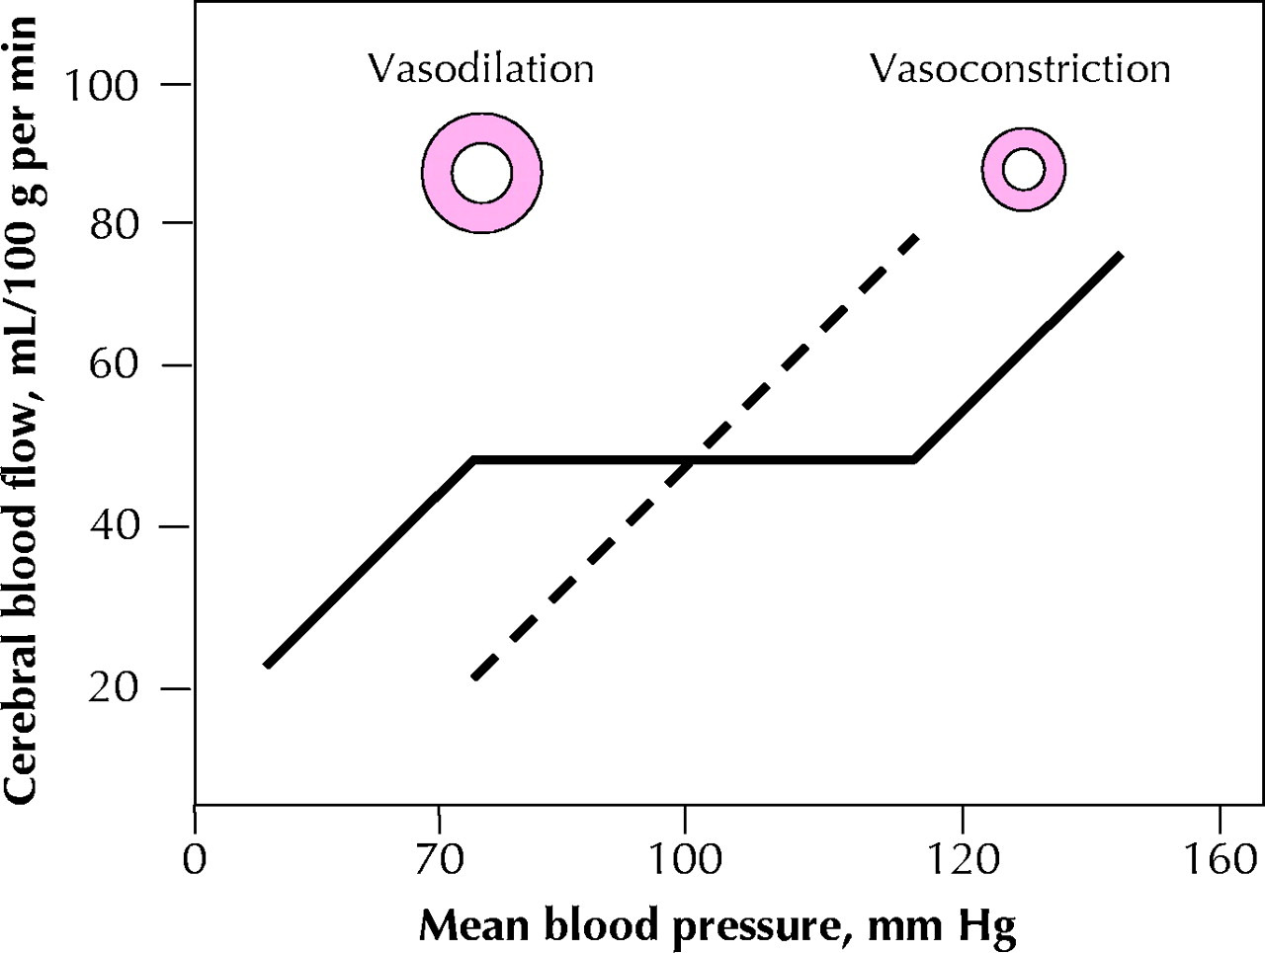

Autoregulation of cerebral blood flow in a normal brain and with loss of autoregulation, as would occur with ischemia
Semplicini A , Calò L CMAJ 2005;172:625-626
©2005 by Canadian Medical Association
Notes:
Fig. 1: Autoregulation of cerebral blood flow in a normal brain and in the ischemic penumbra (the tissues surrounding the ischemic core after a stroke). In the normal brain, cerebral blood flow is kept at 50 mL/100 g per minute, despite continuous fluctuations of mean blood pressure between 70 and 120 mm Hg (continuous line). Any increase in pressure leads to vasoconstriction and any decrease to vasodilation, which prevents the risk of cerebral hyper- and hypoperfusion, respectively. Above and below the limits of cerebral blood flow autoregulation, cerebral perfusion passively follows the perfusion pressure. In the ischemic penumbra, tissue perfusion follows perfusion pressure (dashed line): any fall in blood pressure may precipitate ischemia, while an increase in blood pressure may cause edema and hemorrhagic transformation.
Both forms(pressure and chemical) of autoregulation are often intact in head trauma patients but pressure regulation may be compromised in roughly 30% of patients. (lower BPs)-Dewey
After TBI, CBF autoregulation is impaired or abolished in most patients, no known temporal relationships or correlation with severity, can be transient or persistent-British j of Neurotrauma
Autoregulatory vasoconstriction is more resistant to injury than v.dilation, therefore p more sensitive to damage from low rather than high CPPs
CO2 reactivity only impaired with severe injury, ass with poor outcome-Brit J NT

Slide 31
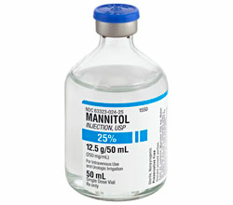
Cushing’s Reflex
Increases in ICP result in decreased CBF
Increased CO2 that is locally sensed at the vasomotor center
Initiates a SNS response leading to an elevated MAP in an attempt to increase CPP
The systemic hypertension is detected by baroreceptors
Reflex bradycardia
Notes:
Baroreceptors located on walls of carotid arteries and aortic arch
This is a sign of potentially life-threatening increase in ICP and should be treated promptly

Slide 32
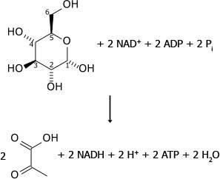
Glucose Metabolism
Increased glucose utilization (30 min-4 hrs) followed by decreased utilization (5-10 days)
Initial hyperglycolysis from disrupted ion gradients and activation of energy dependent ion pumps
Cerebral lactic acidosis
Notes:
In patients with relatively preserved oxidative metabolism, brain uptake of lactate has been associated with improved outcome
Outcome is worse with decreased metabolic rates compared to those w no dysfunction
Severely head injured patients frequently show cerebral lactic acidosis
Post-injury cerebral lactate production is marked by an acute and extended increase in CSF and a negative ateriovenous difference in lactate content
Several investigators have shown a rise in lactate concentration in CSF and in brain tissue within initial 60min following mild to moderate fluid percussion injury in rat models

Slide 33
Lactate concentration following concussive brain injury
Nilsson et al, J Cereb Blood Flow Metab 1990; 10:631-637
Notes:
Weight drop model of injury, showed a 4 to 5 fold increase in the dialysate concentration of lactate for about 80 min post injury; they also demonstrated a signigicantly higher elevation of lactate as injury severity increased.

Slide 34
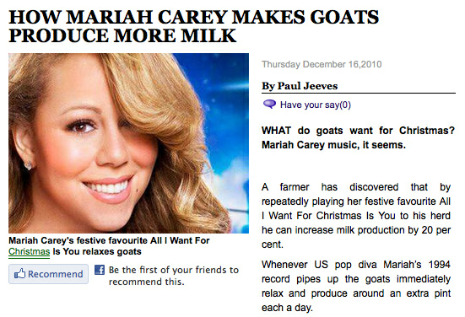
Reasons for increased lactate
Decreased oxydative metabolism
Hyperglycolysis
Produced by astrocytes for energy

Slide 35
Consequences of lactate
Increased lactate may generate neuronal dysfunction as a result of:
  acidosis
  membrane damage
  disruption of the BBB
  cerebral edema
May also make neurons more susceptible to secondary ischemic insults
Increase in CSF production could lead to increases in ICP

Slide 36
Excitatory neurotransmitters
Synthesized within the neuron
Predominantly stored in nerve terminals
Action is dependent on receptor type
Don’t cross BBB
Glutamate makes up the majority (75%) of all excitatory neurotransmission
Notes:
Additional storage in astroglial cells

Slide 37
Glutamate receptors
NMDA
  Wide distribution
  Ligand and voltage are needed
  Major physiologic role
  Ca⁺⁺and Na⁺ influx
AMPA
  Ionotropic
  Permeable to Na⁺ and K⁺
ACPD
  Metabotropic
  Ca⁺⁺ release from ER via PLC (G-proteins)
Kainate
  Limited distribution
  same role as AMPA
L-AP4
  Pre-synaptic,
  provide negative feedback
Notes:
NMDA stands for N-methyl-D-aspartate
Kainate receptors function similarly to AMPA

Slide 38
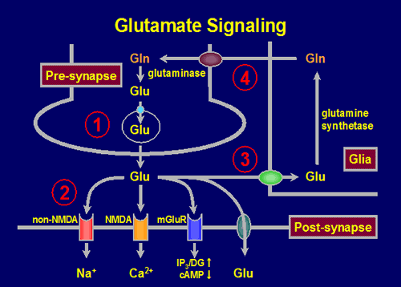
L-AP4
Na
AMPA
NMDA
ACPD
Maintained by
Na/K-ATPase
Na
Notes:
Notice the two receptors that bring GLU back in to the cells, they are coupled with Na and this is a very ENERGY dependent process (2Na:Glu)
There is also a chloride dependent Glutamate carrier

Slide 39
NMDA receptors
When open can conduct Ca⁺⁺ and Na⁺
Two “keys” needed to unlock this potential
Seven different binding sites
This safety only maintained with normal resting membrane potentials
With Na/K-ATPase failure, even resting glutamate concentrations will open channels
Ca⁺⁺ can cause additional release by changing threshold for AP initiation
Notes:
Neuron must be able to rapidly bind (binding proteins), sequester (ER and mitochondria), and extude (Na/Ca exchanger, Ca-ATPase) to prevent cytotoxicity

Slide 40
NMDA receptor regulation
Notes:
Seven binding sites regulating the degree of Na and Ca influx

Slide 41
Pathologic accumulation of glutamate
Dysfunction of Na/K-ATPase (decreased re-uptake)
Positive feedback (Ca⁺⁺ mediated)
Leakage from damaged neighboring cells
Energy deprivation (⬇conversion to glutamine)
Notes:
Elevated levels have been documented in rats, cats, rabbits and humans following brain injury
The higher the concentration of glutamate the worse the cellular injury and outcome
Concentration also associated with severity
Bullock et al.- have used intracerebral microdialysis to study excitatory amino acid release in severe TBI in 80 consecutive human patients. Their main findings were as follows: 1) Dialysate excitatory amino ac- ids were elevated in 30% of their patient population. 2) In contradistinction to animal studies showing a transient and brief increase in glutamate after TBI, the elevated levels in human TBI can persist up to 4 days. 3) High glutamate levels are correlated with high ICP and poor outcome.

Slide 42
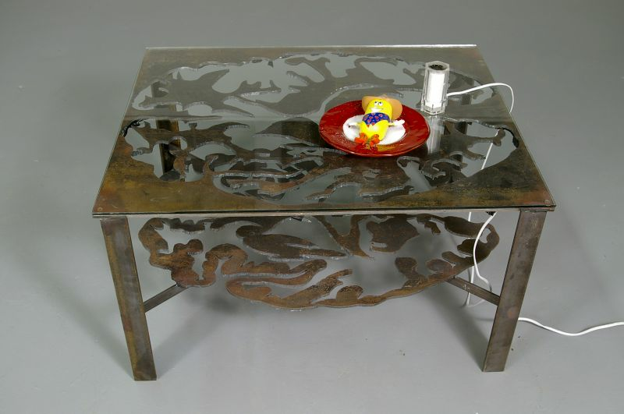
Glutamate excitotoxicity
Osmotic damage
Increased cytosolic Ca⁺⁺
Direct toxicity
Notes:
Glutamate binding leads to influx of Na and Cl, export out of the neuron requires energy, eventually accumulates leading to intracellular mechanisms we will discuss in next slides, but also cellular edema→ necrosis and apoptosis, in addition with these accumulations you will see reversal of the Na/glutamate receptor with additional glutamate
Two different receptors bring Ca intracellularly, major player in injury
Exact mechanism unknown-does cause morphological changes of the dendrites that eventually seem to lead to cellular apoptosis or necrosis

Slide 44
Notes:
Study done by Chamoun et al. involved 165 head trauma patients with GCS < 8.
Initial GLUTAMATE concentrations were predictive of poor outcome (both mortality and functional outcome at 6mos)
-30% mortality if [GLU] > 20mmol/L
-18% mortality if [GLU] < 20mmol/L
Also noticed Patterns as illustrated above

Slide 45
Pattern and outcome

