Slide 1
Parvovirus
Joel Green Weltman
October 18, 2011

Slide 2
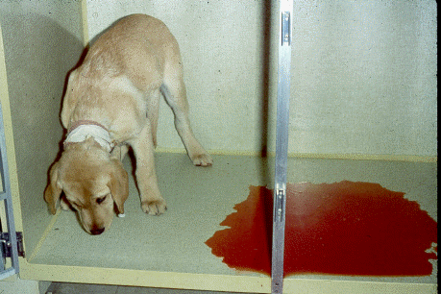
Canine parvovirus

Slide 3
PARVOVIRUS
Canine parvovirus
Feline parvovirus

Slide 4
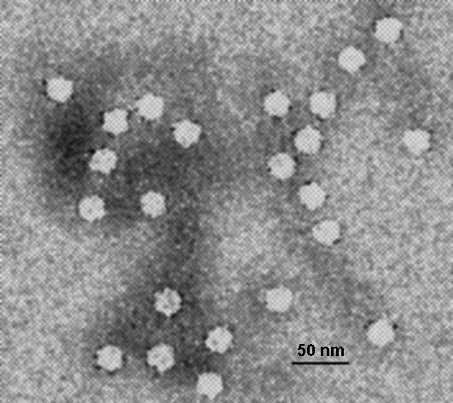
Canine Parvovirus
Virology and Epidemiology
DNA virus
Evironmentally stable
Mortality Rate:
  No therapy: 91%
  Aggressive therapy: 4-48%
Seasonality: July-September
Antigenic variability
  Types 2a, 2b, and 2c most prominent
Notes:
Small, nonenveloped, single-stranded DNA viruses
Environmentally stable, persist 5 months or longer on objects
Resistant to many of the traditional cleaning products
Epidemiology
Original strains only effected dogs, however nower strains have naturaly infected cats
Severe illness most common in young animals with comorbid intestinal infections
Spread in fecal-oronasal route with fomitic transmission common
Fecal excretion occurs 3-4 days after exposure, commonly before clinical signs develop
Almost exclusively affects puppies 6 wks-6 mths
Antigenic variability: initial strains isolated in shelters in the 1970s were deemed to be Canine parvovirus 2, which underwent rapid change to 2a and 2b
In 2000 a new antigenic variant was isolated called 2c, initially in Italy but recent work showing it is cropping up all over the place
Has been found to be causing severe disease even in vaccinated individuals
Has been found to have low sensitivity of traditional testing methods late in the course of disease

Slide 5
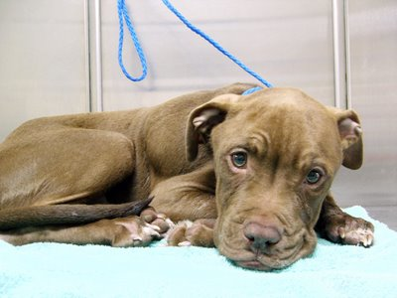
Canine Parvovirus
Risk factors
Lack of protective immunity
Unsanitary/overcrowded conditions
Endoparasitism
Breed:
  Rottweiler
  Doberman
  Labrador
  Pit bull
  German Shepherd
  Alaskan Sled dog
Notes:
Article in JVECC 2007 by Nemzek, predisposed breeds (doberman and rotties) investigated and found to have greater production of TNFalpha from monocytes with lipopolysaccharide stimulation

Slide 6
Canine Parvovirus
Disease course
Replication in oropharynx locally
Viremic state
  3-5 days post-infection
Rapid dividing cells
  Lymphoid tissues
  Intestinal epithelium
  Bone marrow
  Heart

Slide 7
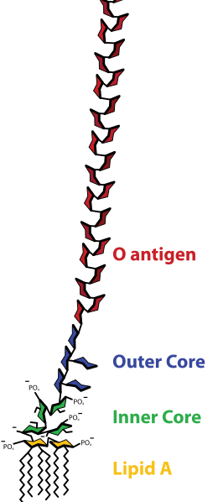
Canine Parvovirus
Clinical Findings
  Enteritis
  Leukopenia
  Neurologic disease
  Cutaneous disease
    Erythema multiforme
  Myocarditis
  Hypercoagulability
Notes:
Replicate rapidly in actively dividing cells
Initial clincial signs are anorexia, depression and fever
Enteritis
Virus reaches intestinal mucosa 4-5 days post infection
Vomiting and diarrhea typically occurs 24-48 hours following onset of initial signs
Due to loss of the intestinal villus and absorptive capacity of the GI tract
Develop hemorrhageic diarrhea
Resultant gram negative sepsis leads to death
Leukopenia
Transient lymphopenia is classic sign
More severe cases develop panleukopenia secondary to lymphoid necrosis
Neutrophils often also get sequestered in the GI
Lack of cytopenia is positive predictor of survival
Immunosuppression
Predisposition to UTI and IV catheter infections
Neurologic disease
Typically thought to be from intracranial hemorrhage secondary to DIC or hypoglycemia
Reports of diffuse leukoencephalomalacia, thought to be secondary to ischemia from severe myocardial lesions
Cutaneous disease
Previously one case report of an individual dog
Recent report of 2 english setters with EM and had canine parvovirus 2b isolated from tongue, spleen, skin, lymph node and small intestine
Myocarditis
Wide spectrum of presenting signs from myocarditis
Occurs from in-utero infection or infection up to 8 weeks of age
Hypercoagulability
DIC has long been recognized as a result of gram negative sepsis
Platelet loss also seen from decreased bone marrow production
Loss of AT from GI tract thought to pontentiate hypercoagulbility

Slide 8
Canine Parvovirus
Clinical Findings
Oxidative stress profiles
Significant increase in lipid peroxide in moderate and severely affected dogs
Increased activity of catalase in moderate and severely affected dogs
Increased activity of superoxide dismutase in moderately affected dogs
Panda, 2009

Slide 9
Canine Parvovirus
Clinical Findings
Plasma citrulline levels
Amino acid derived from production of enterocytes
Marker of global enterocyte mass
Parvovirus enteritis had significantly decreased citrulline levels
No significant difference in prognosis based on citrulline levels
Dossin 2011
Notes:
Has been shown to be decreased in human small intestinal diseases and higher bacterial translocation
Looked at 61 cases of natural parvovirus infection

Slide 10
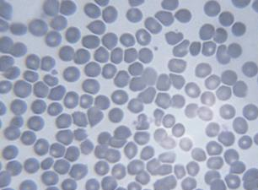
Canine Parvovirus
Diagnostic findings
Lymphopenia
Prerenal azotemia
Elevated liver enzymes
Hypoalbuminemia
Hypokalemia
Hypoglycemia
Notes:
Lymphopenias suggested to be caused by: acute infection and release of cortosol with trapping of lymphocytes in the lymph nodes, direct effect of the virus to destroy lymphoid tissue or loss, sequestration or blackage of flow as seen with PLEs
Impaired monocyte function is believed to play a role in increased susceptibility to secondary infections
Goddard et. al showed signififfant difference in occurrence of leukocytopenias between groups at 24 and 48 hours postadmission. Survivors showed significant increase over time in leukocyte types (specifically lymphocytes), recommended prognostication based on leukocyte counts at 24 hrs postadmission and change in total number, bands (presence carries good prognosis), lymphocytes, monocytes and eosinophils
Elevated liver enzymes secondary to severe dehydration and tissue hypoperfusion
Hypoalbuminemia secondary to GI losses
Hypokalemia secondary to inadequate intake and increased losses
Hypoglycemia from severe sepsis and malnurishment

Slide 11
Canine Parvovirus
Endotoxemia and TNF activity
17 dogs with Parvovirus
82% of dogs had circulating measurable endotoxin
33% of dogs had increased TNF activity
Association between increasing TNF and mortality
Otto, et. al 1997
Notes:
Trend (not significant) for increasing endotoxin activity to predict mortality

Slide 12
Canine Parvovirus
Serum Acute-Phase Proteins
Infected dogs vs. controls
  Higher CRP, ceruloplasmin, and haptoglobin
  Lower albumin
Survivors vs. nonsurvivors
  Significantly higher CRP and ceruloplasmin
Kocaturk 2010
Notes:
Dogs with CPV compared to controls
CRP was more sensitivty with a 91% sensitivity to predict mortality in values higher than 92.4

Slide 13
Canine Parvovirus
Ultrasonographic appearance
Significant reduction in duodenal and jejunal mucosal layer thickness
Mucosal layer with diffuse hyperechoic speckles in duodenum and jejunum
Irregular duodenal luminal surface
Corrugations in duodenum and jejunum
Mild to moderate amount of free peritoneal fluid
Normal jejunal lymph node size
Stander 2010
Notes:
No pathognomotic findings, just all these signs together is highly suggestive

Slide 14
Canine Parvovirus
Lipid profiles
Lower mean total cholesterol in CPV
Higher mean triglyceride in CPV
Negative correlation between serum TNF and total cholesterol
Positive correlation between serum TNF and triglyceride levels
Yilmaz 2007
Notes:
Investigators suggest using total cholesterol levels (low being bad) and triglyceride levels (high being bad) as an index of severity for parvo
Unclear whether they play any role in the course of disease
Thought that TNF plays a role in the development of these abnormalities.

Slide 15
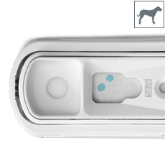
Canine Parvovirus
Diagnosis
  Fecal ELISA
  Electron microscopy
  Virus isolation
  Hemagglutination
  Latex agglutination
  Counterimmunoelectrophoresis
  PCR
  Serology
Notes:
Fecal ELISA for inhospital use
antigen capture method
Relatively sensitive and specific
Previously positive from recent vaccination, proven no cross reaction as per the company
VIRAL PARTICLES SHED IN FECES DAYS 3-12 POST-INFECTION
Reported false-positive 3-10 days after vaccination w/ modified live CPV vaccine
False negatives: binding of serum neutralizing antibodies w/ antigen in diarrhea or cessation of fecal viral shed, late in the course of disease of CPV-2c
One studyby Decaro, et al in Veterinary Journal 2010 investigated the three strains and got sensitivities of 80.4, 78, and 77% for a, b, and c but the paper was funded by idexx and authors suggested PCR for negative with high clinical suspicion
Virus isolation
If performed early can find in feces as well as tissues
Hemagglutination
High titers after 3 days of clinical disease is diagnostic for CPV
PCR has higher sensitivities and specificities than conventional methods
Serology is available
25-90% of healthy unvaccinated dogs can be seropositive
must demonstrate IgM class or have consistent clinical signs
good for ruling out disease if you get a negative result though
d

Slide 16
Canine Parvovirus
Therapy
  Intravenous fluids
  Correction of hypoglycemia
  Broad spectrum antibiotics
  Antiemetics
  Aggressive nutrition
  Broad spectrum dewormer
  Plasma?
Notes:
IV fluids, maintenance of normovolemia
May need to use colloids depending on degree of protein losing dz
Hypokalemia also common and should be corrected
Correction of hypoglycemia
Broad spectrum antibiotics
Bacterial translocation in the face of peripheral neutropenia
Beta-lactam and aminoglycoside (not until well hydrated)
May increase release of endotoxin
May lead to bacterial overgrowth of clostridium perfringens
Antiemetics
Motility agents not typically recommended
Aggressive nutrition-early enteral nutrition has been shown to be beneficial
nutrition paper the EEN group showed significantly earlier appetite improvement, and significant weight gain
significantly decreased % urinary lactulose suggested to reflect improved gut barrier funciton
no difference between albumin concentrations or survival
Broad spectrum dewormer
Plasma
Useful as a colloidal
Data lacking to support contribution to albumin or protein
Conferring antibody protection only in anecdotal reports

Slide 17
Canine Parvovirus
Therapy
Recombinant Human Granulocyte Colony Stimulating factor
  Effective in neutropenia of chemotherapy or radiation therapy
Causes of lack of effect
  Low storage pool
  Lack of receptors
  Lag time
Complications: neutralizing antibodies
Rewarts 1998
Mischke 2000
Notes:
Recombinant human granulocyte colony stimulating factor (neupogen) shown to effective in neutropenia of chemotherapy, and radiation therapy
reports are contradictory on the influence on canine parvovirus, some had an increase in counts and others showed no influence on survival
mischke: one study showed no difference in naturally occuring presumed parvo (consistent sigsn) in regards to mortality, neutrophil and leukocyte counts
rewarts: diagnosed parvo puppies 11 treated puppies and 12 not treated, no difference between groups in hospital stay, neutrophil count at first time neutropenias dectect, lowest neutrophil count, or length of time they were neutropenic
postuated reasons for lack of effect: depletion of storage pool, lack of appropriate receptors, lag time of 2-3 days before results in a measurable effect
complications: develop neutralizing antibiotics w/in 3 weeks of tx→decline in leukocyte counts

Slide 18
Canine Parvovirus
Treatment
Recombinant Canine Granulocyte Colony Stimulating factor
  Higher white blood cell counts
  Higher neutrophil counts
  Reduced hospitalization times
  Decreased survival times
Duffy 2010
Notes:
Compared 28 dogs w/ natural infection parvo treated with rCGCSF to 34 dogs with parvo and not treated with drug
There were small patient numbers and authors suggest mortality rate was due tot chance
Humans treated with recombinant GCF have shown to have rare, serious adverse effects including pulmonary injury, platelet reduction, coag abnormalities and cardiovascular disorders
Suggest repeated study with larger numbers

Slide 19
Canine Parvovirus
Therapy
Endotoxin Neutralization
Polyvalent equine-origin antiendotoxin antiserum
31% decrease in mortality
Increase in mortality in puppies 16 weeks old or less
Notes:
Endotoxin neutralization: one study showed a decrease in mortality by 31%, others have shown an increase in mortality in puppies < 16 weeks of age

Slide 20
Canine Parvovirus
Therapy
Human recombinant bactericidal permeability-increasing protein (rBPI₂₁)
Naturally found in PMN granules
Cytotoxic to gram-negative bacteria
Inhibitory to free LPS
No significant effect on plasma endotoxin concentration
No survival advantage over standard care
Otto, 2001

Slide 21
Canine Parvovirus
Therapy
Recombinant feline interferon ω
Significant reduction in severity of enteritis and decreased mortality (Martin 2002)
4.4-fold overall reduction in mortality (de Mari 2003)
Notes:
First study had a dose of 1-2.5 MU/kg/day IV for 3 days after innoculation-so it was not naturally aquired CPV
Second study was dose 2.5 MU/kg IV for 3 days in dogs w/ naturally aquired CPV
Feline interferon omega has been shown to be beneficial; however the study was sort of shady

Slide 22
Canine Parvovirus
Therapy
Oseltamivir
Neuraminidase inhibitor
Treatment group had significantly more weight gain
Significant lack of decline in WBC count in treatment group
No difference in hospitalization time, treatments needed, morbidity or mortality
Savigny 2010
Notes:
Inhibits viral NA enzyme and prevents cleavage of sialic acid residues
Recruitment study, naturally aquired CPV
Compared to standard therapy, blinded, and randomized
No decrease in hositalization time, treatments needed, clinical scoring, morbidity or mortality
no difference b/t groups in length of time since development of signs,
First line drug for flu epidemics and use for parvovirus may be contraindicated due to contribution to resistance

Slide 23
Canine Parvovirus
Prevention
Maternal antibodies
Vaccination
Environmental control
Twark 2000
Notes:
Maternal antibodies present with half life about 10 days
Vaccines cross protective against CPV-2, 2a and 2b however skepticism for protection against CPV-2c
Recent work shown that vaccination at 4 and 6 weeks of age with high titer vaccine high earlier seroconversion rates
93.7% will have protective immunity at 2 years post vaccination
those recovering from active infection have lifelong immunity
Environmental control recommendations for bleach with 1 hour exposure time

Slide 24

FELINE PARVOVIRUS

Slide 25
Feline Parvovirus
Epidemiology
DNA Virus
Environmentally Stable
Mortality Rate: approximately 50%
Transmission
  Contaminated environment
  In utero infections are also possible
Notes:
DNA virus: Infection with FPV and CPV in cats undergoes a similar disease course except for a few differences
Transmission
Most transmission are contact with contaminated environment
Short shedding period (typically 1-2 d but up to 6 weeks post-recovery) with long environmental stability
In utero infections are also possible

Slide 26
Feline Parvovirus
Pathogenesis
Replication in the lymphoid tissues
  Results in loss of WBC production
Selective replication in the intestinal crypt cells
  Resulting in loss of villus
In utero infection
  Early in pregnancy
  Late in pregnancy
Myocarditis
Notes:
Initial virus replication in the lymphoid tissues results in loss of WBC production
Secondary bacterial infections are common with with DIC with gram negative endotoxemia
Virus selectively replicates in the intestinal crypt cells resulting in loss of villus
In utero infections
Early in pregnancy: fetal death with resorption, abortion or mummified fetuses
Late in pregnancy: damage to late developing neural tissues, particularly cerebellum
Myocarditis
FPV has been isolated from cats dying from idiopathic HCM, DCM and RCM

Slide 27
Feline Parvovirus
Clinical Disease
Acute onset disease
  Depression, anorexia and vomiting
  Rapidly progressive
Leukopenia
  Noted first with sequestration in the GI tract
  Bone marrow suppression
Notes:
Typically present with acute onset disease consisting of depression, anorexia and vomiting
Diarrhea is uncommon and typically only seen late in the disease
Rapid progression of disease is common with high mortality due to secondary infection and DIC
Animals surviving infection beyond 5 days typically recover after several weeks supportive care
Leukocytes at lowest typically 50-3000 cells/μL.
Typically neutropenia noted first with sequestration in the GI tract
Panleukopenia results from bone marrow suppression
Lymphopenia is typically more pronounced with CPV infections than FPV infections

Slide 28
Feline Parvovirus
Diagnosis
Fecal ELISA
  CPV test
  Early detection
  Based on virus neutralization antibody testing
Viral isolation and PCR available from tissues
Notes:
Fecal ELISA
CPV test is sensitive and specific for FPV
Investigated by Abd-Eldaim et al, 97 suspected cats based on signs, positive results found in 55 samples, confirmed by PCR
May only be positive 24-48 hours post infection, prior to the development of clinical signs
Serologic testing available based on virus neutralization antibody testing

Slide 29
Feline Parvovirus
Prognostic factors
Low leukocyte count
Thrombocytopenia
Hypoalbuminemia
Hypokalemia
Kruse 2010
Notes:
Risk of death is 1.77 times higher if leukocyte count is less than 1,000 compared to cats w/ leukocyte count up to 2500, and 1.85 times higher if greater than 2500

Slide 30
Feline Parvovirus
Treatment and Prevention
Treatment
Maternal antibody
Vaccination
Environmental control
Notes:
Treatment is generally the same as CPV with supportive care
High number of subclinical cats with only small proportion of infected cats showing clinical disease
Kittens generally protected from materal antibody up to 3 months of age
Vaccinations are recommended yearly but protection is thought to exist up to 6 years post vaccination
Environmental control is important, similar to CPV

Slide 31
References
Greene CE. Infectious Disease of the Dog and Cat. 3rd Ed. 2006.
Prittie J “Canine parvoviral enteritis: a review of diagnosis, management and prevention.” JVECC. 14(3): 2004.
Otto CM, Drobatz KJ, Soter C. “Endotoxemia and Tumor Necrosis factor activity in dogs with naturally occurring parvoviral enteritis.” JVIM. 11(2): 1997.
Rewerts JM, McCaw DL, Cohn LA, et al. :Recombinant human granulocyte colony-stimulating factor for treatment of puppies with neutropenia secondary to canine parvovirus infection.” JAVMA 213: 1998
Otto CM, Jackson CB, Rogell EJ, et al. “Recombinant bactericidal/permeability-increasing protein (rBPI21) for treatment of parvovirus enteritis: a randomized, doubleblinded, placebo-controlled trial. JVIM. 15: 2001.
Martin V, Najbar W, Gueguen S, et al. “Treatment of canine parvoviral enteritis with interferon-omega in a placebo- controlled challenge trial.” Vet Microbiol 89: 2002.
de Mari K, Maynard L, Eun HM, et al. “Treatment of canine parvoviral enteritis with interferon-omega in a placebocontrolled field trial.” Vet Rec 152: 2003.
Savigny M, Macintire D. “Use of oseltamivir in the treatment of canine pavoviral enteritis.” JVECC. 20: 2010.
Panda D, Patra RC, Nandi S, Swarup D. “Oxidative stress indicies in gastorotenteritis in dogs with canine parvoviral infection.” Res in Vet Sci. 86: 2009.
Duffy A et. al. “Hematologic improvement in dogs with parvoviral enteritis treated with recombinant canine granulocyte-colony stimulating factor.” J Vet Pharmacol Ther. 33: 2010.
Kocaturk, et. al. Prognosic values of serum acute-phase protein in dogs with parvoviral enteritis. JSAP, 51; 2010.

Slide 32
References
Dossin O, Rupassara SI, Weng, HY, Williams da, Garlick PJ, Schoeman JP. “Effect of parvoviral enteritis on plasma citrulline concentrations in dogs. JVIM. 25: 2011.
Stander N, Wagner W, Goddard A, kirberger R. “Ultrasonographic appearance of canine parvoviral enteritis in puppies.” Vet Rad and Ultra. 51: 2010.
Goddard A, Leisewitz A, Christopher M, Duncan N, Becker PJ. “Prognostic usefulness of blood leukocyte changes in canine parvoviral enteritis.” JVIM. 22:2008.
Mischke R, Barth T, Wohlsein P, et al. Effect of recombinant human granulocyte colony-stimulating factor (rhGCSF)on leukocyte count and survival rate of dogs withparvoviral enteritis. Res Vet Sci 2001; 70:221–225.
Mohr, AJ et. al. “Effect of early enteral nutrition on intestinal permeability, intestinal protein loss and outcome in dogs w/ severe parvoviral enteritis.” JVIM. 17:2003.
Twark L. Dodds WJ. “Clinical use of serum parvovirus and distemper virus antibody titers for determining revaccinatino strategies in healthy dogs.” JAVMA. 271(7): 2000.
Yilmaz Z, Senturk S. “Characterisation of lipid profiles in dogs with parvoviral enteritis.” JSAP. 48: 2007.
Potter TM, Macintire DK. “Hepatozoon americanum: an emerging disease in the south-central/southeastern United States.” JVECC. 20(1): 2010.
Beeler E. “Influenza in Dogs and Cats.” Vet Clinics of Small Animal Practice. 39: 2009.
Kruse BD, et al. Prognostic Factors in cats with Feline Panleukopenia. JVIM. 24: 2010

