Slide 1
Other respiratory tests
By Joel Green Weltman

Slide 2
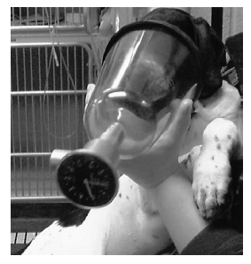
Dynamic lung volumes
Spirometry
Spirometry measures volumes
Measures changes in volume
Attached to airtight face mask, endotracheal tube, or part of a ventilator circuit
Other function tests provide more useful data and are typically preferentially used

Slide 3
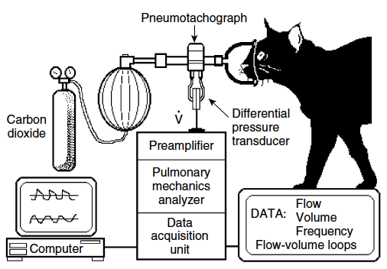
Dynamic lung volumes
Pneumotachography
Measurements:
Expired and minute volume
Flow rates
Duration of breath segments
Computer analysis generates flow/volume loop
Airway resistence
Requires:
Pressure Tubing
Low flow differential pressure transducer
Amplifier
Digitizer
Data acquisition software
Forced expiratory maneuver:
Forceful exhalation promotes airway closure
Tidal breathing can be enhaced by temporary expposure to carbon dioxide

Slide 4
Measurement of resistance
Esophageal balloon method
Pressure of esophagus assumed to be analgous to intrapleural pressure
Intrapleural pressure estimates transpulmonary pressure
Resistance is calculated using esophageal pressure change and flow change during a breath

Slide 5
Measurement of compliance
Dynamic compliance
Calculated as the change in tidal volume divided by change in intrapleural (esophageal) pressure
Static compliance
Volume and pressure changes are measured as the lung is incrementally inflated typically to total lung capacity
Allows for measurement of compliance without the effect of resistance

Slide 6
Static lung volume measurement
Inert gas
Patient breathes known concentration helium
FRC=V₁(C₁-C₂)/C₂
C₁ and V₁ are starting concentrations and volume of helium
C₂ is the ending concentration of helium

Slide 7
Body Plethysmography
Measurements:
Static and dynamic lung volumes
Inspiratory/expiratory times
Inspiratory/expiratory flow rates
Airway resistance
Response to therapy
Bronchodilation
Airway surgery (brachycephalic, laryngeal paralysis)

Slide 8
Body plythesmography
Traditional methods
Patient sits in an airtight box and breathes through a mouthpiece
Mouthpiece has a shutter that may be opened and closed
Subject breathes against closed shutter
Change in pressure of mouth is interpreted as alveolar pressure
Change in pressure of the box is interpreted as thoracic gas volume
FRC=change in volume/change in pressure x (barometric pressure-water vapor pressure)
Largely not used due to methodology

Slide 9
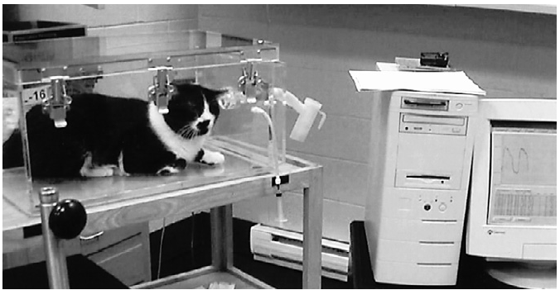
Body plythesmography barometric whole-body
Patient is in an airtight container
Known flow of air in
Pneumotachograph with known resistance controls air leak
Pressure transducer mouted to detect changes in pressure within the chamber

Slide 10
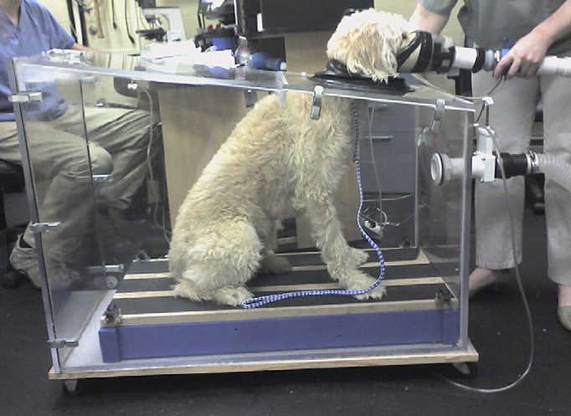
Body plythesmography head out plythesmograph
Patient is placed in an box with shroud forming airtight seal around neck
Head sticks out the box
Face mask applied and directly connected to the box to maintain a closed system

Slide 11
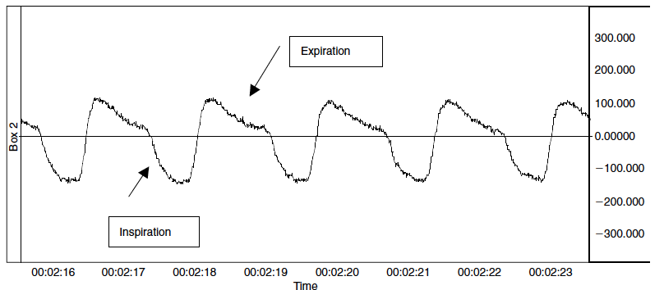
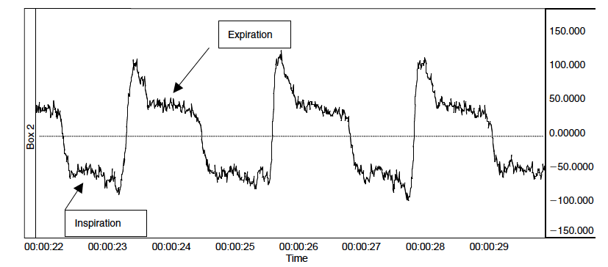
Body plythesmograph tracings
Measured values can be plotted against time:
Normal
Change in volume/time
Airway obstruction
Change in volume/time

Slide 12
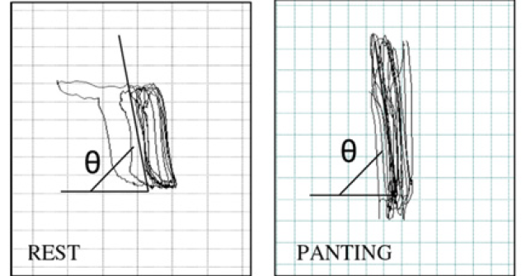
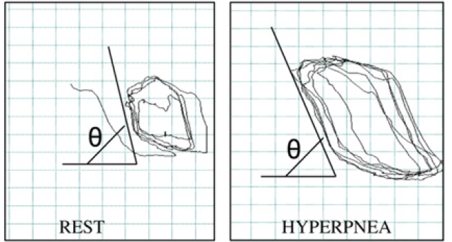
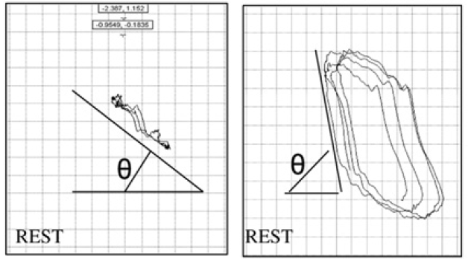
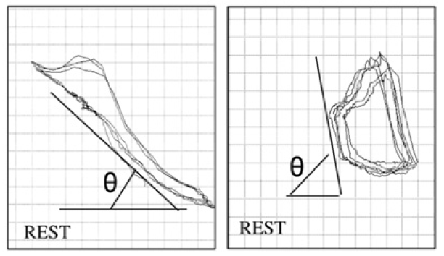
Body plethysmography tracings
Measurements can be computed into loops
Normal flow/volume Bronchitis flow/volume
Laryngeal paralysis flow/volume Bronchiectasis flow/volume
Presurgery Post-surgery Presurgery Post-pneumonectomy

Slide 13
Diagnostic pulmonary scintigraphy
Utilizes labeled carriers
Macroaggregated albumin labeled with technetium
Albumin becomes lodged in pulmonary capillary bed following injection in peripheral vein
Defines blood flow to lungs in PTE
When evaluated with concurrent inhalation of MAA, processed imaged called parametric image and evaluated V/Q mismatch
Following radioactive decay, gamma rays are sensed by a gamma camera

Slide 14
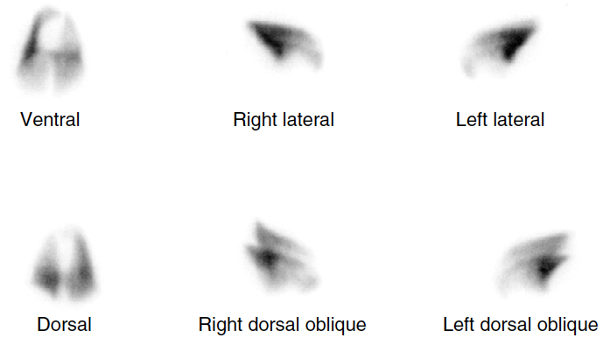
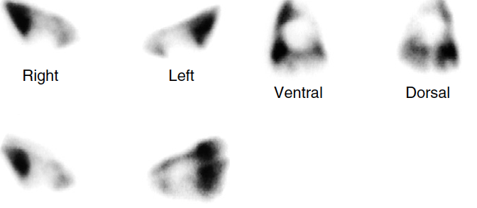
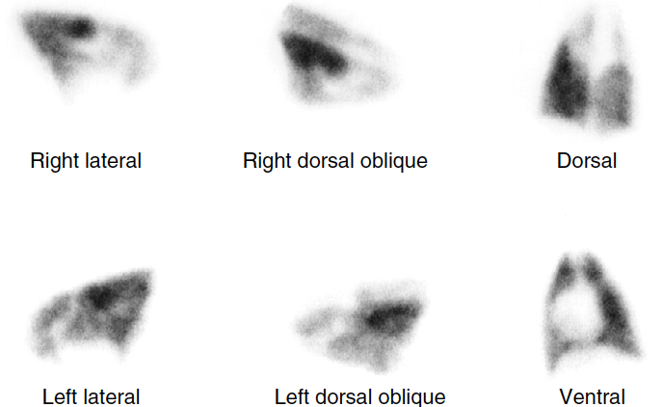
Pulmonary perfusion scintigraphy
Normal
PTE
Bronchopneumonia

Slide 15
Other scintigraphy
Mucociliary scintigraphy
Deposition of radiolabeled particulate matter in the airways
Camera records its progress over time
Inflammatory scintigraphy
Mostly utilizes labeled galladium citrate

