Slide 1
Junctionopathies and Neuropathies
Jillian DiFazio, DVM
Emergency and Critical Care Resident
Cornell University Hospital for Animals

Slide 2
Outline
Junctionopathies
  Normal neuromuscular junction (NMJ) anatomy and physiology
  Major NMJ disease processes, diagnosis and treatment
  Recent literature
Disorders of the peripheral nervous system- mononeuropathies and polyneuropathies
  Polyradiculoneuritis
    Clinical signs, diagnosis and treatment
  Recent literature

Slide 3
Junctionopathies
Neuromuscular junction (NMJ)= junction between an efferent nerve and the muscle innervated by that nerve
Junctionopathies= pathological processes that affect the NMJ

Slide 4
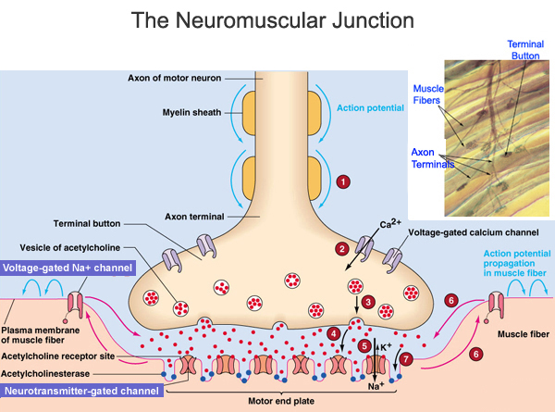
Junctionopathies
Normal Anatomy and Physiology of the NMJ
http://scientopia.org/blogs/scicurious/files/2010/11/neuromuscular-junction.jpg
Notes:
The NMJ can be subdivided into three basic components: the presynaptic membrane, the synaptic cleft, and the postsynaptic membrane in the end plate region of a skeletal muscle fiber. Each motor neuron innervates a number of muscle fibers (myofibers); combined, these are termed the motor unit. For successful NMJ transmission to occur, the action potential traveling down a motor neuron to a myofiber must be successfully propagated to the end plate region of the innervated muscle fiber. The arriving action potential at the level of the nerve terminal results in depolarization of this region and consequent opening of calcium channels on the axolemma surface. The increased cytosolic concentration of calcium triggers exocytosis of Ach by causing Ach-containing vesicles to dock and fuse with the plasmalemma at the synaptic cleft regions. Three classes of proteins are involved in the process of Ach exocytosis and all 3 are vulnerable to toxins and disease processes: 1) Synapsin I (controls the availability of synaptic vesicles) and synaptotagmin (associates with N-type Ca channels), 2) Synaptobrevin (vesicle-associated membrane protein), syntaxin and synaptosome-associated protein 25, which are all essential components of the exocytosis process; 3) N-ethyl-maleimide-sensitive fusion protein (NSF) and soluble NSF-attachment proteins, which are all involved in NT release. The released Ach crosses the synaptic cleft to reach the Ach receptors, located on the end-plate of the skeletal muscle fiber.

Slide 5
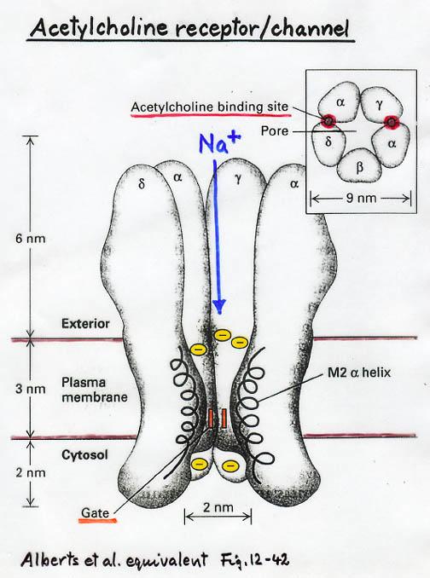
Junctionopathies
Normal Anatomy and Physiology of the NMJ
http://www.chm.bris.ac.uk/webprojects2006/Cowlishaw/acetylcholinereceptor.jpg
Notes:
The Ach receptor molecules are integral membrane proteins consisting of five subunits and function as sodium channels. The five subunits are arranged in a circular shape around the central Na channel. Located on the extracellular portion of the alpha (a)-subunit (2/receptor molecular) are the Ach binding sites. Binding of Ach to the Ach binding sites results in opening of the Na channel and Na influx into the muscle cell. This influx results in depolarization of the end-plate region, termed the end-plate potential (EPP). The EPP has to reach a threshold ot result in sufficient spread of the depolarization along the muscle fiber to cause release of the intracellular Ca stores and result in muscle contraction. The magnitude of the end-plate potential depends on the number of Ach receptors activated. Normally, there is an overabundance of both available ACh and ACh receptorsand the EPP produced by nerve depolarization therefore usually far exceeds the requirement for muscle contraction.

Slide 6
Junctionopathies
Normal Anatomy and Physiology of the NMJ
Safety factor= excess of ACh and ACh receptors available to achieve end-plate potential
Rundown= decrease in the amount of ACh released into the synaptic cleft with repetitive depolarization of the nerve terminal following repeated firing of the motor nerve
Excessive stimulation of muscle fibers prevented by several processes
Notes:
Normally, the degree of rundown is insignificant due to the large safety factor of neuromuscular transmission.
Excessive stimulation of muscle fibers prevented by 1) closure of the Na channels following activation of the ACh receptors. The channels thereby become refractory for a few seconds. 2) Shortly after its release into the synaptic cleft, the ACh is rapidly eliminated by diffusion away from the cleft region and by Ach esterase in the cleft region.

Slide 7
Junctionopathies
Vulnerability of the NMJ
Mechanisms for altering NMJ transmission
  Increasing/decreasing presynaptic ACh release, as a result of altering ACh synthesis, transport, reuptake or presynaptic release
  Altering the concentration or duration of ACh effect in the synaptic cleft as a result of altered removal of ACh from the synaptic cleft
  Acting as an ACh agonist/antagonist at the NMJ by affecting the interaction between ACh and the postsynaptic receptor
Notes:
Disorders affecting NMJ transmission are usually classified as pre- or postsynaptic; some disease processes may affect both.

Slide 8
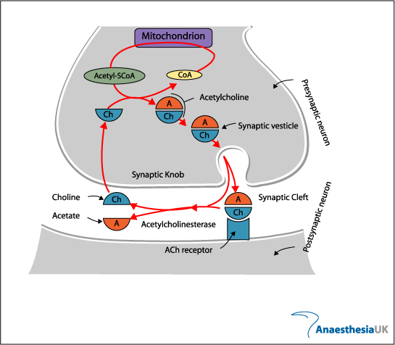
Junctionopathies
Vulnerability of the NMJ
Vulnerability of presynaptic functions
http://www.frca.co.uk/images/acetylcholine.jpg
Notes:
Choline uptake can be inhibited (inhibited by the hemicholium, thereby resulting in NMJ blockade)
The enzyme choline acetyltransferase (not shown), involved in ACh synthesis, can be targeted, resulting in decreased Ach synthesis and NMJ blockade (choline acetyltransferase is targeted by the naphthoquinones and halogenated cholines; additionally targed by false cholinergic NT including triethylcholine and diethylaminoehtanol, which are acetylated by the enzyme, stored in synaptic vesicles, but on synaptic release display cholinergic agonist activity below that of ACh (cholinergic hypofunction)
The transport of ACh to vesicles can also be blocked (vesamicol)

Slide 9
Junctionopathies
Vulnerability of the NMJ
Vulnerability of presynaptic release of ACh
  Botulinum toxin and certain snake toxins (Mojave toxin and b-bungarotoxin) block the release of ACh by cleaving synaptic vesicle fusion proteins
  A-latrotoxin (black widow spider) causes massive ACh release by increasing synaptic vesicle fusion and inhibiting recycling resulting in blockade

Slide 10
Junctionopathies
Vulnerability of the NMJ
Vulnerability of ACh esterase
  Result in increased synaptic presence of ACh and therefore excessive stimulation following ACh release
  Edrophonium, pyridostigmine, neostigmine bind to ACh esterase active site for varying times
  Organophosphates bind with ACh esterase active site to form stable complexes

Slide 11
Junctionopathies
Vulnerability of the NMJ
Vulnerability of ACh receptors
  Myasthenia gravis
Vulnerability of nicotinic muscle receptors
  Strychnine, many snake toxins, anatoxin-a from blue-green algae and curare-like substances

Slide 12
Junctionopathies
Clinical presentation
Symmetric, progressive muscle weakness of both the thoracic and pelvic limbs
Tendon reflexes are often intact in the early stages of the disease (dDx peripheral neuropathies)
Predilection for certain muscle groups, particularly the small, rapid-movement muscle groups
In some postsynaptic disorders, there may be additional cholinergic signs
In most cases, removal of the source of NMJ blockade will result in rapid resolution of signs
Notes:
Because of predilection for certain muscle groups, failure of certain CN musculature may be apparent, including failure of the extraocular muscles nad muscles controlling the palpebral reflex and alterations in the voice (dysphonia) and swallowing.
Additional cholinergic signs include lacrimation, miosis and bradycardia- seen with OP toxicity

Slide 13
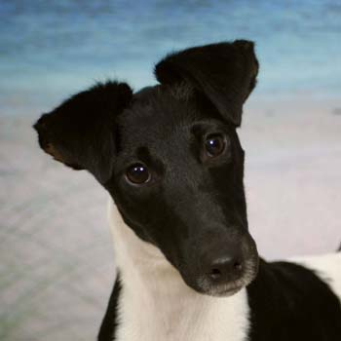
Junctionpathies
Congenital Myasthenia Gravis
Due to an abnormal reduction in the number of ACh receptors on the muscular endplate
Clinical signs of exercise-induced weakness
Springer Spaniels, Jack Russell Terriers, Smooth-Haired Fox Terriers, Samoyeds, Miniature Dachshunds, and Gammel Dansk Honsehund
Rare in cat
6-12 weeks old, multiple pups in litter affected
Megaesophagus typically only in Smooth-Haired Fox Terrier
http://whatafy.com/storage//2012/02/2012/02/24/dog-breeds-smooth-fox-terrier/A-smooth-
fox-terrier.jpg
Notes:
All breeds can develop aspiration pneumonia despite demonstrable megaesophagus typically only in Smooth-Haired Fox Terriers

Slide 14
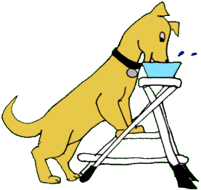
Junctionopathies
Congenital Myasthenia Gravis
Diagnosis is by signalment, history and a suitable response to anticholinesterase drugs (i.e. pyridostigmine)
Remission is unlikely and lifelong management is required
Often progressive
Prognosis is guarded-poor
  Case report of 3 miniature
  dachshunds- clinical signs resolved
http://www.marvistavet.com/assets/images/Dog_using_stepladder_to_eat.gif
Notes:
Due to the absence of antibodies
Affected dogs may develop recurrent or severe aspiration pneumonia
In Miniature Dachshunds, spontaneous resolution of clinical dysfunction by 6 m/o has been reported- report in 2005 of 3 miniature smooth-haired dachshund littermates diagnosed with MG at 8 weeks/old and clinical signs resolved by 6 months/old (Dickinson, PJ et al: Congenital myasthenia gravis in smooth-haired miniature dachshund dogs. JVIM 2005; 19).

Slide 15
Junctionopathies
Acquired Myasthenia Gravis
Autoimmune disease
  Antibodies (mostly IgG) are formed against the nicotinic ACh receptors resulting in decreased numbers of receptors
  Most of the autoantibodies are directed against the main immunogenic region located at the extracellular tip of the alpha-1 subunits
  T-lymphocyte-dependent disease
    Activation of CD4+ T (helper) lymphocytes and interaction with B lymphocytes leading to autoantibody production
Notes:
Autoimmune disease in which antibodies (most cases IgG ) are formed against the nicotinic ACh receptors, resulting in decreased numbers of receptors on the postsynaptic sarcolemmal surface.
End result is skeletal muscle weakness.
In MG, most of the autoantibodies to AChR are directed against the main immunogenic region, a conformation=dependent region located at the extracellular tip of the alpha-1 subunits.
MG is an autoimmune T-lymphocyte-dependent disease with production of specific autoantibodies against muscle AChRs or other muscle proteins.

Slide 16
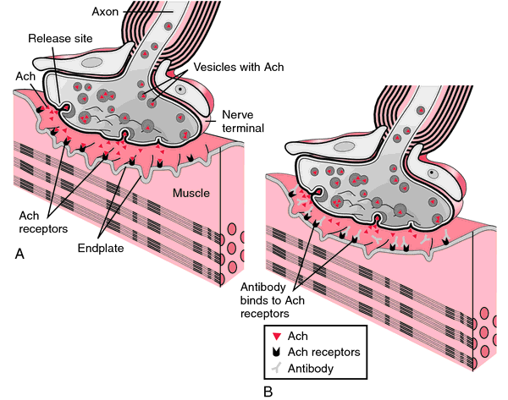
Junctionopathies
Acquired Myasthenia Gravis
Autoimmune disease
  Autoantibodies alter receptor function by one of three mechanisms
    Antibodies may bind directly to the ACh receptor, resulting in a blockade of the ion channel opening
    Antibodies may increase the degradation rate of ACh receptors by cross-linkage
    Complement-mediated lysis of the muscle end plate
http://img2.tfd.com/mk/M/X2604-M-44.png
Notes:
In all cases, there is a reduction in neuromuscular transmission and decreased muscle contaction.

Slide 17
Junctionopathies
Acquired Myasthenia Gravis
Bimodal age distribution
  Dogs 4m/o-4y/o (~3 y/o), 9y/o-13 y/o (~10 y/o)
  Cats 2y/o-3y/o, 9y/o-10y/o
Dogs>>>cats
Akitas, terrier breeds, German Shorthaired Pointers and Chihuahuas; German Shepherd Dog and Golden Retriever have the highest morbidity
Intact dogs may be slightly less likely to develop MG than spayed/neutered
Notes:
Bimodal age distribution in dogs, cats and humans- in people women 20-30 y/o and men 60-70 y/o
Purebred cats more common, with the Abyssinian and Somali breeds overrepresented
Famiial autoimmune MG has been reported int he Newfoundland (Lipsitz D, Berry JL, Shelton GD: Inherited predisposition to myasthenia gravis in newfoundlands. JAVMA 1999; 215) and Great Dane (Kent M, et al: Adult onset acquired myasthenia gravis in three Great Dane littermates. J Small Anim Pract 2008; 49).
While intact dogs may be slightly less likely to develop MG, intact female dogs who develop MG should be spayed as spaying is beneficial in preventing hormonal effects that can exacerbate MG.

Slide 18
Junctionopathies
Acquired Myasthenia Gravis
Three clinical syndromes
  Focal
  Generalized
  Acute fulminating
Associated with other diseases (paraneoplastic)
  Hypothyroidism and other autoimmune diseases, thymomas, thymic cysts, nonepitheliotropic cutaneous lymphoma, cholangiocellular carcinoma, anal sac adenocarcinoma, osteogenic sarcoma and methimazole therapy in cats
    Incidence of thymomas in dogs with acquired MG is 3%; 15-26% in cats
    In dogs that have thymomas, 30-50% of cases have been identified to have MG
Notes:
Paraneoplastic
Association of thymomas and acquired MG has been demonstrated in humans, dogs and cats
In people, 30-60% thymomas are associated with MG.

Slide 19
Junctionopathies
Acquired Myasthenia Gravis
Generalized form is characterized by appendicular muscle weakness that may be induced/exacerbated by exercise
  Decrementing or absent palpebral reflex
  Muscle tremors/fasciculations
  Regurgitation
  Excessive ptyalism
  Dysphonia
  Tendon reflexes are usually normal
  Appendicular weakness pelvic limbs>thoracic lmbs
  Cats- cervical ventroflexion
  Associated with polymyositis in one cat
  3rd degree AV block reported in dogs
Occurs in 57-64% of all canine cases with 84-90% having megaesophagus
Notes:
Cardiac involvement in MG is well documented in human medicine and may be the result of autoantibodies directed against the conducting tissue of the heart or a result of secondary focal myocarditis.
Hackett TB, et al: Third degree atrioventricular block and acquired myasthenia gravis in four dogs. J Am Vet Assoc 1995: 206 (8): Third degree atrioventricular block was diagnosed in 4 dogs with acquired myasthenia gravis (serum acetylcholine receptor antibody titer > 0.6 nmol/L). All 4 dogs had megaesophagus. Two dogs also had mediastinal thymomas, which were resected. One dog with thymoma received a permanent pacemaker at the same time that it underwent thymectomy; the other did not develop third degree atrioventricular block until 3 months after thymectomy. Both dogs with thymoma died of severe aspiration pneumonitis within 3 months after surgery. The third dog received a permanent pacemaker and was treated with pyridostigmine bromide, but also died of aspiration pneumonitis 1 month after the pacemaker was implanted. The fourth dog was treated with prednisolone and pyridostigmine bromide and improved, but did not become clinically normal. Because third degree atrioventricular block as well as myasthenia gravis can cause signs of weakness, acquired myasthenia gravis should be considered in dogs with idiopathic cardiac conduction disturbances. Likewise, an ECG should be evaluated in dogs with acquired myasthenia gravis.
Stats based on studies by Dewey CW, et al: Clinical forms of acquired myasthenia gravis in dogs: 25 cases (1988-1995). J Vet Intern Med 1997; 11 (2) and Shelton GD, Schule A, Kass PH: Risk factors for acquired myasthenia gravis in dogs: 1,154 cases (1991-1995). J Am Vet Med Assoc 1997; 211 (11).

Slide 20
Junctionopathies
Acquired Myasthenia Gravis
Focal MG presents with focal weakness of isolated muscle groups, particularly the esophageal, pharyngeal, laryngeal and facial muscles
  Regurgitation, dysphagia, dropped jaw, diminished or absent palpebral reflexes, dysphonia
  Retrospective studies- 36-43% dogs, 15% cats
Acute fulminating
  Severe and rapidly progressive form of generalized MG
    As high as 16% dogs, 15% cats; most reports <5%
Notes:
In retrospective studies 36-43% of dogs presenting with acquired MG demonstrated focal signs, compared to only 15% of cats. The difference may be ascribed partially to the larger proportion of smooth muscle in the feline esophagus as compared to the predominantly striated muscle of the canine esophagus. Canine retrospective studies: study by Dewey CW, et a: Clinical forms of acquired myasthenia gravis in dogs: 25 cases. JVIM 1997: 11. (25 dogs), Shelton GD: Acquired myasthenia gravis: what we have learned from experimental and spontaneous animal models. Vet Immunol Immunopathol 1999; 69., Shelton GD, Schule A, Kass PH: Risk factors for acquired myasthenia gravis in dogs: 1,154 cases (1991-1995. J Am Vet Med Assoc 1997; 211. Feline retrospective study- Ducote JM et al: Clinical forms of acquired myasthenia gravis in cats. Compendium Continuing Education Practice Vet 1999: 21. - 84% of dogs had megaesophagus and associated aspiration pneumonia vs. 40% cats having megaesophagus and 20% having aspiration pneumonia
In people 15% of all MG patients have the disease restricted to their eyes.
Acute fulminating cases- rapid progression of appendicular muscle weakness and may present nonambulatory in lateral recumbency. Weakness of the skeletal muscles eventually affects the intercostal muscles and/or diaphragm, at which stage affected animals demonstrate severe respiratory distress. Due to concurrent pharyngeal/laryngeal dysfunction, aspiration pneumonia is a frequent complication and prognosis is therefore poor. Furthermore, for successful treatment, these cases require rapid recognition and intensive care, including respiratory supportive care.
16% dogs and 15% cats quoted in Penderis, J: Junctionopathies: Disorders of the Neuromuscular Junction in A Practical Guide to Canine and Feline Neurology 2008.
<5% quoted in Khorzad R, et al: Myasthenia gravis in dogs with an emphasis on treatment and critical care management. JVECC 2011: 21 (3) based on data from Dewey CW, et al: Clinical forms of acquired myasthenia gravis in dogs: 25 cases (1988-1995). J Vet Intern Med 1997; 11 (2) and Shelton GD, Schule A, Kass PH: Risk factors for acquired myasthenia gravis in dogs: 1,154 cases (1991-1995). J Am Vet Med Assoc 1997; 211 (11).
Fulminating MG described in children but best documented in adults- recent study in China 12% had acute fulminating MG.

Slide 21
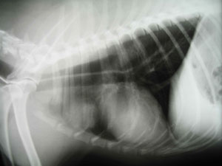
Junctionopathies
Acquired Myasthenia Gravis
Diagnostics:
  Minimum database (CBC, chemistry, urinalysis, +/-thyroid testing and adrenal function testing)
  Imaging
    Thoracic radiographs
      Megaesophagus (84% in dogs, 40% in cats)
        Esophagography, esophageal scintigraphy
      Aspiration pneumonia (84% in dogs, 20% in cats)
      Cranial mediastinal mass (3.4-8% in dogs, 15-25.7% in cats)
        CT, MRI
  ECG
http://www.vetcpdonline.co.uk/images/art_1_16.jpg
Notes:
dDx: other NMJ disorders, neuropathies and myopathies
If high suspicion for megaesophagus but not visualized on radiographs, then can pursue esophagography or esophageal scintigraphy. In light of risk of aspiration pneumonia, a safer alternative to barium esophagram is esophageal scintigraphy
Normal thoracic radiographs does not rule out the possibility of a thymoma; further imaging (CT/MRI) often helpful in human medicine to evaluate the cranial mediastinum.

Slide 22
Junctionopathies
Acquired Myasthenia Gravis
Diagnostics
  Edrophonium chloride challenge (Tensilon response) test
    Positive response is supportive of a presumptive diagnosis of Myasthenia Gravis
    Dogs 0.1-0.2mg/kg IV
    Cats 0.25-0.5mg per cat IV
    Have atropine on hand!
http://www.youtube.com/watch?v=k7YX9kuWrxA
Notes:
Edrophonium is an ultra short-acting anticholinesterase agent, prolonging the residence time of ACh in the synaptic cleft and thereby improving muscle strength where NMJ blockade is present
Have atropine on hand in case a cholinergic crisis is induced (overstimulation of muscarinic ACh receptors can result in adverse side effects including bronchoconstriction and bradycardia).
If the patient has a history of very brief collapse episodes or when IV administration is difficult during a collapse episode, sometimes longer acting anticholinesterases are preferable (neostigmine). If using longer-acting, premedicate with atropine at 0.02mg/kg-0.04mg/kg SQ/IM or glycopyrrolate at 0.01-0.02mg/kg SQ/IM.
Possibility of FP and FN results- other disorders causing NMJ blockade may also demonstrate a partial response to edrophonium chloride and in those MG patients with insufficient available ACh receptors, an inapparent or small response may be evident.
In focal MG, particularly in cats, there is often no detectable improvement in muscular strength and the test is of little use. An exception is in those patients with a decremental palpebral response.
Acute fulminating MG dogs typically do not respond to edrophonium response test because fulminant dogs may not have enough AChRs available to elicit a noticeable response.

Slide 23
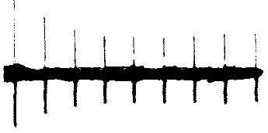
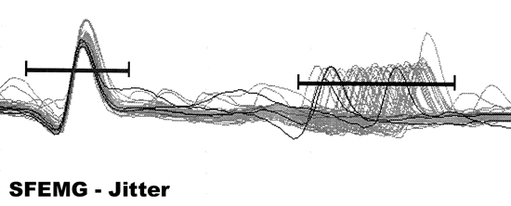
Junctionopathies
Acquired Myasthenia Gravis
Electrodiagnostics
  Repetitive nerve stimulation
    A decremental response to RNS at a stimulation rate of </= 5/sec is supportive of a diagnosis of MG
    A decrease in the successive compound muscle action potentials by >/= 10% is abnormal
  Single-fiber electromyography (SF-EMG)
    Increased variation in latency (jitter) in MG
http://neuromuscular.wustl.edu/pics/decrement1.gif
http://www.uwo.ca/cns/resident/pocketbook/pictures/
sfemg-jitter.jpg
Notes:
Electrodiagnostic assessment is often useful in the diagnosis of MG, but is limited by the availability of equipment and the requirement for GA (which may be contraindicated)
EMG is usually normal
RNS: Utilizes the area or amplitude of successive compound muscle action potentials (CMAP) obtained by repetitively stimulating the nerve supplying that muscle. The tibial, peroneal, or ulnar nerves are usually used with the electrodes placed in the digit innervated by that particular nerve. At higher rates of stimulation, normal animals will often demonstrate a decremental response. The test is highly sensitive for MG in humans, although the test is more likely to yield a positive response in cases with generalized MG than focal MG. RNS in focal MG is still more sensitive than determining ACh receptor Ab concentrations in humans. Some other NMJ disorders (i.e. OP toxicity) may also demonstrate a decremental response.
SF-EMG: Use is limited. SF-EMG is based on obtaining recordings of the evoked action potential from single muscle fibers using a special recording needle with a very small recording surface. Based on recording of the evoked action potential from one muscle fiber,t he time variation in NM transmission for that fiber (i.e. jitter) can be determined. The test is based on the fact that the time variation for neuromuscular transmittion (or latency from stim to AP) is virtually constant for that muscle fiber with repeated measurements. Any alteration in NMJ transmission is likely to result in increased variation in the time of NMJ transmission. Two methods- the latency from the time of stimulus to the peak of an action potential for a single muscle fiber can be recorded repeatedly. The jitter value is then calculated by determining the mean value of the consecutive differences in latency. Normal patients- latency is virtually constant. OR the interval between the evoked AP for two different muscle fibers from the same motor unit (interposital latency) can be measured repeatedly. The jitter value is the mean value of the consecutive differences in interposital latency. Not specific but VERY sensitive for MG.
In people 92-100% have abnormal jitter values.

Slide 24
Junctionopathies
Acquired Myasthenia Gravis
Diagnostics
  Elevated anti-ACh receptor antibody concentrations
    ACh-R Ab test>0.6nmol/L positive for acquired MG in dogs
    ACh-R Ab test>0.3nmol/L positive for acquired MG in cats
    Humans- 10-15% generalized myasthenics and 30-50% focal myasthenics are seronegative
    Dewey CW, et al: nearly 10-15% of generalized myasthenic dogs are seronegative; Shelton GD: 2% of generalized dogs seronegative
    Criteria for diagnosis of SNMG in dogs include clinical signs, a positive edrophonium response test, electrophysiologic findings, normal limb muscle strength following anticholinesterase therapy and at least 2 seronegative AChR titers
  Immune complexes may be demonstrated at the level of the NMJ by immunocytochemistry of fresh muscle biopsy specimens or by incubating the patient’s serum with normal canine muscle samples
Notes:
The test is an immunoprecipitation radioimmunoassay using 125I a-bungarotoxin-labeled ACh receptor
Gold standard for diagnosis in people and dogs.
Test available from Comparative Neuromuscular Lab, UC Davis San Diego
FP extremely rare; positive result, therefore virtually confirmatory for acquired MG
Performed on serum and is relatively inexpensive
Serum ACh receptor Ab concentration will be negative for congenital MG, is lowest for focal MG and highest for acute, fulminating MG although a stat sig correlation between Ab level and disease severity has not been confirmed
Seronegativity is proposed to be due to: 1) in some cases, the affinity of the Ab is such that all of the available Ab is bound to the muscle end plate region with undetectable levels of circulating Ab; 2) during solubilization of the ACh receptors for the test probe, damage to certain antigenic epitopes of the ACh receptor may occur, and the test probe may hterefore fail to recognize some antigenic variations of the ACh receptor antibodies; 3) some of the antibodies in acquired MG may be directed against antigenic proteins of the end plate region other than the ACh receptors, and these would therefore not be identified by the test; 4) prior treatment with immunosuppressive medications
10-15% of generalized dogs seronegative: Dewey CW, et al: Clinical forms of acquired myasthenia gravis in dogs: 25 cases (1988-1995). J Vet Intern Med 1997; 11 (2)- but extrapolated from humans and not based on data from study.
Shelton GD. Myasthenia gravis and disorders of neuromuscular transmission. Vet Clin North Am 2002; 32.
In people, single-fiber EMG is used to diagnose a disorder of neuromuscular transmission, and in people, for a presumptive diagnosis of seronegative MG.
In humans, muscle-specific receptor tyrosine kinase (MuSK) autoantibodies are detected in up to 70% of generalized AChR-Ab negative MG patients. MuSk-Ab positive cases tend to have a more ocular distribution and therefore higher percentage of focal MG. One seronegative myasthenic dog was documented to have autoantibodies against MuSK (Shelton GD: unpublished data (2011)). Autoantibodies against skeletal proteins other than AChRs such as titin and ryanodine receptor (RyR= calcium release channel in striated muscle that is necessary for muscle contraction) are documented in human and canine MG patients with thymomas. The combination of AChR nd RyR antibodies increases the severity of disease.
Immune complex demonstration test is not specific for acq MG because the Staphylococcal protein A-horseradish peroxidase conjugate is not specific to Ab against the ACh receptor. Therefore, a screening test- negative result usually rules out MG.

Slide 25

Junctionopathies
Myasthenia Gravis
Treatment
  Supportive therapy
    Prevention and treatment of aspiration pneumonia
      ***Avoid aminoglycosides, ampicillin
      and tetracyclines
    Fluid therapy
    Nutritional support
    Respiratory support
    Modification of GI tract function
    Mild hypothermia
  Specific therapy
http://www.urbanfinds.com/kamsnaps/images/101uses/tubiefriend.jpg
Notes:
Abs that can cause NMJ blockade include aminoglycosides, lincomycin, penicillamine, polymyxins and tetracyclines. Of these aminoglycosides are clinically the most important.
Aspiration pneumonia- flip freq, Abs ideally based on results of C&S, oxygen support, neb/coupage
In humans 10-20% of MG patients require mechanical ventilation and mortality d/t complications is estimated at 11-14%.
In people ventilated for myasthenic crisis, predictors of respiratory failure included presence of atelectasis, low blood pH and forced vital capacity at extubation. The overall goal of ventilation in these patients is to avoid atelectasis.
Fluid therapy- regurg/ptyalism
Nutritional support- elevated feeding- determining ideal consistency- solid food stimulates pharyngeal/esophageal peristalsis more effectively in the normal dog, but some dogs with pharyngeal/esophgeal dysfunction tolerate semisolid food better. Head elevated for 10-15 minutes post-feeding. Ideally g-tube.
Modification of GI tract function- improving esophageal motility (prokinetic on GIT smooth muscle- metoclopramide and cisapride- no evidence for improving esophageal motility in either the normal or MG-affected esophagus. Cisapride has actually been shown to increase esophageal transit time in the normal dog); increasing lower esophageal sphincter tone (contraindicated in patients being fed orally; benefit if fed via g-tube- metoclopramide and cisapride- cisapride more potent action); prevention and management of esophagitis-feed via g-tube nad increase pH of GIT content; increase pH of GIT content
Mild hypothermia causes decreased muscle temperature which improves synaptic transmission because neuromuscular transmission is temperature-dependent. A cooler body temperature also is advantageous in improving pulmonary function, and is therefore advocated for the management of human myasthenic patients. This has not been evaluated in dogs- Argov Z: Management of myasthenic conditions: nonimmune issues. Current Opinion in Neurology 2009; 22.

Slide 26
Junctionopathies
Acquired Myasthenia Gravis
Specific therapy
  Anticholinesterase therapy
    Pyridostigmine bromide (Mestinon)
      0.5-3mg/kg PO Q8-12hrs dogs
      0.25mg/kg PO Q8-12hrs cats
      0.01-0.03mg/kg/hr IV
    Neostigmine (Prostigmin)
      0.04mg/kg IV Q6hrs dogs
    Variable response to therapy
    Effect on improving esophageal function in dogs is less than effect on appendicular muscle weakness
Notes:
Anticholinesterase therapy is the mainstay of therapy to prolong the availability of ACh for binding to ACh receptors by inhibiting degradation by ACh esterase.
Start low and titrate up
Side effects include muscarinic symptoms- increased GI motility, diarrhea and abdominal pain
Increased gastric acid secretion, salivation and lacrimation d/t muscarinic receptor stim on exocrine glands
Bradycardia can be seen
Watch for cholinergic signs- hypersalivation, vomiting and muscle fasciculations; decrease dose if this occurs
Neostigmine has more rapid onset but shorter duration of action than pyridostigmine

Slide 27
Junctionopathies
Acquired Myasthenia Gravis
Immunosuppressive therapy
  Some animals (particularly young dogs) may go into spontaneous remission
    Shelton GD and Linstrom JM 2001 study
  Glucocorticoid therapy
    In cases responsive to edrophonium chloride, a conservative treatment regime would be prednisone therapy at an alternate-day anti-inflammatory dose (0.5mg/kg EOD)
      Increasing/introducing steroids should be considered if the response to anticholinesterase therapy is suboptimal or if the patient is resistant to therapy
        Prednisone 0.5mg/kg Q12hrs; cats 1-4mg/kg/day (prednisolone)
Notes:
While widely accepted that the etiology for acquired MG is autoimmune, there is some controversy regarding the use of immunosuppressive therapy in MG- mainly because of the high incidence of aspiration pneumonia in MG (particularly in dogs) and the potential for glucocorticoids to worsen NM weakness (observed in 50% of human MG patients and in dogs/cats; 1 study in myasthenic cats- no demonstrable muscle weakness associated with glucocorticoid therapy).
A 2001 study found that 47/53 dogs with MG that were seropositive for AChR antibodies and were treated with anticholinesterase therapy alone went into remission iwthin an average of 6.4 months- Shelton GD, Linstrom JM: Spontaneous remission in canine myasthenia gravis: implications for assessing human MG therapies. Neurology 2001; 57 (study included only those dogs that survived to remission and not dogs that died of aspiration pneumonia early in the course of the disease.
Dogs that go into remission on AChE drugs alone may have a better chance of staying in remission than if immunosuppresion was used.
MOA of steroids: inhibitory on formation and release of inflammatory agents, lymphocyte division, lymphocyte reactivity to ACh receptors and leukocyte chemotaxis

Slide 28
Junctionopathies
Acquired Myasthenia Gravis
Immunosuppressive therapy
  ***No controlled clinical studies in animals that show benefit of any one drug over another
  Azathioprine
    Use of azathioprine alone or with prednisone is highly effective in resolving clinical signs in humans with MG
      Class I evidence (randomized controlled trials) recommendation for MG in people and used as a first line therapy for longterm use
    Dewey CW, et al: Azathioprine therapy for acquired myasthenia gravis in five dogs. JAAHA 1999.
    1-2mg/kg divided Q24-48hrs dogs
    May be considered as a sole immunosuppressive agent in stable MG dogs
  Cyclosporine
    Class I evidence recommendation for use in generalized MG in people
    Bexfield NH, Watson PJ, Herrtage ME: Management of myasthenia gravis using cyclosporine in two dogs. JVIM 2006; 20.
    3-6mg/kg PO or IV Q12hrs4mg/kg Q12hrs
  Mycophenolate mofetil
    Abelson AL, et al: Use of mycophenolate mofetil as a rescue agent in the treatment of severe generalized myasthenia gravis in three dogs. J Vet Emerg Crit Care 2009; 19 (4).
    Dewey CW, et al: Treatment of a myasthenic dog with mycophenolate mofetil. J Vet Emerg Crit Care 2000; 10 (3).
    Dewey CW, et al: Mycophenolate mofetil treatment in dogs with serologically diagnosed acquired myasthenia gravis: 27 cases (1999-2008). J Am Vet Med Assoc 2010; 236 (6).
    20mg/kg Q12hrs
Notes:
Immunosuppressant drugs used for the treatment of MG belong to 3 general groups based on varying mechanisms of action: inhibitors inhibitors of the cell cycle, immunosuppressors of T cells and B cell depleters. The drugs that inhibit the cell cycle include leflunomide, azathioprine, cyclophosphamide, and mycophenolate mofetil (MMF). Glucocorticoids, cyclosporine and tacrolimus are immunosuppressors of T cells. Retuximab depletes B cells. There are no controlled clinical studies in dogs that show benefit of any 1 drug over another
Azathioprine is a cytotoxic antimetabolite that interferes with DNA synthesis, with its beneficial effect in acquired MG probably being mediated through reducing B and T cell lymphocyte numbers nad consequently immunoglobulin production, as well as specifically inhibiting T cell production.
Side effects: BM suppression and, less often, hepatotoxicity, pancreatitis, GIT irritation. BM suppression is much more common in cats, therefore it should not be used in this species.
Monitor CBC q 1-2 weeks during first 1-2 mo of therapy then q 1-2 months thereafter
Clinical response may take up to 6 weeks but in many cases response is seen within 2 weeks
Another study involving 41 humans with MG- azathioprine + prednisolone for the first month had no benefit over prednisolone alone (Hart IK, Sathasivam S, Sharshar T: Immunosuppressant agents for myasthenia gravis. Cochran Database Syst Rev 2007; 17 (4)).
Dewey CW, et al: Azathioprine in 5 dogs- 4/5 dogs showed a therapeutic sequential decline in serum AChR Ab concentration while receiving azathioprine. 4/5 dogs were receiving pyridostigmine therapy prior to implementing azathioprine and 1 dog was treated with a temporary immunosuppressive dose of prednisone
Cyclosporine: inhibits T cell activation and prevents synthesis of several cytokines (IL-2).
Both cyclosporine and cyclophosphamide have been demonstrated to have some efficacy in human cases of acquired MG. In one report cyclosporine was successful in the treatment of 2 dogs with acq MG- 4mg/kg BID dosing extrapolated from humans
Specific for lymphocytes; expensive
Adverse effects- dose-dependent nephrotoxicity, hepatic disorders, hypertension, gingival hyperplasia, weight loss and allergic reactions in people
Bexfield NH study: both dogs had failed therapy with pyridostigmine and pred alone- cyclosporine was effective in achieving clinical remission in these two cases. One of the dogs that went into clinical remission reverted to seropositivity and clinical signs of MG when the immunosuppressive therapy was discontinued.
Max effect typically take several months to achieve.
Cyclophosphamide- more severe side effects
Mycophenolate- successful treatment of a dog with MG reported- rapid resolution of CS (within first week of therapy)
Relative specificty for lymphocytes
Side effects are primarily GI (typ evident by 3-4 weeks of therapy); reduce dose by ½ once CS of MG improve substantially to minimize side effects
Mycophenolate- inhibitor of purine synthesis in both T and B lymphocytes.
Abelson et al: clinical remission in 48 hours with no adverse effects. All 3 were seropositive MG.
Dewey et al: case report of 10 y/o MC Springer Spaniel with focal MG (seropositive for AChR Ab) initially improved with azathioprine but deteriorated after; MMF orally instituted in addition to azathioprine resulting in dramatic improvement.
Dewey CW et al: Combo MMF + pyridostigmine vs. pyridostigmine alone- no beneficial therapeutic effect over longterm.

Slide 29
Junctionopathies
Acquired Myasthenia Gravis
Immunosuppressive therapy
  Leflunomide
  Cyclophosphamide
  Tacrolimus
  Etanercept
  Rituximab
IVIG and plasmapharesis
  Effective, short-term therapies for human acquired MG, particularly acute, fulminating form
Therapeutic vaccines
Notes:
Leflunomide- isoxazo derivative- inhibits T and B cell proliferation, suppresses immunoglobulin production and interferes with cell adhesion.
Not specifically evaluated for MG in dogs- Gregory CR, et a l: Leflunoamide effectively treats naturally occurring immune-mediated and inflammatory diseases of dogs that are unresponsive to conventional therapy. Transpl Proc 1998; 30.
Dose: 1.5-5.5mg/kg PO SID
Adverse effects= decreased appetite, lethargy, GI upset, BM suppression.
Cyclophosphamide is a strong alkylating agent that acts on DNA replication, RNA transcription and replication, to disrupt nucleic acid function and inhibit cell proliferation. In people it is used in patients refractory to other treatments.
No well documented use in vet med MG patients.
Adverse effects= BM suppression, infections, bladder toxicity and in people dose-related neoplasia. CBC should be performed 7-10 days post-initating tx with cyclophosphamide
Tacrolimus is a macrolide compound that acts on T helper cells to suppress pdn of cytokines, spec IL-2
Human studies- 47%-67% show improvement and reduction of AChR antibody titers and IL-2 pdn
No vet studies
Etanercept- soluble recombineant TNF alpha receptor Fc
Limited use in human med but may have potential use in refractory myasthenics
No reported studies in vet med
Rituximab: chimeric IgG k monoclonal antiobdy that targets human CD20 antigen. Expressed on the surface of normal and malignant B cells.
Reported successful in small study pop of humans; not reported in vet med.
IVIG- MOA poorly understood but may be related to binding of circulating autoantibodies, blocking mac/lymphocyte Fc receptors, enhanced suppressor T cell activity, and inhibition of the complement cascade
Documented use of hIVIG in 2 dogs with MG using a dosage of 0.5g/kg IV over 6 hours
Not enough data in vet med to comment on benefits from hIVIG in canine MG.
Must be used with caution for repeat doses d/t anaphylaxis
Plasmapharesis- removing plasma and returning blood elements with stored plasma or plasma substitutes; immunoadsorption therapy- patient’s plasma returned after passing through a filter that adsorbs Ig or via centrifugation. Effective with few side effects in human MG cases and in one dog with acq MG- Bartges JW et al: Clinical remission following plasmapharesis and corticosteroid treatment in a dog with acquired myasthenia gravis. J Am Vet Med Assoc 1990; 196.-clinical remission in a dog with MG following 2 treatments of plasmapharesis and corticosteroids. Plasmapharesis reduced AChR antibody titers by 70% in this single canine case. Plasmapharesis only provides a temporary improvement.
Therapeutic vax- peptides that mimic antigen receptors of T and B cells necessary for generation and maintenance of the autoimmune response in acq MG have been evaluated as therapeutic vax in a rat model and in naturally occurring canine-acq MG- prospective study of 10 AChR Ab-positive myasthenic dogs with focal MG immunized with T and B cell vaccines showed clinical remission rates that were increased compared with a historical control group of dogs that were not vaccinated. AChR Ab concentrations declined greater in the vaccinated group. Not an adequately controlled study.

Slide 30
Junctionopathies
Acquired Myasthenia Gravis
Management of concurrent neoplasia
  Removal of thymic hyperplasia has been demonstrated to improve remission rates in humans with acquired MG
  Thymectomy is recommended in people with malignant thymoma associated MG
  Thymectomy in the absence of thymoma has not been demonstrated to have a beneficial effect in dogs and cats
    Additionally, thymectomy in the presence of thymoma, has typically resulted in poor outcomes in dogs
Notes:
Human patients may occassionally worsen with thymoma removal. Improvement with thymic hyperplasia removal is probably related to the removal of a source of continued antigenic stimulation while the worsening occasionally seen following thymoma removal may be related to the loss of an immunosuppressive effect of the thymus.
Not recommended in dogs/cats d/t risks of sx and anesthesia. In dogs with thymomas, it may be prudent to avoid thymoma removal in acq MG dogs or at least delay sx until the CS have first been adequately controlled medically. Successful management with RT has been reported.

Slide 31

Junctionopathies
Acquired Myasthenia Gravis
Drugs to avoid:
  Aminoglycosides
  Ampicillin
  Lidocaine
  B-blockers
  Quinidine
  Procainamide
  Penicillamine
  Magnesium
  Contrast agents
http://www.realbollywood.com/up_images/say-no-to-drugs16001.gif

Slide 32
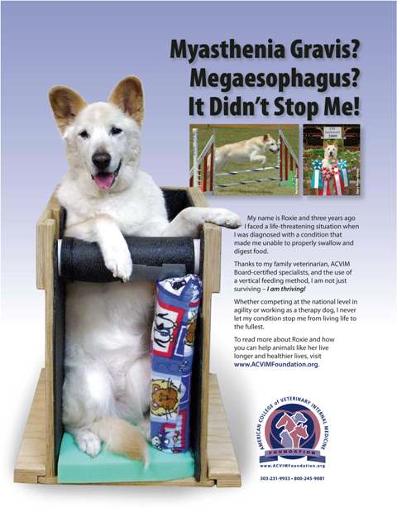
Junctionopathies
Acquired Myasthenia Gravis
Prognosis
  Overall prognosis in dogs is guarded to the high rates of megaesophagus and aspiration pneumonia
    Overall 1 year mortality rate for dogs is 40-60%
    Good prognosis if pharyngeal weakness, megaesophagus and aspiration pneumonia not present
  Overall prognosis in cats may be better than dogs
  Prognosis in uncomplicated acquired MG in humans is good to excellent
  Clinical remission of MG is associated with return of serum ACh-R antibody concentrations to the normal range- monitor q 6-8 weeks
http://www.weareanimalsurvivors.com/wp-content/uploads/2011/07/Roxie1.jpg
Notes:
Series of acq MG in 20 cats- only 3 cats died and all 3 presented with acute, fulminating MG, with death d/t respiratory failure. Of the remaining cats, 11/20 demonstrated improvement of CS at 2 mo after diagnosis, with 6 remaining unchanged. One year follow-up was available for 5 cats, at which time 2 were still alive and 3 were euthanized for unrelated illness. At 1.5 years, 2 cats were free of disease.
Mortality highest for acute, fulminating form. Main cause of death is respiratory failure secondary to muscle weakness, and this may be further complicated by aspiration pneumonia.

Slide 33

Junctionopathies
Botulism
Disease caused as a result of
ingestion of preformed Clostridium
botulinum exotoxin
  Uncooked and spoiled food or carrion
  8 types of toxin- A, B, C1, C2, D, E, F, G
    Human cases- A, B, E
    Veterinary medicine- C, D (*C1)
Uncommon in the dog; no naturally occurring cases reported in cats
http://wannaveg.com/wp-content/uploads/meatcan.jpg
Notes:
Type C2 botulinum toxin is not considered to be neurotoxic, although it may alter vascular permeability

Slide 34
Junctionopathies
Botulism
Main effect of botulinum toxin is to block the release of ACh at the level of the NMJ and at cholinergic autonomic synapses
  Inhibits NT release by cleaving the proteins required for NT exocytosis
Result is a flaccid paralysis and alterations in the autonomic nervous system
Notes:
Botulinum toxin absorbed from upper GI tract following ingestion of food containing preformed toxin. Once absorbed,t he toxin passes into the general circulation, where it circulates to cholinergic synapses in the peripheral nervous system, including the NMJ, followed by binding of the toxin to receptor molecules on the external surface of the cell membrane. The receptor is postulated to be sialic acid to which rapid binding occurs, independent of neural activity and temperature. The toxin is then internalized into the nerve terminal within a vesicle. Internalized toxin is not acessible to neutralization by antitoxin.

Slide 35
Junctionopathies
Botulism
Onset and severity of clinical signs are dependent on the dose of toxin ingested
Signs typically develop rapidly within 12 hours (but can occur up to 6 days) following ingestion
Clinical signs include a progressive, ascending and symmetric paresis
  Progresses to a flaccid paralysis
  Reflexes and muscle tone are decreased to absent
  Death usually secondary to paralysis of respiratory muscles
  +/- CN deficits
  +/- Cholinergic ANS dysfunction
Notes:
CN deficits- facial nerve paralysis, decreased gag reflex, decreased jaw tone and megaesophagus
Cholinergic ANS dysfunction- alteration of heart rate, pupil changes- mydriasis with decreased PLRs, KCS, urinary retention and constipation

Slide 36
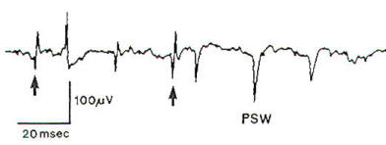
Junctionopathies
Botulism
Diagnosis is primary based on history and clinical presentation
Definitive diagnosis is based on demonstration of toxin early in the course of disease in the blood or GIT contents
  10mL serum or 50g feces, vomitus or food
Electrodiagnostics
  Decreased amplitude of compound evoked muscle action potentials
  Repetitive nerve stimulation at low frequency rates (<5/sec) may produce a small decrement in CMAPs; RNS at rapid rates (50/sec) are likely to produce an increment in successive CMAPs
  EMG may demonstrate fibrillation potentials and positive sharp waves after 7-10 days of paralysis
  Motor nerve conduction velocity may be decreased
http://www.neurosurgery.tv/imgperipheralcns/Fig-3.jpg
Notes:
Electrodiagnostics are not specific for diagnosis

Slide 37
Junctionopathies
Botulism
Treatment
  Internalized toxin is not accessible to antitoxin
    Antitoxin therapy (polyvalent antitoxin, containing type-C antitoxin) should only be considered in severe cases with recent exposure (within 5 days)
  Therapy is largely supportive
    Down dog care
    Maintenance of fluid/nutritional requirements
    Prevention and aggressive treatment of aspiration pneumonia
    Avoidance of medications that can interfere with NMJ transmission
    Bladder/bowel care
Notes:
Perform intradermal antitoxin test prior to administration to avoid anaphylaxis

Slide 38

Junctionopathies
Botulism
Prognosis
  Mild to moderately affected dogs should recover spontaneously in the absence of pneumonia
  Affected animals do not usually develop immunity to future episodes
http://www.offthemark.com/cartoons/2002-07-10.gif

Slide 39
Junctionopathies
Tetanus
Disorder caused by a tetanospasmin toxin (exotoxin) produced by the vegetative form of Clostridium tetani
Uncommon in dogs, rare in cats
Toxin enters the telodendria of the motor nerve axons at NMJ of skeletal muscle, then travels retrograde to reach the CNS
  Interferes with the release of inhibitory NT (glycine, GABA) by interneurons in the spinal cord (Renshaw cells) and brain
  Results in sustained, uncontrolled skeletal muscle contraction (primarily extensor muscles)
  ANS can also be affected by toxin
Notes:
Dogs are very resistant to the effects of tetanus toxin, and cats are over 10 times more resistant than dogs.
Spores of C. tetani are ubiquitous in the environment and can be found in the feces and on the skin of normal dogs nad cats. When spores are introduced into tissues under anaerobic conditions,t hey may germinate to become vegetative exotoxin-producing form fo the orgonism

Slide 40
Junctionopathies
Tetanus
Tetanus can be localized or generalized
  Localized tetanus usually progresses to generalized tetanus
  Localized tetanus is often associated with a wound
  Cats often have localized tetanus, while dogs typically develop generalized tetanus
Onset of clinical signs is variable after inoculation (3-18 days)
Notes:
Usually 5-10 days; cats may have a delay up to 3 weeks since so resistant

Slide 41
Junctionopathies
Tetanus
Hallmark of tetanus is muscle stiffness
  Extensor rigidity of all four limbs with a stiff, stilted, wide-based, sawhorse stance
  Facial muscle contraction (narrowed palpebral fissures and risus sardonicus, wrinkling of the forehead with the tips of the ears being pulled toward eachother)
  Extraocular muscle involvement leads to enophthalmos with protrusion of the third eyelids; strabismus
  Masticatory muscle contraction results in trismus
  Laryngeal and pharyngeal muscle involvement
  Ptyalism
  Increased RR/RE due to laryngeal and lower respiratory musculature involvement
  Difficulty prehending and swallowing food; megaesophagus; hiatal hernia; urine/fecal retention
  Elevated temperature

Slide 42
Junctionopathies
Tetanus
Also may see autonomic dysfunction
  Bradycardia or bradyarrhythmias
  Tachycardia or tachyarrhythmias
  Hypotension
  Hypertension
  Autonomic storms
  Dogs tend to have more parasympathetic signs than sympathetic signs (humans)
    Burkitt JM, et al: Risk factors associated with outcome in dogs with tetanus: 38 cases (1987-2005). JAVMA 2007; 230 (1).
    Panciera DL, Baldwin CJ, Keene BW: Electrocardiographic abnormalities associated with tetanus in two dogs. JAVMA 1988; 192 (2).
Notes:
Burkitt study-12 dogs had moderate bradycardia and, in some, bradycardia was episodic 2/12 had 2nd degree AV block, 3rd had bradyarrhythmia with dropped beats ausculted but no ECG performed. 1 dog required placement of temp pacemaker, eventually weaned. 8 dogs had episodes of tachycardia; 6/8 also had intermittent bradycardia. 2/8 had ventricular arrhythmias (1- intermittent; other accelerated idioventricular rhythm). Only 6 dogs had bp measured. 3/6 had abnormal bps- 2 had hypertension and 1 had severe hypotension.
Panciera paper- bradycardia, sinus arrest, and second degree AV block- both responsive to atropine and resolved with tetanus resolution.

Slide 43
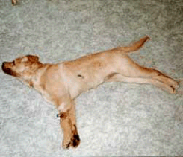
Junctionopathies
Tetanus
Diagnosis
  Clinical signs + history
  Identifying an active source of infection and toxin production supports diagnosis
    Attempts at culturing Clostridium tetani from wounds is typically unproductive
  Measuring serum antibody levels against tetanus toxin is questionable
  Muscle biopsies are not recommended (usually normal)
  EMG may be abnormal
  Bloodwork may be abnormal
http://marvistavet.com/assets/images/dog_tetanus.gif
Notes:
No definitive antemortem test

Slide 44
Junctionopathies
Tetanus
Class I- Any or all of the following:
  miosis, enophthalmos, risus sardonicus, erect ears, or trismus
  hypersensitivity to noise, light or touch
  ambulatory
  + absence of any Class II, III or IV signs
Class II- May include any or all Class I signs + any or all of the following
  dysphagia
  stiff gait, sawhorse stance, or erect tail
  ambulatory
  + absence of any Class III or IV signs
Class III- Must have Class I or Class II signs + any of the following:
  recumbency
  muscle fasciculations or spasms
  seizures
  + absence of any Class IV signs
Class IV- Must have Class I, II or III signs + any of the following
  bradycardia (HR</=60bpm) or bradyarrythmia
  sinus tachycardia (HR>/=140bpm) or tachyarrhythmia
  hypertension (MAP>/=130mmHg or systolic >/=150mmHg)
  hypotension (MAP</=60mmHg or systolic</=80mmHg)
  periods of apnea or respiratory arrest
Notes:
Classification system used in Burkitt JM et al: Risk factors associated with outcome in dogs with tetanus: 38 cases (1987-2005) in JAVMA 2007, 230 (1).

Slide 45
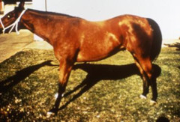
Junctionopathies
Tetanus
Treatment
  Prevention of continued toxin production
    Thorough search for active infection
      If found, drain and debride
      Treat with antibiotics effective against Clostridium tetani
        Metronidazole x 10-14 days; pencillin G x 10-14 days, clindamycin and tetracycline also effective
  Neutralization of toxin not yet bound to the CNS
    Equine antitoxin 100-1000U/kg given IV over 10 minutes
  Supportive care
    Hydration and nutritional requirements
    Bladder/fecal care
    Sedation
    Down dog care
    Temperature monitoring
http://o.quizlet.com/i/mwf5crxSO0ZoWVtoKQiT7g_m.jpg
Notes:
Large clinical trial revealed that metronidazole is more effective than penicillin G in the treatment of tetanus in humans- Ahmadsyah I, Salim A: Treatment of tetanus: an open study to compare the effecicay of procraine penicillin and metronidazole. Br Med J (Clin Res Ed) 1985; 291.
Hydrogen peroxide may inhibit clostridial growth by increasing oxygen tension in the wound
Larger animals receive a proportionally smaller dose than smaller animals
Prior to administration, 0.1-0.2mL antitoxin should be administered SQ or intradermally to avoid anaphylaxis (look for wheal)
Premedicate with glucocorticoids and antihistamines regardless of response to test dose
If anaphylaxis, administer 0.1ml/kg epi (diluted 1:10.000) IV
Sedation- hypersensitivity to auditory and tactile stimuli (reflex muscle spasms)- promazines + diazepam or barbiturates (caution d/t respiratory depression)

Slide 46
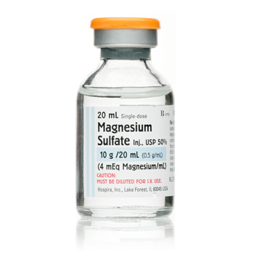
Junctionopathies
Tetanus
X
Magnesium sulfate as an adjunct therapy in the management of severe generalized tetanus in a dog
Erin E. Simmonds, DVM; Amy J. Alwood, DVM, DACVECC and Merilee F. Costello, DVM, DACVECC
Objective – To describe the use of magnesium sulfate in a case of generalized tetanus in a dog.
Case Summary – A 1.5-year-old golden retriever was presented for a digital wound on the right thoracic limb and clinical signs associated with generalized tetanus. Initial case management consisted of wound debridement, treatment with metronidazole, tetanus immunoglobulin,
methocarbamol, airway management via tracheostomy, and nursing care. Sedation to control
severe muscle spasms became insufficient despite increasing doses of benzodiazepine,
methocarbamol, and barbiturate continuous rate infusions. A magnesium sulfate continuous rate
infusion was instituted on day 7 and muscle rigidity improved within 16 hours allowing
discontinuation of sedative infusions over the subsequent 2 days. Clinical improvement continued
and the dog was discharged on day 14.
New or Unique Information Provided – This case demonstrates the use of supraphysiologic
magnesium in the treatment of severe generalized tetanus with a positive outcome. No clinical
signs associated with magnesium toxicity were noted during the course of therapy. Magnesium
sulfate should be considered as a potential adjunct therapy in the management of spastic paralysis
caused by severe tetanus in dogs.
Notes:
Magnesium sulfate had been used in human patients with tetanus to aid in reducing muscle spasms and ultimately sedation requirements, as well as combating autonomic dysfunction. First report of its use in dogs.
1.5 y/o M Golden Retriever with Class III/IV tetanus. Treated with wound debridement (RF), metronidazole, tetanus immunoglobulin, methocarbamol, airway mgt (tracheostomy), sedation and nursing care. MgSO4 CRI targeted supraphysiologic concentrations (2-4mmol/L or 4.86-9.73mg/dL) started on day 7 of hospitalization. Clinical signs of muscle rigidity improved within 16 hours.
Beneficial effects of MgSO4 in tetanus are likely multifactorial-non-specific calcium channel blocker thereby decreasing entry of calcium into presynaptic terminals resulting in decreased ACh release. It decreases the sensitivity of postsynaptic motor endplates to ACh with the net result of muscle relaxation. Magnesium has been reported to decrease catecholamine release from adrenal glands and peripheral adrenergic nerve terminals as well as reduce sensitivity of receptors to these neurotransmitters. Therefore, useful in controlling autonomic dysfunction. Vasodilation, caused by decreasing smooth muscle intracellular calcium may also help alleviate hypertensive episodes due to tetanus-associated autonomic dysfunction. Effects on CV system- decreased HR and systemic vascular resistance and increased SV with preserved CO and control of autonomic dysfunction.
Dose- 70mg/kg over 30 minutes then CRI of 100mg/kg/day, titrating up; monitor Mg q6hrs
CS with hypermagnesemia= lethargy and nausea, resp dep, coma, cardiac conduction complications, bradycardia, hypotension, cardiac arrest
Therapeutic goal close to range of sig resp/cardiac toxicity
Therefore, monitoring essential- hourly assessment of patellar tendon reflex, serial monitoring of mg and ca, cecg, pulse ox and BP. Deep tendon hyporeflexia is one of the earliest signs of mg toxicity. Asymptomatic hypocalcemia is a common effect.

Slide 47
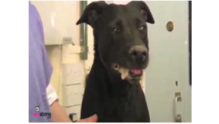
Junctionopathies
Tetanus
Prognosis
  Humans- survival rates globally 50-70%; with intensive care management and mechanical ventilation, survival rates have increased to 85-95%
  Survival rates in dogs 50-92%
    Younger dogs and those with more severe clinical signs +/- autonomic storms have worse prognoses
    No difference in prognosis found in two reports between dogs that did or did not receive tetanus antitoxin
    Median length of hospitalization 13-17 days
    Dogs typically recover within a month of therapeutic intervention; cats may require several months to return to normal
    Frequently the earliest indication of improvement is decreased muscle rigidity in the pelvic limbs

Slide 48
Junctionopathies
Tetanus
Risk factors associated with outcome in dogs with tetanus: 38 cases (1987–2005)
Jamie M. Burkitt, dvm, dacvecc; Beverly K. Sturges, dvm, dacvim; Karl E. Jandrey, dvm, dacvecc; Phillip H. Kass, dvm, phd, dacvpm
Objective—To assess the clinical course of disease and risk factors associated with outcome in dogs with tetanus.
Design—Retrospective case series.
Animals—38 dogs with tetanus.
Procedures—Data were collected from medical records of dogs with tetanus, including signalment; wound characteristics; initial clinical signs; severity of worst clinical signs; time to wound management, antimicrobial treatment, and antitoxin administration; and 28-day survival rate. Statistical analyses were performed to evaluate relationships between the potentially predictive variables and disease progression and outcome.
Results—The 28-day survival rate was 77% (among 35 uncensored dogs). The most common initial clinical signs in affected dogs were ocular (n = 18) and facial (11) abnormalities. Nineteen dogs progressed to recumbency with severe muscle spasms, and 14 dogs had high or low heart rate or blood pressure values. Eight dogs died or were euthanized because of complications of tetanus. There was a significant association between younger age and development of more severe clinical signs. Furthermore, a significant inverse relationship between development of severe clinical signs and survival was identified. There was no association between earlier initiation of wound management, antimicrobial administration, or antitoxin administration and either progression of signs or 28-day survival rate. Wound type was not associated with 28-day survival rate.
Conclusions and Clinical Relevance—Results suggest that younger dogs with tetanus may be more likely to develop severe clinical signs. The prognosis for survival in dogs with tetanus is good if abnormalities in heart rate or blood pressure values do not develop.
Notes:
Younger dogs were significantly more likely to develop a worse tetanus severity class than older dogs.
Worse tetanus severity was inversely associated with survival rate
Most common clinical signs appreciated by owners prior to presentation were ocular changes (48%), specifically third eyelid protrusion or sunken eyes (n=11), an odd appearance of the eyes (n=4), or squinting or swollen eyelids (n=3). Frequently ocular signs were the only initial abnormality detected by the owner.
Most dogs developed more severe cliniocal signs after initial presentation
Autonomic dysfunction has been identified in humans with tetanus and occurs in as many as 30% of humans with the disease. Exact mechanism is unknown, but the most widely accepted theory involved impairment of inhibitory circuits in the autonomic nervous system. Signs of sympathetic and parasympathetic dysfunction may develop, even in the same patient, resulting in violent autonomic storms.
Highest severeity class was class I for 4 dogs, class II for 15 dogs, class III for 5 dogs and class IV for 14 dogs
4 dogs class IV- unable to urinate voluntarily
Hiatal hernia in 1 dog in class III and 2 dogs in class IV
The 28 day survival overall was 77%; severity III or IV- 58% survival; 100% survival in I or II
No association between earlier antitoxin administration and progression of clinical signs or 28 day mortality.
No effect of timing of appropriate antimicrobial treatment or wound management improving clinical course and 28 day survival rate.
Attributed to likely Type I error associated with small sample size
Study called into question usefulness of intradermal test- two dogs with positive skin test results had no clinical reaction to antitoxin administration ; 3 dogs with negative skin test results and diphenhydramine pretreatment had reactions.
Median interval between known wound occurrence and the onset of clinical signs was 9 days (3-18 days) in dogs.
Dogs with surgical introduction of C. tetani appeared to be more likely (though not stat sig) to progress to a higher tetanus severity class than those with external wounds.
10 dogs-no wound identified
C. Tetani was not cultured from wound samples collected from 5 dogs- consistent with human lit.
Complications- 3 dogs- hiatal hernias, three dogs had severe hypoventilation/apnea, six dogs developed aspiration pneumonia, 4 dogs developed GI bleeding (3 had been exposed to steroids), SIRS, renal failure PTE and multiple organ failure developed in 3 dogs in the study

Slide 49
Junctionopathies
Tetanus
Retrospective Study of Tetanus in 20 Dogs: 1988-2004
Bandt C, Rozanski EA, Steinberg T, Shaw SP
The case records of 20 dogs that were treated for tetanus between 1988 and 2004 were reviewed. Young, large- breed dogs were most commonly affected. Twelve dogs had a likely source of infection identified. All dogs were treated with intravenous antibiotics and supportive care, such as muscle relaxants and sedation for muscle
tremors and rigidity. Sixteen dogs received tetanus antitoxin. The mortality rate was 50%. Complete recovery in survivors required approximately 1 month.
J Am Anim Hosp Assoc 2007;43:143-148.
Notes:
Larpar n=8, cardiac arrhythmias n=6, hyperthermia n=4, systemic hypertension n=3
Arrhythmias- atrial standstill n=2, svt n=2, vt n=2
Development of arrhythmias was not associated with increased death although ecg not used for all dogs
4 dogs- hyperthermia
Pneumonia-9 dogs, 8/9-lar par/spasm
10 survived
5 died acutely of unknown cause, 3 died of arrhythmias; 2 euthanized
Median duration hosp 17 days (9-30 days)
Median time to complete recovery 34 days (26-42 days0.
Antitoxin used in 16 dogs- no stat significant difference in survival, severity clinical signs or duration of clinical signs between those that did and those that did not receive antitoxin.

Slide 50
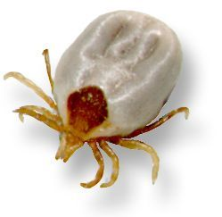
Junctionopathies
Tick bite paralysis
Disorder is caused by a salivary neurotoxin released by ticks
  Toxin acts by interfering with ACh release at the NMJ and/or propagation of the impulse along motor axon terminals
  May affect both sensory and motor nerve fibers by altering ionic fluxes that mediate axon potentials
  *Dermacentor variabilis (common wood tick), Dermacentor andersoni (Rocky Mountain wood tick), Ixodes holocyclus, Ixodes cornuatus and Ixodes hirsti
http://www.lowchensaustralia.com/pests/images/ixholfemhalf.jpg
Notes:
Tick paralysis in Australia appears to result in much more severe clinical signs, frequently leading to death d/t CNS effects and respiratory failure within 1-2 days if dogs are left untreated (ticks-Ixodes holocyclus).
Only gravid females of the ixodid species and larvae of the argasid species cause tick paralysis.
The incubation period is constant with disease progression mirroring the feeding habits of the respective tick species
Precise manipulation of the incubation period is possible by applying ticks that have been allowed to feed on other individuals.
Clinical sings are usually present only when the ticks are fully engorged and rapidly resolve following removal of the ticks
Severity of clinical signs are closely correlated to severity of the tick infestation
Clinical signs of paralysis can be induced by administering tick saliva or tick homogenate to test animals
NMJ blockade can be induced in nerve-muscle explants by administration of tick salivary gland isolates
Inoculation of animals susceptible to tick paralysis with material from affected animals fails to induce paralysis.

Slide 51
Junctionopathies
Tick Bite Paralysis
Acute, rapidly progressive flaccid paralysis with decreased to absent spinal reflexes
  5-9 days of tick attachment is thought to be required for development of clinical signs
  Tetraplegia often develops within 12-72 hours from the onset of clinical signs
  Weakness typically first develops in the pelvic limbs and then progresses to the thoracic limbs
  Tendon reflexes (i.e. patellar reflex) are typically lost before withdrawal reflexes
  CN are occasionally affected
    Laryngeal muscles may be affected
    Facial and masticatory muscles may be affected
  Urethral and anal sphincter function is typically unaffected
  Severe cases may develop respiratory failure or aspiration pneumonia

Slide 52
Junctionopathies
Tick Bite Paralysis
Diagnosis
  History, suggestive clinical presentation, and identification of the offending tick species
  Electrophysiological studies in human patients with Dermacentor-induced NMJ blockade
    Motor neuropathy with decreased motor nerve conduction velocity
    Decreased compound motor-evoked muscle action potential amplitude in nerves and their corresponding muscles
    Impaired afferent nerve impulse propagation
    A requirement for higher nerve stimulus current in order to elicit a muscle response
  Electrophysiological studies in children with Ixodes holocyclus-induced NMJ blockade
    Decreased evoked compound muscle action potential amplitude
    Normal motor nerve conduction velocity, normal sensory conduction, and a normal response to repetitive stimulation

Slide 53
Junctionopathies
Tick Bite Paralysis
Treatment
  Identification and removal of the offending tick
    In tick paralysis cases not due to I. holocyclus, full recovery usually occurs 8-12 hours after tick removal
    More prolonged recoveries are expected with paralysis due to I. holocyclus
  Treat with an acaricide and dip
  Supportive treatment
  Antiserum available for I. holocyclus in severe cases
  No protective immunity; may be more susceptible to future episodes
Notes:
Avoid anaphylaxis by first administering an intradermal test dose. A high incidence of acute allergy nad serum-sickness has been reported in children for whom this has been used.

Slide 54
Neuropathies
Peripheral nerves are composed of myelinated and unmyelinated motor and sensory axons
Mononeuropathy= dysfunction of one cranial nerve or one peripheral nerve
Polyneuropathy= multiple nerve dysfunction
Multiple mononeuropathies= multiple CN dysfunction or multiple peripheral nerve dysfunction in the same limb
Generalized polyneuropathies
Notes:
Some neuropathies are exclusively or primarily characterized by motor dysfunction, others by sensor dysfunction and some by a combination of motor and sensory dysfunction.

Slide 55
Neuropathies
In general, result in LMN signs
Decreased to absent reflexes, poor muscle tone and neurogenic muscle atrophy
Tentative diagnoses are often based on clinical features
Underlying etiology often remains undetermined
No treatments for many of the disorders; some resolve spontaneously

Slide 56
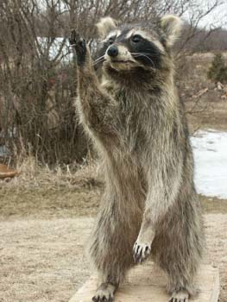
Neuropathies
Polyradiculoneuritis
Acute idiopathic polyradiculoneuritis
or coonhound paralysis
  Idiopathic inflammatory disorder primarily involving both axons and myelin of ventral nerve roots in dogs
  Analogous disorder in cats
  Guillain-Barre syndrome in humans
  Pathogenesis uncertain, but an autoimmune process is suspected
    Campylobacter jejuni infections in people
http://www.animaltalent.com/robo/images/Racoon.jpg
Notes:
Although most cases of Guillan-Barre are associated with widespread demyelination, there is evidence that axonal loss is more prominent than demyelination in most dogs with polyradiculoneuritis. Demyelination is thought to be most severe in the ventral nerve roots in dogs, with minimal myelin loss in the major nerve trunks.

Slide 57
Neuropathies
Polyradiculoneuritis
Seroprevalence of Various Infectious Agents in Dogs with SuspectedAcute Canine Polyradiculoneuritis
N. Holt, M. Murray, P.A. Cuddon, and M.R. Lappin
JVIM 2011; 25
Background: Acute canine polyradiculoneuritis (ACP) is considered to be an animal model of the acute axonal form of Guillain-Barre ́ syndrome (GBS) in humans. Various antecedent events have been associated with GBS, including bacterial or viral infection. The relationship between ACP and previous infection requires additional attention.
Hypothesis: We hypothesized a relationship between ACP and serological evidence of exposure to Ehrlichia canis, Borrelia burgdorferi, Toxoplasma gondii, Neospora caninum, Campylobacter jejuni, and canine distemper virus (CDV).
Animals: Eighty-eight client-owned dogs, 44 with ACP, 44 age-matched controls.
Methods: Retrospective study with stored serum samples. Serum antibodies against the target organisms were measured with commercially available assays. Sera from dogs with and without ACP that were positive for T. gondii IgG by ELISA were assayed by an IgG heavy chain-specific, Western blot immunoassay.
Results: Dogs with ACP (55.8%) were more likely to have T. gondii IgG serum antibody titers than dogs without ACP (11.4%). Serum antibodies from 8 affected dogs and 11 control dogs bound to T. gondii antigens with apparent molecular masses of 67, 61, 58, 45, 33, 24, 9, and 6 kDa. An antigen with an apparent molecular mass of 36 kDa was recognized by 2 dogs with ACP but none of the control dogs.
Conclusions: Results of this study suggest that ACP in some dogs, like GBS in some humans, may be triggered by T. gondii and a prospective study should be performed to further evaluate this potential association.
Notes:
Retrospective study in which the investigators arbitrarily selected infectious agents that commonly infect dogs, have been associated with neurological disease and have commercially available serological assays available that could be used on stored sera. A signifciant association was found between dogs with suspected ACP and the presence of Toxoplasma. In previous studies of hunting dogs that develop ACP, increased exposure to raccoons has been the most common underlying factor predicting disease. Hunting dogs are more likely to ingest raw meat or prey, based on their lifestyles, and thus may be more likely to have previously ingested T. gondii organisms than control dogs. T. gondii has been shown to be endemic in the racoon popuulation also. T. gondii IgG titers but not IgM titers were commonly detected. Dogs were not infected with T. gondii in the same 7-10 days preceding the onset of neurologic signs.

Slide 58
Neuropathies
Polyradiculoneuritis
Clinical signs
  Rapidly developing LMN paresis/plegia, usually beginning in the pelvic limbs
    Most affected animals will progress to being either nonambulatory tetraparetic or tetraplegic within 10 days of onset of clinical signs
    Spinal reflexes typically absent
    Muscles are hypotonic
    Potential for life-threatening respiratory paralysis
    +/- Hyperesthetic
    +/- CN involvement
Notes:
Typically tetraparetic/plegic within 72 hours of onset of C.S.
CN- dysphonia/aphonia, facial paralysis
Patients still retain the ability to urinate/defecate

Slide 59
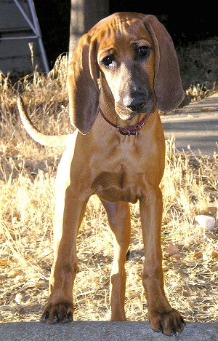
Neuropathies
Polyradiculoneuritis
Diagnosis
  Signalment
  History
  Characteristic clinical signs of a rapidly progressive polyneuropathy
  Electrodiagnostic tests and muscle/nerve biopsies
    *Abnormal EMG activity with normal motor nerve conduction velocities
    Specific NCV test (F wave) may be abnormal
  CSF tap +/- albuminocytologic dissociation
Notes:
Typically an adult, hunting-breed dog
Typically exposure to a racoon 1-2 weeks prior to onset of clinical signs
See normal motor NCV because MNCV primarily reflects myelin integrity rather than the number of functional axons in a peripheral nerve
F wave specifically evaluates the ventral nerve root

Slide 60
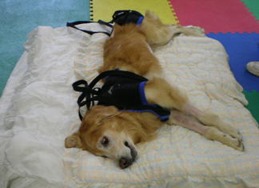
Neuropathies
Polyradiculoneuritis
Treatment
  No specific therapy
  Humans with Guillain-Barre syndrome- plasmapharesis/IVIG
  Inflammatory phase transient, but damaged axons need to remyelinate and regrow
  Nursing care
http://caringcanine.com/photos/PistolIE.jpg
Notes:
Humans with Guillain-Barre treated with plasmapharesis/IVIG- recover more rapidly when treated within 4 weeks of disease onset than those not treated.

Slide 61
Polyneuropathies
Polyradiculoneuritis
Prognosis
  Prognosis for full recovery is typically favorable, but is usually prolonged
  Some patients develop life-threatening respiratory paresis/paralysis in the acute phase of the disease and require mechanical ventilation
  No protective benefit
Notes:
Recovery typically takes several weeks to months to occur
Reexposure to raccons should be avoided having recovered, as this may trigger a relapse of the disease.

Slide 62
Polyneuropathies
Polyradiculoneuritis
Outcome and medical management in dogs with lower motor neuron disease undergoing mechanical ventilation: 14 cases (2003–2009)
Christine R. Rutter, DVM; Elizabeth A. Rozanski, DVM, DACVIM, DACVECC; Claire R. Sharp, BSc, BVMS (Hon), DACVECC; Lisa L. Powell, DVM, DACVECC and Marc Kent, DVM, DACVIMt
Objective – To describe the application of intermittent positive pressure ventilation (IIPV) in dogs with lower motor neuron disease (LMND).
Design – Multi-institutional, retrospective study (2003–2009).
Setting – Intensive care units at multiple university teaching hospitals.
Animals – Fourteen dogs with LMND that underwent IIPV.
Interventions – None.
Measurements and Main Results – The ventilatory logs of 4 teaching hospitals were searched for dogs undergoing IIPV in association with a diagnosis of acute LMND. The medical records were evaluated for signalment, specific LMND, ventilatory management and duration, complications associated with ventilation, duration of hospitalization, and outcome. Descriptive statistics were used as indicated. Fifteen records were evaluated, 1 dog was excluded since it experienced cardiopulmonary arrest (CPA) before commencement of IIPV. The median age was 7.0 years (range 10 mo to 12 y). There were 5 Labrador retrievers, 4 mixed breeds, and 5 other breeds were each represented once. Five dogs were diagnosed with myasthenia gravis, 4 dogs with polyradiculoneuritis, and 5 dogs had an undetermined LMND. Clinical signs of weakness before ventilation were present for a median of 36 hours (range 6 h to 14 d). Dogs were ventilated for a median of 109 hours (range 5–261 h). Nine dogs had temporary tracheostomies performed, and 8 dogs received nutritional support. Five dogs developed ventilator associated pneumonia. Six dogs were successfully weaned from the ventilator with a median ventilatory time of 49 hours (range 25–192 h). Three dogs survived to discharge. No single LMND was associated with a better outcome.
Conclusions – High euthanasia rates and iatrogenic complications limit the ability to accurately prognosticate for affected dogs in this retrospective study, but in dogs with LMND that is severe enough to require IIPV, support may be required days to weeks.
Notes:
5 dogs myasthenics, 4 dogs polyradiculoneuritis, 5 dogs had undetermined LMN disease
Clinical signs presnet for average 36 hours prior
Ventilated for median of 109 hours.
9 had temp trachs
5 developed VAP
6 dogs were successfully weaned from ventilator, 3 dogs survived to discharge

Slide 63
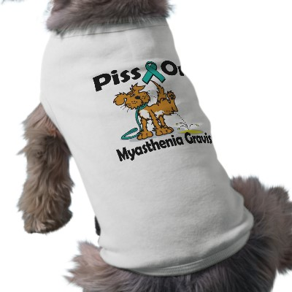
Questions?
http://rlv.zcache.com/piss_on_myasthenia_gravis_dog_shirt-p1557252861551285962vfyw_400.jpg

Slide 64
References
    Abelson AL, et al: Use of mycophenolate mofetil as a rescue agent in the treatment of severe generalized myasthenia gravis in three dogs. J Vet Emerg Crit Care 2009; 19 (4).
    Bartges JW, et al: Clinical remission following plasmapharesis and corticosteroid treatment in a dog with acquired myasthenia gravis. J Am Vet Med Assoc 1990; 196.
    Bexfield NH, Watson PJ, Herrtage ME: Management of myasthenia gravis using cyclosporine in two dogs. JVIM 2006; 20.
Dewey CW, et al: Azathioprine therapy for acquired myasthenia gravis in five dogs. JAAHA 1999.
Dewey CW, et al: Clinical forms of acquired myasthenia gravis in dogs: 25 cases (1988-1995). J Vet Intern Med 1997; 11 (2).
    Dewey CW, et al: Mycophenolate mofetil treatment in dogs with serologically diagnosed acquired myasthenia gravis: 27 cases (1999-2008). J Am Vet Med Assoc 2010; 236 (6).
    Dewey CW, et al: Treatment of a myasthenic dog with mycophenolate mofetil. J Vet Emerg Crit Care 2000; 10 (3).
Dickinson PJ, et al: Congenital myasthenia gravis in smooth-haired miniature dachshund dogs. J Vet Intern Med 2005; 19.
Hackett TB, et al: Third degree atrioventricular block and acquired myasthenia gravis in four dogs. J Am Vet Med Assoc 1995; 206 (8).
Hart IK Sathasivam S, Sharshar T: Immunosuppressant agents for myasthenia gravis. Cochran Database Syst Rev 2007; 17 (4).
Kent M, et al: Adult onset acquired myasthenia gravis in three Great Dane littermates. J Small Anim Pract 2008; 49.
Khorzad R, et al: Myasthenia gravis in dogs with an emphasis on treatment and critical care management. J Vet Emerg Crit Care 2009; 21 (3).
Lipsitz D, Berry JL, Shelton GD: Inherited predisposition to myasthenia gravis in newfoundlands. J Am Vet Med Assoc 1999; 215.
Penderis J: “Junctionopathies: Disorders of the Neuromuscular Junction” in A Practical Guide to Canine and Feline Neurology 2008.
Shelton GD: Acquired myasthenia gravis: what we have learned from experimental and spontaneous animal models. Vet Immunol Immunopathol 1999; 69.
Shelton GD: Myasthenia gravis and disorders of neuromuscular transmission. Vet Clin North Am 2002; 32.
Shelton GD, Schula A, Kass PH: Risk factors for acquired myasthenia gravis in dogs: 1,154 cases (1991-1995). J Am Vet Med Assoc 1997; 211 (11).

