Slide 1
Hypercoagulability, assessment and treatment
Jillian DiFazio, DVM
Cornell University Hospital for Animals
Notes:
Hello, my name is Jillian DiFazio and for those of you who do not know me I am a small animal intern at the CUHA. Over the past year and during my veterinary education I have developed an interest in coagulation and its disturbance. Hypercoagulability often receives much less attention than hypocoagulability does traditionally, both clinically and academically/ Tremendous advances have been made in recent years in the assessment and treatment of hypercoagulability. I will be sharing much of this with you today.

Slide 2
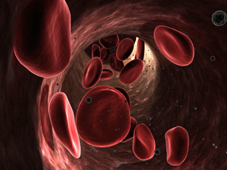
Plan for today
Review of normal coagulation
Pathophysiology behind hypercoagulability
Assessment of hypercoagulability
Treatment of hypercoagulability
http://www.aacc.org/publications/cln/2010/december/PublishingImages/Series-image_12-10.jpg

Slide 3
4 Quadrant System of Hemostasis
Normal hemostasis
Fibrinolytic Activity
Anti-thrombotic Activity
Anti-fibrinolytic Activity
Pro-thrombotic Activity
Hypocoagulability
Hypercoagulability

Slide 4
Hemostasis Review
Endothelium
Platelets (primary hemostasis)
Clotting factors (secondary hemostasis)
Fibrinolytic systems
Endogenous anticoagulant systems

Slide 5
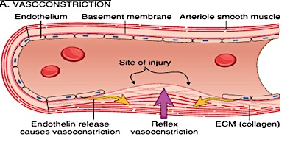
Hemostasis Review
http://3.bp.blogspot.com/_w7hnLbtZ6fM/TH8hOyS6dtI/AAAAAAAAAEQ/8hel-FXGZUU/s1600/hemostasis11.jpg
Notes:
Vascular injury results in transient neurogenic arteriolar vasoconstriction that temporarily decreases blood flow

Slide 6
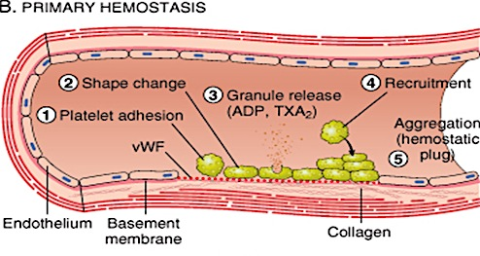
Hemostasis Review
http://3.bp.blogspot.com/_w7hnLbtZ6fM/TH8hOyS6dtI/AAAAAAAAAEQ/8hel-FXGZUU/s1600/hemostasis11.jpg
Notes:
Injury to the endothelium exposes the subendothelial ECM, which results in platelet adhesion and activation and formation of the hemostatic plug= PRIMARY HEMOSTASIS
Healthy endothelial cells inhibit coagulation and platelet adhesion
Injured/activated endothelial cells are procoagulant
Secretion of alpha and dense granules occurs after adhesion. ADP and thromboxane A₂ are products of platelets that are vasoconstrictors and stimulate platelet aggregation. Thus a self-perpetuating cycle of platelet aggregation occurs. This process is initially reversible, until activation of the coagulation cascade and the formation of thrombin. Platelet contraction creates an irreversible fused mass of platelets (also known as viscous metamorphosis) and formation of the secondary hemostatic plug. Simultaneous formation of thrombin by the coagulation cascade converts fibrinogen to fibrin, which cements the platelets in place.

Slide 7
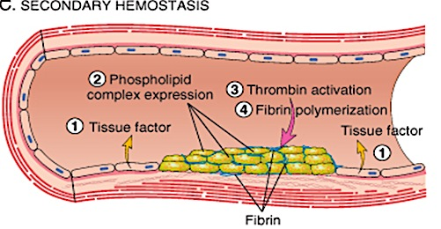
Hemostasis Review
http://1.bp.blogspot.com/-xFRi_WmdCdE/TWANjJF24AI/AAAAAAAACgc/xj6eNTPh6l8/s1600/Secondary%2BHemostasis.png
Notes:
Vascular endothelial injury leads to exposure of membrane-bound protein Tissue Factor which triggers coagulation cascade that eventually forms Thrombin--- converts fibrinogen to fibrin which polymerizes and incorporates platelets to form the more stable fibrin plug= SECONDARY HEMOSTASIS

Slide 8
Coagulation Cascade
Classic model
  Divides into extrinsic and intrinsic pathways which converse into the common pathway
  Artifact of in-vitro testing
Cell-based model of coagulation
  More adequately explains the mechanisms leading to hemostasis in-vivo

Slide 9
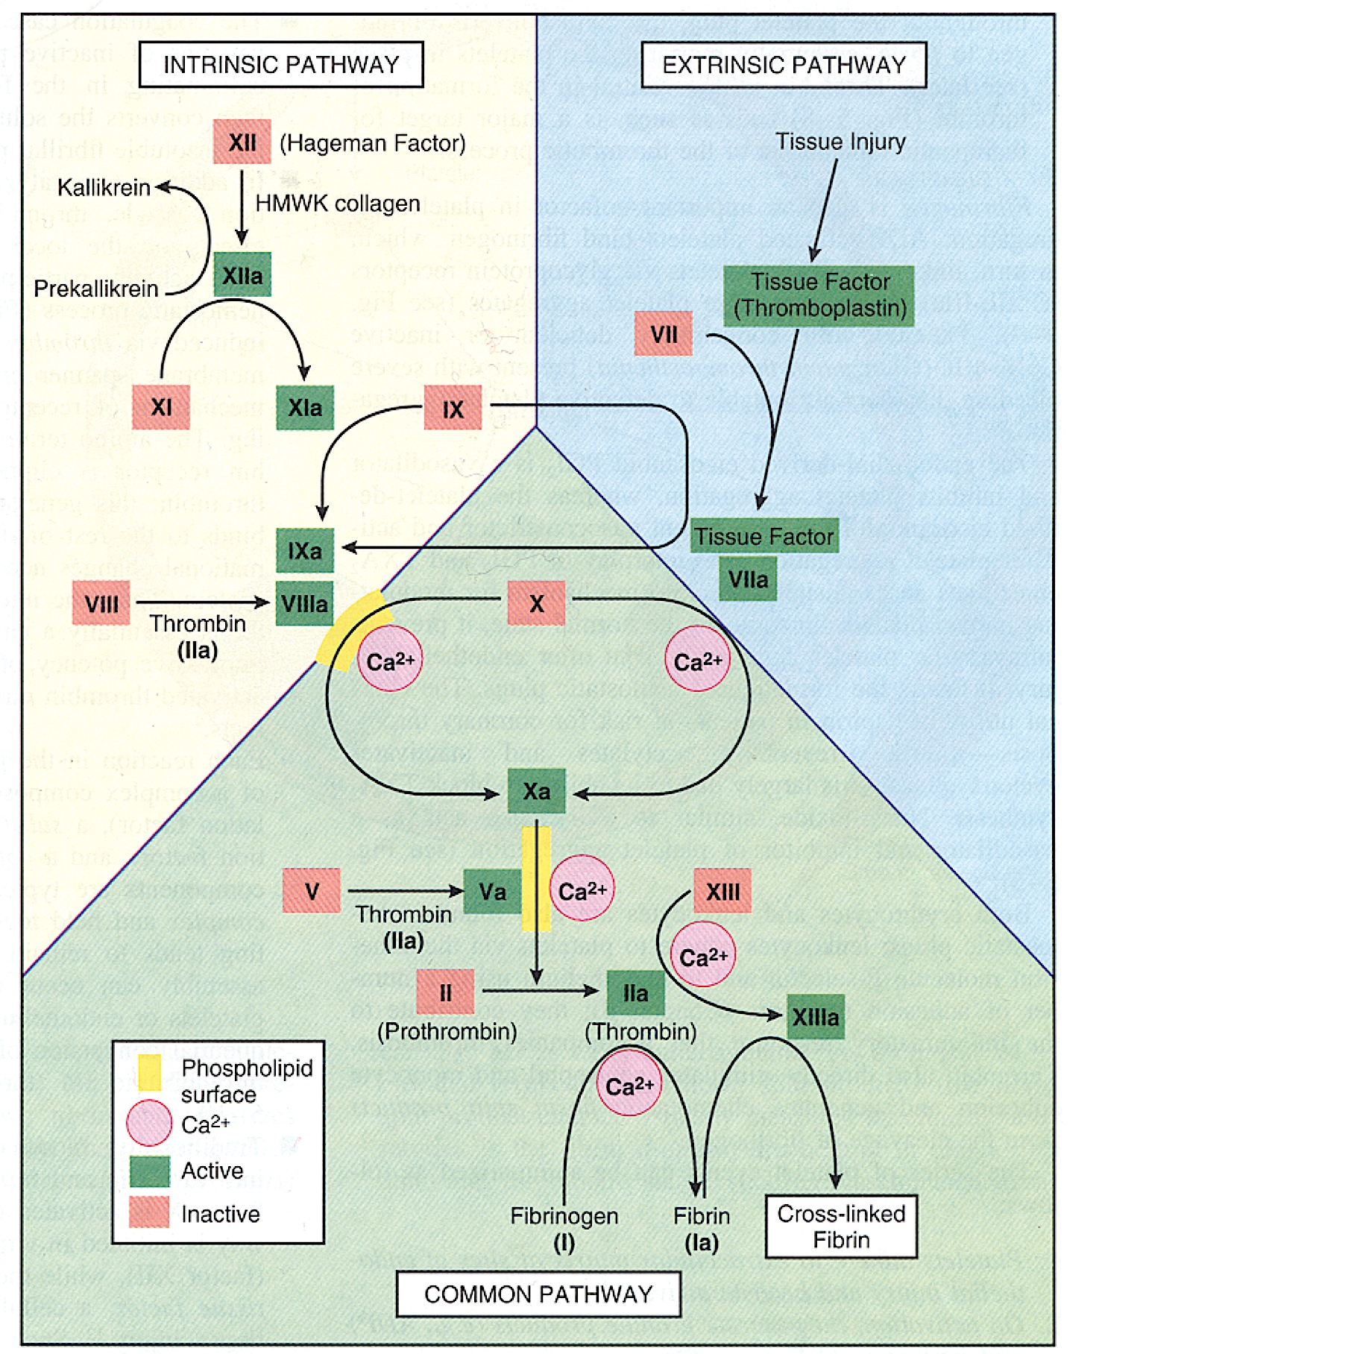
Classic model of coagulation
http://img.medscape.com/fullsize/migrated/409/675/pharm2102.07.fig2.jpg
Notes:
Intrinsic pathway- activated in vitro by factor XII
Factors XI, IX, VIII- all part of intrinsic pathway
Extrinsic pathway- activated by Tissue Factor that is exposed at sites of tissue injury
Extrinsic pathway is Vitamin K dependent
Extrinsic pathway is most activated by systemic inflammation
Common Pathway- begins with activation of Factor X (can be activated by either the intrinsic or extrinsic pathways)
Activated Factor X converts prothrombin to thrombin (Factor V is a critical cofactor)
Activated thrombin converts fibrinogen to fibrin (Factor XIII stabilizes fibrin clot)

Slide 10
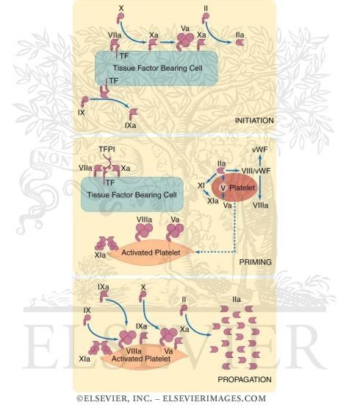
Cell-based model of coagulation
Notes:
3 steps of hemostasis:
Initiation, 2) amplification, 3) propagation
Initiation: Tissue Factor- bearing endothelial cells trigger coagulation (exposed as a result of vascular injury/activation secondary to cytokines)- hemostasis initiated by formation of complex between tissue factor exposed and already activated factor VII normally present in circulating blood
Tissue Factor-factor VIIa complexes convert Factor X to Factor Xa on the tissue factor-bearing cell; also activate factor IX (in turn activates more factor X; process accelerated by factor VIII)
Factor Xa activates prothrombin (factor II) to thrombin (factor IIa); process accelerated by factor V
The limited amount of thrombin activates factor VIII, V, XI, platelets
2) Amplification: Thrombin-activated platelets change shape and expose negatively charged phospholipids, therefore serving as a template for for full thrombin generation involving factors VIIIa and IXa
3) Propagation occurs on the surface of platelets and results in propagation of large amounts of thrombin
Thrombin then activates fibrinogen to fibrin

Slide 11
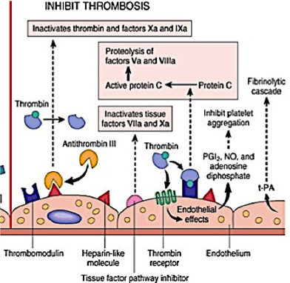
Endogenous anticoagulant systems
Process restricted to phospholipid surfaces
Removal of activated coagulation factors by hepatocytes and mononuclear factors
Constant flow of blood
Antithrombin and Proteins C + S
TF pathway inhibitor (TFPI)-
physiologic inhibitor
of coagulation factor activation
  Inhibits factor Xa
  Inhibits initiation complex of tissue
  factor with factor VIIa
http://4.bp.blogspot.com/-Gz2LVuIxnr8/TWAMyLnZEtI/AAAAAAAACgM/
iY-57wXSjr8/s1600/favor%2Bthrombosis.png
Notes:
Hepatocytes clear soluble factors; mononuclear cells clear particulate debris

Slide 12
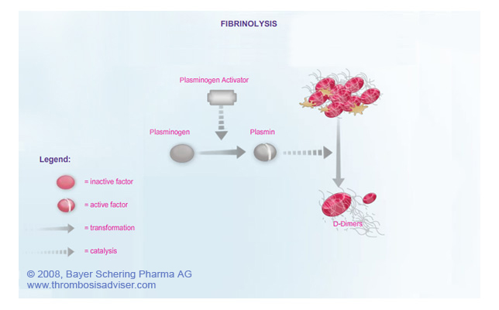
Fibrinolysis
Plasmin is derived from circulating plasminogen in the presence of plasminogen activator (t-PA)
http://www.thrombosisadviser.com/html/images/library/coagulationcascade/fibrinolysis-coag-cascade-PU.jpg
Notes:
T-PA is synthesized by endothelial cells and is most active when attached to fibrin
Plasmin breaks down fibrin and interferes with polymerization
Controlled by presence of plasmin inhibitors in the circulation as well as plasminogen activator inhibitors produced by endothelial cells (inhibit fibrinolysis by inhibiting binding of t-PA to fibrin) i.e. plasminogen activating inhibitor-1 (PAI-1)
FDPs are produced as a result of fibrinolysis- Have weak anticoagulant activity and are removed from the circulation by the liver and kidney
D-Dimers are a specific type of FDP that are produced as a result of degradation of cross-linked fibrin (better marker of pathologic coagulation)

Slide 13
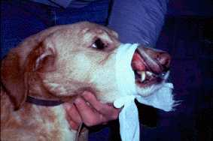
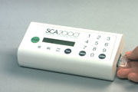
Classic coagulation tests
Platelet count
Buccal mucosal bleeding time
Platelet function assay
Prothrombin time (PT)
Partial thromboplastin time (PTT)
Activated clotting time (ACT)
Antithrombin
Fibrin degradation products (FDPs)
D-Dimers
Fibrinogen
http://ahdc.vet.cornell.edu/images/coag/lip1.JPG
http://www.vetcontact.com/foto/sca2000.jpg
Notes:
Best for assessment of hypocoagulability

Slide 14
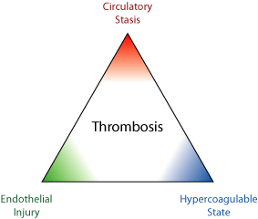
Hypercoagulability
Macrovascular thrombosis
  Virchow’s triad
  Arterial vs. venous thrombi
Microvascular thrombosis
http://scienceroll.files.wordpress.com/2006/12/virchow-triad.gif?w=460
Notes:
Virchow’s triad- thrombus formation occurs secondary to hypercoagulability, blood stasis and vascular injury
Important distinction- arterial thrombi: composed primarily of platelets and are formed in areas of rapid blood flow; venous thrombi: composed of fibrin and RBCs and usually formed in areas of venous stasis or in patients with AT deficiency

Slide 15
Conditions predisposing to thrombosis
Immune-mediated hemolytic anemia (Sott-Moncrieff, et al: Hemostatic abnormalities in dogs with primary immune-mediated hemolytic anemia. JAAHA. 2001)
Congestive heart failure (Tarnow, et al: Hemostatic biomarkers in dogs with chronic congestive heart failure. JVIM. 2007)
Neoplasia (Kristensen et al: Evaluation of human recombinant tissue factor-activated thromboelastography in 49 dogs with neoplasia. JVIM. 2008)
Hyperadrenocorticism
Protein-losing nephropathy
Protein-losing enteropathy (Goodwin et al: Hypercoagulability in dogs with protein-losing enteropathy. JVIM. 2011)
Early disseminated intravascular coagulation
SIRS/Sepsis (De Laforcade AM, et al: Hemostatic changes in dogs with naturally occurring sepsis. JVIM. 2003)
Endothelial injury
Abnormal vascular anatomy
Secondary to immobility and low flow states
Notes:
Hyperadrenocorticism- hypercoagulability- increased levels of factors V, X and fibrinogen
Infectious, inflammatory
Bacterial
Severe localized bacterial infection
Bacterial sepsis
Viral
Infectious canine hepatitis
Canine distemper
Canine parvovirus
Canine herpesvirus
Feline infectious peritonitis
Feline panleukopenia
Fungal
Fulminating systemic fungal diseases
Candida sepsis
Parasitic
Fulminating systemic protozoal diseases
Noninfectious, inflammatory
Neoplastic
Hemangiosarcoma
Inflammatory carcinoma
Leukemias (especially acute)
Malignant histiocytosis
Tissue trauma, ischemia
Severe shock syndromes
GDV
Massive crushing injury
Envenomation
Heat stroke
Pancreatitis
Immune-mediated causes
IMHA
Hemolytic transfusion reactions

Slide 16
Microvascular thrombosis
Occurs almost exclusively in disseminated intravascular coagulation (DIC)
  DIC is “an acquired syndrome characterized by the intravascular activation of coagulation with loss of localization arising from different causes. It can originate from and cause damage to the microvasculature, which if sufficiently severe, can produce organ dysfunction.” International Society on Thrombosis and Haemostasis (ISTH) Consensus Statement (2001)
Underlying pathophysiology is best understood in the context of systemic inflammation (SIRS/sepsis)
  Cytokine activation of inflammation or dysregulation of inflammatory signals
Notes:
Taylor FB Jr, Toh CH, Hoots WK, Wada H, Levi M, Scientific Subcommittee on Disseminated Intravascular Coagulation (DIC) of the International Society on Thrombosis and Haemostasis (ISTH). Towards definition, clinical and laboratory criteria, and a scoring system for disseminated intravascular coagulation. Thromb Haemost. Nov 2001;86(5):1327-30.

Slide 17
Hypercoagulability and Systemic Inflammation
Inflammatory molecular and cellular cross-talk significantly amplifies the formation of fibrin (increased pro-thrombosis)
Inactivation of antithrombotic cascades and loss of local control (decreased anti-thrombosis)
Inflammatory signaling causes amplification of anti-fibrinolysis, resulting in widespread microvascular thrombosis
Notes:
3 primary mechanisms for hypercoagulability associated with SIRS/sepsis

Slide 18
Prothrombosis in SIRS/sepsis
Inflammatory cytokines (IL-6, primarily) induce expression of tissue factor, resulting in excessive fibrin formation
Platelets activated by inflammatory cytokines and bind to activated endothelial cells resulting in platelet aggregation and clot formation
Fibrinolytic Activity
Anti-thrombotic Activity
Hypocoagulability
Normal hemostasis
Hypercoagulability
Anti-fibrinolytic Activity
Pro-thrombotic Activity

Slide 19
Decreased anti-thrombosis in SIRS/Sepsis
Decreased Antithrombin activity
  Decreased production from the liver (negative acute phase protein)
  Degradation from neutrophil elastase
  Rapid consumption due to significant thrombotic activity
  Degradation of HSPG molecules occurs with inflammation,
  resulting in depressed antithrombin activity
Decreased Protein C activity
  Inflammatory cytokines down-regulate thrombomodulin and endothelial
  protein C receptor expression on the endothelial surface
  Leukocyte activation can damage the protein C activation pathway by
  releasing oxidizing agents
Decreased TF pathway inhibitor (TFPI)
Fibrinolytic Activity
Hypocoagulability
Anti-thrombotic Activity
Normal hemostasis
Anti-fibrinolytic Activity
Pro-thrombotic Activity
Hypercoagulability

Slide 20
Enhanced Anti-fibrinolysis in SIRS/Sepsis
Inflammatory cytokines (TNF-alpha, IL-1, IL-6) stimulate
endothelial cells to produce large quantities of
plasminogen activating inhibitor-1 (PAI-1)
Fibrinolytic Activity
Anti-thrombotic Activity
Hypocoagulability
Normal hemostasis
Anti-fibrinolytic Activity
Pro-thrombotic Activity
Hypercoagulability
Notes:
Inflammatory cytokines (TNF-alpha, IL-1, IL-6) stimulate endothelial cells to produce large quantities of plasminogen activating inhibitor-1 (PAI-1)
Net result of interactions between activated protein C (antithrombotic) and PAI-1 (anti-fibrinolytic) depend on the relative activity of each factor
With depletion of APC, balance shifts to further inhibition of activated protein C by PAI-1
Overall effect is enhanced anti-fibrinolysis and further depression of antithrombotic activity

Slide 21
Assessment of hypercoagulability
Using conventional coagulation parameters
  Testing is focused on enhanced fibrinolysis as opposed to enhanced clot formation
  High plasma fibrinogen, low platelet count, low plasma antithrombin can be associated with thrombosis but inconsistent and unreliable predictors of hypercoagulability
  High plasma D-dimers and FDPs are suggestive of thrombosis and fibrinolysis, but can be high in various disorders (and physiologic states) and are inconsistently reliable indicators of hypercoagulability
Thromboelastography
  Evaluates the entire coagulation system
  TEG has been studied in various clinical settings- mostly in dogs; also studied in cats and horses
Notes:
Other disorders that are characterized by elevated FDPs include: increased fibrin production, such as with inflammation, malignancy, and trauma, or decreased hepatic clearance
D-dimers are unique FDPs that are only present after cross-linking and subsequent lysis of the fibrin clot. Elevations in D-dimers imply active thrombosis, since D-dimers originate from the cleavage of cross-linked fibrin in the final clot. In humans, a normal D-dimer level has been shown to rule out deep vein thrombosis and pulmonary thromboembolism (PTE), but specificity is poor, limiting the usefulness of elevated D-dimers in confirming a diagnosis. It has been shown that red blood cell autoagglutination, hypoalbuminemia, and increases in corticosteroids (either exogenous or endogenous) can result in elevated D- dimer levels in humans. This lack of specificity limits the use of D-dimers in diseases such as PLN, IMHA, or hyperadrenocorticism.
Quantitative evaluation of natural anticoagulants is not widely available and generally is limited to measurement of AT activity. Decreased AT activity has been linked with clinical hypercoagulability in dogs and humans. In humans, thrombosis is associated with AT activity <70% of normal. PLNs in humans and dogs are classically associated with decreased AT activity and subsequent risk of thrombosis; however, other factors also contribute to thrombosis, including elevated concentrations of factor V, factor VIII, and fibrinogen, urinary loss of antiplasmins (mostly alpha 1-antitrypsin), and blood stasis. Furthermore, AT may be decreased as a result of thromboembolic disease rather than the cause. An additional complicating factor affecting the potential value of AT for diagnosis of thrombosis is that AT may be decreased by other disease states. For example, AT is decreased in both dogs and cats with chronic renal failure.

Slide 22
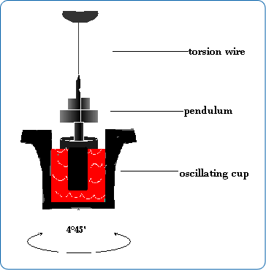
Mechanism of thromboelastography (TEG)
http://www.ras-co.com/images/immagine_pag3.png
Notes:
The TEG apparatus consists of a plastic cup and a pin that is suspended by a torsion wire.
A sample of blood (total volume=0.36 mL) is placed into the cup, which is maintained at 37 degrees C and the pin is lowered into the blood.
The cup is then oscillated through an angle of 4 degrees 45” for a 10 second cycle (TEG cup oscillates; Rotation Thromboelastometer (ROTEM)- pin oscillates).
When fibrin strands form between the pin and the cup, the pin begins to move with the cup and the torque generated is transmitted up the wire to a mechanical/electrical transducer, which is converted to digital data for display of the TEG tracing.
Although times for complete coagulation are variable, most samples will generate the critical parameters within 30 minutes (not including fibrinolysis).
Usually use citrated whole blood

Slide 23
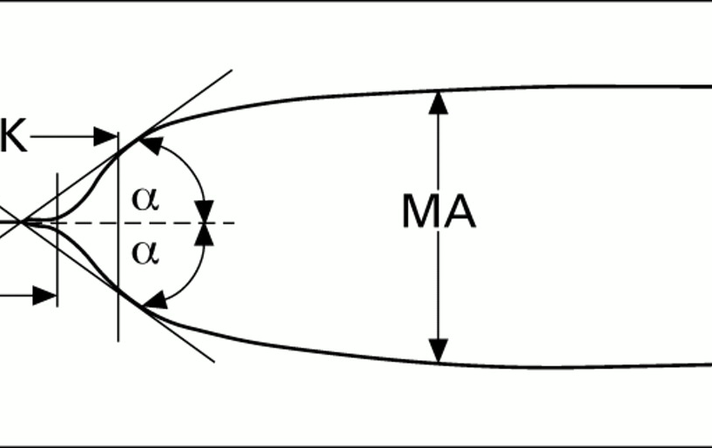
Thromboelastogram
http://jnnp.bmj.com/content/63/3/334/F1.large.jpg

Slide 24
Coagulation Index
Coagulation Index(CI)= 0.1227(R) + 0.0092(K) + 0.1655(MA) – 0.0241 (alpha) – 5.0220
Normal CI in humans is -3.0 to +3.0. Values above 3.0 are considered hypercoagulable, while values below -3.0 are hypocoagulable
Normal values vary amongst machines and reagents used (in addition to species) in veterinary medicine

Slide 25
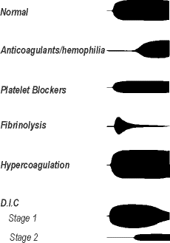
TEG and hypercoagulability
One of the most important applications of TEG
Typical hypercoagulable tracing- decreased R and K and an increased MA and alpha in both humans and dogs.
Hypercoagulability, as evidenced by alterations in the TEG components G and MA, has been demonstrated in dogs with parvoviral enteritis, neoplasia, DIC, IMHA, PLE and in dogs admitted to an ICU.
  Parvovirus: Otto et al, JAVMA, 2000
  Neoplasia: Kristensen et al, JVIM, 2008
  DIC: Wiinberg et al, JVIM, 2008
  IMHA: Sinnott et al, JVECC, 2009; Fenty et al, JAVMA, 2011;
  Goggs et al, Vet J, 2011
  PLE: Goodwin et al, JVIM, 2011
  ICU: Wagg et al, Vet Clin Path, 2009
http://www.ispub.com/ispub/ija/volume_1
number_3_1/thrombelastography/qual.gif
Notes:
PARVO paper: Otto CM, Rieser TM, Brooks MB, Russell MW. Evidence of hypercoagulability in dogs with parvoviral enteritis. J Am Vet Med Assoc. 2000;217:1500–1504- 9 pups with Parvo compared with 9 age-matched control dogs- hypercoagulability documented in all 9 (increased MA)
NEOPLASIA paper: Kristensen AT, Wiinberg B, Jessen LR, Adreasen E, Jensen AL. Evaluation of human recombinant tissue factor-activated thromboelastography in 49 dogs with neoplasia. J Vet Intern Med. 2008;22:140–147- 67% of dogs with malignant neoplasia had hemostatic dysfunction, defined as an altered G value. Of these dogs, 75% were hypercoagulable and 25% were hypocoagulable. Dogs with malignant neoplasia were significantly more likely to be hypercoagulable compared with dogs that had benign neoplasms. Hypercoagulability was not attributable to fibrinogen concentration as there was no significant difference in the fibrinogen concentrations of dogs with malignant compared with those with benign neoplasia. No information was provided on the overall correlation between fibrinogen concentration and G/MA or the number of dogs with TEG tracings indicative of hypercoagulability that developed VT. These findings are consistent with a similar study in which people with malignant neoplasms had increased G/MA values.
DIC Paper: Wiinberg B, Jensen AL, Johansson PI, Rozanski E, Tranholm M, Kristensen AT. Thromboelastographic evaluation of hemostatic function in dogs with disseminated intravascular coagulation. J Vet Intern Med. 2008;22:357–365- 50 dogs diagnosed with DIC based on standard hemostatic assays- 22% were hypocoagulable, 34% were normocoagulable, and 44% were hypercoagulable. Hypocoagulable dogs had a 2.4 times greater relative risk of death within 28 days than hypercoagulable dogs. The G value was concluded to best reflect the hemostatic status of dogs with DIC, and a TEG tracing indicating hypercoagulability was considered a favorable prognostic indicator.
IMHA papers: Sinnott VB, Otto CM. Use of thromboelastography in dogs with immune-mediated hemolytic anemia: 39 cases (2000–2008). J Vet Emerg Crit Care (San Antonio). 2009;19:484–488; Fenty RK, deLaforcade AM, Shaw SP, O’Toole TE. Identification of hypercoagulability in dogs with primary immune-mediated hemolytic anemia utilizing thromboelastography [Abstract]. J Vet Emerg Crit Care (San Antonio). 2008;18:411- majority of dogs in both studies had TEG tracings indicating hypercoagulability; first study- pretreated with corticosteroids (confounding factor)
ICU: Wagg CR, Boysen SR, Bedard C. Thromboelastography in dogs admitted to an intensive care unit. Vet Clin Pathol 2009; 38 (4)- 11 ICU dogs were classified as hypercoagulable, 3 as hypocoagulable, and 13 as normocoagulable.

Slide 26
TEG and hypocoagulability
Used in human medicine much more clinically than in veterinary medicine
TEG may be superior to traditional hemostatic assays in its capacity to correctly predict hemorrhagic episodes in dogs
  Wiinberg et al, Vet Journal, 2009
http://www.ispub.com/ispub/ija/volume_1_number_3_1/thrombelastography/qual.gif
Notes:
Wiinberg B, Jensen AL, Rozanski E, et al. Tissue factor activated thromboelastography correlates to clinical signs of bleeding in dogs. Vet J. 2009;179:121–129-
TEG may be superior to traditional hemostatic assays in its capacity to correctly predict hemorrhagic episodes in dogs. In a prospective study that compared TEG tracings in 27 dogs in hypocoagulable states, 27 in normocoagulable states, and 27 in hypercoagulable states, it was found that G value alone had a positive and a negative predictive value for bleeding of 89% and 98%, respectively. Moreover, G value more accurately predicted bleeding than the combination of platelet concentration, PT and aPTT results, D-dimer concentration, and fibrinogen concentration.

Slide 27
TEG and DIC
4 stages of DIC as assessed by TEG (humans)
  Stage I- hypercoagulable phase
  Stage II- decreased MA due to platelet consumption; coagulation factors still normal
  Stage III- prolongation of the R and K due to consumption of coagulation factors
  Stage IV- excessive fibrinolysis (fibrinolytic or spindle tracing)- LY30/60 significantly decreased
Hyper- and hypocoagulability can occur concurrently
  Transfer test- can determine hypercoagulant activity in the face of hypocoagulability
      Determine R value of normal subject, then mix normal plasma with the patient’s plasma in a 50:50 ratio; ratio=R mixture/R control
      Normal values in humans=1-1.5; if <1- procoagulant activity in
      patient’s blood; if >1.5- anticoagulant activity

Slide 28
TEG and anticoagulant therapy
TEG useful for guiding anticoagulant therapies in humans (prolongation of R+ K; if MA is greater than the sum of R + K then the therapy is both adequate and safe)
  Recent study in dogs found that TEG may be too sensitive, thus limiting its utility as a monitoring tool for unfractionated heparin therapy (Pittman et al, JVECC, 2010)

Slide 29
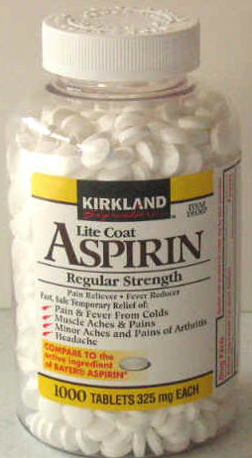
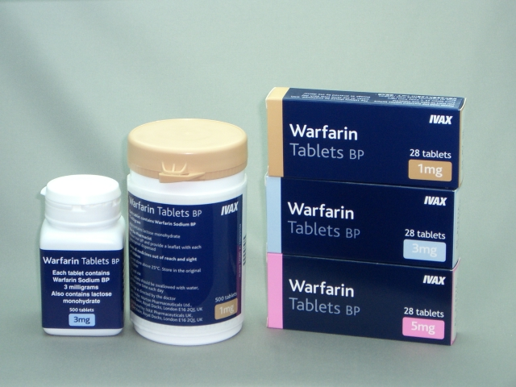
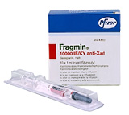
Anticoagulant therapy
Anticoagulant strategies include altering platelet function or affecting clotting factor activity.
  1) Antiplatelet drugs
  2) Oral anticoagulants
  3) Parenteral anticoagulants
http://www.drugspro.org/images/drugs/fragmin.jpg
http://www.drug3k.com/img2/warfarin_20061_4_(big)_.jpg
http://www.google.com/imgres?imgurl=http://www.cannabisnews.org/wp-content/uploads/

Slide 30
Antiplatelet drugs
Platelet aggregation at the site of endothelial damage or in regions of blood stasis is often the first step in the development of a thrombus
  Adherence mediated by collagen and vWF and results in activation of platelets
  Aggregation mediated by vWF and fibrinogen
  Substances that maintain platelet aggregation and activation= collagen fibers, ADP, serotonin, thrombin and arachidonic acid metabolites
Antiplatelet drugs include aspirin, thienopyridine derivates and integrin α _{IIb} β ₃ (glycoprotein IIb/IIIa) receptor inhibitors

Slide 31
Aspirin
Aspirin acts to permanently inhibit COX; in turn, this inhibits the synthesis of thromboxane A2
Low dosages: 0.5-2mg/kg Q24hrs
  Higher dosages- side effects + may lead to hypercoagulable state in dogs due inhibited prostacyclin (PGI2) production
  Hypertrophic Cardiomyopathy (HCM) in cats- previously advocated for high dose aspirin therapy; recent study recommended low-dose (5mg/cat Q72hrs) as long-term approach (Smith et al, JVIM, 2003)
    Though aspirin has been documented to effectively alter platelet function in cats, actual clinical efficacy in preventing aortic thromboemboli is lacking
http://www.google.com/imgres?imgurl=http://www.cannabisnews.org/wp-content/uploads/
Notes:
HCM- retrospective study on low-dose aspirin: Smith SA, Tobias AH, Jacob KA, et al: Arterial thromboembolism in cats: acute crisis in 127 cases (1992-2001) and long-term management with low-dose aspirin in 24 cases, J Vet Intern Med 17: 73, 2003

Slide 32
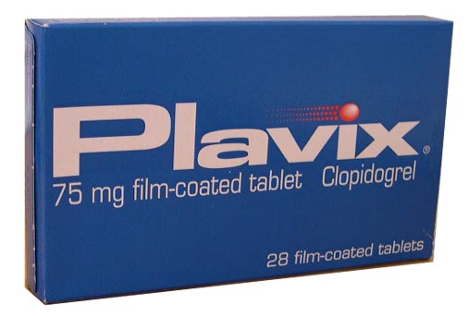
Thienopyridine Derivatives
Ticlopidine (Ticlid) and clopidogrel (Plavix)
Inhibit binding of ADP to the platelet receptor
Ticlopidine- more side effects in humans; clopidogrel mainstay thienopyridine derivative
Dogs
  Ticlopidine study (Boudreaux et al, J Vet Pharm Ther, 1992)
  Clopidogrel studies (Brainard et al, Am J Vet Res, 2010; Mellett et al, JVIM, 2011)
Cats
  Ticlopidine most consistent antiplatelet effects at high dosage (250mg PO Q12hrs)- associated with GI side effects
  Clopidogrel resulted in antiplatelet activity at a dosage as low as 18.75mg/cat Q24hrs without side effects noted (Hogan et al, JAVMA, 2004)
Many human cardiologists recommend combining clopidogrel and aspirin therapy as effects not only additive, but synergistic
http://i.bnet.com/blogs/plavix.jpg
Notes:
OPTICAL PLATELET AGGREGOMETRY (ADP-induced platelet aggregation)
Boudreaux et al (Boudreaux MK, Jeffers C, Lipscomb D, Spano JS: The effect of ticlopidine on canine platelets, fibrinogen, and antithrombin III activity, J Vet Pharmacol Ther. 15 (1), 1992) evaluated effect of ticlopidine in dogs and ID’ed that ticlopidine at 62mg/kg effective in inhibiting ADP and collagen-induced platelet aggregation without detectable effects on AT activity or fibrinogen
Mellett AM, Nakamura RK, Bianco D: A prospective study of clopidogrel therapy with immune-mediated hemolytic anemia, J Vet Intern Med, 25 (1), 2011- no difference between clopidogrel and ultra-low dose aspirin therapy in improving survival in dogs with IMHA.
Hogan DF, Andrews DA, Green HW, et al: Antiplatelet effects and pharmacodynamics of clopidogrel in cats, J Am Vet Med Assoc 225: 1406, 2004.

Slide 33
Integrin α _{IIb} β ₃ (Glycoprotein IIb/IIIa) Receptor Inhibitors
Bind the integrin primarily responsible for vWF attachment to platelets, thereby blocking a final common end point in platelet activation and aggregation
Eptifibatide, abciximab, and tirofiban
Designed for IV infusions; oral formulations available but dissapointing results in humans
Abciximab (oral) was found to be effective at inhibiting platelet function in cats (it inhibited thrombus formation with aspirin better than aspirin therapy alone) (Bright et al, JVIM, 2002)
  Eptifibatide was found to be associated with an unacceptably high mortality rate
Notes:
Bright JM, Dowers K, Powers BE: Effects of the glycoprotein IIb/IIIa antagonist abciximab on thrombus formation and platelet function in cats with arterial injury

Slide 34
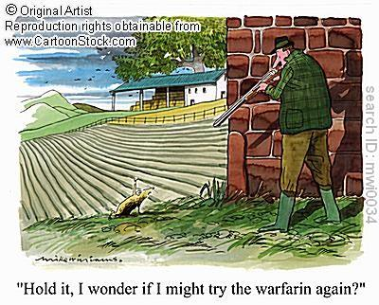
Oral anticoagulants
Inhibit coagulation factors
Most widely used oral anticoagulant is warfarin (coumarin)
Warfarin acts to inhibit factors II, VII, IX and X, as well as proteins C and S
Initial exposure to warfarin may result in a temporary procagulant state due to the shorter half-lives of proteins C and S; therefore, most warfarin protocols include the coadministration of heparin during the initial induction phase of therapy
Warfarin is likely the most effective anticoagulant, however therapy is very challanging (monitor with PT)- (Monnet and Morgan, Am J Vet Res, 2000)
Ximelagatran (Exanta): direct thrombin inhibitor (Europe)
http://www.cartoonstock.com/lowres/mwi0034l.jpg
Notes:
Monnet and Morgan 2000- 3 separate loading doses documented for large breed dogs and recommended that the most rapid anticoagulation obtained with 6mg Q24hrs; practically- very challenging as frequent rechecks indicated and clinically significant hemorrhage remains possibility even months into therapy
MOA of warfarin action- interferes with the cyclic interconversion of vitamin K and vitamin K oxide, thus impairing the hepatic carboxylation of the Vitamin-K dependent coagulation factors

Slide 35
Parenteral anticoagulants
Unfractionated and low-molecular-weight heparins (enoxaparin (Lovenox) and dalteparin (Fragmin))
Heparin complexes with and catalyzes the anticoagulant activity of antithrombin
Unfractionated heparin
  Results in inactivation of factors II, IX, X, XI and XII
  Titrated to effect with a goal of prolongation of aPTT by 1.5-2.5 times baseline (reflects inhibition of factor IIa)
Low-molecular weight heparin
  Inhibits factor X primarily
  Titrated to effect by monitoring anti-Xa levels (inhibition of factor Xa has little effect on aPTT); goal=0.35-0.7U/mL, although relationship between clinical effect and anti-Xa levels is unclear
  Fractionated form of heparin designed to have better bioavailability and more predictable anticoagulant activities thereby requiring less monitoring
Anti-inflammatory effects of antithrombin are diminished with heparin administration

Slide 36
Other antithrombotic therapies
Antithrombin supplementation must be sufficient to achieve an increase of approximately 1.5-2 times the normal concentrations of antithrombin to achieve improved survival in animals and humans.
  Study in critically ill dogs with decreased antithrombin concentrations showed that increases in antithrombin were not demonstrated with moderate doses of FFP (Rozanski et al, JVECC, 2001)
Human sepsis- studies have investigated the efficacy of concentrated forms of antithrombin, activated protein C and tissue factor pathway inhibitor; only APC has demonstrated improved survival (PROWESS STUDY)
Notes:
Rozanski E, Hughes D, Scotti M, et. al.: The effect of heparin and fresh frozen plasma on plasma antithrombin III activity, prothrombin time and activated partial thromboplastin time in critically ill dogs. J Vet Emerg Crit Care 11:15, 2001
Human sepsis study: the Recombinant Human Activated Protein C Worldwide Evaluation in Severe Sepsis (PROWESS study)- single phase III multicenter trial

Slide 37
Thrombolytic therapy
Streptokinase: Produced by B-hemolytic streptococci
  Forms stable complexes with plasminogen, inducing conformational change that promotes the formation of plasmin (degrades fibrin)
  Fibrin independent
Urokinase: Protease produced by kidney cells
  Binds circulating plasminogen
  Also fibrin independent
rt-PA: Activate plasminogen to form plasmin
  rt-PA activates BOUND plasminogen much more than circulating plasminogen, therefore more “clot-specific”
  At pharmacologic doses, can create systemic lytic state, as other thrombolytic agents
Notes:
Targeted toward existing thrombi
Systemic thrombolytic drugs, local thrombolytic drugs and mechanical/surgical extraction
Systemic and local thrombolytic agents: streptokinase, urokinase, and recombinant tissue plasminogen activator

Slide 38
Thrombolytic therapy
Adverse effects:
  Bleeding
  Reperfusion injury
  Streptokinase- hypotension and allergic reactions (anti-streptokinase antibody formation)
Notes:
With reperfusion, can see metabolic acidosis and hyperkalemia

Slide 39
Recommendations for Thrombolytic Therapy in Small Animals
Based on recommendations outlined in Lunsford KV, Mackin AJ: Thromboembolic therapies in dogs and cats:
An evidence-based approach, Vet Clin North Amer 37 (3), 2007
Thrombolytic therapy should not be used for the management of ATE in cats (Killingsworth et al, Am J Vet Res, 1986; Ramsey et al, Fifth International Veterinary Emergency and Critical Care Symposium, 1996; Moore et al, JVECC, 2000; Pion, Vet Clin North Am Small Anim Pract, 1988; Fox, Proceedings of the Fifth Annual Veterinary Medical Forum ACVIM, 1987)
Thrombolytic therapy may reduce morbidity and mortality in some cases of ATE in dogs (Ramsey et al, JAVMA, 1996; Tater et al, JVECC, 2005)
No specific recommendations can be made based on the available veterinary literature with respect to thrombolytic agents in venous thrombosis or PTE (Bliss et al, JAAHA, 2002)
Based on extrapolation from human literature, the use of thrombolytics in most patients with venous thrombosis or PTE is NOT indicated
Thrombolytic therapy may be indicated in veterinary patients with hemodynamically unstable acute PTE or with venous thrombosis associated with severe or unacceptable morbidity and mortality
If thrombolytic therapy is to be performed, agents requiring shorter infusion times (rt-PA) preferred
Notes:
“The thrombolytics streptokinase and rt-PA have been evaluated, at least to a limited extent, in cats and dogs with ATE. A 1986 study (Killingsworth CR, Eyster GE, Adams T, et al: Streptokinase treatment of cats with experimentally induced aortic thrombosis, Am J Vet Res 47, 1986) evaluating the use of streptokinase in experimental ATE in cats established that a loading dose of 90,000 IU given intravenously over 20 to 30 minutes followed by an infusion of 45,000 IU per hour reliably induced a systemic fibrinolytic state but failed to produce clinical improvement or a significant reduction in clot size at necropsy. In a 1996 case series (Ramsey CC, Riepe RD, MacIntire DK, et al: Streptokinase: a practical clot buster?, Proceedings, Fifth International Veterinary Emergency and Critical Care Symposium. San Antonio, TX, 1996) describing the use of streptokinase in 8 cats with naturally occurring ATE or left atrial thrombi, all cats unfortunately died during treatment. In a more recent retrospective study (Moore KE, Morris N, Dhupa N et al. Retrospective study of streptokinase administration in 46 cats with arterial thromboembolism, Journal of Veterinary Emergency and Critical Care 10 (4), 2000. 10 (2000)) describing the use of streptokinase in 46 cats with ATE, although 25 patients achieved return of femoral pulses within a day of commencing therapy, 18 affected cats died in the hospital and an additional 13 were euthanized because of poor response to therapy or treatment complications. A 1988 review (Pion PD: Feline aortic thromboemboli and the potential utility of thrombolytic therapy with tissue plasminogen activator, Vet Clin North Am Small Anim Pract, 18 (1), 1988) discussed the use of rt-PA in cats with naturally occurring ATE; although 50% of treated cats were reported to regain perfusion and use of limbs within 36 hours of initiating therapy, mortality rates were high (50%) and were attributed to reperfusion hyperkalemia during clot lysis. Interestingly, conservative therapy with aspirin alone in cats with naturally occurring ATE has been reported to be associated with a comparable 50% rate return of perfusion and limb function (Fox PR: Feline thromboembolism associated with cardiomyopathy. Proceedings of the Fifth Annual Veterinary Medical Forum ACVIM 1987), and there is thus no clear evidence supporting the use of thrombolytics in cats with ATE. In dogs, a 1996 study (Ramsey CC, Burney DP, Macintire DK, et al: Use of streptokinase in 4 dogs with thrombosis, JAVMA 209 (4), 1996) described the successful use of streptokinase in 4 patients treated for naturally occurring ATE, and a more recent case report describes the successful use of streptokinase and dalteparin in another young dog with ATE (Tater KC, Drellich S, Beck K: Management of femoral artery thrombosis in an immature dog, JVECC 15 (1), 2005). There is also a single case report from 1998 (Clare AC, Kraje BJ: Use of tissue recombinant tissue-plasminogen activator in a dog with chylothorax secondary to catheter-associated thrombosis of the cranial vena cava, JAAHA 38 (5), 2002) describing the successful use of the rt-PA alteplase for the dissolution of a distal aortic thrombus in a dog. Apart from a single case report in 2002 describing the successful use of catheter assisted rt-PA administration in a dog with thrombosis of the cranial vena cava (Bliss SP, Bliss SK, Harvey HJ: Use of recombinant tissue-plasminogen activator in a dog with chylothorax secondary to catheter-associated thrombosis of the cranial vena cava, JAAHA 38 (5), 2002), there have been no clinical reports on the use of thrombolytics for small animals with venous thrombosis, and there have also been no clinical studies evaluating the use of thrombolytic therapy in naturally occurring PTE in dogs or cats.”
“Unlike arterial thrombi, which are typically associated with an acute risk of ischemia and serious organ or tissue damage, venous thrombi often do not present an immediate danger to affected tissues, and emergency medical thrombolysis of venous thrombi is thus often not indicated. In fact, there is no clear evidence in the human literature supporting the early lysis of venous thrombi, especially considering that it is well established that thrombolytic therapies significantly increase the risk for bleeding. Conservative management with anticoagulants alone, without concurrent thrombolysis, does not seem to increase the risk for death or recurrence of the thrombus.”
Taken from Lunsford KV, Mackin AJ: Thromboembolic therapies in dogs and cats: An evidence-based approach, Vet Clin North Amer 37 (3), 2007.

Slide 40
Conclusions
Hypercoagulability is an important consideration in many of our critically ill patients
Hypercoagulability in SIRS/sepsis occurs secondary to increased pro-thrombotic activity, decreased anti-thrombotic activity and decreased anti-fibrinolytic activity
Hypercoagulability is best assessed with thromboelastography
Treatment of hypercoagulability and diseases that predispose to thrombosis involves agents that alter platelet function or alter clotting factor activity
Thrombolytic therapy may be indicated in the treatment of some patients with active thrombosis

Slide 41

Special Thanks
Dr. Cass Rogers
Dr. Armelle De Laforcade

Slide 42
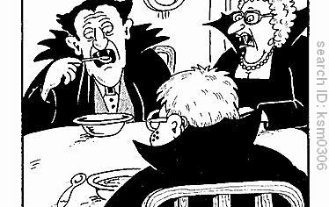
Questions?

Slide 43
References
Altaweel L, Sweeney D, Cui X, Barochia A, Natanson C, Eichacker PQ: Growing insights into the potential benefits and risks of activated protein c administration in preclinical and clinical studies, Biologics, 3, 2009
Bateman SW: Hypercoagulable states, Small Animal Critical Care Medicine (Silverstein DC, Hopper K), 2009
Donahue SM, Otto CM: Thromboelastography: a tool for measuring hypercoagulability, hypocoaguability and fibrinolysis, J Vet Emerg Crit Care 15: 9, 2005
Fenty RK, deLaforcade AM, Shaw SP, O’Toole TE. Identification of hypercoagulability in dogs with primary immune-mediated hemolytic anemia utilizing thromboelastography . JAVMA. 2011;238:4
Good LI, Manning AM: Thromboembolic disease: physiology of hemostasis and pathophysiology of thrombosis, Comp Cont Educ Pract Vet 25: 650, 2003
Hogan DF, Andrews DA, Green HW, et al: Antiplatelet effects and pharmacodynamics of clopidogrel in cats, J Am Vet Med Assoc 225: 1406, 2004.
Kristensen AT, Wiinberg B, Jessen LR, Adreasen E, Jensen AL. Evaluation of human recombinant tissue factor-activated thromboelastography in 49 dogs with neoplasia. J Vet Intern Med. 2008;22:140–147
Kol A, Borjesson DL: Application of thromboelastography/thromboelastometry to veterinary medicine, Vet Clin Pathol 39:4, 2010
Lunsford KV, Mackin AJ: Thromboembolic therapies in dogs and cats: An evidence-based approach, Vet Clin North Amer 37 (3), 2007.

Slide 44
References
McMichael MA: Primary hemostasis, J Vet Emerg Crit Care 15:1, 2005
Otto CM, Rieser TM, Brooks MB, Russell MW. Evidence of hypercoagulability in dogs with parvoviral enteritis. J Am Vet Med Assoc. 2000;217:1500–1504
Rosenberg RD, Aird WC: Vascular-bed-specific hemostasis and hypercoagulable states. New Engl J Med 340: 15555, 1999
Rozanski EA, Chan DL: Anticoagulants, Small Animal Critical Care Medicine (Silvertstein DC, Hopper K), 2009
Sinnott VB, Otto CM. Use of thromboelastography in dogs with immune-mediated hemolytic anemia: 39 cases (2000–2008). J Vet Emerg Crit Care (San Antonio). 2009;19:484–488
Smith SA, Tobias AH, Jacob KA, et al: Arterial thromboembolism in cats: acute crisis in 127 cases (1992-2001) and long-term management with low-dose aspirin in 24 cases, J Vet Intern Med 17: 73, 2003
Wagg CR, Boysen SR, Bedard C. Thromboelastography in dogs admitted to an intensive care unit. Vet Clin Pathol 2009; 38 (4)
Wiinberg B, Jensen AL, Johansson PI, Rozanski E, Tranholm M, Kristensen AT. Thromboelastographic evaluation of hemostatic function in dogs with disseminated intravascular coagulation. J Vet Intern Med. 2008;22:357–365
Wiinberg B, Jensen AL, Rozanski E, et al. Tissue factor activated thromboelastography correlates to clinical signs of bleeding in dogs. Vet J. 2009;179:121–129.
Wiinberg B, Kristensen AT: Thromboelastography in Veterinary Medicine, Semin Thromb Hemost 36: 7, 2010

