Slide 1
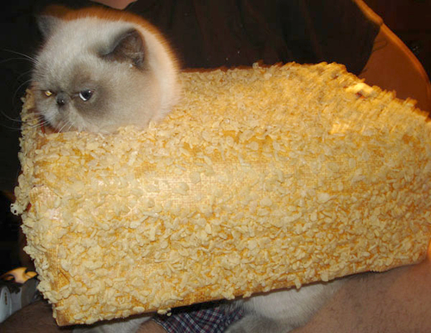
Dialysis
Joel Green Weltman, DVM

Slide 2
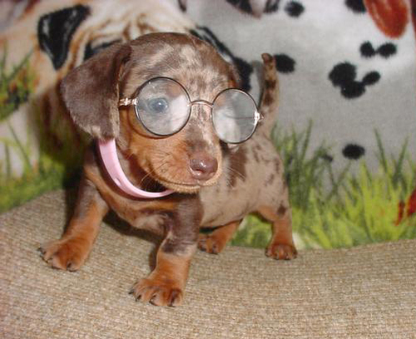
Dialysis Outline
History
Principles
Indications
Equipment
Dosing
Anticoagulation
Complications
Outcomes/Prognosis

Slide 3
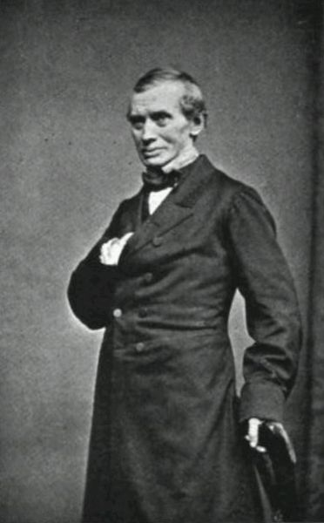
Hemodialysis
Thomas Graham
1854: Developed the osmotic membrane
Founder of colloid chemistry and dialysis
Notes:
Utilized the principles of dialysis to separate the “crystalloid” from the “colloid”
Also very interested in the diffusion of gases and developed Grahams law, which is the rate of effusion of a gas is inversely proportional to the square of its molar mass

Slide 4
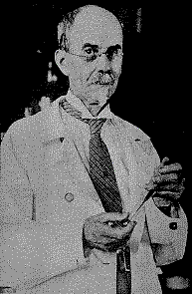
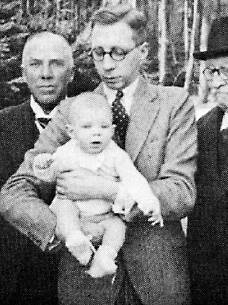
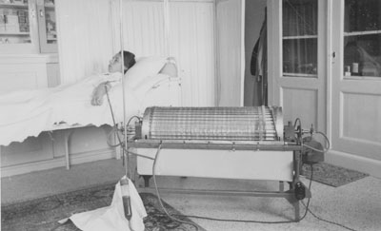
Hemodialysis
1924: first human hemodialysis performed by Georg Haas
1943: Willem Kolff developed the coil dialyzer and refined the semipermeable membrane
Notes:
Georg Haas was forced to abandon his work d/t dissent amoungst the medical community, which continued through the 1960s and the work of willem Kolff
Nils Alwall went on to develop the concept of the drum dialyzer, in which a dialysate was ciruclated around the semi permeable membrane
Also was the first to manipulate hydrostatic pressures to influcence fluid flux, a concept later described as ultrafiltration
Willem Kolff was living in the Netherlands during WWII and was an active member of german resistance
Experiments performed during the Nazi rule, but he was forced to hide his work
Made first dialyzer out of available materials including a washing machine, beverage cans and sausage casings
In 1950s he moved to the US and became father of artificial organs as he also developed the heart-lung machines for cardiac surgery
Continued to make innovations in artificial organ medicine up to his death in 2009, including work in artificial ears and eyes

Slide 5
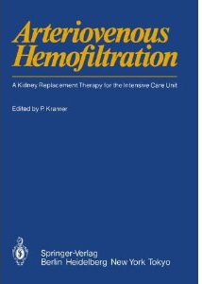
Continuous Renal Replacement Therapy
1977: Peter Kramer utilized arterio-venous fistulas to provide continuous arterio-venous hemofiltration
1982: CAVP approved by FDA
Rapidly replaced by veno-venous systems
Notes:
Born of the frustrations with delayed solute recovery in peritoneal dialysis and delayed onset of therapies with IHD due to limited treatment centers and risk of hemodynamic instability
Peter Kramer
1977 introduced accidently a catheter into the femoral artery as opposed to the vein
Allowed passive movement from an artery to a vein with blood passing through an extracorporeal circuit containing the semi-permeable membrane
Termed the practice continuous arterio-venous hemofiltration
1982-FDA approves CAVH, however these techniques were quickly replaced with a dual lumen venous catheter and the treatment of veno-venous hemofiltration was adopted
by the 1990’s fully automated CRRT machines were being produced and became commonplace in human intensive care settings

Slide 6
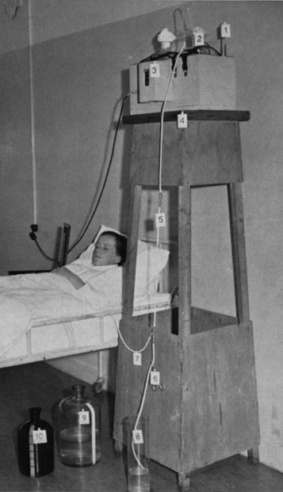
Peritoneal Dialysis
1938: First recorded case
Improved systems developed in 1950s
Notes:
Underwent its development alongside hemodialysis measures
First treated case (1938) for obstructive renal failure in Wisconsin
Initial therapies riddled with same complictions currently faced
New catheters were described starting in the 50s to minimze complications

Slide 7
Dialysis Principles
Blood is exposed to a solution intended to transfer solutes across a semipermeable membrane (dialysate)
All methods of dialysis are led by a few principles:
  Diffusion
  Convection/ultrafiltration
  Adsorption

Slide 8
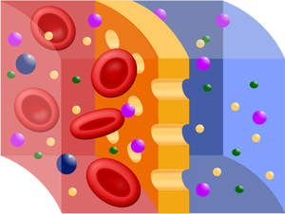
Diffusion
Solutes diffuse across pores in the membrane
  [High] to [Low]
  Goal is to remove toxins and preserve electrolytes
  Same principle delivers depleted blood components
Notes:
Equal solute concentrations result in equal movement in both directions with no net movement
Uremic toxins as well as exogenous toxins
Depleated blood components - Ie, bicarb in this case

Slide 9
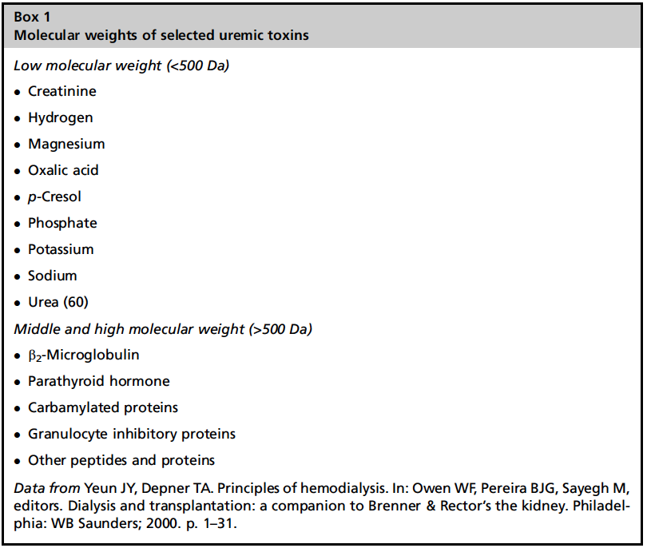
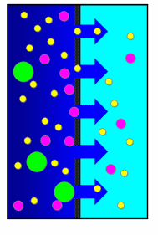
Diffusive Properties of Solutes
Diffusion rate inversely proportional to molecular size
Urea (60 d) diffuses faster than creatinine (113 d)
Protein bound substances do not diffuse well
Notes:
The lower molecular weight solutes are what we predominantly remove and will predominantly guide therapies
Middle and high molecular weight do not significantly get removed and predominant removal is by solvent drag with convection

Slide 10
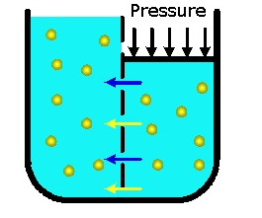
Convection
Expose blood to positive transmembrane pressure
Excess fluid can be removed
Fluid carries small molecules and electrolytes
Achieved using osmotic gradients in peritoneal dialysis
Notes:
Either put positive pressure within blood circuit or negative pressure w/in the dialysate circuit or combination of both
Fluid, called ultrafiltrate, is pushed into the dialysate and discarded after treatment
Allows for larger molelcules to be removed than simple diffusive measures
unwanted fluid or electrolytes removal must be replaced

Slide 11
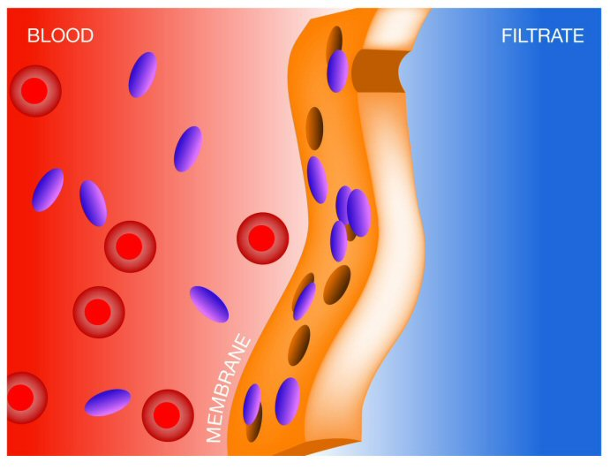
Adsorption
Molecules adhere to membrane
Continuous renal replacement
Notes:
Inflammatory mediators of SIRS have been shown to adhere to membrane, however, removal does not appear to improve prognosis
Considered to be an important role of continuous renal replacement, not major in IHD, doesn’t happen with PD

Slide 12
CRRT Modes of Operation
Slow continuous ultrafiltration
  Blood exposed to a positive transmembrane pressure
  Removal of excess fluid
Continuous venovenous hemofiltration
  Blood exposed to a positive transmembrane pressure
  IV fluids administered to replace the ultrafiltrate
Continuous venovenous hemodialysis
  Blood exposed to countercurrent dialysate flow
  Similar to IHD
Continuous venovenous hemodiafiltration
  Blood exposed to dialysate and positive transmembrane pressure
Notes:
SCUF: blood enters the dialyzer, is divided into thousands of strawlike semipermeable membranes, and is exposed to a positive transmembrane pressure.
-purely convective
-used in humans for non-diuretic responsive CHF
CVVH: blood enters the dialyzer and exposed to a positive transmembrane pressure as well as a sterile balanced electrolyte solution is used to replace the ultrafiltrate following dialysis
-purely convective therapy
CVVHD: Blood enters the dialyzer and is divided into thousands of strawlike semipermeable membranes that are bathed in a solution that flows countercurrent to the blood flow.
-most similar to IHD, utilizes diffusion only
CVVHDF: Blood enters the dialyzer and is exposed to the dialysate as well as a positive transmembrane pressure. A sterile balanced electrolyte solution is used to replace the ultrafiltrate.
-uses both diffusion and convective properties

Slide 13
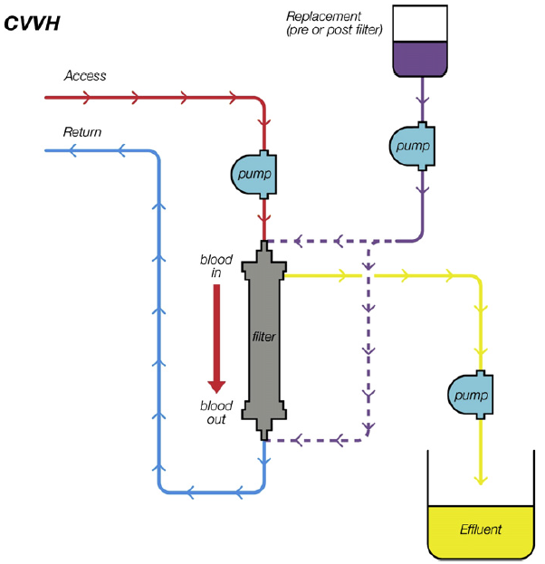
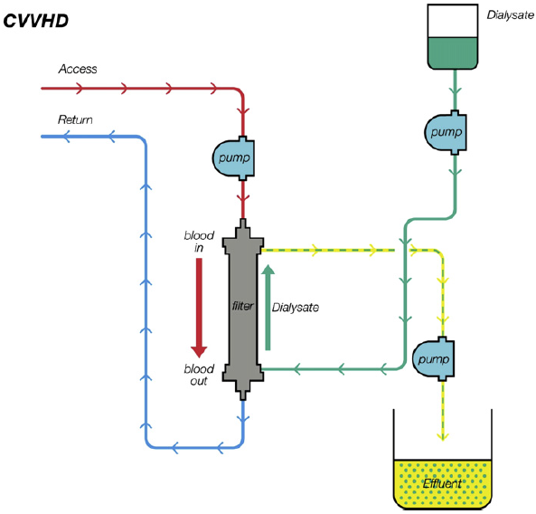
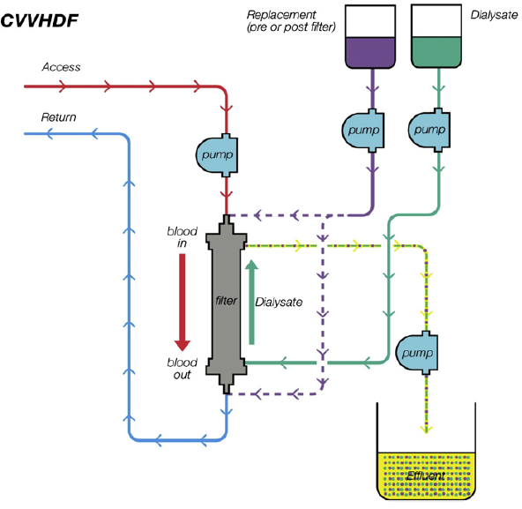
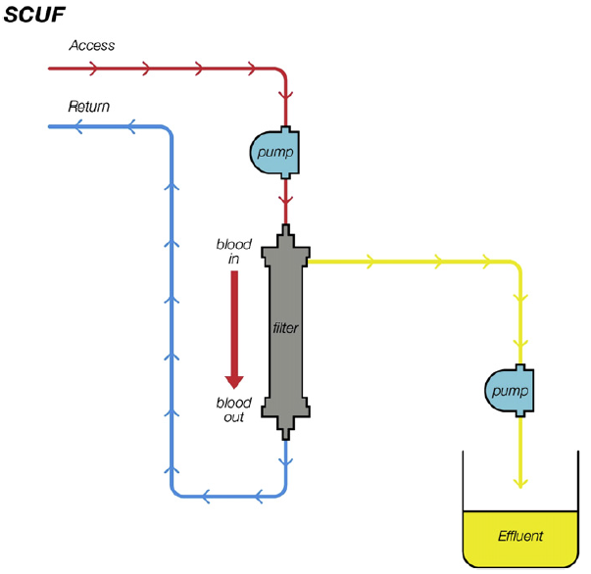
CRRT Modes of Operation

Slide 14
Indications to Initiate Dialysis
When to institute dialysis
  Worsening azotemia despite medical management
  Severe or worsening electrolyte abnormalities
  Worsening acidosis
  Oliguria/anuria despite medical management
Criteria to fulfill
  Fully rehydrated patient
  Correct hypotension, use pressors as necessary
  Challenge anuria/oliguria with diuretics
Bloom 2011
Notes:
Veterinary literature.

Slide 15
Indications to Initiate Dialysis
Early dialysis model
  Early retrospectives:
    Initiate at BUN levels 120-150 mg/dL, 43-75% survival
    Initiate at BUN >200 mg/dL, 12-26% survival
  Prospective
    Post-traumatic AKI
      BUN <70, creat <5 mg/dl, 36% mortality
      BUN~150, creat~10 mg/dL, 80% mortality
    Variable cause AKI
      BUN <75 mg/dl, 39% mortality, 43.5% recuperation renal fxn
      BUN >75 mg/dl, 69.8% mortality, 11.1% recuperation renal fxn
Notes:
Human studies
Post cardiac surgery patients: survival rates were higher (77%-78%) in patients undergoing dialysis when urine output was < 100ml/8hr, if patient creat raised to 5 mg/dl survival dropped to 45%-57%
All the information published on when to institute dialysis is based on uremic indications, does not talk about toxin removal or other non-renal indications for dialysis

Slide 16
Indication for Hemodialysis
Uremia
  Acute and acute-on-chronic kidney injury
    Ischemia
    Toxins
    Infection
Toxin Removal
Hepatic encephalopathy
Electrolyte abnormalities
Notes:
Hepatic encephalopathy-improvement has been noted w/ the use of polyacrylonitriate membranes, thought to be associated w/ removal of “middle molecular weight” substances
Electrolyte abnormalities predominantly associated w/ renal failure but also reported to use w/ acute tumor lysis syndrome, CRRT, Martin 2010.

Slide 17
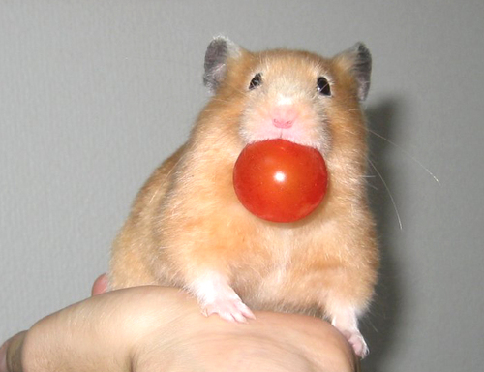
Indications for Hemodialysis
Toxin removal
  Low molecular weight
  Water soluble
  Small volume of distribution
  Influenced by:
    Extracellular fluid volume status
    Age
    Gender
    Thyroid function
    Obesity
    Renal function
    Cardiac output
Notes:
Key principles
Low molecular weight substances that are water soluble pass easily
Large, protein-bound or lipid soluble molecules are more difficult to remove
Small volume of distribution will be more easily removed
Water-soluble molecules remain more accessible, toxic levels more easily reduced
Lipid-soluble molecules will have a smaller proportion available to the dialyzer
Rebound:
Intravascular levels of lipid-soluble molecules may decline quickly after initial session but increase again as serum levels re-equilibrate
Effected by: obesity, extracellular fluid volume status, age, gender, thyroid function, renal function, and cardiac output

Slide 18
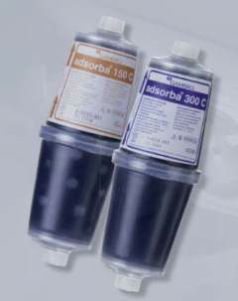
Indications for Hemodialysis
Charcoal Hemoperfusion
  Cartriage similar to dialysis membrane
  Toxin removal by binding to activated charcoal
  Highly protein-bound and lipid-bound molecules
Notes:
Cartriage similar to dialysis membrane
Toxins are removed by binding to activated charcoal or resin, rather than diffusion
Useful w/ highly protein-bound and lipid-bound molecules
Disadvantage: needs to be changed every 2-3 hours
Can be used alone or in circuit w/ traditional IHD filters

Slide 19
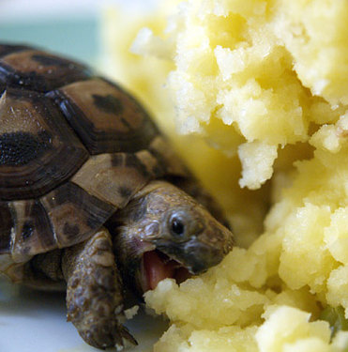
Indications for Hemodialysis
Toxin removal
  Baclofen toxicosis
    Torre 2008, Scott 2007
  Lily Toxicosis
    Berg 2007
  Ethanol toxicosis
    Keno 2011
  Grape and Raisin toxicosis
    Mazzaferro 2004
  Propylene glycol toxicosis
    Claus 2011
Notes:
Toxin removal
Baclofen toxicosis: Torre 2008, Scott 2007
Used in dogs to decrease urethral resistance
One presumed and one confirmed case
Both required PPV, both recovered
Lily Toxicosis
Berg 2007
Cat already developed AKI, treated w/ one treatment of dialysis
Had dialysis disequilibrium
No chronic changes noted
Ethanol toxicosis
Keno 2011
Measured ethanol in serum, w/ rapid decline following initiation of dialysis
Historical dogs using dialsysis to remvoe ethanol w/ exposure was 4.3 times faster than physiologic removal
Grape and Raisin toxicosis
Mazzaferro 2004
2/4 cases lived, ½ had peritoneal dialysis
Propylene glycol toxicosis
Signs were similar to ethylene glycol
Treated w/ hemodialysis and improved and lived

Slide 20
Indications for CRRT
Diehl 2008
  Non-responsive azotemia with fluid overload
  Hyperkalemia in cats
Vriese 1999
  Inflammatory mediators and sepsis
  CVVH nonspecifically removes cytokines
  No change in hemodynamics or respiratory function
Notes:
CRRT paper: Diehl 2008:
retrospective
indications included non-responsive azotemia w/ fluid overload and anuria in both species, cats also had hyperkalemia
Vriese 1999, Inflammatory mediators and sepsis
CVVH w/ the AN69 membrane nonspecifically removes cytokines from circulation
Achieved predominantly by membrane adsorption but also by convection
Pro and anti-inflammatory mediators are removed
No change in hemodynamics or repiratory function was observed
Unclear if this benefits patients with sepsis

Slide 21
Indications for Peritoneal dialysis
Uremia
  Leptospirosis, Bekel 2005
  Cats with AKI, variable etiology Dorval 2009
Acid-base and electrolyte distrubances
Toxin removal
  Any dialyzable toxin
  Hepatic encephalopathy
Hypothermia, hyperthermia
Presurgical management of uroabdomen
Non-renal indications:
  Congestive heart failure
  Peritoneal lavage as a complement to surgery
Notes:
Traditionally for AKI associated w/ oliguria or anuria
Uremia
Used in a case series in dogs w/ Leptospirosis Bekel et al 2005
Case series in cats with AKI of veriable etiology Dorval 2009
Acid-base and electrolyte distrubances
Toxins
May be used for dialyzable toxins (ethylene glycol, ethanol, barbiturate, sodium monofluroacetate poisoning)
Hepatic encephalopathy
Treatment for hypo or hyperthermia
Presurgical management of uroabdomen
Non-renal indications:
Congestive heart failure
Ultrafiltration has been advocated in refractory CHF, but may be more effective w/ CRRT
Postulated that the dialysis may also remove myocardial depressant substances, such as ANP
Patients can be transitioned from CRRT to an automated, potentially ambulatory PD
Periteonal lavage as a compliment to surgery
Currently under debate
Generalized peritonitis
Acute necrotizing pancreatitis

Slide 22
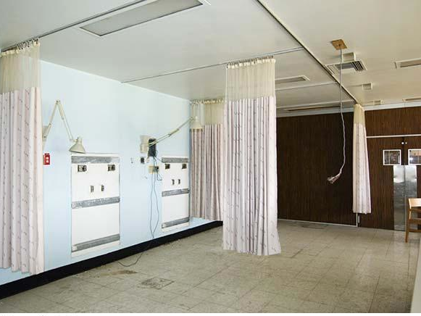
CRRT/IHD Contraindications
Pre-existing hypotension
Small patient size
Inadequate staffing
Notes:
Published data recommends patient sizes no smaller than 2.5 kg
Due to continuous nature of the therapy, a staff member trained in CRRT must be available at all times

Slide 23

PD Contraindications
Peritoneal adhesions
Peritoneal fibrosis
Peritoneal malignancy
Vascular leak states
Recent abdominal surgery
Inguinal or abdominal hernias
Risk for hypoproteinemia
Pleuroperitoneal fistula
Notes:
Peritoneal adhesions
Peritoneal fibrosis
Peritoneal malignancies/inflammation
Vascular leak states
Recent abdominal surgery
Inguinal or abdominal hernias
Patients at risk for hypoproteinemia
Patients with hypoproteinemia may get amino acid supplementation via the dialysate
Pleuroperitoneal fistula

Slide 24
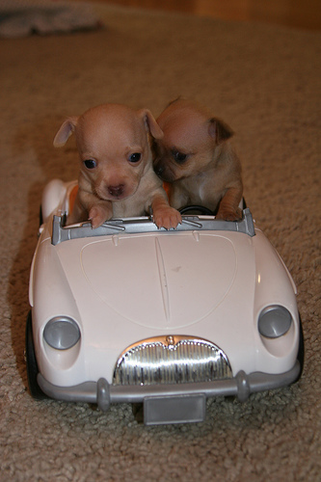
Equipment
Access
Machinery
Hemodialysis prescription
Peritoneal dialysis
Monitoring

Slide 25
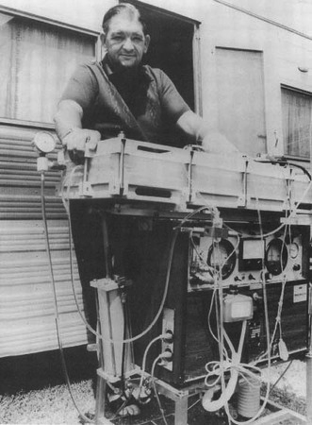
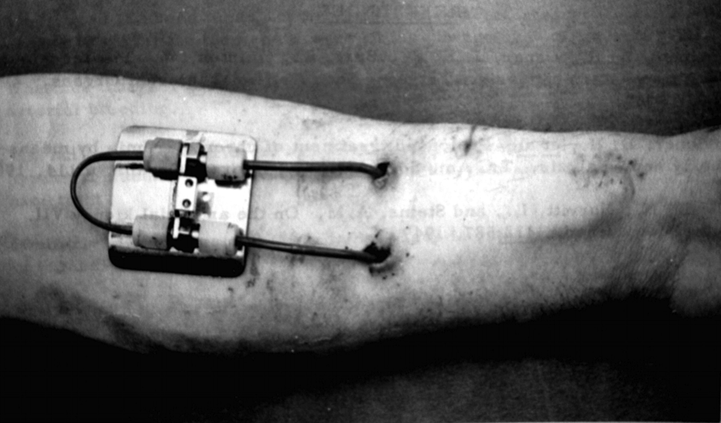
Vascular Access
Belding Hibbard Scribner, 1960
  Described a shunt between an artery and a vein
  Introduced Teflon as material
  Utilized in ESRD patients
  for chronic dialysis
  Formed 1st bioethics committee
Notes:
The AV shunt in 1960 was initially described by Quinton and Scribner
Was a shunt between an artery and a vein, which constant flow of blood between the two was utilized to maintain patency of the catheter between treatments
Allowed for end stage renal disease patients to receive chronic dialysis
Introduction of chronic dialysis put strain the limited resources of dialysis machines
Scribner went on to form the first bioethics committee-a group of residents and doctors unrelated to renal medicine who decided who received dialysis

Slide 26
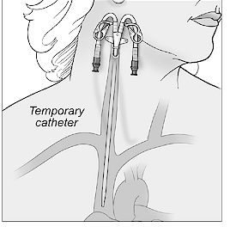
Vascular Access
Catheter inserted to the level of the right atrium or cranial vena cava via the jugular vein
Catheter maintained between uses with heparin, preventing thrombosis
AV fistulas may be surgically placed
Notes:
Dual lumen catheters are preferred as well as largest gauge which will fit to increase efficacy and prevent blood stasis/clotting
-in dual lumen one side sucks out and the other delievers dialized blood
-single lumens are used in very small patients and the machine alternates between removal and delivery of blood
Some degree of systemic heparin uptake is expected
With proper maintenance a catheter can be used for months
Subcutaneous AV fistulas and AV autographs can be constructed using native tissues, in the acute setting these are not appropriate as they take several months before they are usable
almost always a temporary catheter is utilize

Slide 27
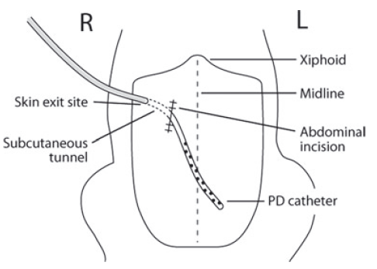
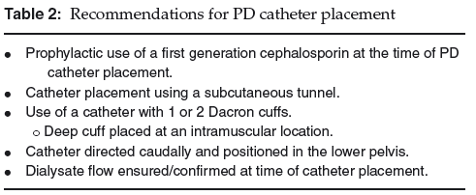
Peritoneal Access
Specialized equipment
  PD catheter
    Acute vs. chronic
    Variable designs
  Placement
    Dictated by catheter type
    Blind vs surgical
Notes:
Most of the complications w/ PD are going to be cathter related, so this is the most important part of this therapy
Ideal catheter→reliable, rapid dialysate flow rates with minimal leakage or infections
Most manufactured out of silicone or polyurethane
Numerous side holes for influx and outflow of fluids
Many different types available
Acute vs. chronic catheters
Chronic ones typically have 1-2 dacron cuffs
Used to develop a fibrous seal to minimize dialysate leakage and infection
Placed in the SQ or musculature 2-3 cm prior to a skin exit site
Make removal more difficult
Placement:
Typically going to be dictated by catheter selection
For blind placements, human medicine recc filling the abdomen w/ saline first
can be midline or paramedian
Mini-surgical approaches, and fluroscopically guided have been described
Surgical approach
May consider omentectomies to minimize entrapment
Recc if already having exploratory lap or if the patient is expected to have >3 days of treatment or when using simple tube type catheters or the Tenckhoff catheters
Subcutaneous tunnel
Recc abdominal penetration at 3-5 cm right of the midline, through the rectus muscle at the level of the umbilicus
Rectus sheath is closed w/ simple continuous or interrupted pattern with absorbable, monofilament suture
Simple tubes w/ catheter and stylet insertion (multipurpose)
Percutaneous cystostomy tubes, pneumothorax catheters invariably kink
Seldinger technique for insertion
Used as interim management until more permanent catheter can be inserted
Typically become obstructed in 12-24 hours (according to Bersenas et al 2011

Slide 28
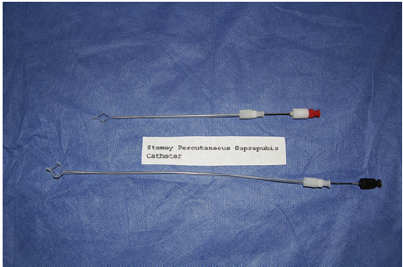
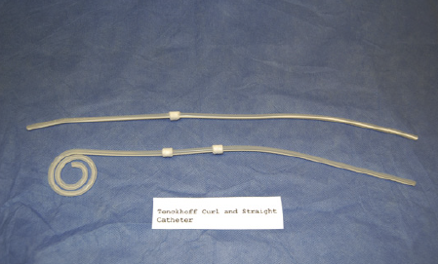
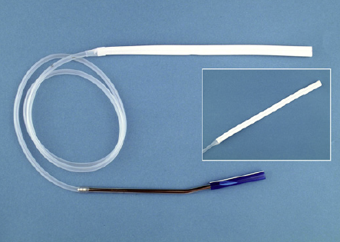
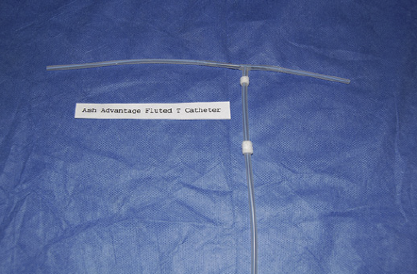
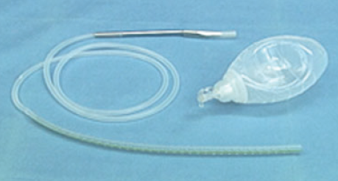
Peritoneal Access
Catheter type
  Acute, multipurpose
  Tenckhoff catheters
  Blake silicon fluted drain
    Dorval 2009
  Fluted T catheter
  Jackson-Pratt continuous suction drains
Notes:
Acute, multipurpose:
stamey cystostomy has been reported in vet med
also pneumothorax cathters, considered to invariably kink
seldinger technique for insertion, used as interim management until a permanent catheter can be inserted, typically obstruct in 12-24 hours
Tenckhoff catheters
Predominantly used in humans, coiled design is thought to minimize chances of kinking and omental entrapment
Separates the layers of the visceral and parietal peritoneum
Blake silicon fluted drain
Evaluated in cats Dorval 2009
Successful in all cases w/ average duration of treatment of 75 hours
Fluted T catheter
Requires surgical placement
Long, inverted T-shaped channels
Extends both cranially and caudally from the insertion site
Preferred by many veterinary practitioners
Jackson-Pratt continuous suction drains
Cochrane review
No benefit between catheter type and development of peritonitis
Straight catheters vs. coiled catheters had survival benefit, but unclear explanation

Slide 29
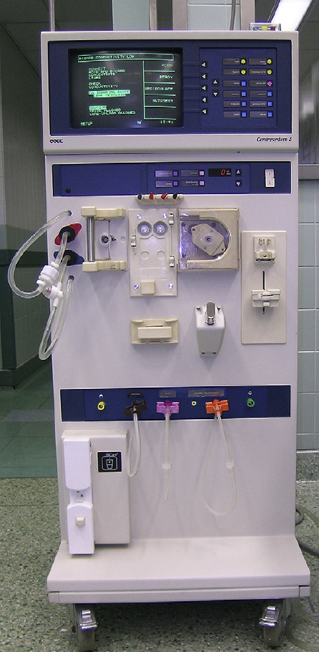
Intermittent Hemodialysis
Specialized equipment
  Blood flow rate
  Dialysate flow rate
  Direction of blood flow
  Dialysate composition
  Ultrafiltration
  Treatment length
  Sodium profiling
  Anticoagulant administration
  Temperature regulation
Notes:
Blood flow rate
Dialysate flow rate
Direction of blood flow
Dialysate composition
Machine will manufacture the solution according to parameters entered
Basic ingredients:
Concentrated solute containing sodium, potassium and calcium
May also contain dextrose, chloride, and magnesium
Concentrated bicarbonate
Purified water
Ultrafiltration→machine will administer the postive/negative pressure necessary to create gradients
Treatment length
Sodium profiling→attempts to regulate plasma osmolality and stabilize fluid shifts
Typically keeps the dialysate sodium slightly higher than patient plasma sodium
Typically able to gradually decrease the dialysate sodium during a session
Anticoagulant administration rate
Temperature of returning blood
Fluid removal from the bloodstream

Slide 30
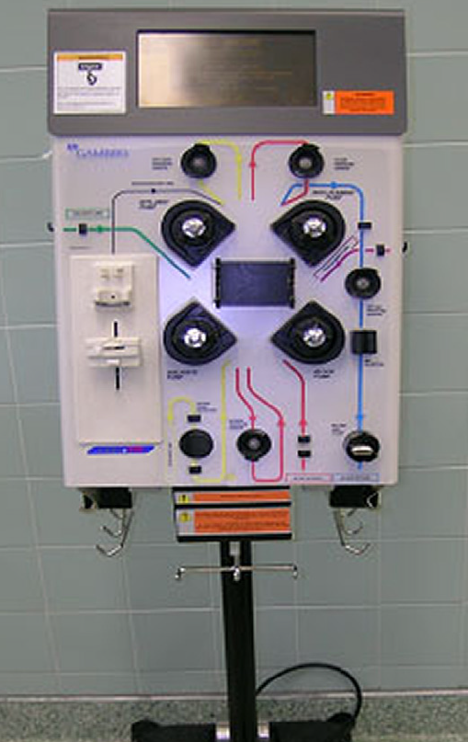
Continuous Renal Replacement Therapy
Functions similar to IHD machine
  Continuous treatment
  Convection more efficient
Administers mode of operation
Notes:
Benefits of CRRT over IHD in the equipment is that the machine is self contained, does not require water purfication systems
Does require 24 hours monitoring, however

Slide 31
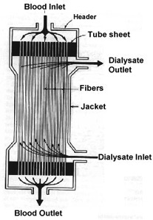
Semi-Permeable Membrane
Blood flows in straws
Dialysate flows around straws
Efficacy of treatment determined by:
  Pore size
  Unit size
Composed of variable materials
Notes:
Membrane and dialyzer unit:
Sealed compartment w/ connections on either end to allow for blood and dialysate flow
Blood flows within straws whereas dialysate flows around the straws, countercurrent or concurrent fashion
Larger the unit greater the surface area for exchange of water and solutes
Allows for more efficient dialysis sessions
Results in greater extracorporeal blood volume, limiting in small patients
Smallest circuits available are 50 mL, so for <7 kg patients, need to prime the circuit with either hetastarch or blood
Membrane types
Synthetic membranes are less reactive and less likely to induce complement activation
More expensive
Older, cellulose membranes are still available

Slide 32
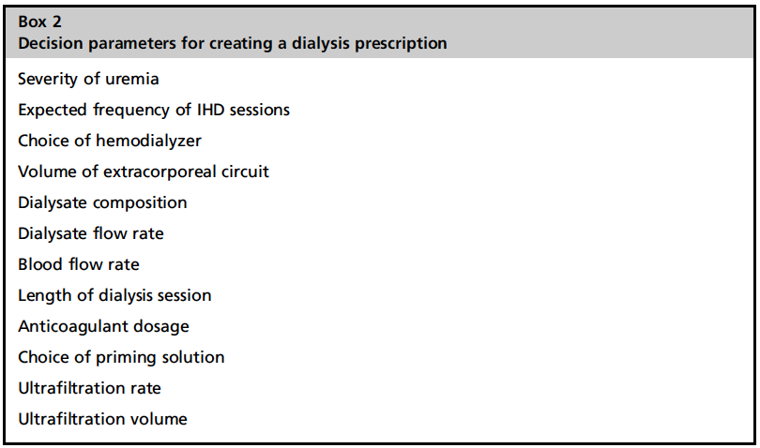
Hemodialysis Dosing
Expected frequency
  Goal ≤ 3 sessions weekly
  Generally will be based on clinical signs and labwork findings
Ultrafiltration
  Should not exceed 20 mL/kg/h
  Calculation: % overhydration x kg x 10=mL to remove
  Calculate hourly dose based on expected length of session
Dialysate flow rate
  Conventionally 500 mL/m
  Faster rates provide modest increase in clearance
  Slower rates provide modest decrease in clearance
Length of session
  1st session: 1.5-2 hr
  Second session: 3 hr
  ≥3rd session: 4 hr cats, 5 hr dogs
Blood flow rate
  Primary determinant of small molecule clearance
  Avoid rapid changes in solute concentrations
  Utilize calculations to simulate expected solute changes

Slide 33
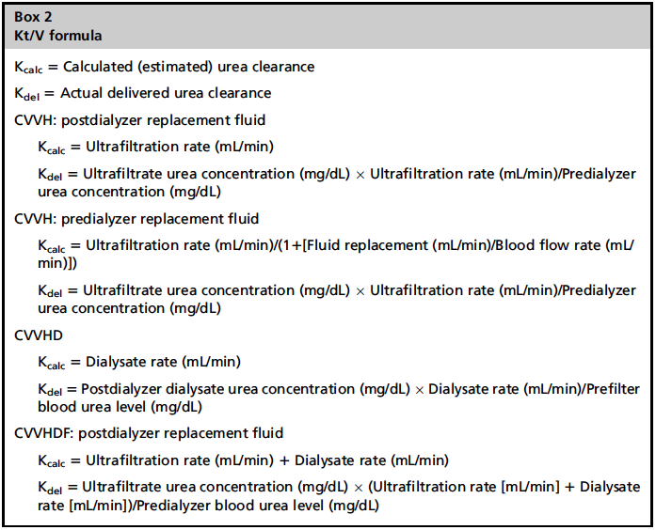
Estimating Efficacy
Urea reduction ratio (URR)
  URR=(BUN_{pre}-BUN_{post})/BUN_{post}
  Measured after the session has been initiated
  Target URRs should be no greater than 0.1 URR per hour
Kt/V
  Kt/V = ln(BUN_{pre}/BUN_{post})
    K=urea clearance of the dialyzer (mL/min)
    T=time of the dialysis session
    V=Volume of urea distribution (L)
  K_{calc} represents the estimated prescription as calculated prior to the administration of dialysis
  K_{del} can be calculated once dialysis has started
Notes:
Urea kinetics, measuring efficacy utilizing the urea reduction ratio (URR)
URR=(BUN_{pre}-BUN_{post})/BUN_{post}
Obviously will be measured after the session
If it is higher than anticipated, session has been more efficient than expected
If lower than anticipated, may be clotting/clogging of the dialysis membrane
Target URRs should be no greater than 0.1 URR per hour
Kt/V
Kt/V = ln (BUN_{pre}/BUN_{post})
K=urea clearance of the dialyzer (mL/min)
T=time of the dialysis session
V=Volume of urea distribution (L)
Higher value the greater the dose administered and efficiency of the treatment session
K_{calc} represents the estimated prescription as calculated prior to the administration of dialysis
K_{del} can be calculated once dialysis has started
Values between 1.2-1.4 are considered adequate in human patients
Conventional values in dogs usually between 2.5-3

Slide 34
Dialysis Principles
Blood is exposed to a solution intended to transfer solutes across a semipermeable membrane (dialysate)
All methods of dialysis are led by a few principles:
  Diffusion
  Convection/ultrafiltration
  Adsorption

Slide 35
Diffusion
Solutes diffuse across pores in the membrane
  [High] to [Low]
  Goal is to remove toxins and preserve electrolytes
  Same principle delivers depleted blood components
Notes:
Equal solute concentrations result in equal movement in both directions with no net movement
Uremic toxins as well as exogenous toxins
Depleated blood components - Ie, bicarb in this case

Slide 36
Diffusive Properties of Solutes
Diffusion rate inversely proportional to molecular size
Urea (60 d) diffuses faster than creatinine (113 d)
Protein bound substances do not diffuse well
Notes:
The lower molecular weight solutes are what we predominantly remove and will predominantly guide therapies
Middle and high molecular weight do not significantly get removed and predominant removal is by solvent drag with convection

Slide 37
Convection
Expose blood to positive transmembrane pressure
Excess fluid can be removed
Fluid carries small molecules and electrolytes
Achieved using osmotic gradients in peritoneal dialysis
Notes:
Either put positive pressure within blood circuit or negative pressure w/in the dialysate circuit or combination of both
Fluid, called ultrafiltrate, is pushed into the dialysate and discarded after treatment
Allows for larger molelcules to be removed than simple diffusive measures
unwanted fluid or electrolytes removal must be replaced

Slide 38
Adsorption
Molecules adhere to membrane
Continuous renal replacement
Notes:
Inflammatory mediators of SIRS have been shown to adhere to membrane, however, removal does not appear to improve prognosis
Considered to be an important role of continuous renal replacement, not major in IHD, doesn’t happen with PD

Slide 39
CRRT Modes of Operation

Slide 40
Peritoneal Dialysis
Dialysate composition
  Contains glucose, lactate, sodium, potassium, and calcium
  Commercial solutions available: Dianeal
    LRS with added glucose
    0.9% saline with hyperkalemia
  Various additives:
    Heparin
    Antibiotics
    Insulin
  Warmed to body temperature prior to use
Notes:
Dialysate composition
Contain glucose, lactate, sodium, potassium, and calcium
Generally have a high concentration of glucose and lactate as well as high osmolarity and low pH
Acetate has been discontinued for use in human medicine due to association w/ loss of ultrafiltration and development of sclerosing peritontitis
So don’t use plasmalyte or normasol as a base solution
Commercial solutions available: Dianeal
Can use LRS w/ added glucose in its place
For hyperkalemic patients can use 0.9% saline
Has been associated with development of adhesions and is not recommended for long term use
Should have added sodium bicarbonate to act as a buffer
Can consider addition of heparin to the solution (500 U/L initially and up to 5 days after) to minimize the chances of catheter failure
other additives include antiboitics in cases of peritonitis or insulin in diabetic cases
Dialysate should be warmed to body temperature prior to its use

Slide 41
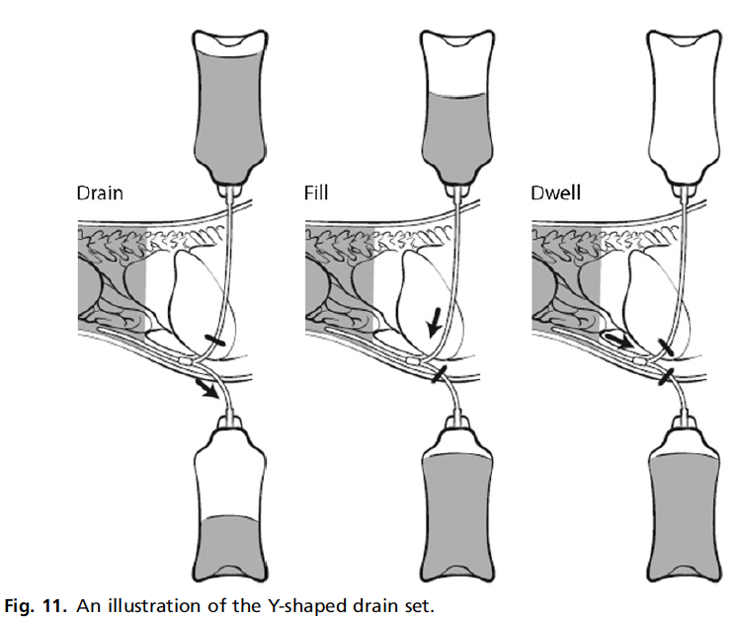
Peritoneal Dialysis Dosing
Dialysate exchange
  Dwell times vary from 20 min to 6 hours
  Initial volumes are small: 10-20 mL/kg
  Increased volumes after the first 24 hours: 30-40 mL/kg
Notes:
Dialysate exchange
Ideally there should be a dialysis free time of 10-15 days following insertion of the catheter
Dwell times will vary from 20 min to 6 hours
Early treatments should be shorter, longer treatments later on
Initial volumes are small: 10-20 mL/kg
Increased volumes after the first 24 hours: 30-40 mL/kg
Decrease volumes if signs of discomfort or respiratory compromise are noted
For later treatments, the dialysate is left to dwell in the abdomen between exchanges
Every 4-6 hours
If effluent is < influent volumes, consider either catheter occlusion or patient dehydration

Slide 42
Peritoneal Dialysis
Ultrafiltration:
  Result of transcapillary ultrafiltration minus the lymphatic reabsorption
  Dextrose
    Standard concentrations are: 1.5%, 2.5%, and 4.25%
  Amino acid
    Potential benefit to act as a protein based caloric source
    1% amino acid provides similar volumes of ultrafiltration to 1.5% dextrose
  Macromolecules
    Polypeptides derived from milk whey protein
    Provide prolonged ultrafiltration with the higher average molecular weight and higher oncotic pressure
    Provide a protein based caloric source
Notes:
Ultrafiltration:
Net ultrafiltration result of transcapillary ultrafiltration minus the lymphatic reabsorption
Dextrose
Standard concentrations are: 1.5%, 2.5%, and 4.25%
Associated w/ osmolarties of: 346, 396, and 405 mOsm/L
Typically 1.5% solutions are considered for patients that are euvolemic
Amino acid
Potential benefit to act as a protein based caloric source
1% amino acid provides similar volumes of ultrafiltration to 1.5% dextrose
Macromolecules
Polypeptides derived from milk whey protein
Example: Icodextin
Provide prolonged ultrafiltration b/c of the higher average molecular weight and higher oncotic pressure
Provide a protein based caloric source

Slide 43
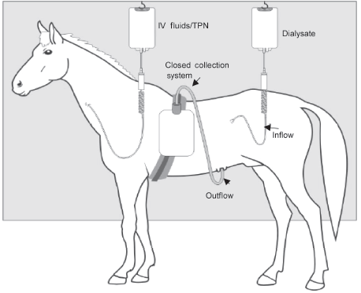
Peritoneal Dialysis
Continuous flow peritoneal dialysis
  Described in a horse, Gallatin 2005
  Reported to increase clearance of toxins
  Less complications than IPD
Continuous ambulatory peritoneal dialysis
  No veterinary reports

Slide 44
Monitoring
Continuous EKG
Activated clotting time
Pulse oximetry
Blood pressure monitoring
In-line blood-volume profiling for IHD/CRRT:
  Hematocrit
  Oxygen saturation

Slide 45
Anticoagulation
Coagulopathy of Renal disease
  Hypercoagulability increases as renal function declines
  Increased bleeding tendencies in uremia
    Platelet dysfunction
  Chronic renal failure
    High prevalence of systemic inflammation
    Diffuse endothelial damage
    Higher platelet-derived microparticle counts
    Reduced antithrombin and antithrombin activity
    Deficiencies in proteins C and S
    Activated protein C resistance
Notes:
Hypercoagulability increases as renal function declines
Shown to be corrected in human renal transplant cases
Increased bleeding tendencies in uremia
Platelet dysfunction
Chronic renal failure
High prevalence of systemic inflammation
Diffuse endothelial damage
Previously documented activation of platelets and monocytes
Higher platelet-derived microparticle counts
Reduced antithrombin and antithrombin activity has been documented
Patients w/ end stage renal disease
Deficiencies in proteins C and S have been seen
Activated protein C resistance with increased endogenous protein C inhibitors

Slide 46
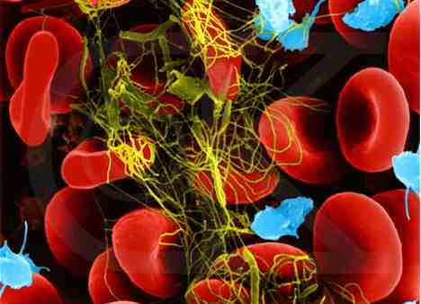
Anticoagulation
Hypercoagulability in dialysis
  Anticoagulant use
  Vascular access thrombosis
  In the dialysis unit
    Direct platelet activation
      Turbulent blood flow
      High shear rates
      Slow blood flow
    Exposure to artificial surfaces
Notes:
Hypercoagulability in dialysis
Anticoagulant use
Vascular access thrombosis
In the dialysis unit
Direct platelet activation:
Turbulent blood flow
High shear rates
Slow blood flow
Platelets bind to fibrinogen adherent to artificial surface vis GPIIb/IIIa receptor
Leads to release of platelet secretion proucts, platelet aggregation and activation of coag cascade
Contact of blood w/ artificial surfaces induces profound activation of plasmatic coagulation

Slide 47
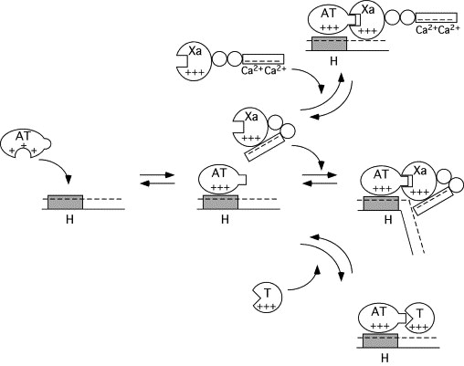
Anticoagulation-Traditional
Unfractionated heparin
  Initial bolus
    25-50 units/kg
  CRI rate based on ACT measurements
    ACT 1.6-2 times normal
Notes:
Binds antithrombin, potentiating its activity to inhibit factors IIa, IXa, Xa, Xia, and XIIa.
Infused directly into the blood before the filter
Bolus 25-50 units/kg
Adjustment of CRI based on ACT goal of 1.6-2 times normal (160-200 seconds)
In humans they recommend the ACT be adujusted to 80% above baseline values
Patient considered heparinized for 6-8 hours following a session

Slide 48
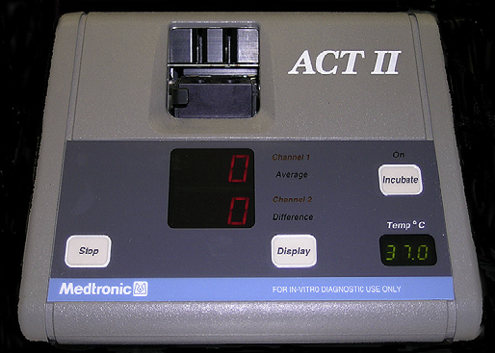
Anticoagulation-Traditional
Heparin Complications:
  Increased bleeding risk
  Osteoporosis
  Allergic reaction
  Heparin induced thrombocytopenia (HIT)
    Type I modest reduction in platelet count (<100k)
      Direct heparin-induced degranulation of platelet
    Type II:
      Immune mediated destruction, 4-10 days following initiation
      Antibody formation against heparin and platelet factor 4
      Highest rate of clot formation in human procoagulant states
Notes:
Increased bleeding risk
Osteoporosis
Allergic reaction
In humans a recognized condition called immune-mediated heparin induced thrombocytopenia (HIT), rare but life threatening
Two types:
Type I modest reduction in platelet count (<100k)
Direct heparin-induced degranulation of platelet
Considered harmless
Type II:
Immune mediated destruction, 4-10 days following initiation
Antibody formation against complex of heparin and platelet factor 4
Results in thromboembolic diseases
Results in the highest rate of clot formation amongst reported procoagulant diseases
Present w/ ischemia to multiple limbs and high mortality rate due to cerebral and myocardial infarction

Slide 49
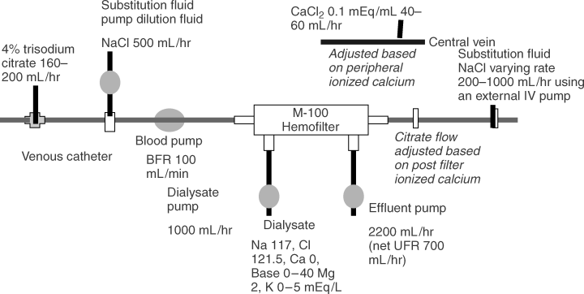
Anticoagulation-Traditional
Citrate
    “Regional” anticoagulation
    Infused into blood prior to the filter
    CRI is adjusted based on post-filter ionized calcium in extracorporeal blood
    Calcium is infused into the blood prior to return
    Side effects:
      Metabolic alkalosis
      Hypernatremia
Notes:
Binds calcium preventing its important role as a cofactor in coagulation
Considered “regional” in that the extracorporeal circuit is anticoagulated, but patient is not
Infused into blood prior to the filter
CRI is adjusted based on post-filter ionized calcium in extracorporeal blood
Calcium is infused into the patient blood prior to return, binding and inactivating citrate
Side effects:
Metabolized in the liver to bicarbonate-may get metabolic alkalosis
May cause hypernatremia if sodium levels in the dialysate are not adjusted

Slide 50
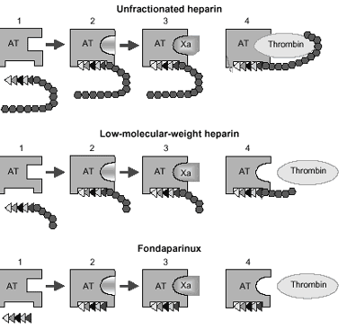
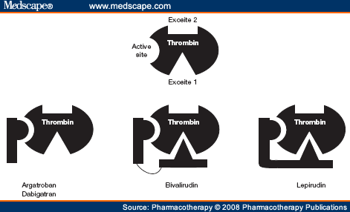
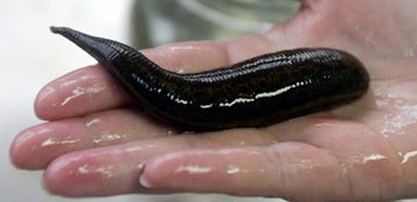
Anticoagulation-Non-traditional
Hepranoids
  Low-molecular-weight heparin
    Smaller sized glucosaminoglycans
  Fondaparinux
    Synthetic pentasaccharide
    Very high anti-Xa activity
  Danaparoid
    Low molecular weight (5.5 kDa)
    More selective to Xa than LMWH
Direct thrombin inhibitors
  Lepirudin
    Recombinant hirudin
  Argatroban
Notes:
Low-molecular-weight heparin
Smaller sized glucosaminoglycans (4-8 kDa)
Predominantly act by inhibition of factor Xa and have much less affinity to thrombin
Anticoagulant effect in human patients w/ normal renal function is highly correlated to body weight, allowing for fixed doses
Recommend dose reductions in renal failure
Minimizes side effects including HIT
Fondaparinux
Synthetic pentasaccharide derived from the minimal binding region of heparin
Exerts very high anti-Xa activity
Half-life is longer than LMWH and is further prolonged in renal failure
Danaparoid
Hararinoid w/ low molecular weight (5.5 kDa)
Even more selective to Xa than LMWH
Direct thrombin inhibitors
Based on hirudin-which is the substance secreted from the salivary glands of the leech
Bind to and block thrombin
Lepirudin
Recombinant hirudin
High rate of anti-hirudin antibody formation, resulting in dose adjustments
Monitor therapy by PTT 1.5-2.5 x normal
Argatroban
Metabolism is predominantly in the liver
Not approved for use in the US yet, so monitoring is not clear

Slide 51
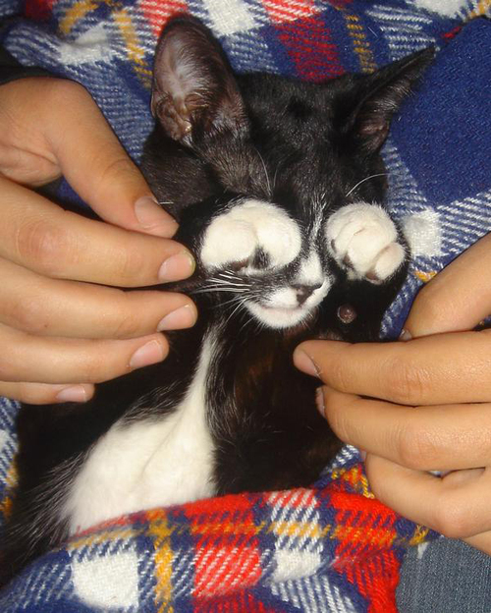
IHD/CRRT Complications
Anticoagulation
Hypotension
Vascular access
Neurologic
Respiratory
Hematologic
Gastrointestinal
Vascular access
  Thrombosis
  Failure to provide adequate blood flow
  Bleeding
Neurologic
  Uremic encephalopathy
  Intracranial bleeding or thrombosis
  Dialysis disequilibrium
Hypotension
  Ultrafiltration
  Large extracorporeal blood volumes
  50% of feline cases
  Bradykinin production in the dialyzer circuit
Gastrointestinal
  Underlying disease
  Dialysis induced hypotension
  DDS
  Dialysate contaminant
  Incompatible blood
Respiratory
  Uremic pneumonititis
  Pulmonary hemorrhage
  Pleural effusion
  Pulmonary edema
  hypoventilation
  Pulmonary thromboembolism
Hematologic
  Anemia
  Thrombocytopenia
  Leukopenia/leukocytosis
  Likely due to primary disease
Notes:
Hemodialysis
Anticoagulant complications
Hypotension, hypovolemia
Result of ultrafiltration and large extracorporeal blood volumes
Reported that approximately 50% of feline cases have these issues
Also can be associated w/ bradykinin production w/in the dialyzer circuit
Particularly if acidic blood (stored blood) is exposed to the dialyzer unit
Vascular access
Thrombosis
Failure to provide adequate blood flow
Bleeding
Infection
Neurologic
Uremic encephalopathy
Intracranial bleeding or thrombosis
Dialysis disequilibrium
Caused by rapid shifts in sodium, urea or bicarbonate leading to cerebral edema
Clinical signs include agitation, disorientation, vomiting, seizure, coma and death
Due to gradual changes with PD/CRRT, much less likely to develop
Prevention:
Mannitol during the dialysis sessions
Sodium modeling
Limited efficiency sessions
Reported in approximately 38% of cats
78% of affected cats respond to treatment with mannitol
8% died despite treatment
Respiratory
uremic pneumonititis
pulmonary hemorrhage
iatrogenic
uremic
leptospirosis
pleural effusion
pulmonary edema
hypoventilation/hypoxemia
neurologically driven
pulmonary thromboembolism
Hematologic
Caused by primary disease
Blood loss d/t dialysis sessions
Gastrointestinal
d/t underlying disease
dialysis induced hypotension
DDS
Dialysate contaminant
Incompatible blood

Slide 52

Osmotic Shift Disequilibrium
Rapid change in solute concentrations
Clinical signs:
  Agitation
  Disorientation
  Vomiting
  Seizure
Prevention
  Mannitol
  Sodium modeling
  Limited efficiency sessions
Notes:
Also called dialysis disequilibrium
Caused by rapid shifts in sodium, urea or bicarbonate leading to cerebral edema
Clinical signs include agitation, disorientation, vomiting, seizure, coma and death
Due to gradual changes with PD/CRRT, much less likely to develop
Prevention:
Mannitol during the dialysis sessions
Sodium modeling
Limited efficiency sessions
Reported in approximately 38% of cats
78% of affected cats respond to treatment with mannitol
8% died despite treatment

Slide 53
CRRT Complications
Diehl 2008:
    Predominantly reported to be due to dialysate composition
      Hypokalemia
      Hypernatremia
      Metabolic acidosis
    Citrate gap
      Ionized hypocalcemia and total hypercalcemia
      Result of citrate administration
    Hypotension
      Two patient deaths
    Filter clotting
      High frequency of blood transfusions necessary
Notes:
Most of the reported complications were felt to be due to dialysate composition:
Hypokalemia
Hypernatremia
Metabolic acidosis
Citrate gap developed:
The development of an ionized hypocalcemia and total hypercalcemia as a result of citrate administration
As citrate is processed in the liver, will resolve but a metabolic alkalosis may develop
Hypotension
2 patients died w/ hypotension
high frequency of filter clotting
resulted in high frequency of blood transfusions necessary

Slide 54
CRRT Complications/disadvantages
Prolonged hypothermia
Calcium dysregulation
Labor intensive
Long treatment times

Slide 55
CRRT Advantages
Improved hemodialytic tolerance
  Improved fluid balance
  Slower ultrafiltration
Improved long term control of azotemia, electrolytes, and acid-base status
Minimized complications due to gradual changes in toxin concentrations
Removes larger substances

Slide 56
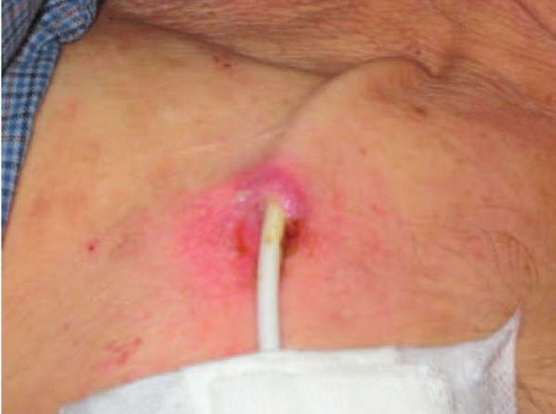
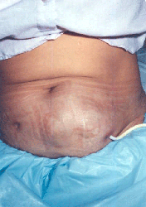
PD Complications
  Catheter occlusion
  Loss of ultrafiltration
  Placement issues
  Dialysate leakage
  Dialysis disequilibrium
  Metabolic complications
    Electrolyte derangements
    Protein loss
    Hyperglycemia
  Peritonitis
Notes:
Catheter occlusion
Early obstruction ususally due to kinking, omental intrapment or clot formation
Most commonly going to see dialysate retention as result (defined as recovery <90% of initial volume)
Loss of ultrafiltration
Predominantly due to absorption of osmotic agents
Peritoneal neogenesis→result of high glucose levels in solutions and results in loss of ultrafiltration
Degradation of large concentration of glucose in the PD solution→development of cytotoxic glucose degradation products (likely as a result of high temperatures used for sterilization)
Directly toxic to fibroblasts, enhance VEGF production and are proinflammatory
Also can react with amino acids to produce advanced glycosylation end products. These cause fibrosis to peritoneum and contribute to ultrafiltration failure
Placement issues:
Hemorrhage
Perforation of the intestine
Typically only an issue w/ placement of acute cathteters
Kinking of the cathteter
Misplacement of the catheter w/in facial planes
Wound infection
Dialysate retention
Dialysate leakage
Pleuroperitoneal communication→pleural effusion
Dialysis disequilibrium
Metabolic complications
Electrolyte derangements
Most commonly hyponatremia, hypochloremia, hypomagnesemia, hypokalemia and hyperkalemia
Protein loss
Increased BUN w/ amino acid solutions
Hyperglycemia
Result of use of dextrose as an osmotic agent
Rapidly absorbed from peritoneal cavity
Also can result in hyperinsulinemia, hyperlipidemia, weight gain, decreased plasma glucagon
Estimated 60-80% of the Dextrose is absorbed during a 6 hour dwell

Slide 57
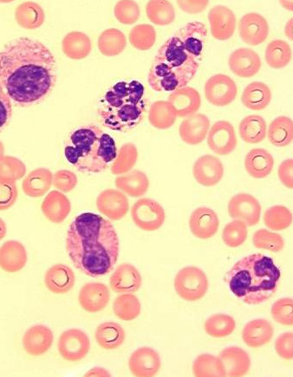
PD Complications
Septic peritonitis
  Ascending bacterium
  Bowel perforation
Therapy
  Catheter exchange
  Antibiotics
Notes:
Peritonitis
Most commonly going to be from ascending bacterium from the skin site (common skin contaminants)
Cochrane review:
Intermittent dosing of vancomycin, gentamicin, ceftazidime, and teicoplanin are as effective as CRI
Simultaneous catheter removal and replacement is superior to urokinase in relapsing and remitting PD associated peritonitis
IP antibiotics are more effective than IV antibiotics
No difference between IP and PO antibiotics
IP IG decreased the time to fall in intraperitoneal white blood cell count but did not make a difference in treatment failure or relapse

Slide 58
Outcomes, hemodialysis
Cats and hemodialysis, Langston 1997
  Overall survival was 34%
  55% of oliguric/anuric survived
  75% of nonoliguric/anuric survived
  Worwag 2008: 2/8 survived AKI with dialysis
Secondary to Leptospirosis in dogs, Adin 2000
  14 dogs failing medical management for AKI and requiring dialysis
  86% survival
Secondary to grape or raisin toxicity in dogs, Stanley 2008
  Reversal of currant-induced AKI in dog
Secondary to lily intoxication in cats, Berg 2007
  Reversal of AKI presumed secondary to Lilium lancifolium
Notes:
Langston 1997, cats and hemodialysis
Overall survival was 34%
60% of AKI survived
1/8 cats w/ AoCRF survived
0/6 CKD lived
no difference b/t BUN or creat and survival
no difference in age of survivors/nonsurvivors
Best prognosis was with pyelonephritis (100% survivial)
Ethylene glycol 60% survival but needed more prolonged course of dialysis
More azotemic at the end of treatment
55% of oliguric/anuric survived
75% of nonoliguric AKD survived
Worwag 2008: unreported causes of dialysis, 2/8 survived to discharge
Secondary to lepto in dogs Adin 2000 (JAVMA 216(3) Treatment and outcome of dogs w/ leptospirosis: 36 cases):
14 dogs failing medical management for AKI and requiring dialysis
86% survival
1/14 needing chronic renal replacement therapy
Secondary to grape or raisin toxicity in dogs
Reported survivial rates w/ medical management is 53%
Stanley and Langston 2008:
Successful reversal of currant-induced AKI in dog w/ progressive azotemia and oliguria
AKI in cats, Worwag 2008: 61% survival
Lily ingestions in cats
Reported 0% survival w/ anuria
2/8 cases Worwag and Lagston 2008

Slide 59

Outcome, hemodialysis
  Segev et al 2008
  Scoring system for AKI in dogs managed by hemodialysis
    182 dogs analyzed
    52.7% mortality
Notes:
Scoring system for outcome in dogs w/ AKI managed by hemodialysis Segev 2008
182 dogs analyzed
52.7% mortality
half due to euthanasia w/ uncontrolled signs, half d/t death
developed a score based on several different laboratory values and additional weighting factors were included if they were known.
Higher scores were associated with decreased probability of survival

Slide 60
Outcome, CRRT
Median duration of CRRT 16.3 hours in dogs, 11.5 hours in cats
41% of dogs survived to discharge
  3 dogs non-azotemic at recheck
  4 dogs remained azotemic on recheck
44% of cats survived to discharge
  5 cats non-azotemic
  1 cat remained azotemic
  1 cat was euthanized without recheck labwork
Diehl 2008
Notes:
No report of outcomes b/c of small patient numbers
Median duration of CRRT 16.3 hours in dogs, 11.5 hours in cats
41% of dogs survived to discharge, 3 dogs nonazotemic at recheck (pigment nephropathy, aspirin, and pancreatitis w/ ATN), 4 dogs remained azotemic on recheck (all 4 had prior CKD and AKI from pancreatitis, UTI, nsaids, and steroid administration)
44% of cats survived to discharge, 5 cats nonazotemic (presumed lily ingestions w/ biopsy of ATN and the UOs which did not get biopsies) 1 cat remained azotemic on recheck and 1 cat was euthanized without recheck labwork (unknown etiology of persistently azotemic)

Slide 61
Outcome, Peritoneal Dialysis
Crisp 1989
  27 dogs and cats treatment for AKI
  22% survived to discharge
Beckel 2005
  5 dogs treated for leptospirosis
  4 survived to discharge
Fox 1987
  Case report: a dog treated for ethylene glycol successfully with PD
Wyatt 1998
  Case report: a dog treated with ischemic renal failure successfully
Dorval 2009
  Six cats treated for AKI
  5/6 survived to discharge
Cooper 2011
  22 cases of PD in cats w/ AKI
  45.5% discharged from hospital
Notes:
Crisp 1989
27 dogs and cats treatment for AKI
22% survived to discharge
Beckel, et al 2005
5 dogs treated for leptospirosis
4 survived to discharge
Fox, et al 1987
Case report of a dog treated for ethylene glycol successfully with PD
Wyatt 1998
Case report of a dog treated with ischemic renal failure successfully w/ PD
Dorval, et al 2009
Six cats treated for AKI
5/6 survived to discharge
Cooper 2011
22 cases of PD in cats w/ AKI
females more likely to survive than males
45.5% discharged from hospital

Slide 62
Questions
Intermittent hemodialysis predominantly functions by
  Diffusion
  Convection
  Adsorption
  Ultrafiltration

Slide 63
Questions
Of the four types of continuous renal replacement therapy, which is the most similar to intermittent hemodialysis
  Slow, continuous ultrafiltration
  Continuous venovenous hemofiltration
  Continuous venovenous hemodialysis
  Continuous venovenous hemodiafiltration

Slide 64
Questions
Removal of toxins is highest with
  High molecular weight
  Small volume of distribution
  High lipid solubility
  Low extracellular fluid volume

Slide 65
Questions
List four strategies to toxin removal:

Slide 66
Questions
List four strategies to increase large molecular weight toxin removal:
  Increased frequency of dialysis
  Increased flow rate (blood or dialysate)
  Increased length of session
  Increased unit size
  Increased pore size

Slide 67
Overview
 | IHD | CRRT | PD
Treatment time
Primary forces
Ultrafiltration
Pump mechanism
Exchange surface

Slide 68
Overview
 | IHD | CRRT | PD
Treatment time | 1-6 hours as needed | 24/7 | 3-6 hour dwell times, 3-4 times daily
Primary forces
Ultrafiltration
Pump mechanism
Exchange surface

Slide 69
Overview
 | IHD | CRRT | PD
Treatment time | 1-6 hours as needed | 24/7 | 3-6 hour dwell times, 3-4 times daily
Primary forces | Diffusion | Diffusion, convection | Diffusion
Ultrafiltration
Pump mechanism
Exchange surface

Slide 70
Overview
 | IHD | CRRT | PD
Treatment time | 1-6 hours as needed | 24/7 | 3-6 hour dwell times, 3-4 times daily
Primary forces | Diffusion | Diffusion, convection | Diffusion
Ultrafiltration | Transmembrane pressure | Transmembrane pressure | Osmotic or oncotic pressure
Pump mechanism
Exchange surface

Slide 71
Overview
 | IHD | CRRT | PD
Treatment time | 1-6 hours as needed | 24/7 | 3-6 hour dwell times, 3-4 times daily
Primary forces | Diffusion | Diffusion, convection | Diffusion
Ultrafiltration | Transmembrane pressure | Transmembrane pressure | Osmotic or oncotic pressure
Pump mechanism | Extracorporeal | Extracorporeal | Patient blood supply
Exchange surface

Slide 72
Overview
 | IHD | CRRT | PD
Treatment time | 1-6 hours as needed | 24/7 | 3-6 hour dwell times, 3-4 times daily
Primary forces | Diffusion | Diffusion, convection | Diffusion
Ultrafiltration | Transmembrane pressure | Transmembrane pressure | Osmotic or oncotic pressure
Pump mechanism | Extracorporeal | Extracorporeal | Patient blood supply
Exchange surface | Semi-permeable membrane | Semi-permeable membrane | Mesentery

Slide 73

Future directions?
Liver dialysis
SIRS
CHF
Apheresis
Notes:
Liver dialysis: dialyzer exposes the blood to dialysate that removes lipophilic, albumin-bound substances such as bilirubin, bile acids, metabolites of aromatic amino acids, medium-chain fatty acids and cytokines→also may have applications for PD in hyperammonemia
SIRS/sepsis/other inflammatory conditions: use of adsorptive measures to remove the inflammatory mediators-treatment of sick serum syndrome?
CHF: dialysis therapies have yet been presented as a useful treatment for congestive heart failure; however, SCUF is commonplace in human CHF, also for human patients which are unable to be gotten out of congestive heart failure will be transitioned from SCUF to a ambulatory peritoneal dialysis set up
Apheresis: removal of a blood component-may be useful for primary polycythemia, plasma/pRBC donations, removal of toxins w/in the plasma

