Slide 1
PeopleSoft Payroll
Data Dependencies
Setup Tables
(Installation, HRMS, Benefits, Payroll)
Person
PeopleSoft
Payroll
Benefits
Job Component

Slide 2
Conceptual Flow Diagram
PeopleSoft
Assumption: Hub will not cleanse data back into WD values
Person
Workday
Data Cleansing Hub
(edits for lengths, transform into PS values etc)
Payroll
Job
Many events in Workday will trigger data integration into PS.
Benefits

Slide 3
Payroll Pay Sheet
Table Name | Table Owner | Table Name | Table Owner
PS_VACATION_BEN | Benefits | PS_ADDL_PAY_DATA | Payroll
PS_VACATION_TBL | Benefits | PS_BALANCE_ID_DEF | Payroll
PS_HOLIDAY_DATE | HR | PS_BALANCE_ID_QTR | Payroll
PS_HOLIDAY_TBL | HR | PS_BALANCE_ID_TBL | Payroll
PS_INSTALLATION | HR | PS_DED_NA | Payroll
PS_JOB | HR | PS_EARNINGS_TBL | Payroll
PS_NAMES | HR | PS_FREQUENCY_TBL | Payroll
PS_PER_ORG_ASGN | HR | PS_JOB_EARNS_DIST | Payroll
PS_PRIMARY_JOBS | HR | PS_PAYGROUP_TBL | Payroll
PS_SET_CNTRL_REC | HR | PS_PAYGRP_EMPLTYPE | Payroll
PS_BEN_PROG_PARTIC | HR/Benefits | PS_PAYROLL_DATA | Payroll
PS_COMPANY_TBL | HR/Benefits | PS_PAYSHEET_RUNCTL | Payroll
 |  | PS_PAY_CALENDAR | Payroll
 |  | PS_PAY_EARNINGS | Payroll
 |  | PS_PAY_PAGE | Payroll
 |  | PS_SRC_BANK | Payroll
 |  | PS_TAX_DISTRIB | Payroll
Payroll Pay Calc
Table Name | Table Owner | Table Name | Table Owner | Table Name | Table Owner | Table Name | Table Owner
PS_AGE_COVG_TBL | Benefits | PS_JOB_USF | HFG | PS_SRC_BANK | Payroll | PS_GENL_DED_FREQ | Payroll
PS_AGE_RATE_TBL | Benefits | PS_COMPANY_TBL | HR | PS_ADDL_PAY_DATA | Payroll | PS_GENL_DED_TBL | Payroll
PS_BEN_DEFN_COST | Benefits | PS_FREQUENCY_TBL | HR | PS_BALANCE_ID_DEF | Payroll | PS_GENL_DEDUCTION | Payroll
PS_BEN_DEFN_OPTN | Benefits | PS_JOB | HR | PS_BALANCE_ID_QTR | Payroll | PS_LOCAL_TAX_DATA | Payroll
PS_BEN_DEFN_PGM | Benefits | PS_NAMES | HR | PS_BALANCE_ID_TBL | Payroll | PS_LOCAL_TAX_TBL | Payroll
PS_BEN_PROG_PARTIC | Benefits | PS_PER_ORG_ASGN | HR | PS_CO_STATETAX_TBL | Payroll | PS_LOCTX_RECIP_TBL | Payroll
PS_BN_PERSON | Benefits | PS_PERS_NID | HR | PS_DED_ARREARS | Payroll | PS_PAY_CAL_BAL_ID | Payroll
PS_CALC_RULES_TBL | Benefits | PS_CONTRACT | HR | PS_DEDUCTION_BAL | Payroll | PS_PAY_CALC_RUNCTL | Payroll
PS_COVG_GROUP_TBL | Benefits | PS_DED_PREPAY | HR | PS_DEDUCTION_CLASS | Payroll | PS_PAY_CALENDAR | Payroll
PS_DISABILITY_BEN | Benefits | PS_PAY_TAX_1042 | HR | PS_DEDUCTION_FREQ | Payroll | PS_PAY_CHECK | Payroll
PS_DISBLTY_PLN_TBL | Benefits | PS_TAX1042_BALANCE | HR | PS_DEDUCTION_TBL | Payroll | PS_PAY_DEDUCTION | Payroll
PS_FLAT_RATE_TBL | Benefits | PS_TREATY_EARN_TBL | HR | PS_EARNINGS_ACCRL | Payroll | PS_PAY_EARNINGS | Payroll
PS_FSA_BENEF_TBL | Benefits | PS_TREATY_NRA_TBL | HR | PS_EARNINGS_BAL | Payroll | PS_PAY_GARN_OVRD | Payroll
PS_FSA_BENEFIT | Benefits | PS_EMPL_DED_PROC | HR | PS_EARNINGS_SPCL | Payroll | PS_PAY_LINE | Payroll
PS_HEALTH_BENEFIT | Benefits | PS_INSTALLATION | HR | PS_EARNINGS_TBL | Payroll | PS_PAY_ONE_TIME | Payroll
PS_HSA_CONTRIB_LMT | Benefits | PS_PERS_SMOKER | HR | PS_EARNS_SPCL_DEDN | Payroll | PS_PAY_OTH_EARNS | Payroll
PS_LIFE_ADD_BEN | Benefits | PS_PERSON_ADDRESS | HR | PS_ERN_PROGRAM_DEF | Payroll | PS_PAY_PAGE | Payroll
PS_LIFE_ADD_TBL | Benefits | PS_PERSONAL_DT_FST | HR | PS_ERN_PROGRAM_TBL | Payroll | PS_PAY_SPCL_EARNS | Payroll
PS_LIMIT_COORD_TBL | Benefits |  |  | PS_FED_TAX_DATA | Payroll | PS_PAY_TAX | Payroll
PS_LIMIT_EXCLD_TBL | Benefits |  |  | PS_GARN_BALANCE | Payroll | PS_PAY_TAX_OVRD | Payroll
PS_LIMIT_IMPIN_TBL | Benefits |  |  | PS_GARN_DE_DED | Payroll | PS_PAYGROUP_TBL | Payroll
PS_LIMIT_INCLD_TBL | Benefits |  |  | PS_GARN_DE_DEFN | Payroll | PS_PAYROLL_DATA | Payroll
PS_LIMIT_TBL | Benefits |  |  | PS_GARN_DE_EARN | Payroll | PS_ST_OTH_TAX_TBL | Payroll
PS_PENSION_PLAN | Benefits |  |  | PS_GARN_EMPL_DED | Payroll | PS_STATE_TAX_DATA | Payroll
PS_PRIMARY_JOBS | Benefits |  |  | PS_GARN_EXEMPT_TBL | Payroll | PS_STATE_TAX_TBL | Payroll
PS_RTRMNT_PLAN | Benefits |  |  | PS_GARN_OPERANDS | Payroll | PS_STATE_TAXRT_TBL | Payroll
PS_SAVINGS_MGT_EE | Benefits |  |  | PS_GARN_PRORATE_RL | Payroll | PS_STTAX_RECIP_TBL | Payroll
PS_SAVINGS_PLAN | Benefits |  |  | PS_GARN_RULE | Payroll | PS_TAX_BALANCE | Payroll
PS_SAVINGS_PLN_TBL | Benefits |  |  | PS_GARN_RULE_TBL | Payroll | PS_TAXGR_BASE_TBL | Payroll
PS_VACATION_BEN | Benefits |  |  | PS_GARN_SPEC | Payroll | PS_TAXGR_CMPNT_TBL | Payroll
 |  |  |  | PS_GENL_DED_FREQ | Payroll | PS_TAXGR_DEFN_TBL | Payroll

Slide 4
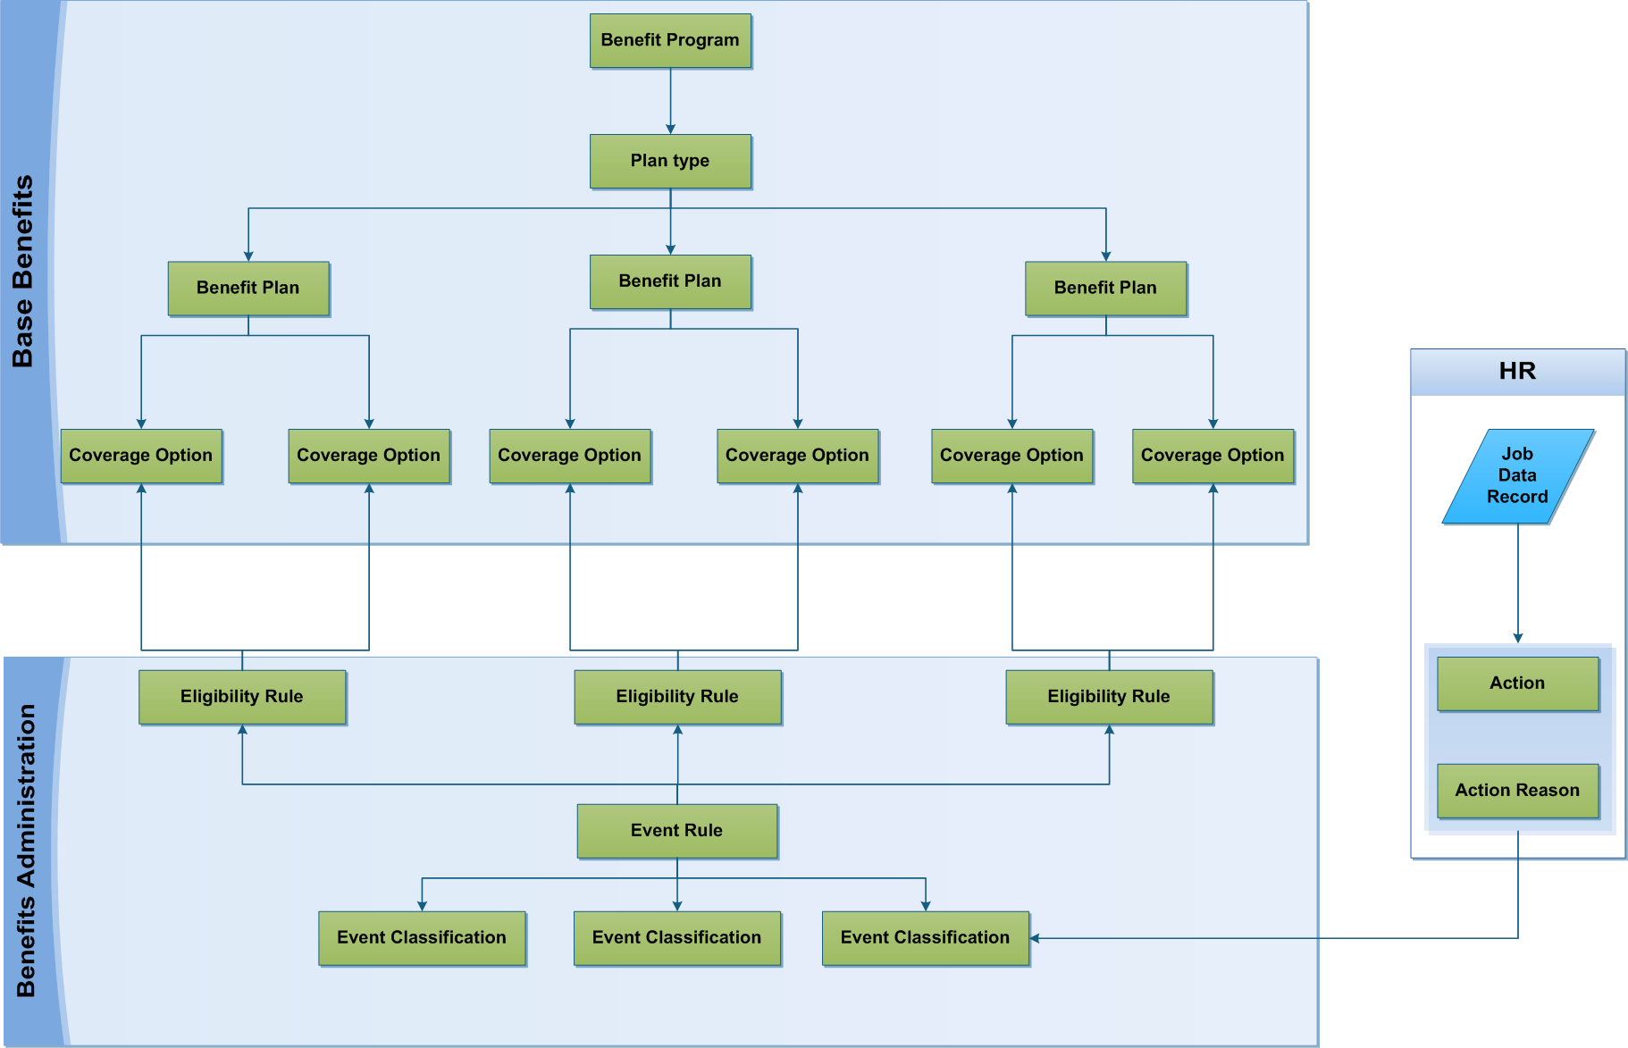
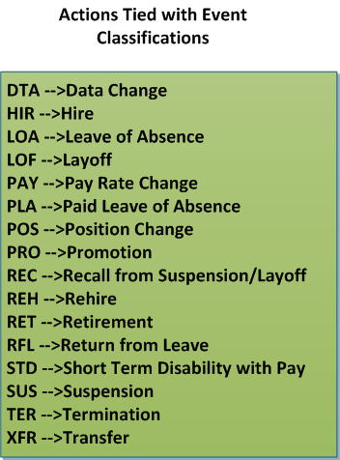
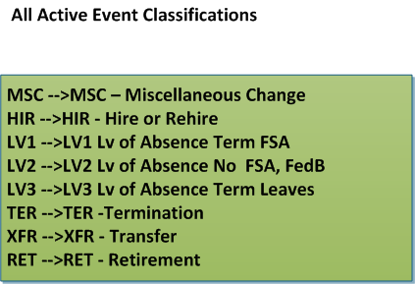
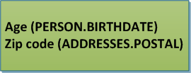
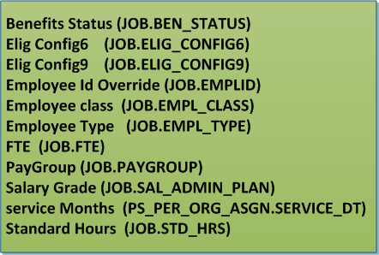
Base Benefits and Benefits Administration Flow & Separation
Each plan has eligibility rules associated (note: eligibility rules are only used when processing thru BenAdmin)
On Job record. Each employee is associated with 1 benefit program (exmpt employee, contract college exmpt)
Each program has multiple plan types (medical, dental, savings, life etc)
Each plan type has specific plans (ie: Medical Plan Type has 131 plans (Blue Cross, HealthNow, 80/20 etc)
Each plan has each coverage option identified (indiv, spouse+children etc)
Each event rule contains all the event classes associated with it.
Each action reason can have an benefits event classification associated with it. On the action reason setup it is called benefits admin action

Slide 5
Job component

Slide 6
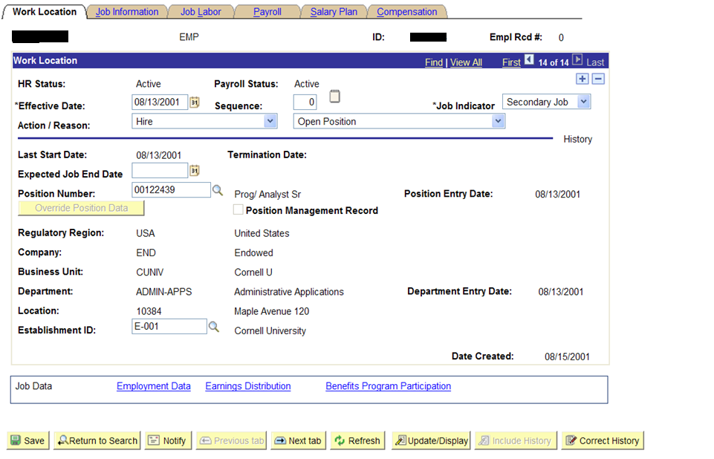
All setup values must be transformed from WD to PS valid values
Name
Emplid

Slide 7
Defining data mappings for setup values
Between 2 systems will be:
Complicated
Operationally intensive to maintain
Tightly coupled and need close collaboration between WD & PS
Subject to data integrity, timing & discrepency issues
Difficult to define
when no 1:1 relationships

Slide 8
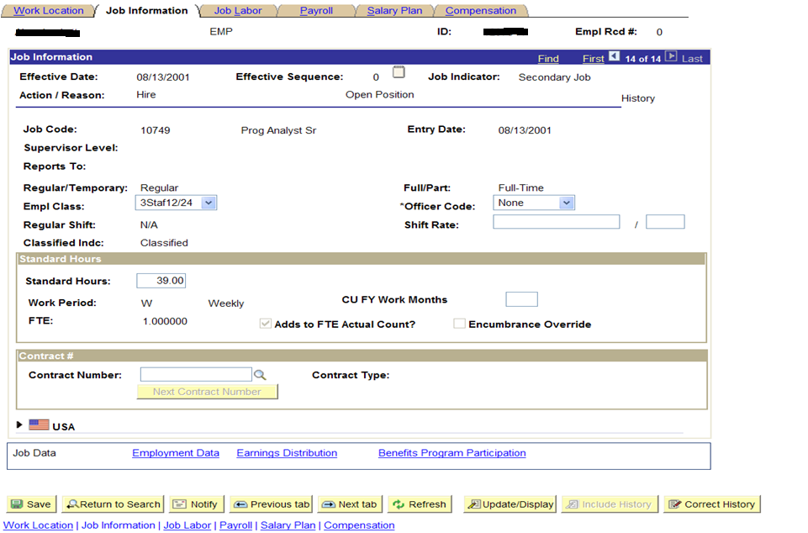

Slide 9
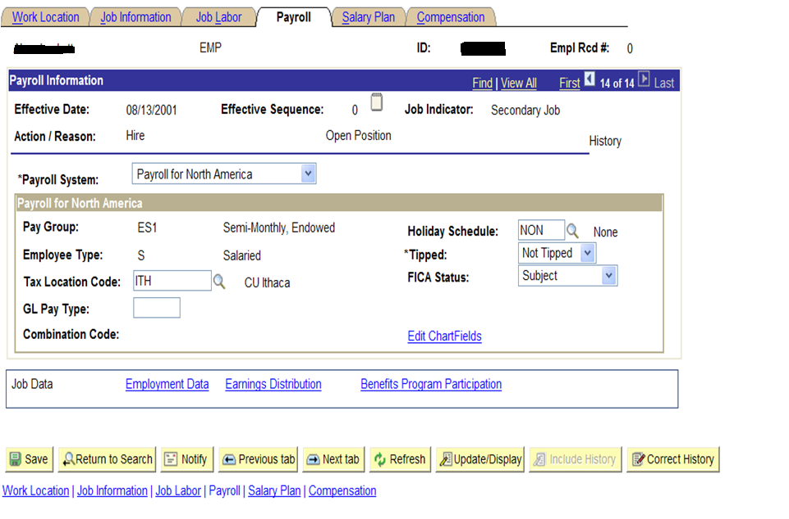

Slide 10
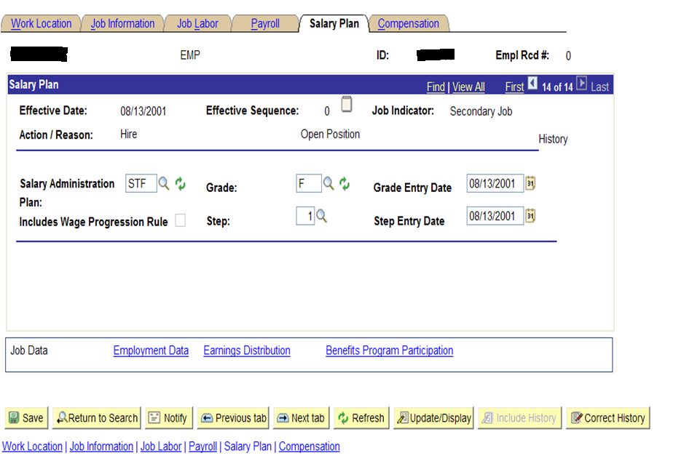

Slide 11
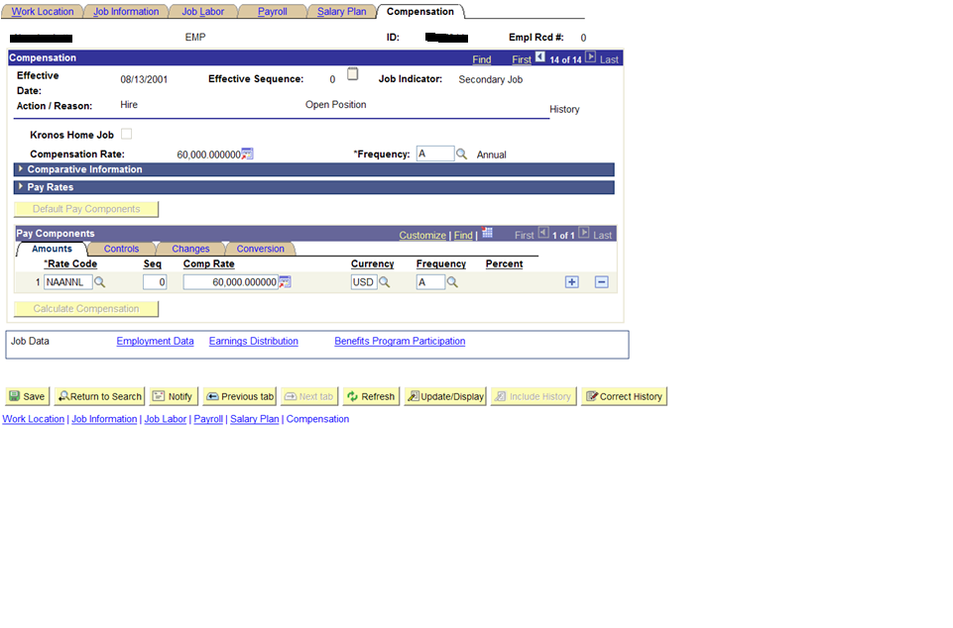

Slide 12
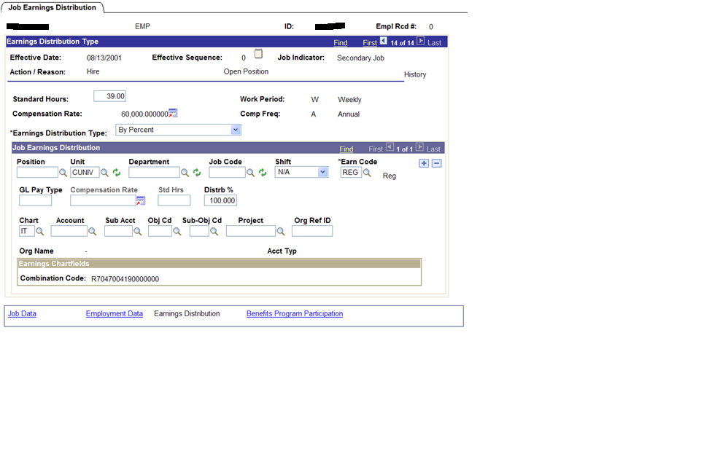

Slide 13
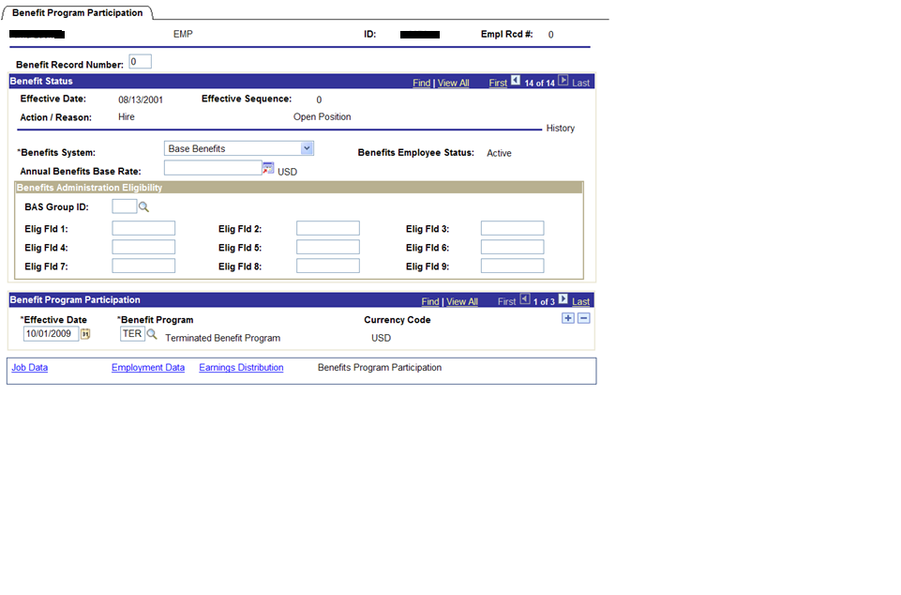

Slide 14
Data Questions:
Does Workday have the same required concepts as PeopleSoft (ie: empl_rcd)?
Will all necessary data attributes from Workday map into PeopleSoft?
How will setup data be maintained? Manual or automated?
What data attributes are needed (required and optional)?
What data will Workday need back from PeopleSoft?
Are there are major components needed in PeopleSoft that haven’t been identified during this BRIEF analysis period?

Slide 15
Integration and Interface Questions:
Batch or real-time integrations?
Will PeopleSoft transmit files to all Payroll providers? (Tax Deferred, Select Benefits)
Are there any outbound interfaces from Payroll that require more than just Payroll data?
Are there any inbound interfaces into Payroll that post data needed by HR?
Re-assessment of all current integration design work will be needed based on this approach – must keep in mind long-term.
Process Questions:
Will Workday self-service provide information about paychecks or will PS e-Pay be used?
Employee Essentials?
Which business processes will trigger events?
Are there multiple business processes that trigger same event?
Are there Payroll audit reports that are run that require data outside of what has been identified?

Slide 16
Operational Questions:
How will upgrades in WD and PS be coordinated, tested?
Will HR continue to be a functional sign-off point for PS upgrades since PS HR/Benefits functionality will continue to be used?
How will data failures be addressed?
Who will maintain non-Payroll setup tables? Payroll? HR?
Support for integrations – new skill set to current staff – training?
How will upgrades in WD and PS be coordinated, tested?
Will the subset of HRPY data that exists in PS continue to flow into HRPY data mart?

