Slide 1

Everyday Usability
Kathy Chiang
Matt Connolly
Mary Beth Martini-Lyons
Career Development Week 2011

Slide 2
College students on the web : usability guidelines for creating compelling websites for college students
Students consider websites as tools. A good site is one that helps them quickly accomplish their goals.
Students are busy individuals -- If they don‘t perceive immediate payoff for their efforts, they will not click on a link, fix an error, or read detailed instructions.
There is a correlation between the amount of information people process and the number of items on a page. People remember more with fewer items on the page.

Slide 3
College students on the web : usability guidelines for creating compelling websites for college students
Students fled the website immediately when confronted with a page full of dense text—not even reading the first sentence.
students ignored or misinterpreted links that began with the wrong keyword
Making design decisions based on your preferences or those of students you know may result in disastrous outcomes because you are not representative of your target audience

Slide 4
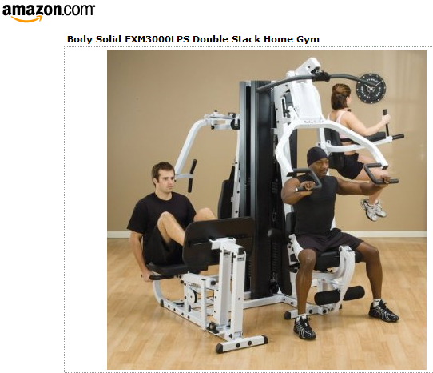

Slide 5
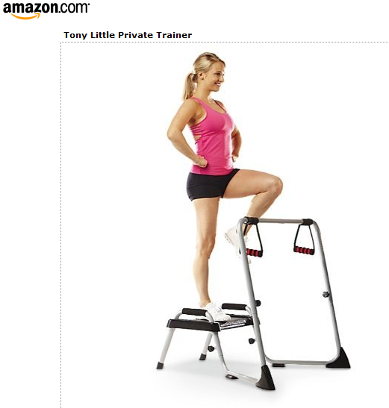

Slide 6
Tools
Site review/heuristic evaluation
Interview
Paper prototype
“Formal” usability test
Cognitive walkthrough
Questionnaire/survey
Focus group
Log data
Ethnographic study/user design

Slide 7
Tools
 | “Expert” | Amateur
Fast | Site review Cognitive walkthrough | Questionnaire Log data Ethnographic study/user design
Slow | Interview Paper prototype Formal usability test | Focus group

Slide 8
Qualtrics: The Cornell Survey Tool
Log in to create an account
Tutorials and online classes available
Institutional Review Board approval required
Usability Team can assist in survey creation and administration
http://surveys.cornell.edu/

Slide 9
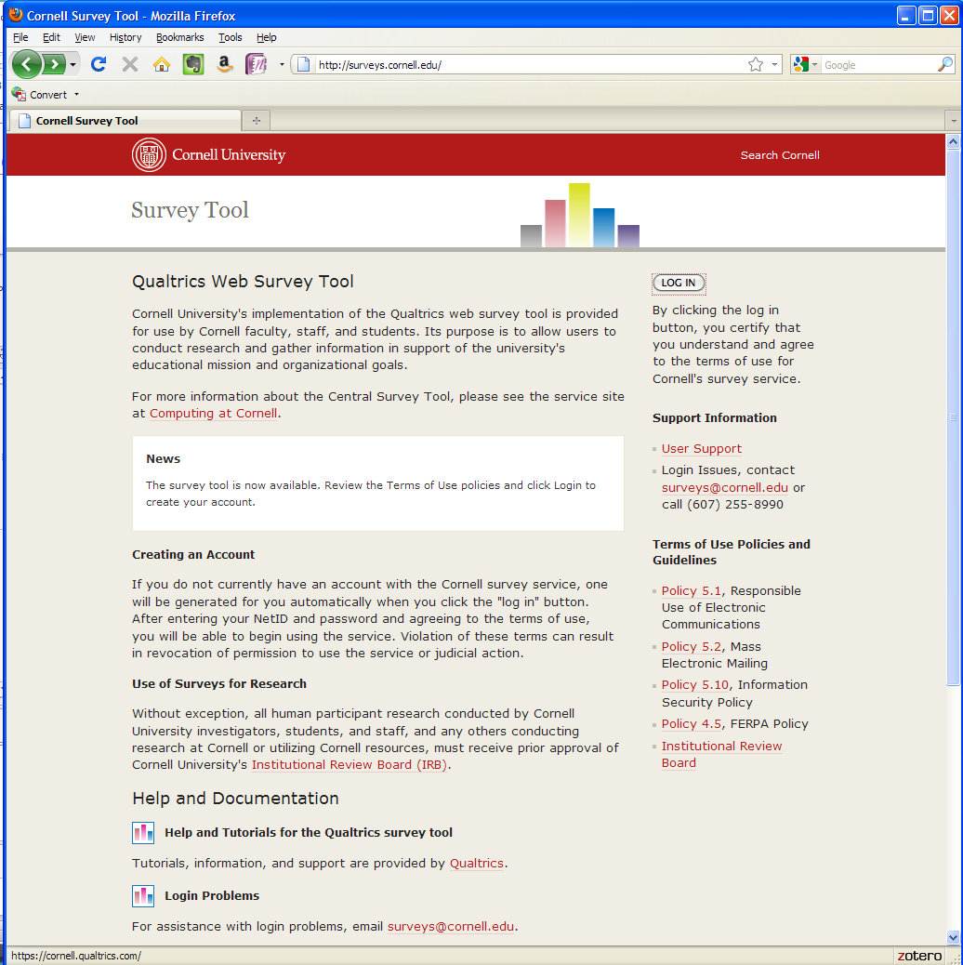
http://surveys.cornell.edu/

Slide 10
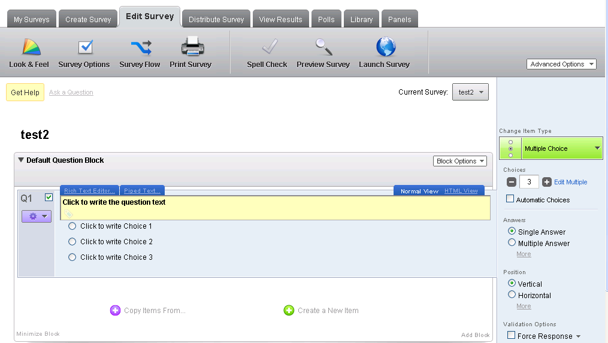
Creating Survey Questions

Slide 11
Question Types
Multiple choice
Text entry
Rank order
Pick, group, rank
Heat map
Hot spot
Likert scale
Gap analysis

Slide 12
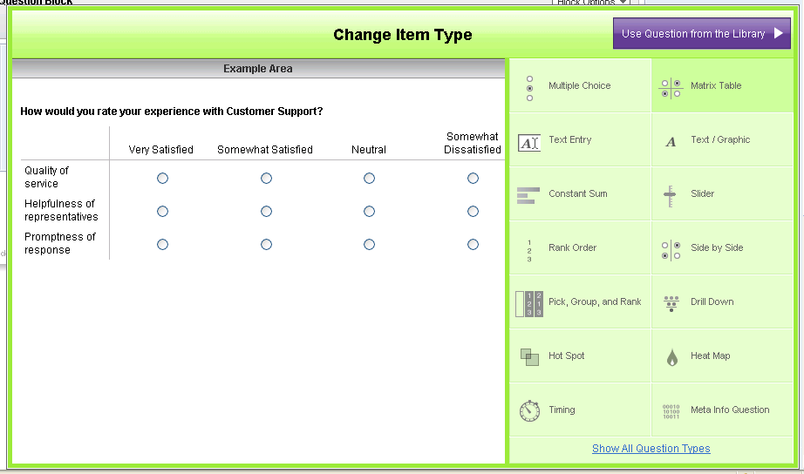
Examples of Question Types

Slide 13
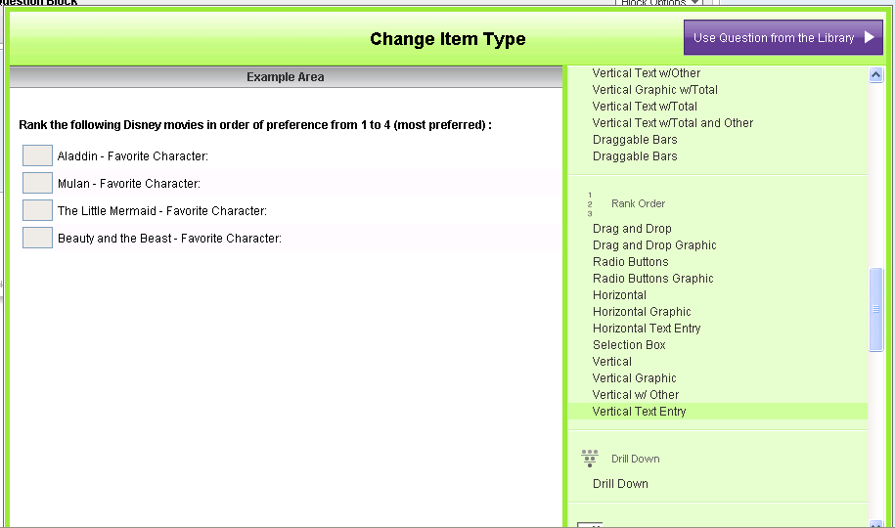
Show All Question Types

Slide 14
Hot Spot
Uses a screen clipping
Define regions of the page to test
Users highlight regions to mark them useful, not useful

Slide 15
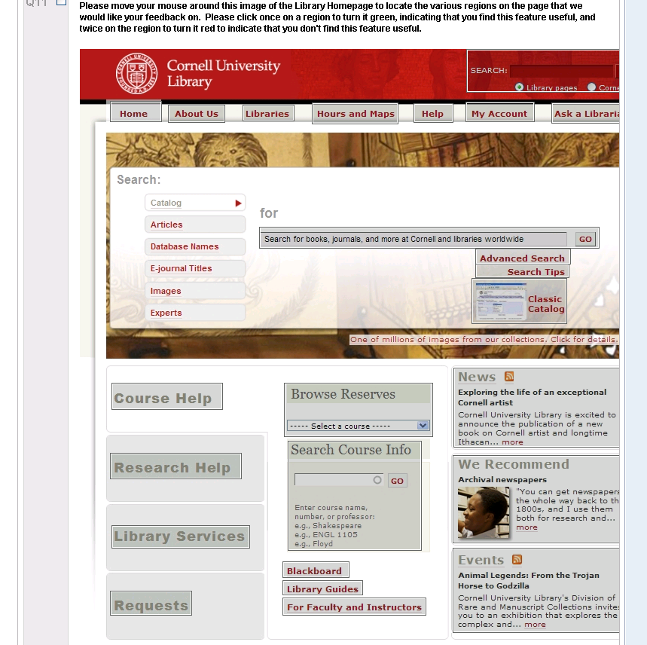
regions defined

Slide 16
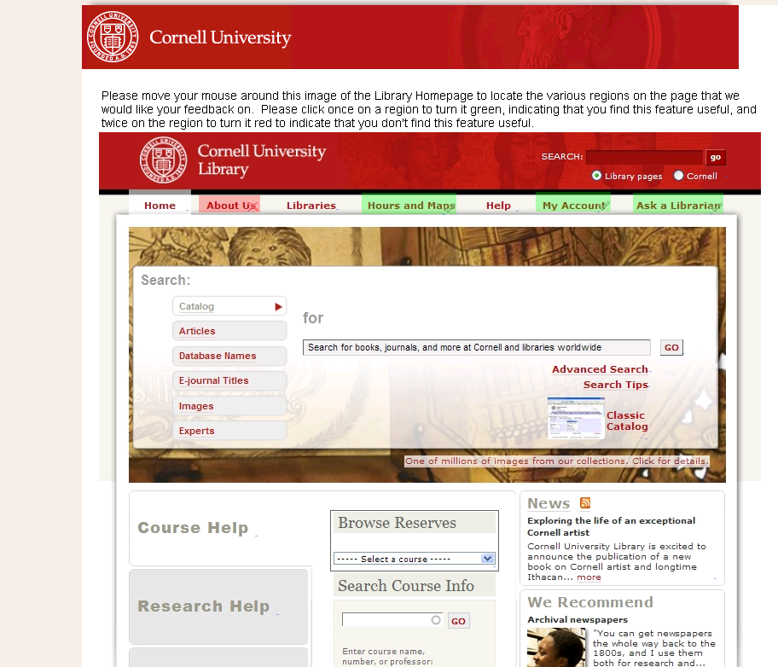
Users click once to turn the region green and twice to turn the region red
Boxes appear around
regions when moused over

Slide 17
Distribute the Survey
Preview it first
Activate the survey
Email the link to participants
  Open access?
  Invitation only?
  Password protected?

Slide 18
View Survey Results
View reports online
  View survey response overall
  View by sugroup, i.e. per question
  View by respondent
Download data as csv file into Excel
Use Qualtrics cross tabulations tool online

Slide 19
Pick Group and Rank
https://cornell.qualtrics.com/SE/?SID=SV_diKljtlFTz7OAiE

Slide 20
Heat map
https://cornell.qualtrics.com/SE/?SID=SV_aidHv1MwLopwWeU

Slide 21
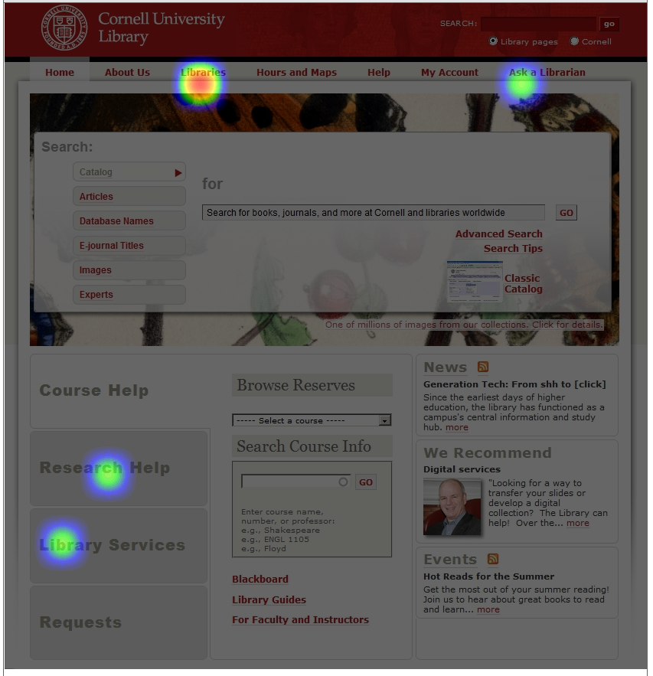

Slide 22
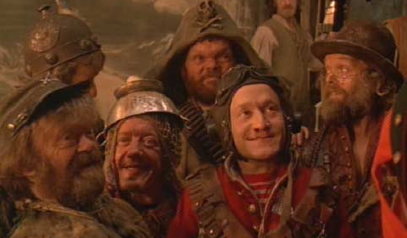
Join our group
We need new associates for the 2011-13 cycle
Image from Screencaps database. Original: Time Bandits – Handmade films, Terry Gilliam

