Slide 1
Foldable Oven Final Presentation
Spring 2013
Hayley Kantor
Paroma Chakravarty
Derek Sung
Brendan Brown

Slide 2
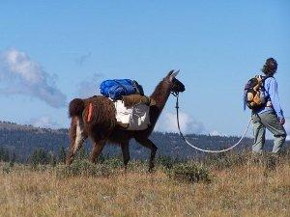
Why a Foldable Oven?
lifestyle of user mandates regular movement
  foldable oven can be carried on pack animals
  can be brought to new areas for education
intended destination lacks capacity for building
  oven is prefabricated
Notes:
Paroma

Slide 3
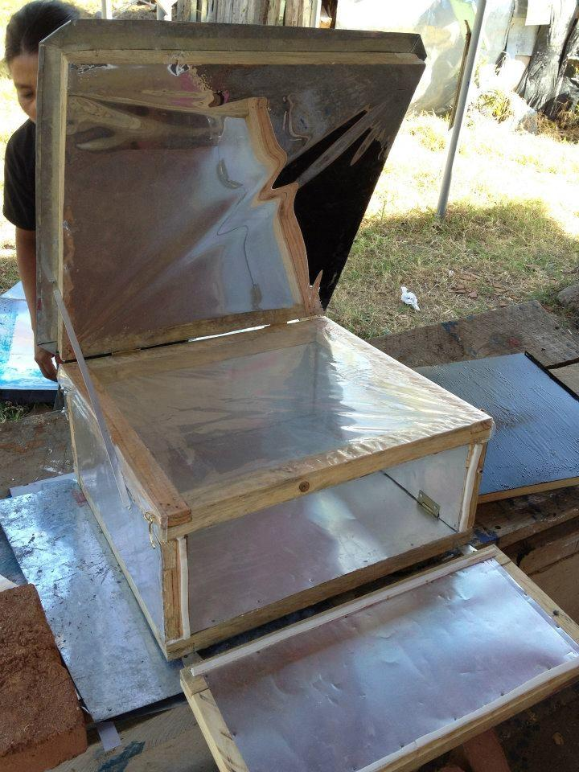
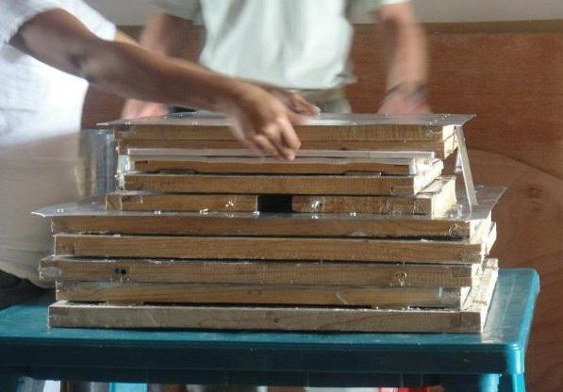
Semester Goals
Finish oven
Identify flaws in construction method
Test oven
Notes:
Paroma

Slide 4
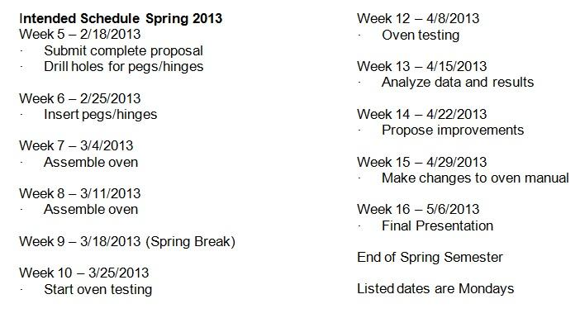
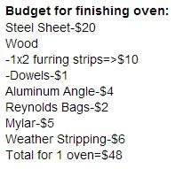
Schedule and Budget
Oven built, but not tested
Ran into construction delays
did not go over budget!
Notes:
Derek

Slide 5
Complications with the execution
Uneven Gaps
  heat could escape through holes
  weatherstripping filled them
Poorly aligned hinges
Steep learning curve during lamination
Crooked frame
Measuring once; cutting several times

Slide 6
Complications with the design
Pegs
  Difficult to line up pegs and notches
  Better to drill notches and glue pegs after placing hinges
Hooks
  Needed in some places not indicated
  Not necessary in some places where indicated
Hinges
  Unnecessarily complicated
  Expensive and heavy
Lap Joints
  Unnecessarily complicated
Notes:
B.B

Slide 7
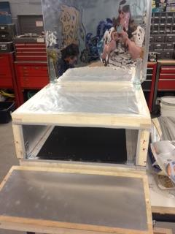
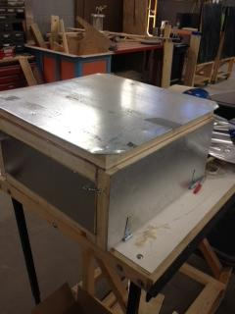
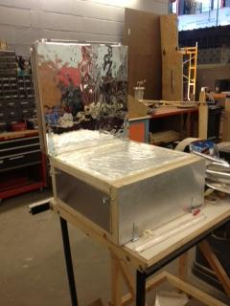
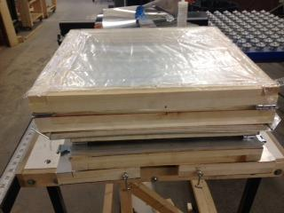
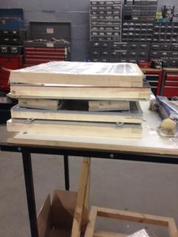
Completed Project
Notes:
Derek

Slide 8
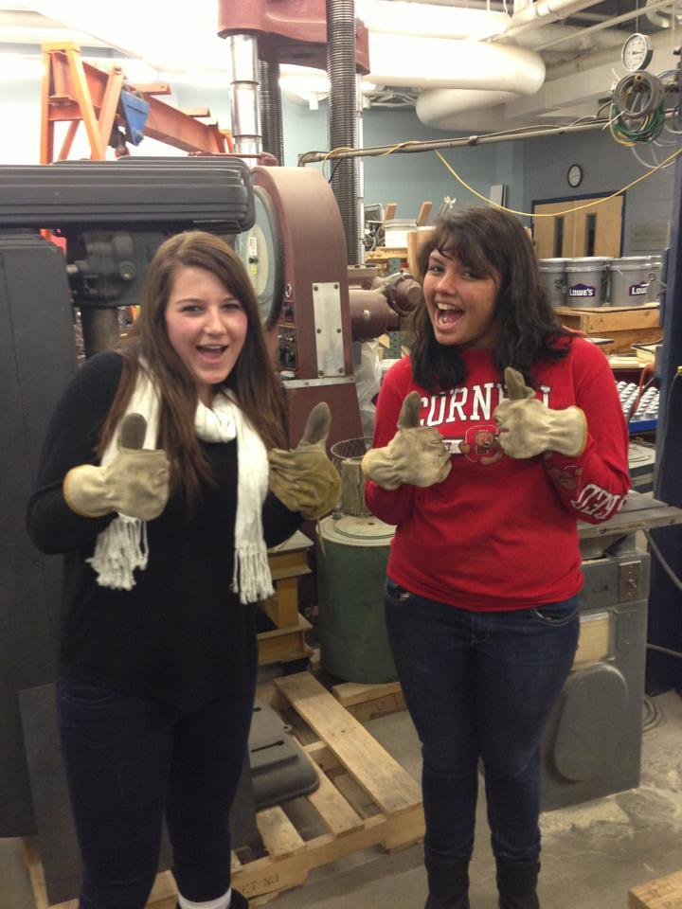
Results
Completed the oven!
We learned...
  Better construction methods
  How to plan a schedule
  How to fix mistakes along the way
  How to work with the materials available
Notes:
Hayley

Slide 9
Future Work
Test the current oven
  Testing method worked out this semester
Work on new designs
Try building the new design from Nicaragua
  write construction manual based on building experience
Notes:
Hayley

