Slide 1

Workday/CIT Technical Impact Discovery Project
Executive Summary
May 25, 2011

Slide 2
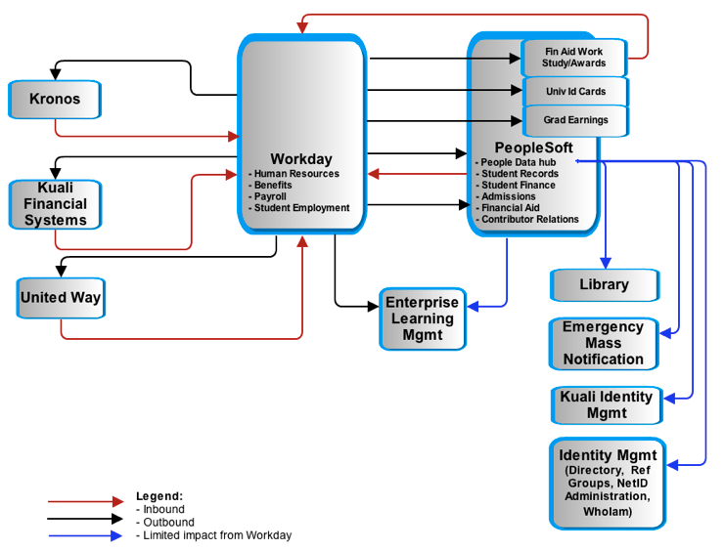
System Impact Diagram

Slide 3
Timeline with deliverables
PHASE 1
PHASE 2
July 2011
Jan 2012
July 2012
Phase 2 end: TBD
Launch
Kronos Capital Project:
Upgrade
Expand use to 24 additional units
Switch 7000 users from COLTS
Cost not included.
Workday Phase 1:
Conversion support
ELM
Harris Connect
ID Card
ID Mgmt – Authentication
ID Mgmt – Provisioning
Integration Architecture
KFS
Kronos integration and remediation
Needs analysis for data delivery
PeopleSoft
People data hub
Student Employment
United Way
Workday Phase 2:
Data delivery solution
Decommission COLTS

Slide 4
Timeline with cost estimates
Phase 1
Phase 2
Low Estimate High Estimates
Reallocated: $440,000 - $740,000
Cash: $1,030,000 - $1,900,000
Total cost: $1,470,000 - $2,640,000
Low Estimate High Estimates
Staff Costs: $30,000 - $470,000
Cash: $300,000 - $2,400,000
Total cost: $330,000 - $2,870,000
July 2011
Jan 2012
July 2012
Phase 2 end: TBD

Slide 5
Clarifications
Kronos
  Part 1: The Kronos Capital project must be completed prior to the Workday go-live. The cost of $690K, per Payroll’s estimate, is not included.
  Part 2: Kronos prep for Workday includes data conversion, configuration and integration work for an additional $500K to $1M, per Payroll’s estimate.
Data delivery
  Phase 1: Requirements analysis to define a solution.
  Phase 2: Design and implement a solution.
Current project prioritization and resource availability affect costs.
Unidentified impacts could not be estimated.
A PeopleSoft people data hub will be used to minimize remediation efforts.

