Slide 1

Workday/CIT Technical Impact Discovery Project
Executive Summary
Scenario for delayed
Workday Payroll deployment
June 1, 2011

Slide 2
Goals and Approach
Goal:
  Integrate Workday as a new SaaS HR /Payroll system with all Cornell systems that interoperate with Cornell’s current HR/Payroll solution.
Approach:
  Phase 1 July 2012:
    Remediate and integrate CU systems with Workday’s HR
    Keep PeopleSoft Payroll in place
  Phase 2 July 2013:
    Kronos Capital project (separate but related)
    Workday’s Payroll
  Phase 3 TBD:
    HR/Payroll data delivery

Slide 3
Costs and Optimizations
Cost Management:
  Reallocated staff will be used when possible.
  Contractors will be hired when CU talent shortages and resource availability due to other projects require it.
Cost reduction proposals:
  Delay Payroll via Workday to July 2013, enabling less use of consultants.
  Deliver the Kronos Capital project before July 1, 2013 to avoid remediation of COLTS.
  Create a PeopleSoft people data hub to avoid forcing multiple systems, such as the Directory and Emergency Mass Notification, from having multiple interfaces – one with Workday and one with PeopleSoft.

Slide 4
Assumptions
Payroll office will need to use both Workday and PeopleSoft for 1 year.
Workday job and benefit data will be sent and transformed to fit PeopleSoft job and benefit data structures exactly.
The solution that extracts and transforms Workday job and benefit data will be used through the completion of phase 2 and then discarded.
Payroll interfaces will continue from PeopleSoft through the end of Phase 2.

Slide 5
Stakeholders
People Data Hub stakeholders:
  Student Administration, Contributor Relations, HR, Payroll, Identity Management, Data Administration
Impacted Systems’ Functional Stakeholders:
  Directory, NetID Administration, Authorization tools: CIT/Identity Management
  Emergency Mass Notification: CU Police
  Enterprise Learning Management : Sponsored programs, Facilities, HR
  IDCard : Registrar
  KFS (Budget, Labor Ledger, GL) : DFA/Accounting, Budget office, DFA/Payroll
  Kronos (time collection): DFA/Payroll
  United Way: DFA/UBSC
  Voyager : Library

Slide 6
Recommended Workday Deployment Project Structure
Exec Sponsors
Project Director
Stakeholders
Workday Project Manager
Integration and Remediation Technical Project Manager
Workday Functional adoption team
Technical team

Slide 7
Timeline with deliverables
Phase 3 end:
TBD
July 2011
July 2012
July 2013
Phase 1
Phase 2
Phase 3
Workday Phase 1:
ID Mgmt – Authentication
Integration Architecture
PeopleSoft integrations
PeopleSoft People data hub with job data and benefits deductions
Student Employment (part 1)
Needs analysis for data delivery
Kronos Capital Project:
Upgrade
Expand use to 24 additional units
Switch 7000 users from COLTS
Workday Phase 2: (All Payroll related remediations)
COLTS (Decommission)
ELM
Harris Connect
ID Card
ID Mgmt – Provisioning
KFS
Kronos integration and remediation
Payroll data conversion
Statler
Student Employment (part 2)
Traffic
United Way
Windstar
Workday Phase 3:
Data delivery

Slide 8
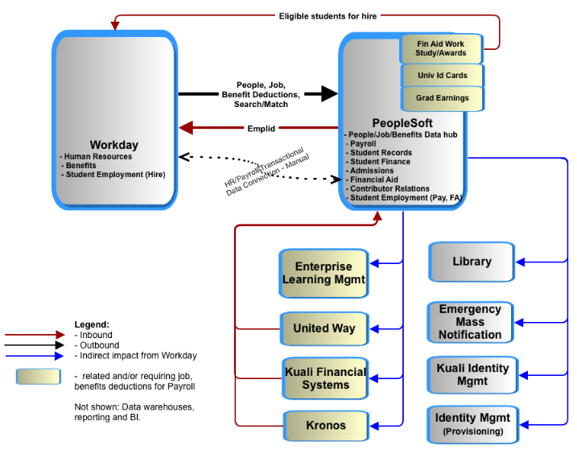
Appendix A: System Impact Diagram, Phase 1

Slide 9
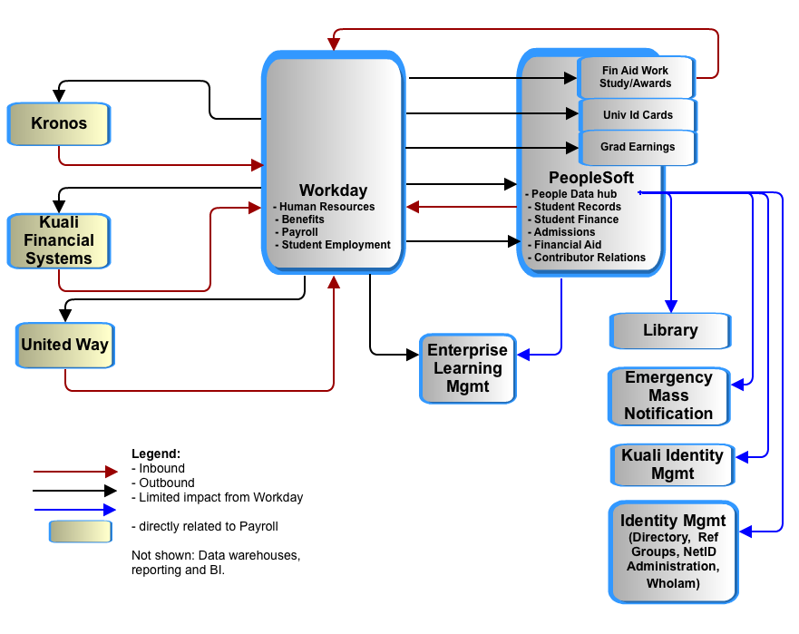
Appendix B: System Impact Diagram, Phase 2

Slide 10
Appendix C: Total Cost Summary
 |  | Estimates
Project | Target date | Low -Staff | Low– Cash ⁽¹⁾ | High - Staff | High - Cash ⁽¹⁾
Kronos Capital Project ⁽²⁾ | June 2012 | $150,000 | $540,000 | $150,000 | $540,000
Phase 1 ⁽³⁾ | July 2012 | $440,000 | $1,030,000 | $740,000 | $1,900,000
Phase 2 ⁽⁴⁾ | TBD | $30,000 | $0 | $470,000 | $2,400,000
TO BE REPLACED
Total of lower estimates | $2,190,000
Total of high estimates | $6,200,000
Cash is for licenses and VMs for Kronos and consulting for most systems.
Kronos’ estimates are from Payroll.
Refer to the Timeline With Deliverables slide and Appendix A for systems included. Remediation efforts for unit systems that might be indirectly affected by Workday could not be included at this time.
Data delivery requirements will not be known until the end of phase 1 so the upper estimates are based on 2/3s of the KFS data delivery effort.

