Slide 1
Workday
Revised technical summary
May 17, 2011

Slide 2
Recap from 5/12
Scope considerations:
  Data delivery
  PeopleSoft as Person data hub
Schedule options:
  7/2012
  1/2013
Resources options:
  Consulting and reallocated rates
Check in with other schools

Slide 3
Resource options for
July 2012 and Jan 2013
July 2011
July 2012
Jan 2013
100% consultants at $150 /hour
50% consultants at $150 /hour and
50% CU staff at $100 / hour

Slide 4
Changes made
Time collection: The costs still exist, and this is a prerequisite, but the costs will be counted separately in another project.
Result: No longer included.

Slide 5
Changes made
Data delivery:
  Low Estimate:
    Reduced to Operational Data Store
    Followed Georgetown’s investment of 1.5 FTE for the low estimate.
  High Estimate
    Keep with CU’s KDW estimate.
Result: Low estimate reduced.

Slide 6
Changes made
Integration of People data:
  Rather than having EMN, Library and the IdManagement tools connect with Workday we would keep PeopleSoft as intact as possible to minimize changes to them.
  PeopleSoft stays as the 'People Data Hub'.
  Architecturally and for long term support it is better, but the financial implications of this change are relatively small.
  Creating services for applications to get that data rather than using the high number of direct connects should be done, and is outside the scope of Workday.
Result: Changed

Slide 7
Changes made
Reserves for impacts to 'other' systems:
  We believe there are other systems that will be impacted than those listed.
  They will either be allowed to fail or require separate funding to remediate.
Result: No longer included.

Slide 8
Changes made
Consulting for Payroll:
  If Payroll wants additional consulting for help with tools such as Windstar that CIT does not currently support it will require separate funding.
Result: No longer included.

Slide 9
Changes Made
Technical Project Management:
  It was moved up into the 'General technical and Project Management' category.
  It is an hour count now rather than a % of the project.
Result: Reduced and moved.

Slide 10
Changes discussed and not made
Replace Id. Mgmt software:
  PS Data Hub concept reduces impact.
  Parallel replacement of NetID management and Kerberos infrastructure not needed for Workday
Result: Effort reduced.

Slide 11
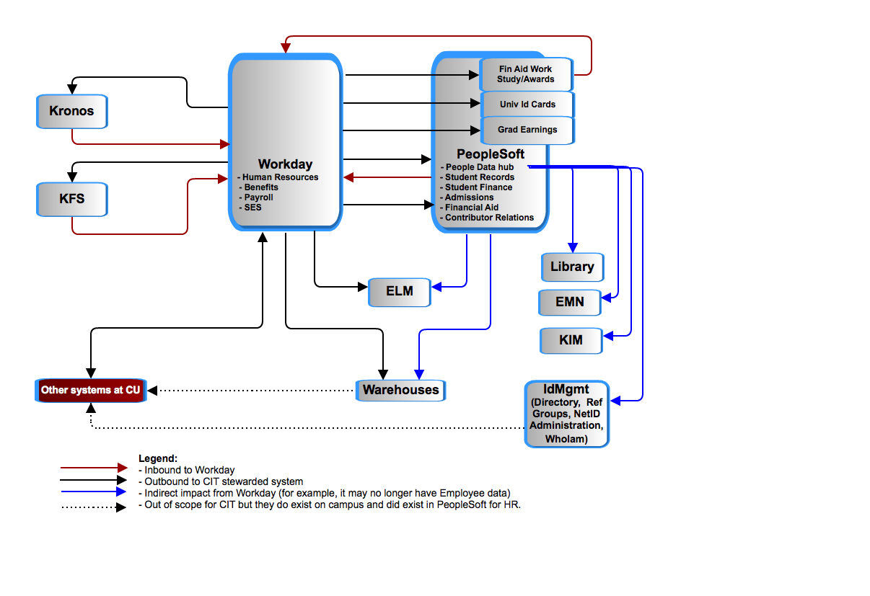
PeopleSoft as the person ‘data hub’

Slide 12
Ratios of efforts

Slide 13
Ratios of efforts

Slide 14
Basic time/dollar
$
Delivery Date

