Slide 1


A Technical Point of View
@
Data collection coordination and presentation
by
Vicky Mikula: CIT Information Systems’ PeopleSoft team manager and Blackboard tech support team manager
Steve Lutter: CIT Information Systems’ Assistant Director, Enterprise Software
May 12, 2011
Notes:
This is the culmination of the Discovery project and a set of meetings with data delivery, IdMgmt, S&O/Prod control and Engineering, and IT policy. 20 some slides full of pictures and explanations of the scope of Workday from a technical point of view.

Slide 2
Topics to cover
Impacts to other systems
  PeopleSoft
  Time collection
  Kuali Financial System
  Identity Management’s tools
  Data delivery solutions
  Others
Risks and challenges
Estimates
Next steps

Slide 3
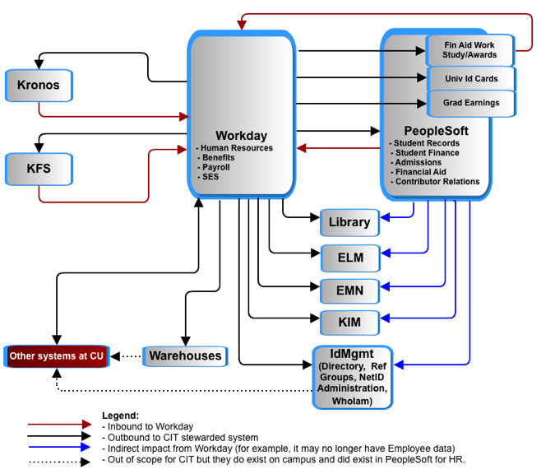
Workday – Application to Application
Notes:
This is the basic context from an application to application point of view. We’ll dive into PeopleSoft, KFS, id Mgmt and data delivery.

Slide 4
Workday – Application to Application
Enterprise Learning Mgmt.
1 of 2 time collection systems.
Emergency Mass Notification
Kuali Id.Mgmt for Coeus and KFS
Set of Identity Mgmt tools
Notes:
Acronyms explained.

Slide 5
Cornell’s People Records in PeopleSoft
Workday is expected to take ownership of records for employees active the year it is deployed, which is under 20% of all employee records in PeopleSoft today. It is expected that historical employee records will not be converted.
  + 65,449 NON-Student employees
  + 51,295 Student employees
    = 116,723 Employees
  + 229,417 Students
  + 191,131 Applicants
  + 761,722 Prospects
    = 1,182,270 Campus Solutions people
  + 5,062 Trustees and Affiliates
  + 468,018 Alumni and Related
    = 473,080 Contributor Relations Persons
  + 28,409 unidentifiable people
    = 1,800,452 Total People records in PeopleSoft
  NOTE: Based on data from March 2011. The numbers are based on primary affiliations so no one is counted more than once.

Slide 6
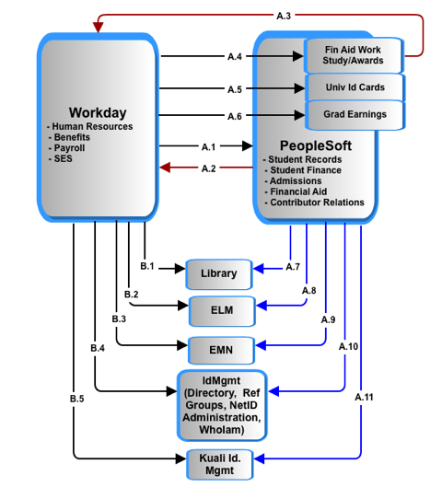
Synchronizing people data
Notes:
A1:Employee data…
A2:ID created
A3: Student employment update: Financial Aid packaging requires tracking of work study, award and gross pay earnings.
A4, 5,6: Assumption: all people (employees and students) records, including bio/demo and basic status/affiliation with University will still exist in PS. The systems using this data from PS today should function post-Workday with little remediation. Those systems requiring more specific job/position data will require interaction with Workday as data of record for employee data. PS will continue to be data of record for student data.
A and B: 7,8,9,10
: Modified to just send non-Employee data since that all comes from B1-4.

Slide 7

Search – Match : match and avoid duplicate People records in both systems.
Conceptual
Conceptual
Not shown: A process for checking for duplicates.
Notes:
PeopleSoft and Workday have to jointly avoid duplicate people records and jointly manage the data of record for individuals who are employees and also students, prospects, or alumni. Currently, that is done in PeopleSoft as the delivered Search-Match function.

Slide 8
Recap: In Numbers
# of PS Campus Community tables shared between HRPY, Campus Solutions, CR | 25
# of PS Campus Community business processes impacted by above tables | 712
# of PS HRPY tables used by Campus Solutions & CR | 32
# of PS Campus Solution & CR business processes impacted by above tables | 585
# of PS Production Control jobs to decommission | 51
# of new Workday integration related batch jobs to create, test and schedule and monitor | ~ dozen
# of direct connections by other applications to PeopleSoft that are affected | ~ dozen
5/12/11
CIT's report on the impact of Workday
8
Notes:
Vicky: INTEGRATION jobs

Slide 9
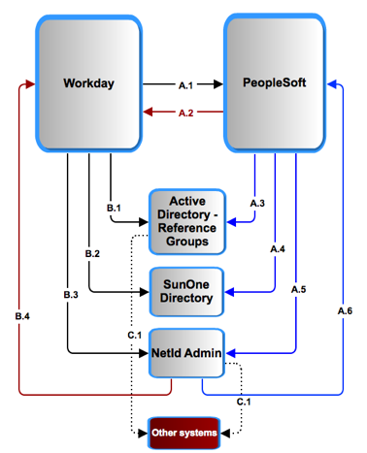
Workday and Identity Management
Notes:
Explain department tree use in Reference Groups and the reference groups’ use.
Explain B3/4 A5/6: NETID Admin is a tool for HR to create netIDS.
Synch up netid records’ and status. Much analysis and design is needed on those alone. We’re pointing out the areas that need work at a high level.

Slide 10
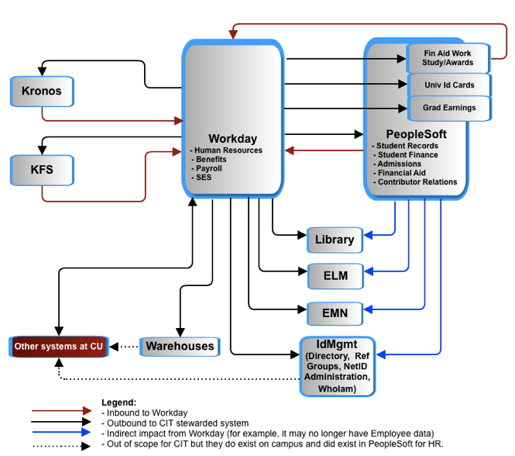
Kronos
(time collection) :
Options:
  Kronos takes over all campus time collection. Upgrading Kronos to replace COLTS will require licensing, more training, more technical support and a project.
  or
  COLTS (not illustrated) has to be remediated
In either case Kronos requires remediation.

Slide 11
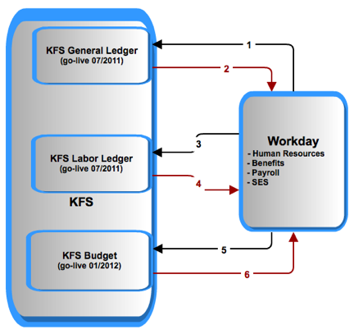
Workday and KFS
Notes:
Legend:
1: liabilities
2: CoA
3: salaries and encumbrances
4: labor object codes
5: position distributions
6: new position distributions
NOTE timing of Budget. We will have to remediate it with PeopleSoft for 1 year’s use and then redo it for Workday.

Slide 12
Other systems on campus will be impacted indirectly, such as:
Vivo
Academic Reporting (Activity Insight)
Other systems with INDIRECT IMPACT exist, such as:
Vivo
Academic Reporting (Activity Insight)
All full inventory has not been done.
Specialized systems with DIRECT IMPACT.
Notes:
We don’t know yet we made a guess in the estimates. This requires much more investigation.
We just heard there are traffic, united way, windstar, puerto rico pay, statler tips.

Slide 13
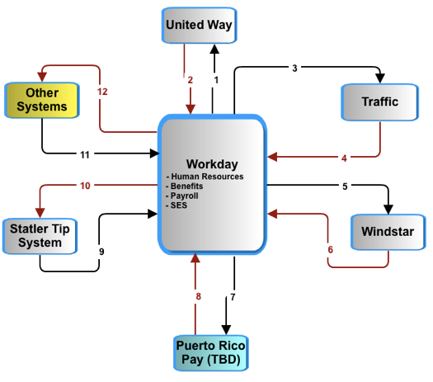
Workday and Payroll impact
Notes:
So far, little to no Workday oriented analysis has been done on these interfaces.

Slide 14
Warehouse and reporting:
Not enough requirements exist at this time to do anything other than compare the effort to that of the KDW.
IF the effort is similar to that of the Kuali Data Warehouse then it will be between 20000 and 30000 hours.
KFS data delivery work is expected to consume the CIT Data Delivery group through FY12.
Notes:
Much more investigation is needed for data delivery and for other systems’ impacts.
We used KDW effort to date and projections for future work for now.

Slide 15
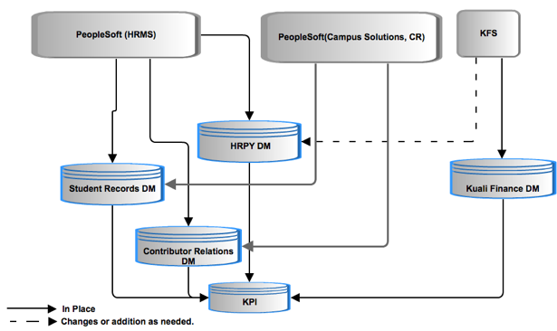
HR/Payroll data propagation for data delivery: current
Notes:
Point is: SRDM and CR both get HRMS data.

Slide 16
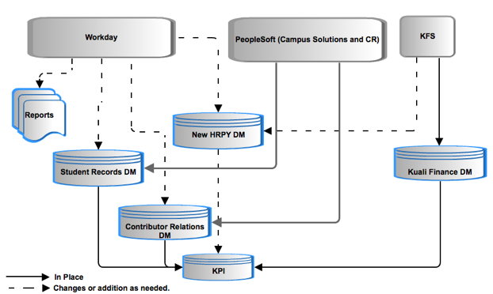
HR/Payroll data propagation for data delivery: future
Notes:
New HRPY DM, plus changes to other systems.
There is no clear information to determine if the new system from workday will allow the student and CR datamarts to continue to function without remediation. Hr data usage by these other datamarts must be clarified and documented to determine this.
The data between Workday and PS uses different metaphors or contexts, data translation between systems may require additional mappings and data administration to determine correct results.

Slide 17
HR/Payroll data propagation for data delivery: questions
Do we keep our historical data as is or convert it?
Workday data representation and extraction is unconventional and there is no data model or data dictionary. What is the process and effort extract, transform and load?
What are the requirements of the new data mart?
Notes:
New HRPY DM, plus changes to other systems.
Converting data is almost impossible in that the semantics are probably to divergent. Many elements combine to form one and vica versa and this would require massive mapping efforts that are usually not cost justifiable. To date no Cornell project has converted historical data for a legacy datamart into the format of the new datamart.
There is no data model, no data dictionary in short no meta data to assist with this effort, which means that the knowledge to develop dimensional models must be gained through trial and usage of the application. This is not planned or supported currently.

Slide 18
High-Level Risk Assessment
Summary
1 | IT Governance of University’s administrative applications | High
2 | Reporting and business intelligence (BI) | High
3 | Multiple enterprise systems containing basic PEOPLE data (Cornell Community) | High
4 | Provisioning and De-Provisioning Process | High
5 | Talent Shortage | High
6 | Multiple time collection applications | High
7 | Unit level solutions designed around PeopleSoft data | Med
8 | Historical data retention in PeopleSoft and HRPY warehouse | Med
Notes:
Identity Management provisioning and troubleshooting NetIDs , reference groups is dramatically affected.
Time Collection: challenges and decisions
Technical troubleshooting : real-time and batch a2a between multiple large apps, one of which is SaaS means new tools, skills, knowledge, practices. This is different that other SaaS CU integrations we have now – more records, more processes, more real time means more impact when there is a problem.
Timeline: 12 months for time collection and reporting alone will present significant challenges.
----- Meeting Notes (5/5/11 09:27) -----
add risks for
- Interfaces... all the other systems stand up
- contextual data in Employee/ data- mapping,
- historical data in PS, data retention for W2s
- troubleshooting integrations
-W2s and puerto Rico

Slide 19
High-Level Risk Assessment
1. IT Governance of University’s administrative applications
Probability: High Risk | Risk: Individual business areas making IT decisions affecting direction, solutions, resources that have short and long term consequences which could impede the University’s IT strategic objectives.
Mitigation Strategies: Gain executive sponsorship to implement a framework and process with well-defined roles of responsibility for data, applications and infrastructure both during and after the project.
Notes:
Identity Management provisioning and troubleshooting NetIDs , reference groups is dramatically affected.
Time Collection: challenges and decisions
Technical troubleshooting : real-time and batch a2a between multiple large apps, one of which is SaaS means new tools, skills, knowledge, practices. This is different that other SaaS CU integrations we have now – more records, more processes, more real time means more impact when there is a problem.
Timeline: 12 months for time collection and reporting alone will present significant challenges.
----- Meeting Notes (5/5/11 09:27) -----
add risks for
- Interfaces... all the other systems stand up
- contextual data in Employee/ data- mapping,
- historical data in PS, data retention for W2s
- troubleshooting integrations
-W2s and puerto Rico

Slide 20
High-Level Risk Assessment
2. Reporting and business intelligence (BI)
Probability: High Risk | Risk: The University loses the ability to combine data for historical and analytical purposes, particularly across domains of data.
Mitigation Strategies: Obtain executive support for a vision for data delivery of people data. Assign resource(s) dedicated to defining a data mapping strategy and creation of data dictionary specific to Workday. Design and implement a data mapping and reporting solution that supports cross- functional reporting needs and scales to meet the University’s warehouse and BI objectives.

Slide 21
High-Level Risk Assessment
3. Multiple enterprise systems containing basic PEOPLE data (Cornell Community)
Probability: High Risk | Risk: Duplicate entry of people, increased overhead/costs to maintain across multiple systems, inaccurate reporting, incompleteness of data and data currency.
Mitigation Strategies: Design and implement technological solutions that will validate and synchronize PEOPLE data across multiple enterprise systems. Define and implement business processes that support multiple points of data entry and common data management processes.

Slide 22
High-Level Risk Assessment
4. Provisioning and De-Provisioning Process (including the identification, administration and termination of identities with access to information systems, buildings and data.)
Probability: High Risk | Risk: Improper provisioning will result in technical, data privacy, user access, incorrect privileges (based on roles, rules and policies) and increased system and business administration costs.
Mitigation Strategies: Overhaul provisioning practices and tools. Re-design and implement technological solutions to facilitate common, consistent, automated provisioning/de-provisioning solutions that scale multiple enterprise systems.

Slide 23
High-Level Risk Assessment
5. Talent Shortage
Probability: High Risk | Risk: Competing priorities, staff reduction and skillset availability will cause a delay in the design, development, integration, remediation and troubleshooting for the University’s most complex, mission critical, administrative applications.
Mitigation Strategies: Clearly define priorities. Do realistic planning based on skillsets needed and competing priorities. Augment staff with skilled consultants based on defined objectives. Realize that consultants can not work independently and that technical and functional resources are necessary for each phase of deployment and operational transition.

Slide 24
High-Level Risk Assessment
6. Multiple time collection applications
Probability: High Risk | Risk: Maintaining multiple time collection systems, 1 Cornell modified vendor supplied application (Kronos) and 1 custom application (COLTS), will force extra remediation work.
Mitigation Strategies: Invest in Kronos early enough to avoid all COLTS remediation.

Slide 25
High-Level Risk Assessment
7. Unit level solutions designed around PeopleSoft’s person data representation
Probability: Medium Risk | Risk: Unit level solutions that are designed to PeopleSoft’s representation of person data fail.
Mitigation Strategies: Identify impacted solutions and engage functional owners in project.

Slide 26
High-Level Risk Assessment
8. Historical data retention in PeopleSoft and HRPY warehouse
Probability: Medium Risk | Risk: 1. Continued use of outdated (“stale”) data from PeopleSoft or HRPY warehouse can result in inaccurate reporting and proliferation of stale data to shadow systems. 2. Historical data won’t be able to be combined with Workday employee data.
Mitigation Strategies: Disable access to the legacy employee records in PeopleSoft and revisit access to the legacy PeopleSoft HRPY warehouse.

Slide 27
Labor Subtotals
Detailed notes available at link ->
Numbers based on
$100/hour.
Category | Lower Estimate | Upper Estimate
Identity Management and IT Security | $212,000 | $318,000
Direct, Core Workday transactional impact | $1,067,000 | $1,853,500
Data delivery, warehouses and BI | $2,000,000 | $3,000,000
Niche or unit apps | $61,000 | $90,000
General Technical | $19,000 | $28,500
Consult/Advise Payroll | $30,000 | $37,500
Core CIT Technical labor subtotal | $3,389,000 | $5,327,500
Not included yet:
Increased KRONOS license and support costs;
Additional contingency for contractors ($150 hour for ¼ of the work);
Changes to all systems downstream of datamarts;
All time for functional team members;
Technical Project overhead.
Notes:
All detail is in the link.

Slide 28
Total Estimates
Category | Lower Estimate | Upper Estimate
Core CIT Technical labor subtotal (from previous slide) | $3,389,000 | $5,327,500
Kronos licenses , VMs, and 1st year support | $410,000 | $410,000
Contingency for $150/ hour contractors for 1/4 of the work | $423,000 | $665,000
Changes to all down stream systems (a complete guess!) | $100,000 | $500,000
Technical Project overhead of CIT tech Labor (15%) | $508,000 | $799,000
TOTAL (rounded to nearest ten thousand) | $4,830,000 | $7,700,000
Not included:
All time for functional team members

Slide 29
Next steps
Understand executive expectations, priorities, and direction.
When IT governance approves it….
  Get a project manager for the Technical Implementation.
  Determine and resolve resource contentions with KFS and KC for data delivery work
  Address risks and open questions presented
  Prepare an implementation plan
  Prototype key integrations
  Extend PS Consulting engagement

Slide 30
More
The slides and supporting documentation are available here:
https://confluence.cornell.edu/display/WRKDAYTCHPOV/Home

