Slide 1


A Technical Point of View
@
Data collection coordination and presentation
by
Vicky Mikula: CIT Information Systems’ PeopleSoft team manager and Blackboard tech support team manager
Steve Lutter: CIT Information Systems’ Assistant Director, Enterprise Software
May 12, 2011
Notes:
This is the culmination of the Discovery project and a set of meetings with data delivery, IdMgmt, S&O/Prod control and Engineering, and IT policy. 20 some slides full of pictures and explanations of the scope of Workday from a technical point of view.

Slide 2
Topics to cover
Impacts to other systems
  PeopleSoft
  Time collection
  Kuali Financial System
  Identity Management’s tools
  Data delivery solutions
  Others
Risks and challenges
Estimates
Next steps

Slide 3
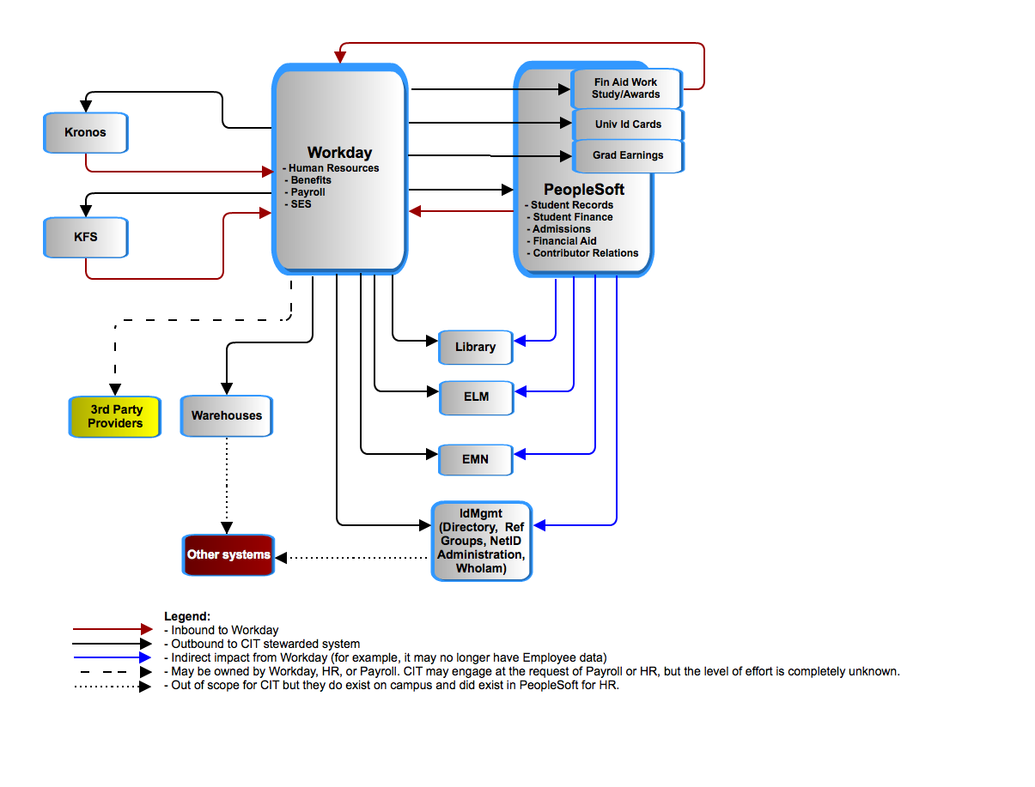
Workday – Application to Application
Notes:
This is the basic context from an application to application point of view. We’ll dive into PeopleSoft, KFS, id Mgmt and data delivery.

Slide 4
Workday – Application to Application
Enterprise Learning Mgmt.
1 of 2 time collection systems.
Emergency Mass Notification
Set of Identity Mgmt tools
Notes:
Just explain the acronyms.

Slide 5
Cornell’s People Records in PeopleSoft
Workday is expected to take ownership of records for employees active the year it is deployed, which is under 20% of all employee records in PeopleSoft today. Historical employee records will not be converted.
  + 65,449 NON-Student employees
  + 51,295 Student employees
    = 116,723 Employees
  + 229,417 Students
  + 191,131 Applicants
  + 761,722 Prospects
    = 1,182,270 Campus Solutions people
  + 5,062 Trustees and Affiliates
  + 468,018 Alumni and Related
    = 473,080 Contributor Relations Persons
  + 28,409 unidentifiable people
    = 1,800,452 Total People records in PeopleSoft
  NOTE: Based on data from March 2011. The numbers are based on primary affiliations so no one is counted more than once.

Slide 6
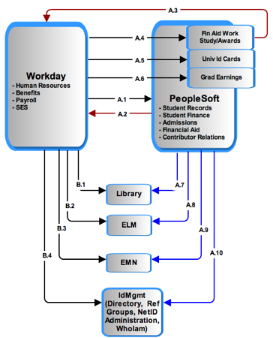
Workday and PeopleSoft
Notes:
A1:Employee data…
A2:ID created
A3: Student employment update: Financial Aid packaging requires tracking of work study, award and gross pay earnings.
A4, 5,6: Assumption: all people (employees and students) records, including bio/demo and basic status/affiliation with University will still exist in PS. The systems using this data from PS today should function post-Workday with little remediation. Those systems requiring more specific job/position data will require interaction with Workday as data of record for employee data. PS will continue to be data of record for student data.
A and B: 7,8,9,10
: Modified to just send non-Employee data since that all comes from B1-4.

Slide 7

Search – Match : match and avoid duplicate People records in both systems.
Conceptual
Conceptual
Not shown: A process for checking for duplicates.
Notes:
PeopleSoft and Workday have to jointly avoid duplicate people records and jointly manage the data of record for individuals who are employees and also students, prospects, or alumni. Currently, that is done in PeopleSoft as the delivered Search-Match function.

Slide 8
Recap: In Numbers
# of PS Campus Community tables shared between HRMS, Campus Solutions, CR | 25
# of PS Campus Community business processes impacted by above tables | 712
# of PS HRMS tables used by Campus Solutions & CR | 32
# of PS Campus Solution & CR business processes impacted by above tables | 585
# of PS Production Control jobs to decommission | 51
# of new Workday integration related batch jobs to create, test and schedule and monitor | A dozen
# of Direct connections by other applications to PeopleSoft that are affected | A dozen
5/9/11
CIT's report on the impact of Workday
8

Slide 9
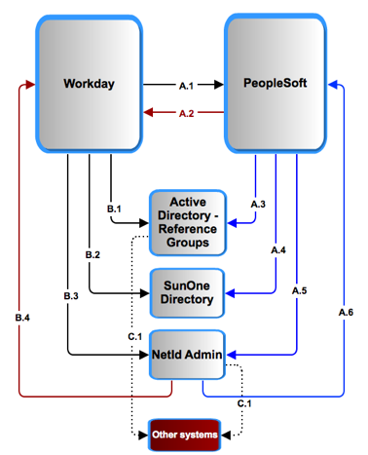
Workday and Identity Management
Notes:
Explain B3/4 A5/6: Synch up netid records’ and status. Much analysis and design is needed on those alone. We’re pointing out the areas that need work at a high level.

Slide 10
Kronos
(time collection) :
Options:
  Kronos takes over all campus time collection. Upgrading Kronos to replace COLTS will require licensing, more training, more technical support and a project.
  or
  COLTS (not illustrated) has to be remediated
In either case Kronos requires remediation as CU requirements have and will continue to require custom a2a interface development.

Slide 11
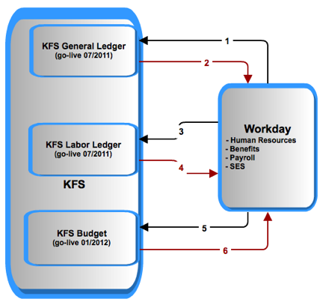
Workday and KFS
Notes:
Legend:
1: liabilities
2: CoA
3: salaries and encumbrances
4: labor object codes
5: position distributions
6: new position distributions
NOTE timing of Budget. We will have to remediate it with PeopleSoft for 1 year’s use and then redo it for Workday.

Slide 12
3rd party oversight: Payroll has requested CIT help in overseeing/developing their Workday integrations and reports. Payroll is also seeking on-going support of all integrations and reports post-Workday go-live. It is not known yet what that entails in terms of number of integrations, actual responsibilities, or level of effort.
Notes:
We don’t know yet we made a guess in the estimates. This requires much more investigation.

Slide 13
Warehouse and reporting:
Not enough requirements exist at this time to do anything other than compare the effort to that of the KDW.
IF the effort is similar to that of the Kuali Data Warehouse then it will be between 20000 and 30000 hours.
KFS data delivery work is expected to consume the CIT Data Delivery group through FY12.
OTHER SYSTEMS:
Some systems, such as Cornell Connect and Activity Insight for Academic reporting, are fed from the HRPY data mart and will be affected by changes in the structure. Impact to these systems is not accounted for at this time.
Notes:
Much more investigation is needed for data delivery and for other systems’ impacts.
We used KDW and made guesses for estimates for now.

Slide 14
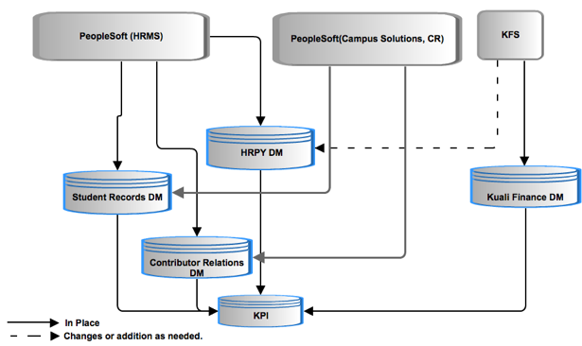
HR/Payroll data propagation for data delivery: current
Notes:
Point is: SRDM and CR both get HRMS data.

Slide 15
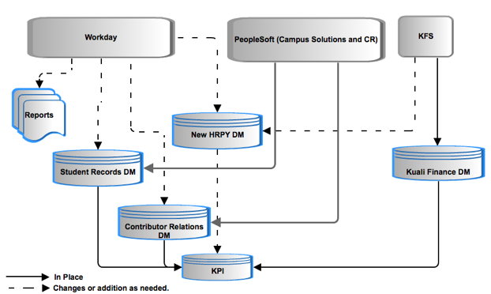
HR/Payroll data propagation for data delivery: future
Notes:
New HRPY DM, plus changes to other systems.

Slide 16
HR/Payroll data propagation for data delivery: questions
Do we keep our historical data as is or convert it?
Workday data representation and extraction is unconventional and there is no data model or data dictionary. What is the process and effort extract, transform and load?
What are the requirements of the new data mart?
Notes:
New HRPY DM, plus changes to other systems.

Slide 17
High-Level Risk Assessment
Summary
1 | IT Governance of University’s administrative applications | High
2 | Reporting, data mapping and business intelligence (BI) | High
3 | Multiple enterprise systems containing basic PEOPLE data (Cornell Community) | High
4 | Provisioning and De-Provisioning Process | High
5 | Lack of internal talent and resources | High
6 | Time collection | High
7 | Downstream impacts of systems designed to use current PeopleSoft data constructs and values | Med
8 | Historical data retention in PeopleSoft and data warehouses | Med
Notes:
Identity Management provisioning and troubleshooting NetIDs , reference groups is dramatically affected.
Time Collection: challenges and decisions
Technical troubleshooting : real-time and batch a2a between multiple large apps, one of which is SaaS means new tools, skills, knowledge, practices. This is different that other SaaS CU integrations we have now – more records, more processes, more real time means more impact when there is a problem.
Timeline: 12 months for time collection and reporting alone will present significant challenges.
----- Meeting Notes (5/5/11 09:27) -----
add risks for
- Interfaces... all the other systems stand up
- contextual data in Employee/ data- mapping,
- historical data in PS, data retention for W2s
- troubleshooting integrations
-W2s and puerto Rico

Slide 18
High-Level Risk Assessment
1. IT Governance of University’s administrative applications
Probability: High Risk | Risk: Individual business areas making IT decisions affecting direction, solutions, resources that have short and long term consequences which could impede the University’s IT strategic objectives.
Mitigation Strategies: Gain executive sponsorship to implement a framework and process with well-defined roles of responsibility for data, applications and infrastructure both during and after the project.
Notes:
Identity Management provisioning and troubleshooting NetIDs , reference groups is dramatically affected.
Time Collection: challenges and decisions
Technical troubleshooting : real-time and batch a2a between multiple large apps, one of which is SaaS means new tools, skills, knowledge, practices. This is different that other SaaS CU integrations we have now – more records, more processes, more real time means more impact when there is a problem.
Timeline: 12 months for time collection and reporting alone will present significant challenges.
----- Meeting Notes (5/5/11 09:27) -----
add risks for
- Interfaces... all the other systems stand up
- contextual data in Employee/ data- mapping,
- historical data in PS, data retention for W2s
- troubleshooting integrations
-W2s and puerto Rico

Slide 19
High-Level Risk Assessment
2. Reporting, data mapping and business intelligence (BI)
Probability: High Risk | Risk: The University loses the ability to combine data for reporting across the institution; historical reporting; use of data for analytics (trends, projections etc).
Mitigation Strategies: Obtain executive support for a vision for data delivery of people data. Assign resource(s) dedicated to defining a data mapping strategy and creation of a data dictionary specific to Workday. 3. Design and implement a data mapping and reporting solution that supports cross-functional reporting needs and scales to meet the University’s warehouse and BI objectives.
Notes:
Identity Management provisioning and troubleshooting NetIDs , reference groups is dramatically affected.
Time Collection: challenges and decisions
Technical troubleshooting : real-time and batch a2a between multiple large apps, one of which is SaaS means new tools, skills, knowledge, practices. This is different that other SaaS CU integrations we have now – more records, more processes, more real time means more impact when there is a problem.
Timeline: 12 months for time collection and reporting alone will present significant challenges.
----- Meeting Notes (5/5/11 09:27) -----
add risks for
- Interfaces... all the other systems stand up
- contextual data in Employee/ data- mapping,
- historical data in PS, data retention for W2s
- troubleshooting integrations
-W2s and puerto Rico

Slide 20
High-Level Risk Assessment
3. Multiple enterprise systems containing basic PEOPLE data (Cornell Community)
Probability: High Risk | Risk: Duplicate entry of people, increased overhead/costs to maintain across multiple systems, inaccurate reporting, incompleteness of data and data currency.
Mitigation Strategies: Design and implement technological solutions that will validate and synchronize PEOPLE data across multiple enterprise systems. Define and implement business processes that support multiple points of data entry and common data management processes.
Notes:
Identity Management provisioning and troubleshooting NetIDs , reference groups is dramatically affected.
Time Collection: challenges and decisions
Technical troubleshooting : real-time and batch a2a between multiple large apps, one of which is SaaS means new tools, skills, knowledge, practices. This is different that other SaaS CU integrations we have now – more records, more processes, more real time means more impact when there is a problem.
Timeline: 12 months for time collection and reporting alone will present significant challenges.
----- Meeting Notes (5/5/11 09:27) -----
add risks for
- Interfaces... all the other systems stand up
- contextual data in Employee/ data- mapping,
- historical data in PS, data retention for W2s
- troubleshooting integrations
-W2s and puerto Rico

Slide 21
High-Level Risk Assessment
4. Provisioning and De-Provisioning Process (including the identification, administration and termination of identities with access to information systems, buildings and data.)
Probability: High Risk | Risk: Improper provisioning will result in technical, data privacy, user access, incorrect privileges (based on roles, rules and policies) and increased system and business administration costs.
Mitigation Strategies: Overhaul provisioning practices and tools. Re-design and implement technological solutions to facilitate common, consistent, automated provisioning/de-provisioning solutions that scale multiple enterprise systems.
Notes:
Identity Management provisioning and troubleshooting NetIDs , reference groups is dramatically affected.
Time Collection: challenges and decisions
Technical troubleshooting : real-time and batch a2a between multiple large apps, one of which is SaaS means new tools, skills, knowledge, practices. This is different that other SaaS CU integrations we have now – more records, more processes, more real time means more impact when there is a problem.
Timeline: 12 months for time collection and reporting alone will present significant challenges.
----- Meeting Notes (5/5/11 09:27) -----
add risks for
- Interfaces... all the other systems stand up
- contextual data in Employee/ data- mapping,
- historical data in PS, data retention for W2s
- troubleshooting integrations
-W2s and puerto Rico

Slide 22
High-Level Risk Assessment
5. Lack of internal talent and resources
Probability: High Risk | Risk: Competing priorities, staff reduction and skillset availability will cause a delay in the design, development, integration, remediation and troubleshooting for the University’s most complex, mission critical, administrative applications.
Mitigation Strategies: Clearly define priorities. Do realistic planning based on skillsets needed and competing priorities. Augment staff with skilled consultants based on defined objectives. Realize that consultants can not work independently and that technical and functional resources are necessary for each phase of deployment and operational transition.
Notes:
Identity Management provisioning and troubleshooting NetIDs , reference groups is dramatically affected.
Time Collection: challenges and decisions
Technical troubleshooting : real-time and batch a2a between multiple large apps, one of which is SaaS means new tools, skills, knowledge, practices. This is different that other SaaS CU integrations we have now – more records, more processes, more real time means more impact when there is a problem.
Timeline: 12 months for time collection and reporting alone will present significant challenges.
----- Meeting Notes (5/5/11 09:27) -----
add risks for
- Interfaces... all the other systems stand up
- contextual data in Employee/ data- mapping,
- historical data in PS, data retention for W2s
- troubleshooting integrations
-W2s and puerto Rico

Slide 23
High-Level Risk Assessment
6. Multiple time collection applications
Probability: High Risk | Risk: Maintaining multiple time collection systems – 1 Cornell modified vendor supplied application (Kronos) and 1 custom application (COLTS) will force extra remediation work.
Mitigation Strategies: Pick the vendor supplied Kronos application and invest in expansion of it early enough to avoid all COLTS remediation.
Notes:
Identity Management provisioning and troubleshooting NetIDs , reference groups is dramatically affected.
Time Collection: challenges and decisions
Technical troubleshooting : real-time and batch a2a between multiple large apps, one of which is SaaS means new tools, skills, knowledge, practices. This is different that other SaaS CU integrations we have now – more records, more processes, more real time means more impact when there is a problem.
Timeline: 12 months for time collection and reporting alone will present significant challenges.
----- Meeting Notes (5/5/11 09:27) -----
add risks for
- Interfaces... all the other systems stand up
- contextual data in Employee/ data- mapping,
- historical data in PS, data retention for W2s
- troubleshooting integrations
-W2s and puerto Rico

Slide 24
High-Level Risk Assessment
7. Downstream impacts of systems designed to use current PeopleSoft data constructs and values
Probability: High Risk | Risk: Applications and interfaces designed around the PeopleSoft data construct and values may not be operational. The number of downstream systems at the University affected is unknown.
Mitigation Strategies: Identify impacted systems and engage application stewards in project.
Notes:
Identity Management provisioning and troubleshooting NetIDs , reference groups is dramatically affected.
Time Collection: challenges and decisions
Technical troubleshooting : real-time and batch a2a between multiple large apps, one of which is SaaS means new tools, skills, knowledge, practices. This is different that other SaaS CU integrations we have now – more records, more processes, more real time means more impact when there is a problem.
Timeline: 12 months for time collection and reporting alone will present significant challenges.
----- Meeting Notes (5/5/11 09:27) -----
add risks for
- Interfaces... all the other systems stand up
- contextual data in Employee/ data- mapping,
- historical data in PS, data retention for W2s
- troubleshooting integrations
-W2s and puerto Rico

Slide 25
High-Level Risk Assessment
8. Historical data retention in PeopleSoft and data warehouses
Probability: High Risk | Risk: 1. Continued use of outdated (“stale”) data from PeopleSoft and/or data warehouses can result in inaccurate reporting, proliferation of stale data to shadow systems, compliance/regulatory/legal issues if misinterpreted. 2. Historical data won’t be able to be queries with Workday employee data.
Mitigation Strategies: Keep it simple by keeping the current HRPY datamart alive, possibly for a decade or more.
Notes:
Identity Management provisioning and troubleshooting NetIDs , reference groups is dramatically affected.
Time Collection: challenges and decisions
Technical troubleshooting : real-time and batch a2a between multiple large apps, one of which is SaaS means new tools, skills, knowledge, practices. This is different that other SaaS CU integrations we have now – more records, more processes, more real time means more impact when there is a problem.
Timeline: 12 months for time collection and reporting alone will present significant challenges.
----- Meeting Notes (5/5/11 09:27) -----
add risks for
- Interfaces... all the other systems stand up
- contextual data in Employee/ data- mapping,
- historical data in PS, data retention for W2s
- troubleshooting integrations
-W2s and puerto Rico

Slide 26
Estimate Subtotals
Category | Lower Estimate | Upper Estimate
Identify Management and IT Security | $212,000 | $318,000
Direct, Core Workday transactional impact | $1,067,000 | $1,853,500
Data deliver, warehouses and BI | $2,000,000 | $3,000,000
Niche or unit apps | $61,000 | $90,000
General Technical | $19,000 | $28,500
Consult/Advise Payroll | $30,000 | $37,500
Core CIT Technical work totals | $3,389,000 | $5,327,500
Not included:
Increased KRONOS license and support costs;
Additional contingency for contractors ($150 to $200/hour)
Changes to all systems downstream of datamarts;
All time for functional team members;
Technical Project overhead.
Based on
$100/hour.
Notes:
----- Meeting Notes (5/5/11 09:27) -----
go with $100 an hour (non consulting) which makes it
----- Meeting Notes (5/5/11 09:30) -----
Add something about the burn rate and the

Slide 27
Estimate Subtotals
Category | Lower Estimate | Upper Estimate
Technical labor | $3,389,000 | $5,327,500
Kronos licenses , VMs, and 1st year support: | $410,000 | $410,00
Contingency for $150/ hour contractors for ½ of the work | $500,000 | $750,000
Changes to all down stream systems (a complete guess!) | $100,000 | $500,000
Technical Project overhead (15%) | $525,000 | $37,500
Most complete estimate | $4,924,000 | $6,615,000
Not included:
All time for functional team members;
Notes:
----- Meeting Notes (5/5/11 09:27) -----
go with $100 an hour (non consulting) which makes it
----- Meeting Notes (5/5/11 09:30) -----
Add something about the burn rate and the

Slide 28
Next steps
Understand executive expectations for the next set of HR’s workday requests.
When IT governance approves it….
  Get a project manager for the Technical Implementation.
  Determine and resolve resource contentions with KFS and KC for data delivery work in particular.
  Address open risks and open questions presented
  Prepare an implementation plan
  Prototype a few integrations technically
  Extend PS Meta Data analysis Consulting engagement, and try out 1 or 2 PS remediations

Slide 29
More
The slides and supporting documentation is available here:
https://confluence.cornell.edu/display/WRKDAYTCHPOV/Home

