Slide 1


A Technical Point of View
@
Data collection coordination and presentation
by Vicky Mikula and Steve Lutter
May 12, 2011
Notes:
This is the culmination of the Discovery project and a set of meetings with data delivery, IdMgmt, S&O/Prod control and Engineering, and IT policy. 20 some slides full of pictures and explanations of the scope of Workday from a technical point of view.

Slide 2
Topics to cover
Impacts to other systems
  PeopleSoft
  Time collection
  Kuali Financial System
  Identity Management’s tools
  Data delivery solutions
  Others
Risks and challenges
Estimates
Next steps

Slide 3
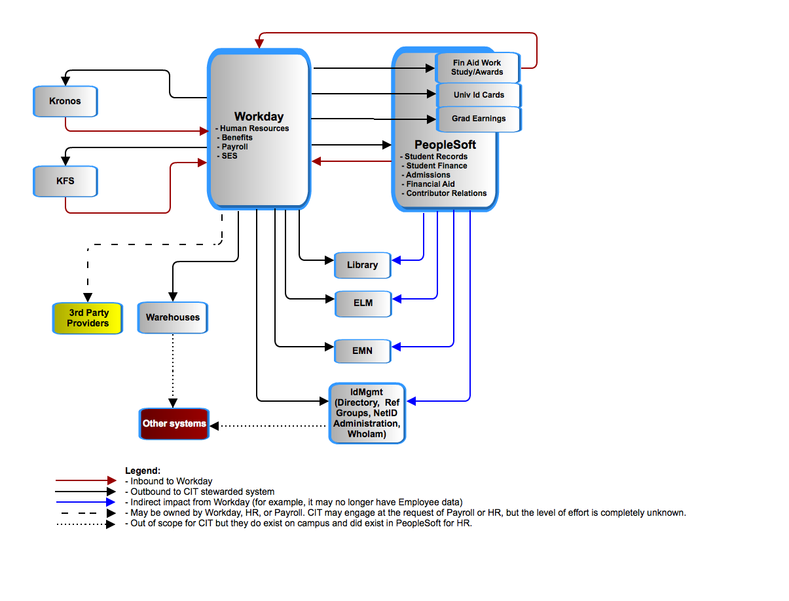
Workday – Application to Application
Notes:
This is the basic context from an application to application point of view. We’ll dive into PeopleSoft, KFS, id Mgmt and data delivery.

Slide 4
Workday – Application to Application
Enterprise Learning Mgmt.
1 of 2 time collection systems.
Emergency Mass Notification
Set of Identity Mgmt tools
Notes:
Just explain the acronyms.

Slide 5
Making use of the
PeopleSoft’s Meta Data model
PeopleSoft requires changes:
# setup type of tables that are impacted: 27
# of transactional type of tables that are impacted: 30
# of batch PS production control jobs to be decommissioned: 52
Scripts go through the user navigation and ultimately find the data structures used to support processes.
Code accesses data to support business processes.
PS DB
Scripts
Excel
Excel
Excel
PS Code
Notes:
Point is: we automated the PS part of the impact.

Slide 6
Cornell’s People Records in PeopleSoft
  + 65,449 NON-Student employees
  + 51,295 Student employees
    = 116,723 Employees
  + 229,417 Students
  + 191,131 Applicants
  + 761,722 Prospects
    = 1,182,270 Campus Solutions people
  + 5,062 Trustees and Affiliates
  + 468,018 Alumni and Related
    = 473,080 Contributor Relations Persons
  + 28,409 unidentifiable people
    = 1,800,452 Total People records in PeopleSoft
  NOTE: Based on data from March 2011. The numbers are based on primary affiliations so no one is counted more than once.

Slide 7
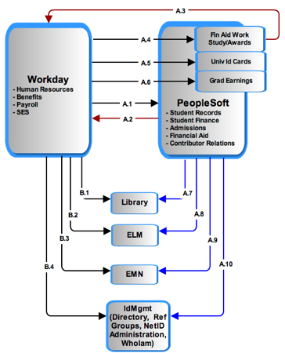
Workday and PeopleSoft
Notes:
A1:Employee data…
A2:ID created
A3: Student employment update: Financial Aid packaging requires tracking of work study, award and gross pay earnings.
A4, 5,6: Assumption: all people (employees and students) records, including bio/demo and basic status/affiliation with University will still exist in PS. The systems using this data from PS today should function post-Workday with little remediation. Those systems requiring more specific job/position data will require interaction with Workday as data of record for employee data. PS will continue to be data of record for student data.
A and B: 7,8,9,10
: Modified to just send non-Employee data since that all comes from B1-4.

Slide 8

Search – Match : match and avoid duplicate People records in both systems.
Conceptual
Conceptual
Not shown: A process for checking for duplicates.
Notes:
PeopleSoft and Workday have to jointly avoid duplicate people records and jointly manage the data of record for individuals who are employees and also students, prospects, or alumni. Currently, that is done in PeopleSoft as the delivered Search-Match function.

Slide 9
Recap: In Numbers (1 of 2)
Number of PeopleSoft Campus Community business processes impacted: 98
Number of PeopleSoft Campus Community tables shared between HR/Payroll and Campus Solutions: ~25
Number of PeopleSoft Campus Solutions/Contributor Relations business processes impacted: 585
Number of PeopleSoft Production Control jobs to decommission: 57
Number of systems interfacing with PeopleSoft directly or indirectly that are affected to some degree: About 16
Number of Interfaces (individual files, services called) to Cornell managed systems: 100s when including extracts to local warehouses.

Slide 10
Recap: In Numbers (2 of 2)
Number of payroll manual or automated jobs to decommission: 100s.
Number of new Workday integration related batch jobs to create, test and schedule and monitor: 100s (We are assuming that is similar to HR/Payroll jobs now)
Number of Payroll reports now: Unknown
Number of Direct Database connections by other applications to PeopleSoft that are affected: Dozens.
Number of Tables in PeopleSoft whose use, feed or definition will change: Less than 10

Slide 11
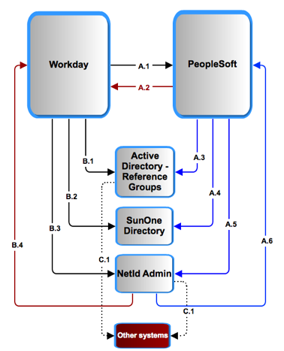
Workday and Identity Management
Notes:
Explain B3/4 A5/6: Synch up netid records’ and status. Much analysis and design is needed on those alone. We’re pointing out the areas that need work at a high level.

Slide 12
Kronos
(time collection) :
Options:
  Kronos takes over all campus time collection. Upgrading Kronos to replace COLTS will require licensing, more training, more technical support and a project.
  or
  COLTS (not illustrated) has to be remediated.
CU requirements have and will continue to require custom a2a interface development.

Slide 13
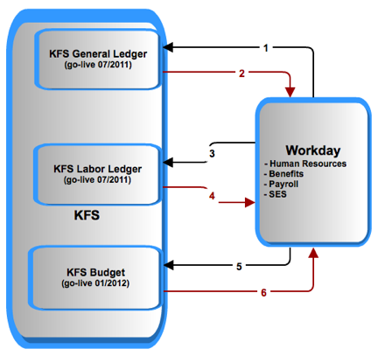
Workday and KFS
Notes:
Legend:
1: liabilities
2: CoA
3: salaries and encumbrances
4: labor object codes
5: position distributions
6: new position distributions
NOTE timing of Budget. We will have to remediate it with PeopleSoft for 1 year’s use and then redo it for Workday.

Slide 14
3rd party oversight: Payroll has requested CIT help in overseeing/developing their Workday integrations and reports. Payroll is also seeking on-going support of all integrations and reports post-Workday go-live. It is not known yet what that entails in terms of number of integrations, actual responsibilities, or level of effort.

Slide 15
Warehouse and reporting:
Not enough requirements exist at this time to do anything other than compare the effort to that of the KDW.
IF the effort is similar to that of the Kuali Data Warehouse then it will be between 20000 and 30000 hours.
KFS data delivery work is expected to consume the CIT Data Delivery group through FY12.
OTHER SYSTEMS:
Some systems, such as Cornell Connect and Activity Insight for Academic reporting, are fed from the HRPY data mart and will be affected by changes in the structure. Impact to these systems is not accounted for at this time.

Slide 16
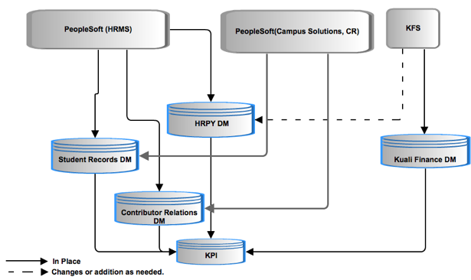
HR/Payroll data propagation for data delivery: current
Notes:
Point is: SRDM and CR both get HRMS data.

Slide 17
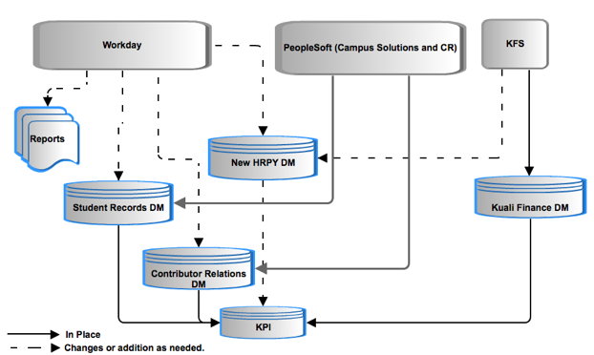
HR/Payroll data propagation for data delivery: future
Notes:
New HRPY DM, plus changes to other systems.

Slide 18
HR/Payroll data propagation for data delivery: questions
Do we keep our historical data as is or convert it?
Workday data representation and extraction is unconventional and there is no data model or data dictionary. What is the process and effort extract, transform and load?
What are the requirements of the new data mart?
Notes:
New HRPY DM, plus changes to other systems.

Slide 19
Impact – Risks
Category of Risk | Risk of Failure
Reporting and Business Intelligence | Reporting over time, reporting with other data such as financial records is inadequate.
Cornell Community | Multiple enterprise systems will be the data of record for creation of “people”. Duplicate people, reporting, knowledge of primary affiliation to university, inaccurate data, duplicity of data and so forth will be issues the University will need to address technically and through business process definition.
Provisioning | All processes related to provisioning and de-provisioning a person within the Cornell community who spans multiple enterprise systems.
Time Collection | University has 2 time collection systems. Upgrade to one or both time collection systems imposes a significant risk to calculation of paychecks.
Resources
Notes:
Identity Management provisioning and troubleshooting NetIDs , reference groups is dramatically affected.
Time Collection: challenges and decisions
Technical troubleshooting : real-time and batch a2a between multiple large apps, one of which is SaaS means new tools, skills, knowledge, practices. This is different that other SaaS CU integrations we have now – more records, more processes, more real time means more impact when there is a problem.
Timeline: 12 months for time collection and reporting alone will present significant challenges.
----- Meeting Notes (5/5/11 09:27) -----
add risks for
- Interfaces... all the other systems stand up
- contextual data in Employee/ data- mapping,
- historical data in PS, data retention for W2s
- troubleshooting integrations
-W2s and puerto Rico

Slide 20
Impact – The Biggest Variables
  Data delivery for HR/PY: What is the end goal? What are the requirements? Just how different will the extract/transforms from Workday be? (Based purely on the KDW experience and plans, this is currently 2/3s of the entire technical cost estimate.)
  Time collection options: Kronos 100% or (remediate both COLTS and Kronos)?
  Integration options : point to point or through a SOA tool for CU <->Workday a2a traffic? (SOA is not included in the estimate at all so the default is point to point.)
  Payroll 3rd party integration advice: to what degree?
  Payroll: data modeling and report writing request

Slide 21
Estimate Subtotals
Category | Lower Estimate | Upper Estimate
Identify Management and IT Security | $212,000 | $318,000
Direct, Core Workday transactional impact | $1,067,000 | $1,853,500
Data deliver, warehouses and BI | $2,000,000 | $3,000,000
Niche or unit apps | $61,000 | $90,000
General Technical | $19,000 | $28,500
Consult/Advise Payroll | $30,000 | $37,500
Core CIT Technical work totals | $3,389,000 | $5,327,500
Based on $100/hour.
Not included:
Increased KRONOS license and support costs;
Additional contingency for contractors ($150 to $200/hour)
Changes to all systems downstream of datamarts;
All time for functional team members;
Technical Project overhead.
Notes:
----- Meeting Notes (5/5/11 09:27) -----
go with $100 an hour (non consulting) which makes it
----- Meeting Notes (5/5/11 09:30) -----
Add something about the burn rate and the

Slide 22
Estimate Subtotals
Category | Lower Estimate | Upper Estimate
Technical labor | $3,389,000 | $5,327,500
Kronos licenses , VMs, and 1st year support: | $410,000 | $410,00
Contingency for $150/ hour contractors for ½ of the work | $500,000 | $750,000
Changes to all down stream systems (a complete guess!) | $100,000 | $500,000
Technical Project overhead (15%) | $525,000 | $37,500
Most complete estimate | $4,924,000 | $6,615,000
Not included:
All time for functional team members;
Notes:
----- Meeting Notes (5/5/11 09:27) -----
go with $100 an hour (non consulting) which makes it
----- Meeting Notes (5/5/11 09:30) -----
Add something about the burn rate and the

Slide 23
Recommended next near-term steps
Understand executive expectations for the next set of HR’s workday requests.
When IT governance approves it….
  Get a project manager for the Technical Implementation.
  Determine and resolve resource contentions with KFS and KC for data delivery work in particular.
  Address open questions presented
  Prepare an implementation plan
  Prototype a few integrations technically
  Extend PS Meta Data analysis Consulting engagement, and try out 1 or 2 PS remediations

