Slide 1


A Technical Point of View
@
Data collection coordination and presentation
by Vicky Mikula and Steve Lutter

Slide 2
Topics to cover
Background and status
Impact to Business processes and technologies supporting those processes that CIT stewards.
  Diagrams
  Risks
  Biggest Factors
Tasks and Estimates
Recommended next steps

Slide 3
Background and status
April 2010
  Received our first introduction to Workday and did our first assessment.
November and December 2010
  Vicky Mikula (CIT/IS/ES) joins the HR Core Workday team as overall CIT Liaison.
January through April 2011
  CIT Charters a Discovery project, reverse engineers impact from PeopleSoft, and meets to track down other technical impacts.

Slide 4
Making use of the PS to Meta Data model
The end result are reports showing which Campus Community, CR and Student driven processes use which HR/Payroll owned or supported data.
Scripts go through the user navigation and ultimately find the data structures used to support processes.
Code accesses data to support business processes.
PS DB
Scripts
Excel
Excel
Excel
PS Code

Slide 5
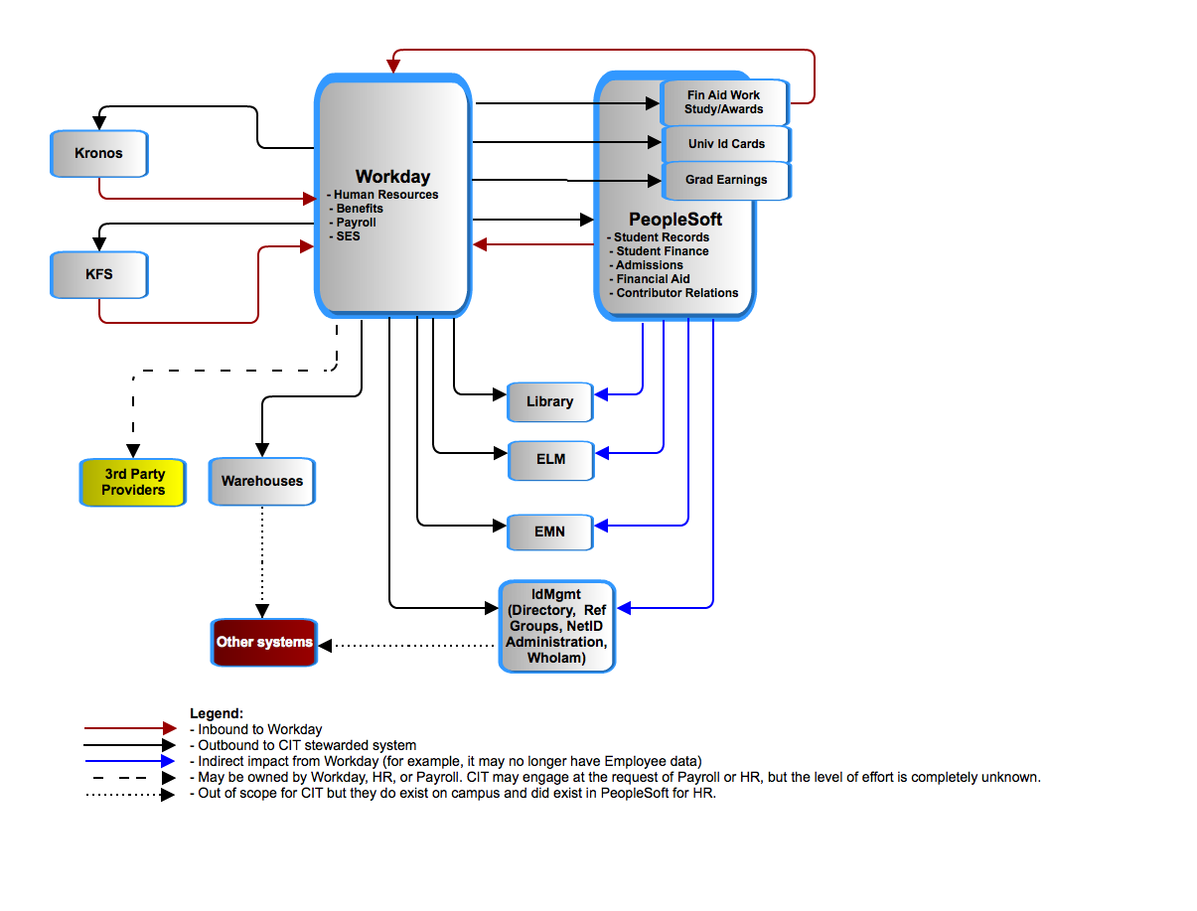
Workday – Application to Application
Notes:
----- Meeting Notes (5/5/11 09:12) -----
larger fonts for the Legend; add new diagram

Slide 6
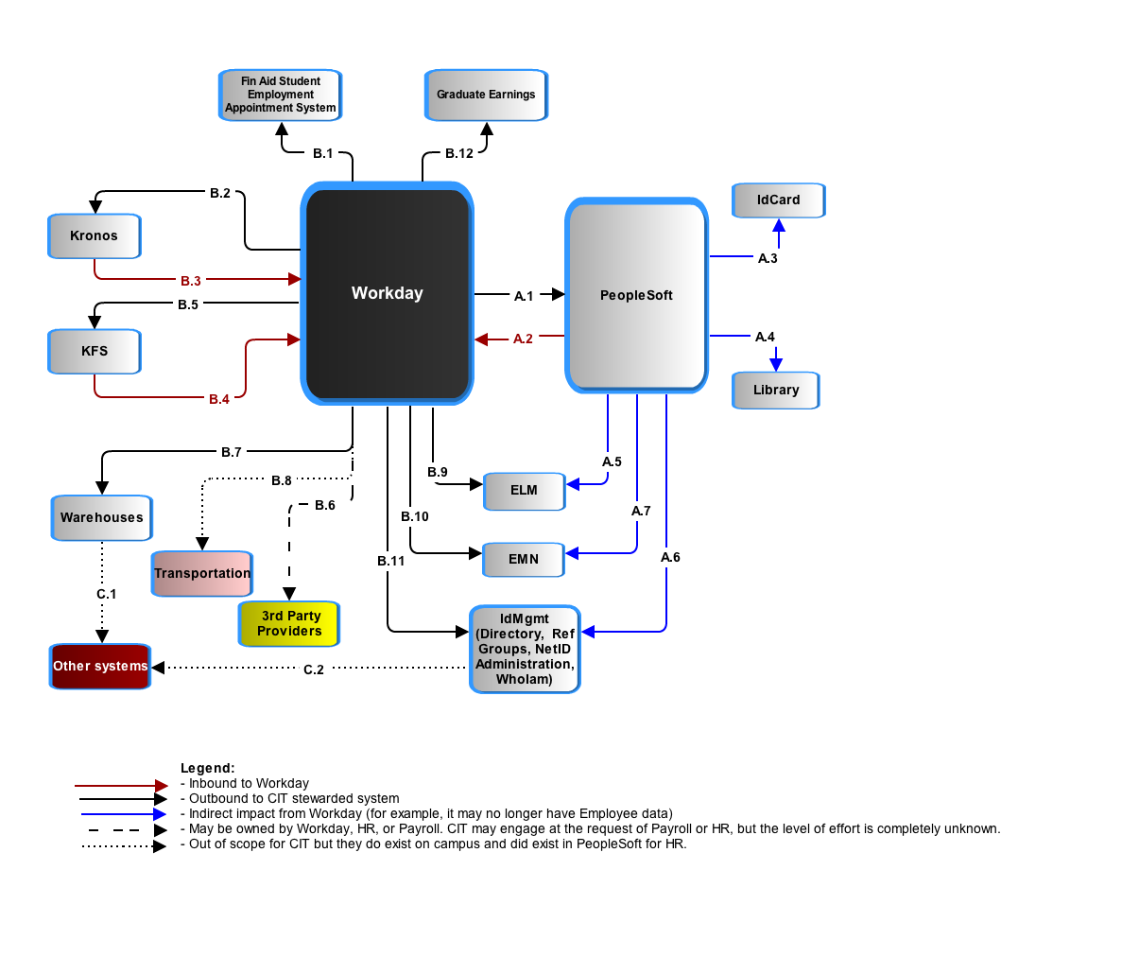
PeopleSoft and Workday have to jointly avoid duplicate people records and jointly manage the data of record for individuals who are employees and also students, prospects, or alumni. Currently, that is done in PeopleSoft as the delivered Search-Match function.

Slide 7
Cornell’s People Records in PeopleSoft
 |  | Total Population PERSON Record
 |  | 1,800,482
 | Total number of Employees |  | Total Number of Campus Solutions Persons |  | Total Number of Contributor Relations Persons
 | 116,723 |  | 1,182,270 |  | 473,080
 | Non-Student Employees |  | Students |  | Trustees and Affiliates
 | 65,449 |  | 229,417 |  | 5,062
 | Student Employees |  | Total Number of Applicants |  | Alumni and Related
 | 51,295 |  | 191,131 |  | 468,018
 |  |  | Total Number of Prospects
 |  |  | 761,722
*Person record counts are based on primary affiliation with the University. For example: A person who is an employee and a student was counted as an employee.

Slide 8

Search – Match and avoiding duplicate People records.
Conceptual
Conceptual
Not shown: A process for checking duplicates.
Notes:
----- Meeting Notes (5/5/11 09:12) -----
Add 'Conceptual' to the slide.
Doesn't show the duplication checking process.

Slide 9
PeopleSoft requires changes:
# setup type of tables that are impacted: 27
# of transactional type of tables that are impacted: 30
# of batch PS production control jobs to be decommissioned: 52

Slide 10
Assumption is that all people (employees and students) records, including bio/demo and basic status/affiliation with University will still exist in PS. The systems using this data from PS today should function post-Workday with little remediation. Those systems requiring more specific job/position data will require interaction with Workday as data of record for employee data. PS will continue to be data of record for student data.

Slide 11
Financial Aid packaging requires tracking of work study, award and gross pay earnings.

Slide 12
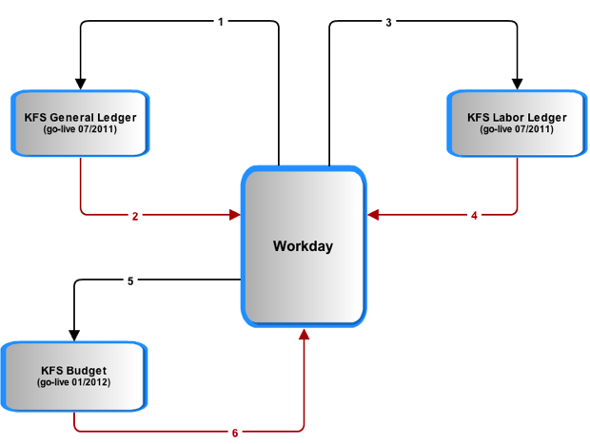
Notes:
1: liabilities
2: CoA
3: salaries and encumbrances
4: labor object codes
5: position distributions
6:

Slide 13
Warehouse and reporting:
Most operational reporting will be done straight from Workday. All historical analysis and merging/reporting with other institutional data requires a warehouse.
Not enough requirements or assumptions are known at this time to do anything other than compare the effort to that of the KDW.
IF the effort is similar to that of the Kuali Data Warehouse then it will be between 20000 and 30000 hours, which is ~ 2/3 of the overall IT estimate for Workday.
Some systems, such as Cornell Connect, Academic Personnel Database and Activity Insight for Academic reporting, are fed from the HR/PY datamart and will be affected by changes in the structure. Impact to these systems are not accounted for at this time.

Slide 14
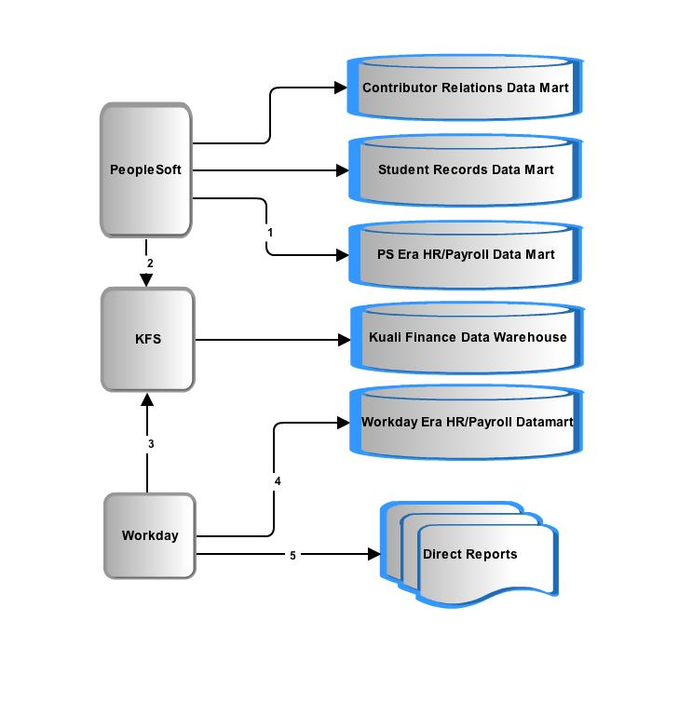
Data delivery: more questions than answers
Question 1: Do we keep our historical data as is or convert it?

Slide 15
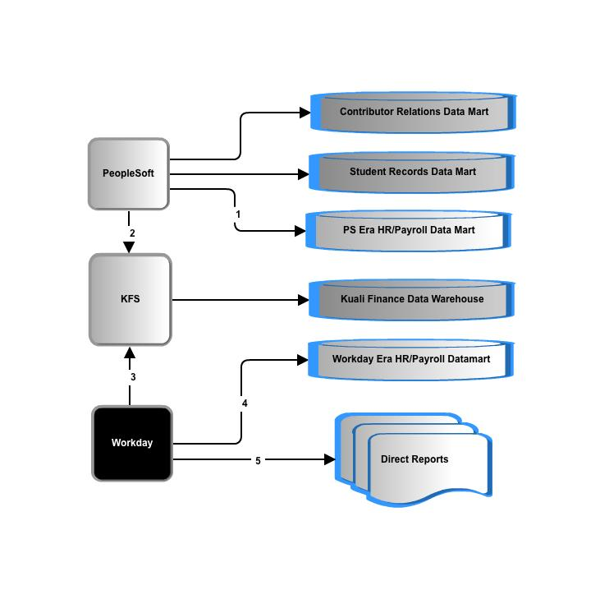
Data delivery: more questions than answers
Question 2: Workday data representation and extraction is unconventional and there is no data model or data dictionary. What is the process and effort extract, transform and load?
Question 3: What are the requirements of the new datamart?

Slide 16
3rd party oversight: Payroll has requested CIT help in overseeing/developing their Workday integrations and reports. Payroll is also seeking on-going support of all integrations and reports post-Workday go-live. It is not known yet what that entails in terms of number of integrations, actual responsibilities, or level of effort.

Slide 17
Kronos (time collection) :
Options:
  Kronos takes over all campus time collection. Upgrading Kronos to replace COLTS will require licensing, more training, more technical support and a project.
  or
  COLTS (not illustrated) has to be remediated.
CU requirements have and will continue to require custom a2a interface development.

Slide 18
Impact – Risks
Category of Risk | Risk of Failure
Reporting and Business Intelligence | Reporting over time, reporting with other data such as financial records is inadequate.
Cornell Community | Multiple enterprise systems will be the data of record for creation of “people”. Duplicate people, reporting, knowledge of primary affiliation to university, inaccurate data, duplicity of data and so forth will be issues the University will need to address technically and through business process definition.
Provisioning | All processes related to provisioning and de-provisioning a person within the Cornell community who spans multiple enterprise systems.
Time Collection | University has 2 time collection systems. Upgrade to one or both time collection systems imposes a significant risk to calculation of paychecks.
Resources
Notes:
Identity Management provisioning and troubleshooting NetIDs , reference groups is dramatically affected.
Time Collection: challenges and decisions
Technical troubleshooting : real-time and batch a2a between multiple large apps, one of which is SaaS means new tools, skills, knowledge, practices. This is different that other SaaS CU integrations we have now – more records, more processes, more real time means more impact when there is a problem.
Timeline: 12 months for time collection and reporting alone will present significant challenges.
----- Meeting Notes (5/5/11 09:27) -----
add risks for
- Interfaces... all the other systems stand up
- contextual data in Employee/ data- mapping,
- historical data in PS, data retention for W2s
- troubleshooting integrations
-W2s and puerto Rico

Slide 19
Impact – The Biggest Variables
  Data delivery for HR/PY: What is the end goal? What are the requirements? Just how different will the extract/transforms from Workday be? (Based purely on the KDW experience and plans, this is currently 2/3s of the entire technical cost estimate.)
  Time collection options: Kronos 100% or (remediate both COLTS and Kronos)?
  Integration options : point to point or through a SOA tool for CU <->Workday a2a traffic? (SOA is not included in the estimate at all so the default is point to point.)
  Payroll 3rd party integration advice: to what degree?
  Payroll: data modeling and report writing request

Slide 20
Estimate Subtotals
Category | Lower Estimate | Upper Estimate
Identify Management and IT Security | $212,000 | $318,000
Direct, Core Workday transactional impact | $1,067,000 | $1,853,500
Data deliver, warehouses and BI | $2,000,000 | $3,000,000
Niche or unit apps | $61,000 | $90,000
General Technical | $19,000 | $28,500
Consult/Advise Payroll | $30,000 | $37,500
Core CIT Technical work totals | $3,389,000 | $5,327,500
Based on $100/hour.
Not included:
Increased KRONOS license and support costs;
Additional contingency for contractors ($150 to $200/hour)
Changes to all systems dowstream of datamarts impacted by data mart changes;
All time for functional team members;
Technical Project overhead.
Notes:
----- Meeting Notes (5/5/11 09:27) -----
go with $100 an hour (non consulting) which makes it
----- Meeting Notes (5/5/11 09:30) -----
Add something about the burn rate and the

Slide 21
Estimate Subtotals
Category | Lower Estimate | Upper Estimate
Technical labor | $3,389,000 | $5,327,500
Kronos licenses , VMs, and 1st year support: | $410,000 | $410,00
Contingency for $150/ hour contractors for ½ of the work | $500,000 | $750,000
Changes to all down stream systems (a complete guess!) | $100,000 | $500,000
Technical Project overhead (15%) | $525,000 | $37,500
Most complete estimate | $4,924,000 | $6,615,000
Not included:
All time for functional team members;
Notes:
----- Meeting Notes (5/5/11 09:27) -----
go with $100 an hour (non consulting) which makes it
----- Meeting Notes (5/5/11 09:30) -----
Add something about the burn rate and the

Slide 22
Recommended next near-term steps
Continue planning and research
  Determine and resolve resource contentions with KFS and KC
  Determine scope of data delivery
  Prepare an implementation plan
  Prototype a few integrations technically
  Extend PS Meta Data analysis Consulting engagement, and try out 1 or 2 PS remediations

