Slide 1


A Technical Point of View
@
Data collection coordination and presentation
by Vicky Mikula and Steve Lutter

Slide 2
Topics to cover
Background and status
Impact to Business processes and technologies supporting those processes that CIT stewards.
  Diagrams
  Risks
  Biggest Factors
Tasks and Estimates
Recommended next steps

Slide 3
Background and status
April 2010
  Received our first introduction to Workday and did our first assessment.
November and December 2010
  Vicky Mikula (CIT/IS/ES) joins the HR Core Workday team as overall CIT Liaison.
January through April 2011
  CIT Charters a Discovery project, reverse engineers impact from PeopleSoft, and meets to track down other technical impacts.

Slide 4
Reverse Engineering PS
Page/function Navigation association to modules to tables is all available for harvesting.
Custom scripts by a Consultant extracted the meta data and found community tables used by HRMS and the HRMS tables used by each module.
The scripts reported the tables used in business process (navigation selections from the PS Portal) that are owned or used by HRMS functions and vica versa.
PS DB
Scripts
Excel
Excel
Excel
PS Code

Slide 5
Reverse Engineering PS
After 3 months of iterative development and validation the reverse engineering has delivered detailed reports of which CC tables are jointly used and which HRMS tables are used by which other PS modules.
PS DB
Scripts
Excel
Excel
Excel
PS Code

Slide 6
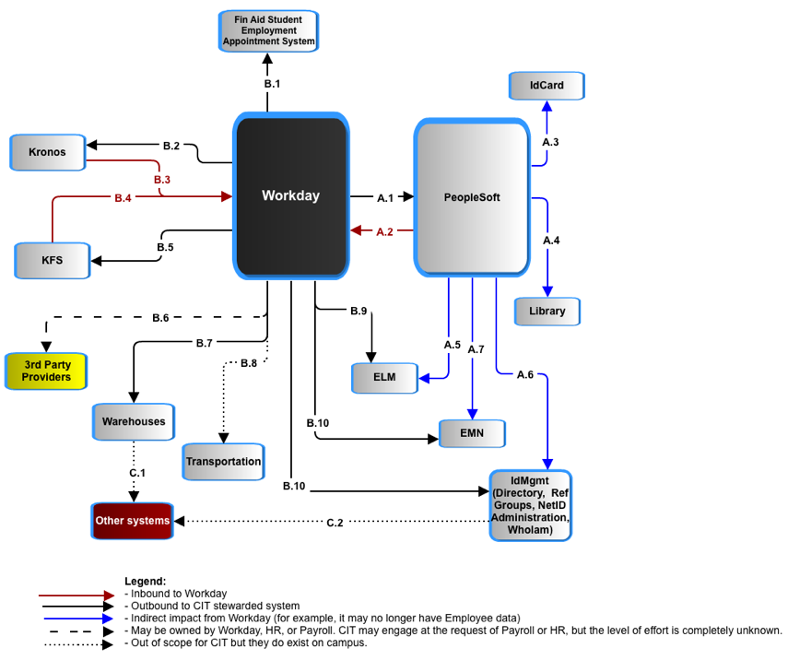
Impact – a System POV
Workday – Application to Application

Slide 7
Impact – a System POV
PeopleSoft and Workday have to jointly avoid duplicate people records and jointly manage the data of record for individuals who are employees and also students, prospects, or alumni. Currently, that is done in PeopleSoft as the delivered Search-Match function.

Slide 8
Cornell’s People Records in PeopleSoft
 |  | Total Population PERSON Record
 |  | 1,800,482
 | Total number of Employees |  | Total Number of Campus Solutions Persons |  | Total Number of Contributor Relations Persons
 | 116,723 |  | 1,182,270 |  | 473,080
 | Non-Student Employees |  | Students |  | Trustees and Affiliates
 | 65,449 |  | 229,417 |  | 5,062
 | Student Employees |  | Total Number of Applicants |  | Alumni and Related
 | 51,295 |  | 191,131 |  | 468,018
 |  |  | Total Number of Prospects
 |  |  | 761,722
*Person record counts are based on primary affiliation with the University. For example: A person who is an employee and a student was counted as an employee.

Slide 9
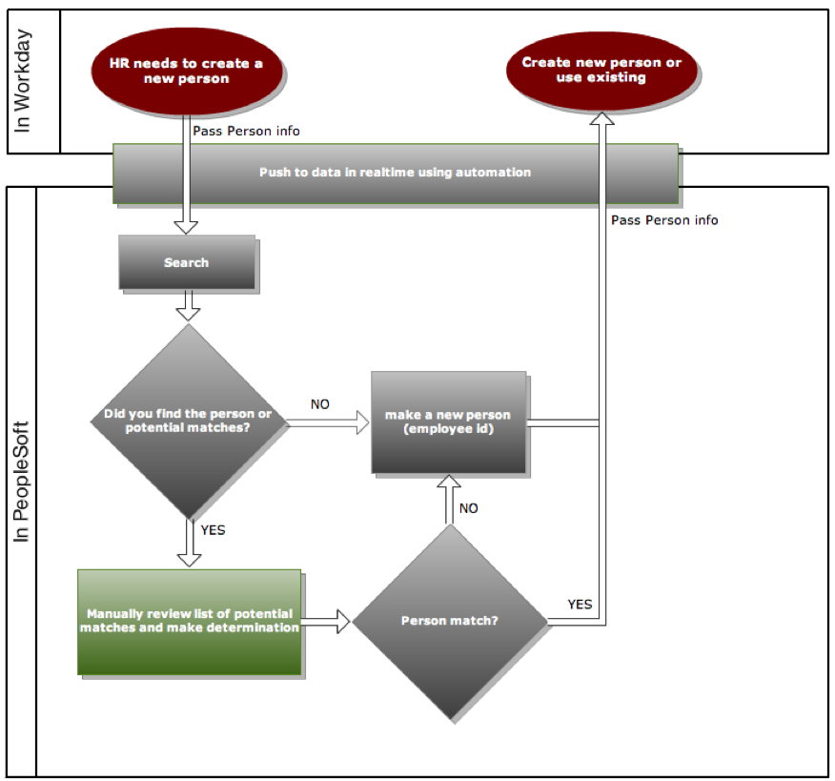
Search – Match and avoiding duplicate People records.

Slide 10
Impact – a System POV
PeopleSoft requires changes:
# setup type of tables that are impacted: <FILL THIS>
# of transactional type of tables that are impacted: <FILL THIS>
# of batch PS Jobs impacted and/or decommissioned: 52

Slide 11
Peoplesoft: HR and Campus community coupling
Admissions
HRMS
Recruitment
Finance
Student
Records
Campus
Community
Financial
Aid
Employment
Contributor
Relations
Shared use set up tables:<###>
Shared use transaction tables:<###>
Number of portal navigation functions/processes using them:

Slide 12
Peoplesoft: HR and Campus community coupling
Admissions
HRMS
Recruitment
Finance
Student
Records
Financial
Aid
Employment
Contributor
Relations
Shared use HRMS owned setup tables (e.g. Department):
Shared use HRMS owned transaction tables (e.g. Job):
Number of portal navigation functions/processes using them:
Shared use HRMS owned setup tables (e.g. Department): <###>
Shared use HRMS owned transaction tables (e.g. Job):<###>
Number of portal navigation functions/processes using them:

Slide 13
Impact – a System POV
Vicky, I want to make sure we’re clear on why EMN, ELM, and Idmgmt need two feeds from now on and why IdCard and Library still get one. I’m not happy with this text, but that was the intent.
ID Card and Library: Both the ID Card system and the Library require basic employee and student data and since they are tightly coupled to PeopleSoft it is best to have them get it from PeopleSoft.

Slide 14
Impact – a System POV
ELM (Enterprise Learning Management): It requires student and employee data for the variety of training tracking it does - human subject research training, emergency services, chemical handling, etc. So we need one new feed and the existing one from PS changes.

Slide 15
Impact – a System POV
Emergency Mass Notification: EMN requires student and employee emergency data be captured and sent for both students and employees. So we need one new feed (and UI to capture the data in Workday) and the existing one from PS changes. This is a staging database from which the outsourcer (not illustrated) gets a daily feed.

Slide 16
Impact – a System POV
IdMgmt toolset :
- Campus Reference groups
- the Directory
- WhoIam
- a set of NetID admin tools.
Student and Employee data will be coming from two sources now.
Vicky, Won’t the Primary affiliation have to be clear and in synch ion Workday and PS for these IdMgmt tools to work right? Is that important enough to mention here or on another slide?
HR attributes in the directory are used by other systems, such as Vivo. With Workday those attributes are likely to change, affecting such down stream systems.

Slide 17
Impact – a System POV
Warehouse and reporting:
Much operational reporting will be done straight from Workday. All historical analysis and merging/reporting with other institutional data requires a warehouse.
Not enough requirements or assumptions are known at this time to do anything other than compare it to the KDW.
IF the effort is similar to that of the Kuali Data Warehouse then it will be between 20000 and 30000 hours, which is ~ 2/3 of the overall IT estimate for Workday.
Some systems, such as Academic Personnel Database and Activity Insight for Academic reporting, are fed from the HR/PY datamart and will be affected by changes in the structure. Impact to these systems are not accounted for at this time.

Slide 18
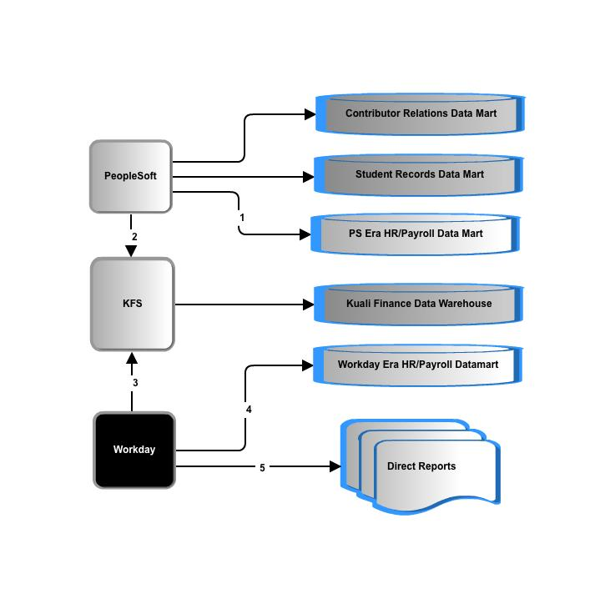
Data delivery: more questions than answers
Question 1: Do we keep our historical data as is or convert it?

Slide 19
Data delivery: more questions than answers
Question 2: What percentage of operational reports come directly from Workday and rely on Workday authorization data?

Slide 20
Data delivery: more questions than answers
Question 3: Workday data representation and extraction is unconventional and there is no data model, so what will it take to extract, transform and load?
Question 4: What are the requirements of this new datamart?

Slide 21
Data delivery: more questions than answers
Question 5: Finance reporting provides labor detail. Is there an impact to the KDW and labor reporting from a finance point of view?
Question 6: SRDM and CRDM make use of HR data. How extensive are the changes there?
Question 6: SRDM and CRDM make use of HR data. How extensive are the changes there?

Slide 22
Impact – a System POV
3rd party oversight: Payroll has requested CIT help in overseeing the interfaces that they are concerned with. It is not known yet what that entails in terms of number of interfaces, actual responsibilities, or level of effort.

Slide 23
Impact – a System POV
KFS (Kuali Finance):
Ships account data to Workday.
Gets transaction data for liabilities, gross pay, encumbrances.
Some transformation of the data between the two applications, as with all of these, should be expected.

Slide 24
Impact – a System POV
Kronos (time collection) :
Either Kronos takes over all campus time collection or COLTS (not illustrated) has to be redone. Upgrading Kronos to replace COLTS will require licensing, more training, more technical support and a project.
CU requirements have and will continue to require custom a2a interface development.

Slide 25
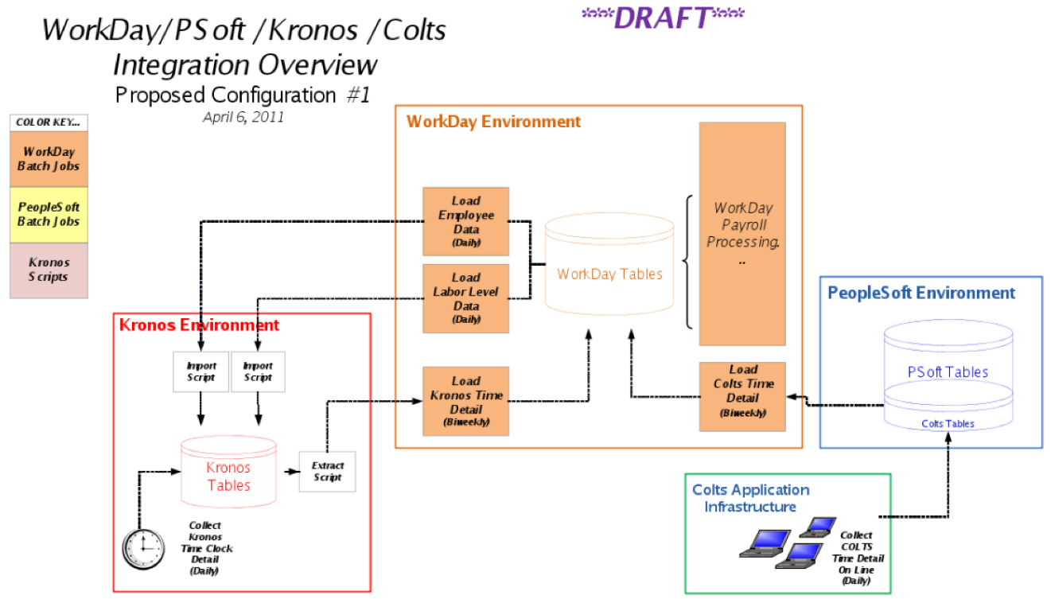
Workday and Cornell Time Collection
Question 1: Expand Kronos to all of campus and eliminate COLTS? Or redo COLTS for Workday?
Answer: If we plan on going to Kronos 100% within a couple of years anyway then decommission COLTS rather than fixing it for Workday just to decommission it shortly afterwards

Slide 26
Workday and Cornell Time Collection
Question 2: If we are keeping COLTS then .. Fix or rewrite it?
Answer: Rewrite it because of the tight coupling of COLTS and PS. And the bill is likely around $500 to $600K.

Slide 27
Workday and Cornell Time Collection
Question 3: What is the time frame needed for either the expansion of Kronos or the remediation or rewrite of COLTS?
Answer: Either way it is a solid year of effort.
Question 4: What are the TCO differences of the options?
Answer: This hasn’t been computed.
Kronos takes about .5 FTE for 4700 users.
COLTS takes .3 FTE for 9000 users.

Slide 28
Impact – a System POV
This Financial Aid Student Employment System takes some HR data for students in order to support their own appointment process.

Slide 29
Impact – Risks
  Campus Level Processes disrupted and/or redone:
    Reporting
    Identifying unique people (Search/Match)
    Core CR, Campus Community and Campus Solutions processes
      List the top 5 or so <<<<<<
    Identity Management provisioning and troubleshooting NetIDs , reference groups is dramatically affected.
    Time Collection
  Technical troubleshooting
  Timeline
I am looking for a way to summarize the largest processes at risk on this page. Maybe a table format is better. See the next slide and the notes below.
Notes:
Reporting: no strategy yet
Identifying unique people (Search/Match) requires a new design.
Core CR, Campus Community and Campus Solutions processes
List the top 5 or so <<<<<<
Identity Management provisioning and troubleshooting NetIDs , reference groups is dramatically affected.
Time Collection: challenges and decisions
Technical troubleshooting : real-time and batch a2a between multiple large apps, one of which is SaaS means new tools, skills, knowledge, practices. This is different that other SaaS CU integrations we have now – more records, more processes, more real time means more impact when there is a problem.
Timeline: 12 months for time collection and reporting alone will present significant challenges.

Slide 30
Impact – Risks
Systems | Processes | Scope of Risk
Reporting and Business Intelligence | All processes support by reporting | Reporting over time, reporting with other data such as financial records is inadequate.
PS<->Workday | Searching and matching records | We generate multiple records or assign ids to the wrong people.
PS/Workday <->Idmgmt | Netid creation, directory entries, group associations | All on boarding processes delayed and trouble prone.
Workday<->Time Collection | Hourly pay compensation and Accrual management | Payroll for hourly
Vicky, I am looking for a way to summarize the largest processes at risk on this page. Help!
Notes:
Reporting: no strategy yet
Identifying unique people (Search/Match) requires a new design.
Core CR, Campus Community and Campus Solutions processes
List the top 5 or so <<<<<<
Identity Management provisioning and troubleshooting NetIDs , reference groups is dramatically affected.
Time Collection: challenges and decisions
Technical troubleshooting : real-time and batch a2a between multiple large apps, one of which is SaaS means new tools, skills, knowledge, practices. This is different that other SaaS CU integrations we have now – more records, more processes, more real time means more impact when there is a problem.
Timeline: 12 months for time collection and reporting alone will present significant challenges.

Slide 31
Impact – The Biggest Variables
  Data delivery for HR/PY: What is the end goal? What are the requirements? Just how different will the extract/transforms from Workday be? (Based purely on the KDW experience and plans, this is currently 2/3s of the entire technical cost estimate.)
  Time collection options: Kronos 100% or (remediate both COLTS and Kronos)?
  Integration options : point to point or through a SOA tool for CU <->Workday a2a traffic? (SOA is not included in the estimate at all so the default is point to point.)
  Payroll 3rd party integration advice: to what degree?
  Payroll: data modeling and report writing request

Slide 32
High Level Estimates

Slide 33
High Level Estimates

Slide 34
Estimate Subtotals
Category | Lower Estimate in Hours | Upper Estimate in Hours
Identify Management and IT Security | 2120 | 3180
Direct, Core Workday transactional impact to CU systems | 10670 | 18535
Data deliver, warehouses and BI | 20000 | 30000
Niche or unit apps | 610 | 900
General Technical | 190 | 285
Consult/Advise Payroll | 300 | 375
Total | 33890 | 53275
Rounded Hours | 30,000 | 50,000
TOTAL IN FTE | 19.42 | 30.53
TOTAL in $ at $100,000 per FTE | $1,942,120 | $3,053,009
TOTAL $s ROUNDED UP | $1,950,000 | $3,060,000

Slide 35
Recommended next near-term steps
Continue planning and research
  Determine scope of data delivery
  Prepare an implementation plan
  Prototype a few integrations technically
  Extend PS Reverse Engineering Consulting engagement, and try out 1 or 2 PS remediations
  Clarify resource contentions with previously approved projects
  Figure out if SOA Oracle Suite is in the picture or not and if not if we can upgrade webMethods in time.

