Slide 1


A Technical Point of View
@
Data collection coordination and presentation
by Vicky Mikula and Steve Lutter

Slide 2
Topics to cover
Background and status
Impact to Business processes and technologies supporting those processes that CIT stewards.
  Diagrams
  Numbers
  Risks
Tasks and Estimates
  Must dos
  Options
Recommended next steps

Slide 3
Background and status
April 2010
  Received our first introduction to Workday and did our first assessment.
November and December 2010
  Vicky Mikula (CIT/IS/ES) joins the HR Core Workday team as overall CIT Liaison.
January through April 2011
  CIT Charters a Discovery project, reverse engineers impact from PeopleSoft, and meets to track down other technical impacts.

Slide 4
Reverse Engineering PS
Page/function Navigation association to modules to tables is all available for harvesting.
Custom scripts by a Consultant extracted the meta data and found community tables used by HRMS and the HRMS tables used by each module.
The scripts reported the tables used in business process (navigation selections from the PS Portal) that are owned or used by HRMS functions and vica versa.
PS DB
Scripts
Excel
Excel
Excel
PS Code

Slide 5
Reverse Engineering PS
After 3 months of iterative development and validation the reverse engineering has delivered detailed reports of which CC tables are jointly used and which HRMS tables are used by which other PS modules.
PS DB
Scripts
Excel
Excel
Excel
PS Code

Slide 6
Peoplesoft: # records
115K Employee records
Admissions
HRMS
Recruitment
Finance
Student
Records
Financial
Aid
Employment
1.8 Million People records
Campus
Community
1.2 Million student records
Contributor
Relations
470K Alumni records

Slide 7
Peoplesoft: HR and Campus community coupling
605 uses of 25 CC tables
by PS HRMS – some to all may be updates
Admissions
HRMS
Recruitment
Finance
Student
Records
Financial
Aid
Employment
98 CC Business
process references
of 10 HRMS owned
tables
Campus
Community
Contributor
Relations

Slide 8
Peoplesoft: CR and the rest tables
Admissions
HRMS
Recruitment
Finance
Student
Records
Financial
Aid
Employment
Campus
Community
585 uses of N
tables owned
by HRMR shown
by table or
by navigation.
585 uses of
tables owned
by HRMS - shown
by table or
by navigation.
Contributor
Relations

Slide 9
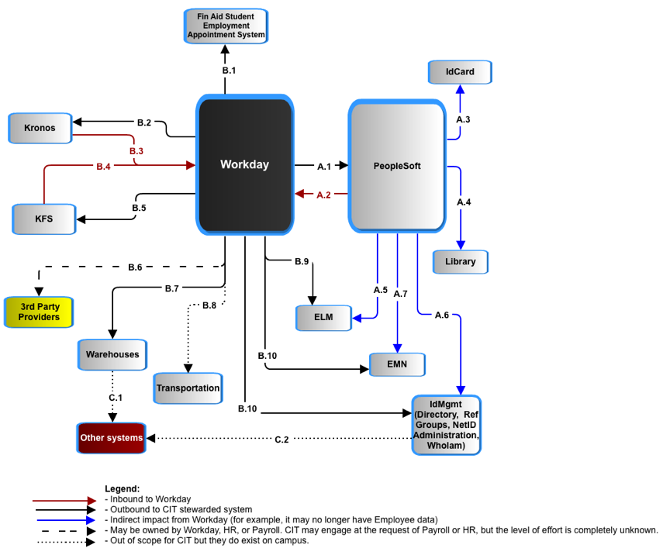
Impact – a System POV
Workday - System to System

Slide 10
Impact – a System POV
PeopleSoft and Workday have to jointly avoid duplicate people records and jointly manage the data of record for individuals who are employees and also students, prospects, or alumni. Currently, that is done in PeopleSoft as the delivered Search-Match function.

Slide 11
Impact – a System POV
PeopleSoft requires changes:
585 PeopleSoft business processes are impacted. 98 of those are in Campus Community. Numbers and impact are from reverse engineering PS meta data.
100s of PS Payroll batch jobs have to be decommissioned.

Slide 12
Impact – a System POV
ID Card and Library: Both the ID Card system and the Library require basic employee and student data and since they are tightly coupled to PeopleSoft it is best to have them get it from PeopleSoft.

Slide 13
Impact – a System POV
ELM (Enterprise Learning management): It requires student and employee data for the variety of training tracking it does - human subject research training, emergency services, chemical handling, etc. So we need one new feed and the existing one from PS changes.

Slide 14
Impact – a System POV
Emergency Mass Notification: EMN requires student and employee emergency data be captured and sent for both students and employees. So we need one new feed (and UI to capture the data in Workday)and the existing one from PS changes. This is a staging database from which the outsourcer gets a daily feed

Slide 15
Impact – a System POV
IdMgmt toolset: Campus Reference groups used by other applications, the Directory, WhoIam self service tool, and a set of NetID administration tools all work directly or from periodic feeds from PeopleSoft for all campus identity data. Student and Employee data will be coming from two sources now. This requires significant re-analysis and development. Another factor is HR attributes in the directory that are used by other systems, such as Vivo. With Workday those attributes are likely to change, affecting down stream systems.

Slide 16
Impact – a System POV
Warehouse and reporting:
Much operational reporting will be done straight from Workday. All historical analysis and merging with other institutional data requires a warehouse.
Not enough requirements or assumptions are known at this time to do anything other than compare it to the KDW.
IF the effort is similar to that of the Kuali Data Warehouse then it will be between 20000 and 30000 hours, which is 2/3s of the overall IT estimate for Workday.
Some systems, such as Activity Insight for Academic reporting, are fed from the HR/PY datamart and will be affected by a change in the structure. Impact to these systems are not accounted for at this time.

Slide 17
Impact – a System POV
3rd party oversight: Payroll has requested CIT help in overseeing the interfaces that they are concerned with. It is not known yet what that entails in terms of number of interfaces, actual responsibilities, or level of effort.

Slide 18
Impact – a System POV
KFS (Kuali Finance):
Ships account data to Workday.
Gets transaction data for liabilities, gross pay, encumbrances.
Some transformation of the data between the two applications, as with all of these, should be expected.

Slide 19
Impact – a System POV
Kronos (time collection) :
Takes over all campus time collection so COLTS doesn’t have to be remediated and we have 1 system and goes from 4000 to 12000 users. This will require licensing, more training, and more technical support.
CU requirements have and will continue to require custom a2a interface development.

Slide 20
Impact – a System POV
This Financial Aid Student Employment System takes some HR data for students in order to support their own appointment process.

Slide 21
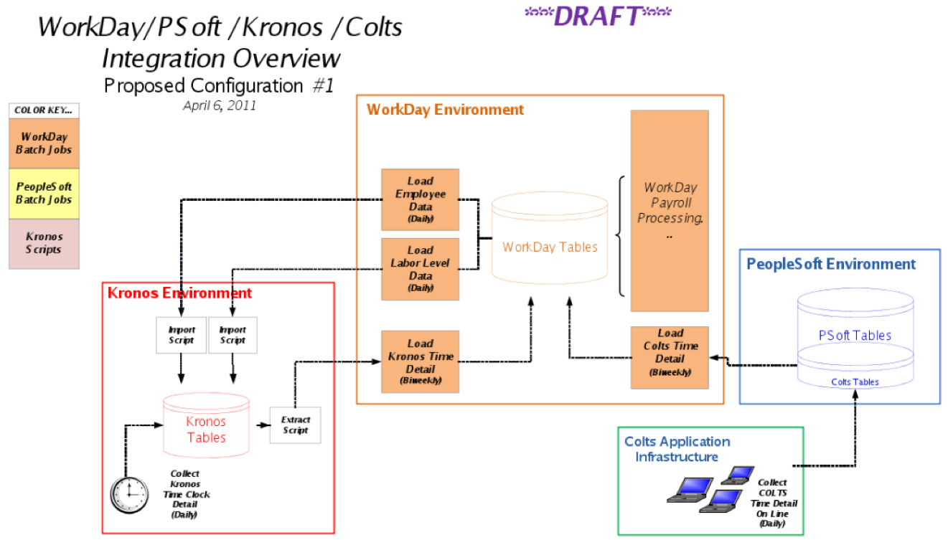
Workday and Cornell Time Collection
Question 1: Is COLTS better off being rewritten because of all the Payroll data it?
Answer: yes because of the tight coupling of COLTS and PS. And the bill is likely around $500 to $600K to redo it.

Slide 22
Workday and Cornell Time Collection
Question 2: Is it better to expand Kronos to all of campus and eliminate COLTS? (1 time system and no COLTS remediation /rewrite.)
Answer: If we plan on going to Kronos 100% within a couple of years anyway then YES.

Slide 23
Workday and Cornell Time Collection
Question 3: What is the time frame needed for either the expansion of Kronos or the remediation or rewrite of COLTS?
Answer:
Deploying Kronos to all of campus is likely around a year of effort because of the communication, training/support prep, data conversion, and upgrade needed. Redoing COLTS is also around 1 year of effort.
Question 4: What are the TCO differences of the options?
Answer: This hasn’t been computed.
Kronos takes about .5 FTE for 4700 users.
COLTS takes .3 FTE for 9000 users.

Slide 24
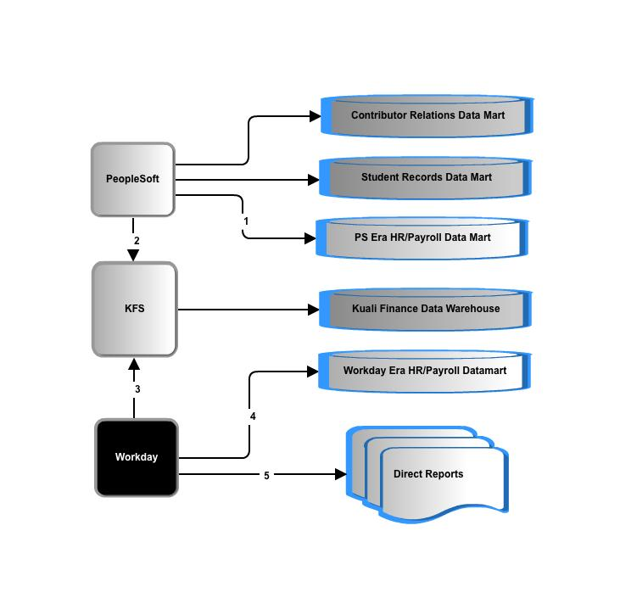
Data delivery: many questions
Question 1: Do we keep our historical data as is or convert it?

Slide 25
Data delivery: many questions
Question 2: What percentage of operational reports come directly from Workday and rely on Workday authorization data?

Slide 26
Data delivery: many questions
Question 3: Workday data representation and extraction is unconventional and there is no data model, so what will it take to extract, transform and load?
Question 4: What are the requirements of this new datamart?

Slide 27
Data delivery: many questions
Question 5: Finance reporting provides labor detail. Is there an impact to the KDW and labor reporting from a finance point of view?

Slide 28
Impact – The Biggest Variables
  Data delivery: no warehouse, some or improved? (currently 2/3s of the technical cost estimate)
  Time collection: Kronos or COLTS and Kronos?
  Integration : point to point or through a SOA tool?
  Payroll 3rd party integration advice: to what degree?
  Payroll: data modeling and report writing request

Slide 29
Impact – Risks
  Campus Level Processes disrupted and redone:
    Identifying unique people (Search/Match)
    Core CR, Campus Community and Campus Solutions processes
      List the top 5 or so
    Identity Management provisioning and troubleshooting NetIDs
    Time Collection: It is not vanilla Kronos.

Slide 30
Impact – Risks
  Known unknowns:
    Activity Insight (using HR data from the Directory and the HRPY DW)
    United Way
  Unknown unknowns:
    ?

Slide 31
High Level Tasks and Estimates

Slide 32
Recommended next steps
Master planning
Prototyping integrations.
Implementation sign off
Consulting engagement
…?

