Slide 1


A Technical Point of View
@
Data collection coordination and presentation
by Vicky Mikula and Steve Lutter

Slide 2
Topics to cover
Background and status
Impact to Business processes and technologies supporting those processes that CIT stewards.
  Basic Diagrams
  Biggest Numbers
  Biggest Risks
Technical Prerequisites
Best possible estimates at this time
Recommended next steps

Slide 3
Background and status
April 2010
  Received our first introduction to Workday and did our first assessment.
November and December 2010
  Vicky Mikula (CIT/IS/ES) joins the HR Core Workday team as overall CIT Liaison.
January through April 2011
  CIT Charters a Discovery project, reverse engineers impact from PeopleSoft, and meets to track down other technical impacts.

Slide 4
Reverse Engineering PS
Page/function Navigation association to modules to tables is all available for harvesting.
Custom scripts by a Consultant extracted the meta data and found community tables used by HRMS and the HRMS tables used by each module.
The scripts reported the tables used in business process (navigation selections from the PS Portal) that are owned or used by HRMS functions and vica versa.
PS DB
Scripts
Excel
Excel
Excel
PS Code

Slide 5
Reverse Engineering PS
After 3 months of iterative development and validation the reverse engineering has delivered detailed reports of which CC tables are jointly used and which HRMS tables are used by which other PS modules.
PS DB
Scripts
Excel
Excel
Excel
PS Code

Slide 6
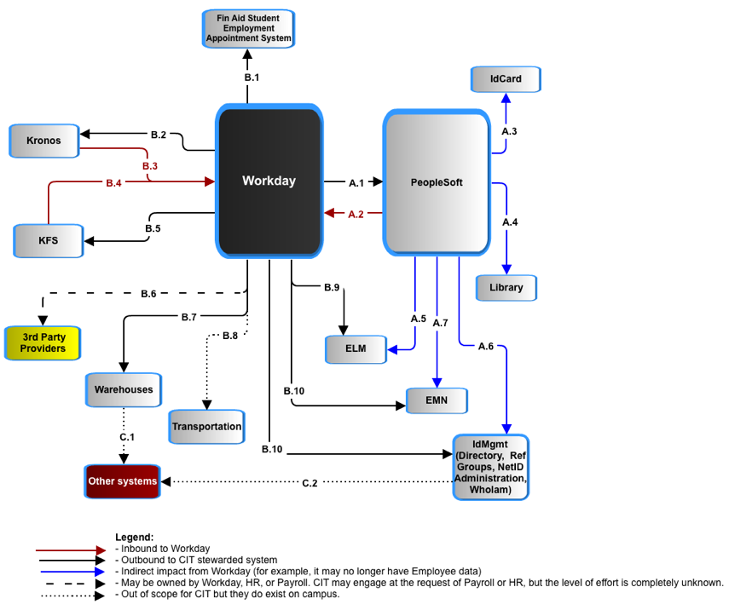
Impact – a System POV

Slide 7
Impact – a System POV
PeopleSoft and Workday have to jointly avoid duplicate people records and jointly manage the data of record for individuals who are employees and also students, prospects, or alumni. Currently, that is done in PeopleSoft as the delivered Search-Match function.

Slide 8
Impact – a System POV
PeopleSoft requires changes:
585 PeopleSoft business processes are impacted. 98 of those are in Campus Community. Numbers and impact are from reverse engineering PS meta data.
100s of PS Payroll batch jobs have to be decommissioned.

Slide 9
Impact – a System POV
ID Card and Library: Both the ID Card system and the Library require basic employee and student data and since they are tightly coupled to PeopleSoft it is best to have them get it from PeopleSoft.

Slide 10
Impact – a System POV
ELM (Enterprise Learning management): It requires student and employee data for the variety of training tracking it does - human subject research training, emergency services, chemical handling, etc. So we need one new feed and the existing one from PS changes.

Slide 11
Impact – a System POV
Emergency Mass Notification: EMN requires student and employee emergency data be captured and sent for both students and employees. So we need one new feed (and UI to capture the data in Workday)and the existing one from PS changes. This is a staging database from which the outsourcer gets a daily feed

Slide 12
Impact – a System POV
IdMgmt toolset: Campus Reference groups used by other applications, the Directory, WhoIam self service tool, and a set of NetID administration tools all work directly or from periodic feeds from PeopleSoft for all campus identity data. Student and Employee data will be coming from two sources now. This requires significant re-analysis and development. Another factor is HR attributes in the directory that are used by other systems, such as Vivo. With Workday those attributes are likely to change, affecting down stream systems.

Slide 13
Impact – a System POV
Warehouse and reporting:
Much operational reporting will be done straight from Workday. All historical analysis and merging with other institutional data requires a warehouse.
Not enough requirements or assumptions are known at this time to do anything other than compare it to the KDW.
IF the effort is similar to that of the Kuali Data Warehouse then it will be between 20000 and 30000 hours, which is 2/3s of the overall IT estimate for Workday.
Some systems, such as Activity Insight for Academic reporting, are fed from the HR/PY datamart and will be affected by a change in the structure. Impact to these systems are not accounted for at this time.

Slide 14
Impact – a System POV
3rd party oversight: Payroll has requested CIT help in overseeing the interfaces that they are concerned with. It is not known yet what that entails in terms of number of interfaces, actual responsibilities, or level of effort.

Slide 15
Impact – a System POV
KFS (Kuali Finance):
Ships account data to Workday.
Gets transaction data for liabilities, gross pay, encumbrances.
Some transformation of the data between the two applications, as with all of these, should be expected.

Slide 16
Impact – a System POV
Kronos (time collection) :
Takes over all campus time collection so COLTS doesn’t have to be remediated and we have 1 system and goes from 4000 to 12000 users. This will require licensing, more training, and more technical support.
CU requirements have and will continue to require custom a2a interface development.

Slide 17
Impact – a System POV
This Financial Aid Student Employment System takes some HR data for students in order to support their own appointment process.

Slide 18
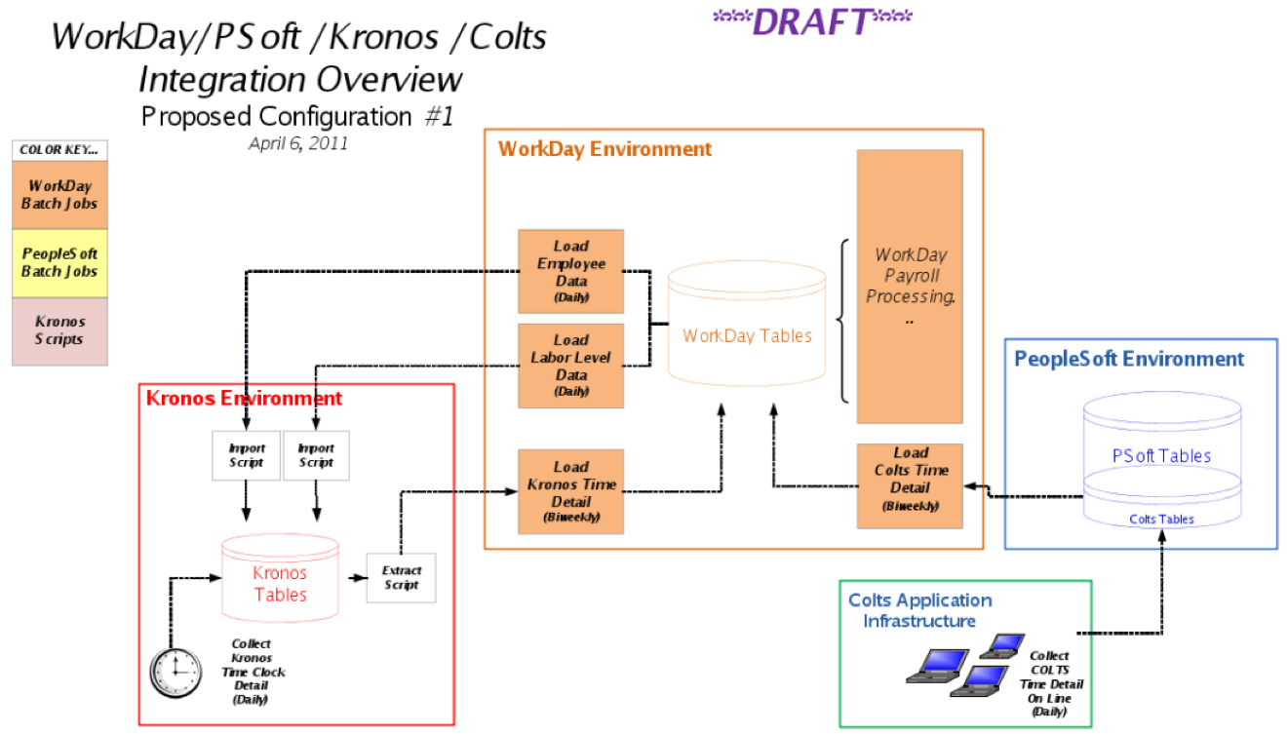
Workday and Cornell Time Collection
Question 1: Is COLTS better off being rewritten because of all the Payroll data it relies on in PeopleSoft?

Slide 19
Workday and Cornell Time Collection
Question 2: Is it better to expand Kronos to all of campus and eliminate COLTS? (1 time system and no COLTS remediation /rewrite.)

Slide 20
Workday and Cornell Time Collection
Question 3: What is the time frame needed for either the expansion of Kronos or the remediation or rewrite of COLTS?
Question 4: What are the TCO differences of the options?

Slide 21
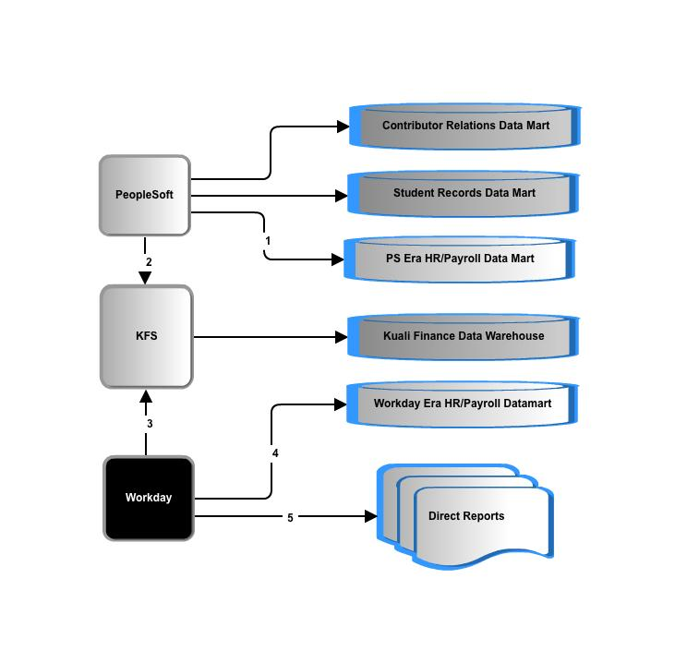
Data delivery: many questions
Question 1: Do we keep our convert our historical data as is?

Slide 22
Data delivery: many questions
Question 2: What percentage of operational reports come directly from Workday and rely on Workday authorization data?

Slide 23
Data delivery: many questions
Question 3: What are the requirements of this new datamart?
Question 4: Workday data representation and extraction is unconventional and there is no data model, so what exactly will it take to extract, transform and load?

Slide 24
Data delivery: many questions
Question 5: Finance reporting provides labor detail. Is there an impact to the KDW and labor reporting from a finance point of view?

Slide 25
PICK UP FROM HERE

Slide 26
Impact – The Biggest Variables
Largest Transaction system impacts
  PeopleSoft
  Identity Management
  Kronos or COLTS and Kronos
  Integration tools and governance
Data delivery impacts (2/3 of the overall estimate)
  Assumptions
  Open questions

Slide 27
Biggest Assumptions
Time collection: decommission COLTS and deploy Kronos for all time collection
PeopleSoft
  Function: Search and match of people
Identity Management
Reporting

Slide 28
Impact – getting a sense of the scale
Number of PeopleSoft PERSON records: 1.8 million
  # EMPLOYEE PERSON records: +115,000 (includes history)
  # STUDENT PERSON records: 1.2 million (includes history)
  # ALUMNI PERSON records: +470,000 (includes history)
  # of PeopleSoft Campus Community business processes impacted: 98
PeopleSoft Campus Community tables shared between HR/Payroll and Campus Solutions: ~25
PeopleSoft Campus Solutions/Contributor Relations business processes impacted: 585
PeopleSoft Production Control jobs to decommission: 57
Systems interfacing with PeopleSoft directly or indirectly that are affected to some degree: About 16
Interfaces (individual files, services called) to Cornell managed systems: 100s when including extracts to local warehouses.
External interfaces that Payroll requests IT oversight of: Unsure but probably less than 10.
Manual or automated Payroll programs/jobs in PeopleSoft to decommission: 100s.
Number of new Workday integration related batch programs/jobs to create, test and schedule and monitor: 100s (We are assuming that is similar to HR/Payroll jobs now)
Number of Payroll reports now: Unknown
Number of Direct Database connections by other applications to PeopleSoft that are affected: Dozens.
Number of Tables in PeopleSoft whose use, feed or definition will change: Less than 10

Slide 29
Impact – Risks
Point to a page in Confluence that will have risks categorized in some manner.

Slide 30
Technical Prerequisites
List ITSO, Integration, IdMgmt, Data delivery, and any other pure technical prerequisites

Slide 31
Estimates and Caveats
By CIT Group and effort and major FTE and method and margin of error…?

Slide 32
Recommended next steps
Master planning
Prototyping integrations.
Implementation sign off
Consulting engagement
…?

