Slide 1

Plate Settlers Spacing
Ying Zhang
Adela Kuzmiakova
Ashleigh Choi
Cosme Somogyi

Slide 2
Contents
Introduction
Theory
Experimental design
  Apparatus
  Data analysis
Results and Discussion
Conclusion and Future work
Questions

Slide 3
Introduction
Smaller spacing is better
  Reduces construction costs
  More uniform flow distribution
How much can we decrease the spacing?
Our hypothesis: Limit given by Floc roll-up theory
𝛼
Q_{plate}
Notes:
More uniform flow distribution

Slide 4
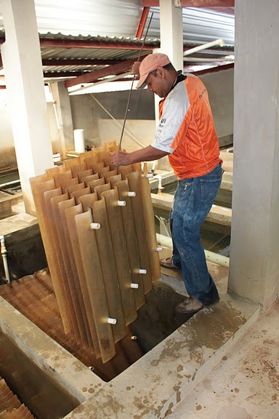
Introduction
Goal
Find optimal spacing for plate settlers
Traditional Guideline:
    Spacing = 5cm
    No scientific reason for using this
Notes:
Your team will receive full credit for the teach-in if new team members participate in speaking, good visuals are used to clearly convey the concepts your team is working with, you try to follow the suggestions posted on this page and you respect the time limits.
Don’t discuss why the height is the important
Tr

Slide 5
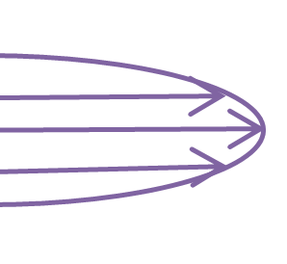
Theory
Key concepts to describe sedimentation:
Capture Velocity
Flow Condition
Floc Roll-up
S
L
𝛼
Q_{plate}
Notes:
- Draw boxes/change layout

Slide 6
Theory
Capture velocity
  The slowest settling velocity of a floc that will be
  captured
S
Particle size distribution
Capture
velocity
L
Carried out
Captured
𝛼
Q_{plate}
Settling velocity
Function of V_{up}, S, L, and α
Notes:
Capture velocity – only a definition

Slide 7
Theory
Flow Condition
  Parabolic flow profile
  Velocity gradient experienced by the particle near the wall function of Q_{plate}
  Parameter for comparing experiments
S
v_{z}
L
v_{α}
𝛼
Notes:
Speak about Q plate

Slide 8
Theory
Floc Roll-up
  A failure mechanism!
  Occurs when velocity at the bottom plate causes flocs to roll up plate settlers into the effluent.
S
L
𝛼
Q_{plate}
V_{fluid on particle edge}
V_{capture}

Slide 9
Theory
Floc Roll-up
  Predicted by a dimensionless parameter:
  Π_{v} < 1 suggests failure (smallest particle not captured)
  Π_{v} > 1 suggests success (smallest particle captured)
Notes:
Emphasize the “success condition” and “failure condition”.

Slide 10
Experimental Design
Small scale AguaClara plant with
  Constants, e.g.:
    Capture Velocity = 0.10 mm/s
    S=1/4” and =60˚
    Raw water turbidity = 100 NTU
    Plant flow rate = 300 mL/min
  Varying Parameters:
    Qplate ; Corresponds to different tubes Lengths (L)
  Measured: Turbidities
L
S
𝛼
Q_{plate}
Notes:
Looks like this slide is about Scaling down the real mechanism into an experimental design? (Cosme’s perception)

Slide 11
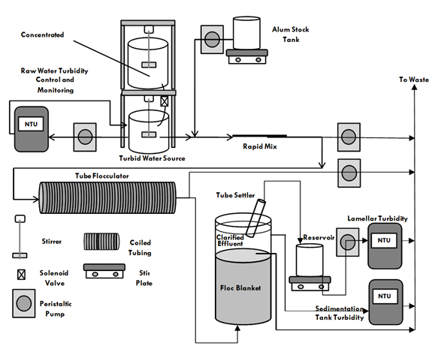
Apparatus
4 States
Raw Water Turbidity
Floc Blanket Formation
Loading State
Withdrawal state
Notes:
Draw boxes/change layout.
Emphasize on the turbidity measurements we collect

Slide 12

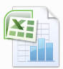
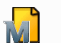

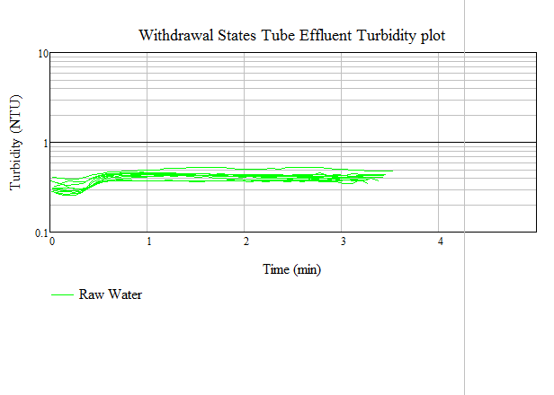
Data Analysis
Data
Raw data
Metafile (information about the experiment)
MathCAD
Collects data
Loading + Withdrawal
Calculations
Graphs
pC*
pC* vs vgrad
pC* vs Pi ratio
Statistics

Slide 13
Results and discussion constant v.capture=0.10mm/s
pC* vs velocity gradient
pC* vs pi ratio
Extra info:
  Reynolds number from 19 to 184 →Laminar
  Entrance region length from 4% to 6% tube length
Notes:
Relationships between % removal and velocity gradient (from experiment) and Pi ratio (from theory)
- change graphs
-re number
-entrance region length
negligible

Slide 14
Pi-ratio sensitivity
Sensitivity of the П ratio
Notes:
-on the field
-

Slide 15
Conclusions & Future work
Conclusions
  Smaller spacing are possible
    But limited by floc roll-up
    As velocity gradient increase, performance decreases (for constant V_{c}) – as expected
  Π_{v} can be used as a design parameter
Future work
  Experiments
    More data points in high velocity gradients
    Change Alum to PAC
Notes:
What have we done so far
what are the future implications/suggestions?
Link to the data. As we saw in the graph, …

Slide 16

Questions??

Slide 17
Appendix

Slide 18
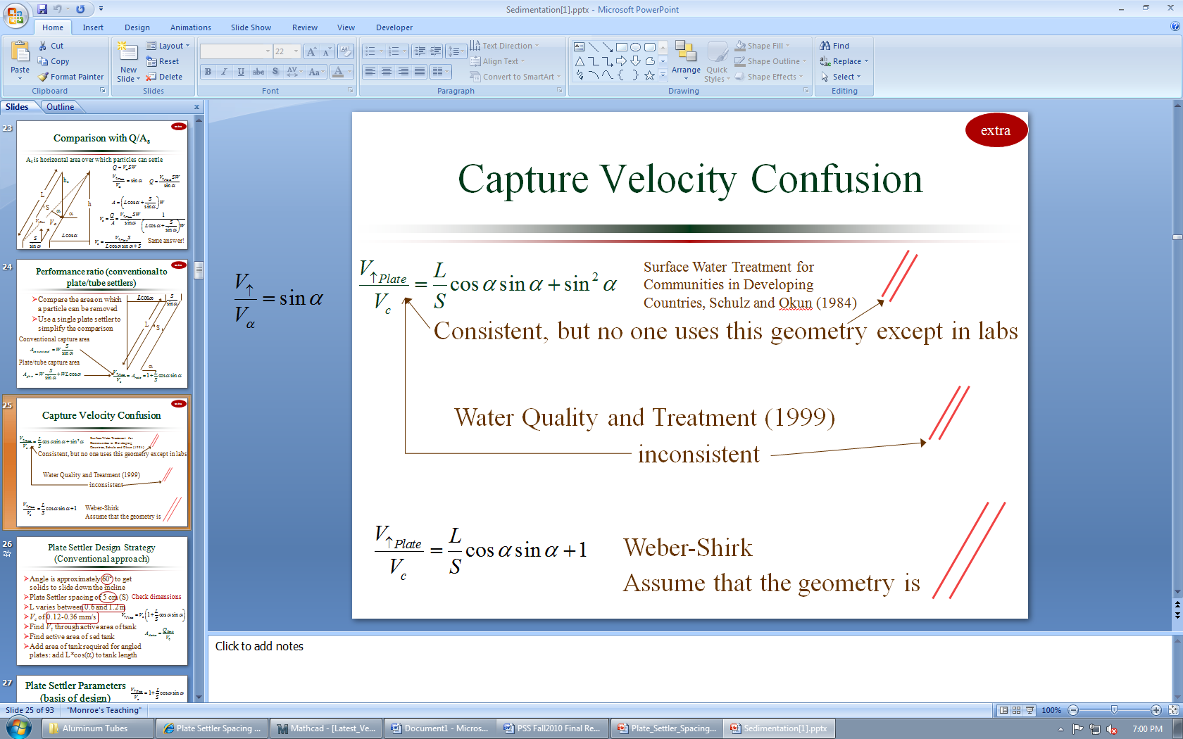

Appendix – Capture Velocity
L
L
S
S
𝛼
𝛼

Slide 19
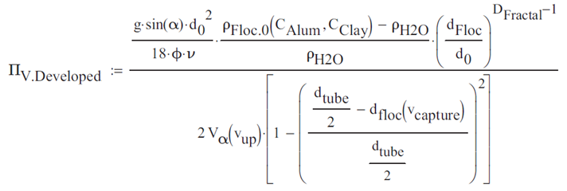
Appendix - Pi ratio

Slide 20
Appendix – Data analysis

Slide 21
Appendix– Data analysis

Slide 22
Appendix– Data analysis

Slide 23
Apparatus
Characteristics
  water influent
    100 NTU
  column upflow velocity
    ~10 m/day
  Clay Stock Concentration
    10 g/L
  Alum Stock Concentration
    18 g/L
  Alum dosage
    45 mg/L
  Plant Flow
    ~ 300 mL/min
  Alum Flow
    ~ 1.78 mL/min
Notes:
- Draw boxes/change layout

