Slide 1
Grassroots Initiatives Part III: VIVO
Career Development Week
May 17, 2011

Slide 2
VIVO as a grassroots initiative
Stimulus
Motivations
Response
Collaboration
Feedback
Commitment
Challenges
Complexities
Evolution
Community
Sustainability
Reflection

Slide 3
Stimulus
A significant faculty initiative
Issues touching libraries
A desire to engage
Encouragement to explore

Slide 4
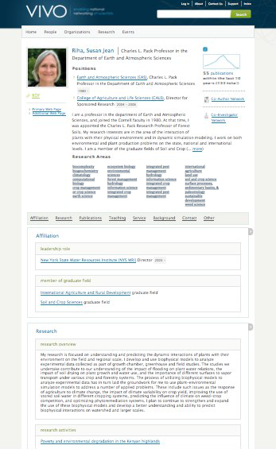
VIVO is:
An open-source semantic web application that enables the discovery of research and scholarship across disciplines in an institution.
Populated with detailed profiles of faculty and researchers; displaying items such as publications, teaching, service, and professional affiliations.
A powerful search functionality for locating people and information within or across institutions.
Notes:
What is VIVO?
It’s a semantic web application with consistent contextual rich profiles that display publications, teaching, service and professional affiliations. Faceted search for fast and meaningful results.
---------
Foster team science by providing tools for identifying potential collaborators.
Improve collaboration by creating tools using this information for enhancing new and existing teams.
Not limited to science – at Cornell, VIVO covers all disciplines across the entire institution

Slide 5
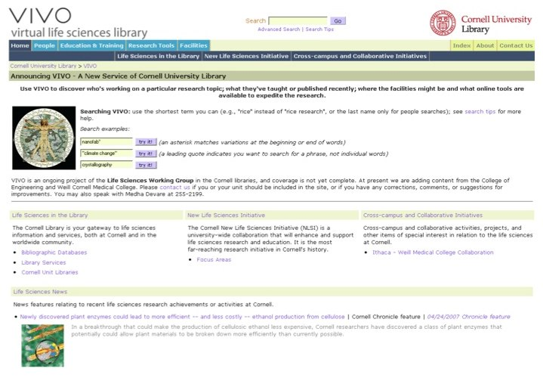
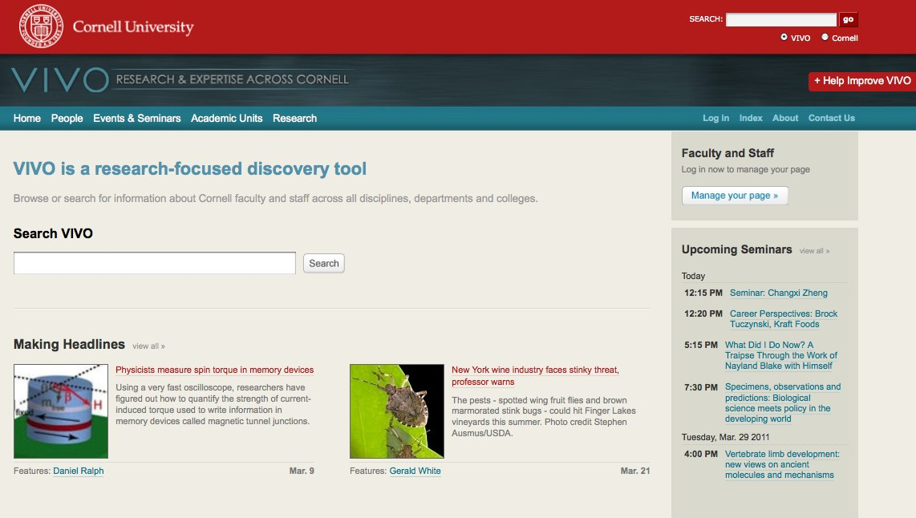
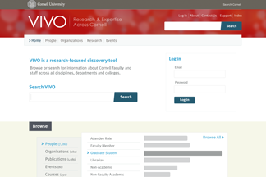
VIVO Cornell: In-house to National Cloud
2003-2007 Development of research profiles using ontologies in a database-driven website to meet the needs of the Life Sciences initiative.
2007-2009 Converted to Semantic Web standards. Expanded to include disciplines across the institution
2009–2011+ NIH grant, moved to national and international network of institutions and organizations and their faculty and researcher profiles
Notes:
Bridge between campuses

Slide 6

A Library-based Support Model
Libraries
Are a trusted, neutral entity
Have a tradition of service and support
Strive to serve all missions of the institution
Are technology centers and have IT and data expertise
Librarians
Have skills—information organization, instruction, usability, subject expertise
Have close relationships with their clients (buy in)
Understand user needs
Understand the importance of collaboration and know how to bring people together
Have knowledge of institution, research, education, clinical landscape
Notes:
Part of the solution
Libraries are posed to meet participation challenges due to their role on campus as information resource and technology centers.
Librarians are subject matter experts, understand their user’s needs and institution’s research environment.
In VIVO-funded institutions, the librarians are the ones negotiating with the owners of local data sources to explain what data we need and why we need it.
The library is a stable and natural home for VIVO, but the implementers need to work closely with the institution’s administration and faculty.

Slide 7
Motivations
“New life sciences” – changing patterns of research and teaching
New urgency to interdisciplinary activities
Faculty and student recruitment
Many layers of issues – informatics, ethics

Slide 8
Response
Recognition of relevance to libraries
  Information access
  Informatics and text mining
  Training needs for librarians and students
  Faculty reaching out beyond home departments
Life Sciences Working Group
New bioinformatics librarian position

Slide 9
Collaboration
Ideas already circulating
  FRBR, Dublin Core
  IMLS proposal
  Mann connection to UN FAO
  ABC ontology
Life Sciences Working Group approach
  Training and information access as well as web focus
  Visits to labs and other outreach

Slide 10
Feedback
Early response to web pages not predicated on reflecting administrative structure
Recognition that the web is not a translation of a print brochure
Can we expand?
Can we filter?

Slide 11
Commitment
This has taken a lot of effort by a lot of people
  Life Sciences Working Group
  CALS portals team
  Social Sciences, Veterinary/Medical, Environmental Sciences, and Humanities curators
  Coordinators
  Program aides, data specialists, programmers
Support by leadership in the library and Cornell

Slide 12
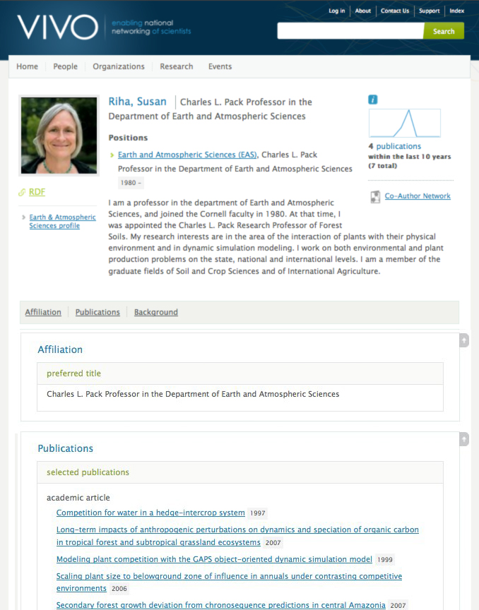
Notes:
Hr
Manual
Faculty reporting tool
OSP
Registrar

Slide 13
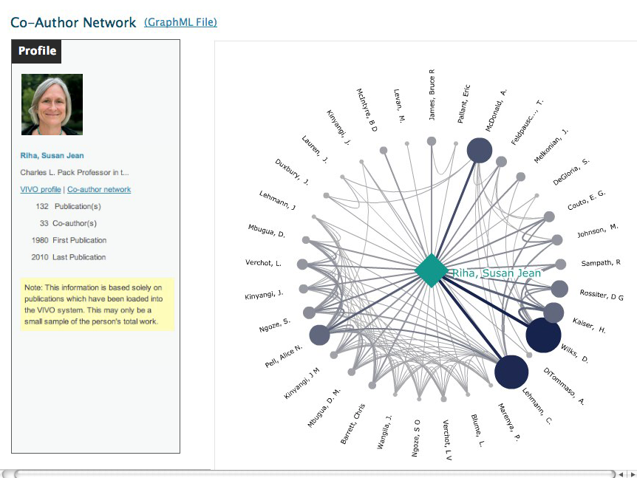

Slide 14
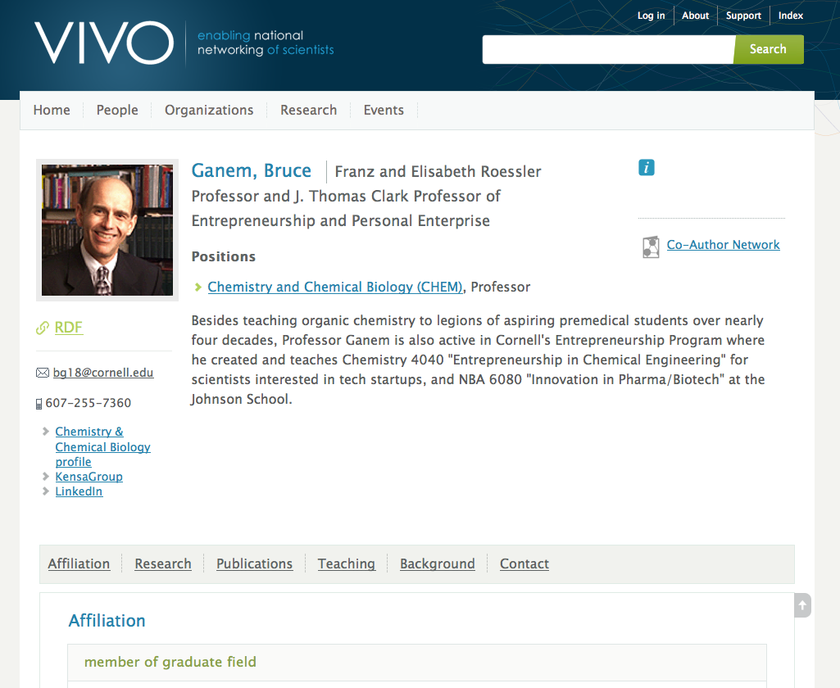
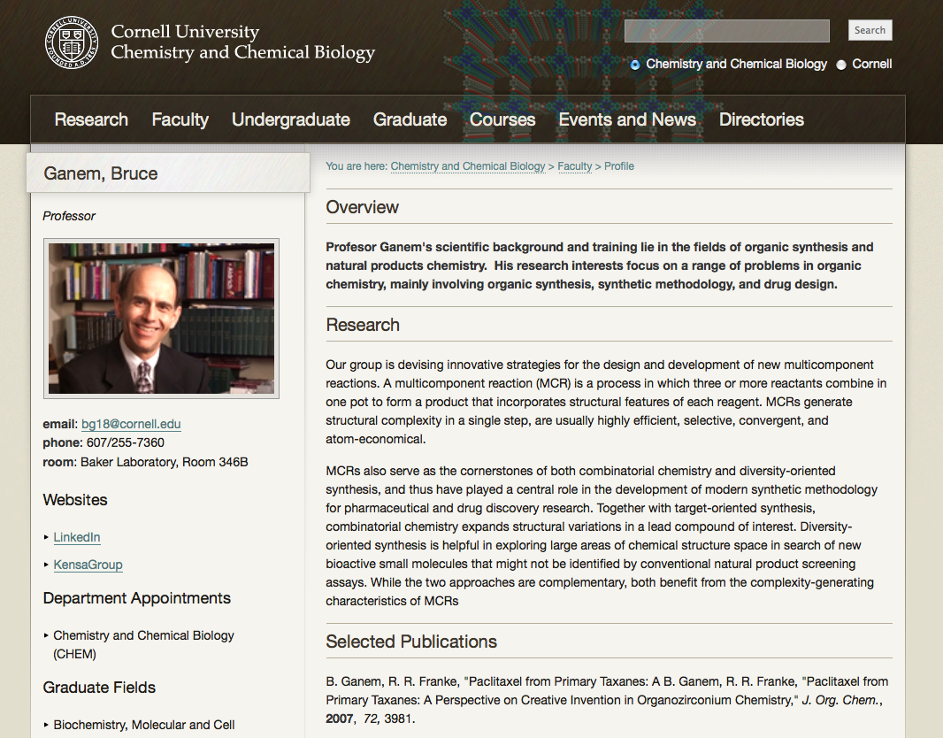

Slide 15
Challenges
The idea is simple, but the execution is not
Pushes a lot of envelopes
Pushes a few buttons
  “I am not VIVO”
Writing our own tools, eating our own dog food
Landscape in motion
  Facebook, Linked in, data mining, mobile devices

Slide 16
Complexities
Data boundaries (there aren’t)
  Portals
Sensitivies
  Research trends vs. performance metrics
Overlapping initiatives
Institutional change

Slide 17
Evolution
Linked Open Data
Moving beyond one institution
  Multiple campuses
  Consortia
Integration/interoperability
  Institutional repositories
  Preprint services
  Research data sharing, publication, and discovery

Slide 18
Community
Moving a project from 5 to 120 people
Moving to community open source development
  Ceding control
  Welcoming new initiative
Reaching out at Cornell
  Communications and outreach
  Reimagining IT

Slide 19
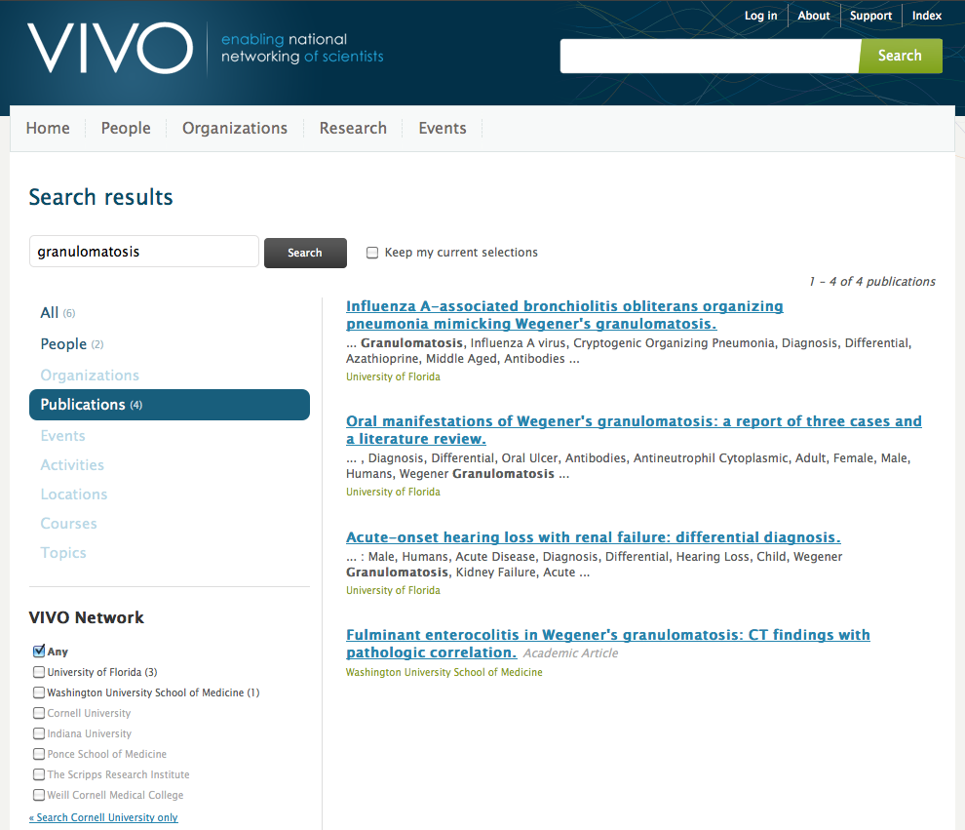

Slide 20
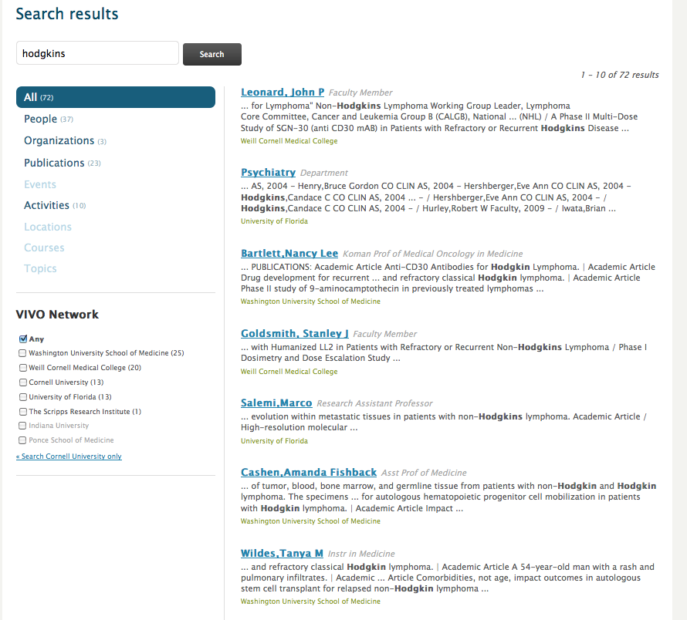

Slide 21
Sustainability
After the grant
As part of what this library does
As part of the fabric of what libraries do
  Distributed repositories, virtual collections, annotations
  LOD a frequent topic at conferences
Transition to more collaborative approaches
  2CUL
  Hathi Trust

Slide 22
Reflection
Projects like this never wrap up neatly
Risks continue
Resources are required
Personnel must change
Individual efforts make the difference
Encouragement and teamwork help make it through the hard parts
Something new and even better will come along

Slide 23
Questions
What have we learned?
What could we have done instead?
What good ideas have we overlooked?
How do we assess what worked? what didn’t?
What should we be focusing on now?

