Slide 1

Participation in the international DDI Alliance
CUL Career Development Week 2011
Stefan Kramer
Research Data Management Librarian
Cornell Institute for Social and Economic Research (CISER)

Slide 2

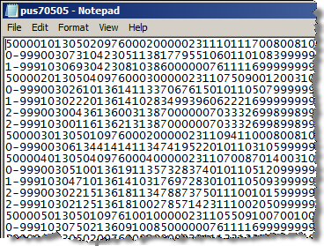
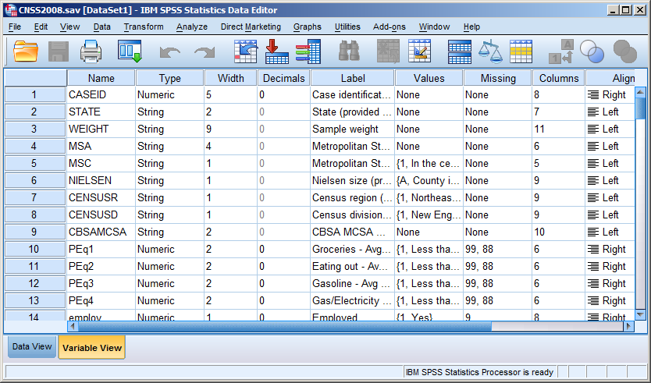
A problem with the searchability and discoverability of (numeric) social science microdata: it’s either meaningless (without external documentation) or in a proprietary format (cannot be read without the associated software):

Slide 3
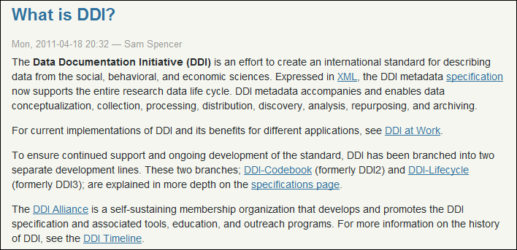
Enter the Data Documentation Initiative
From http://www.ddialliance.org/what

Slide 4
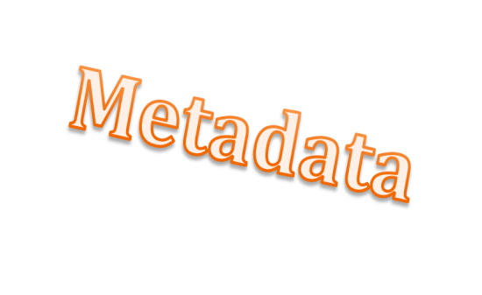
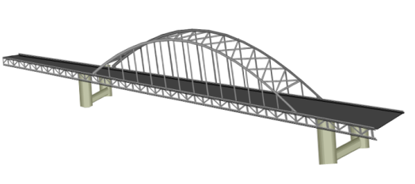
Lifecycle of Research Data
Research study is conceived and planned, methodologies selected, funding sources explored
Idea
By search tools utilizing metadata from data stores, new research data becomes available for finding and exploring by researchers
For some projects, existing data sources may be sought and explored
Search & Discovery
Ideally begins early in data lifecycle to assure long-term preservation and access of data.
Data management
Measurement instruments are designed, developed, acquired; data are collected through appropriate methodologies
Collection
Archiving
Final datasets are deposited for long-term preservation – e.g., into institutional or domain repository
Collected data are merged, cleaned, analyzed, subsetted, coded, harmonized, linked, etc.
Analysis & Processing
Publication
Final datasets are made publicly accessible – e.g. via researcher’s and/or department’s and/or journal publisher’s web site
Based on slide from: http://hdl.handle.net/1813/17472

Slide 5
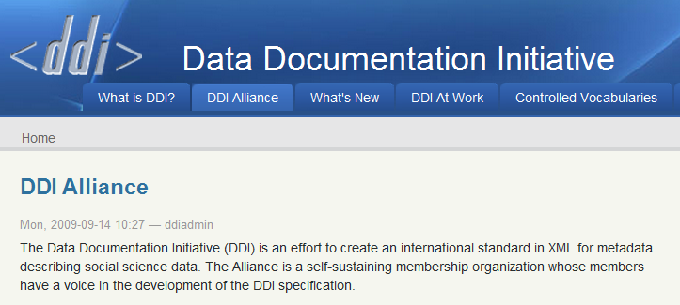

Slide 6
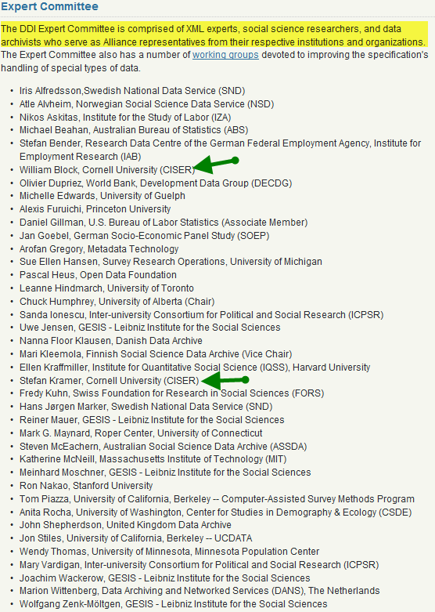
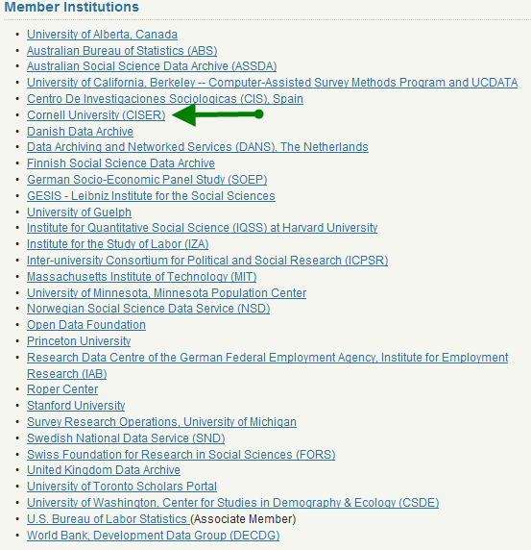
DDI Alliance members: (primarily) national statistical offices and data archives; universities; research institutions from USA, Canada, Australia, Europe

Slide 7
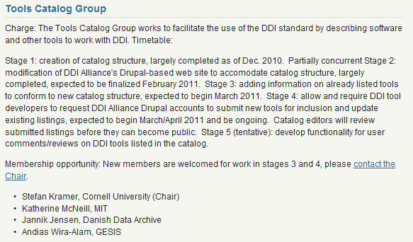
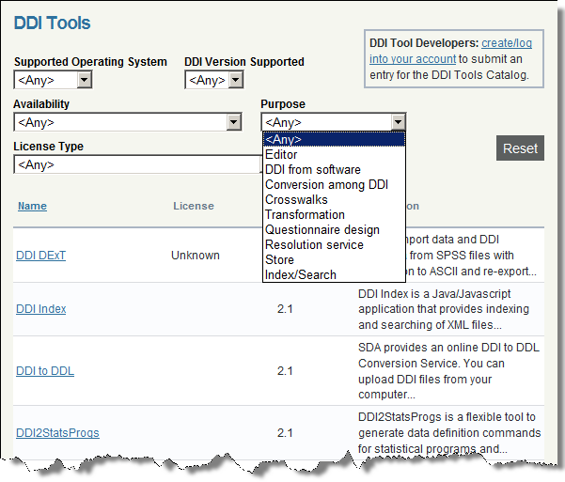

Slide 8
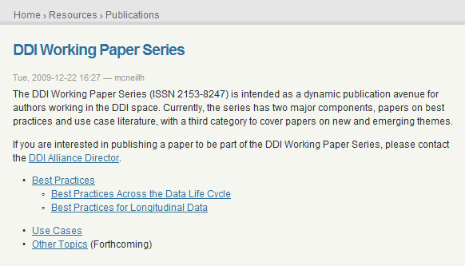
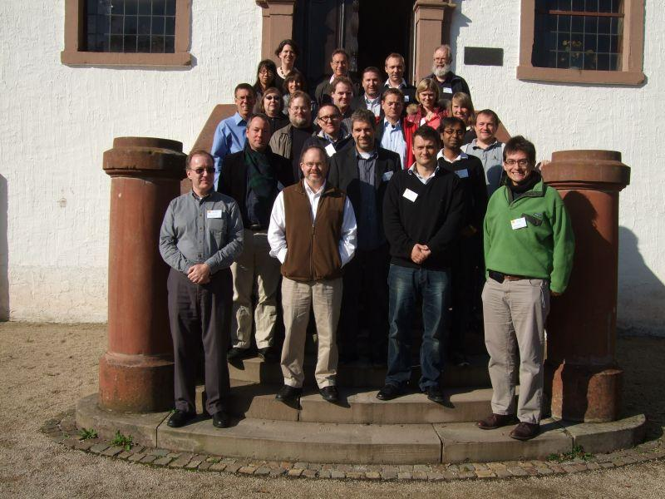


Slide 9
Thank you for your time & attention!
Stefan Kramer
stefan.kramer@cornell.edu

