Slide 1
Food Safety, Quality and Consumer Protection
Saeed Hayek, M.S.
Graduate research assistant
Food Microbiology and Biotechnology Laboratory
North Carolina A & T State University

Slide 2
Food Safety:
What?
Why?
How?
Where?
Safe, Hazard, and Risk

Slide 3
What is Food Safety?
Food safety: refers to all those hazards that may make food harmful to human health.
Food safety: absence any substance that may make food harmful to health on an acute or chronic basis
Such as: contaminants, adulterants, or naturally occurring toxins.
It is not negotiable

Slide 4
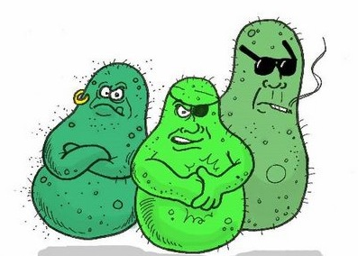
Why Food Safety?
Health
Illnesses
Deaths
To ensure that the food supply is safe
Minimizing food contamination
Safety concerns critical for consumers

Slide 5
How Food Safety?
Proper food safety guidelines
Sanitation Process: follow a general cleaning and sanitation system
Pest Control: Does the facility have pest control system

Slide 6
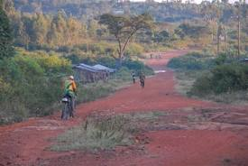
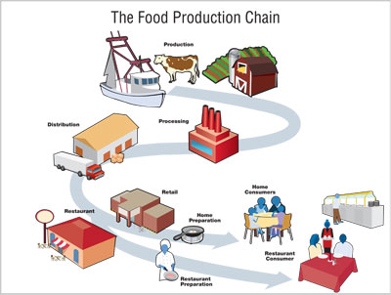
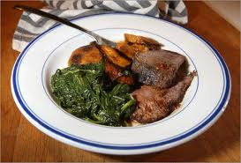
Where Food Safety?
Farm To Table
Eat Like a Peasant and Enjoy

Slide 7
Safe, Hazard, and Risk
Safe: Nothing harmful when consume the food
Hazard: Is the capacity of things to cause harm
Risk: Probability of that harm to occur
GOAL-GOAL-GOAL
Reduce risk to unacceptable or improved level

Slide 8
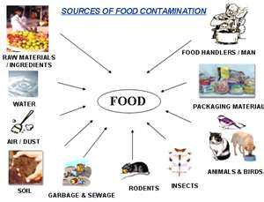
Sources of food Hazard

Slide 9
Harmful conditions:
Biological …. Salmonella, E. Coli
Chemical ….Pesticides, Lead, Mercury.
Physical …. Glass, Metal.
Most important is the biological

Slide 10
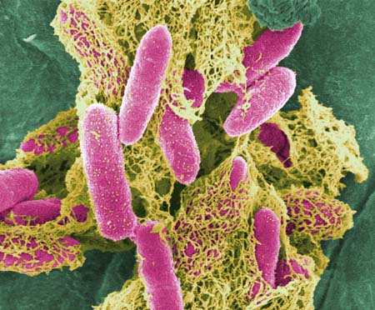
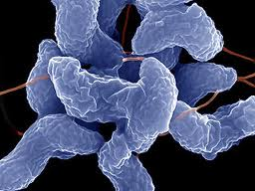
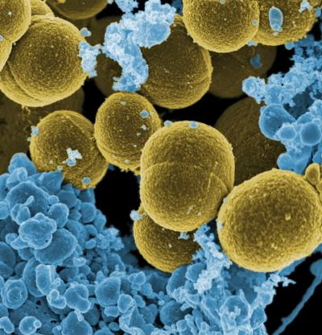
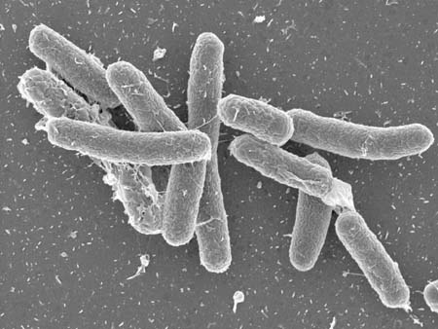
E coli O157:H7
Campylobacter jejuni
Staphylococcus
aureus
Salmonella
enteritids

Slide 11
WARNING!!!!!!!!!!!!
Deaths and Illnesses Caused by Food Contamination
Foodborne illness causes an estimated 48 million illnesses
and 3,000 deaths each year in the United States by eating contaminated food. (USDA report May 24, 2011)

Slide 12
COST OF FOODBORNE ILLNESS IN THE UNITED STATES
Bacterial | Cases | Cost Per Case ($) |  | Total Cost ($ Millions)
Campylobacter spp. | 2,112,302 | 8,901 |  | 18,803
Salmonella spp | 1,597,947 | 9,146 |  | 14,609
Staphylococcus | 254,121 | 163 |  | 163
E. coli O157:H7 | 66,905 | 14,838 |  | 993
Listeria monocytogenes | 5,205 | 1,695,143 |  | 8,823
Others (22 different Bacteria, Parasites, and Viruses) |  |  |  | 108,235
Total Cost |  |  |  | 151,626
Scharff R 2010. From foodborne illness in the united states. Produce Safety Project. March 3, 2010:1-28. http://www.producesafetyproject.org/admin/assets/files/Health-Related-Foodborne-Illness-Costs-Report.pdf-1.pdf. Accessed 13 February 2011.

Slide 13
Good to know:
Symptoms food contamination:
flu-like symptoms
nausea
vomiting
diarrhea
fever
Within minutes to weeks

Slide 14
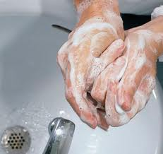
Hand Washing
The first line of defense against disease.
38% food contamination from improper hand washing.
Supervisors should practicing appropriate hand washing.

Slide 15
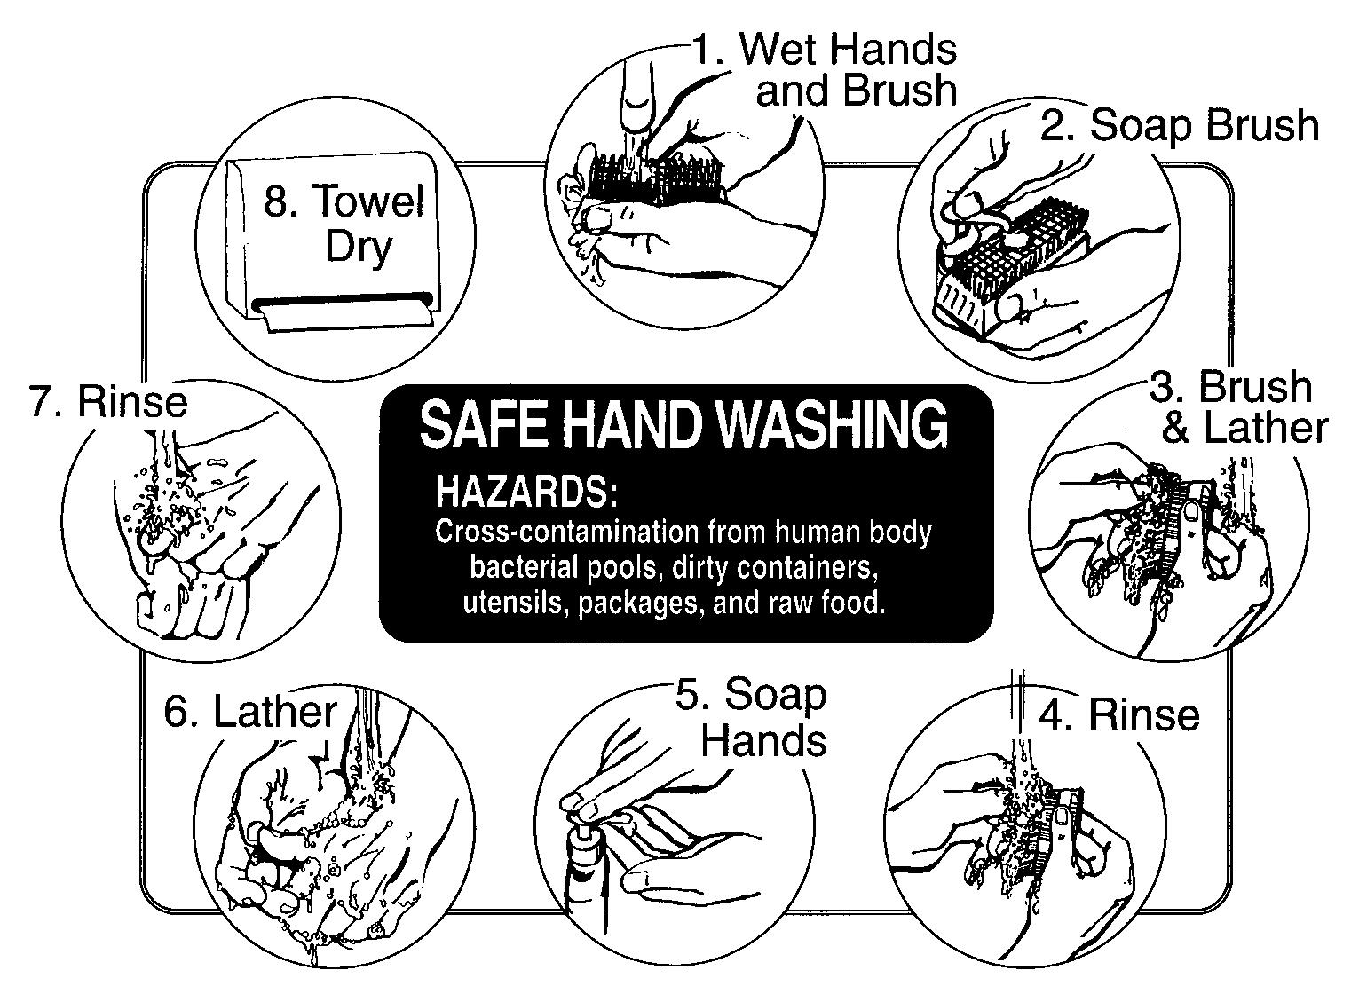

Slide 16

Thank you
Eat safe
and
enjoy
Saeed Hayek

