Slide 1
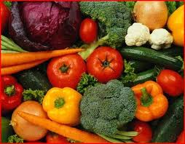
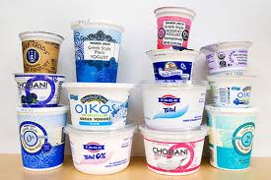
Functional Foods
Rabin Gyawali
NC A&T State University
December, 12, 2012

Slide 2
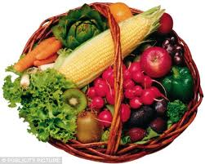
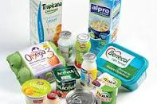
What is functional food?
Foods that provide positive effect beyond basic nutrition.

Slide 3
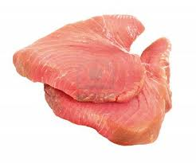
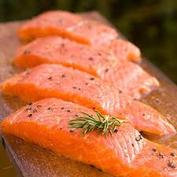
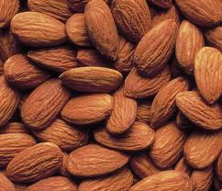
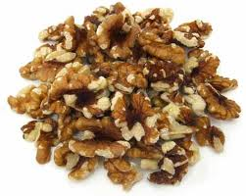
Functional foods
I. Meats and Nuts
Tuna
Salmon
Almonds
Walnuts

Slide 4
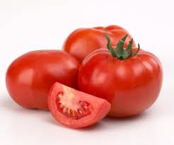
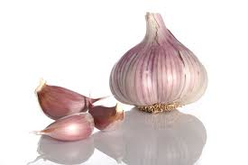
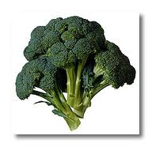
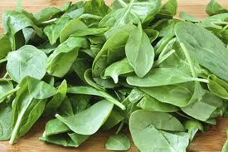
II. Vegetables
Tomatoes
Source of many nutrients
Contain lycopene
Reduce risk of chronic diseases

Slide 5
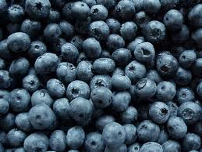
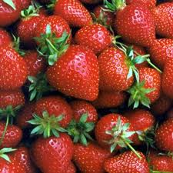
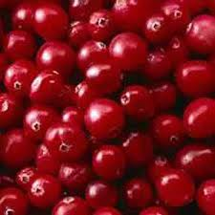
III. Fruits
Berries are loaded with antioxidants
Reduces the risk of cancer and heart disease

Slide 6
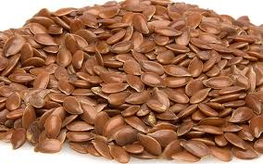
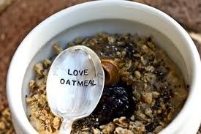
IV. Grains
Source of many nutrients including fiber
Flaxseed
Oatmeal

Slide 7
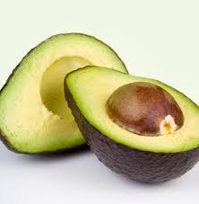
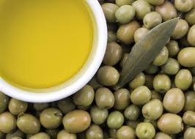
V. Fats
Contain heart healthy fat
Omega-3 fatty acids
Avocado
Olive oil

Slide 8
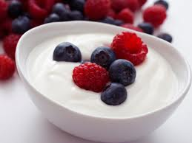
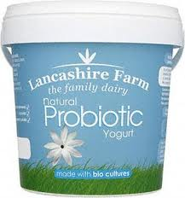

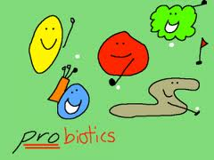
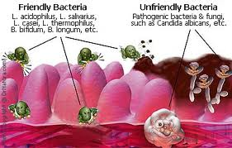
VI. Dairy
Probiotics
Yogurt
Good bacteria (probiotics)

Slide 9
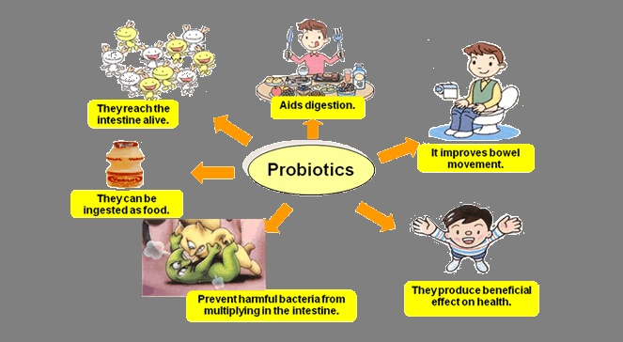
What probiotics can do for you ?
Excellent for your well-being and better digestive health

Slide 10
Thank you !
Let food be your medicine.

