Slide 1
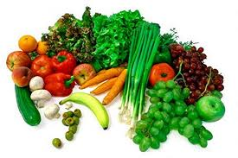
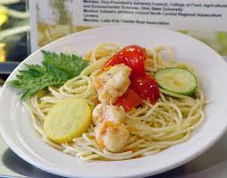
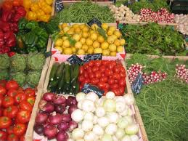
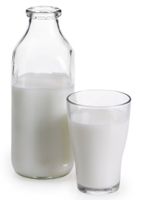
Food Safety Applications
Bernice Karlton-Senaye
North Carolina A & T State university
Jan 10th, 2011
Workshop on Food Science and Safety (South East Middle School- Kernersville)

Slide 2
Overview
Introduction
Factors affecting microbial growth
Pathogens of food safety concern
How food become unsafe
Key practices for ensuring food safety
Conclusion

Slide 3
Introduction
In recent years micro-organisms in foods have been associated with causing food-borne illnesses, which can sometimes be fatal.
Food-borne illnesses have become a large and growing public health problem.
Storing and handling food properly is key to food safety.

Slide 4
Factors affecting microbial growth
F = food
A = acid
T= time
T = temperature
O = oxygen
M = moisture

Slide 5
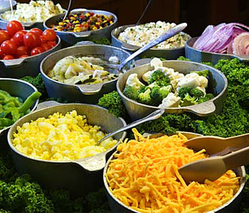
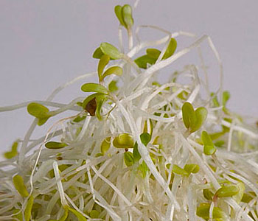
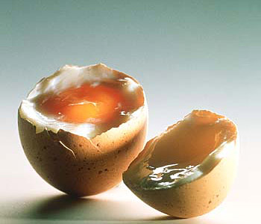
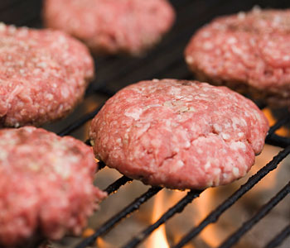
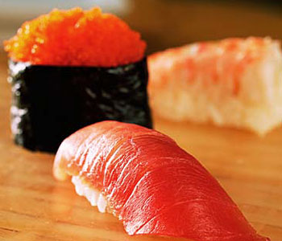
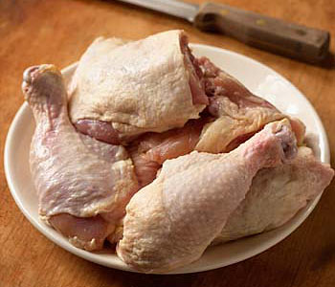
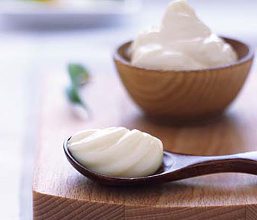
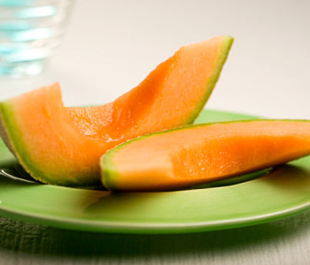
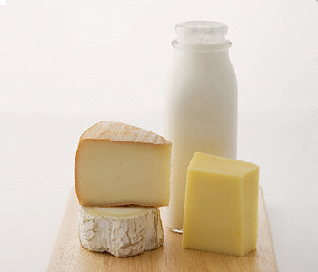
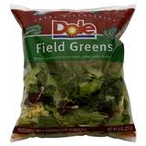
Food
Potentially hazardous foods-Moist protein-rich foods.
Eg: meat, milk, eggs and fish.

Slide 6
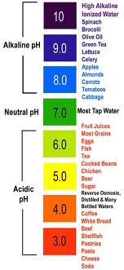
Acidity
pH is the degree of acidity or alkalinity of a substance.
pH is measured on a scale from 0 to 14.0.
pH of 7.0 =neutral
pH<7.0 = acidic
pH >7.0=alkaline.
Precaution: Keep food safe at pH levels below 4.6.
6.6 and 7.5 Optimum pH for bacteria growth.

Slide 7
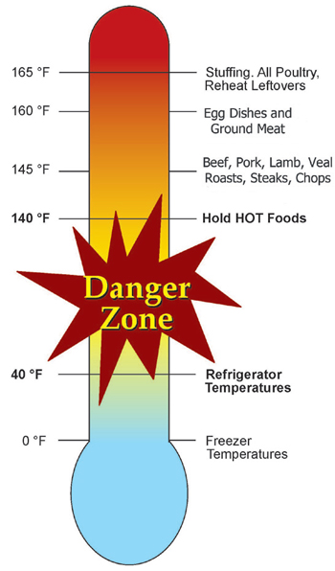
Temperature
Microorganisms thrives best around room temperature.
Keep potentially hazardous foods out of this zone.
Precaution: Keep cold food cold and warm food warm.
Keep food out of the danger zone- 40°-140° F.

Slide 8
Time
Bacteria grow and multiply in a warm, moist environment with time.
Multiplication is by cell division.
Potentially hazardous food in the Danger Zone for long period of time results in growth and multiplication of pathogens.
Precaution:
  Restrict the time for foods in the DANGER ZONE to two hours or less.

Slide 9
Oxygen
Aerobic microorganisms need oxygen (air).
Anaerobic microorganisms grow in the absence of oxygen.
Facultative microorganisms grow with or without oxygen.
they can grow and contaminate.
Some bacteria can live in or adjust to an environment without oxygen, they can grow and contaminate foods in sealed containers, such as cans, bottles, and plastic bags or pouches.
Precaution: Potentially hazardous food exposed to air increase bacterial growth.

Slide 10
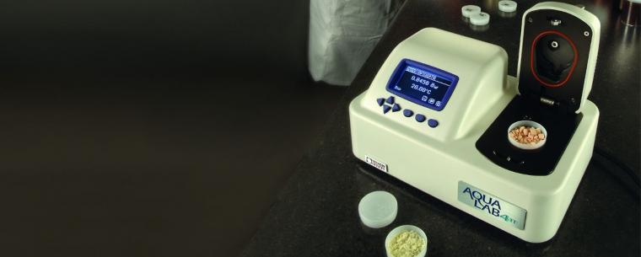
Moisture
Water activity is the term used to describe the moisture content of food.
Water activity values range from 0 to 1.
Microorganisms grow best in moist foods. eg: meat, produce and soft cheeses.
A food that has a water activity value below 0.85 will not support the growth of the bacteria that cause foodborne disease.
Safer foods have less moisture. Dry foods eg: crackers, breads.

Slide 11
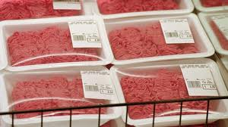
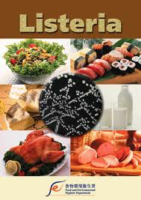
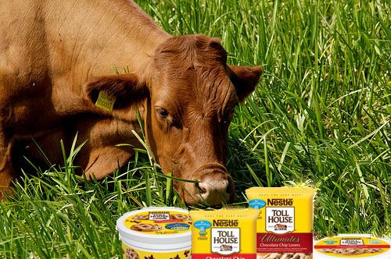
Pathogens of food safety concern
Pathogen | Food
Salmonella | Poultry, eggs, produce, peanut butter
Listeria | Deli meat, dairy products
E. Coli | Ground beef
Campylobacter | Poultry, raw milk

Slide 12
How food become unsafe
Time-Temperature abuse
  Failing to hold, store or thaw food at required temperature.
  Failing to cook or reheat foods to temperatures that kill microorganisms.
  Failing to properly cool foods.
  Preparing foods a day or more before they are served.

Slide 13
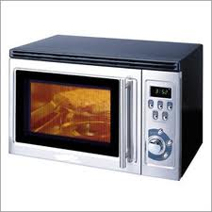
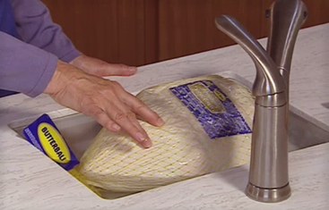
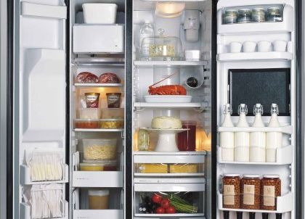
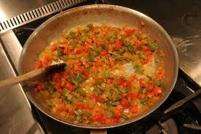
Thawing Foods Safely
Thaw food in the refrigerator at temperatures of 41 F or less.
Submerge the frozen product in running potable water at a temperature of 70 F or less.
Food may be thawed in a microwave oven only if it will be cooked immediately.
Food may be thawed as part of cooking to reach required minimum internal temperature

Slide 14
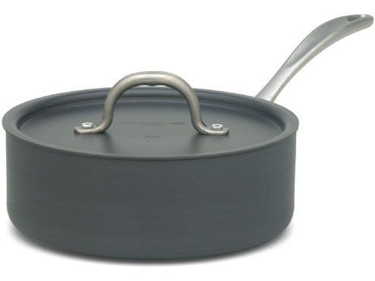
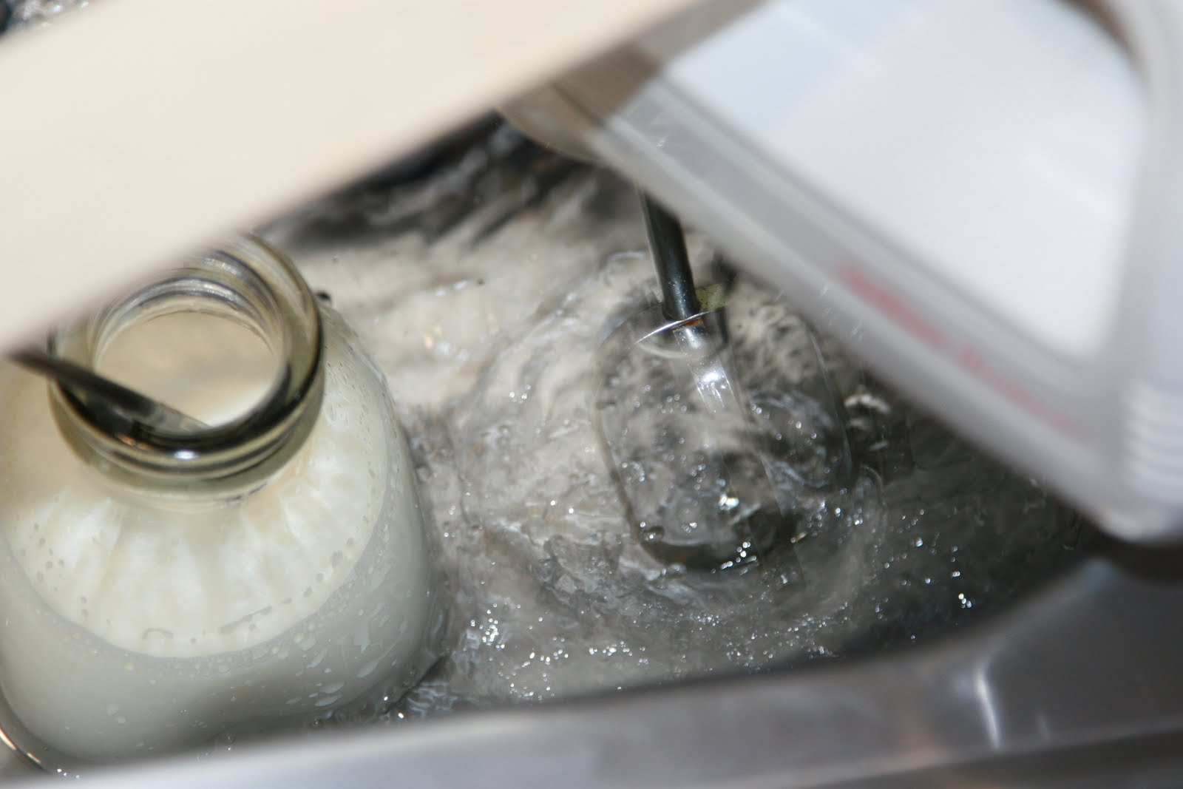
Safe methods of cooling foods
Divide hot food in smaller quantities in shallow pans and refrigerate.
Use ice-water to bring food temperatures down quickly

Slide 15
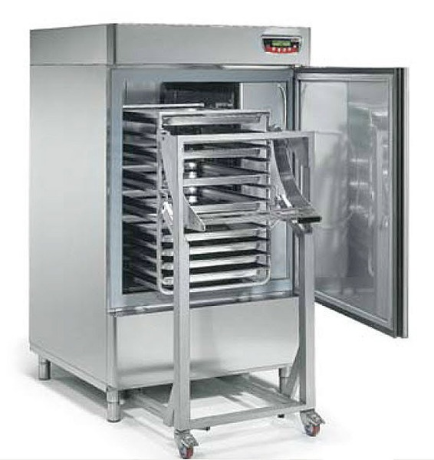
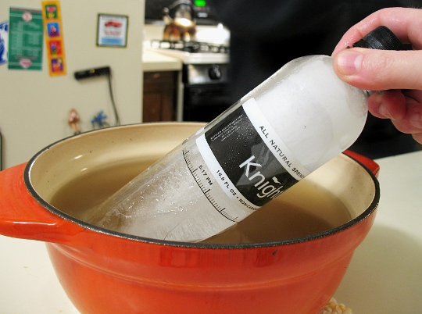
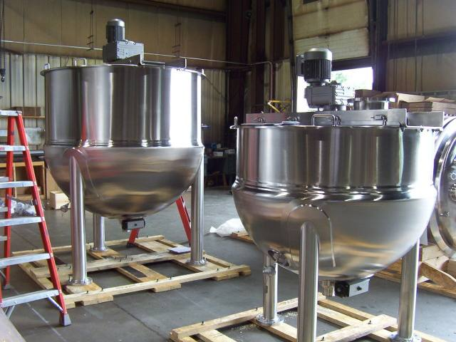
Use blast chillers to cool food.
Stir food as they cool with cold paddles.
A steam-jacketed kettle cools food.

Slide 16
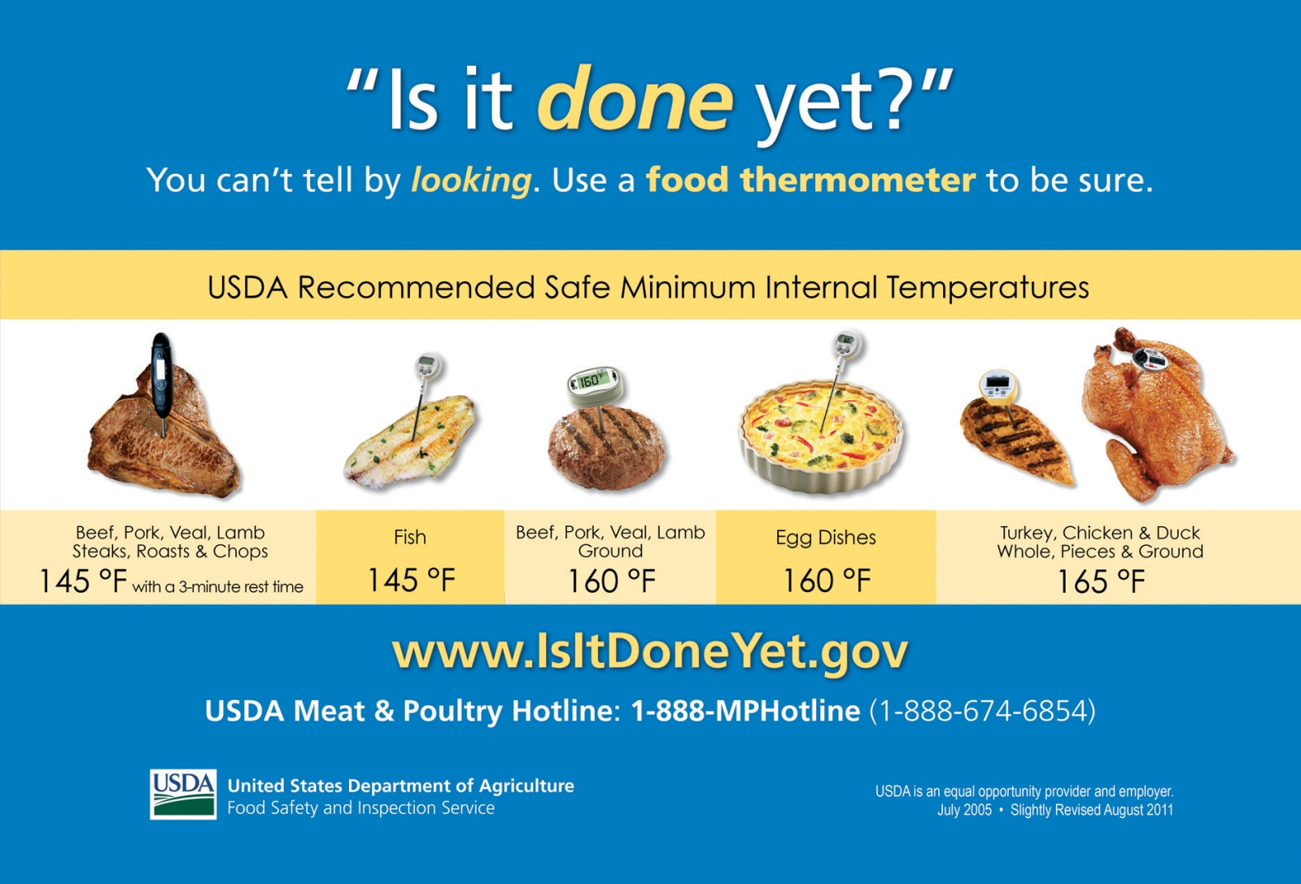
Cook or reheat foods to temperatures that kill microorganisms

Slide 17
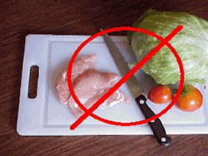
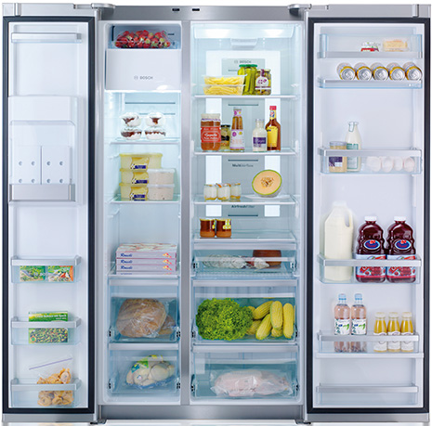
How to prevent cross-contamination
Cross-contamination occurs when microorganisms are transferred from one food or surface to another.
Food, Utensils/Equipment and Human
  Do not add raw ingredients to foods that receive no further cooking.
  Use separate cutting board for raw and read-to-eat foods.

Slide 18
Equipment and Utensils-Food contact surfaces
Equipment and utensils that are not cleaned and sanitized before touching cooked or ready-to-eat foods
  Do not allow raw food to touch or drip fluids onto cooked or ready-to-eat food.
  Do not touch contaminated (usually raw) food and then touch cooked or ready-to-eat food.
  Keep Kitchen towel clean before use.

Slide 19
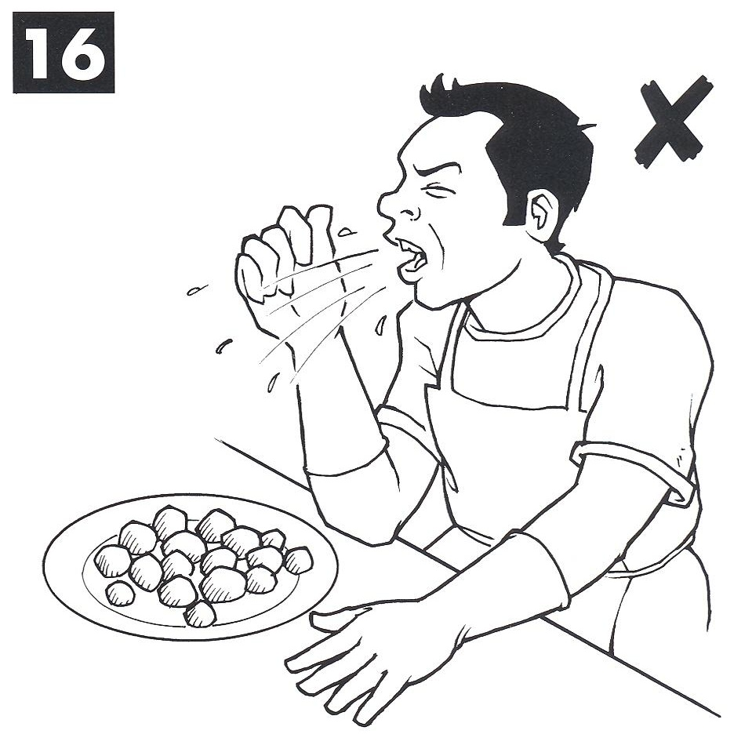
Human-Poor Personal Hygiene
Failure to properly wash hands after using restroom.
Coughing or sneezing on food.
Touching or scratching sores, cuts, or boils and then touch food.
practicalaction.org

Slide 20
Key practices for ensuring food safety
Controlling time and temperature.
Practicing good personal hygiene
  Proper handwashing: Hands and fingers nails should be washed for 20 sec before handling foods and after using the restroom.

Slide 21
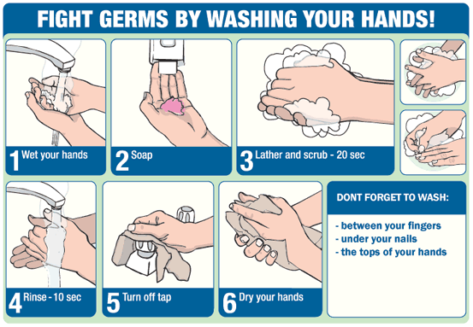
Fight germs through proper handwashing
Wet hands.
Lather and scrub hands for 20 sec.
Rinse for 10 sec.
Dry with towel.
weltschmertzed.blogspot.com

Slide 22
Conclusion
We can fight bacteria and be safe by
  Clean
  Separate foods
  Cook food thoroughly
  Refrigerate food promptly
Practicing good personal hygiene

