Slide 1
Probiotics and Dairy products
By
Temitayo Obanla
North Carolina A&T

Slide 2
Introduction
Microbiology is the study of microorganisms-
bacteria, parasites, viruses and fungi.
Microbes are found everywhere.
Bacteria play a hugely important role in producing a whole variety of delicious foods.
Bacteria can be classified as the good, bad and ugly.

Slide 3
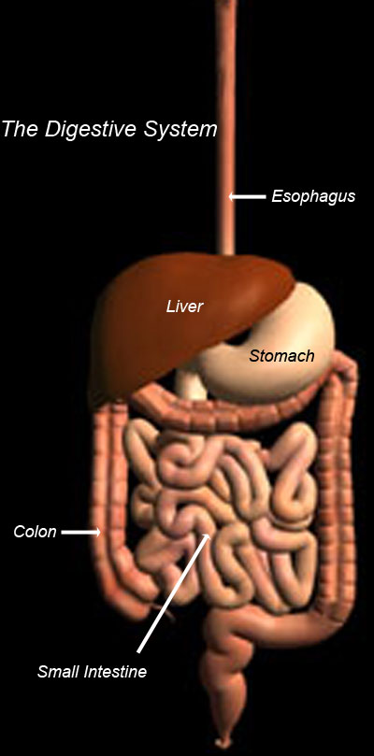
Probiotics and Dairy products
Good bacteria, known as probiotics impact numerous health benefits.
Ability enhance immunity
Improve food digestion
Reduce lactose intolerance
Prevent illness.

Slide 4
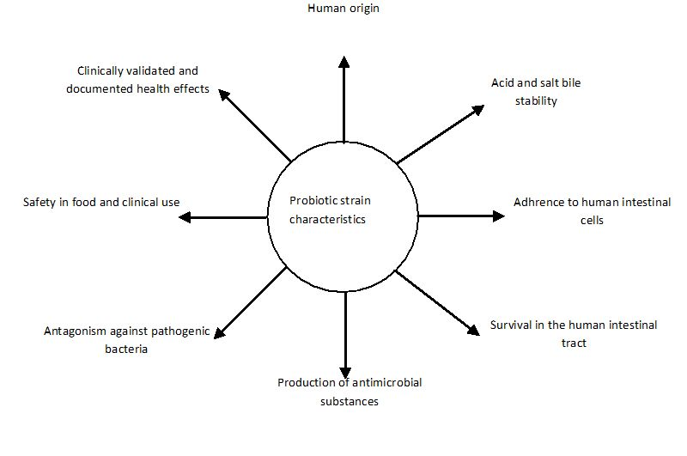
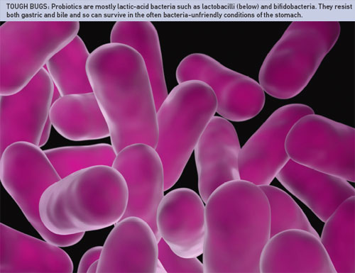
Probiotics strains

Slide 5
Probiotics and Dairy products
Good bacteria are exposed to substances that affect their benefits.
Antibiotics
Bad bacteria in the gut
Starvation

Slide 6
probiotics
Probiotics are mainly found in dairy products
Yogurt
Milk
Cheese

Slide 7
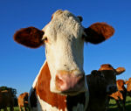
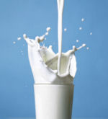

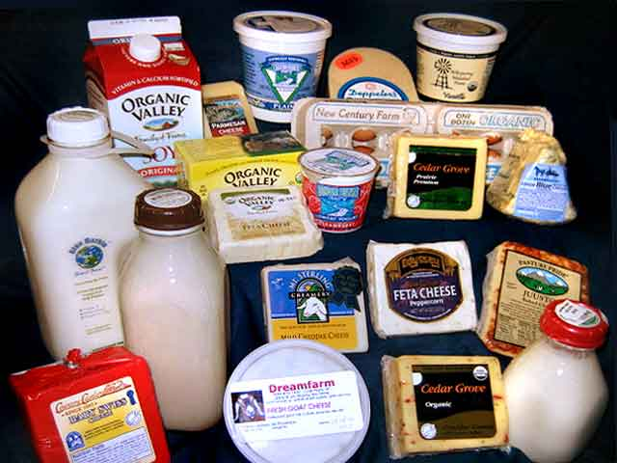
Probiotics and Dairy products
Dairy is the term used to describe milk-based or milk-related products

Slide 8
Composition of milk
Dairy products are important in the diet of all age-groups
calcium,
phosphorous,
protein,
fat soluble vitamins
B vitamins

Slide 9
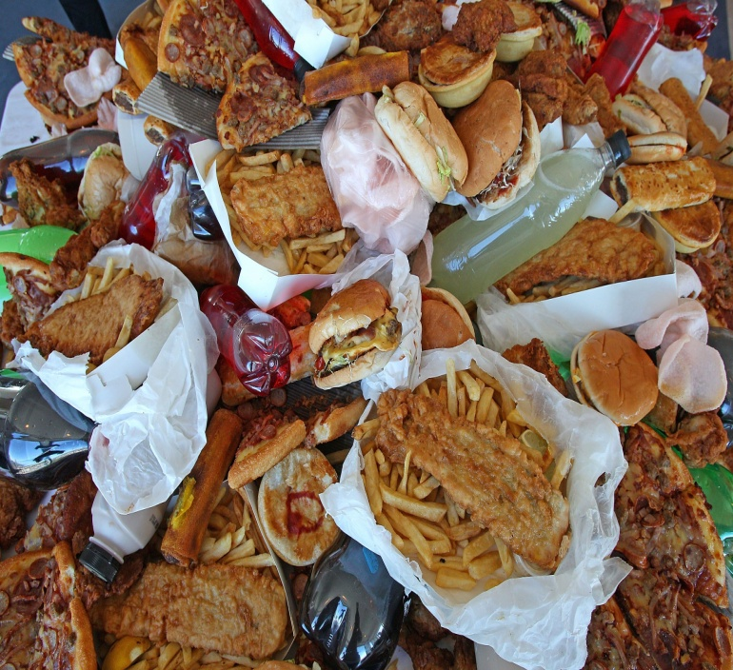

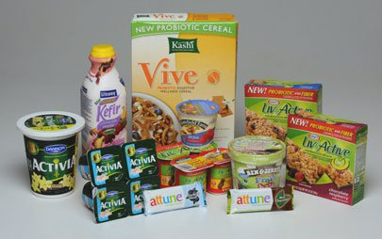
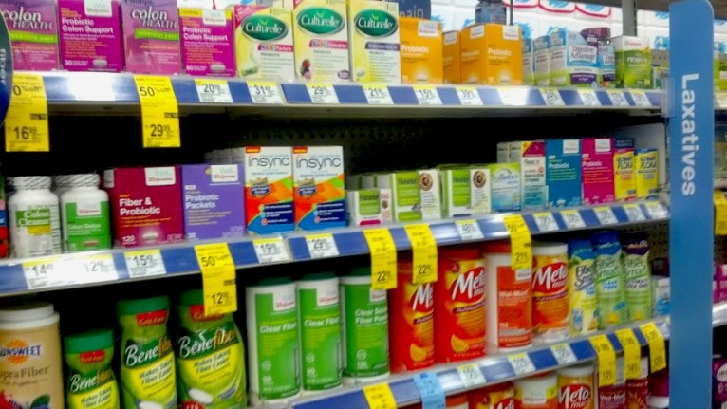
Dairy and health
A healthy, balanced diet is made up of five main food groups and milk and dairy foods are one of these

Slide 10
Conclusion
Evidence suggests that probiotics milk products enhance digestive and overall health by improving gut microbiota and promoting immunity.

Slide 11
Conclusion
You are what you eat
Eat right

Slide 12
Probiotics and Dairy products
Thank You

