Slide 1
Food Safety
Dr. Saeed A. Hayek
Food Microbiology and Biotechnology Laboratory
North Carolina A & T State University

Slide 2
Food Safety:
What?
Why?
How?
Where?
Safe, Hazard, and Risk

Slide 3
What is Food Safety?
Food safety: refers to all those hazards that may make food injurious to consumer health.
Food safety: absence of acceptable and safe levels of contaminants, adulterants, naturally occurring toxins or any other substance that may make food injurious to health on an acute or chronic basis.
It is not negotiable

Slide 4
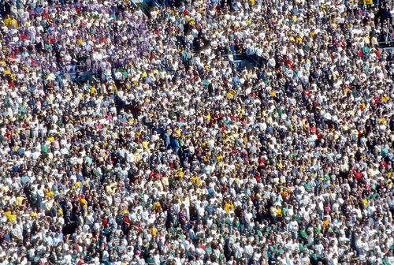
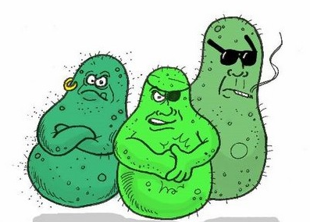
Why Food Safety?
Over 7 billion people on the planet
Millions of foodborne illnesses
and death every year
In USA 48 million illnesses
and 3,000 deaths each year
Insure that every one eat safe food
Minimizing food contamination
Minimizing foodborne illnesses

Slide 5
How Food Safety?
Proper food safety guidelines
Sanitation Process: follow a general cleaning and sanitation system
Control contamination resources:
    Human
    Raw food
    Water

Slide 6
Control Factors Affecting Microbial Growth (FATTOM)
F = food
A = acidity
T= time
T = temperature
O = oxygen
M = moisture

Slide 7
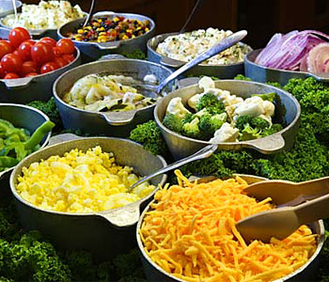
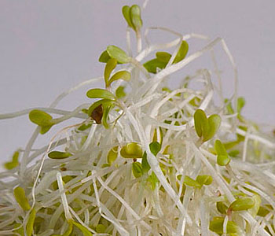
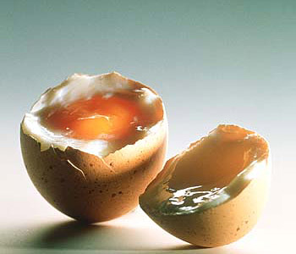
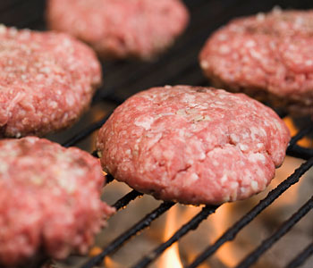
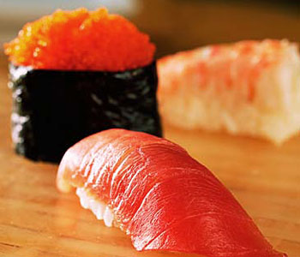
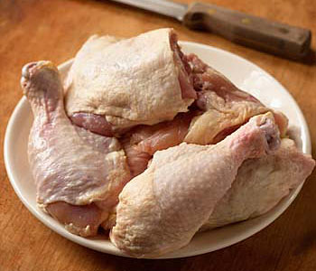
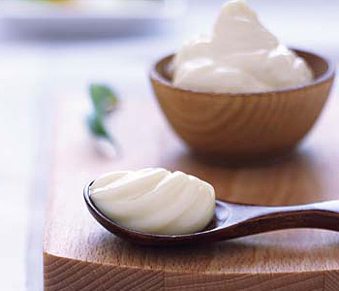
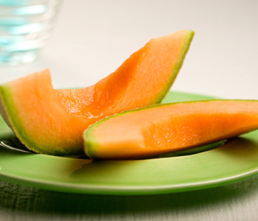
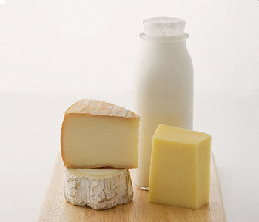
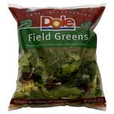
Food
Microorganisms growth best in moist protein-rich foods.
Potentially hazardous foods (PHF)-
Moist protein-rich foods.
Example:
    Fish
    Eggs
    Meat,
    Milk

Slide 8
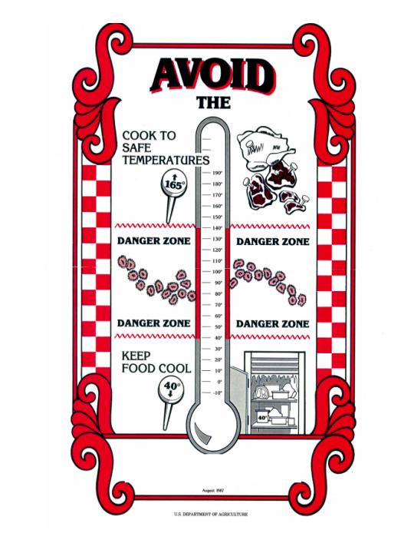
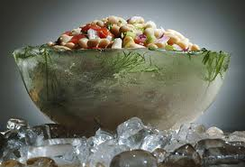
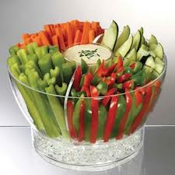
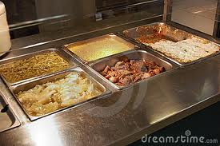
Temperature
Microorganisms thrives best around room temperature.
Keep food out of the danger zone- 40°-140° F.
Precaution: Keep cold food cold below 40 ºF and warm food warm above 140 ºF.

Slide 9
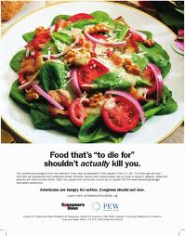
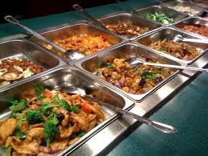
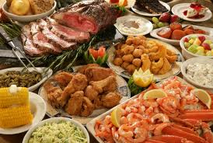
Time
Bacteria grow and multiply in a warm, moist environment with time. Growth doubles every 20 mins.
PHF in the Danger Zone for long period of time promotes growth and multiplication of pathogens.
Precaution: Do not keep food in the danger zone for 4 hours!! Foods in the DANGER ZONE ≤ 2h

Slide 10
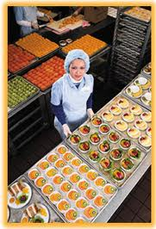
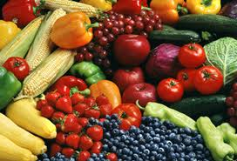
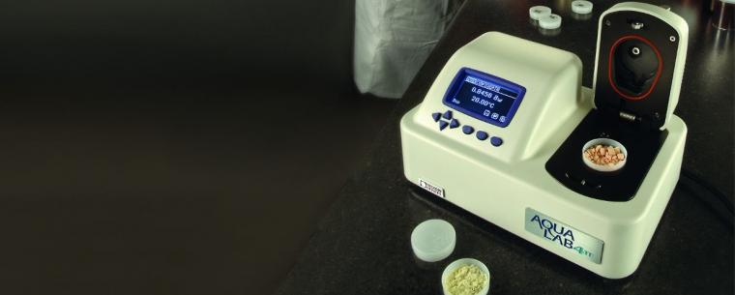
Moisture
Moisture content of food=Water activity, a_{W.} (0 -1).
Microorganisms grow best in moist foods (a_{W} =0.91-0.99). eg: meat (FEMM), vegetables and soft cheeses.
a_{W} ≤ 0.85 will not support the growth of pathogens.
Safer foods have less moisture. Eg: Dry foods such as crackers, cereal etc.

Slide 11
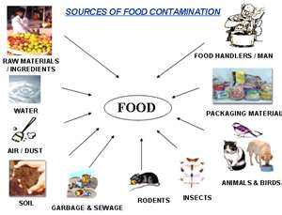
Sources of food contamination
o

Slide 12
Harmful conditions:
Biological …. Salmonella, E. Coli
Chemical ….Pesticides, Lead, Mercury.
Physical …. Glass, Metal.
Most important is the biological

Slide 13
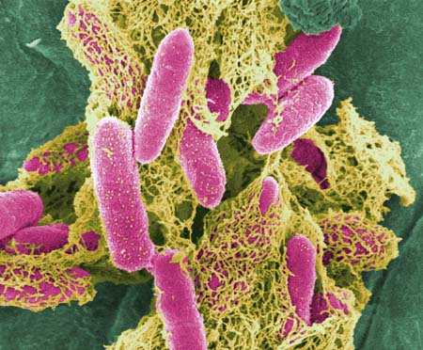
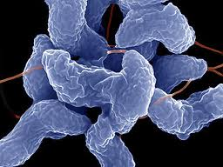
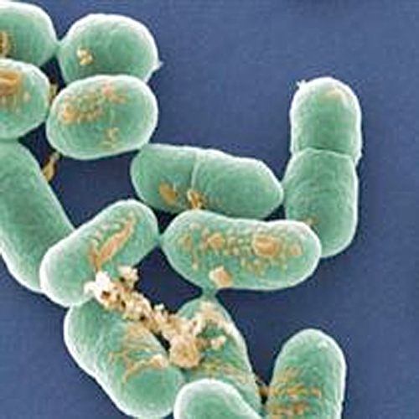
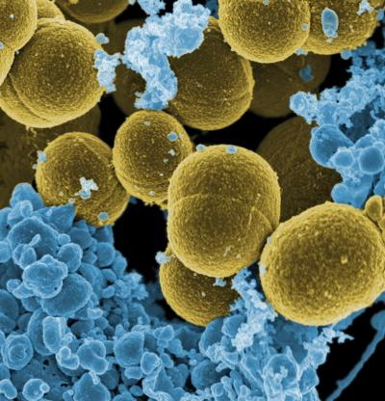
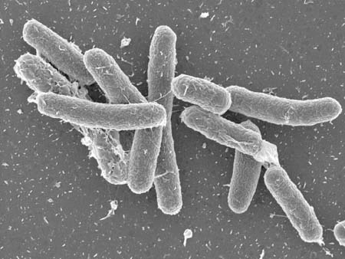
Campylobacter jejuni
E coli O157:H7
Listeria monocytogenes
Staphylococcus
aureus
Salmonella
enteritids

Slide 14
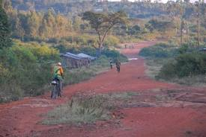
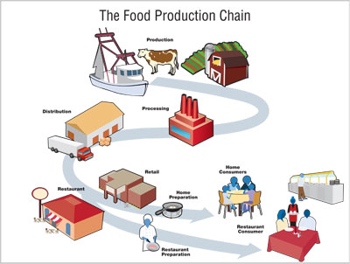
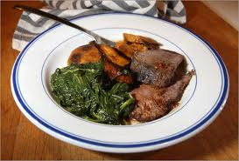
Where Food Safety?
Farm To Table

Slide 15
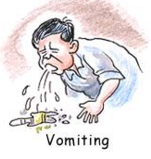

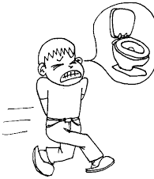
Good to know:
Symptoms food contamination:
flu-like symptoms
nausea
vomiting
diarrhea
fever
Within minutes to weeks

Slide 16
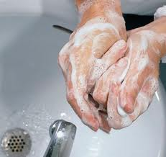
Hand Washing
The first line of defense against food borne illnesses.
38% food contamination from improper hand washing.

Slide 17

Food Science Quiz
Which of the following is NOT a carbohydrate?
  Sugar
  Starch
  Cellulose
  Amino acid

Slide 18
Food Science Quiz
Which of the following contribute caloric intake in the human diet? (may be more than one answer)
  Lipids
  Minerals
  Water
  Proteins

Slide 19
Food Science Quiz
Which of these food is not a PHF? Why?
    Meat
    Egg
    Cereal
    Yogurt
    Fish
    Milk.

Slide 20
Food Science Quiz
Which of these food is not a PHF? Why?
    Meat
    Egg
    Cereal
    Yogurt
    Fish
    Milk.

Slide 21
Food Science Quiz
Rank the following in terms of moisture content from highest (1) to lowest (4).
  Maple Syrup
  Potato chips
  Dried Fruit
  Fresh produce

Slide 22
Food Science Quiz
Rank the following in terms of moisture content from highest (1) to lowest (4).
  Maple Syrup
  Potato chips
  Dried Fruit
  Fresh produce
  Fresh Produce>Maple Syrup>Dried Fruit>Potato Chips

Slide 23

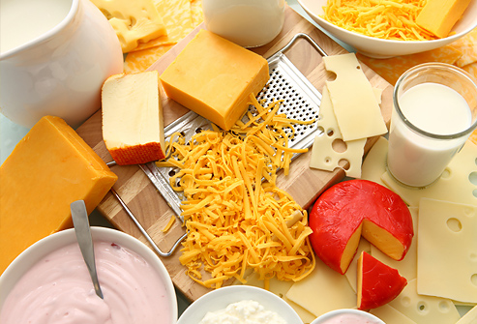
Eat safe and stay healthy
DON’T FORGOT
MILK, YOGURT, & CHEESE FOR YOUR HEALTH

